Slide 1
How many deleted bits can one recover?
Venkatesan Guruswami
Carnegie Mellon University
Joint work with Boris Bukh & Johan Håstad
Big-O Theory Club
Georgia Tech, Dec 3, 2018

Slide 2
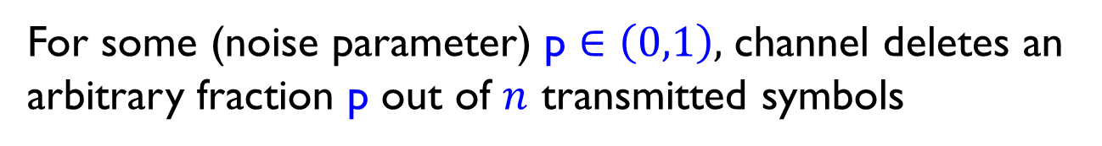
Codes for worst-case deletions
We consider problem of recovering from
constant fraction of adversarial deletions
For some (noise parameter) p $∈\left(0,1\right),$ channel deletes an
arbitrary fraction p out of $n$ transmitted symbols
abracadabrainlastsessnatsda aracbrinlasesnatsda
001110010001 01100001
Receiver gets a shorter subsequence of transmitted sequence (locations of deletions NOT known to receiver)
Makes recovery much more challenging compared to erasure model, where locations of missing symbols are known 001110010001 0?1?100??001

Slide 3

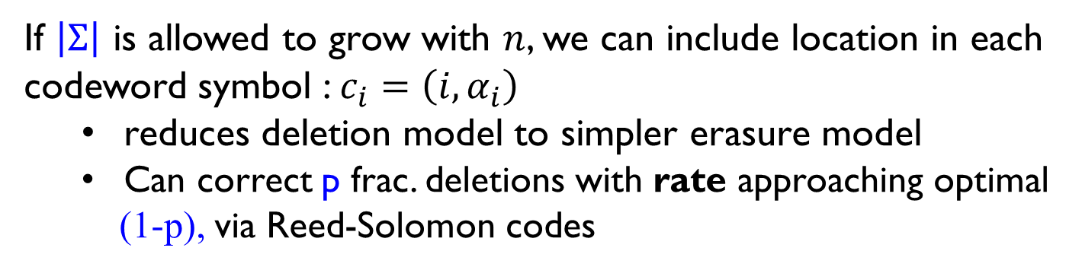

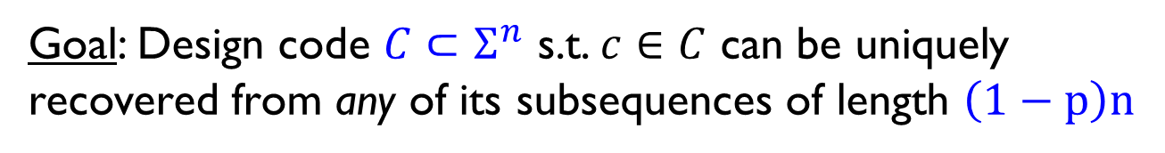
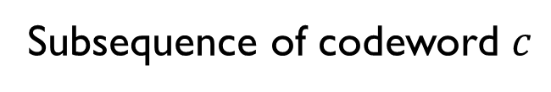
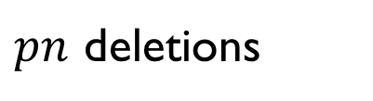

Deletion model (worst-case)
$pn$ deletions
$$c∈Σ^{n}$$
$$y_{1}y_{2}⋯y_{\left(1−p\right)n}∈Σ^{\left(1−p\right)n}$$
(arbitrary)
Subsequence of codeword $c$
Goal: Design code $C⊂Σ^{n}$ s.t. $c∈C$ can be uniquely recovered from any of its subsequences of length $\left(1−p\right)n$
Rate = $\frac{\log{|C|}}{n\log{|Σ|}}$
= ratio of # information bits to # codeword bits
If $\left|Σ\right|$ is allowed to grow with $n$, we can include location in each
codeword symbol :$c_{i}=\left(i,α_{i}\right)$
reduces deletion model to simpler erasure model
Can correct p frac. deletions with rate approaching optimal
(1-p), via Reed-Solomon codes
Deletion model challenging for fixed alphabets e.g., $Σ= \{0,1\}$

Slide 4

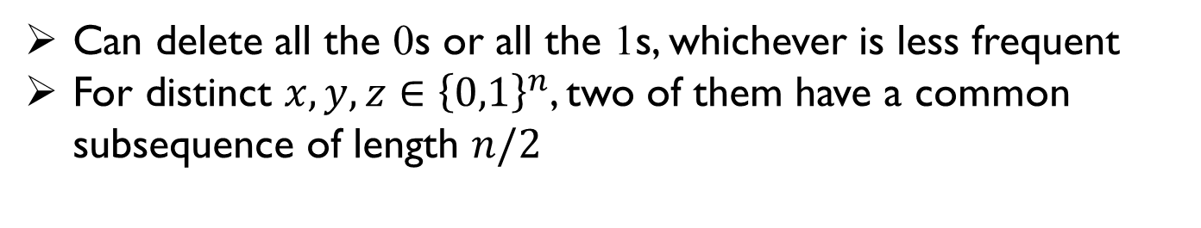
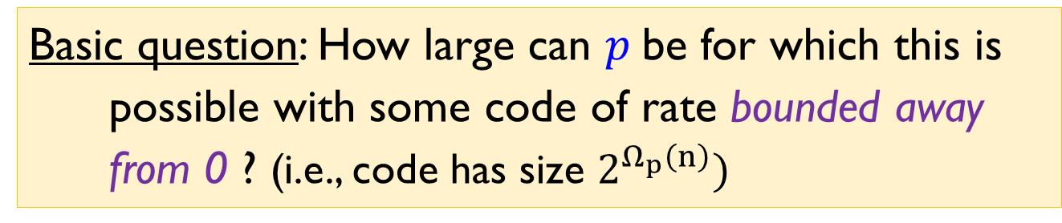
High-deletion case
Channel adversarially deletes fraction $p$ of codeword bits
001110010001 01100001
- Combinatorial property desired of code: no two distinct codewords share a common subsequence of length $\left(1−p\right)n$
Basic question: How large can $p$be for which this is possible with some code of rate bounded away from 0 ? (i.e., code has size $2^{Ω_{p}\left(n\right)})$
Certainly $p<1/2$
Can delete all the 0s or all the 1s, whichever is less frequent
For distinct $x,y,z∈{\left\{0,1\right\}}^{n}$, two of them have a common subsequence of length $n/2$
Note: ½ is also a limit for simpler erasure model (Plotkin bound)

Slide 5
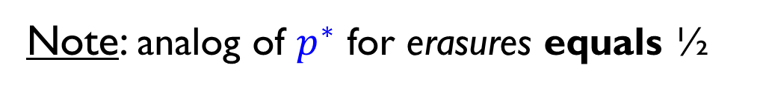
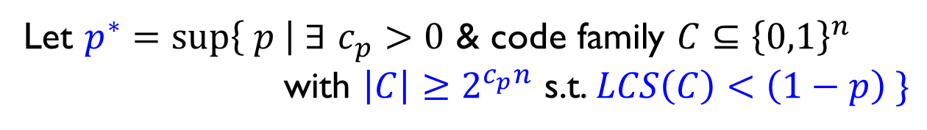
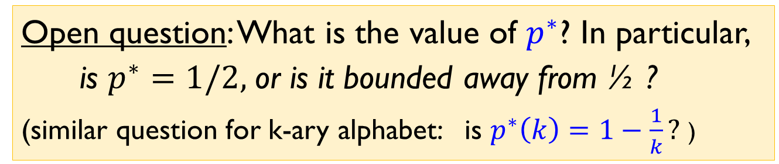
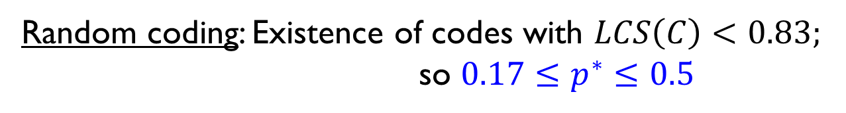
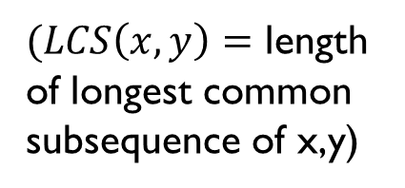
Binary deletion codes
$(LCS\left(x,y\right)=$ length
of longest common
subsequence of x,y)
For $C⊂Σ^{n},$ define $LCS\left(C\right)=\max_{x≠y∈C }{\frac{LCS\left(x,y\right)}{n}}$
Let $p^{∗}=\sup\left\{ p \right| ∃$ $c_{p}>0$ & code family $C⊆{\left\{0,1\right\}}^{n}$
with $\left|C\right|≥2^{c_{p}n}$ s.t. $LCS\left(C\right)<\left(1−p\right) \}$
Random coding: Existence of codes with $LCS\left(C\right)<0.83;$
so ${0.17≤p}^{∗}≤0.5$
Open question: What is the value of $p^{∗}$? In particular, is $p^{∗}=1/2,$or is it bounded away from ½ ?
(similar question for k-ary alphabet: is $p^{∗}\left(k\right)=1−\frac{1}{k}?$ )
Note: analog of $p^{∗}$ for erasures equals ½

Slide 6
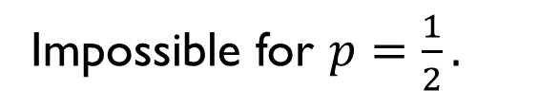
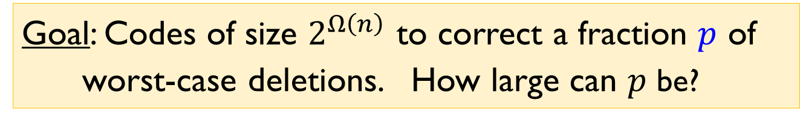
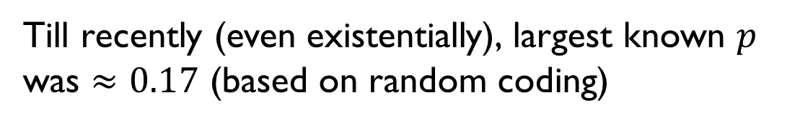
Goal: Codes of size $2^{Ω\left(n\right)}$ to correct a fraction $p$ of worst-case deletions. How large can $p$ be?
Impossible for $p=\frac{1}{2}.$
Till recently (even existentially), largest known $p$ was $≈0.17$ (based on random coding)

Slide 7
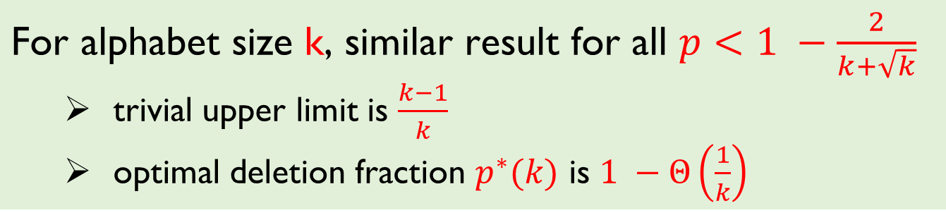
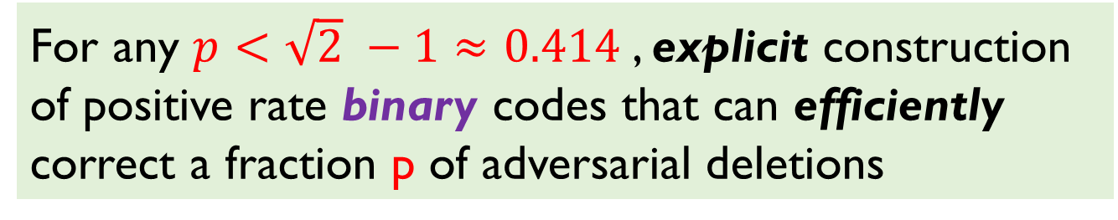
Our Result
$\text{For} \text{any} p<\sqrt{2} −1≈0.414$, explicit construction of positive rate binary codes that can efficiently correct a fraction p of adversarial deletions
Even existence of such codes not known before.
Shows bit deletions “easier” to deal with than bit flips, for which ¼ is the limit of correctable error fraction
Can handle combination of insertions and deletions [G.-Li’16]
$\text{For} \text{alphabet} \text{size}$k$\text{, }\text{similar} \text{result} \text{for} \text{all} p<1 −\frac{2}{k+\sqrt{k}}$
trivial upper limit is $\frac{k−1}{k}$
optimal deletion fraction $p^{∗}(k)$ is $1 −Θ\left(\frac{1}{k}\right)$

Slide 8
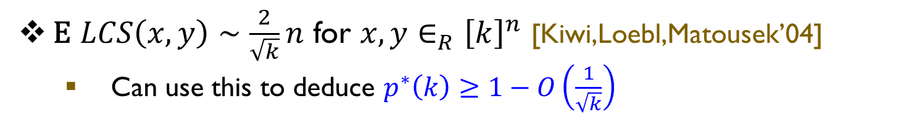
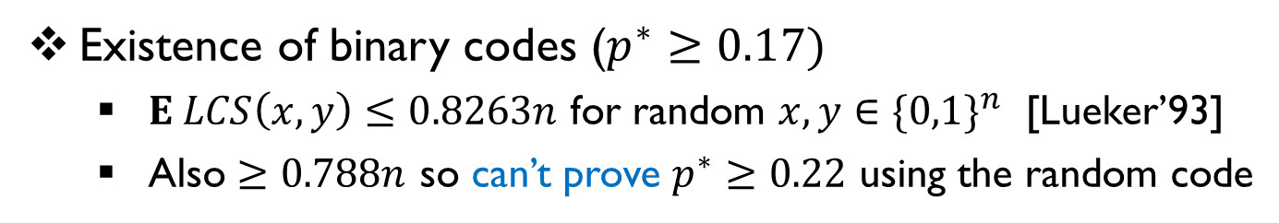
Prior work (Existence)
Existence of binary codes ($p^{∗}≥0.17)$
$E LCS\left(x,y\right)≤0.8263n$ for random $x,y∈\{0,1\}^{n}$ [Lueker’93]
Also $≥0.788n$ so can’t prove $p^{∗}≥0.22$ using the random code
E $LCS\left(x,y\right)∼\frac{2}{\sqrt{k}}n$ for $x,y∈_{R}{\left[k\right]}^{n}$ [Kiwi,Loebl,Matousek’04]
Can use this to deduce $p^{∗}\left(k\right)≥1−O\left(\frac{1}{\sqrt{k}}\right)$

Slide 9
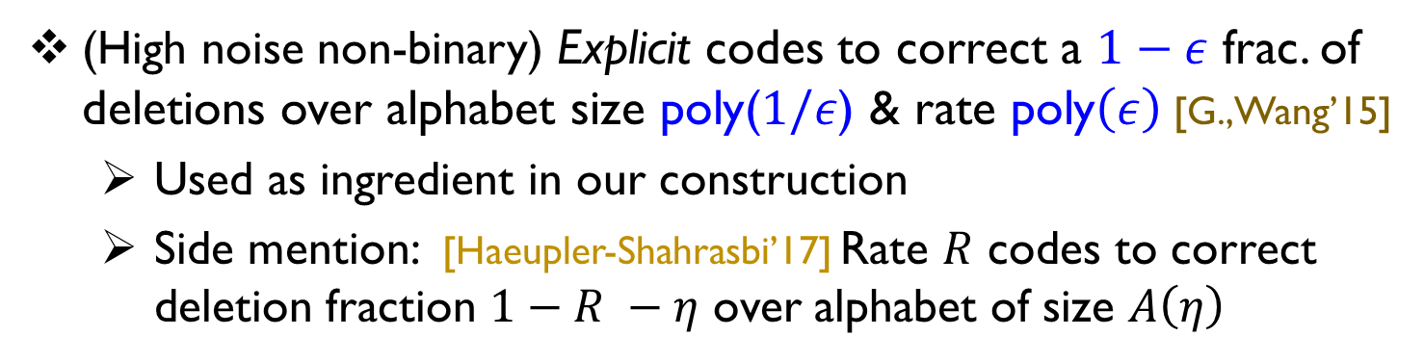

Prior/related work (constructive)
(Low noise binary) Explicit positive rate binary codes to correct a small $Ω\left(1\right)$ fraction of deletions [Schulman-Zuckerman’97]
[G.,Wang’15] achieve this with high rate
(rate $1−O(\sqrt{ζ})$ for recovery from $ζ→0$ fraction of deletions)
Recent construction with rate $1−O(ζ\log^{2}{ ζ^{−1})}$ [Cheng-Jin-Li-Wu’18, Haeupler’18] (optimal, non-constructive, bound is $1−O(ζ\log{ ζ^{−1})}$ )
(High noise non-binary) Explicit codes to correct a $1−ε$ frac. of deletions over alphabet size poly($1/ε$) & rate poly$\left(ε\right)$[G.,Wang’15]
Used as ingredient in our construction
Side mention: [Haeupler-Shahrasbi’17] Rate $R$ codes to correct deletion fraction $1−R −η$ over alphabet of size $A\left(η\right)$

Slide 10

For talk: Weaker result giving binary codes for recovery from 1/3 deletion fraction
$\text{For} \text{any} p<\sqrt{2} −1≈0.414$, explicit construction of positive rate binary codes that can efficiently correct a fraction p of adversarial deletions
Note: this is already much better than the earlier 17% deletion fraction bound

Slide 11
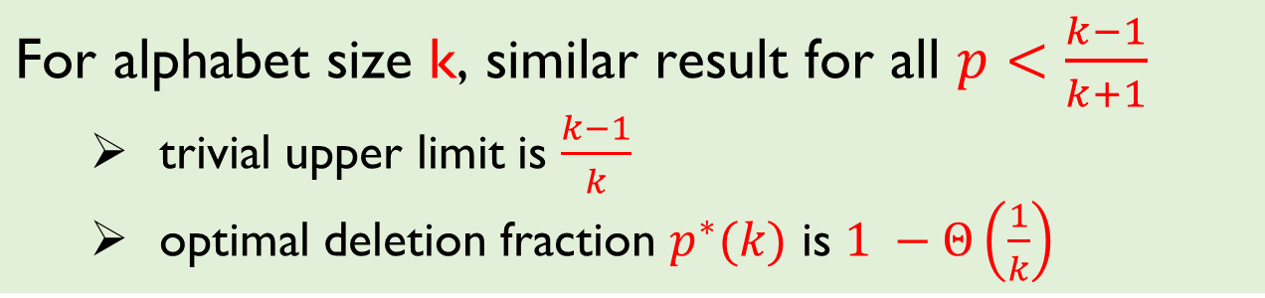
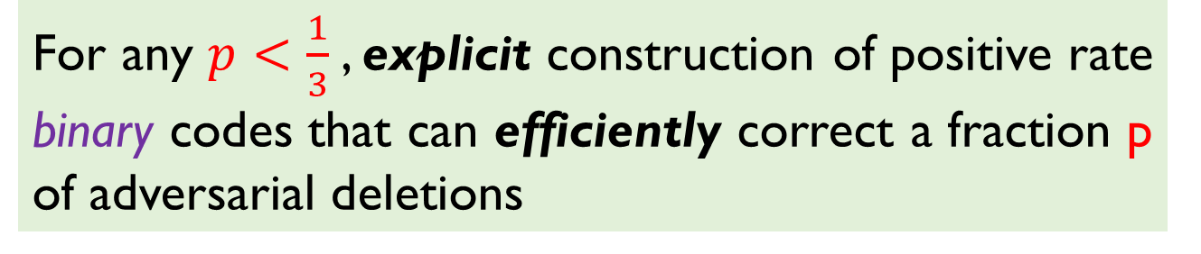
$\text{For} \text{any} p<\frac{1}{3}$, explicit construction of positive rate binary codes that can efficiently correct a fraction p of adversarial deletions
$\text{For} \text{alphabet} \text{size}$k$\text{, }\text{similar} \text{result} \text{for} \text{all} p<\frac{k−1}{k+1}$
trivial upper limit is $\frac{k−1}{k}$
optimal deletion fraction $p^{∗}(k)$ is $1 −Θ\left(\frac{1}{k}\right)$

Slide 12
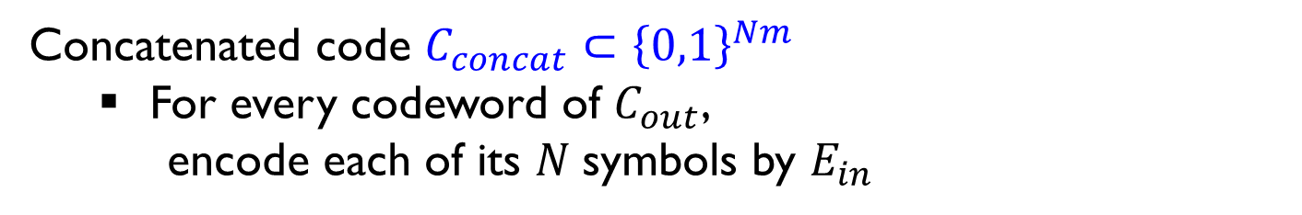
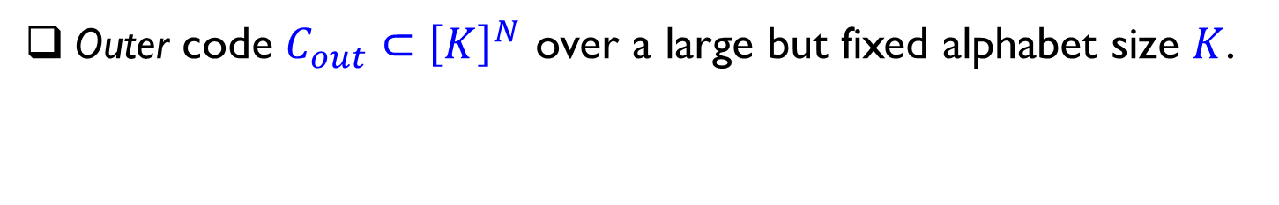
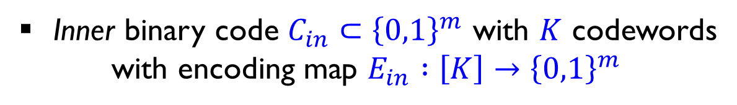
Concatenated codes approach
Outer code $C_{out}⊂{\left[K\right]}^{N}$ over a large but fixed alphabet size $K$.
Inner binary code $C_{in}⊂{\left\{0,1\right\}}^{m}$ with $K$ codewords
with encoding map $E_{in} :\left[K\right]→{\left\{0,1\right\}}^{m}$
Concatenated code $C_{concat}⊂{\left\{0,1\right\}}^{Nm}$
For every codeword of $C_{out}$,
encode each of its $N$symbols by $E_{in}$
$c_{1} { c}_{2} ⋯ c_{N}$ (outer codeword)
${E_{in}(c}_{1}) {E_{in}(c}_{2}) ⋯ { E_{in}(c}_{N})$ (concatenated codeword)

Slide 13
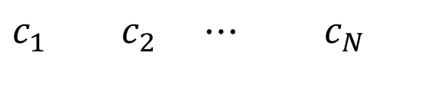
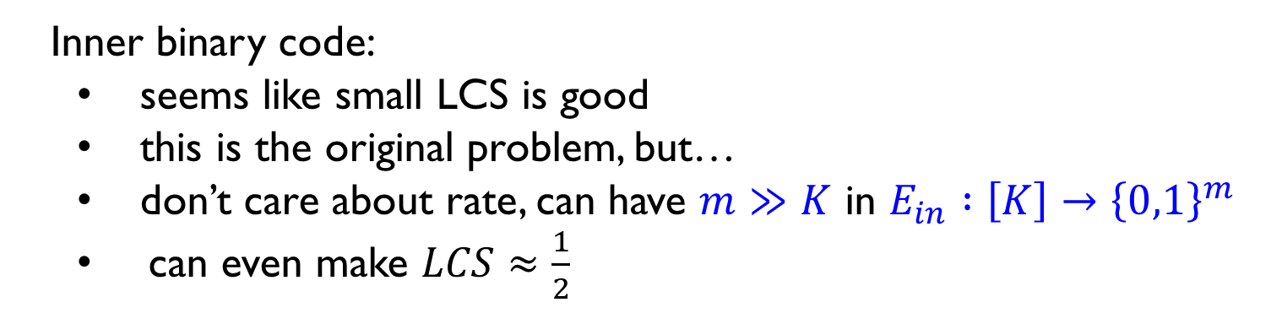
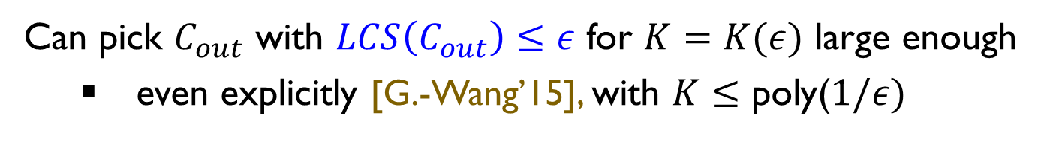
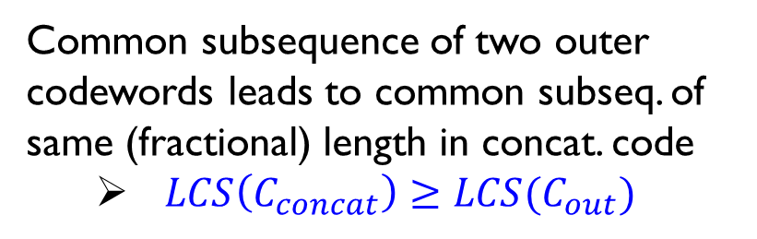
Choosing outer & inner codes
$c_{1} { c}_{2} ⋯ c_{N}$
Common subsequence of two outer codewords leads to common subseq. of same (fractional) length in concat. code
$LCS\left(C_{concat}\right)≥LCS(C_{out})$
${E_{in}(c}_{1}) {E_{in}(c}_{2}) ⋯ { E_{in}(c}_{N})$
Can pick $C_{out}$ with $LCS\left(C_{out}\right)≤ε$ for $K=K(ε)$ large enough
even explicitly [G.-Wang’15], with $K≤$ poly($1/ε)$
Inner binary code:
seems like small LCS is good
this is the original problem, but…
don’t care about rate, can have $m≫K$ in $E_{in} :\left[K\right]→{\left\{0,1\right\}}^{m}$
can even make $LCS≈\frac{1}{2}$

Slide 14
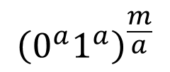
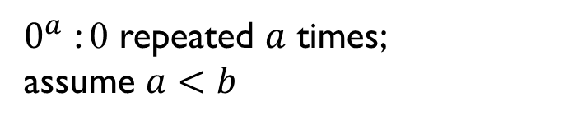
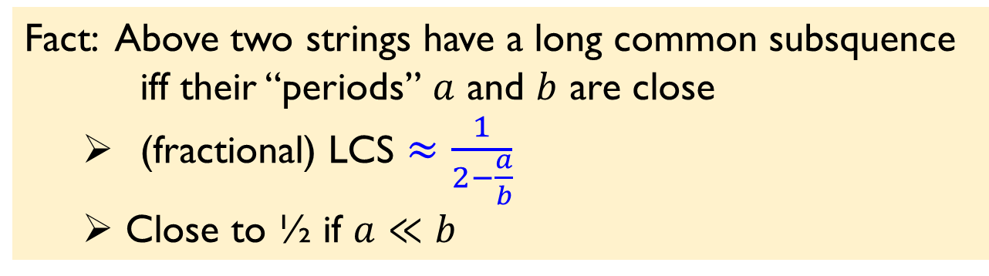
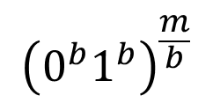
Inner code idea
How to pick small no. of binary strings with $LCS≈\frac{1}{2}$ [Bukh,Ma]$?$
000000000000
1111111111111
Consider strings oscillating at different
frequencies:
$${\left(0^{a}1^{a}\right)}^{\frac{m}{a}}$$
$${\left(0^{b}1^{b}\right)}^{\frac{m}{b}}$$
000000111111
010101010101
$0^{a}$ : 0 repeated $a$ times;
assume $a<b$
Fact: Above two strings have a long common subsquence
iff their “periods” $a$ and $b$ are close
(fractional) LCS $≈\frac{1}{2−\frac{a}{b}}$
Close to ½ if $a≪b$

Slide 15
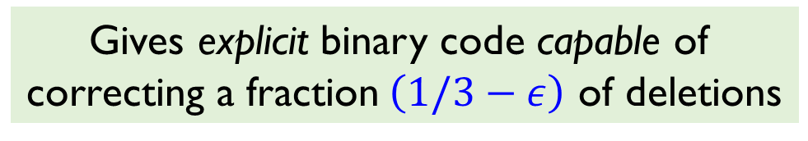
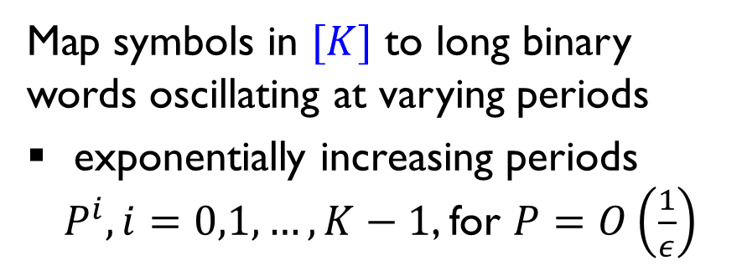
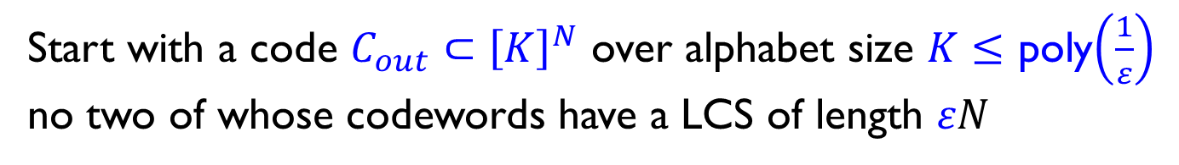



Deletion 1/3 codes: construction
Start with a code $C_{out}⊂{\left[K\right]}^{N}$ over alphabet size $K≤$ poly$\left(\frac{1}{ε}\right)$
no two of whose codewords have a LCS of length $εN$
Map symbols in $[K]$ to long binary words oscillating at varying periods
exponentially increasing periods
$P^{i}, i=0,1,…,K−1$, for $P=O\left(\frac{1}{ε}\right)$
$$000000000111111111$$
$$000111000111000111$$
$$010101010101010101$$
Thm: Resulting binary code $C⊂\{0,1\}^{n}$ has LCS $≤\left(\frac{2}{3}+ε\right)n$
Gives explicit binary code capable of
correcting a fraction$\left(1/3−ε\right)$ of deletions

Slide 16
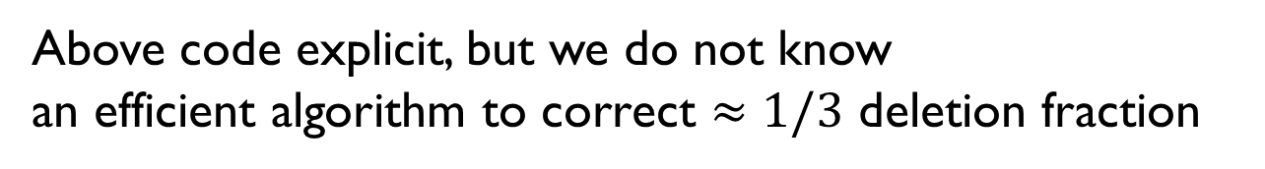
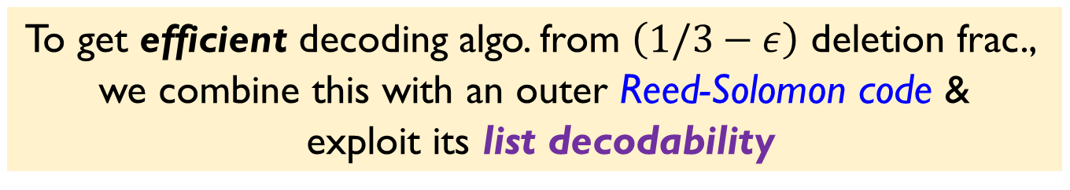
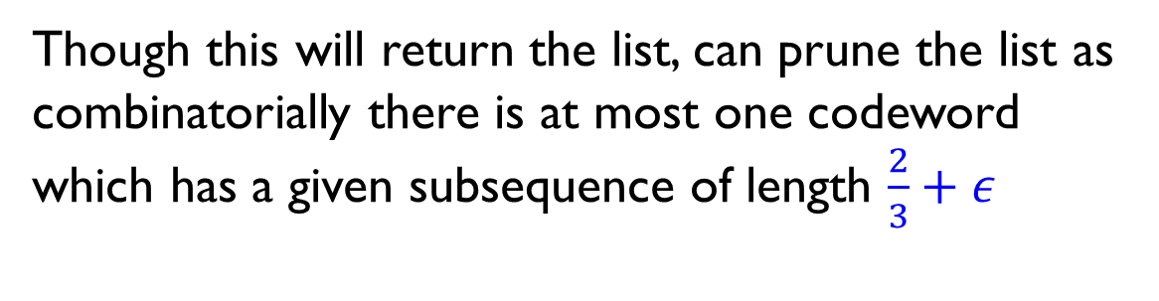
Efficient deletion correction
Above code explicit, but we do not know
an efficient algorithm to correct $≈$ $1/3$ deletion fraction
To get efficient decoding algo. from $\left(1/3−ε\right)$ deletion frac.,
we combine this with an outer Reed-Solomon code &
exploit its list decodability
Though this will return the list, can prune the list as
combinatorially there is at most one codeword
which has a given subsequence of length $\frac{2}{3}+ε$

Slide 17
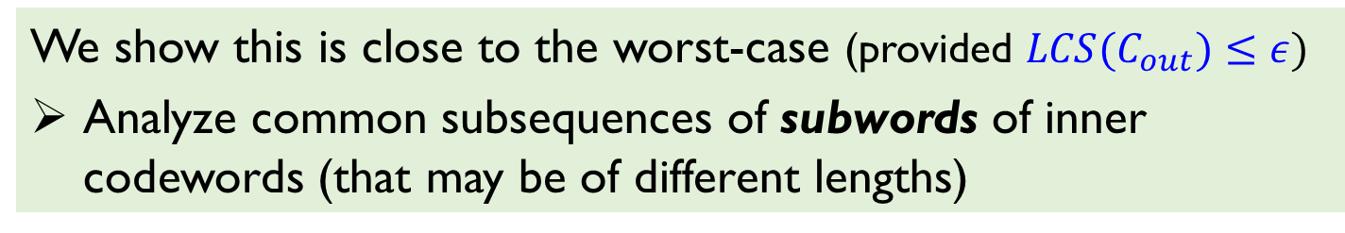
Why 2/3 ?
a
b
d
$$0000000011111111$$
$$0000111100001111$$
$$0101010101010101$$
$$0101010101010101$$
$$0011001100110011$$
$$0000000011111111$$
d
c
a
Match larger period block fully with two smaller period blocks
Over 3 blocks can get LCS of length 2 blocks
We show this is close to the worst-case (provided $LCS(C_{out})≤ε)$
Analyze common subsequences of subwords of inner codewords (that may be of different lengths)

Slide 18
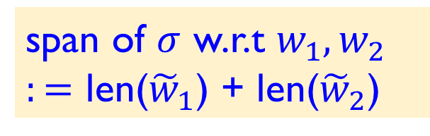

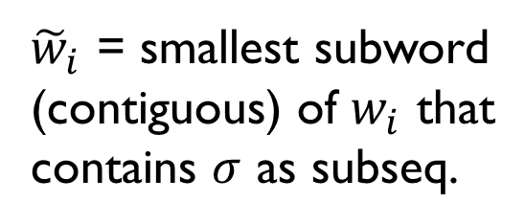



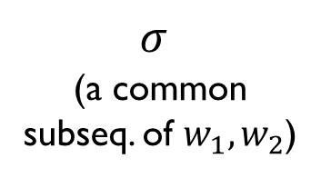
Key notion: span of common subsequences
$${\tilde{w}}_{1}$$
$$w_{1}$$
${\tilde{w}}_{i}$ = smallest subword
(contiguous) of $w_{i}$ that
contains $σ$ as subseq.
$σ$
(a common
subseq. of $w_{1},w_{2}$)
span of $σ$ w.r.t $w_{1},w_{2}$
$:=$ len(${\tilde{w}}_{1}$) + len(${\tilde{w}}_{2}$)
$$w_{2}$$
$${\tilde{w}}_{2}$$
span = cost measure of creating common subsequence in
terms of # symbols “consumed” in the two parent strings

Slide 19
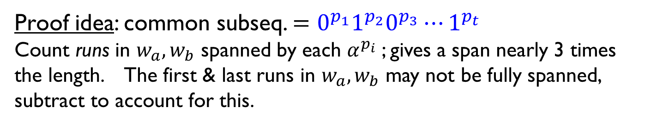

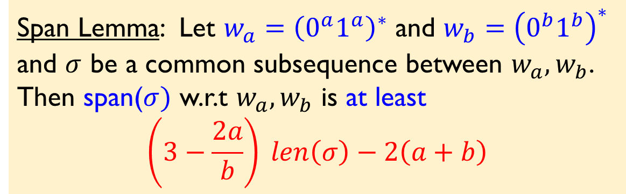
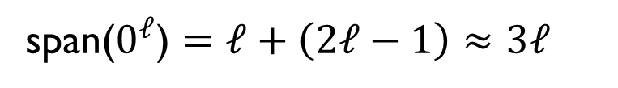


Span example & analysis
$$←L 0^{′}s→$$
$$w_{1}$$
0000000011111111
span($0^{ℓ}$) $=ℓ+\left(2ℓ−1\right)≈3ℓ$
$$w_{2}$$
0101010101010101
span($0^{ℓ_{0}}1^{ℓ_{1}}$) $=ℓ_{0}+ℓ_{1}+2\left(ℓ_{0}−1\right)+2ℓ_{1}≈3(ℓ_{0}+ℓ_{1})$
Span Lemma: Let $w_{a}={\left(0^{a}1^{a}\right)}^{∗}$ and $w_{b}={\left(0^{b}1^{b}\right)}^{∗}$ and $σ$ be a common subsequence between $w_{a},w_{b}$.
Then span($σ)$ w.r.t $w_{a},w_{b}$ is at least
$$\left(3−\frac{2a}{b}\right) len\left(σ\right)−2\left(a+b\right)$$
Proof idea: common subseq. $=0^{p_{1}}1^{p_{2}}0^{p_{3}}⋯1^{p_{t}}$
Count runs in $w_{a},w_{b}$ spanned by each $α^{p_{i}}$; gives a span nearly 3 times the length. The first & last runs in $w_{a},w_{b}$ may not be fully spanned, subtract to account for this.

Slide 20
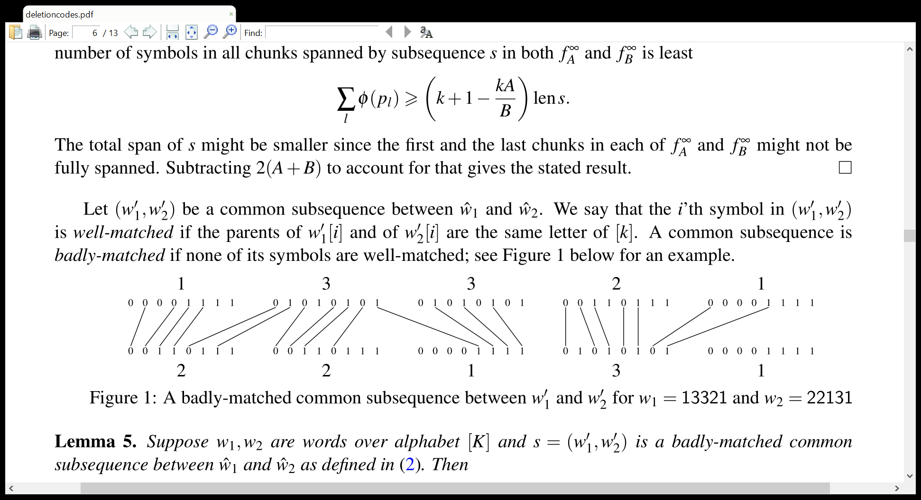


Analysis of concatenated code
Let $σ$ be a common sequence of $c,c′$ from concatenated code
Look at parent symbols in outer codewords that yield $i^{′}$th symbol of common subsequence $σ$
If these are different letters in $\left[K\right],$ say $i′$th symbol is badly-matched.
By span lemma:
if all symbols of $σ$ badly-matched, span$\left(σ\right)$ w.r.t $c,c^{′}≈3 len\left(σ\right)$
span($σ$) $≤2n⟹len\left(σ\right)≤2n/3$
$LCS\left(C_{out}\right)≤ε⇒$Well-matched symbols don’t contribute much

Slide 21



Summary
One can correct deletion fraction $p$ with binary codes of positive rate for any $p<1/3$
+ explicit construction with efficient decoding algo
$\text{For} \text{alphabet} \text{size}$k$\text{, }\text{similar} \text{code} \text{construction} \text{for} \text{deletion} \text{fraction} p<\frac{k−1}{k+1}$
A code correcting t deletions can correct (combinatorially) any combination of a total of t insertions and deletions [Levenshtein’66]
Can also make this efficient for our codes [G.,Li’16]
Further improvement: Different choice of inner binary code that enables correction of $\frac{1}{1+\sqrt{2}}$ fraction of deletions

Slide 22









Increasing the span
${{ w}_{a} = \left(0^{a}1^{a}\right)}^{∗}$
$${w_{b}=\left(0^{b}1^{b}\right)}^{∗}$$
For $b≫a$, can think of runs in $w_{b}$ as infinite
(relative to $w_{a}$)
Get relative span (i.e., span/length) of 3 by
consuming symbols at rate 1 in $w_{b}$ and rate 2 in $w_{a}$
Idea: Introduce “dirt” (of proportion $c<1)$in runs, appropriately often
$$0^{d} 1^{cd} 0^{d} 1^{cd} …$$
Run of $b$ 0’s ($b≫a$) interspersed
with dirt of $1$’s
$$0^{a}1^{a} 0^{a} 1^{a} ….$$
If we skip the dirt and only match 0’s,
relative span $≈\left(1+c\right)+2=3+c$
If we match $1$’s also, eg. substring of ${\left(0^{a}1^{a}\right)}^{∗}$ fully,
relative span $≈1+ \frac{1}{2}\left( 1+c+ \frac{1+c}{c} \right)=2+ \frac{c^{2}+1}{2c}$

Slide 23



Better span
Balance these by picking $c=\sqrt{2} −1$
$⟹$ gives relative span $≈2+\sqrt{2}$
To get more strings, introduce dirt in all clean strings
(with varying periods) at frequencies that are well separated
Dirt introduced more often in strings of longer periods
Gives inner code $C_{in }$with relative span $≈2+\sqrt{2}$
Plugging into concatenation scheme gives explicit
binary code C with LCS(C) $≤ \frac{2}{2+\sqrt{2}}+ε≈0.414+ε$

Slide 24


Open questions
What is the value of $p^{∗}$ (largest correctable deletion frac. for binary codes)?
Is $p^{∗}=\frac{1}{2}?$
Or can one show non-trivial limitation of deletion codes?
What is the value of $p^{∗}\left(k\right)?$
Rate vs. deletion fraction trade-off.
better constructions (even inefficient)
as well as combinatorial limitations on codes

Slide 25




How large can span be?
Construction approach: A growing size collection of binary
strings s.t. common subseqs. of every pair have (relative) span $≥S$
$⟹$ Positive rate binary codes $C$with LCS$(C)$ $≤\frac{2}{S}+ε$
Oscillating strings with different periods: span $≈3$
Dirty oscillating strings: span $≈2+√2$
What’s the largest (relative) span one can have?
Formally, what’s the supremum $S^{∗}$ of reals $S$ s.t.
$∀m, ∀ε>0$, $∃ℓ$ and$C⊂{\left\{0,1\right\}}^{ℓ}$of size $m$
s.t $∀c≠c′∈C$ and common subsequence $σ$ of $c, c′$,
the span of $σ$ w.r.t $c,c′$ has length $≥S⋅len\left(σ\right)−εℓ$
We have $2+\sqrt{2}≤S^{∗}≤4$

Slide 26

Thoughts on larger span?
Two reasons why subsequences have big span in our construction:
Oscillation frequencies are very different
Impurities in the form of dirt
Span is large because we discard
half of the high frequency word,
and all the dirt
To approach (relative) span 4, need fraction of dirt to approach
half the word length.
At odds with intuition of being “dirt,” which should be in minority.
Perhaps different approach needed to prove $p^{∗}=1/2$
(if that’s indeed the right answer)

Slide 27


Which way would you bet?
Can we correct a fraction $0.499$of deletions
with rate bounded away from 0?
That is,
Does there exist $C⊂ \{0,1\}^{n}$ with $\left|C\right|≥2^{Ω\left(n\right)}$such that
$∀x≠y∈C,$ the length of $LCS\left(x,y\right) <0.501n$.
THANK YOU FOR YOUR ATTENTION!
Notes:
In case you care I thought no but am no longer sure

