Slide 1
The Moon: Optical Illusion?
DeVon Ingram

Slide 2
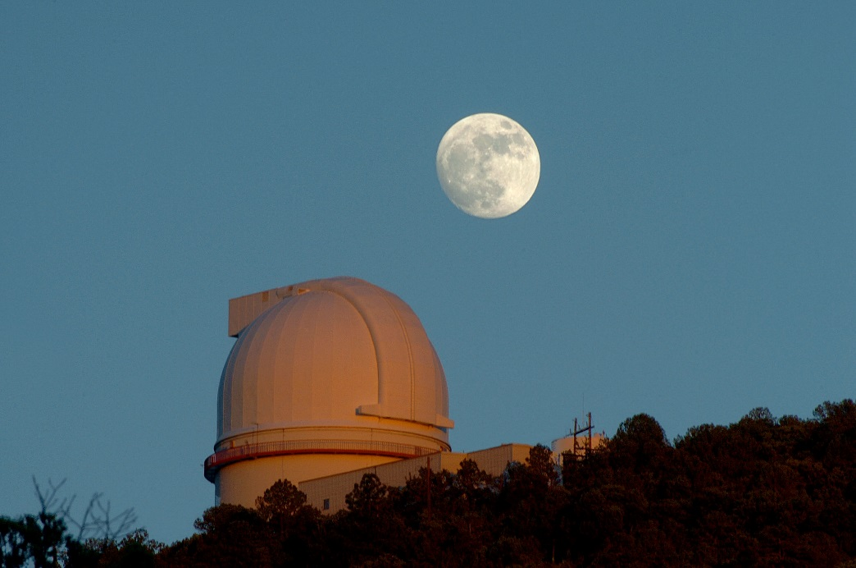
But… we can see it?
How do you REALLY know what you’re
looking at?
There are so many more plausible
explanations than what the eXpErTs tell
you

Slide 3
Don’t the ExPeRtZ unanimously agree that there is a moon?
Since when do humans agree on something?????
Aren’t scientists to approach problems without preconceived notions?????????????????????????

Slide 4
Why would the X-P E H R T S perpetrate such a hoax?
No way to know: the depth of the deception is unfathomable
Blame the Templars, The Rosicrucians, the Illuminati, the Masons, George Bush, NASA, Elon Musk, etc.

Slide 5
But the ECKS PERTZ said we landed on the moon?!?!?!
Photographs are unreliable
Moon landing was filmed in a Hollywood studio (images weren’t even in 1080p wtf)
NASA is to blame (as always)
Motivation by the Cold War

Slide 6
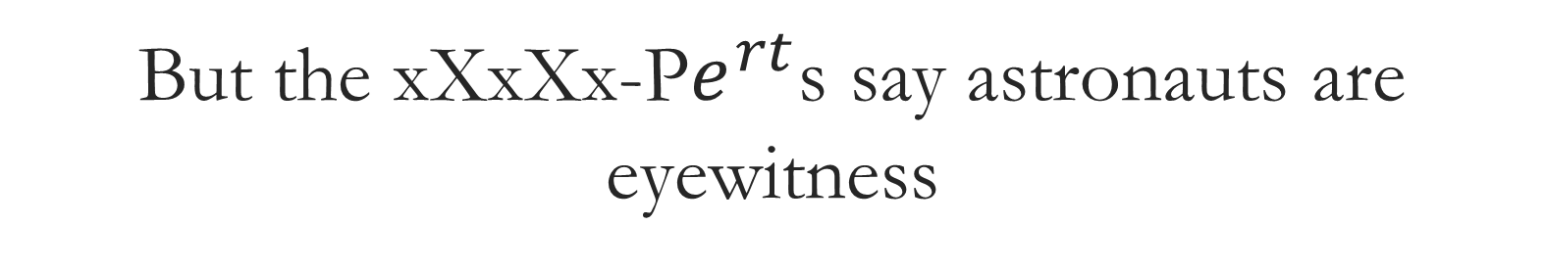
But the xXxXx-P$e^{rt}$s say astronauts are eyewitness
Do you believe everything people tell you??????
Tbh astronauts were prob bribed

