Slide 1
Lending Club Loan Approvals Analysis
Tan Yong Ern Paul (A0195389H)
Wang Shumin (A0195334B)
Wang Ruochen (A0087653U)

Slide 2
Business Exploration & Insights
Business Goal: The goal is to formulate a strategy to mitigate losses due to borrowers defaulting.
Analytics Goal: To build a predictive model that can predict if the client will default.
The data available includes:
Borrowers’ loan application (Loan amount, Loan purpose etc)
Borrowers’ financial situation provided by themselves upon the registration (Employment length, Annual income, Homeownership etc)
Borrowers’ credit report provided by lenders (DTI, Past 2 years delinquency, Revolving balance, Revolving line utilization rate etc)
Ratings given by LC loan department (Initial credit policy and Assigned loan grade)
Initial Insights:
Variables in the credit report such as DTI (debt-to-income ratio), Past 2 years delinquency (Unable to pay back with 30 days due) and Revolving Line Utilization Rate (Used vs Available credit) are intuitively linked to the borrowers’ ability to repay the loans.
Variables from the loan applications against those in the borrowers’ financial situation, such as applied loan amount against borrowers’ annual income should be statistically significant when it comes to predicting default.
Data Exploration Insights
Grade is the most important variable affects loan defaulting
Loan amount has positive relationship with loan status (higher the amount, higher probability in defaulting)
Using Random Forest, we found that Interest Rate, Term and Annual Income are top attributes.

Slide 3
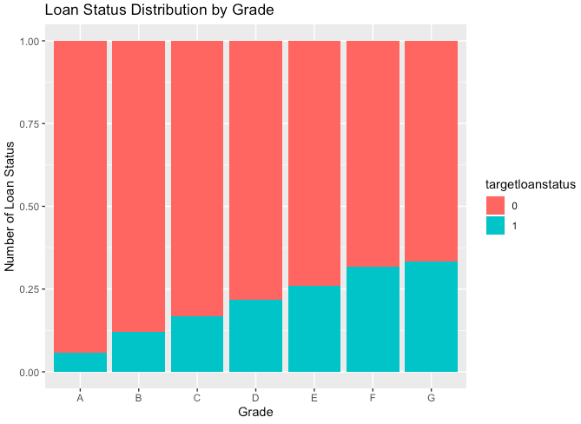
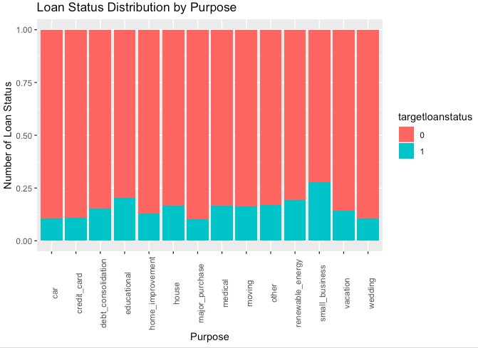
Data Exploration & Preparation
Assumption about the target variable:
Loan Status: 1 for defaulted/charged off loans and 0 for fully paid loans.
85% of the data has the value 0 and intuitively, the majority should be fully paid loans.
Data Exploration
Data Type: creditpolicy and targetloanstatus, are defaulted to numeric.
Missing values:
69 rows incomplete cases due to NA value.
1109 ‘N/A’ in emplength
Variable influences on target loan status:
Numeric: Besides ‘annulinc’, no significant trend/influence shown as the difference of mean is close between 2 groups:
Categorical: Grade shows positive relation with loan status. Purpose shows some hikes in small business
Data Preparation
Data cleaning
Drop the ‘id’ column since it’s not relevant to the model.
Drop incomplete cases which account for less than 1%.
Convert data type
Convert the ‘creditpolicy’ variable to object data type.
Create dummy variables
Get dummy variables for categorical variables: 'creditpolicy', 'term', 'grade', 'emplength', 'homeownership', 'purpose', 'verificationstatus'
Derive variable
Payback = terms * installment

Slide 4
Sampling & Validation
Split train and test set
Train set: 70%
Test set: 30%
Handle imbalance data
In the dataset, the target variable, Loan Status, has an imbalanced ratio of 5.61.
To prevent a biased model, the training set is balanced using the SMOTE algorithm (Synthetic Minority Oversampling Technique) to make the proportions of 'targetloanstatus' of 0 and 1 to be both 50%. The test set remains.
Validation Techniques
From the confusion matrix, we can calculate Recall, Precision and F1-score
Recall: To capture the false negative rate (Defaulters getting their loan application approved). We can focus on Recall score as the cost of defaulting is potential much higher than losing non-defaulting customers (Losing loan amount vs losing interest).
Precision: To capture the false positive rate (Losing non-defaulting customers)
F1-score: Balanced between Precision and Recall.
ROC and Area Under Curve.

Slide 5

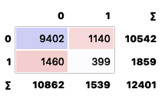
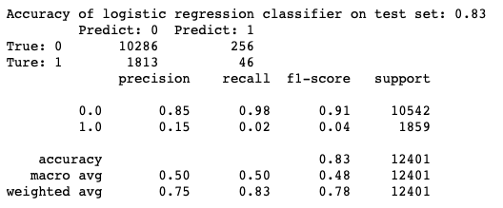
Accuracy
Confusion Matrix Comparison
As our goal is to identify who are the loan defaulter and to minimize the chance to classify potential customer into defaulter, therefore following points should be ensured when selecting the right model:
Highest TP (Actual 1, Predicted 1) rate: TP rate indicates the accuracy of capturing real loan defaulter. This is the primary goal.
Lowest FN (Actual 1, Predicted 0) rate: FN rate implies actual loan defaulter but predicted as non-defaulter.
Looking at the confusion matrix generated from forecasting of the test set using the 3 models, the logistic regression model is the most suitable model to be implemented as it has highest TP rate (9.5%) and lowest FN rate (5.5%) comparing to others.
Logistic
Regression
Random
Forest
Neural
Network

Slide 6
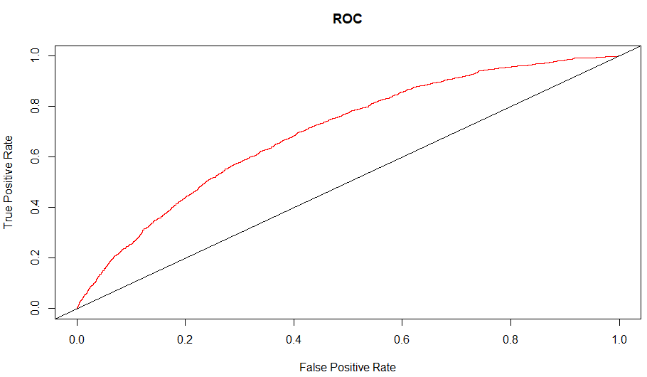
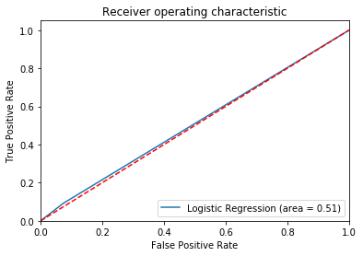
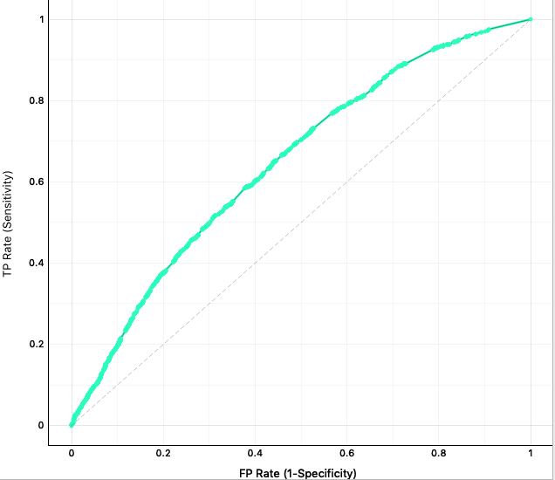
Accuracy
F1 score is used as an accuracy measurement among models as it shows weighted average of precision and recall. Similarly, high recall shows low FN, which indicated the percentage of relevant defaulter classified correctly in the model.
AUC is another measure used to select final model. Ideally, as Sensitivity (TP rate) increase, Fall-out (FP rate) should slowly extend. Therefore, AUC should be as large as possible.
 | Recall |  |  | Precision |  |  | F1-Score
Model | Logistic Regression | Random Forest | Neural Network | Logistic Regression | Random Forest | Neural Network | Logistic Regression | Random Forest | Neural Network
1 = default | 0.63 | 0.215 | 0.02 | 0.24 | 0.259 | 0.15 | 0.35 | 0.235 | 0.04
Conclusion: Logistic Regression is the best model as:
Logistic regression has the highest Recall and F1 score among all techniques.
Logistic regression has the highest AUC.
Logistic Regression:
AUC = 0.70
Random Forest:
AUC = 0.645
Neural Network
AUC = 0.51

Slide 7
Implementation
Potential Implementation Issues:
As certain variables, those from income verification and credit reports, are not immediately available, the usage of predictive model will have to be delayed until those information is available.
The credit reports may not be complete if the borrowers have borrowed from lenders not linked to LC.
Potential challenge in lenders providing borrowers’ credit reports to LC as this is a confidential data. Privacy law might prevent lenders from sharing data with third parties.
Criteria set for the initial credit policy and assigned loan grade may change over time changing the definitions of the variables. The predictive model will have to be updated when such occasion occurs.

