Slide 1
Ridership Forecast and Analysis
Planning for
Future Ridership
Tan Yong Ern Paul (A0195389H)
Wang Shumin (A0195334B)
Wang Ruochen (A0087653U)

Slide 2
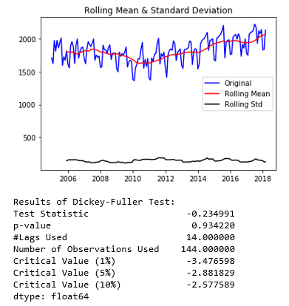
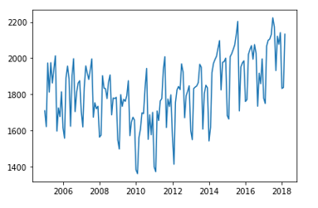
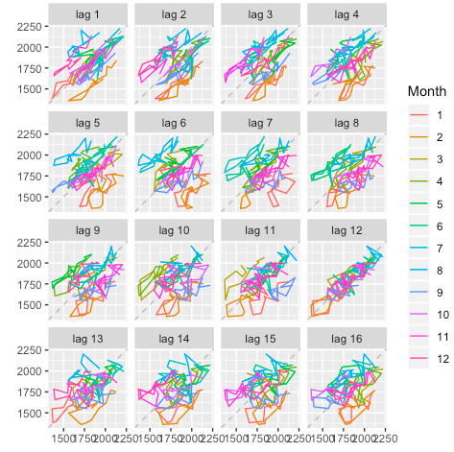
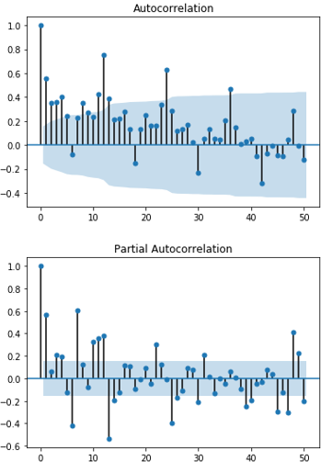
Data Exploration
Convert data to time series format and plot the time series data to overview
Monthly data, frequency = 12
the time series is non-stationary as it is shows seasonality (repeated patterns) and trend (decreasing before 2011 and increasing after)
Ridership data set is an additive time series
Perform Dickey-Fuller test to check stationarity:
high p-value indicates non- stationarity
Autocorrelation/ACF/PACF Plots
The graph shows strong autocorrelation when lag is 12. (display a seasonality of 12 months)
Relatively high autocorrelation in lag 1, decreasing from lag 2

Slide 3
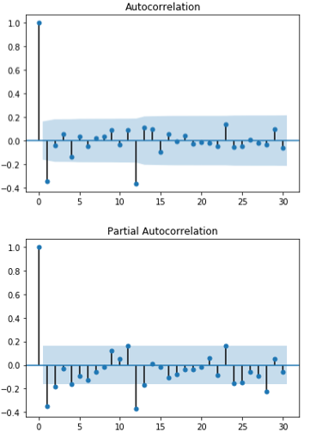
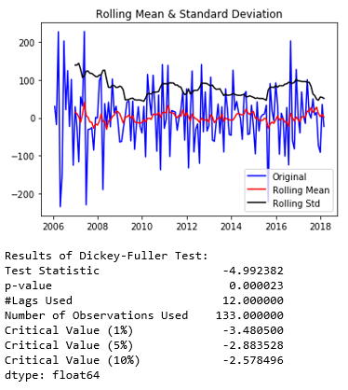
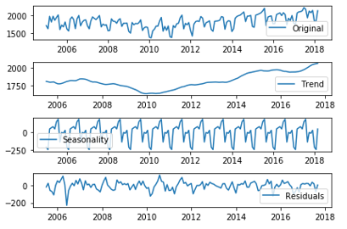
Data Preparation Achieving Stationarity
Plot ACF and PACF on differenced time series data:
ACF dies down and shows clear cut-off at lag 1, indicating MA(q) = 1
PACF dies down and shows clear cut-off at lag 1, indicating AR(p) = 1
Skip AR and MA model as both ACF and PACF die down
Conduct one order of differencing with lag 12 and check stationarity again:
Low p-value indicates the time series data reaches stationarity
Data hovers around zero indicates stationary
Perform decomposition to observe the trend, seasonality and residuals of the time series data:
A growing trend of ridership overtime
An obvious seasonality
The random residuals
Split train and test set before building models:
Train set: 132 months till end of 2015
Test set: 27 months from beginning of 2016

Slide 4
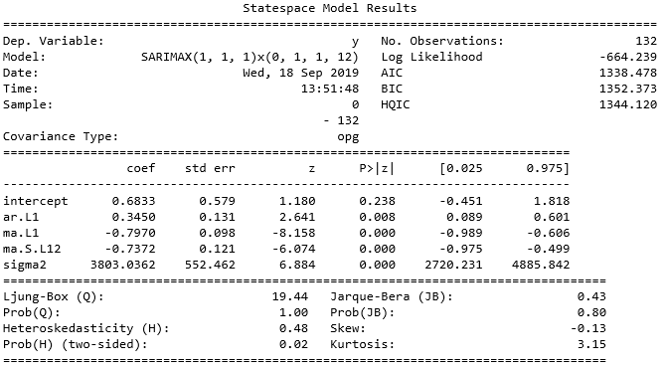
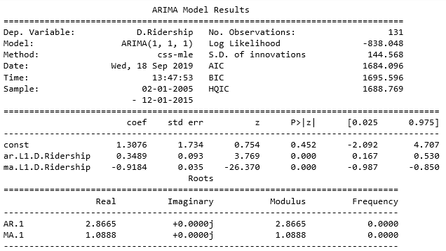

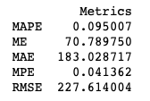
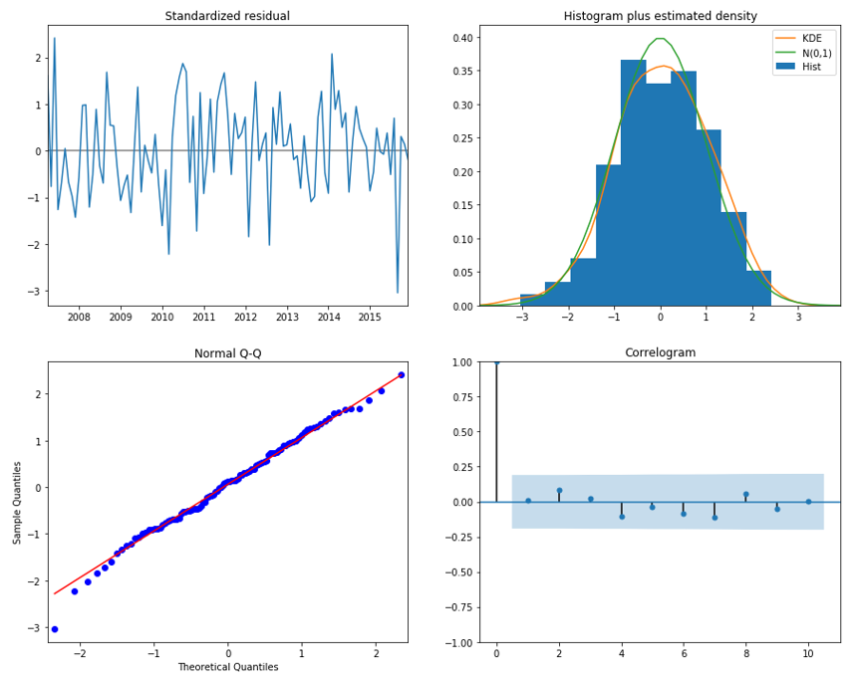
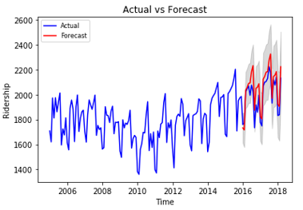
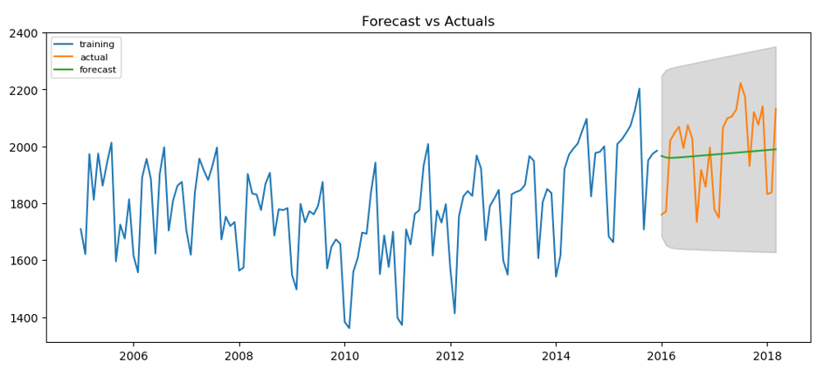
Methods & Accuracy Seasonal ARIMA
Seasonal: SARIMAX(1, 1, 1)x(0, 1, 1, 12)
Lower AIC
AR1, MA1, SMA1 significant
Predicted line is close to actual data, similar trend and seasonality
Non-seasonal: ARIMA(1, 1, 1)
Higher AIC
AR1, MA1 significant
Prediction line only shows the trend but not seasonality
Residuals for seasonal model
Normally distributed
No autocorrelation (low p-value from Ljung-Box test)
Residuals for seasonal model
Normally distributed
No autocorrelation (low p-value from Ljung-Box test)
Pic-9
Pic-10

Slide 5
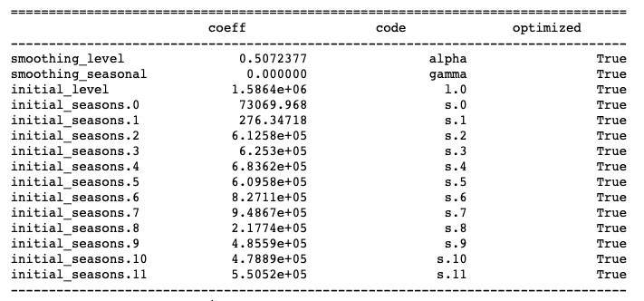
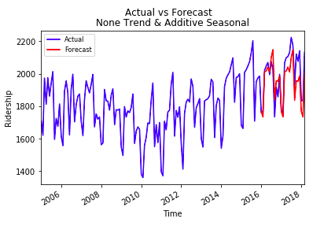
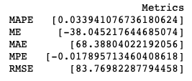
Methods & Accuracy ETS
ETS (N,N,A)
ETS Model Selection:
Holt-Winters exponential smoothing is used as we detected both seasonality and trend in dataset. After comparing AIC and error measure, we found ETS(N,N,A) has the lowest AIC and error terms. We suspect the model works better with none trend is due to the offset of trending before and after 2010
Pic-9
Pic-10

Slide 6
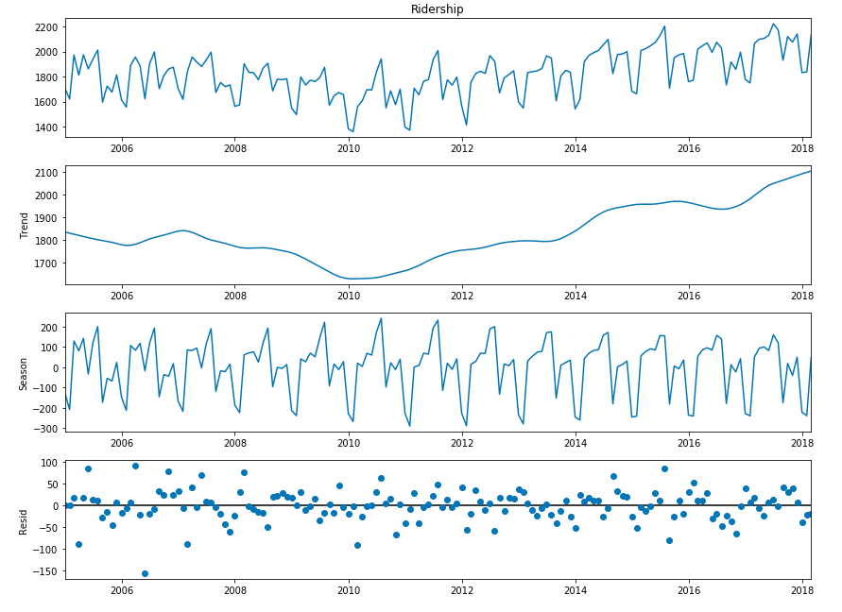

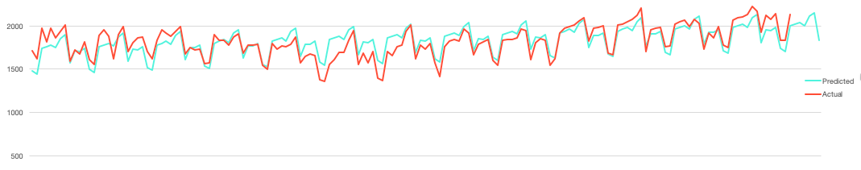
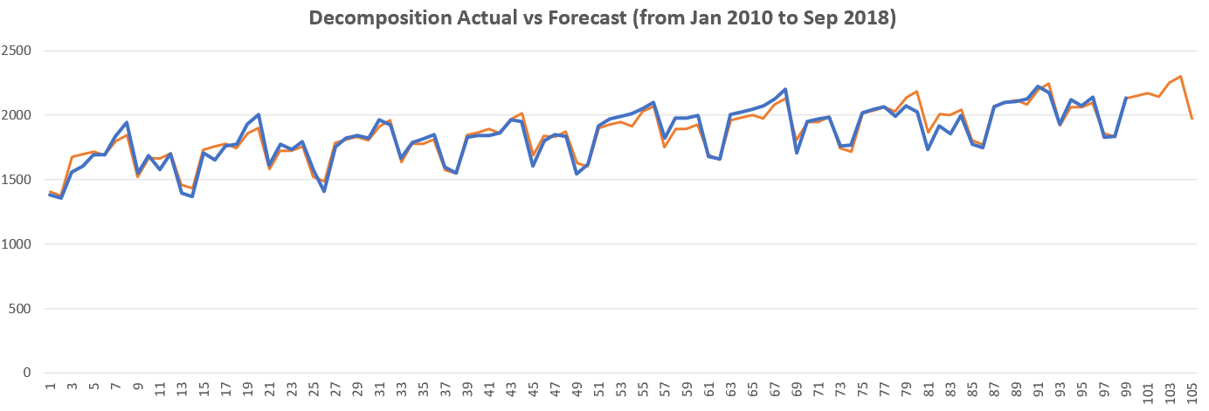
Methods & Accuracy Decomposition
Decomposition Model Selection Additive Data Decomposition:
After decomposition, data shows clear trend and seasonality. The trend went down before 2010 and went up after. Decomposition on full data set smoothed the trend whereas using 2010 onwards data shows better prediction value.
Decomposition on full data points
Decomposition on 2010 onwards data
Pic-9
Pic-10

Slide 7
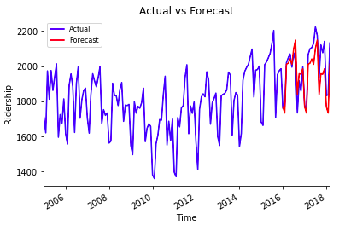
Methods & Accuracy
Model | SARIMA | ETS | Decomposition
MAPE | 0.1 | 0.03 | 2.34
MAE | 183.03 | 68.39 | 42.7
RMSE | 227.61 | 83.77 | 55.19
Model Comparison:
Exponential Smoothing has low MAPE, MAE and RMSE than SARIMA
AIC should not be used in comparing different models
Exponential smoothing’s predicted value is closer to actual data points for all 2 year, whereas SARIMA’s predicted value has big gap
Decomposition has low RMSE and MAE but poor prediction in chart
SARIMA
ETS
Conclusion:
Holt-Winters exponential smoothing has better prediction based on testing data set, hence ETS(N,N,A) is chosen to predict ridership for next 6 months
Pic-9
Pic-10

Slide 8
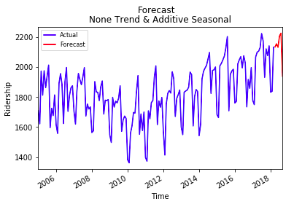
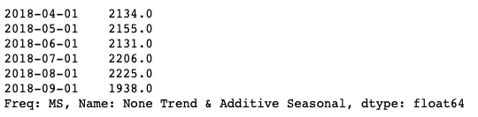
Findings
6 months forecast for ridership illustrates increasing demand of train commuting from Apr to Aug, peaking in Aug. Therefore, we suggest to deploy more trains gradually in these months.
However, train demand is facing a dramatic drop in Sep, we recommend to reduce number of trains.
According to previous 8 years observation, on the same month, ridership has grown year-on-year.
We recommend adding more trains to accommodate the 8% increase in ridership than the previous 6 months to ensure efficiency of city rail network

