Slide 1

Stakeholder Centered Coaching for Guaranteed & Measurable Leadership Growth
The major challenge faced by executives today:
NOT understanding the practice of leadership (KNOW HOW)
BUT practicing their understanding of leadership (SHOW HOW)
Stakeholder Centered Coaching (SCC):
Enables successful leaders to achieve positive & measurable change in leadership behavior
Is a system for continuous improvement for themselves and their teams

Slide 2

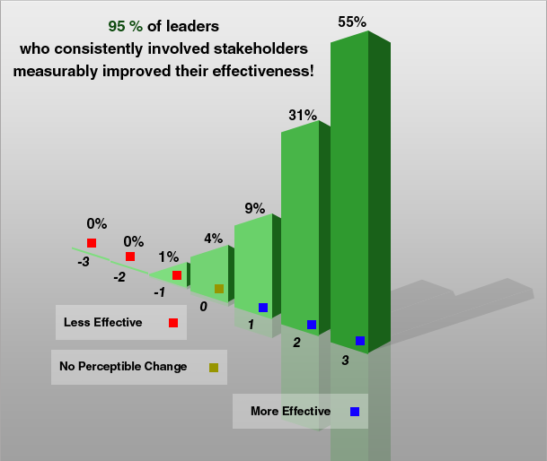
Goal = Measurable Leadership Growth
Leadership is a Contact Sport – Real time on the job !
Requirements:
Stakeholders’ involvement creates real time on the job coaching
Monthly follow up creates sustainability of changed leadership behavior → Habits
Leadership Growth Progress Reviews provide measurable perceived leadership effectiveness growth
95% of leaders using Stakeholder Centered Coaching improved their effectiveness
11,000 leaders on 4 continents

Slide 3
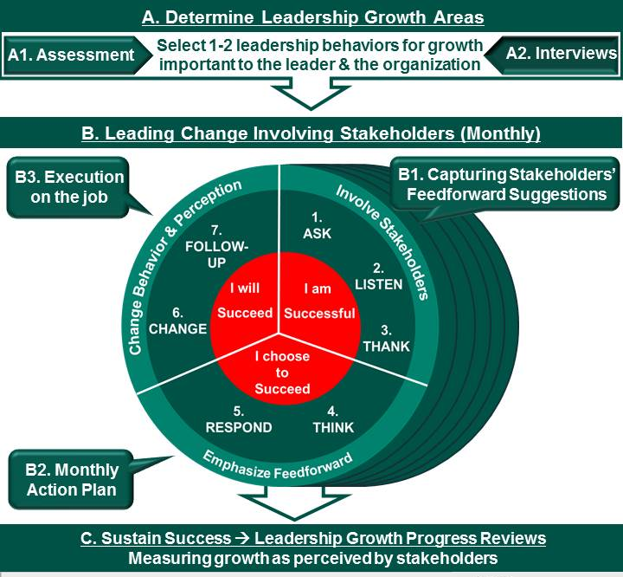
Stakeholder Centered Coaching Guarantees Measurable Leadership Growth
Phases
A1. Behavioral interviews, structural assessment
A2. Determine leadership growth areas
B1. Stakeholders briefing
B2. Leading Change Involving Stakeholders
(Monthly Action Plan)
C1. Leadership Growth Progress Review
C2. Leader becomes coach

Slide 4


Stakeholder Centered Coaching
Guarantees leadership growth for leaders who have:
Courage ( = about YOU) - get out of the comfort zone, be vulnerable, try new things, rethink deeply held beliefs and do what it takes to change
Humility (= NOT about YOU) - involve stakeholders on the job, consider their suggestions, admit you aren't perfect and demonstrate leadership growth
Discipline to implement and hone more effective behaviors / habits / processes

Slide 5

Select stakeholders
‘Feedback is the breakfast of champions’ (Ken Blanchard)
Feedforward is a key lever in behavioral change and leadership growth
Select stakeholders important for your leadership effectiveness / impact :
Not your fan club!
Leading direct reports is your contract with the company (not peers)
 | Name of stakeholders | e-mail address | Phone number | Relation to participant (boss, peer, direct report)
1 | YOU |  |  | leader
2 |  |  |  | boss
3 |  |  |  | direct report
4 |  | 5-7 stakeholders is manageable |  | direct report
5 |  |  |  | direct report
6 |  |  |  | peer
Notes:
See MS Word file

Slide 6
My Leadership Growth Areas
360⁰ feedback summarized strengths – weaknesses – areas to develop:
Structured assessment
Behavioral interviews
I selected the following Leadership Growth Areas:
…. Be a better listener ….
… Delegate better …
Superior(s)
Peers
YOU
Put YOUR 1 or 2 leadership growth areas here
Direct
Reports
Notes:
For coach: share your own example on getting tough feedback, developing a plan, and implementing that successfully.

Slide 7
E-mail stakeholders to initiate the coaching program
E-mail: Invitation to stakeholder briefing for my yearlong Stakeholder Centered Coaching program
Dear Colleague,
As you know, I have just completed a 360 ⁰ leadership assessment designed to provide feedback on specific core competencies and leadership behaviors within our organization. It was a very insightful process and provides an opportunity for me to improve as a leader.
First of all I want to thank you for participating in my 360 ⁰ assessment and providing your candid, honest feedback to me. I greatly appreciate that.
Feedback results:
A. It was very rewarding to receive positive results in a number of areas. Two aspects that were especially gratifying were:
(put 1-2 key areas only) (Sample) Collaborating across organization/geographic boundaries and demonstrating a bias for action.
B. The report also provided me with helpful information on some leadership areas in which I want to grow. I believe it is a very opportune time to focus on growth in these areas. Therefore I decided to focus my leadership growth in the coming year on:
(Sample) 1) Delegating more effectively and 2) Including opinions of others in my decision making process
The next steps:
The 360 ⁰ feedback report was only the initial step in what I believe will be a very useful course of action for my leadership development. I would like you to continue to support me in my process of growth and change and therefore like to enlist you as my stakeholder to help me stay focused on the leadership growth areas described above. Being a stakeholder will only take 5-10 mins of your time per month. I have asked you to be one of my stakeholders in this process moving forward because I value your constructive input and I know you will be honest and fair.
As part of this coaching process I will also be using a coach, ABC. I will describe him as my personal trainer and conscience to stay focused on my leadership growth. I have scheduled a short (30 minutes) briefing with all my stakeholders, myself, and my coach Will Linssen on Thursday November 7th at 8:30am. During that briefing I will explain the process I will be going through in more depth and introduce you to the stakeholder role.
Please let me know if you can support me as a stakeholder (ref 1) and can attend above mentioned stakeholder briefing
(ref 2). All of this is important to me. Thank you for your support. Best regards.

Slide 8
Role of Stakeholders = support leadership growth on the job
Leadership Growth Areas:
…. Be a better listener ….
… Delegate better …
Aim
Deliver the following benefits:
Better communication
Higher productivity
More focus for strategic issues
Accelerated development DRs
Better quality of relationships
Higher engagement and satisfaction of DRs
Etc.
Involving
Stakeholders
Monthly feedback and feedforward from stakeholders include (expert) suggestions that leader can include in action plan to deliver results and benefits
Should

Slide 9
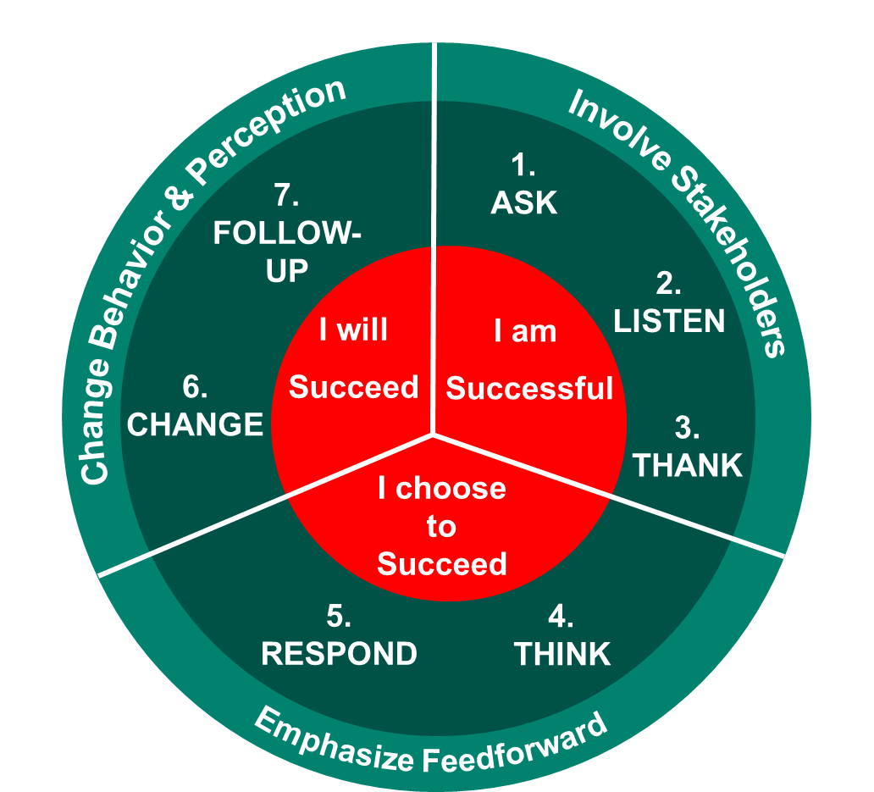
Leader’s commitment: Leading Change Involving Stakeholders (Monthly)
On a monthly basis I commit to:
Meet and re-emphasize to you the leadership areas in which I want to become more effective:
Better listening
Better delegation
Ask for feedback: ‘How did I do last month’
Ask for feedforward suggestions: ‘What can I do in my relationship to you to demonstrate & use these leadership behaviors? Give me 2-3 suggestions for the next 30 days.’
Put YOUR 1 - 2 leadership growth areas here
Listen carefully to your suggestions
Thank you for your contribution to my leadership growth
Think about your suggestions and make an action plan
Respond to you via e-mail on which of your suggestions I will focus in the next 30 days
Implement my action plan to make change visible
Consistent monthly follow up ((in)formal)

Slide 10
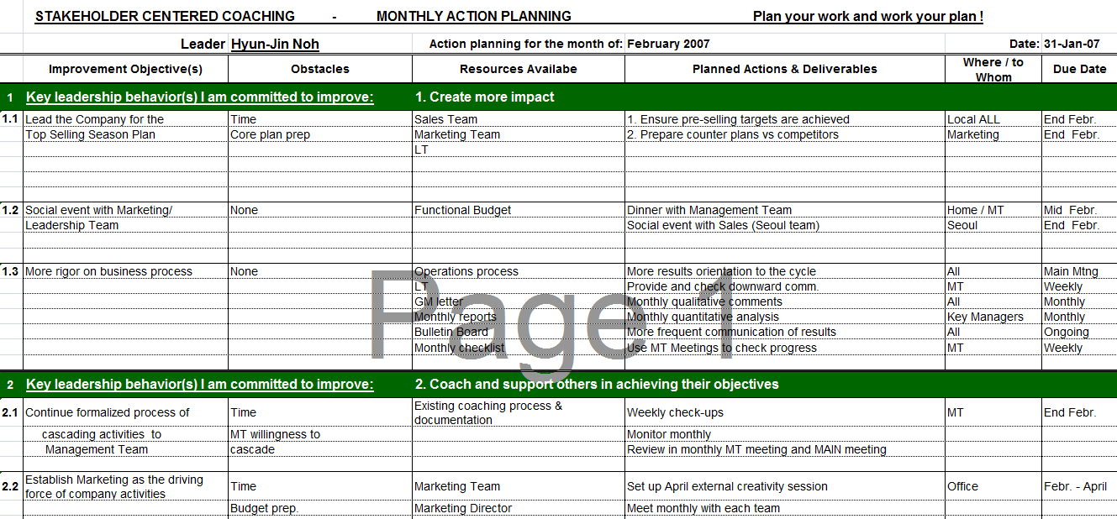

Slide 11
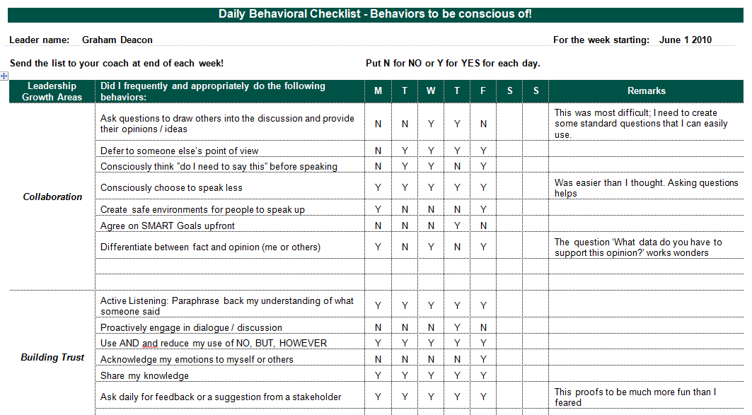
Daily Behavioral Checklist

Slide 12
e-mail: Responding to stakeholders (& share MAP)
Subject: My monthly action plan for leadership growth
Dear … (Stakeholder),
Thank you for your support in the leadership growth process.
During the recent monthly follow up discussions, stakeholders provided me a.o. with the following feedforward suggestions:
Listen to people more often
Be more clear in my communication
Do not interrupt others while talking
As you remember I am committed to become more effective in the following leadership behaviors:
More constructive in resolving conflict
Better listening
Based on the feedforward suggestions and my commitment above I will focus in the next 30 days on the following actions:
Listen with more attention
Stay calm when there is conflict
All action details are in the Monthly Action Plan (MAP) (enclosed)
Kindly hold me accountable to improve this behavior and let me know your feedback by the end of the month (or any other time you feel appropriate).
Thank you again for your support in my leadership growth and development.
Best regards, B Leeder
Put here what stakeholders suggested
Put YOUR 1 - 2 leadership growth areas here
Put here what you commit to stakeholders for next month

Slide 13
E-mail: Monthly follow up to involve Stakeholders
Subject: Leadership growth suggestions to be implemented in the next 30 days!
Dear … (Stakeholder),
I have been trying hard to implement the actions that I committed to last month.
Going forward, I would like to get your input on my leadership growth focus. As you know I am committed to become more effective in the following leadership behavior(s):
1. Create more impact
2. Coach and support others in achieving their objectives
Feedback from Past Month
A. “How did I do during the past 30 days ?”
…..
Feedforward for Next Month
B. What can I do in my relationship to you to demonstrate & use this key leadership behavior. Give me 3-4 suggestions for the next 30 days?
……
Please reply to me on the above in the next 2 days alternatively we can talk about this when we meet … (this Friday) ... Thank you for taking the time to provide me with your suggestions for my leadership growth.
Best regards B Leeder

Slide 14
Stakeholder Centered Coaching Guarantees Measurable Leadership Growth
Phases
A1. Behavioral interviews, structural assessment
A2. Determine leadership growth areas
B1. Stakeholders briefing
B2. Leading Change Involving Stakeholders
(Monthly Action Plan)
C1. Leadership Growth Progress Review
C2. Leader becomes coach

Slide 15


Continuous leadership development for you & others
Sarcopenia: Muscles become smaller and weaker as people age
Starts in 30’s & 40’s
Lose 25% muscle mass by age 70
+ Lose 25% muscle mass by age 90
That which is used develops, that which is not used wastes away (Hippocrates)
Light diet of feedback / feedforward, done regularly will keep us from losing leadership strength
Management development → Engage in life long Stakeholder Centered Coaching with your direct reports and reap business and personal benefits for yourself and your team!

