Slide 1

The Best Software

Slide 2
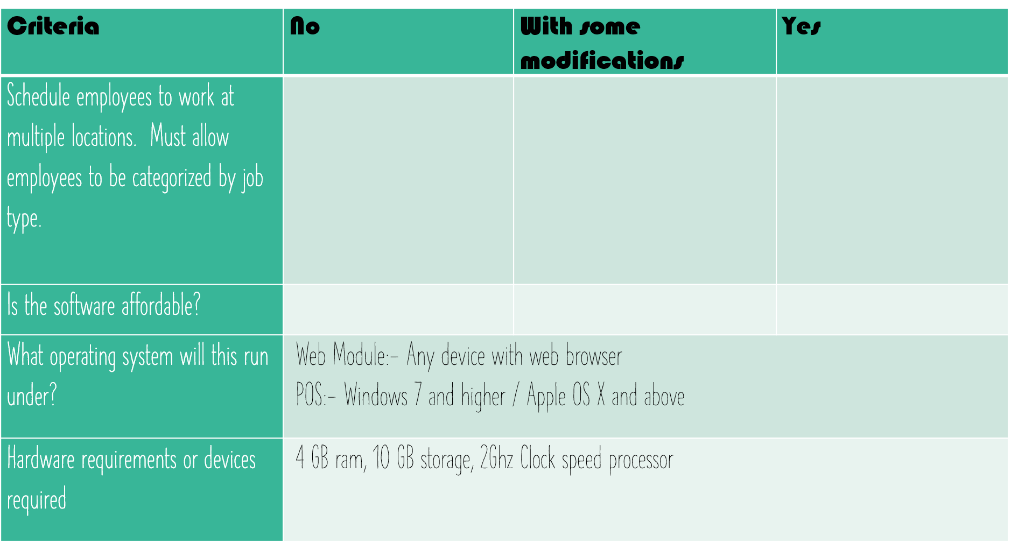

Slide 3
Thank For Watching
😀

