Slide 1
Lending club case study
09-Feb-2020
-Varsha R, Shreyas P

Slide 2
Problem statement:
To understand the driving factors (or driver variables) behind loan default, i.e. the variables which are strong indicators of default which would help in better management of company portfolio and risk assessment
Analysis approach:
We carried out our analysis using the following approach:
Initial data understanding: Go through the data and
get an understanding of the variables
level of data
identifying categorical and numerical values
distinct values present in the categorical columns and the range of values in the numerical variables
Data cleaning
Removing columns with >50% of null values
Removing columns which have information about customer behavior and which are irrelevant
Removing highly correlated columns
Standardizing the values of columns
Creating box plots to remove the outliers in numerical columns

Slide 3
Univariate analysis for unordered categorical variables
Creating log frequency rank plots
Univariate analysis for ordered categorical variables
Creating bar plots across variable – one bar plot for charged off members and the other one for fully paid members
Creating histograms by considering bins for numerical variables
Bivariate analysis
Creating bar plots by plotting 2 variables against each other and also creating labels for chaarge offs and fully paid for comarison

Slide 4
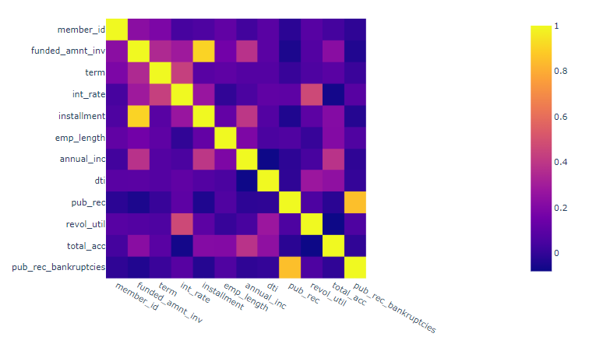
Results
Univariate analysis on unordered categorical variables
Based on the log frequency rank plot for loan purpose and state, it doesn’t give us clear insights on whether charge offs would happen or not
Univariate analysis on ordered categorical variables
Except for corrrelation between funded amount inv and installment, pub_rec and pub_rec_bankrutcies, no significant positive or negative correlation found between other variables

Slide 5
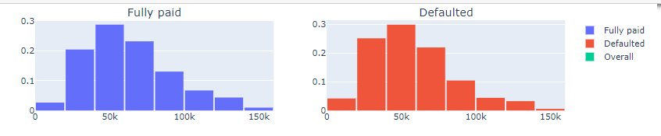
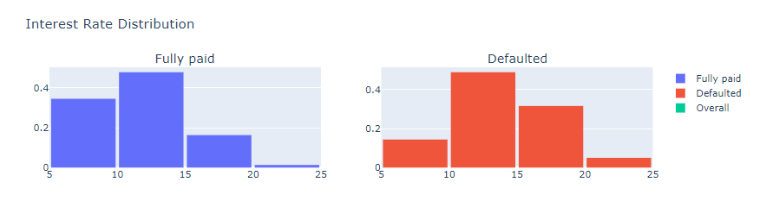
Univariate analysis on ordered categorical variables
Income distribution: The probability of defaulters in lower income range (<50K) is higher
Interest rate: For lower interest rates, loans are more likely to be fully paid whereas higher interest rates (>15%) saw higher number of defaulters

Slide 6
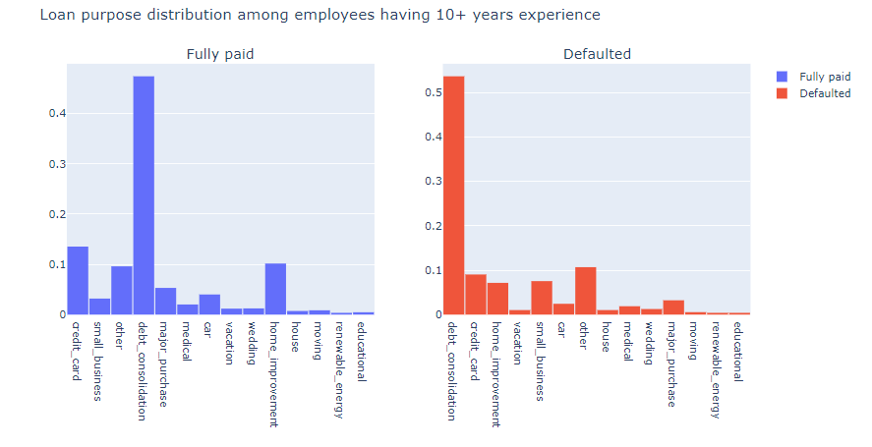
Employment length distribution: The number of employment years do not differ much for fully paid and defaulters. Max probability of defaulters are seen in 10+ years of experience and deep diving into loan purpose among these members, it was observed that small business have a slightly higher probability of defaulting

Slide 7
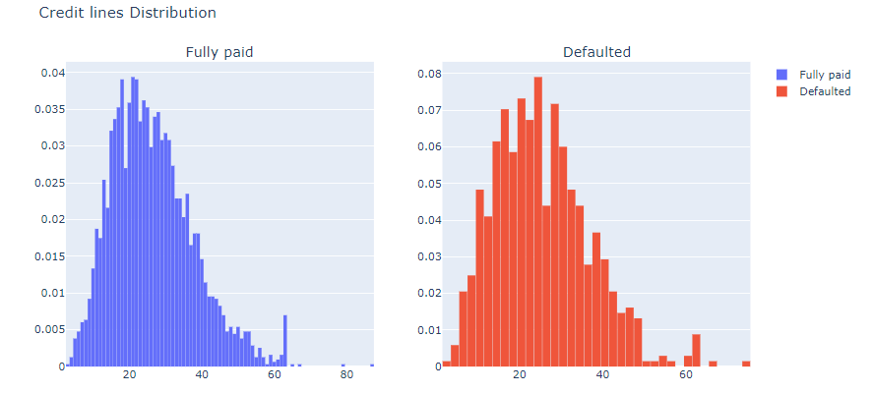
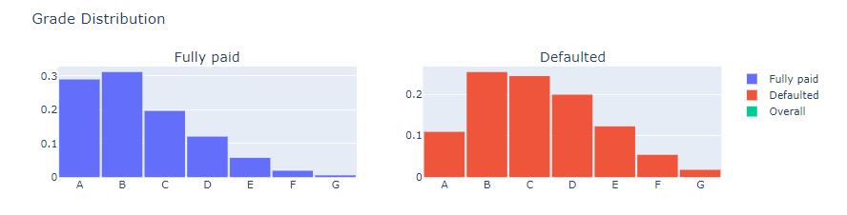
Credit line distribution among members having 10+ years of employment and have debt consolidation as loan purpose: Members having 10+ years of emp length who have taken the loan for debt consolidation and having higher credit lines are more likely to get a charge off
Grade distribution: Higher grades (>C) are likely to have more number of charge offs¶
Loan grade distribution: Higher grades (>C) are likely to have more number of charge offs

Slide 8
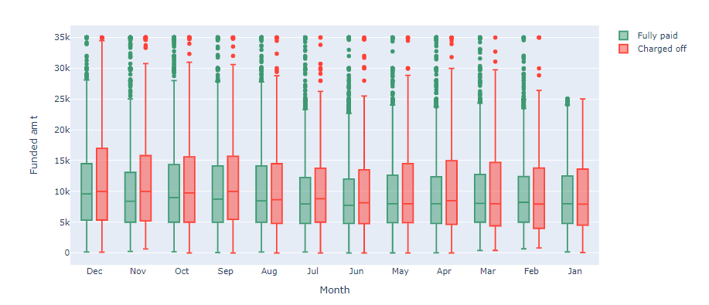
Bivariate analysis
Funded amount across months – box plot comparison between charged off and fully paid members

Slide 9
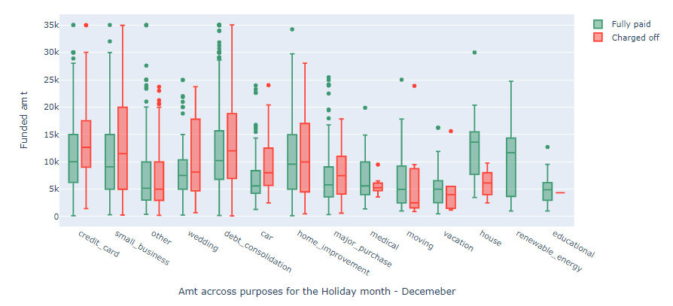
Funded amount across purpose during december month– box plot comparison between charged off and fully paid members

