Slide 1
Vehicles (Index)
Shards
Replica Shards
Inside index there are 100 documents
0
1-50
R0
1
51-100
R1
Node1
Node2
P1
P0
P - Primary Shards
R - Replica Shards
R0
R1
Shards - is the exact copy of the Primary Shard
Replica Shards - is the exact copy of the Primary Shard
Note:
Index and Delete process goes to the Primary Shards First then replicate it in the Replica Shards.
Get process use round robin method
Index
Client

Slide 2
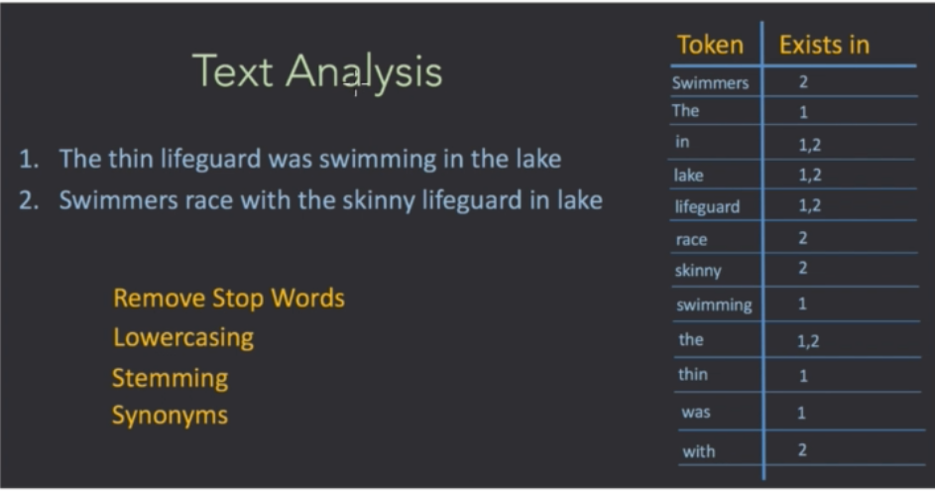
Shards (Lucene Indexes)
Segments (Inverted Index)
Indexing - is the slowest process.
Immutable Inverted Index
Inverted Index
Document
Elasticsearch
Analysis

Slide 3
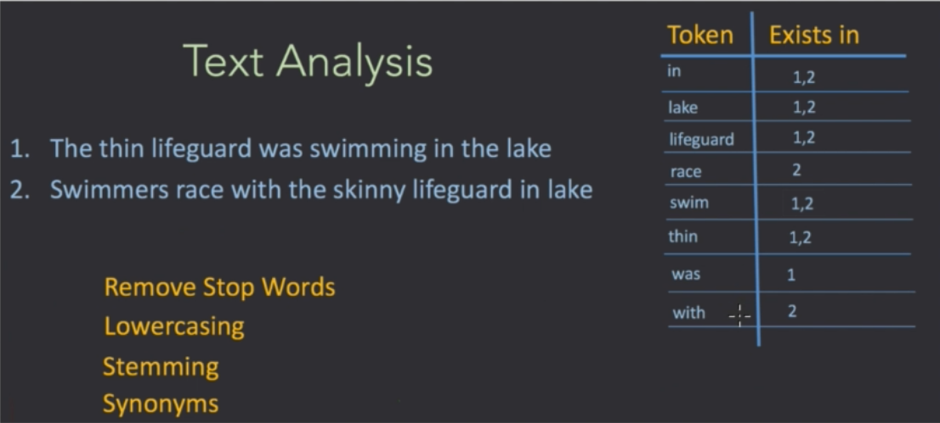
Analysis Steps: 1. Tokenizing - splitting the words
2. Filtering
Remove Stop Words - removing words that are not really important. Ex. the word “the”
Lowercasing - case insensitivity
Stemming - get into the root of the word. Ex. swimming and swimmers root word is “swim”
Synonyms - Ex. “thin” is same meaning a “skinny”

