Slide 1
Investigation of Modeling Differences between OpenSim and Visual3D for Gait Analysis of Healthy Gait
Beth Eng Wan Xuan¹, Chan Sherwin Stephen^{2*}, Henry Johan², Lim Lek Syn², Zuo Bing Ran², Ang Wei Tech²
¹ National University of Singapore
² Rehabilitation Research Institute of Singapore
* Corresponding Author: sherwin.chan@ntu.edu.sg

Slide 2


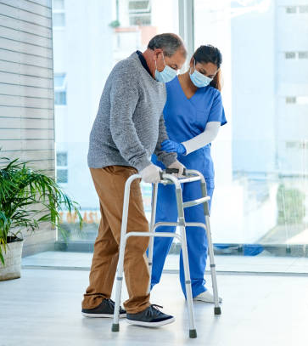

Background
Ageing Population
Rise of Ageing Population
Increased Gait Impairments
More Targeted Gait Rehabilitation
40% increase of population aged 60 years and above by 2030
Increased risk of impairment due to ageing related conditions (e.g. stroke)
Provide gait analysis to caregivers to better understand impairment
Notes:
There is a rise of ageing population where the population aged 60 years and above is projected to increase by 40% by 2030. This leads to a greater incidence of gait impairments due to the associated increased risk of ageing related conditions such as stroke. This puts a strain on our current healthcare system, as such, we need a more targeted approach to gait rehabilitation and the first step to this is to provide the caregivers with the right information of the patient’s gait condition.

Slide 3
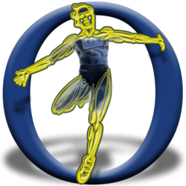

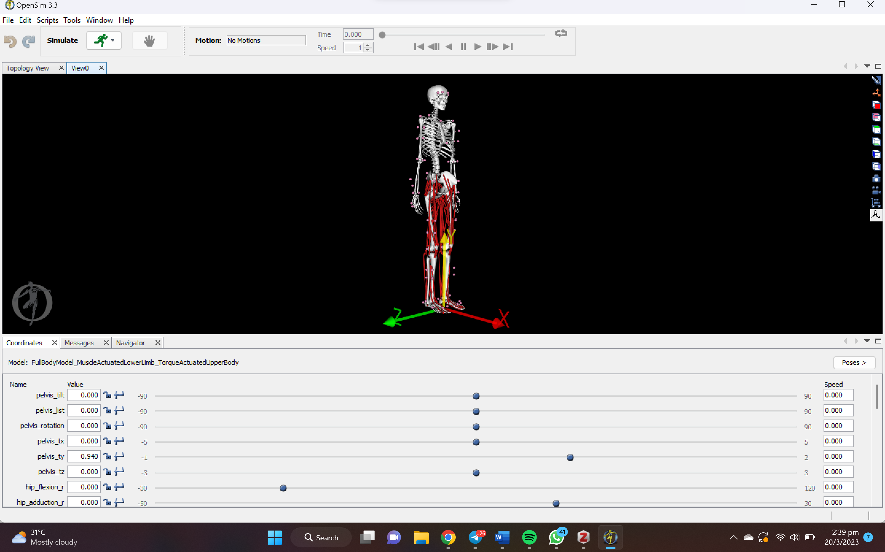
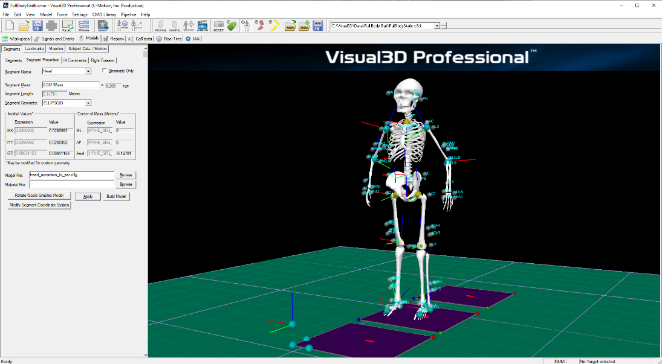
Background
Simplified computational models to model after complex human biomechanical system for computational efficiency.
Calculation of kinematics & kinetics given motion capture data
GUI to perform biomechanics operations
OpenSim
Visual3D
Model: Musculoskeletal models
Model: 6-DOF Link Model (skeletal)
Notes:
Visual3D and OpenSim are widely used biomechanics analysis tools for gait analysis, both offering a user-friendly GUI. Visual3D excels in motion capture data analysis, renowned for its accuracy and reliability, with extensive validations available on their website. Conversely, OpenSim is celebrated for its musculoskeletal simulation capabilities, letting researchers delve into the mechanics of muscles, bones, and joints, while also offering transparency in its mathematical formulations. This makes OpenSim ideal for those keen to grasp the core mechanics of simulations.
---------------------------------------------------------
Detailed:
Two commonly used biomechanics analysis software tools that provide further gait analysis is Visual3D and OpenSim. Both software provides tools for calculating the kinematics and kinetics of the model given the motion capture data through a simple graphical user interface (GUI). Visual3D is primarily known for its ability to provide full visibility into biomechanical processes. It is often used in the analysis of motion capture data and is widely recognized for its accuracy and reliability. In addition, Visual3D has been extensively validated across a range of papers available on their website, making it a popular choice for researchers and clinicians. On the other hand, OpenSim is primarily known for its musculoskeletal simulation capability. It is a powerful software that allows researchers to simulate the mechanics of the musculoskeletal system, including the muscles, bones, and joints. OpenSim also provides visibility over the mathematical formulations, making it an ideal choice for researchers who want to understand the underlying mechanics of the simulations

Slide 4
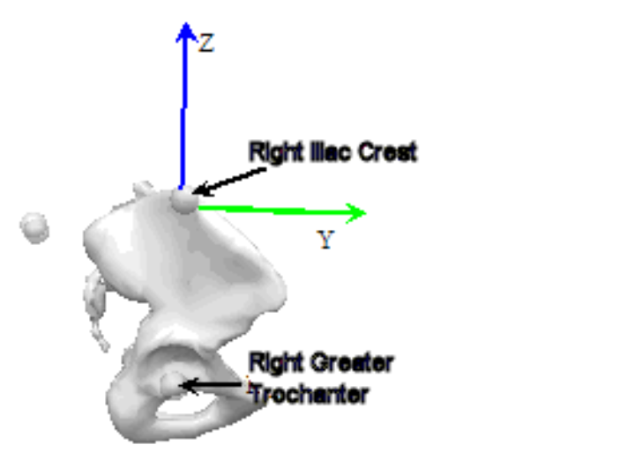
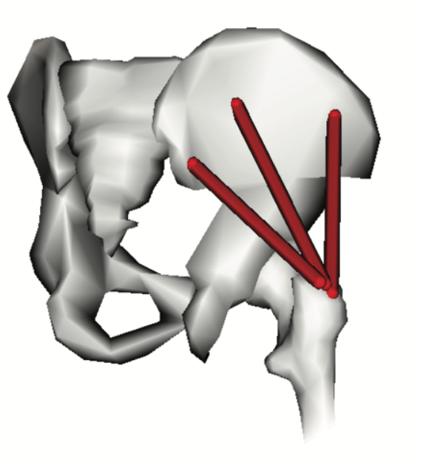
Comparison of OpenSim and Visual3D
01
Different Inverse Kinematic Algorithms
02
Different Pelvis Body Definition
02
Visual3D: Segment Optimisation
Computes position and orientation of each individual body segment of model
Joint has 6 degrees of freedom (DOF) (Note: Joints constraints allowed but 6 DOF maintained to obtain as much information)
OpenSim: Global Optimisation
Each joint constrained to anatomical linkage constraints
Visual3D: Two bodies, respective to motion of left and right limb
OpenSim: One body
OpenSim Pelvis Body¹⁰
Right component of Visual3D Pelvis Body¹⁰
Notes:
The key difference between OpenSim and Visual3D lies in their optimization approaches in kinematics computation and the pelvis body definition.
Visual3D employs segment optimization, giving each body segment six degrees of freedom (DoF) - three for rotation and three for translation. OpenSim, on the other hand, uses global optimization to minimize discrepancies between experimental and model markers while maintaining joint constraints. Although Visual3D allows for optional joint constraints, many comparative studies neglect this. Excessive constraints can result in lost movement information, especially in cases with marker shifts or gait impairments. For precision, our work with Visual3D doesn't apply these constraints. Additionally, while OpenSim treats the pelvis as one body, Visual3D divides it into left and right bodies.
----------------------------------------------------------
Detailed:
The key difference between OpenSim and Visual3D lies in their optimization approaches in kinematics computation.
Visual3D uses segment optimization, which computes the position and orientation of each individual body segment of a model. The segments are independent of each other with unconstrained joints where each joint has six degrees of freedom (DoF), three rotation DoFs and three translation DoFs.
In contrast, OpenSim uses global optimization where each joint is constrained by anatomical linkage constraints according to the model of choice.
However, it is critical to note that users have the option to apply constraints to individual joints in Visual3D. Existing comparative literature between OpenSim and Visual3D fails to mention this point and it can be inferred that these studies did not apply joint constraints in their kinematics calculations.
This imposition of joint constraints largely depends on the context. Excessive constraints lead to loss of information of the constrained axis of movement. This is especially applicable in subjects where markers shift during the motion capture session or in gait-impaired individuals. In this work, the joints in Visual3D are not constrained to ensure the most precise tracking of markers.
Another notable difference between OpenSim and Visual3D as highlighted is that the pelvis is defined as one body in our selected model in OpenSim as compared to two bodies, left and right pelvis, for Visual3D.
Compared to existing literature, our study focuses more on how the different model definitions across OpenSim and Visual3D results in a difference in the kinematic and kinetic output of the two platforms.

Slide 5
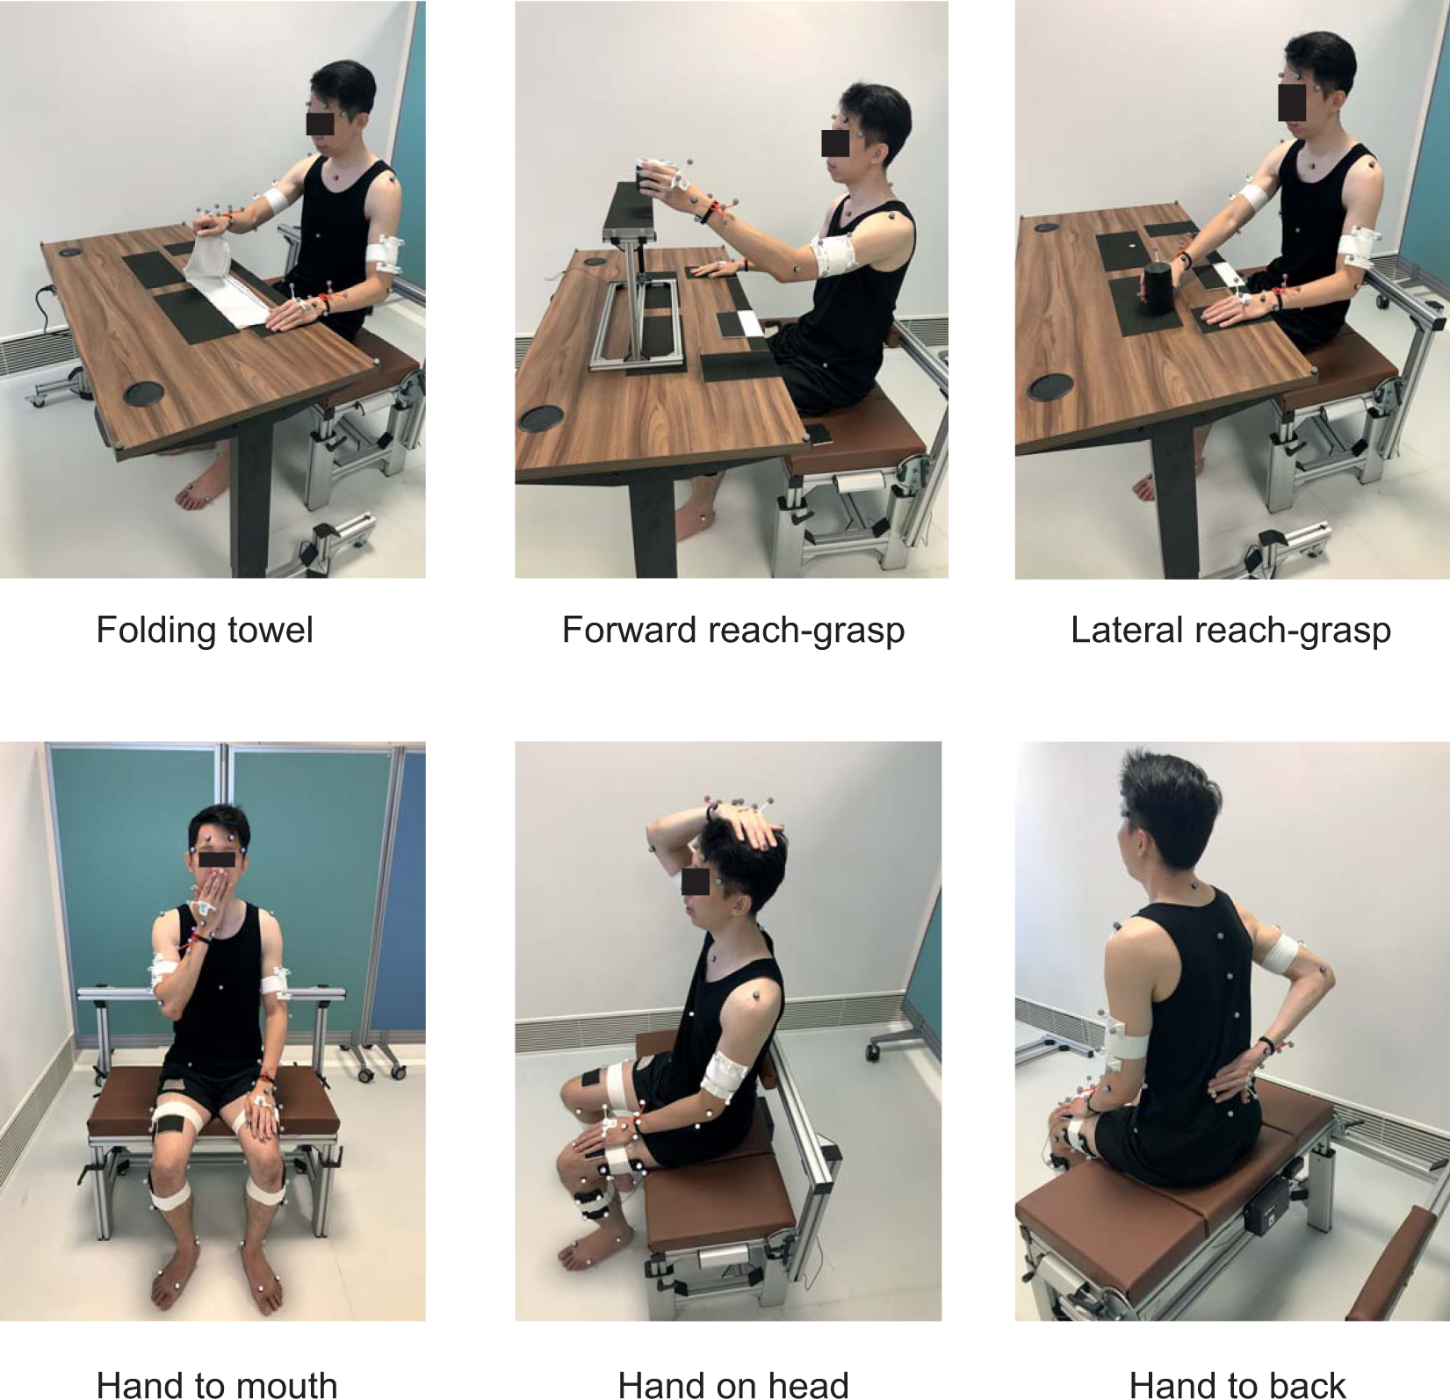
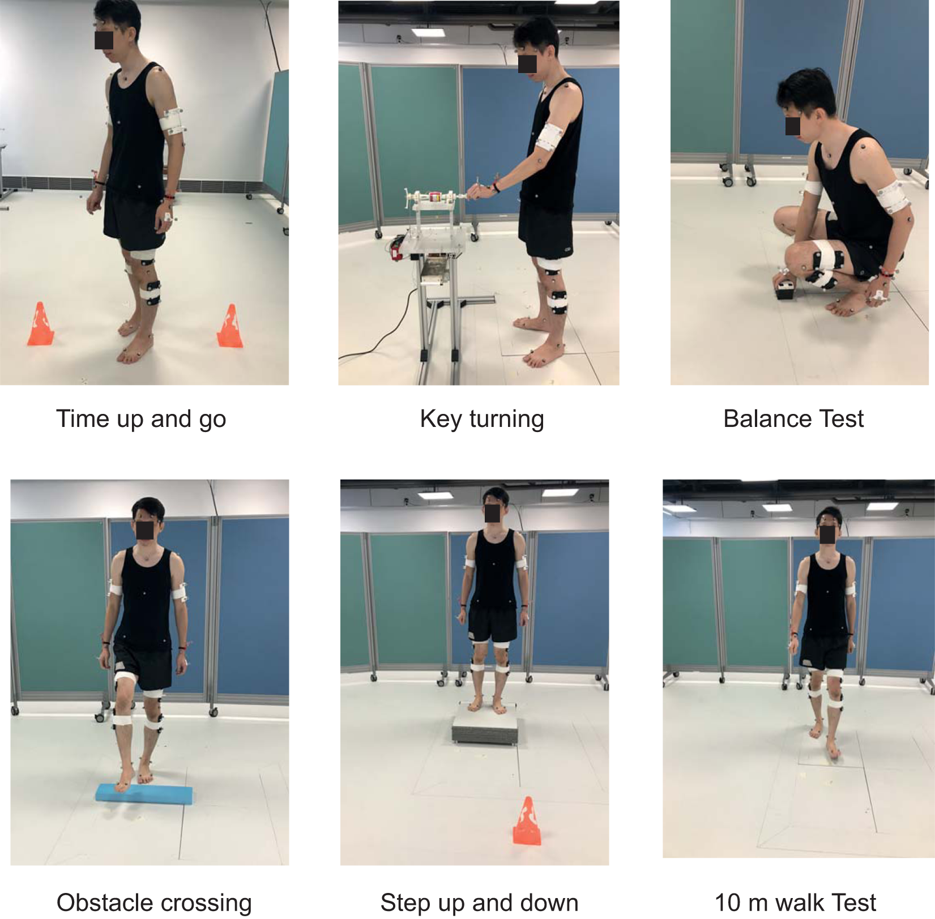
Method: RRIS Motion Capture Data
In this work, gait analysis is derived from 10m walk test for nine subjects.
Upper-limb dynamic trials¹
Lower-limb dynamic trials¹
[1] P. Liang et al., “An Asian-centric human movement database capturing activities of daily living,” Sci Data, vol. 7, no. 1, Art. no. 1, Sep. 2020, doi: 10.1038/s41597-020-00627-7
Notes:
Given the optimization and modelling differences, we need to understand how this affects the kinematic and kinetic output to ensure that users of each software make an informed decision when deciding between the two. As such, for this study, we use the open-source motion capture data from Rehabilitation Research Institute of Singapore (RRIS). We utilize only the walking tasks in the motion capture data. The motion capture data from RRIS were recorded at 200Hz using a mixture of Qualisys Aqus and Miqus three-dimensional infrared motion capture system (Qualisys AB, Sweden). Marker position follows a modified Calibrated anatomical systems technique as recommended by the Qualisys system

Slide 6
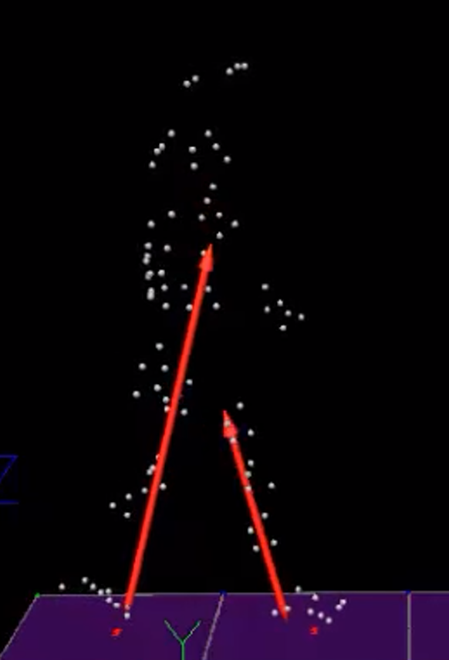
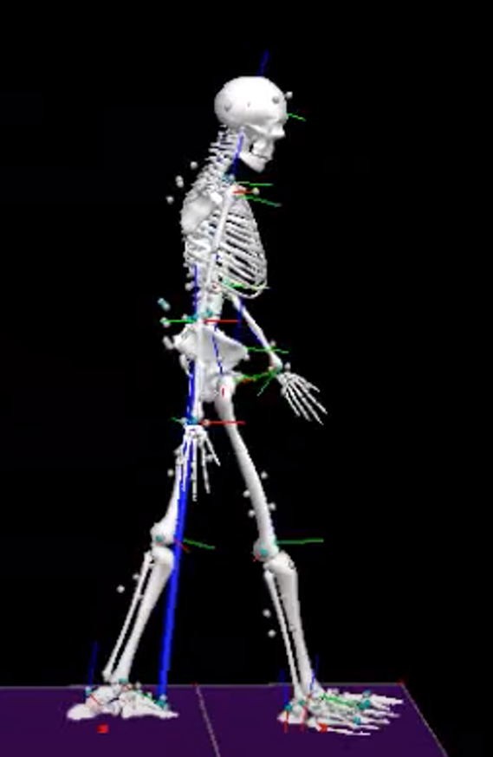
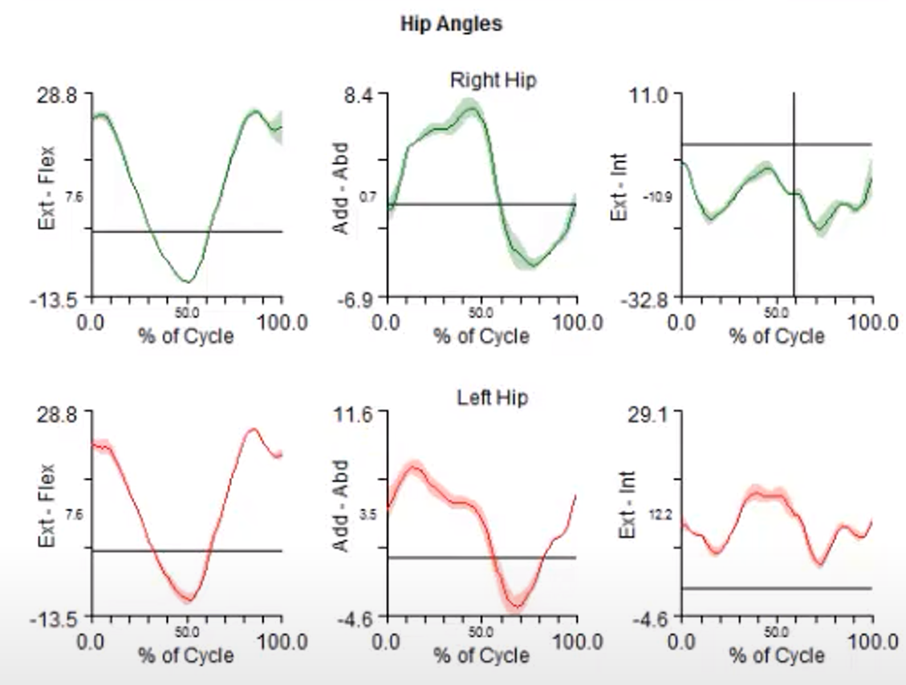
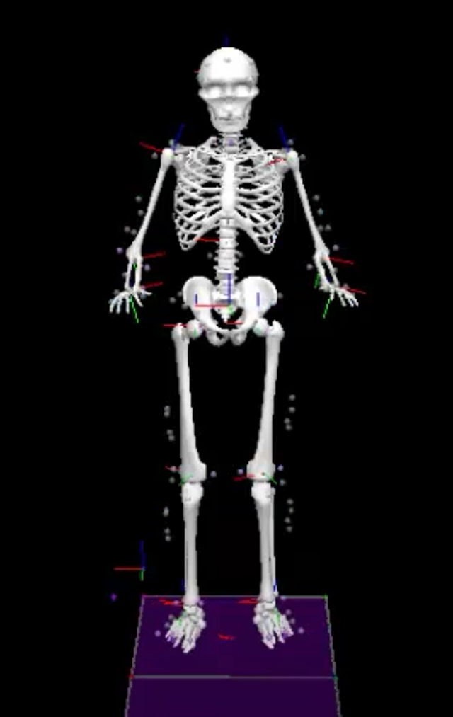
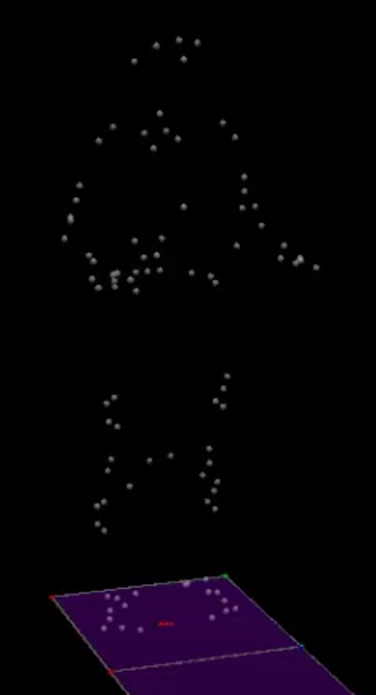
Method: Visual3D
Dynamic .c3d
2) Apply dynamic .c3d to model
Motion and Forces
Scaled Model
3) Generate reports
Static .c3d
1) Apply model template
[1] P. Liang et al., “An Asian-centric human movement database capturing activities of daily living,” Sci Data, vol. 7, no. 1, Art. no. 1, Sep. 2020, doi: 10.1038/s41597-020-00627-7 [2] W. G et al., “ISB recommendation on definitions of joint coordinate system of various joints for the reporting of human joint motion--part I: ankle, hip, and spine. International Society of Biomechanics,” Journal of biomechanics, vol. 35, no. 4, Apr. 2002, doi: 10.1016/s0021-9290(01)00222-6.
Notes:
This is a simplified overview of a typical workflow in Visual3D. We use the six degree of freedom biomechanics model following the joint coordinate recommendation from the International Society of Biomechanics (ISB). We followed the standard Visual3D workflow of defining proximal and distal joint of each segment. No inverse kinematic (IK) constrain was used. In short, with the static c3d file, the user can select to apply a model template to obtain a scaled model. The user can then choose to apply the motion and force information from the dynamic c3d file to obtain the respective motion and forces at different joints. The user can also generate multiple gait graphs with this information.

Slide 7
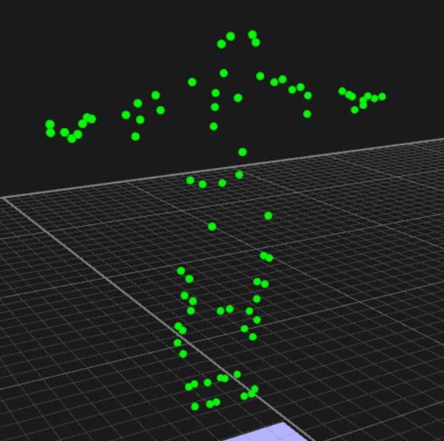
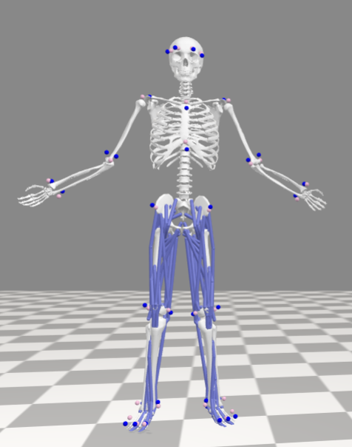
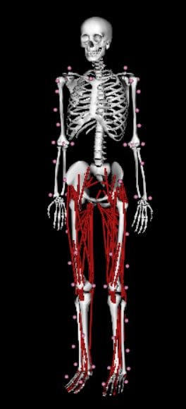
Method: OpenSim
Dynamic Motion Capture Data
Force Plate Data
3) Inverse Dynamics
Joint Forces,
Moments
Marker Trajectory Data
Static Motion Capture Data
Marker Trajectory Data
Generic OpenSim Model
1) Scaling
2) Inverse Kinematics
Mass of Subjects
Scaled OpenSim Model
Joint Angles
Notes:
This is an overview of the OpenSim process. For each participant, motion capture data in the C3D format is first transformed to be OpenSim-compatible. Using the static trial's marker trajectory and the participant’s weight, a scaled OpenSim model is generated. This model, combined with dynamic trial marker trajectories, is utilized in inverse kinematics to deduce joint angles matching each dynamic trial. Subsequently, ground reaction forces from the dynamic trials and results from inverse kinematics are used in inverse dynamics to produce the associated joint forces and torques.

Slide 8
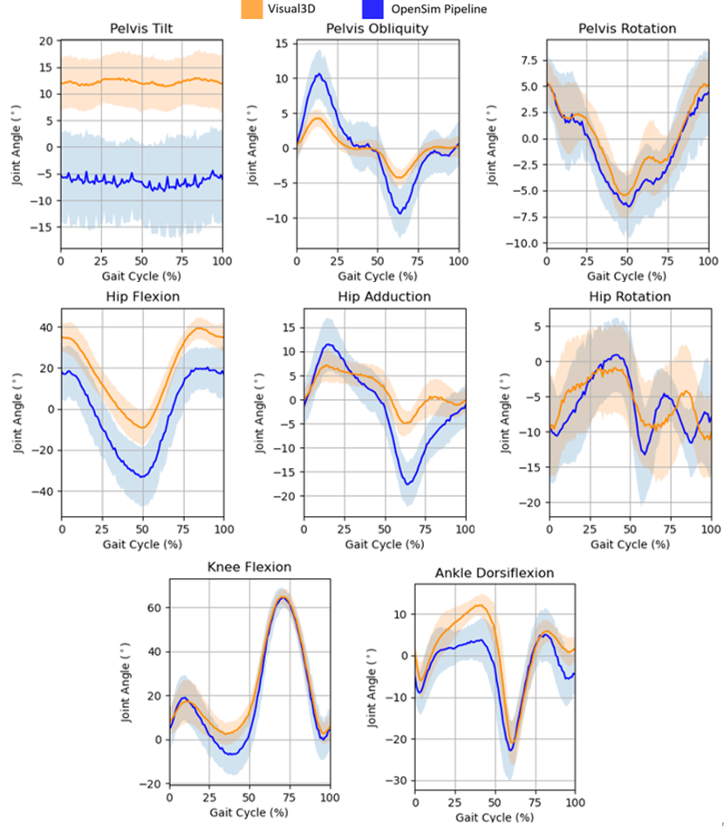
Results: Lower Limb Joint Kinematics
Pelvis
Similar Pelvis Rotation.
Large difference in pelvis tilt.
Large difference in range of values of pelvis obliquity.
Hip
10 more degrees of hip flexion from Visual3D as compared to OpenSim, in line with existing literature³.
Smaller range of motion for hip adduction of Visual3D as compared to OpenSim.
Hip rotation has phase difference.
Knee & Ankle
Knee flexion & ankle dorsiflexion is similar across both software.
[3] A. Am, W. Q, O. R, V. Jr, and C. N, “Effect of Two Different Pose Estimation Approaches on Lower Extremity Biomechanics in Professional Dancers,” Annual International Conference of the IEEE Engineering in Medicine and Biology Society, vol. 2019, Jul. 2019, doi: 10.1109/EMBC.2019.8857683.
Notes:
For gait analysis of straight walking, we plot the various results against percentage of the subject’s gait cycle as per gait analysis convention.
The kinematic results of OpenSim and Visual3D, while similar in shape, differ in value ranges during specific periods. As depicted in the Figure, which presents the average and standard deviation of kinematics from nine subjects, pelvis rotation is closely matched. However, significant disparities are evident in pelvis tilt and obliquity values. Visual3D records roughly 10 degrees more hip flexion than OpenSim, consistent with previous studies. While hip adduction shapes in both platforms align, Visual3D's range is more constrained than OpenSim's. Hip rotation patterns resemble each other but with a noticeable phase shift. Broadly, sagittal plane angles like hip flexion, knee flexion, and ankle dorsiflexion across both tools are notably more aligned than those in other planes.

Slide 9
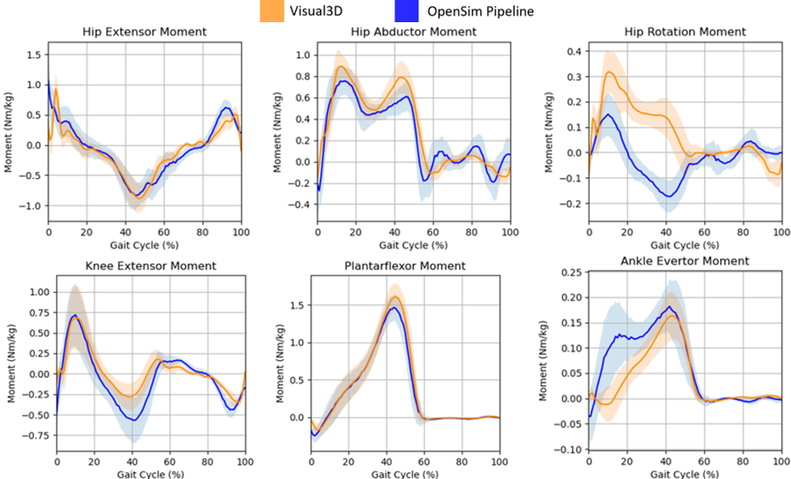
Results: Lower Limb Joint Kinetics
Hip
Hip rotation is different in range and magnitude. This difference likely attributed to differences propagated from different kinematics results.
Knee & Ankle
Knee moments are similar to one another, Visual3D has lower minimum.
Ankle evertor moment of OpenSim and Visual3D visually different at initial 30% of the gait cycle, with Visual3D much lower than OpenSim
Notes:
In our analysis, lower limb joint kinetics—specifically normalized moments at the hip, knee, and ankle—are plotted against the gait cycle percentage. While OpenSim and Visual3D kinetic results appear similar at first glance, discrepancies emerge in peak moments' timings and magnitudes. Given that both platforms model humans as rigid body dynamic systems, differences likely stem from varied kinematic outcomes. Specifically, the kinetics graphs' most notable variations align with significant value range disparities in the kinematic graphs. A marked distinction is also observed in the ankle evertor moment during the initial 30% of the gait cycle, with Visual3D registering a considerably lower moment than OpenSim.
--------------------------------
Detailed
As for lower limb joint kinetics, normalized joint moments at the hip, knee and ankle joints were plotted against the percentage of gait cycle in the Figure. The kinetics results of both OpenSim and Visual3D are visually similar but closer inspection reveals differences in the peaks of certain moments at different times and magnitudes. Both Visual3D and OpenSim human models are rigid body dynamic systems and relate the motion of the system to forces and torques acting on its rigid components. The difference in results is likely due to the differences that propagated from the different kinematic results, as most of the timeframe of the kinetics graphs with more significant difference between the OpenSim and Visual3D results corresponds to the timeframe of the kinematic graphs with significant differences of value ranges. Additionally, we observe that the ankle evertor moment of OpenSim and Visual3D are both visually different at the initial 30% of the gait cycle with Visual3D posting a much lower moment than OpenSim.

Slide 10
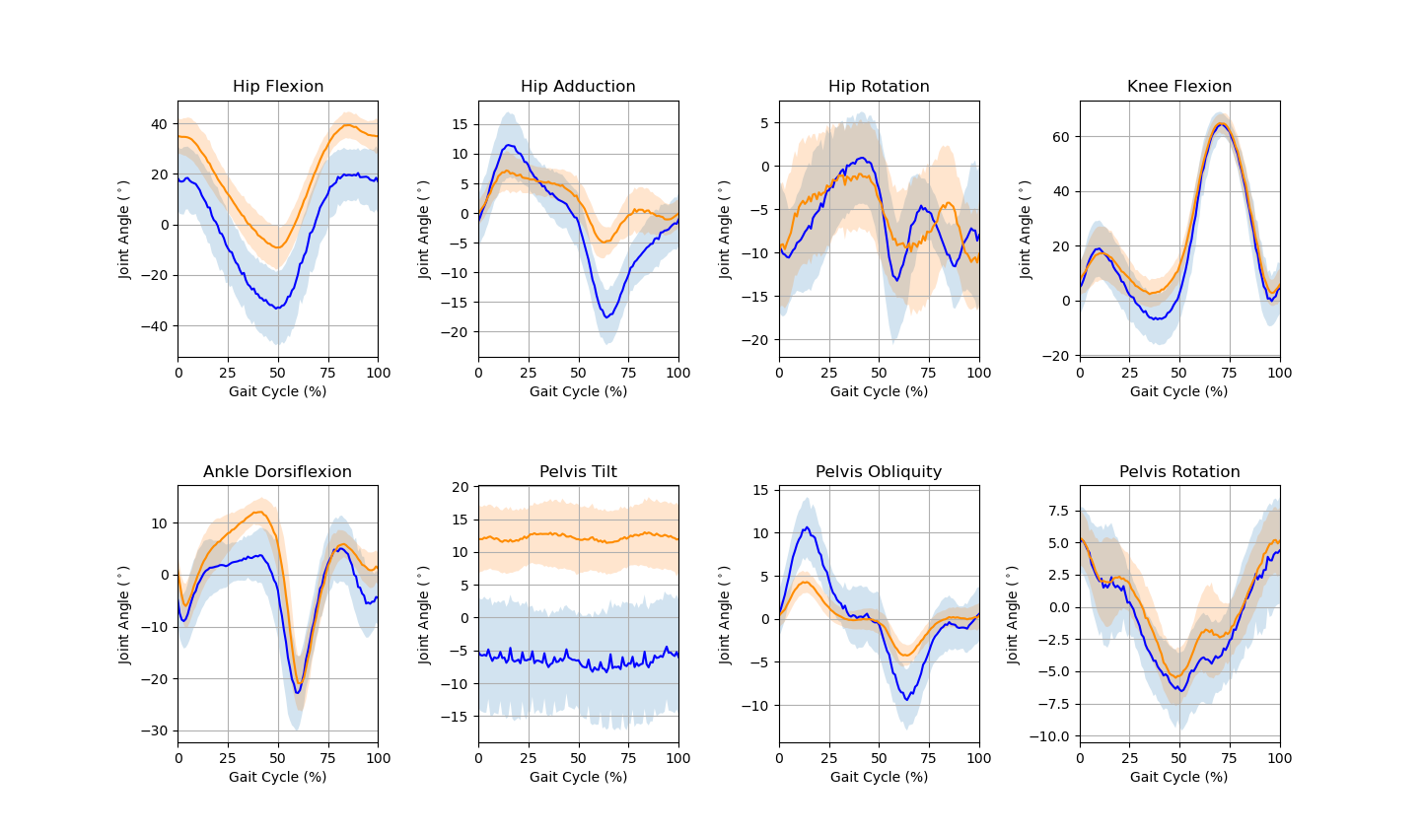

Discussion: Difference in Pelvis Obliquity
Difference in Pelvis Segment
Anatomical: Complex structure of many bony structures and synovial joints that allow intrapelvic movement
OpenSim: One rigid structure
Visual3D: Two separate bodies respective of motion of left and right limb
OpenSim Pelvis Body¹⁰
Right component of Visual3D Pelvis Body¹⁰
[10] “Visual3D Pelvis - Visual3D Wiki Documentation.” https://www.c-motion.com/v3dwiki/index.php/Visual3D_Pelvis (accessed Apr. 01, 2023)
Notes:
The difference between pelvis obliquity range of values could be attributed to how the pelvis body is defined in OpenSim and Visual3D. The pelvis is a complex structure that is comprised of many bony structures and synovial joints in which intrapelvic movement between these bony structures can occur, thus there is not one predetermined way to represent the pelvic body in biomechanical studies. OpenSim defines their pelvis as one body where the pelvis moves and rotates as one rigid structure and Visual3D defines as two separate bodies corresponding to the motion of the right and left lower limbs. This definition of pelvis directly affects the accuracy of tracking the movement of the actual pelvis markers, potentially explaining the difference of the pelvis obliquity. Future work should analyze the effect of this definition of the pelvis on biomechanical outputs.

Slide 11
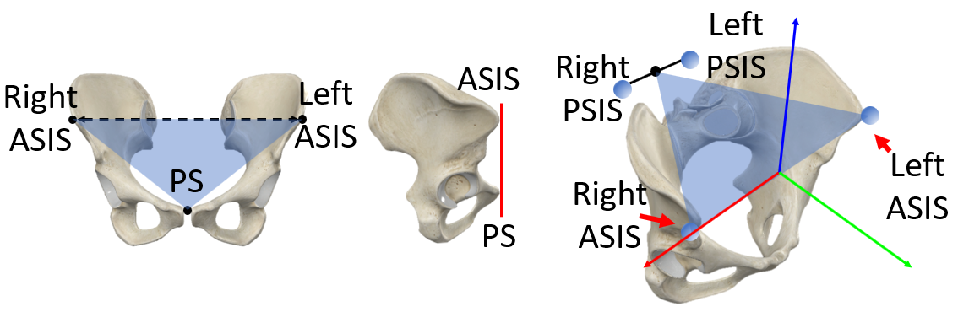
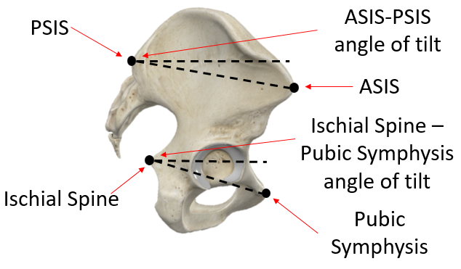
Discussion: Difference in Pelvis Tilt
Difference in Pelvis Tilt Neutral Position (Zero Pelvic Tilt)
OpenSim: Anterior pelvic plane (two anterior-superior iliac spines (ASIS) and pelvic tubercles are in frontal (y-z) plane) aligns with frontal plane of body
Visual3D: Plane passing through right and left ASIS markers and mid-point of right and left posterior-superior iliac spine (PSIS) align with ground
ASIS-PSIS angle about 13 degrees ± 5 degrees
OpenSim Y-Z Plane
Visual3D X-Y Plane
ASIS-PSIS Angle
Notes:
The discrepancy in pelvic tilt between OpenSim and Visual3D might arise from their differing definitions of the neutral position. In OpenSim, a 0-degree pelvic tilt aligns the anterior-superior iliac spines (ASIS) and pelvic tubercles with the frontal (y-z) plane. This plane, called the anterior pelvic plane, comprises the ASIS, pelvic tubercles, and pelvic symphysis. Thus, zero tilt occurs when this plane matches the body's frontal plane. In contrast, Visual3D's neutral position is when the plane defined by the right and left ASIS markers and the midpoint between the PSIS markers is level with the ground. Given the OpenSim model's neutral position, the ASIS-PSIS angle averages 13 degrees with a standard deviation of 5 degrees. This could explain the pronounced value shift in OpenSim's pelvic tilt graphs compared to Visual3D.
-------------------------------------
Detailed:
The difference in pelvic tilt may be attributed to the variation in the definition of neutral position in OpenSim and Visual3D. The OpenSim model is oriented such that at 0-degree pelvic tilt, the two anterior-superior iliac spines (ASIS) and pelvic tubercles are in the frontal (y-z) plane, which is also known as the anterior pelvic plane where it is an anatomical reference plane containing both ASIS, pelvic tubercles (PT) and pelvic symphysis (PS).
Hence, the neutral position of zero pelvic tilt is where this anterior pelvic plane aligns with the frontal plane of the body. In Visual3D, the (x-y) plane of the pelvis coordinate system is defined as the plane passing through the right and left ASIS markers and the mid-point of the right and left PSIS markers of the actual subject. Hence, the zero pelvic tilt is determined to be the position where the (x-y) plane of the pelvis segment is aligned with the ground. At neutral position defined by our selected OpenSim model where the plane containing both ASIS and the pelvis symphysis is aligned with the coronal plane of the body, it is reported for the ASIS-PSIS angle to have a mean 13 degrees with a standard deviation of 5 degrees, which could be the possible explanation to the large downshift of values observed in the pelvic tilt graphs of OpenSim as compared to Visual3D.

Slide 12
Discussion: Difference in Hip Joint Angles
Difference in Hip Joint Centre Estimation
OpenSim: Uses functional hip joint centre.
Visual3D: Uses anthropometrical mathematical estimation equation to determine hip joint centre.
Notes:
The difference in hip joints between OpenSim and Visual3D is likely attributed to the different methods of hip joint estimation. Visual3D uses a method of anthropometrical mathematical estimation to determine the hip joint whereas our selected OpenSim model utilizes functional hip joint center estimation. This difference in hip joint estimation is likely the cause of the difference in hip joint angles in flexion, adduction and rotation.

Slide 13
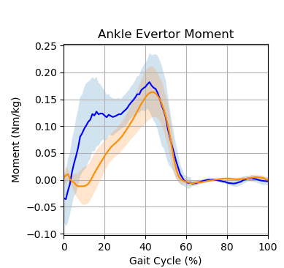
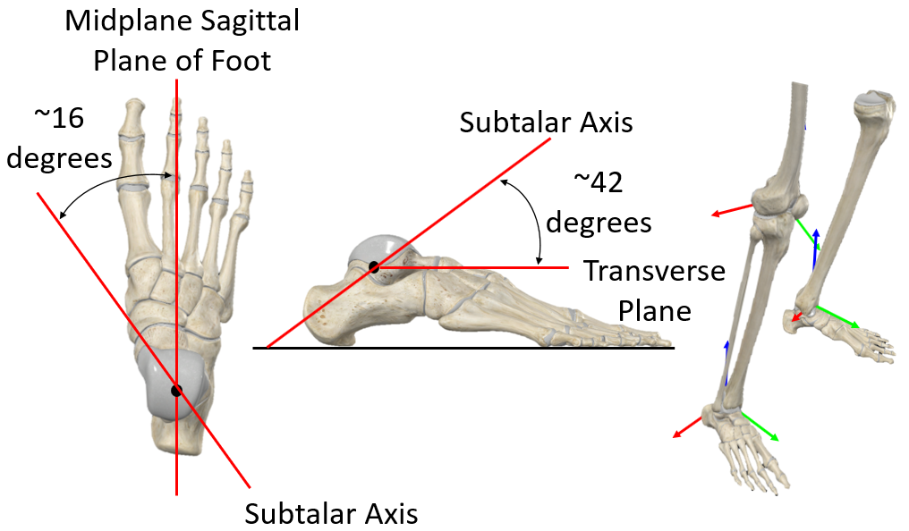
Discussion: Differences in Ankle
OpenSim
Ankle inversion-eversion angle constrained to zero
Subtalar axis, superior to sagittal plane and medial to transverse plane of ankle joint
Visual3D:
Free movement for ankle inversion-eversion
y-axis of ankle coordinate system
Visual3D Ankle Coordinate System
OpenSim Subtalar Axis
Notes:
The difference in ankle evertor moments at the initial 30% of the gait cycle could be due to how the subtalar inversion and eversion ankle angle is constrained to zero in OpenSim, whereas Visual3D allows for free motion. Furthermore, the axis defined for ankle inversion-eversion movement differs between OpenSim and Visual3D as illustrated in the Figure. In OpenSim, ankle inversion-eversion movement occurs in the subtalar axis where the subtalar axis lies superiorly to the sagittal plane and medially to the transverse plane of the ankle joint. In Visual3D, ankle inversion-eversion movement occurs in the y-axis of the ankle coordinate system. Therefore, the differences in the ankle evertor moments observed could be attributed to the difference in the kinematic motion of the subtalar ankle and the axis defined for the ankle inversion and eversion moment.

Slide 14
Conclusion
Notable difference between kinematic and kinetic output of OpenSim and Visual3D.
We anticipate if pathological gait is used, difference would be accentuated as
More information loss in OpenSim’s global optimization method.
Segment optimization allows closer matching to motion capture
Choice of software depends on user requirements
OpenSim
Visual3D
Notes:
In conclusion, our results demonstrate notable differences between the kinematic and kinetic output of OpenSim and Visual3D. Whilst our analysis focuses on healthy gait, we anticipate that utilizing pathological gait could accentuate kinematic disparities. Pathological and healthy gaits exhibit significant distinctions, leading to increased information loss in OpenSim's global optimization compared to Visual3D's segment optimization. Visual3D's utilization of six DoFs per segment enables closer mocap matching, resulting in enhanced kinematic accuracy. However, OpenSim's reliance on the model for global optimization allows it to overcome information loss if an appropriate model accurately represents the subject's pathological gait. Ultimately, the choice of software depends on user requirements, as each has its own strengths and weaknesses. Nevertheless, users should exercise caution when interpreting results, emphasizing an understanding of the complete processing pipeline.

Slide 15
Thank You!
* Corresponding Author: sherwin.chan@ntu.edu.sg

