Slide 1
CS596 Machine Learning Lecture 2: Programming Environment Setup
Instructor: Yang Xu

Slide 2
Part 1: Install Python
Windows (starting at slide 4)
Mac/Linux (starting at slide 8)
Install Python through Anaconda (recommended, slide 10)

Slide 3

Resources
Python website
https://www.python.org/
Official documentation
https://www.python.org/doc/
Python 3.x
Python 2.x (official support to Python 2 ends in 2020!) So, don’t use it!
Python setup and usage
https://docs.python.org/3/using/index.html

Slide 4
Install Python on Windows – Step 1
Download the latest release of installer for Python 3.7.4
https://www.python.org/downloads/windows/
Choose “Windows x86” or Windows x86-64 executable installer according to your system

Slide 5
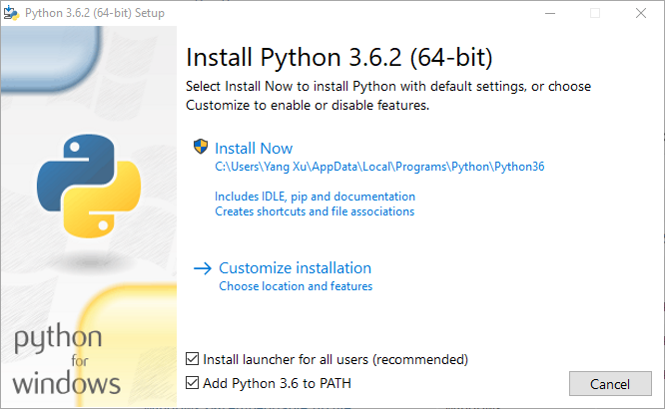
Install Python on Windows – Step 2
Double Click → Install Now
Check the two boxes

Slide 6
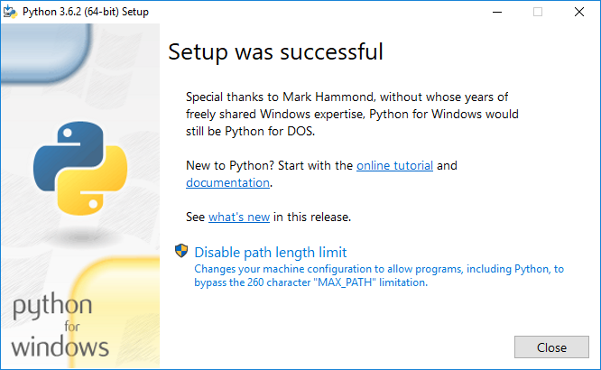
Install Python on Windows – Step 3
Disable path length limit

Slide 7
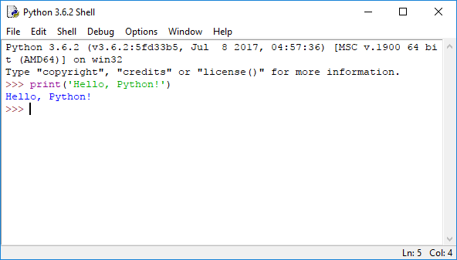
Install Python on Windows – Success
Click on “IDLE Python 3.7.4 shell” in the Start menu
You will see a prompt for entering Python code such as >>>

Slide 8
Install Python on Mac/Linux
MacOS
Install opensource homebrew, free for download from the link below. This is also known as “the missing package manager for macOS” https://brew.sh/
After you install brew, invoke terminal window (you can use Spotlight search to find terminal)
In terminal, run: brew install python
Ubuntu Linux
Ubuntu 16.04 comes with Python 2.7 and Python 3.5 by default

Slide 9
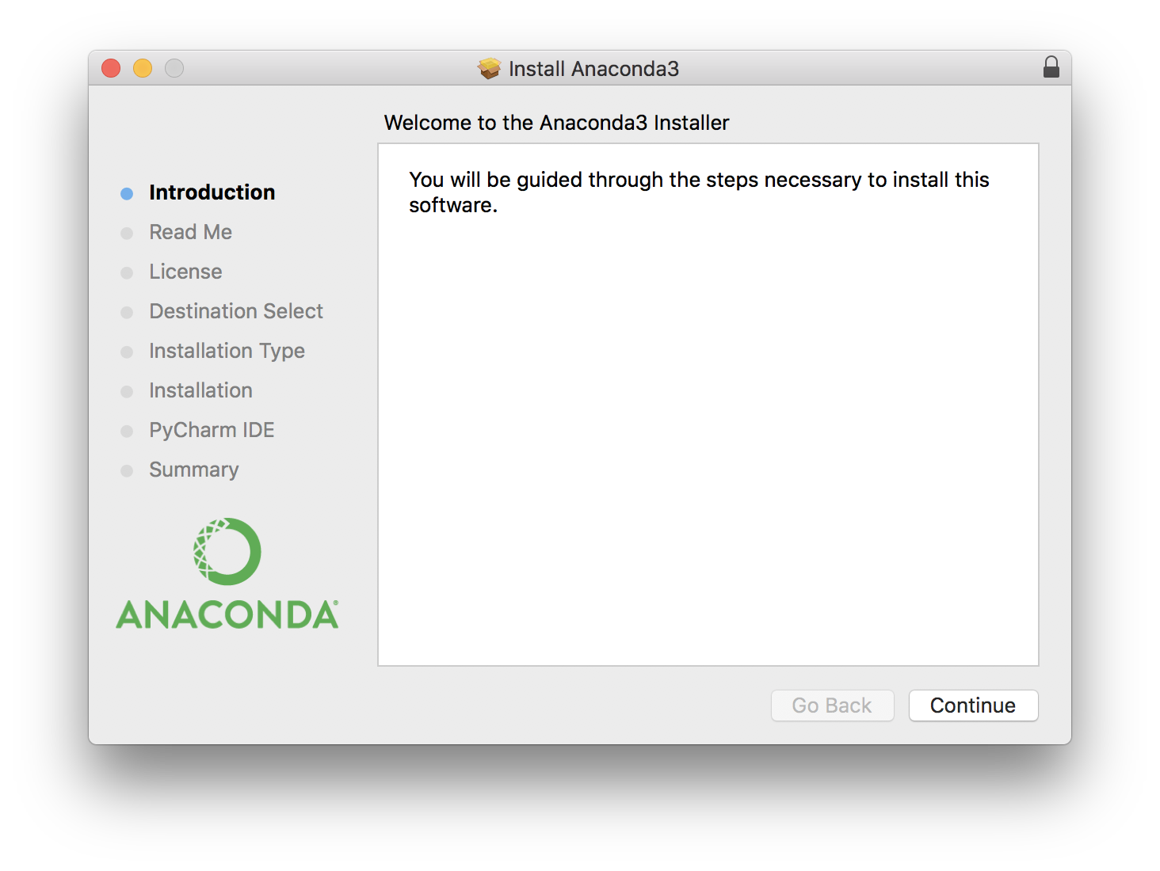
Install through Anadaconda
Link: https://www.anaconda.com/distribution/ ==> choose the distribution that suits you
Python3 is integrated in Anaconda platform
Packages such as numpy, pandas are also pre-installed

Slide 10
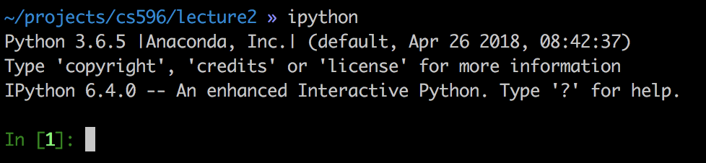
Install packages
Fro Mac/Linux
Open terminal
Run: pip install -U numpy jupyter
To check if the installation is successful
Type ipython (or python) in terminal.

Slide 11
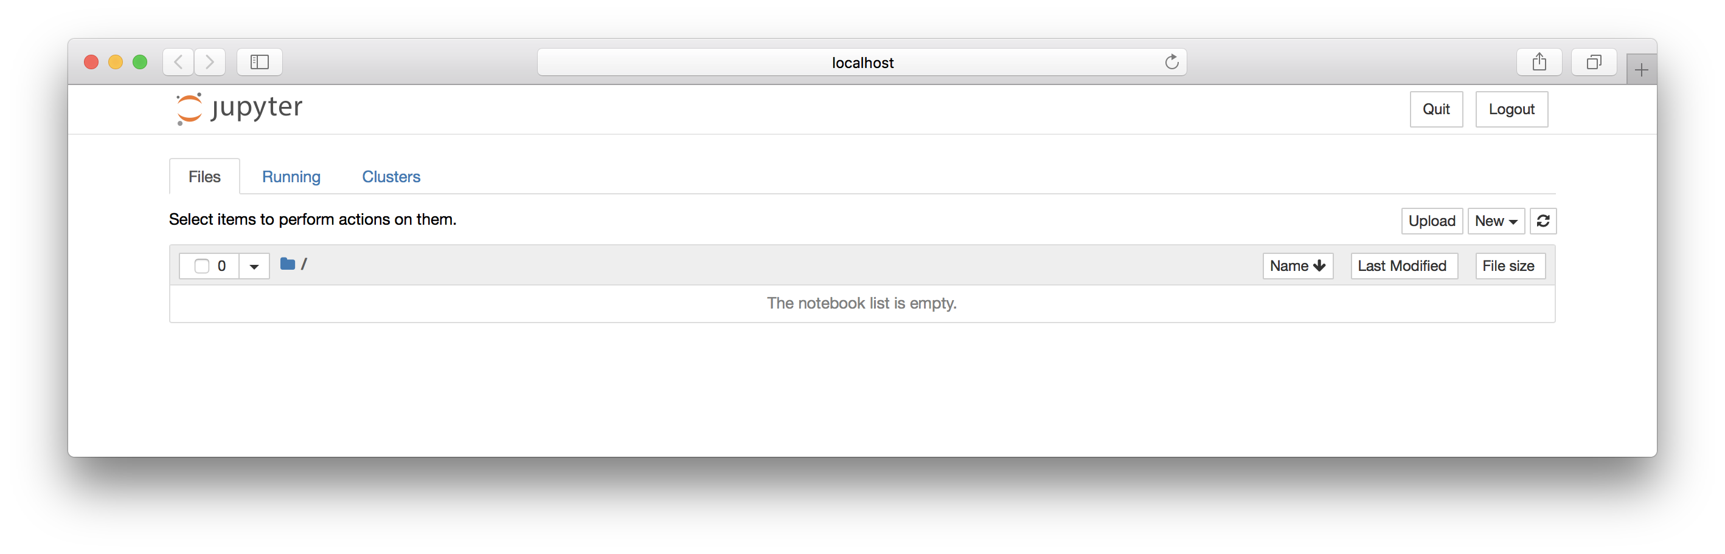
Use Jupyter notebook
Go to any folder you would like: $ cd ~/projects/cs596/lecture2
type “jupyter notebook”
Open a browser

Slide 12
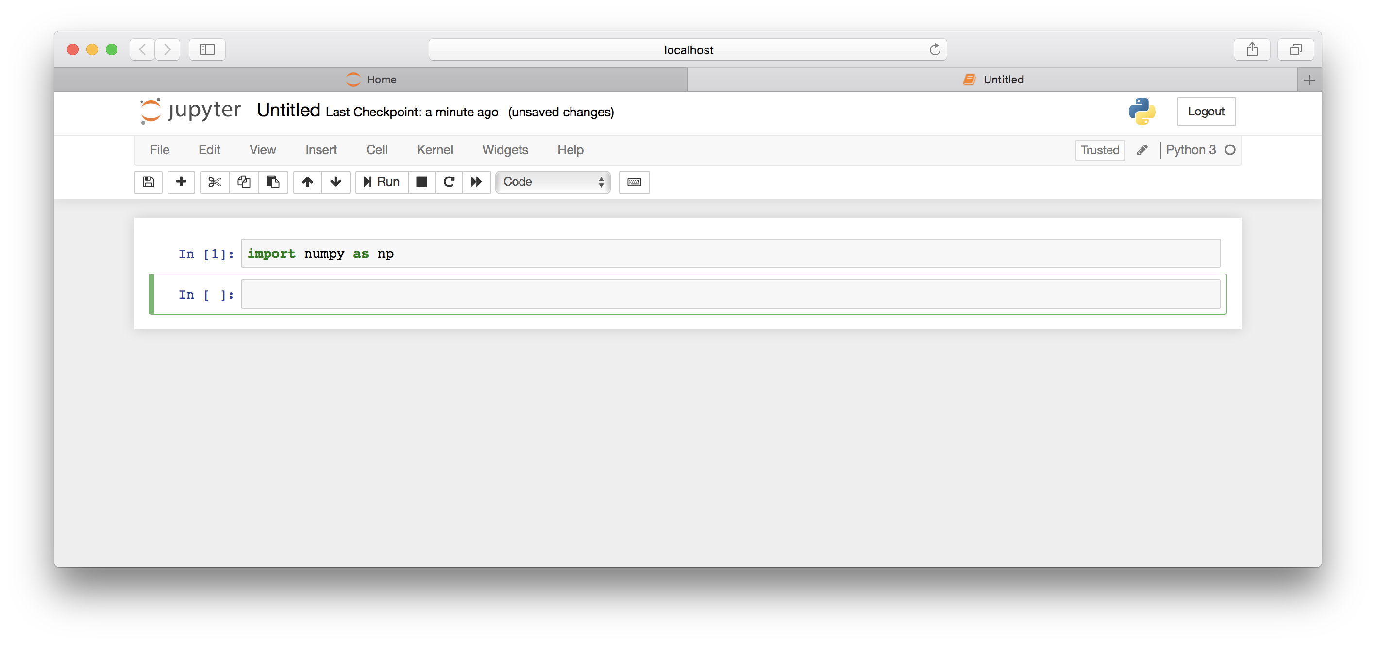
Jupyter notebook: Create a new Python3 notebook

Slide 13
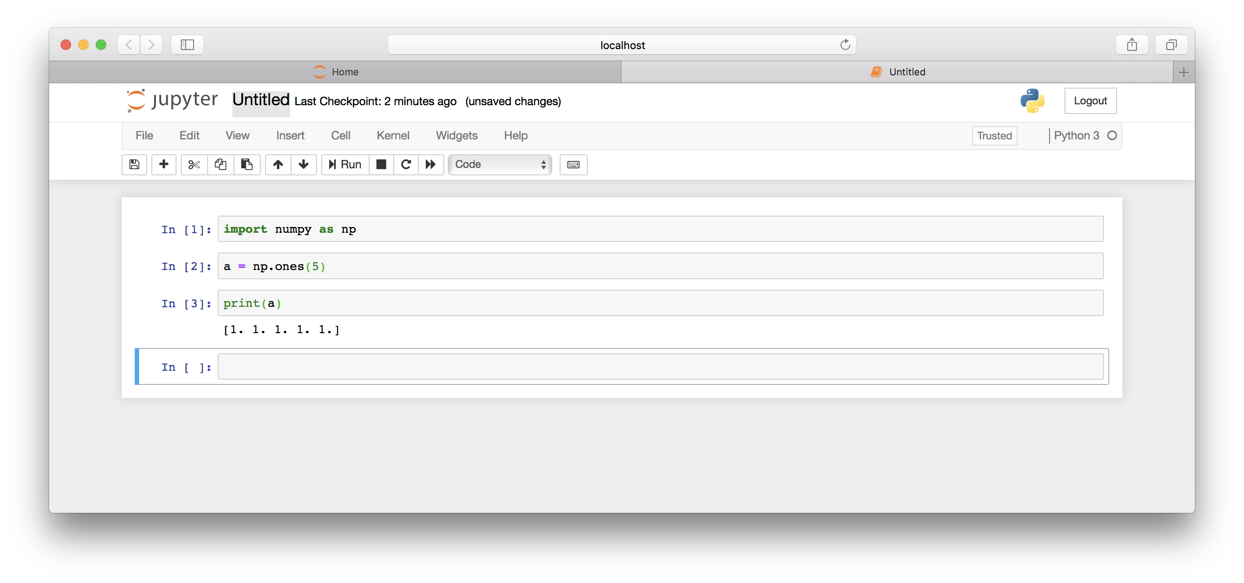
Jupyter notebook: Save the notebook

Slide 14
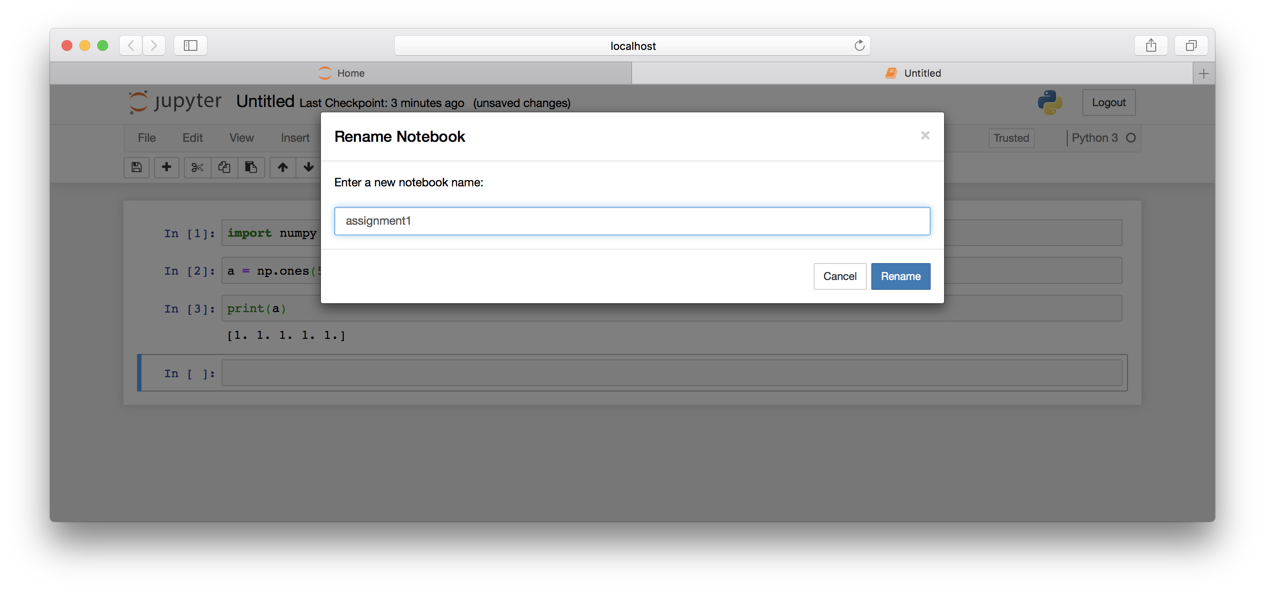
Jupyter notebook: Save the notebook
Notebook is saved as “assignment1.ipynb” under folder ~/projects/cs596/lecture2

Slide 15
Part 2: Python basics
Variable and assignment & Built-in data types
Common operations on built-in types
Simple control flow statement

Slide 16
Variables and Assignment
Name of places to hold data (temporarily) for processing.
Name of variables are Unique
Same name refers to the same place
Different name refers to different places for holding data
The “assignment” statement assigns data to a variable as its “value”.
Each variable takes only one value.
Each assignment replaces the old value of the variable with the new value.

Slide 17
Variables and Assignment
a = 10
b = 20
c = a + b
s1 = ‘he’
s2 = ‘likes’
s3 = s1 + s2
Variables names must start with a letter or an underscore, e.g., a, _a
The remainder may consist of letters, numbers and underscores, e.g., a_1
Variable Names in Python are case sensitive, (i.e., my_var, My_Var, MY_VAR are all DIFFERENT in Python).

Slide 18
Types of Variables
Different types of data require different ways to “code” them in binary form.
Characters can be represented by “ASCII” code
Integer and real number also need to be represented differently.
“Types” of data supported by a programming language are called “built-in” types.

Slide 19
Built-in Data Types of Python
int: Integers, e.g., 1, 2, 3, 100
float: Floating-point numbers, e.g., 1.5, 2.6, 3.1416, 2000.2
boolean: True, or False
str: (String data type) A sequence of Unicode characters (in the range of U+0000 - U+10FFFF) in Python 3.x E.g., ‘I love Python!’, ‘我爱Python!’, ‘私はPythonが大好き’

Slide 20
Mutable vs Immutable
A type is mutable if it can be modified in-place (at the same location).
A type is not immutable if it can NOT be modified in-place.

Slide 21
Built-in Data Types
list: A sequence of objects (of same or different types) E.g., list1 = [1, 2, 3, 4] list2 = [‘I’, ‘love’, ‘Python’] list3 = [‘I’, ‘love’, ‘Python’, 3]
List is mutable, e.g., list1.append(5) changes list1 to [1, 2, 3, 4, 5]
tuple: a sequence of immutable objects E.g., tup1 = (1, 2, 3, 4), tup2 = (‘I’, ‘love’, ‘Python’, 3)
“append” cannot be applied to tup1 or tup2
Operations on tuple are ALL FUNCTIONS

Slide 22
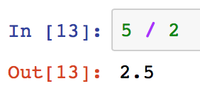
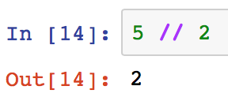
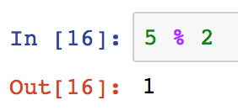
Common operations on built-in types
Numeric and arithmetic operations on int and float types
x + y, x - y, x * y, x / y
x // y floored quotient of x and y
x % y remainder of x / y
x ** y, or pow(x, y) x to the power of y

Slide 23
Common operations on built-in types
Comparison of int and float types
x < y strictly less than
x <= y less than or equal
x > y strictly greater than
x >= y greater than or equal
x != y not equal
x == y equal

Slide 24
Common operations on built-in types
Boolean operations
x or y if x is false, then y, else x
x and y if x is false, then x, else y
not x if x is false, then True, else False

Slide 25
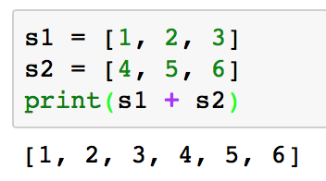
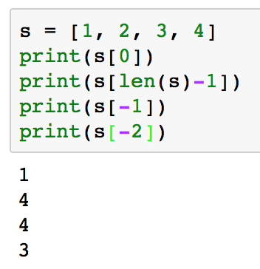
Common operations on built-in types
Common sequence operations, on str, list, and tuple
x in s True if an item of s is equal to x, else False
x not in s False if an item of s is equal to x, else True
s + t the concatenation of s and t
len(s) the length of s
s[i] the ith element of s, start from 0

Slide 26
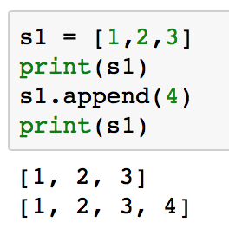
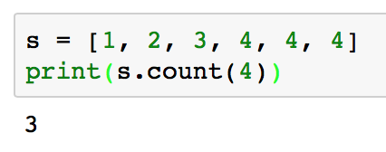
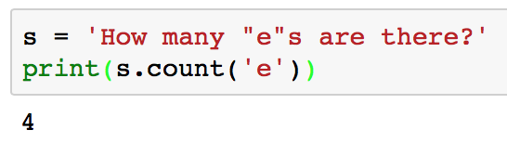
Common operations on built-in types
Common sequence operations (cont.)
s = [1, 2, 3, 4, 5]
s[i:j] slice of s from i to j, i is included and j is not E.g., s[0:3] = [1,2,3], s[1:4] = [2,3,4]
s[i:] slice of s from i to the end E.g., s[2:] = [3,4,5]
s.append(x) append x to the end of s
s.count(x) total number of occurrences of x in s

Slide 27
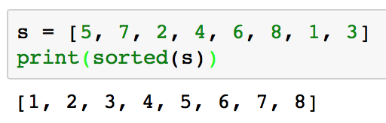
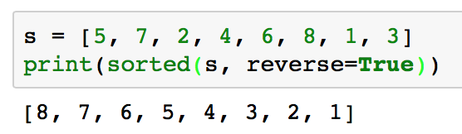
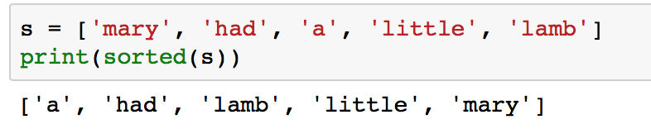
Common operations on built-in types
Common sequence operations (cont.)
sorted(iterable) Return a new sorted list from iterable

Slide 28
Common operations on String (str)
str.split(sep) Return a list of substrings (e.g., words) in the string, resulted from using sep as the delimiter. The default separator is space ‘ ‘. E.g., ‘I love Python’.split() = ['I', 'love', 'Python']
‘I love Python’.split(‘ ‘) = ['I', 'love', 'Python'] ‘144.182.67.1’.split(‘.’) = [‘144', ‘182', ‘67‘, ‘1’]
str.upper() Return a copy of the string with all the cased characters converted to uppercase
str.lower() Return a copy of the string with all the cased characters converted to lowercase

Slide 29
String is Immutable
Operations on string do NOT change the value of the string.
S1= “WE ARE! PENN STATE!”
S1.split(‘ ‘)
What does Python return?
What is the value of S1 now?
S2=S1.split(‘ ‘)
What is the value of S1 now?
What is the value of S2 now?
S1=S1.split(‘ ‘)
What is the value of S1 now?

Slide 30
Common operations on String (str)
str.strip() Returns a copy of the string with the leading and trailing characters removed E.g., ‘ hello\n ’.strip() = ‘hello’
str.startswith(prefix) Returns True if string starts with the prefix E.g., ‘Python’.startswith(‘P’) = True
str.endswith(suffix)

Slide 31
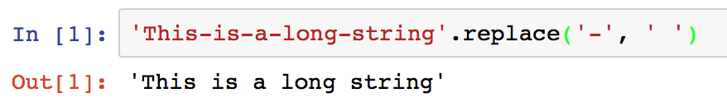
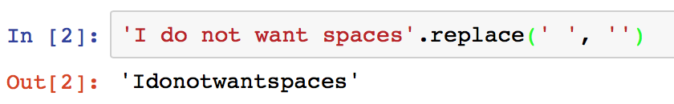
Common operations on String
str.replace(old, new) Return a copy of the string with all occurrences of substring old replaced by new

Slide 32
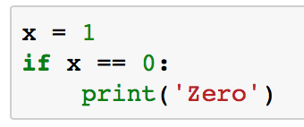
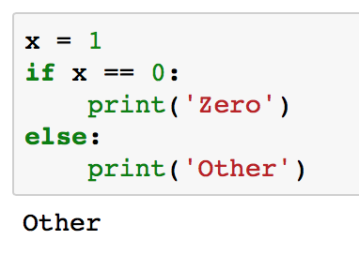
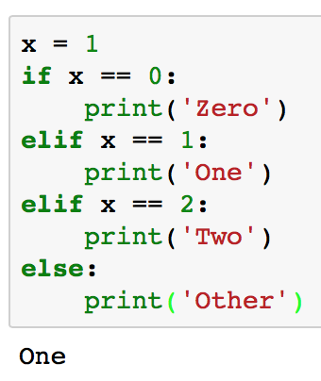
Control Statement: If-then-else
if statement: executes “then” part if the “if condition” is TRUE, otherwise execute “else” part.
else part is optional
elif is short for “else if”, and there can be zero or more elif parts

Slide 33
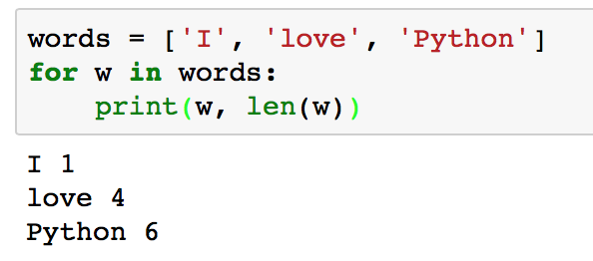
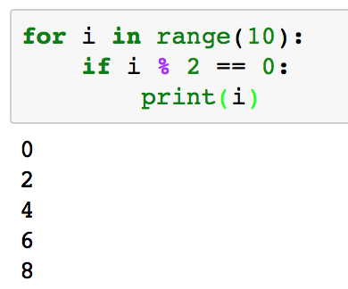
Control Statement: Iteration
for statement
Iterates over the items of any sequence (a list, tuple, or str), in the order that they appear in the sequence
Arbitrary name
Do whatever you want in a for statement

Slide 34
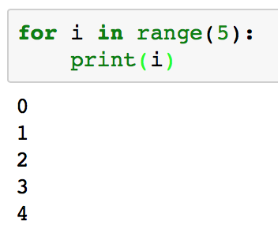
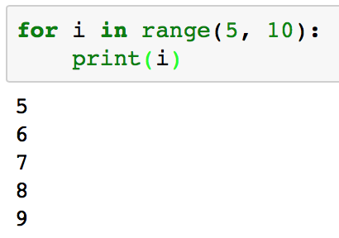
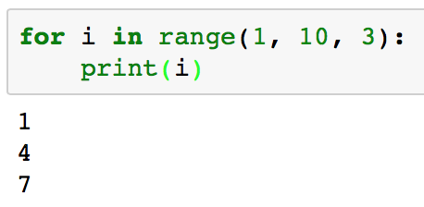
Simple control flow statement
More about range function: iterate over the value of index variable (e.g., i) from “start” to “end”, increase by “step”.
It generates arithmetic progressions to iterate over a sequence of numbers
start
end
step

Slide 35
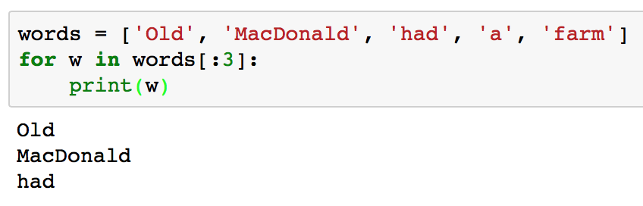
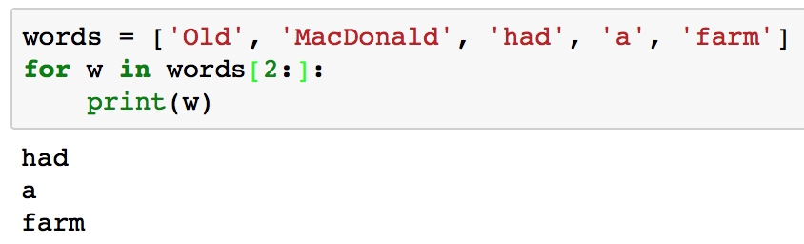
Iterate over the First n or the Last n of a Sequence
Iterate over the first n elements of a sequence [:n]
Iterate over the last n element of a sequence [n:]

Slide 36
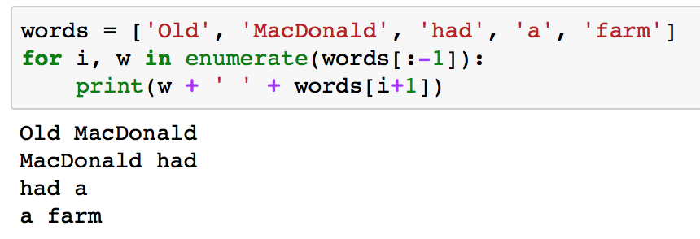
Simple control flow statement
enumerate function
To retrieve the position index and corresponding value at the same time when iterating over a sequence
i is the position index
w is the value
-1 is the position index of the last element in the sequence
Short for: len(s) - 1

Slide 37
Part 3: numpy basics
numpy is a third-party package in Python
Frequently used in data science, machine learning, statistics etc.
Advantages over built-in types in Python (e.g., List)
Size - Numpy data structures take up less space.
Performance - They are faster than lists.
Functionality – They have optimized functions such as linear algebra operations built in.

Slide 38
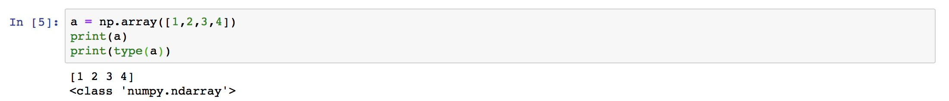
Use numpy
Import it as a module
The basic data structure in numpy is array, or ndarray

Slide 39
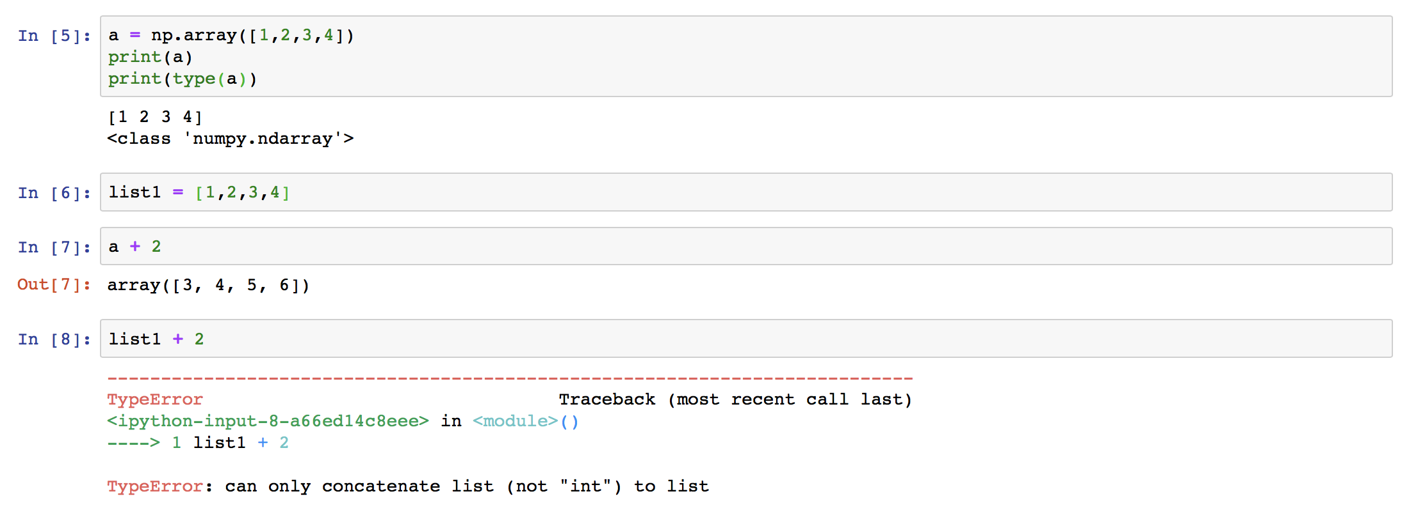
np.ndarray is different from a Python list
arrays are designed to handle vectorized operations (while a Python list is not)

Slide 40
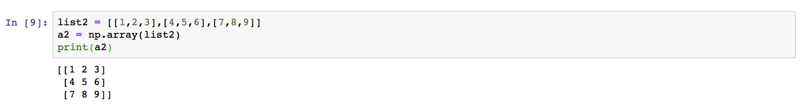
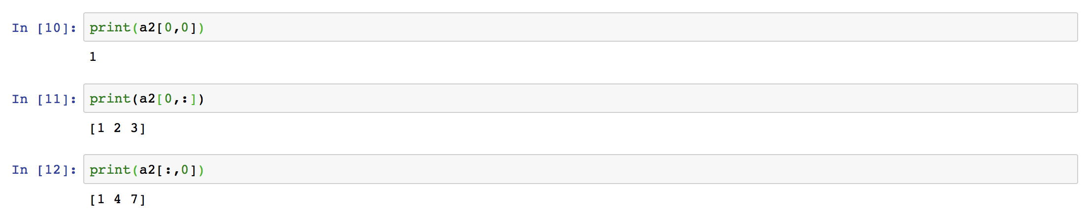
2d arrays
Create a 2d array from a list of lists
Access elements in array

Slide 41
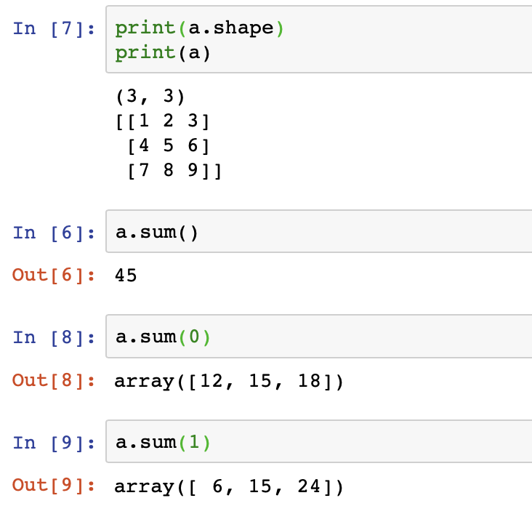
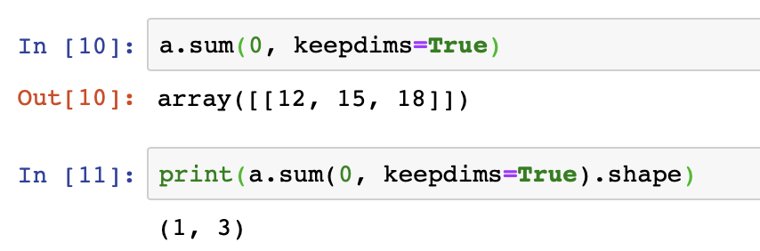
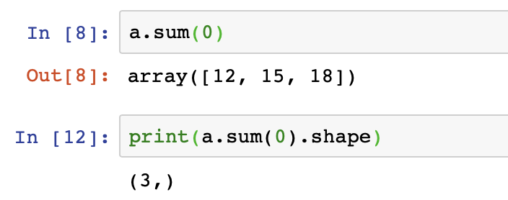
2d arrays: fast vectorized computation
summation over axes
Keeping dimensionality:
Not keeping dimensionality:

Slide 42
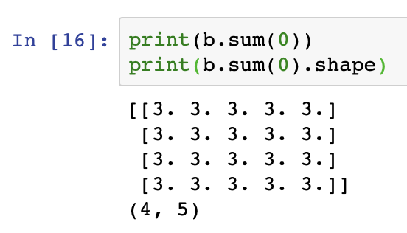
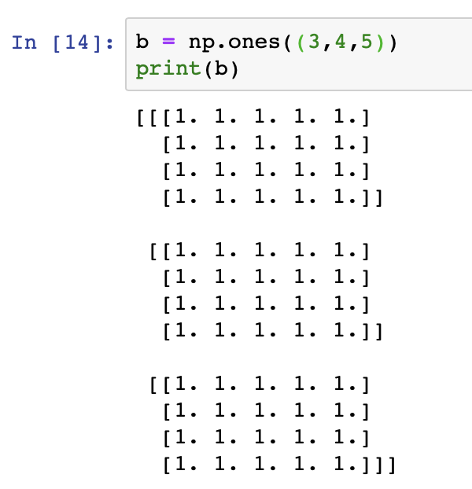
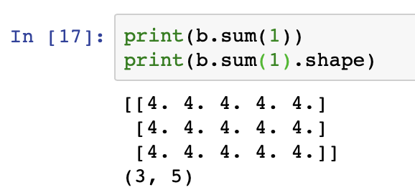
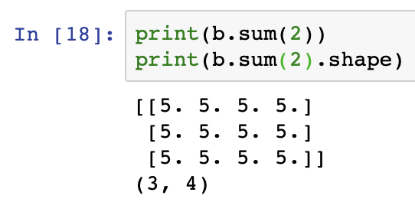

arrays of even higher dimensions
A $3×4×5$ array of all 1s.
reduce along axis=0
reduce along axis=1
reduce along axis=2

Slide 43
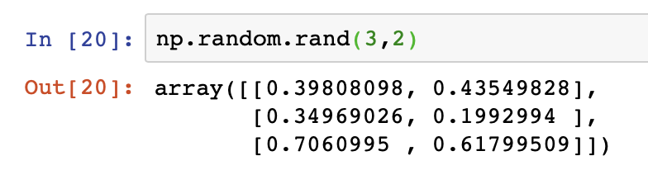
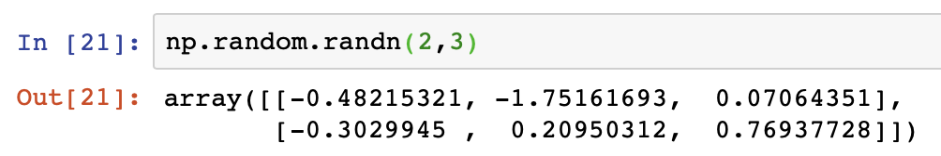
arrays of random numbers
numpy.random.rand, random numbers sampled from a uniform distribution $[0,1)$
numpy.random.randn, random numbers sampled from a normal distribution whose mean = 0, variance = 1

Slide 44
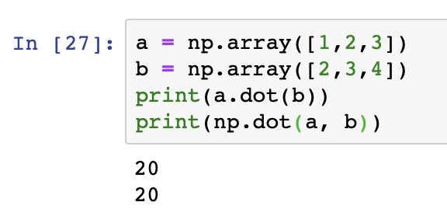
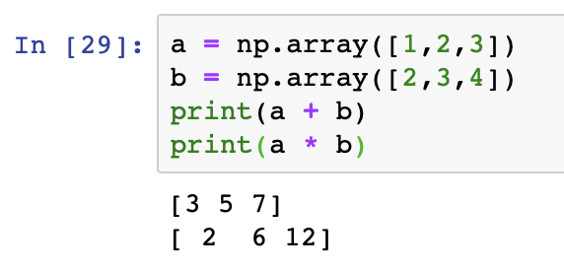
Linear algebra support
Dot product between vectors
Point-wise operation

Slide 45
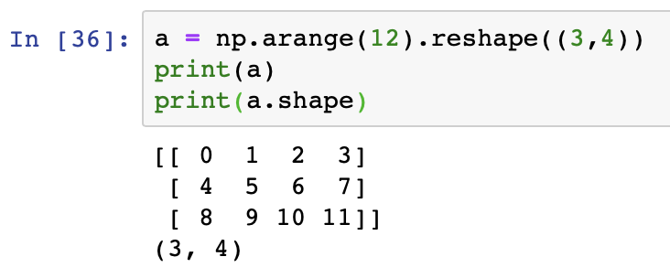


Linear algebra support: Matrix operations
Create a matrix
Matrix multiplication
Transpose

