Slide 1
Sherwin Ebook
September 9, 2020

Slide 2
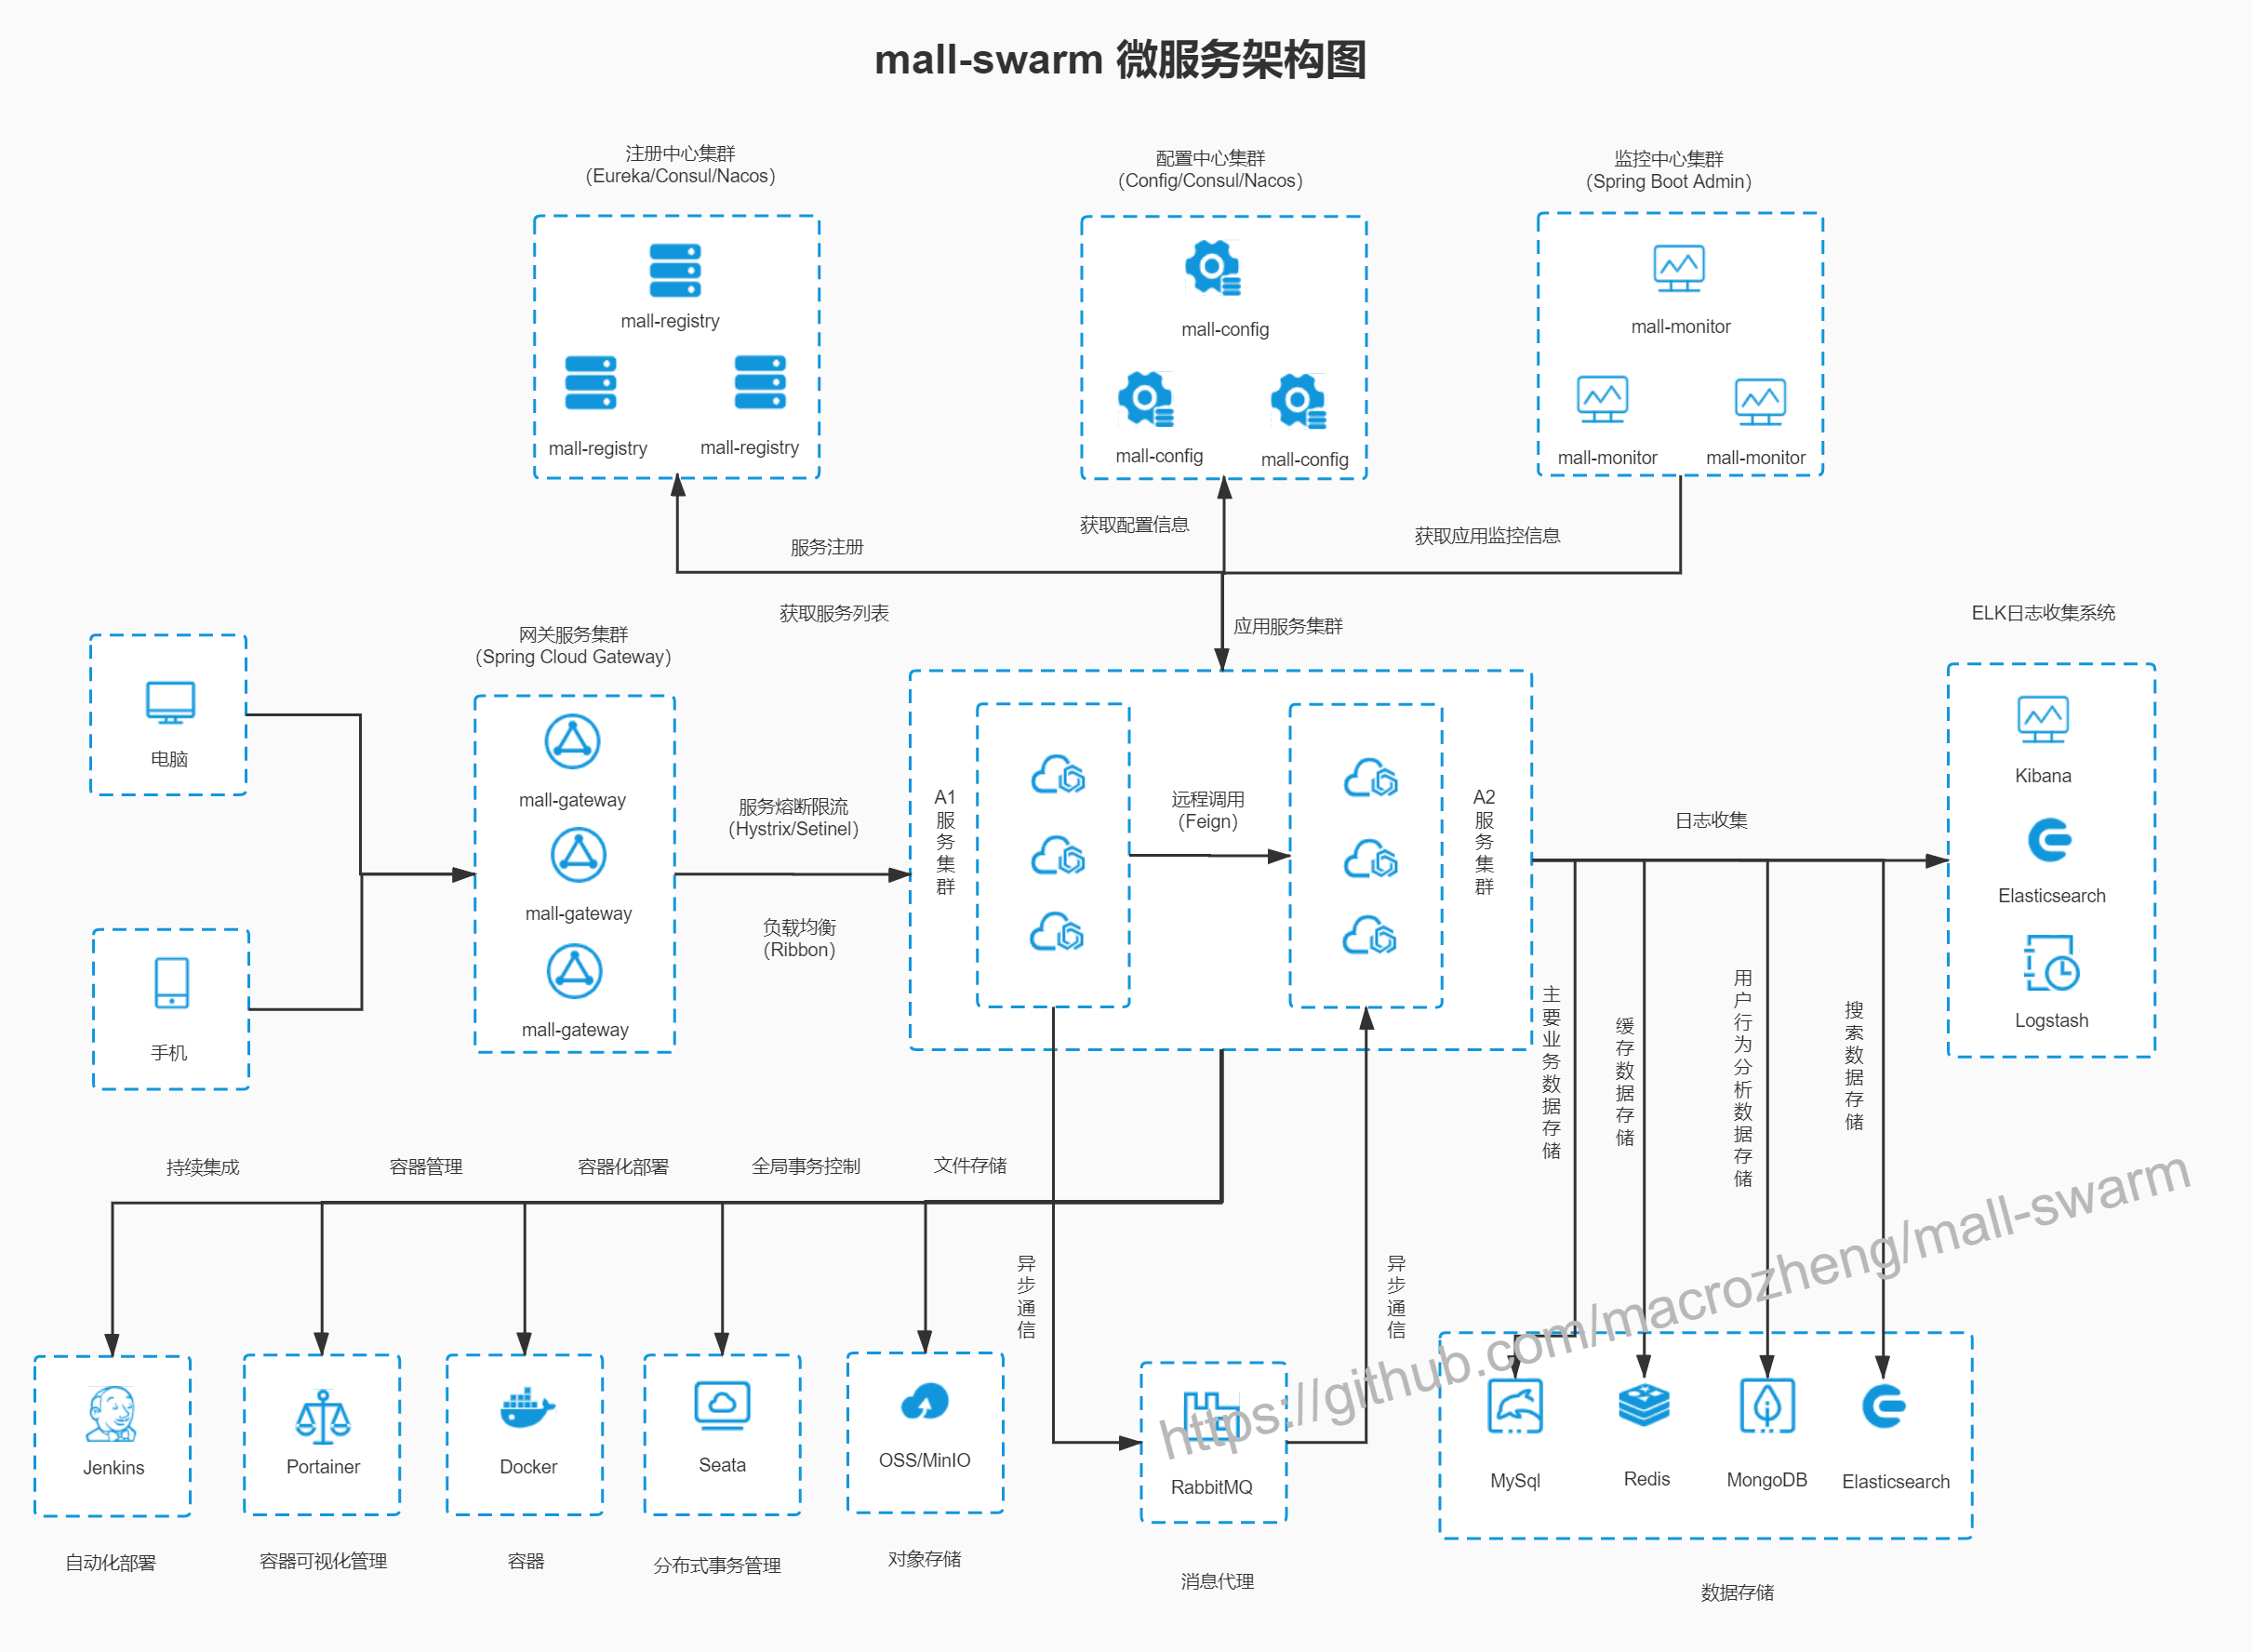

Slide 3
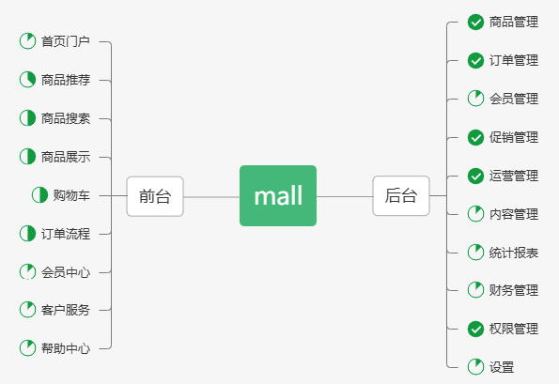
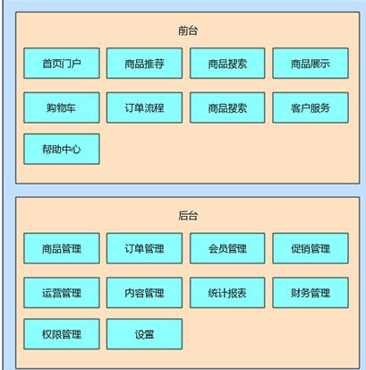
ebook
Browser products
Search products
Order Management
Shopping cart
Order
Product Management
Account Management
account
Setting Management
front
back

Slide 4
design
front | back | database | platform | production
JS | Java Spring boot | Postgresql | Springboot | Heroku

Slide 5
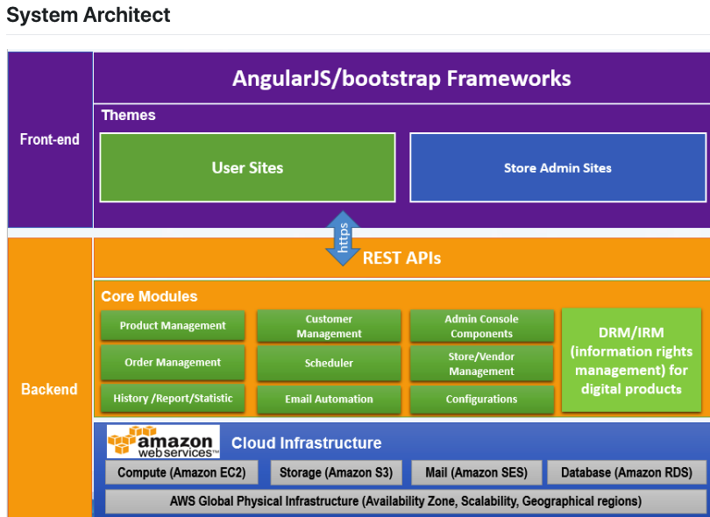

Slide 6
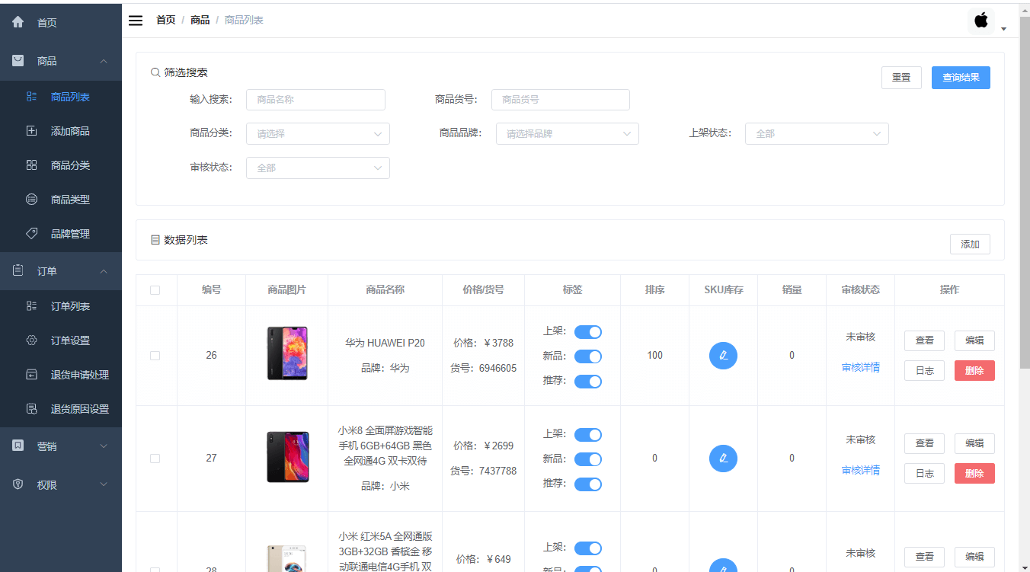

Slide 7
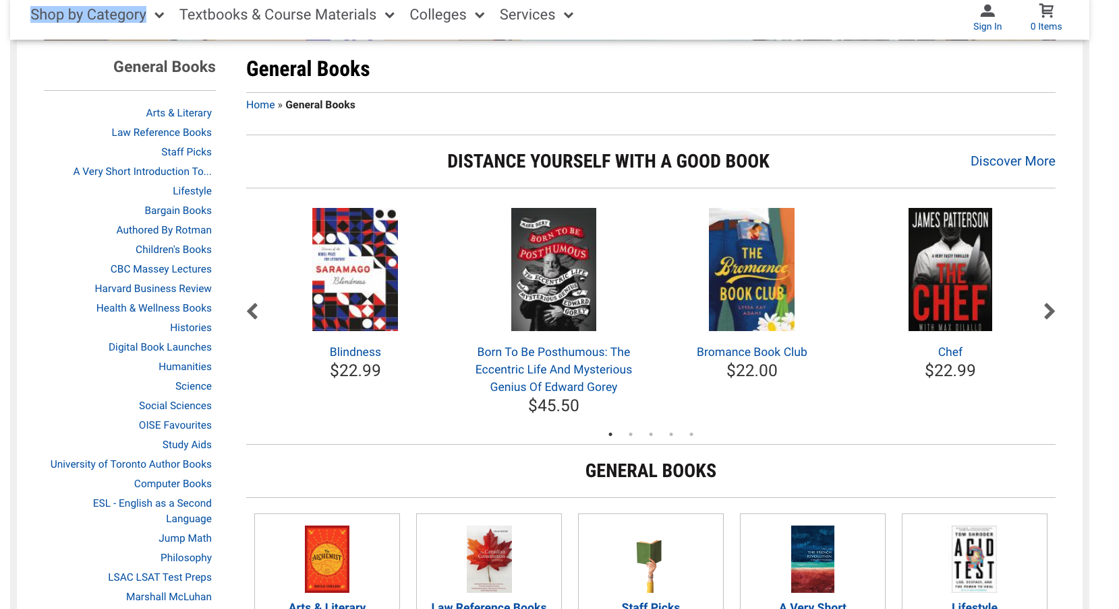
category

Slide 8
