Slide 1
Convolution Neural Network on Handwritten Digit Recognition
Xiangguang Zheng (Sherwood)

Slide 2
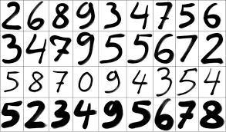
handwritten digit recognition(MNIST data set)

Slide 3
Experiment Environment
Keras using TensorFlow backend with only CPU support
Keras is is a high-level neural networks library, written in Python and capable of running on top of either TensorFlow or Theano

Slide 4
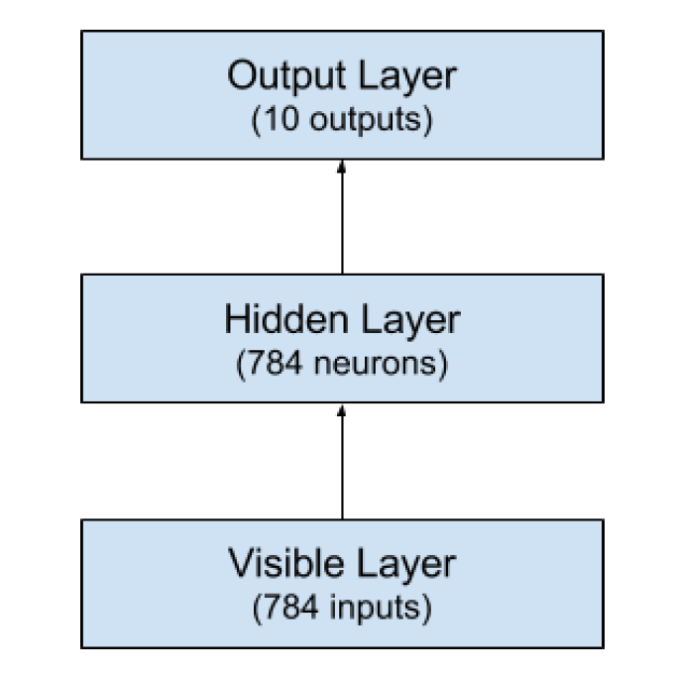
Generic neural network
using perceptron neural network with one hidden layer
28 * 28 size image = 784 pixel input
input are gray scaled
784 neurons in hidden layer
batch size of 200 with 10 epoches

Slide 5
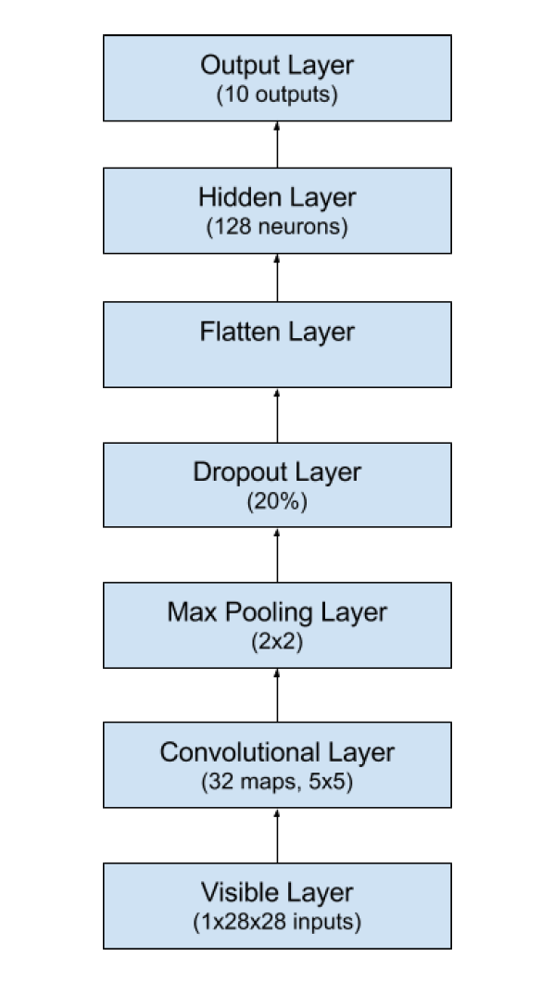
Basic CNN
Basic CNN with one convolution layer and one fully connected layer
input size 28 * 28 * 1 with only 1 channel (grayscale)
convolutional layer:
32 filters with stride 1
create 24 * 24 * 32 activation maps
max pooling layer 2*2 with stride 2
output is (24 - 2) / 2 + 1 = 12
output volume: 12 * 12 * 32
flatten layer : 4608 * 0.8 = 3686 neurons
Notes:
why 5 * 5

Slide 6
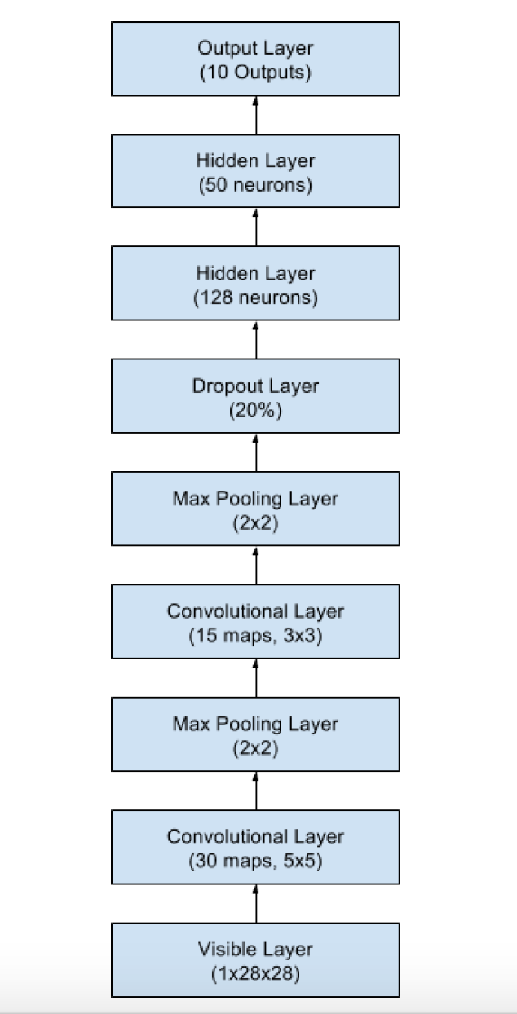
larger CNN
larger CNN with two conv layer and 2 fully connected hidden layer
input size 28 * 28 * 1
first convolution layer 24 * 24 * 30
first max pooling layer 12 * 12 * 30
second convolution layer 10 * 10 * 15
second max pooling layer 5 * 5 * 15
flattern layer: 375 * 0.8 = 300 neurons

Slide 7
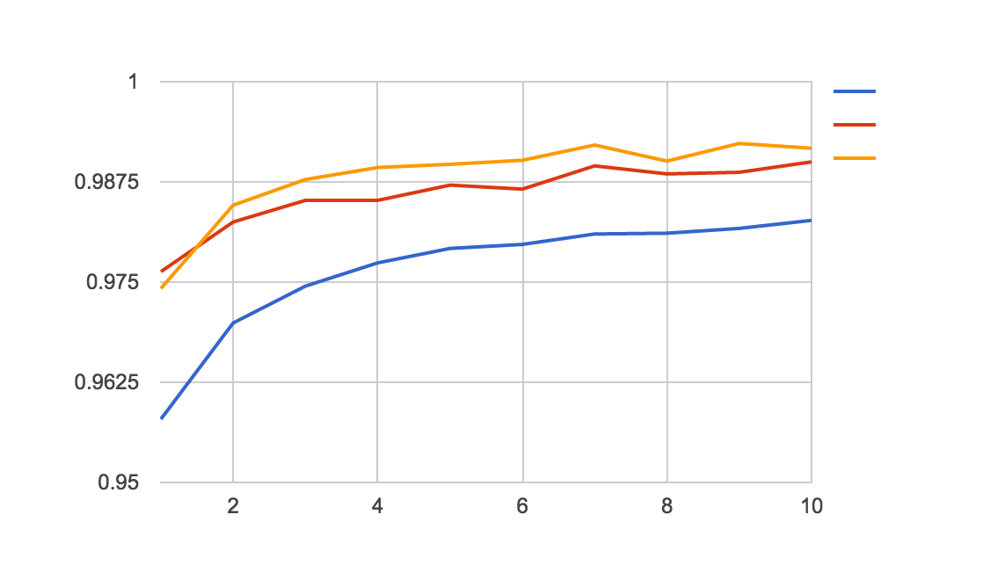
Performance Comparison
NN
1.73%
CNN
1.03%
large CNN
0.83%

Slide 8
How the improvement is achieved
From generic to CNN
capture structural feature
blockify the image through each convolution layer to capture each feature individually
using multiple filters to capture each feature in depth
customized filters for convolution layer
From CNN to larger CNN
two convolutional layer to transfer low-level feature to higher level feature
adding hidden layer adds the depth of flattened fully connected layer
improvement is not significant in this case
Notes:
smaller filter and deeper architecture

Slide 9
Question

