Slide 1
Analysis of College Scorecard
Sheryan Resutov, Eugene Sokolov, Harrison Zhao

Slide 2
Dataset
Kaggle dataset for 7804 U.S. universities
Around 1700 features
Data covers 1996 – 2013
Features cover
About the school
Academics
Admissions
Costs
Student body
Financial aid
Completion
Earnings
Repayment

Slide 3
Problems With The Dataset
Many elements are available only for students who receive federal grants and loans
Treasury elements are protected for privacy purposes and shown as PrivacySuppressed
Most elements are data pooled over two years to reduce year-over-year variability
Many very specific features such as family income for 75k – 110k range

Slide 4
Transforming The Dataset
Binning maps continuous values such as salary into discrete ranges
f_{max} – f_{min} are divided into n discrete bins
f_{max} is the maximum value for the feature
f_{min} is the minimum value for the feature
n is the number of bins
For example, 43 binned into the range 40 – 50 with 5 bins would give a bin number of 2

Slide 5
Preliminary Algorithms Used
Logistic Regression
Support Vector Machines (SVM)
Grid search to find optimal parameters
Five fold cross validation
Both algorithms did not perform well for classification

Slide 6


Lasso Regression
Least Absolute Shrinkage and Selection Operator
Regularized least squares

Slide 7
Random Forests
How it works
Bagging
Random feature selection
Ensemble learning
Used 100 or 200 trees

Slide 8
Analysis Performed
Analysis for:
Mean earnings
Loan default rate based on income bracket
Loan default rate based on major
Completion rate

Slide 9
Mean Earnings Analysis
Dependent Variable: Mean earnings of students working and not enrolled 10 years after entry (mn_earn_wne_p10)
Independent Variables:
ADM_RATE_ALL (Admission Rate)
COSTT4_A (Average cost of Attendance)
UGDS_BLACK (% black students)
PPTUG_EF (% students part time)
UG25abv (% students age>25)
PAR_ED_PCT_1STGEN (% first gen)
PCTFLOAN (% receiving fed loan)
TUITIONFEE_OUT (Out-state tuition)
TUITIONFEE_IN (In-state tuition)
UGDS_WHITE (% white students)
TUITFTE (net tuition)
AVGFACSAL (faculty salary)
INC_PCT_LO (% poor students)
UGDS (total undergrad students)
PCTPELL (% receive Pell Grant)
DEBT_MDN (loan principal)
INC_PCT_H2 (% wealthy students)

Slide 10
Mean Earnings Analysis
Using 8 bins
13.4k bin size
20.7k min
128.4k max
Classification accuracy using
Logistic Regression: 62%
SVM: 59.7%
Random Forest: 72%

Slide 11
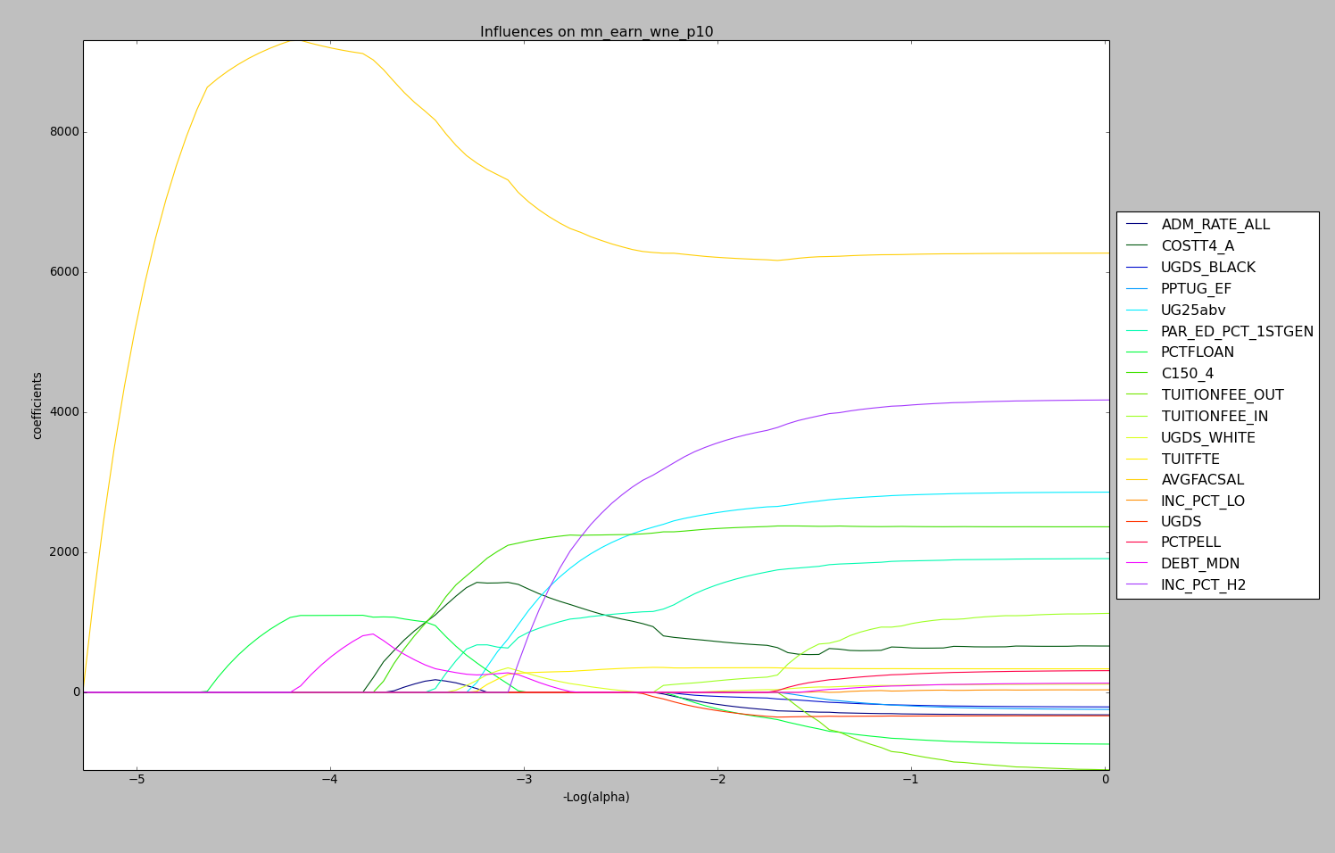
Lasso Regression on Mean Earnings
Notes:
Use TUITFTE and INC_PCT_H2

Slide 12
Lasso Regression on Mean Earnings
Used only TUITFTE and INC_PCT_H2
TUITFTE - Net tuition revenue per full-time equivalent student
INC_PCT_H2 - Dependent students with family incomes between $110,001+ in nominal dollars
Accuracy with Random Forest increases to 78%
The rich get richer

Slide 13
Loan Default Rate Analysis
Dependent Variable: Three-year cohort default rate (CDR3)
Independent Variables:
INC_PCT_M1 *(between $30,001-$48,000)
INC_PCT_M2 *(between $48,001-$75,000)
INC_PCT_H1 *(between $75,001-$110,000)
INC_PCT_H2 *(between $110,001+)
*Dollar amounts correspond to aided students’ family incomes

Slide 14
Loan Default Rate Analysis
Using 10 bins
0.2 bin size
0 min
1 max
Classification accuracy using
Logistic Regression: 53%
SVM: 50%
Random Forest: 75%

Slide 15
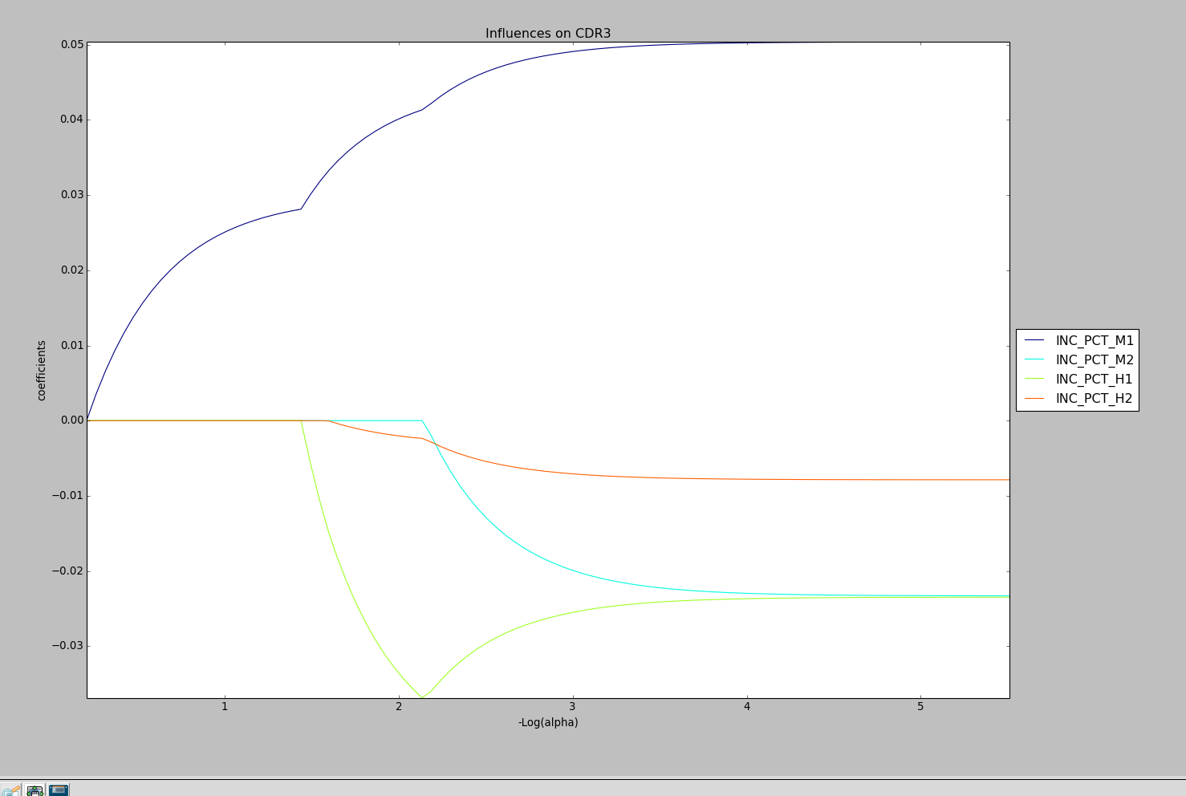
Loan Default Rate Analysis

Slide 16
Loan Default Rate Analysis
Using only INC_PCT_M1 (aided family incomes $30,001-$48,000) accuracy goes down to 55% for Random Forest
Perform Lasso regression based on the majors:
PCIP04 (% degrees Architecture)
PCIP14 (% degrees Engineering)
PCIP50 (% degrees Art)

Slide 17
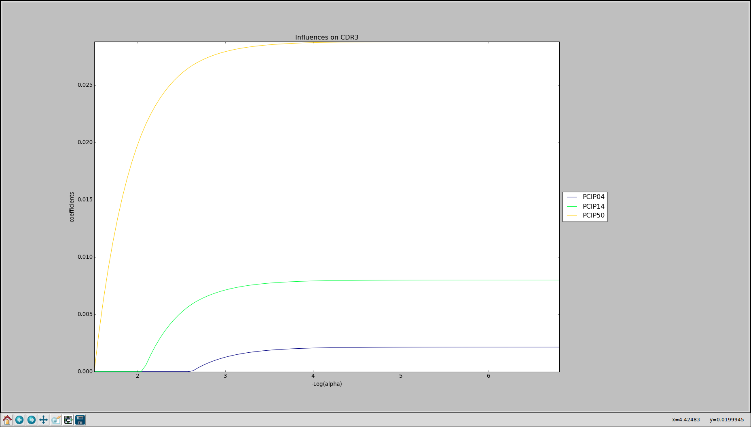
Loan Default Rate By Major

Slide 18
Completion Rate Analysis
Dependent Variable: Completion rate for first-time, full-time students at four-year institutions (C150_4)
Independent Variables:
COSTT4_A (Average cost of Attendance)
ADM_RATE_ALL (Admissions Rate)
UGDS_BLACK (% black students)
PPTUG_EF (% students part time)
INC_PCT_LO (% poor students)
UG25abv (% students age>25)
PAR_ED_PCT_1STGEN (% first gen)
PCTFLOAN (% receiving fed loan)
SATVR75 (Reading SAT 75th %tile)
SATWR75 (Writing SAT 75th %tile)
SATMT75 (Math SAT 75th %tile)
TUITIONFEE_IN (In-state tuition)
TUITIONFEE_OUT (Out-state tuition)
UGDS_WHITE (% white students)
AVGFACSAL (Faculty Salary)
TUITFTE (Tuition Fees)

Slide 19
Completion Rate Analysis
Using 5 bins
0.18 bin size
0.057 min
0.9628 max
Classification accuracy using
Logistic Regression: 45%
SVM: 37%
Random Forest: 62%

Slide 20
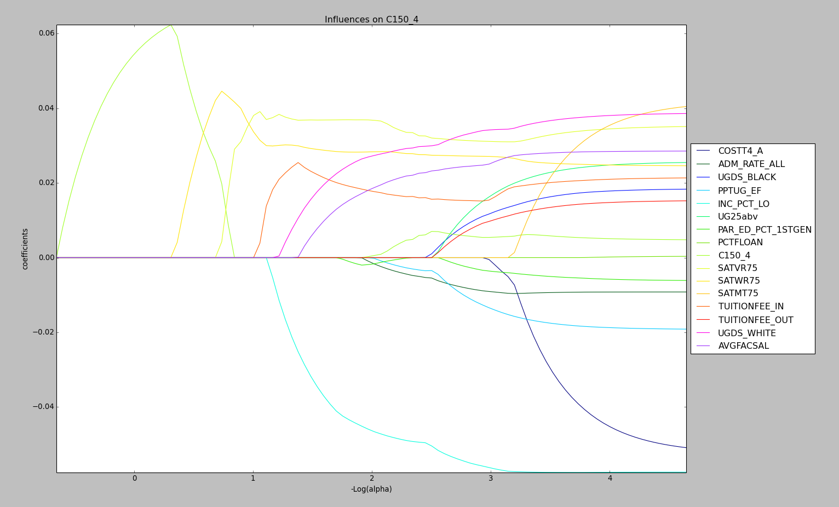
Completion Rate Analysis

Slide 21
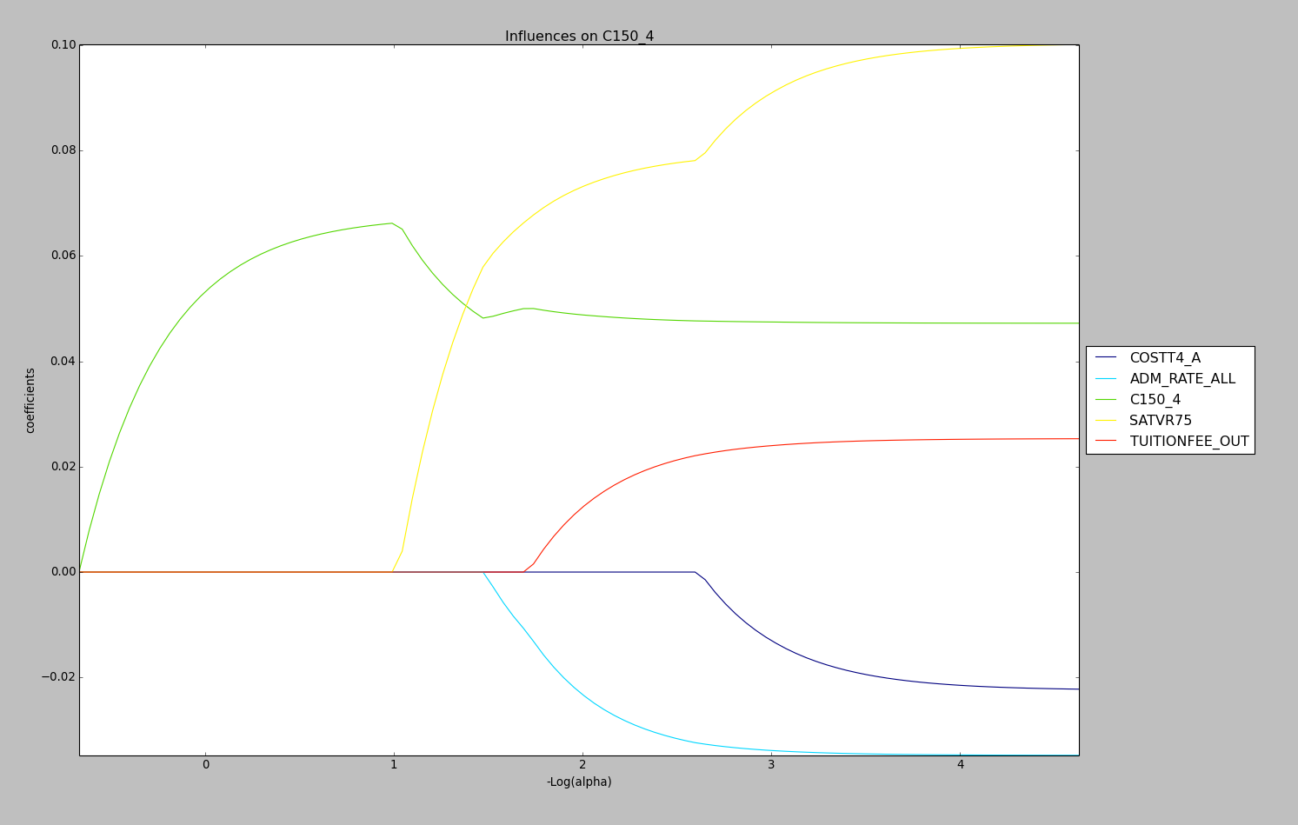
Completion Rate Analysis

Slide 22
Completion Rate Analysis
Lasso analysis independent variables:
COSTT4_A (Average cost of Attendance)
ADM_RATE_ALL (Admission Rate)
SATVR75 (Verbal SAT 75th percentile)
TUITIONFEE_OUT (Out-state tuition)
UGDS_WHITE (% white students)
Classification accuracy using
Logistic Regression: 41%
SVM: 38%
Random Forest: 62%

Slide 23
Conclusion and Future Work
Feature reduction
Different classifiers
Collecting more data
Privacy suppression lowers classification accuracy

Slide 24
Thank You!

