Slide 1


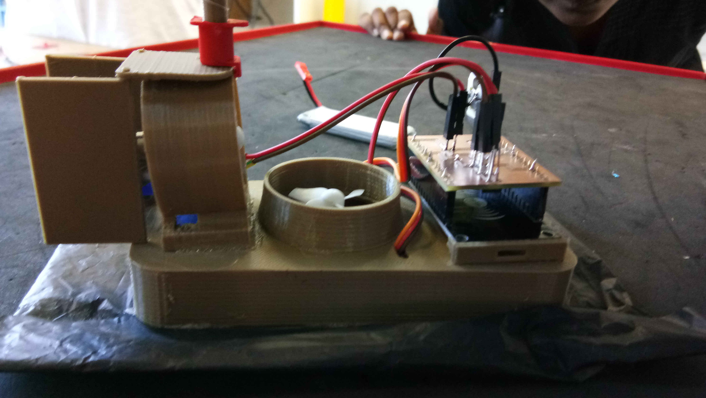
HOVERCRAFT

Slide 2
A hovercraft, also known as an air-cushion vehicle or ACV, is a craft capable of travelling over land, water, mud, ice, and other surfaces. Hovercraft are hybrid vessels operated by a pilot as an aircraft rather than a captain as a marine vessel.

Slide 3
Uses of hovercraft
Travel over any surface.(eg. air, water, land etc.)
It is fuel efficient since it slides through the surface. At maximum speed fuel consumption of the hovercraft is less than 70% of the fuel consumed by fast petrol boat.
Military use : Hovercraft are frequently used as transporters for military purposes for the U.S. Marines and Navy.
Passenger and commercial use : A group in Niagara, Canada is hoping to use hovercraft to ferry tourists and workers from Toronto and Niagara .
Oil spill response : Hovercraft are also often used to respond to oil spills.

Slide 4
Parts of an Hovercraft
Hull :
The hull is the front part of the hovercraft. Hovercraft use blowers to produce a large volume of air below the hull that is slightly above atmospheric pressure.
Skirt:
Typically this cushion is contained within a flexible "skirt", which allows the vehicle to travel over small obstructions without damage.
PCB : (Printed Circuit Board)
The PCB contains the soldered components such as transistor(drain, supply and gate), 10 k-ohm resistor and the connecting pins.

Slide 5
Wi-Fi Module :
ESP8266 is the cheapest chip available
which is coded in arduino, with the PCB board.
Propellers:
They are the aerodynamic surface which
generates the lift
Motors and Battery:
It is the main part of the hovercraft which
supplies the power to the propeller which
causes the lift and the movement.

Slide 6
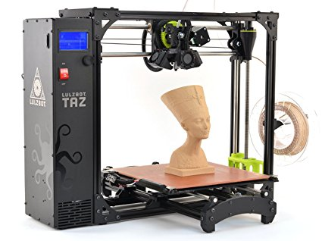
Design and Manufacture Methods
3D Printer : The flag holder was designed using the solid works software and was constructed by using the software that loads the 3DPrinter.
Embroidering Machine:
We use the embroidering
machine to prepare the logo
for the fllag.

Slide 7
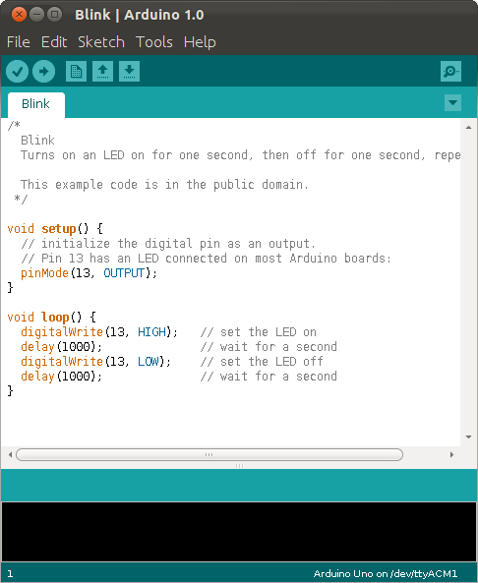
Arduino software :
This software can be
used with any Arduino
board. Using the arduino
board the server motors
are controlled by using
the arduino uno software.

Slide 8
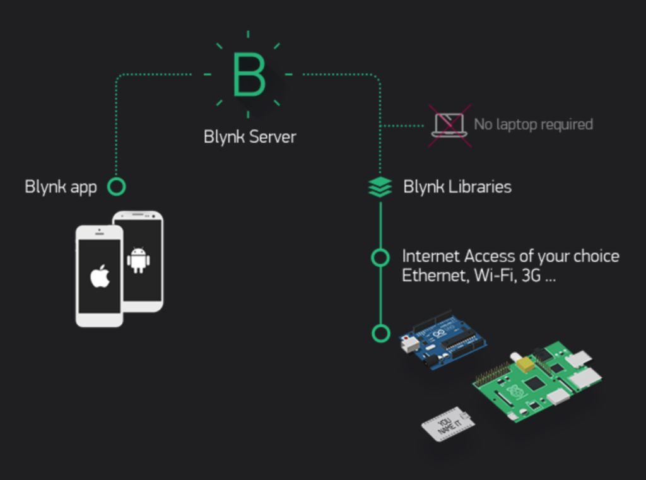
Blynk
It is an application which is used to control the hovercraft using the Wi-Fi module.
The application gives
us some predefined
control tools which
help us to create a
connection with the
Wi-Fi board.

Slide 9
Assembly
Soldering of the components like the resistor and transistor on the PCB board were done.
The materials printed using the 3D printer were assembled and the required motor connections were done with the PCB board.
The Wi-Fi board is then connected with the PCB board and the corresponding program is loaded into the Arduino board and the application can be used to control the direction of the hover craft.

Slide 10
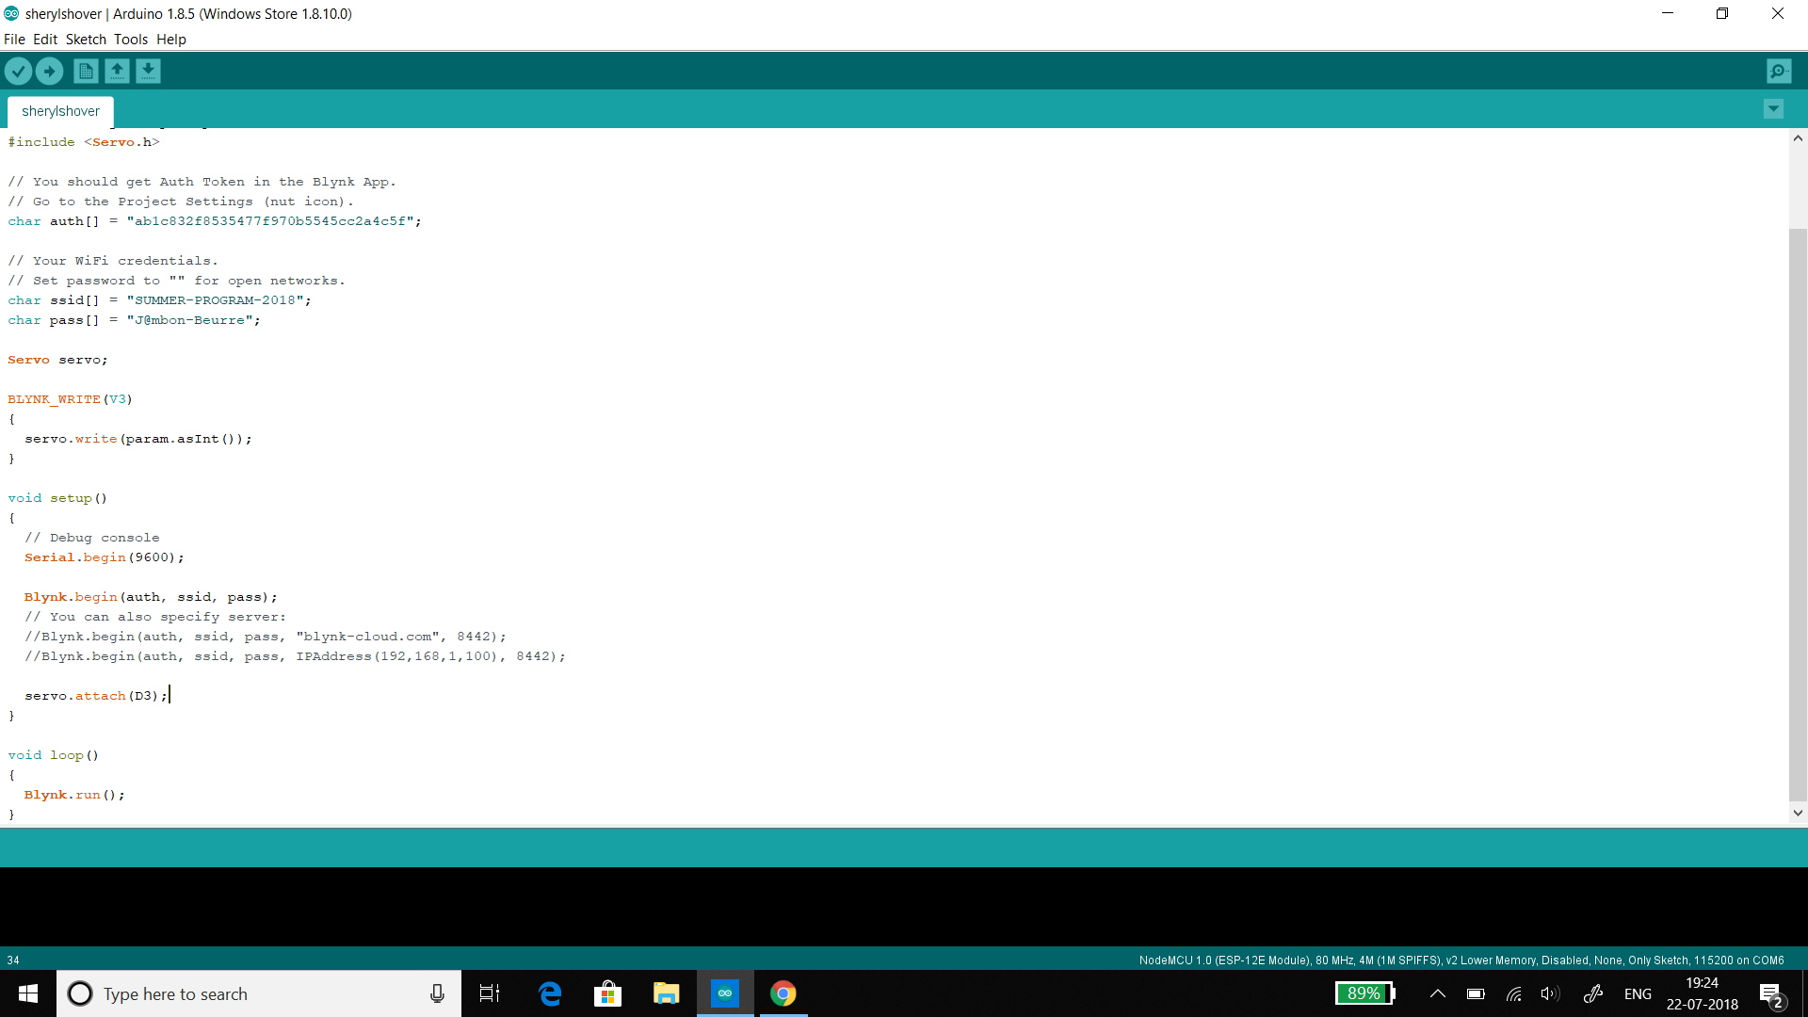

Slide 11
THANK YOU!
Presentation by Sheryl, Michel Ditto, Christina and Stefan Raja

