Slide 1
Dave Mace – Cloud Services dave.mace@osn.com

Slide 2
Bringing DevOps to a non-DevOps world

Slide 3
DevOps - Types of work and The Three Ways
The First Way - Maximise flow left to right
The First Way emphasizes the performance of the entire system, as opposed to the performance of a specific silo of work or department
The Second Way - Amplify feedback loop right to left
The goal of almost any process improvement initiative is to shorten and amplify feedback loops so necessary corrections can be continually made.
The Third Way - Culture of freedom and experimentation
The Third Way is about creating a culture that fosters two things: continual experimentation, taking risks and learning from failure; and understanding that repetition and practice is the prerequisite to mastery.
Business Projects
Internal Projects
Operational Change
Unplanned Work
Notes:
Applying Lean principles to the IT world

Slide 4
What’s the goal…(or at least one of them…..)
How do we get development, operations and other groups within the organisation to collaborate around a set of shared goals, to deliver software faster and more reliably to customers and end users
How do we release more often?
Organizational change is hard
Culture change is even harder

Slide 6
Projects vs Products - (Damon Edwards has some good info)
What if we could release every four hours instead of every four weeks and deploy our own stuff to production, wouldn’t that be cool?
Define a sense of urgency - by recognizing at some point that ‘something needs to happen’ to keep enabling growth, innovation and a faster time to market
Run what you build - build it, run it, love it
Empower (ownership) - autonomy, mastery and purpose - (Daniel Pink ‘Drive’)
‘people want to believe in what/who they are working for (purpose). They want to get better at what they are doing every day (mastery) and they want some say (ownership) in how they do that work (autonomy).’
Educate - involve everyone!
Entrust - trust can be earned in three ways: get rid of the barriers between the teams, have a ‘one goal strategy’ and prove with piloting and prototyping products and tools, that this will work.

Slide 7
Projects vs Products - (Damon Edwards has some good info)
Cross functional teams
Autonomous teams based upon the devops principles.
In a space (feature, platform..), teams have an end-to-end responsibility for both building, deploying and running ‘their’ services.
Have a framework for all teams - version control, retrospectives, demos, viable products

Slide 8
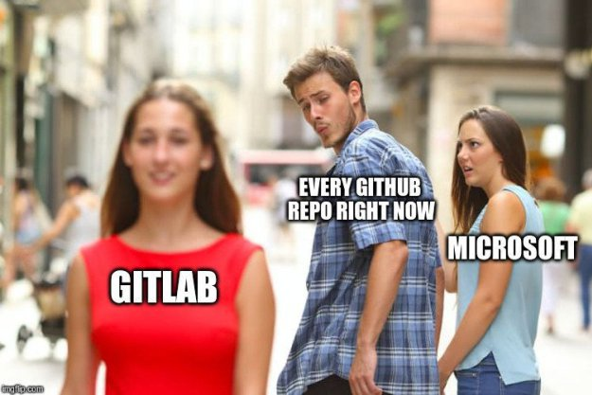
Projects vs Products

Slide 9
Projects vs Products - (Damon Edwards has some good info)
Cross functional teams
Autonomous teams based upon the devops principles.
In a space (feature, platform..), teams have an end-to-end responsibility for both building, deploying and running ‘their’ services.
Have a framework for all teams - retrospectives, demos, viable products
Forming, storming, norming, and performing - Bruce Tuckman
Mixing expertise creates a mutual understanding, builds trust and fosters the collaboration process
Self service tools - have a base layer and a customizable layer
Provision resources
Close resources
Everything is IAC

Slide 10
Culture - You Build It
A lot of companies want or need to improve their culture. Many think a one off activity, such as a motivational speaker or a team building day or an engagement survey will do the trick. IT WONT
You build culture and you build it by doing things over and over again. It’s a commitment and takes time and energy. Those who make the commitment to build and invest that time and energy will win.
Many will never build any culture as they just don't understand it

Slide 11
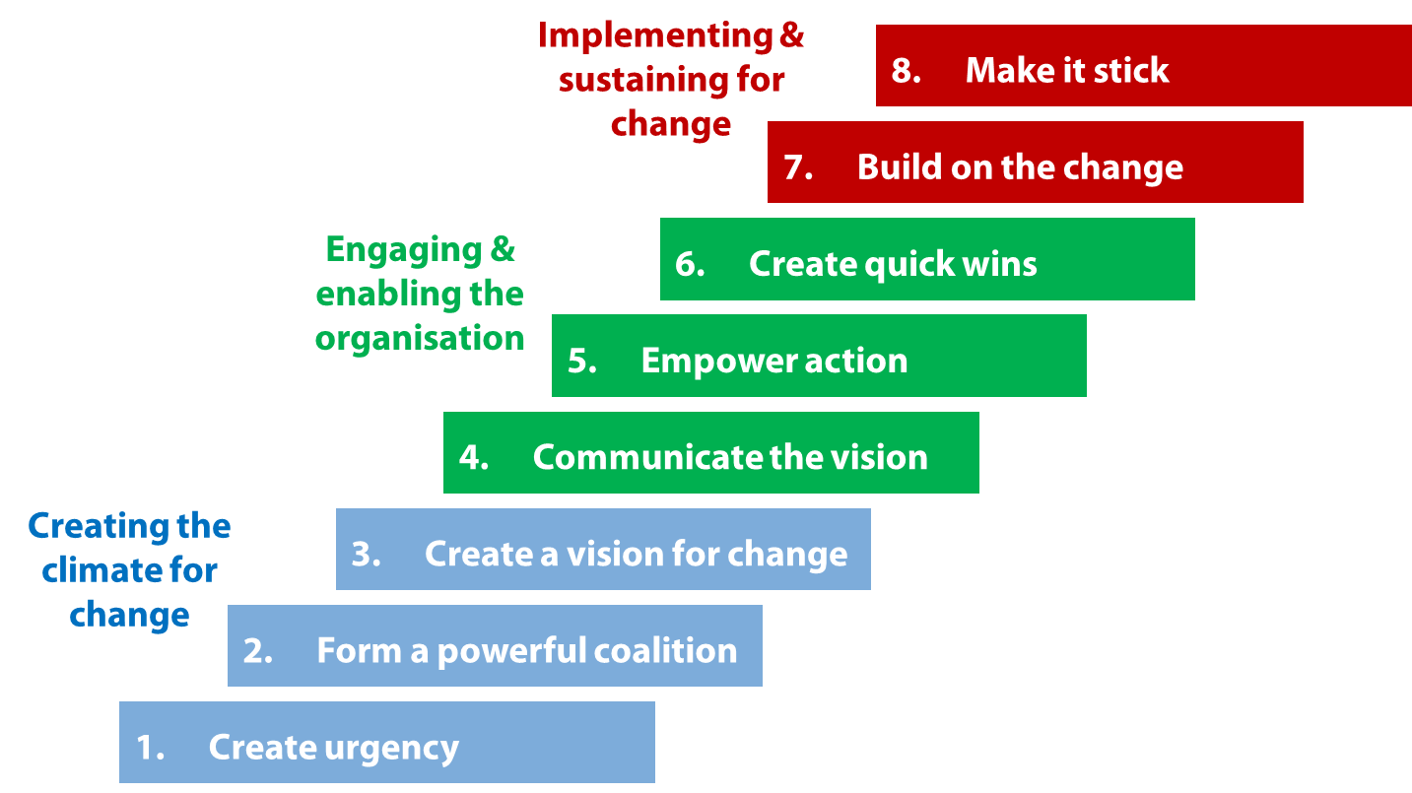
John Kotter’s Eight-Steps Model
Notes:
John Kotter’s eight-steps model.

Slide 12
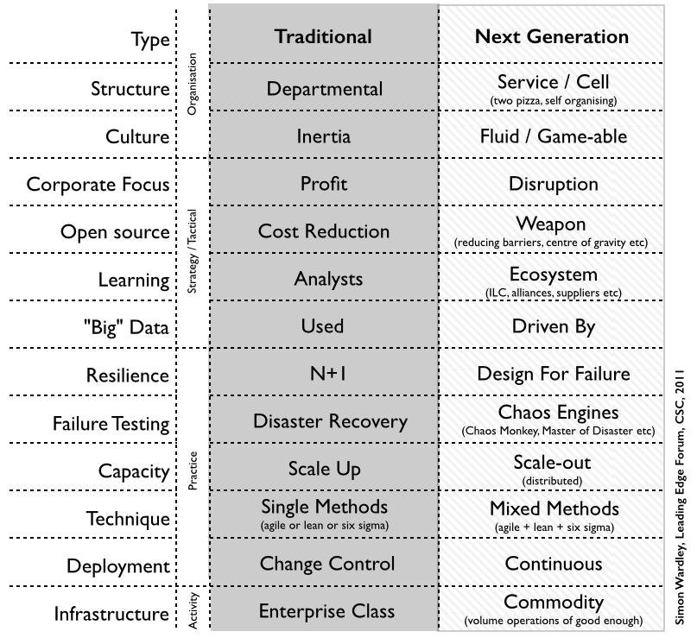
Notes:
simon wardley

Slide 13
