Slide 1
SMARTBUS
Phase II Integration Architecture
Presentation map
01
04
Topic overview
Messaging and recovery
Transforming the original static ticketing website into a service-oriented system with Flowable orchestration, Kafka messaging, correlation state, layered caching, formal contracts, and bounded fault recovery.
02
05
Architecture and services
Correlation and caching
FLOWABLE BPMN
KAFKA RECOVERY
CACHING
03
06
Workflow semantics
Contracts, faults, and demo
Sherzod Omonov
CSE 598 Software Integration and Engineering
Slides 1-16 | March 18, 2026

Slide 2
SCOPE
02
/ 16
Assignment coverage built from repository evidence
The deck follows the exact presentation rubric and ties every section to code, docs, tests, or runnable APIs.
Required presentation targets
1
Topic
2
Architecture
Original static UI became a backend-owned bus ticketing system.
Gateway, booking, schedule, payment, and notification services.
Topic overview
Integration architecture
Workflow explanation
3
Workflow
4
Messaging
Messaging implementation
Flowable BPMN with receive, invoke, flow, switch, and reply.
Kafka event retained while notification-service stays offline.
Correlation logic
Caching strategy
5
Correlation
6
Caching
Fault handling demonstration
bookingReference reused across API, state, logs, and events.
Caffeine plus output-cache measured from 60 ms to under 1 ms.
Live or recorded demo
7
Faults
8
Demo
Timeouts, retries, and structured 422/503/504 responses.
Live sequence plus backup evidence path if runtime setup fails.
Acceptance criteria: 15-20 slides and every section tied to implementation evidence.

Slide 3
STORY
03
/ 16
Phase I UI shell to Phase II integration system
The strongest narrative is the before-and-after shift from browser-only behavior to durable backend coordination.
Phase I baseline
Phase II delivered state
Routes, schedules, and fares lived in static frontend JavaScript.
Gateway-backed APIs now serve routes, quotes, bookings, and state inspection.
Booking behavior was simulated in-browser with localStorage.
Flowable runs the booking BPMN process with explicit partner-service invokes.
No server-owned lifecycle state or durable operational data existed.
Kafka decouples booking confirmation from notification delivery.
PostgreSQL stores business lifecycle state per bookingReference.
There was no asynchronous messaging, orchestration, or fault policy.
Schedule-service applies layered caching with invalidation and measured gains.
OpenAPI and message contracts define every integration boundary.
Original deliverable: a 15-page website prototype
Outcome: a real service-oriented SmartBus shape, not only a demo UI
Static data -> schedule-service APIs
localStorage -> PostgreSQL state
single page logic -> Flowable BPMN
sync only -> Kafka recovery

Slide 4
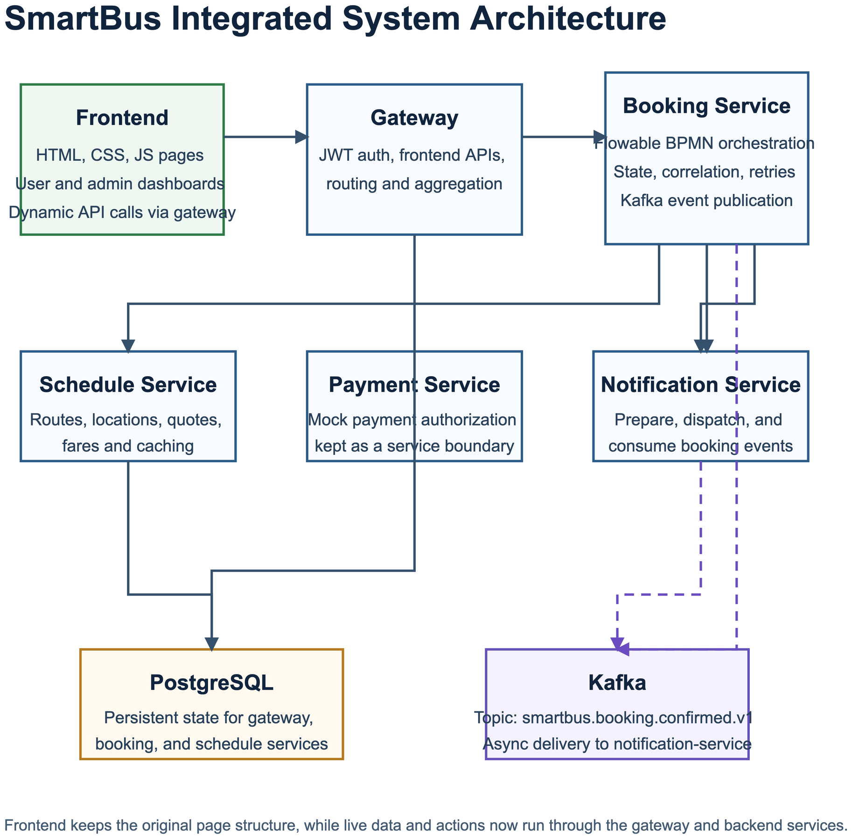
ARCHITECTURE
04
/ 16
Integration architecture keeps booking orchestration central
The design separates responsibilities by business capability and keeps state out of the browser.
What the diagram proves
Gateway fronts the existing frontend and API composition layer.
Booking-service owns the multi-step purchase lifecycle.
Schedule, payment, and notification stay independently owned and replaceable.
State lives in PostgreSQL while Kafka handles the async confirmation edge.
5
4

Slide 5
SERVICES
05
/ 16
Clear service boundaries and a pragmatic technology stack
Each service stays small enough to explain, while still demonstrating enterprise integration patterns.
gateway
port 8080
booking-service
port 8081
Frontend-oriented routing and API composition
Flowable orchestration, retries, correlation, lifecycle state
schedule-service
port 8082
payment-service
port 8083
Routes, fares, quotes, and layered caching
Mock payment authorization boundary
notification-service
port 8084
Confirmation preparation, dispatch, and delivery visibility
Stack: Java 25 | Spring Boot 4.0.3 | PostgreSQL 17 | Kafka 3.9 | Flowable BPMN | OpenAPI 3.1 | Caffeine

Slide 6
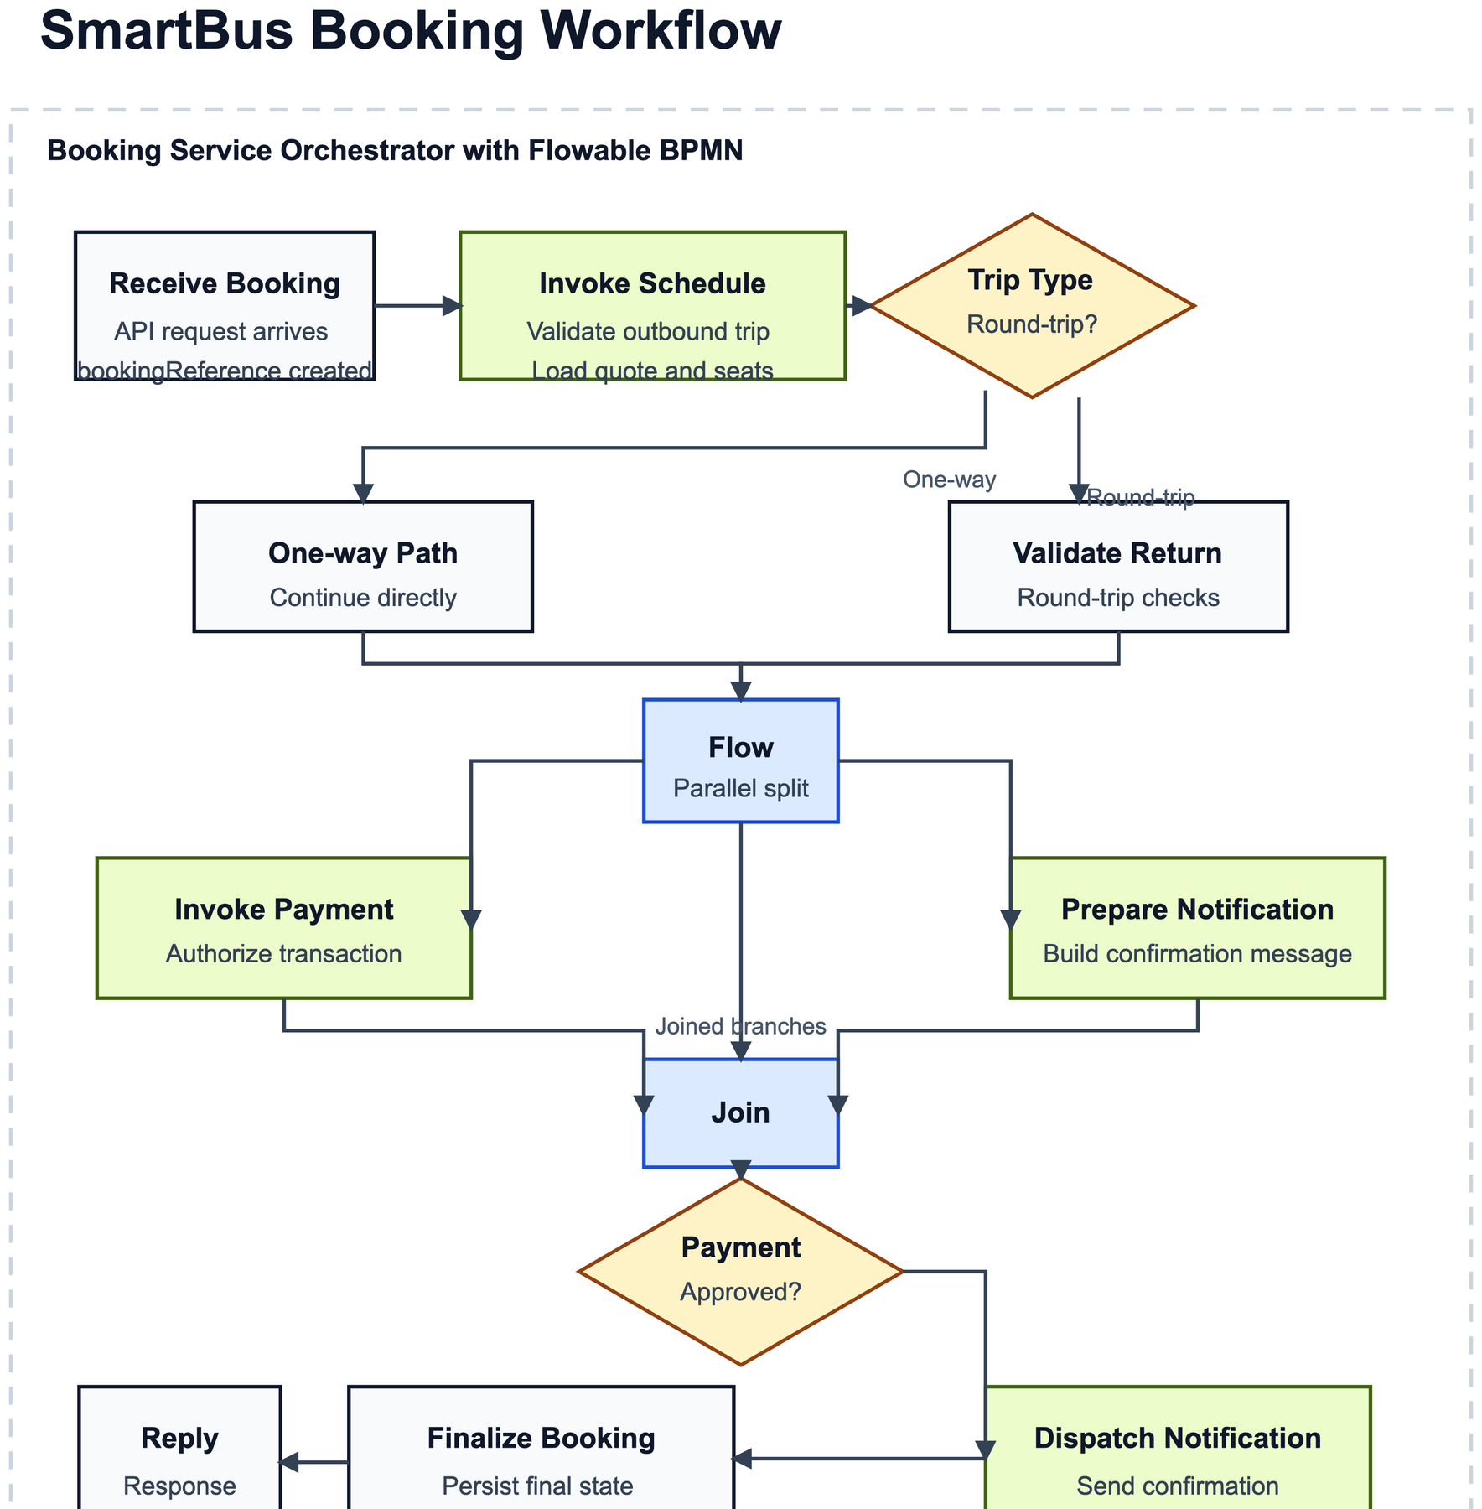
WORKFLOW
06
/ 16
The booking flow runs on a real Flowable BPMN process engine
The BPMN model is executable runtime behavior, not only a documentation artifact.
Runtime anchors
Entrypoint: POST /api/v1/bookings/orchestrated-bookings
Process key: smartbusBookingProcess
Runner: FlowableBookingWorkflowRunner
Partner calls: schedule-service, payment-service, notification-service
Finalize step also publishes booking-confirmed.v1 to Kafka
Supplementary summary still exists in orchestration/booking-workflow.yaml, but the BPMN XML is the executable source.

Slide 7
WORKFLOW
07
/ 16
Assignment workflow semantics are visible in concrete implementation points
This slide maps the rubric terms directly to runtime artifacts and service behavior.
1
Receive
2
Invoke
3
Flow
4
Switch
5
Reply
Controller hands the booking request into the Flowable start event.
Delegates call schedule, payment, and notification partner services.
Parallel gateway splits payment authorization and notification preparation.
Availability and payment decisions branch to success or failure paths.
API returns the confirmed booking response and workflow trace.
Key delegates and process artifacts
InitializeBookingDelegate | ValidateScheduleDelegate | AuthorizePaymentDelegate | PrepareNotificationDelegate | DispatchNotificationDelegate | FinalizeBookingDelegate
The BPMN model makes logging, retries, and state transitions observable at each orchestration step.

Slide 8
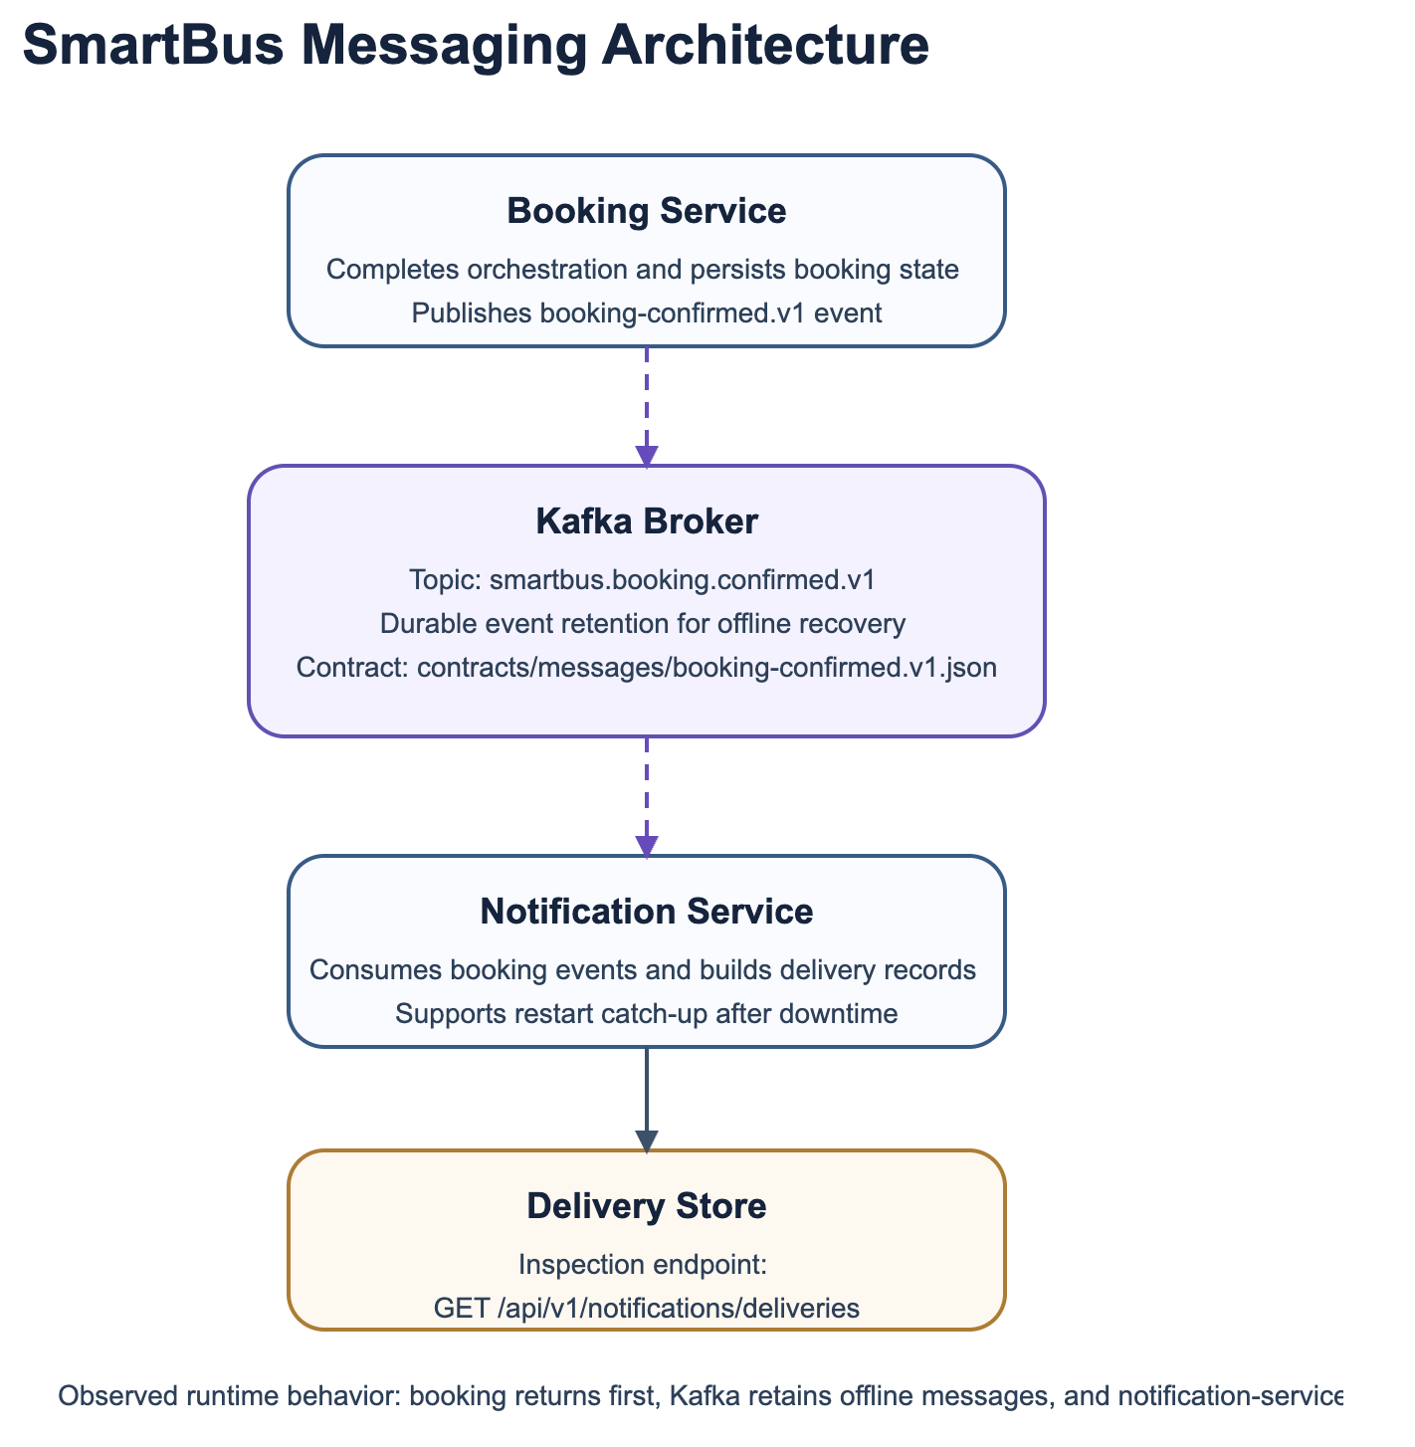
MESSAGING
08
/ 16
Kafka introduces asynchronous confirmation delivery with offline recovery
Booking-service can finish the user-facing flow without blocking on notification-service availability.
Recovery proof points
Producer: booking-service
Consumer: notification-service
Topic: smartbus.booking.confirmed.v1
Persistence comes from the kafka-data Docker volume
Observable evidence
bookingEventPublished proves the event was produced after booking success.
bookingEventConsumed appears when notification-service comes back online.
GET /api/v1/notifications/deliveries confirms backlog delivery replay.

Slide 9
CORRELATION
09
/ 16
bookingReference is the business key that ties every stateful interaction together
The same identifier appears in the response, persistence layer, logs, partner calls, and Kafka events.
bookingReference
is generated once at the start of orchestration and then reused everywhere SmartBus needs traceability or recovery.
Where it appears
Lifecycle state progression
Booking API success response
booking_process_instances state rows
RECEIVED
SCHEDULE_VALIDATED
ROUND_TRIP_VALIDATED
PAYMENT_PENDING
Structured workflow logs
Partner service request context
Kafka booking-confirmed events
PAYMENT_AUTHORIZED
NOTIFICATION_PENDING
CONFIRMED
FAILED
State inspection endpoint
Inspection endpoint: GET /api/v1/bookings/{bookingReference}/state

Slide 10
STATE
10
/ 16
Concurrent requests stay isolated because every path is keyed by bookingReference
No mutable booking state is shared between parallel requests; each instance keeps its own persistence, logs, and events.
1
Unique correlation key
2
Database isolation
3
Event and log matching
Each booking request gets a unique bookingReference.
State rows are keyed by booking_reference in PostgreSQL.
Kafka messages carry the same business key.
Responses keep their own key instead of reusing shared browser state.
Retry and failure logs keep the bookingReference in MDC context.
Failures update only the matching process instance.
Automated verification: BookingCorrelationConcurrencyTests confirms unique references, successful persistence, and matching event counts under parallel requests.

Slide 11
CACHING
11
/ 16
schedule-service uses two cache layers with explicit invalidation
The design trades a small amount of heap for dramatically faster repeated reads while still bounding stale data risk.
Cache path
Policy details
Data-level cache: Spring Cache with Caffeine, capped at 200 entries.
Client request
Route catalog or quote search arrives
Output cache: explicit in-memory quote response cache.
Absolute TTLs: 5 minutes for data, 30 seconds for output responses.
Output cache
CachedQuoteResponseService stores complete quote payloads for 30 seconds
Invalidation and trade-offs
Data cache
Spring Cache with Caffeine keeps route catalog and route definitions for 5 minutes
POST /api/v1/schedules/admin/routes/{routeCode}/fare evicts data cache and clears quote cache.
Output cache costs more memory than route metadata, but the short TTL bounds stale risk.
Simulated datastore
Cold path still exists for cache misses and invalidated reads
If SmartBus scales beyond one node, Redis is the next logical step.

Slide 12
CACHING
12
/ 16
Measured tests show cache warm reads drop from about 60 ms to under 1 ms
Results come from ScheduleCachingTests with simulated datastore latency, not from rough estimates.
Measured result
Cold path: 60-62 ms. Warm path: under 1 ms for both catalog and quote responses.
Invalidation proof
Fare updates force both caches back through the datastore path and verified SB-101 = 18.75.
Why it matters
The performance slide gives measurable before/after evidence instead of only a cache design claim.

Slide 13
CONTRACTS
13
/ 16
Every integrated boundary is backed by a formal REST or message contract
Versioned contracts reduce ambiguity between the frontend, gateway, backend services, and event consumers.
gateway.v1.yaml
booking-service.v1.yaml
Message contract
Frontend-facing routes and composed responses
Orchestrated bookings, failures, and state inspection
contracts/messages/booking-confirmed.v1.json defines the retained booking-confirmed event.
schedule-service.v1.yaml
payment-service.v1.yaml
Catalog, quote, and admin fare operations
Authorization boundary for mocked payment flow
Validation
sh contracts/validate-openapi.sh plus tests keep the OpenAPI files machine-readable and complete.
notification-service.v1.yaml
Deliveries and notification visibility
Why it matters
Reviewers can verify schemas, examples, and status codes without guessing the boundaries.

Slide 14
RESILIENCE
14
/ 16
Fault handling is bounded, observable, and mapped to clear client responses
Retries are used only for transport-style failures; business rejections remain immediate and explicit.
250 ms
3 attempts
50 ms
bookingReference
timeout threshold
bounded retry budget
starting linear backoff
included in retry and failure logs
Failure mapping
Execution model
Operational visibility
Business rejection -> HTTP 422
PartnerCallExecutor wraps downstream calls in timed CompletableFuture execution.
partnerCallStart
Downstream unavailable after retries -> HTTP 503
partnerCallSuccess
Transient ResourceAccessException failures retry with bounded backoff.
partnerCallRetry
Downstream timeout after retries -> HTTP 504
partnerCallFailure
Every failed booking persists terminal state FAILED
bookingWorkflowFailed
Timeouts prevent orchestration threads from hanging indefinitely.
Structured ApiErrorResponse returns service, operation, path, and stable error code

Slide 15
EVIDENCE
15
/ 16
Fault simulations prove recovery behavior and graceful failure paths
The project includes concrete scenarios instead of only describing resilience policies in theory.
Scenario 1
Scenario 2
Scenario 3
Transient notification preparation failure
Schedule-service timeout
Concurrency under fault middleware
First two attempts fail with ResourceAccessException.
Quote call delays to 60 ms while timeout is reduced to 20 ms.
bookingReference values remain unique in parallel tests.
Third attempt succeeds within the retry budget.
Retry budget is exhausted after two attempts.
Successful bookings still publish matching Kafka events.
Booking still ends in CONFIRMED.
API maps the failure to 504 and persists FAILED state.
Fault handling does not break correlation isolation.
Conclusion: failures stay bounded, client-visible, and recoverable without crashing the orchestration runtime.

Slide 16
DEMO
16
/ 16
Live demo plan is short, observable, and has a clean fallback path
The plan is designed to fit class time while still proving orchestration, state, and asynchronous recovery.
Suggested live sequence
Backup evidence if runtime setup fails
Start PostgreSQL and Kafka with docker compose.
Use architecture, workflow, caching, and fault slides as the main narration path.
1
2
Start schedule-service, payment-service, and booking-service.
Open docs/messaging-demo.md and docs/fault-simulations.md for expected logs and outcomes.
3
Keep notification-service offline.
4
Submit an orchestrated booking and capture bookingReference.
What the reviewer should remember
5
Show GET /api/v1/bookings/{bookingReference}/state.
SmartBus now demonstrates orchestration, async messaging, correlation, caching, contracts, and resilience in one coherent repository.
6
Start notification-service and verify GET /api/v1/notifications/deliveries.
7
If time allows, mention cache invalidation or fault evidence.

