Slide 1
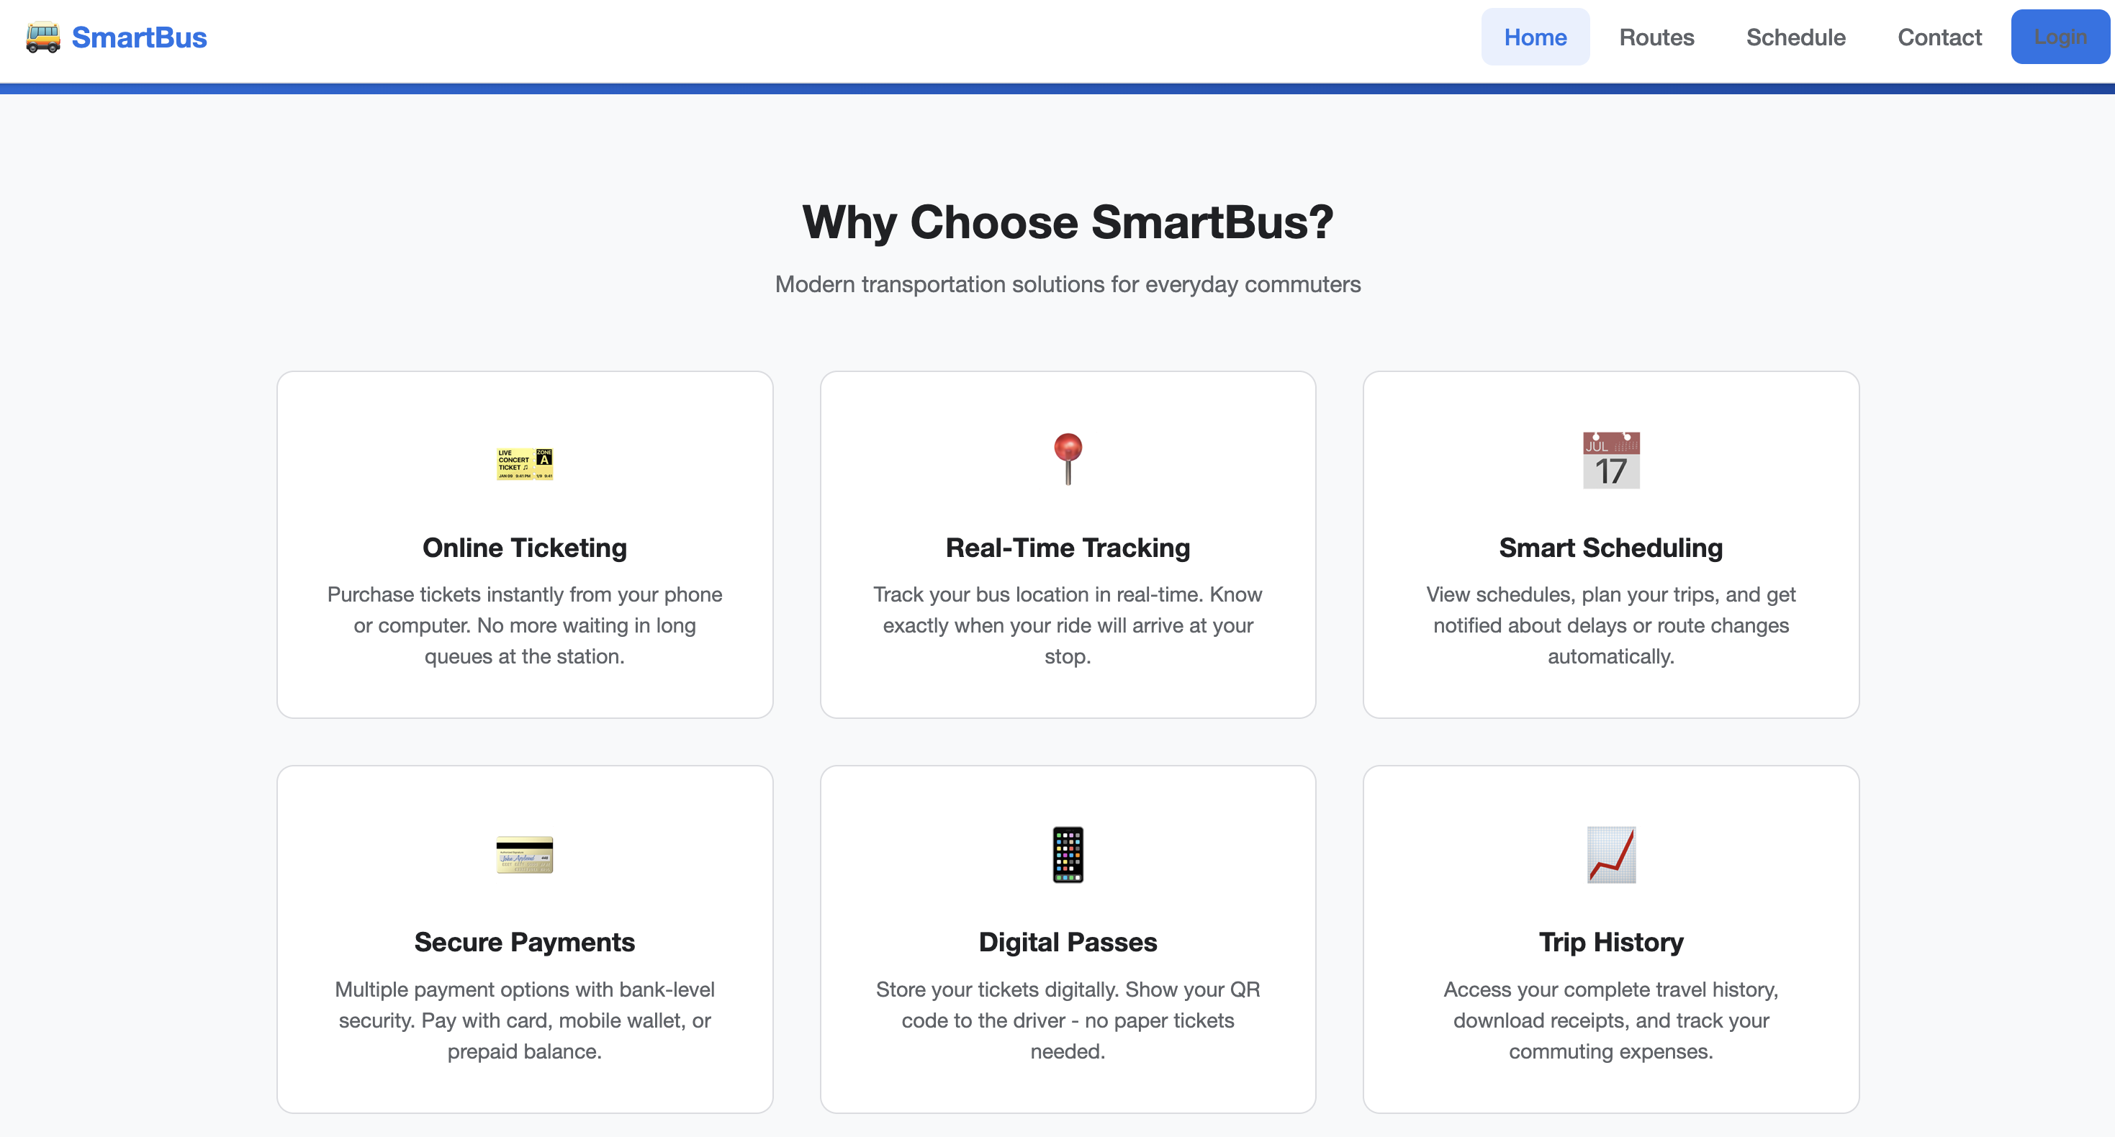
SmartBus
Smart Transportation & Ticketing Integration
Course: CSE 598 — Software Integration & Engineering
Repo: https://github.com/sherzodbeek/smart-bus (frontend prototype)
Presenter: Sherzod Omonov
Notes:
[Sources] - https://github.com/sherzodbeek/buss-go - https://raw.githubusercontent.com/sherzodbeek/buss-go/main/index.html [/Sources]

Slide 2
Problem & Motivation
What commuters struggle with
Goal for SmartBus
Long queues and manual ticketing
Unclear schedules and route info
Limited visibility into delays
Fragmented experiences (tickets, routes, support)
One place to browse routes + schedules
Buy and store tickets digitally (QR)
User dashboard for trips and tickets
Admin portal for operations (routes, buses, users)
SmartBus is a UI prototype demonstrating an integrated transportation experience.
It focuses on the end-to-end flow: discover → plan → purchase → manage → administer.
Notes:
[Sources] - https://raw.githubusercontent.com/sherzodbeek/buss-go/main/index.html [/Sources]

Slide 3
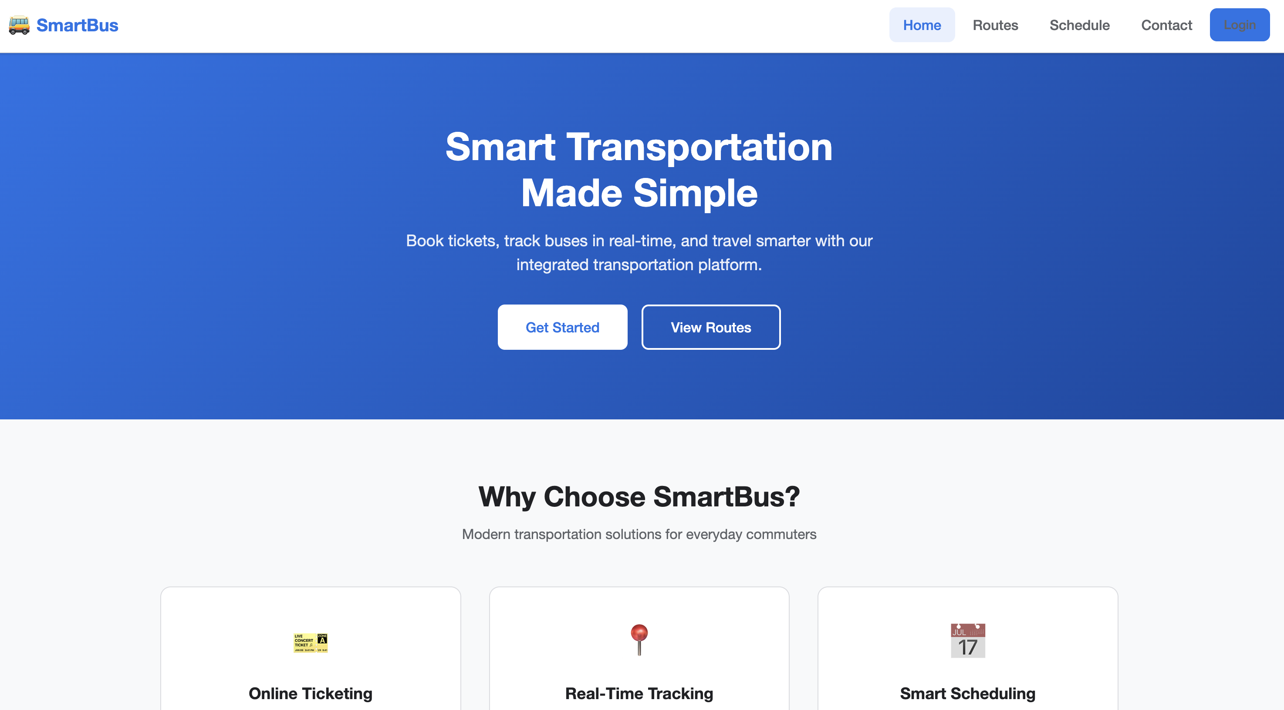
Solution Overview
Core value (as implemented in the UI)
Landing page (mock)
Online ticketing + digital passes (QR concept)
Browse routes with frequency and fare
Schedule table with filters (route/day)
Contact page with FAQ accordion
Separate User and Admin portals
Two roles:
User Portal
Admin Portal
Notes:
[Sources] - https://raw.githubusercontent.com/sherzodbeek/buss-go/main/index.html - https://raw.githubusercontent.com/sherzodbeek/buss-go/main/routes.html - https://raw.githubusercontent.com/sherzodbeek/buss-go/main/schedule.html - https://raw.githubusercontent.com/sherzodbeek/buss-go/main/fares.html - https://raw.githubusercontent.com/sherzodbeek/buss-go/main/contact.html [/Sources]

Slide 4
Project / Site Structure
Public Website
User Portal
Admin Portal
index.html
routes.html
schedule.html
fares.html
contact.html
login.html
register.html
user/dashboard.html
user/buy-ticket.html
user/my-tickets.html
user/routes.html
user/profile.html
admin/dashboard.html
admin/routes.html
admin/buses.html
admin/users.html
admin/tickets.html
admin/reports.html
admin/settings.html
Shared assets: css/style.css • js/app.js • img/ (icons) • webpack configs
Notes:
[Sources] - https://github.com/sherzodbeek/buss-go [/Sources]

Slide 5
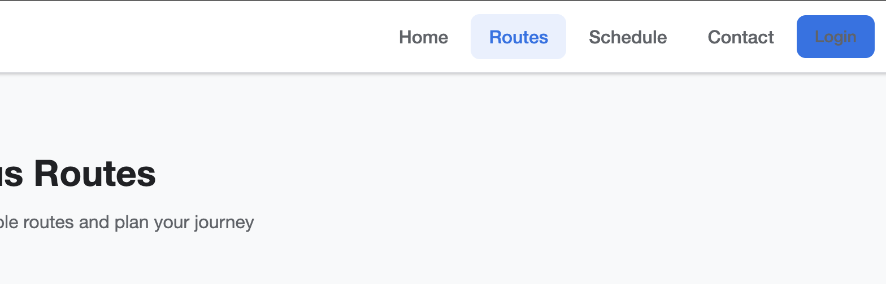
Public UI Walkthrough
Public pages (Home → Routes → Schedule → Contact)
Key interactions
Mobile nav toggle
Schedule filters + search
FAQ accordion expand/collapse
Buttons route to login / register
Demo tip:
Use Routes → pick any route → then go to Login to enter the user/admin portals.
Routes page: cards with route status, frequency, and fare
Schedule page: filter by route and day; table of trips
Contact page: form + FAQ accordion (interactive)
Notes:
[Sources] - https://raw.githubusercontent.com/sherzodbeek/buss-go/main/index.html - https://raw.githubusercontent.com/sherzodbeek/buss-go/main/routes.html - https://raw.githubusercontent.com/sherzodbeek/buss-go/main/schedule.html - https://raw.githubusercontent.com/sherzodbeek/buss-go/main/fares.html - https://raw.githubusercontent.com/sherzodbeek/buss-go/main/contact.html - https://raw.githubusercontent.com/sherzodbeek/buss-go/main/js/app.js [/Sources]

Slide 6
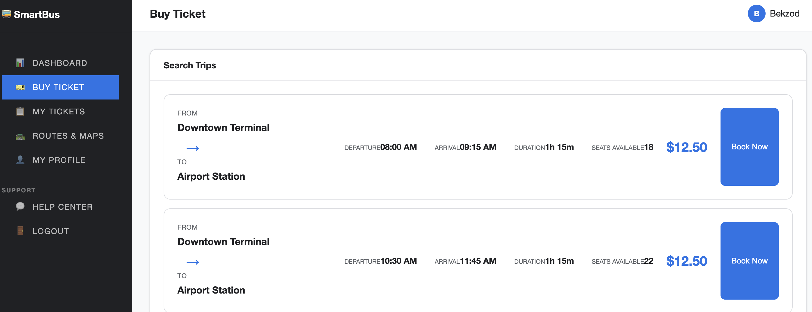
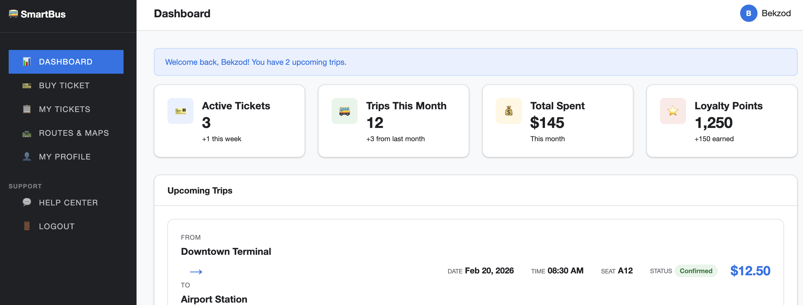
User Journey (Demo Flow)
1. Register
2. Login
3. Buy Ticket
4. My Tickets
5. Dashboard
Create an account
➜
Authenticate (demo)
➜
Search trips + confirm
➜
QR tickets + history
➜
Upcoming trips + stats
Buy Ticket (mock)
User Dashboard (mock)
Suggested demo: Register → Login → Buy Ticket → My Tickets → Dashboard
Notes:
[Sources] - https://raw.githubusercontent.com/sherzodbeek/buss-go/main/register.html - https://raw.githubusercontent.com/sherzodbeek/buss-go/main/login.html - https://raw.githubusercontent.com/sherzodbeek/buss-go/main/user/buy-ticket.html - https://raw.githubusercontent.com/sherzodbeek/buss-go/main/user/my-tickets.html - https://raw.githubusercontent.com/sherzodbeek/buss-go/main/user/dashboard.html [/Sources]

Slide 7
User Portal (Key Screens & Features)
Dashboard + My Tickets
Buy Ticket
Trip search (from/to/date/passengers)
Available trips rendered as cards
Booking modal: confirm & pay (demo)
Profile + Preferences
Edit personal info
Account settings (password)
Notification preferences + language
Stats: active tickets, trips, spending, points
Upcoming trips list with status
Ticket tabs: Active / Past / Cancelled
QR code concept per ticket
User portal pages live under /user
Notes:
[Sources] - https://raw.githubusercontent.com/sherzodbeek/buss-go/main/user/dashboard.html - https://raw.githubusercontent.com/sherzodbeek/buss-go/main/user/my-tickets.html - https://raw.githubusercontent.com/sherzodbeek/buss-go/main/user/buy-ticket.html - https://raw.githubusercontent.com/sherzodbeek/buss-go/main/user/profile.html [/Sources]

Slide 8
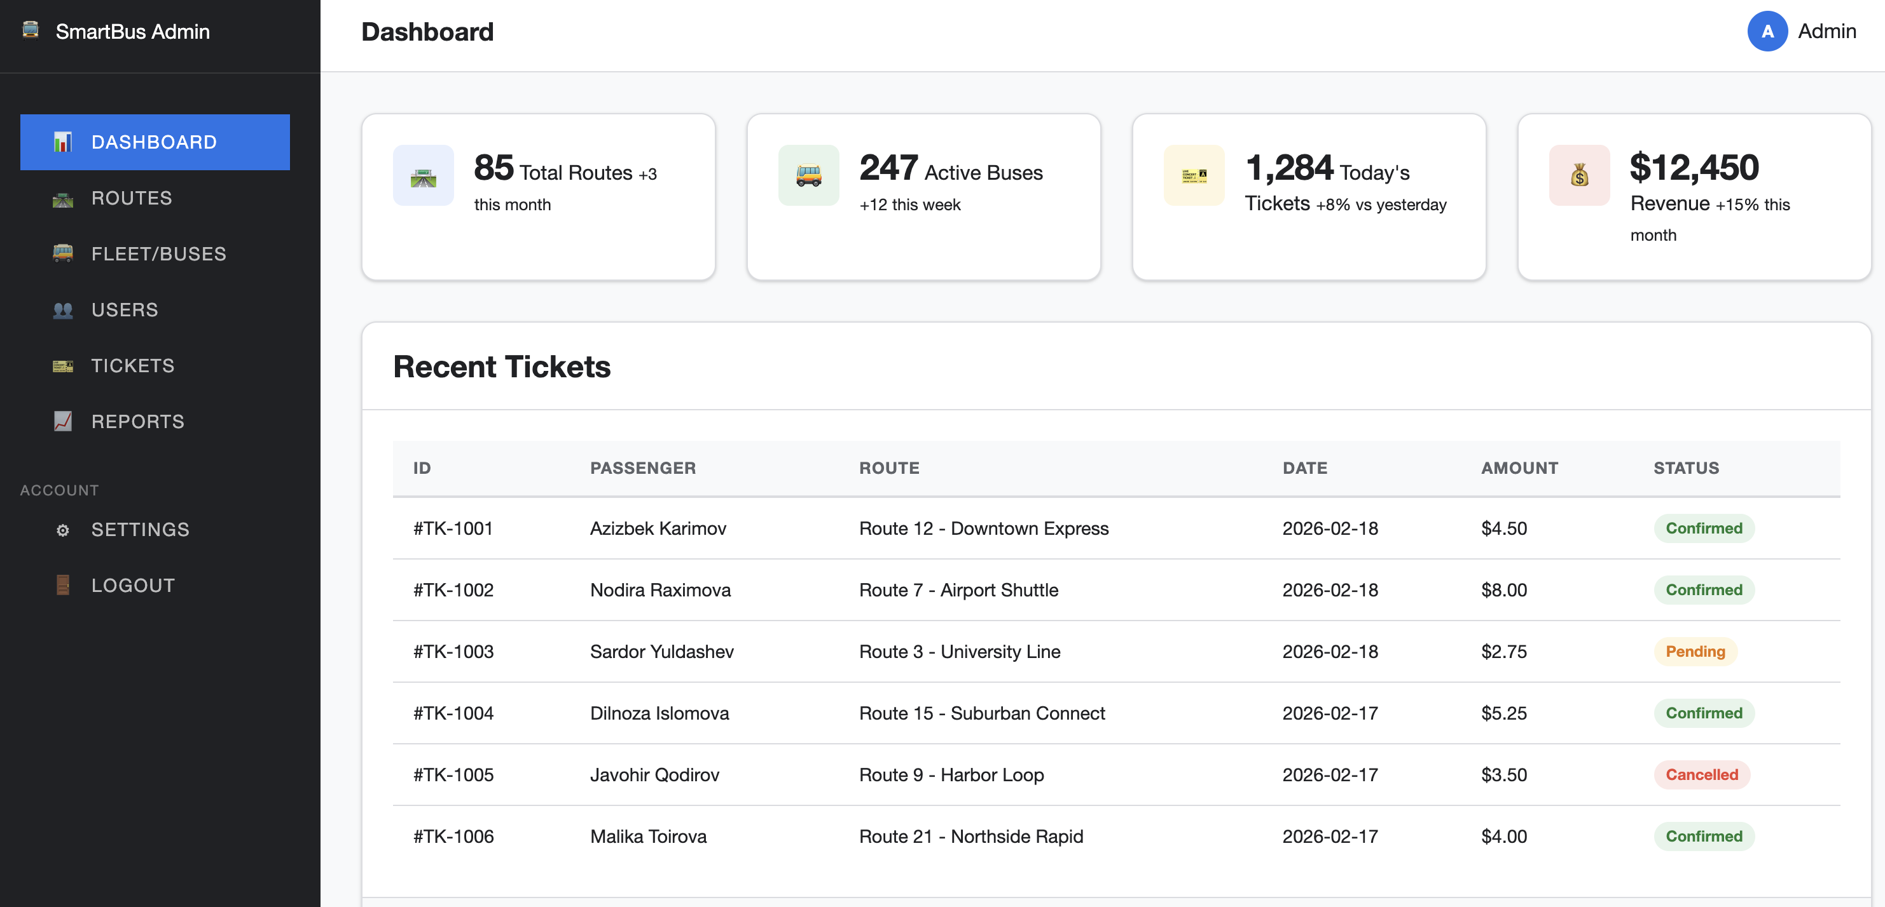
Admin Portal (Operations View)
Admin capabilities (prototype)
Admin dashboard (mock)
Route management: add/edit routes + status
Fleet management: buses, assignments, maintenance
User management: roles (Admin/User/Driver)
Ticket management: sales KPIs + passes
Reports & analytics placeholders
Settings: ticket rules, notifications, security
Login tip: use an email containing “admin” to land on the admin dashboard (demo behavior).
Admin portal pages live under /admin
Notes:
[Sources] - https://raw.githubusercontent.com/sherzodbeek/buss-go/main/admin/dashboard.html - https://raw.githubusercontent.com/sherzodbeek/buss-go/main/admin/routes.html - https://raw.githubusercontent.com/sherzodbeek/buss-go/main/admin/buses.html - https://raw.githubusercontent.com/sherzodbeek/buss-go/main/admin/users.html - https://raw.githubusercontent.com/sherzodbeek/buss-go/main/admin/tickets.html - https://raw.githubusercontent.com/sherzodbeek/buss-go/main/admin/reports.html - https://raw.githubusercontent.com/sherzodbeek/buss-go/main/admin/settings.html - https://raw.githubusercontent.com/sherzodbeek/buss-go/main/js/app.js [/Sources]

Slide 9
Key Frontend Behaviors (JavaScript)
Reusable UI behaviors (js/app.js)
Demo login routing
Navigation toggle (mobile) and dashboard sidebar toggle
Modal open/close + overlay click + Escape key handling
Tab system for switching views (e.g., My Tickets)
FAQ accordion expand/collapse on Contact page
Client-side form validation (required fields, email, password match)
Table search/filtering for lists
function handleLogin(event) {
event.preventDefault();
// Demo: redirect based on email
if (email.value.includes('admin')) {
window.location.href = 'admin/dashboard.html';
} else {
window.location.href = 'user/dashboard.html';
}
}
Note: this repo is a frontend prototype (demo data + UI flows). In a full system, this would call an authentication API and return a token/session.
Reusable JS helpers power interactions across pages
Notes:
[Sources] - https://raw.githubusercontent.com/sherzodbeek/buss-go/main/js/app.js [/Sources]

Slide 10
Technologies & Build Setup
Tech stack
Local dev + bundling (Webpack)
HTML (multi-page site)
CSS (shared theme + components)
Vanilla JavaScript (interactions)
No backend included (demo flows)
npm start → webpack-dev-server (opens browser)
npm run build → production bundle
Plugins: html-webpack-plugin, copy-webpack-plugin
Quick run commands
npm install
npm start # local dev server
npm run build # production build
Static multi-page frontend, packaged with Webpack
Notes:
[Sources] - https://raw.githubusercontent.com/sherzodbeek/buss-go/main/package.json - https://github.com/sherzodbeek/buss-go [/Sources]

Slide 11
Integration Plan (How this becomes a real system)
Services to integrate
Reference architecture
Authentication & user profiles (JWT / sessions)
Ticketing API (purchase, cancel/refund, passes)
Real-time vehicle positions (GPS feed)
Schedules & routes (GTFS / agency feed)
Payments (Stripe/PayPal/Click/Payme/Uzcard/Humo/VISA/Mastercard) + receipts
Notifications (email/SMS for delays and confirmations)
Admin analytics dashboards
External integrations
Frontend UI
Payments
Backend API (REST)
GTFS Schedules
Database
Real‑time GPS
Email/SMS
Next step: replace demo redirects with real API calls + persistence
Notes:
[Sources] - https://raw.githubusercontent.com/sherzodbeek/buss-go/main/js/app.js - https://raw.githubusercontent.com/sherzodbeek/buss-go/main/index.html [/Sources]

Slide 12
Live Demo (5–7 minutes)
Suggested click-path
1) Home → explain project purpose + key features
2) Routes → show route cards (status, frequency, fare)
3) Schedule → use filters (Route + Day)
4) Contact → FAQ accordion
5) Register (optional) → Login
6) User portal: Buy Ticket → confirm booking modal → My Tickets → Dashboard
7) Admin portal: login with an email containing “admin” → show dashboards and management pages
Demo prep
Run locally with:
npm install
npm start
Or open the HTML files directly (static).
Tip: narrate each screen as “What the user wants → what the UI provides”
Notes:
[Sources] - https://raw.githubusercontent.com/sherzodbeek/buss-go/main/package.json - https://github.com/sherzodbeek/buss-go [/Sources]

Slide 13
Future Improvements & Q&A
Next enhancements
Questions?
Backend API + database (users, tickets, routes)
Real-time map view (bus locations)
Payments + refunds + receipt history
Role-based access control (Admin / User / Driver)
Analytics charts on Reports page
Accessibility + responsive testing
Automated tests (unit + UI)
Thanks!
Repo: https://github.com/sherzodbeek/smart-bus
SmartBus — Smart Transportation & Ticketing Integration
Notes:
[Sources] - https://github.com/sherzodbeek/buss-go [/Sources]

