Slide 1

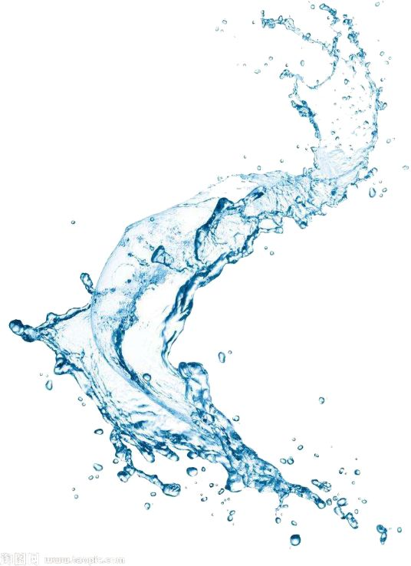

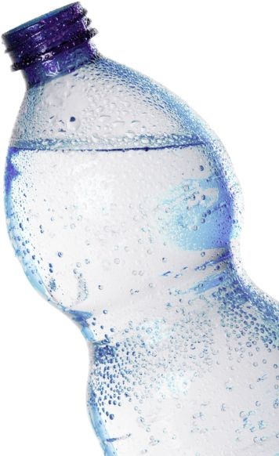


WATER
PURIFICATION
R26-IT-005
Progress Presentation 1
2026/05/11

Slide 2

WATER PURIFICATION
Comments for the Proposal and how you/team addressed them
STUDENT’S NAME & ID | COMMENTS FOR THE PROPOSAL | HOW YOU/TEAM ADDRESSED THEM
R.M.N.A. RATHNAYAKE IT22193940 | Propose to test the quality of the water using sensor data from the water collected using water sources The member 2's component can be incoperated with the same component | The component scope was refined to focus on intelligent water purification and monitoring.The system was designed to automatically adjust mineral composition based on sensor feedback. IoT-enabled monitoring ensures real-time control of pH levels and mineral concentration, enabling consistent alkaline water output.
W.N.N. DE SILVA IT22211750 | Propose to classify water types using sensors Scope needs to be defined properly, could be incopeated with Member 1's component | A machine learning model was implemented to classify water types using sensor data such as pH, TDS, turbidity, conductivity, and temperature. Training and testing were done using collected datasets to improve classification accuracy for different water categories (safe, unsafe, distilled, alkaline, etc.)
D. DODANWELA IT22212122 | Propose to develop an IoT device Check with portability of the device | The system design was refined to ensure the IoT device is compact, portable, and suitable for household use cases. The device integrates a water purification and boiling mechanism that produces clean, safe drinking water.
W.A.S.P.D. WIJESINGHA IT22295460 | Check with the feasibility of the component Propose to develop an IoT device | The system incorporates an atmospheric water generation mechanism, where moisture from air is collected and condensed into liquid water, making the overall solution practical for real-world implementation and sustainable water production.
R26-IT-005
2026/05/11

Slide 3
WATER PURIFICATION
WATER PURIFICATION
PROBLEM
  Traditional water purification and monitoring methods rely on manual testing, fixed purification settings, and separate monitoring systems. Existing systems cannot intelligently identify different water types or automatically optimize purification and mineral balancing based on real-time sensor data.
IMPACT
  Develop an ai and iot-based smart water management system capable of automatically identifying water types using multi-sensor data, optimizing purification processes, monitoring water quality in real time, and supporting intelligent mineral balancing and alkaline water adjustment.
DESIGN EXCELLENCE
  The proposed system integrates IoT sensors, machine learning, automated purification, alkaline optimization, and real-time monitoring into a unified smart water ecosystem.
  The system improves water quality analysis, reduces manual intervention, enhances purification efficiency, and provides intelligent decision-making based on live sensor readings.
R26-IT-005
2026/05/11

Slide 4

IT22295460 | W.A.S.P.D. WIJESINGHA
ATMOSPHERIC WATER GENERATION
(IoT-BASED)
Specialization : Information Technology
IT22295460 | W.A.S.P.D. WIJESINGHA| R26-IT-005
2026/05/11

Slide 5
ATMOSPHERIC WATER GENERATION (IoT-BASED)
How the Solution Addresses the Sub-Problem
  Solves clean water scarcity using moisture from air
  IoT-based smart atmospheric water generator
  Optimizes cooling and condensation cycles
  Supports low-power and energy-efficient operation
  Enables automated water generation and collection
  Integrates with purification and AI-based water testing modules
User Requirements Addressed by the Solution
  Can be use to provide clean water in remote or dry areas
  Enables real-time monitoring through IoT Supports:
- Automatic system control
- Smart energy optimization
- Reduces dependency on traditional water sources
- Supports sustainable and smart water generation
- Easily integrates with the smart water ecosystem
IT22295460 | W.A.S.P.D. WIJESINGHA| R26-IT-005
2026/05/11

Slide 6
ATMOSPHERIC WATER GENERATION (IoT-BASED)
Design Excellence / Contribution
  Smart atmospheric water generation approach: IoT-based environmental monitoring, temperature monitoring, humidity detection, and water level measurement.
  Energy-efficient condensation and cooling control with modular system design for easy integration.
  Supports integration with water purification modules, AI-based water quality analysis, and smart monitoring dashboards with real-time monitoring and remote access capability.
User Feedback on Prototype
  Users found the system innovative and useful for water-scarce areas
  Real-time IoT monitoring improved user confidence and usability
  Users appreciated the automatic water generation and collection process
IT22295460 | W.A.S.P.D. WIJESINGHA| R26-IT-005
2026/05/11

Slide 7

IT22212122 | D. DODANWELA
HOUSEHOLD DISTILLED WATER MAKER
Specialization : Information Technology
IT22212122 | D. DODANWELA| R26-IT-005
2026/05/11

Slide 8
HOUSEHOLD DISTILLED WATER MAKER (IoT-BASED)
How the Solution Addresses the Sub-Problem
  Solves clean water scarcity by converting unclean water into purified distilled water through a controlled boiling and condensation process.
  IoT-based smart household distilled water generation system optimizes heating, boiling, and condensation cycles for improved efficiency.
  Supports low-power and energy-efficient operation through smart control mechanisms.
User Requirements Addressed by the Solution
  Provides clean and safe drinking water at household level by purifying unclean water.
  Enables real-time monitoring through IoT, supporting automatic system control smart energy optimization, and improved operational efficiency.
  Reduces dependency on external or traditional water sources.
  Supports sustainable and smart water generation within households.
  Easily integrates with the smart water ecosystem for future expansion and upgrades.
IT22212122 | D. DODANWELA| R26-IT-005
2026/05/11

Slide 9
HOUSEHOLD DISTILLED WATER MAKER (IoT-BASED)
Design Excellence / Contribution
  To design, develop, and validate a smart, energy-optimized household distilled water generation system that converts unclean water into purified distilled water through a controlled boiling and condensation process.
  The system integrates IoT-based monitoring to enhance user convenience and operational efficiency.
User Feedback on Prototype
  Users found the smart distillation concept useful for household water purification
  Users liked the ability to control and monitor the system remotely
  Positive feedback received for integrating smart automation into traditional distillation methods
  Suggested improvements:
- Reduce distillation time further
- Add water quality indicators and maintenance alerts
IT22212122 | D. DODANWELA| R26-IT-005
2026/05/11

Slide 10
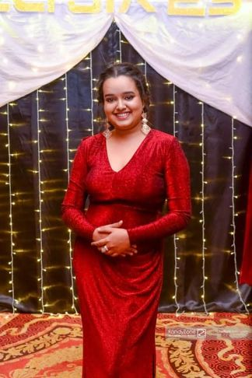
IT22193940 | R.M.N.A.RATHNAYAKE
ALKALINE WATER GENERATION USING
IoT-BASED MINERAL BALANCING
Specialization : Information Technology
IT22193940 | R.M.N.A. RATHNAYAKE| R26-IT-005
2026/05/11

Slide 11
ALKALINE WATER GENERATION USING
IoT-BASED MINERAL BALANCING
How the Solution Addresses the Sub-Problem
  Addresses the need for safe and healthy drinking water by converting regular water into alkaline water through IoT-controlled mineral balancing.
  The system optimizes pH adjustment and mineral infusion cycles to maintain consistent water quality.
  Enables fully automated alkaline water generation with minimal manual intervention.
  Integrates with water quality monitoring and AI-based analysis modules for improved safety and consistency.
User Requirements Addressed by the Solution
  Provides automated alkaline water generation using smart mineral balancing
  Reduces manual intervention in alkaline water preparation
  Ensures consistent water quality and balanced mineral content
  Enables IoT-based monitoring and system control
  Supports customized water optimization for different user needs
  Integrates with AI/ML modules for intelligent decision-making
  Improves efficiency and reliability of alkaline water production
IT22193940 | R.M.N.A. RATHNAYAKE| R26-IT-005
2026/05/11

Slide 12
ALKALINE WATER GENERATION USING
IoT-BASED MINERAL BALANCING
Design Excellence / Contribution
  To design, develop, and validate a smart IoT-based alkaline water generation system using mineral balancing techniques to produce healthy drinking water with controlled pH levels.
  The system integrates IoT-based monitoring and mobile application control to enhance user convenience and operational efficiency while ensuring consistent water quality through automated mineral adjustment.
User Feedback on Prototype
  Users found the automated alkaline water adjustment feature useful and innovative
  Users appreciated the smart mineral balancing and reduced manual effort
  The IoT-based monitoring interface was easy to understand and use
  Users liked the idea of customized alkaline water generation
  Automatic adjustment features were considered more efficient than manual methods
  Suggested improvements:
- Improve accuracy of mineral dosing mechanisms
- Add personalized alkaline level recommendations
IT22193940 | R.M.N.A. RATHNAYAKE| R26-IT-005
2026/05/11

Slide 13
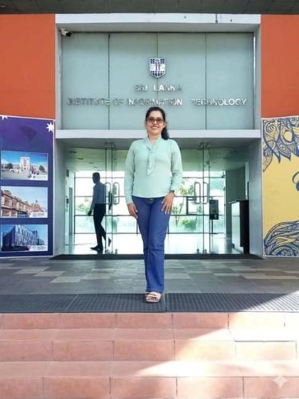
IT22211750 | DE SILVA W.N.N.
DIFFERENT TYPES OF WATER
IDENTIFIER – ML & AI
Specialization : Information Technology
IT22211750 | DE SILVA W.N.N | R26-IT-005
2026/05/11

Slide 14
DIFFERENT TYPES OF WATER IDENTIFIER – ML & AI
How the Solution Addresses the Sub-Problem
  The solution addresses the difficulty in identifying different types of water by introducing an AI/ML-based classification system that analyzes real-time sensor data.
  Using inputs such as pH, TDS, turbidity, conductivity, and temperature, the model classifies water into categories (e.g., safe drinking, alkaline, distilled, contaminated).
  This removes manual testing and enables fast, automated, and accurate water quality identification at each purification stage.
User Requirements Addressed by the Solution
  Real-time identification of water type using sensor data
  Accurate classification of safe and unsafe water
  Simple and automated decision-making without manual testing
  Continuous monitoring during purification process
  Clear output indicators for user understanding
IT22211750 | DE SILVA W.N.N.| R26-IT-005
2026/05/11

Slide 15
DIFFERENT TYPES OF WATER IDENTIFIER – ML & AI
Design Excellence / Contribution
  The design integrates machine learning classification models with IoT sensor data pipelines, enabling intelligent decision-making.
  Feature selection from multiple water quality parameters improves prediction accuracy.
  The system is modular, allowing easy integration with other subsystems such as purification, distillation, and atmospheric water generation.
User Feedback on Prototype
  Users reported that the system was easy to understand and provided clear water type results in real time
  The automated classification reduced the need for manual water testing
  The system increased user trust in water safety decisions
  Visual indicators and simple labels improved usability and clarity of results
  Suggested Improvements:
- Expand support for additional water types and edge cases
- Increase accuracy of the ML model with larger and more diverse datasets
IT22211750 | DE SILVA W.N.N.| R26-IT-005
2026/05/11

Slide 16
WATER PURIFICATION
Commercialization & Sustainability
  Can be marketed as a smart IoT-based water purification system
  Suitable for households, rural communities, and small institutions
  Low-power operation ensures energy-efficient and sustainable usage
  Modular system allows easy scaling and product expansion
Customer Persona & Market
  Households needing safe and clean drinking water
  Rural and semi-urban communities with limited water infrastructure
  Schools, clinics, and small institutions requiring purified water
  Smart home users interested in IoT-based appliances
Uniqueness & Cost Recovery
  Integrates IoT monitoring with water purification process
  Real-time water quality tracking via mobile application
  Automated purification reduces manual intervention and maintenance cost
  Cost recovery through device sales, maintenance, and service subscriptions
R26-IT-005
2026/05/11

Slide 17
THANK
YOU
ANY QUESTIONS ?

