Slide 1
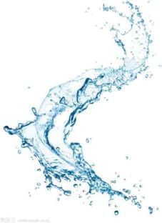

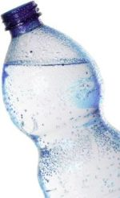

WATER
PURIFICATION
R26-IT-005
Progress Presentation 2
2026/08/31

Slide 2


Automated Water Quality & Contamination Detection System
Comments for the PP1 and how you/team addressed them
STUDENT’S NAME & ID | COMMENTS FOR THE PP1 | HOW YOU/TEAM ADDRESSED THEM
R.M.N.A. RATHNAYAKE IT22193940 | Only have brought the device, but the device also doesn't work. No software implementation, needs to discuss with supervisor | Developed a software solution to analyse water quality inputs and provide automated results, addressing the lack of software implementation.
W.N.N. DE SILVA IT22211750 | Have trained only 1 model, better to train 2 models and do a comparison on model performance. 4 Quality classifications with water samples and test the water | Trained two machine learning models, compared their performance using evaluation metrics, and selected the better-performing model for water quality classification.
D. DODANWELA IT22212122 | Only have brought the device, but the device also doesn't work. No software implementation, needs to discuss with supervisor | Developed the required software component to analyse water quality data and provide automated results.
W.A.S.P.D. WIJESINGHA IT22295460 | Only have brought the device, but the device also doesn't work. No software implementation, needs to discuss with supervisor | Implemented the software component for automated water contamination detection and analysis.
R26-IT-005
2026/08/31

Slide 3
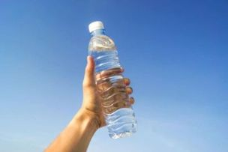
Automated Water Quality & Contamination Detection System
Problem
  Unsafe water causes health risks and waterborne diseases.
  Water testing often requires laboratory equipment and trained personnel.
  Existing methods can be costly and time-consuming.
  Many users cannot easily identify contamination in water.
Stakeholders
  Households
  Rural communities
  Water treatment authorities
  Environmental organizations
  Schools and universities
  Researchers
R26-IT-005
2026/08/31

Slide 4
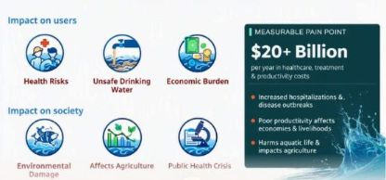
Automated Water Quality & Contamination Detection System
Impact and Measurable Pain Point
R26-IT-005
2026/08/31

Slide 5
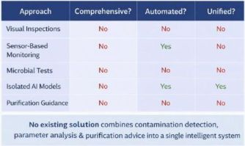
Automated Water Quality & Contamination Detection System
Research Gap
R26-IT-005
2026/08/31

Slide 6

Automated Water Quality & Contamination Detection System
Objectives
  Detect visible contaminants in water samples.
  Classify water quality using measured parameters.
  Detect microorganisms from microscope images.
  Generate an automated water safety report.
  Recommend suitable purification methods.
R26-IT-005
2026/08/31

Slide 7
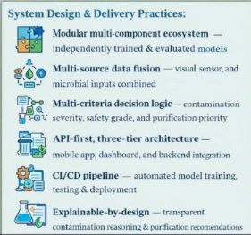
Automated Water Quality & Contamination Detection System
Solution Overview + Architecture
R26-IT-005
2026/08/31

Slide 8
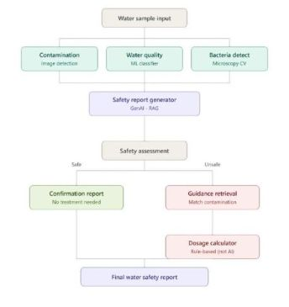
Automated Water Quality & Contamination Detection System
R26-IT-005
2026/08/31

Slide 9
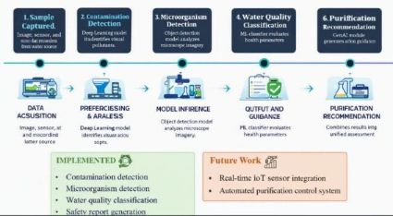
Automated Water Quality & Contamination Detection System
Integration and Completion Status
R26-IT-005
2026/08/31

Slide 10
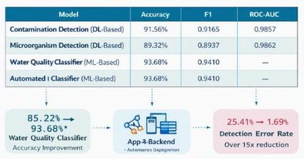
Automated Water Quality & Contamination Detection System
Evaluation Evidence
R26-IT-005
2026/08/31

Slide 11
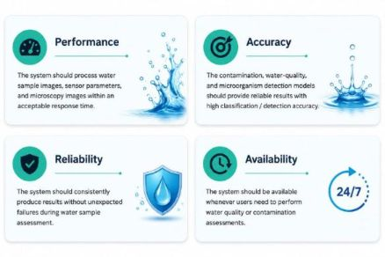
Automated Water Quality & Contamination Detection System
Non-Functional Requirements
R26-IT-005
2026/08/31

Slide 12
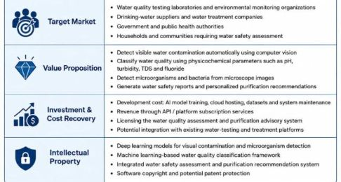
Automated Water Quality & Contamination Detection System
Commercialization
R26-IT-005
2026/08/31

Slide 13
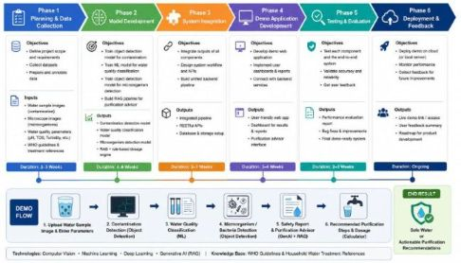
Automated Water Quality & Contamination Detection System
Demo Roadmap
R26-IT-005
2026/08/31

Slide 14
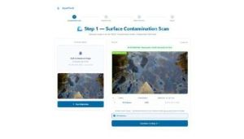
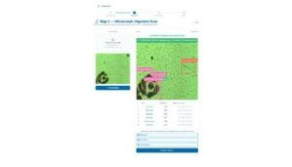
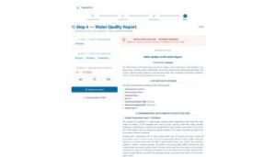
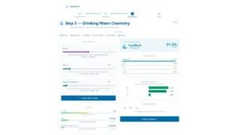
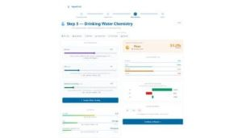
Automated Water Quality & Contamination Detection System
R26-IT-005
2026/08/31

Slide 15
THANK
YOU
ANY QUESTIONS ?

