Slide 1

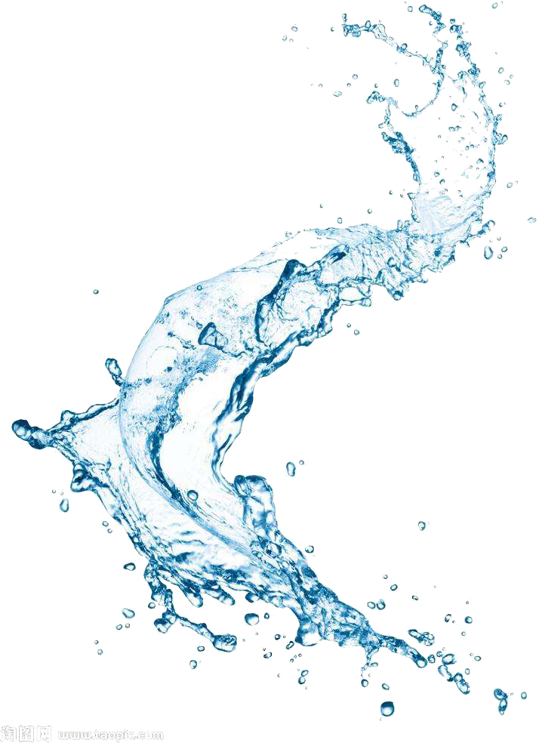


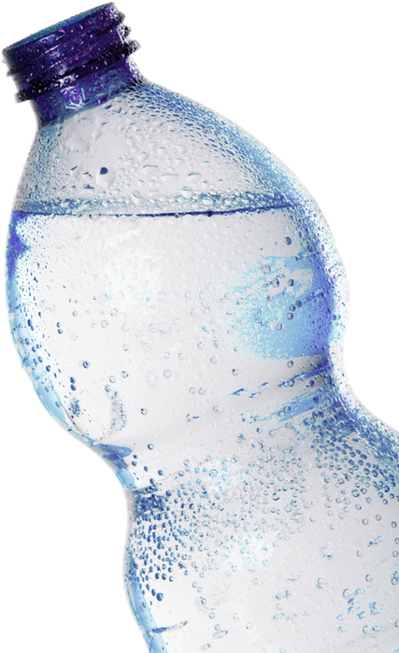


WATER
PURIFICATION
R26-IT-005
Final Presentation
2026/10/19

Slide 2

WATER PURIFICATION
Comments for the PP2 and how you/team addressed them
STUDENT’S NAME & ID | COMMENTS FOR THE PP2 | HOW YOU/TEAM ADDRESSED THEM
R.M.N.A. RATHNAYAKE IT22193940 | Lacks idea on the architecture/models used for report generation. No proper idea on how the component works. Less work done. Needs improvement
W.N.N. DE SILVA IT22211750 | Uses sensor reading as inputs. Better, if demonstrated with both pure/impure water samples. Better, if some sensors can be added, take readings only from pH and a TDS sensor. Needs to have a clear idea on the trained models, why selected, and on what considerations, parameters used, why?
D. DODANWELA IT22212122 | Lacks idea on the trained models. Needs to have a clear idea on why the models have selected, and on what considerations, parameters used, why? Moderate idea on the parameters, and need to use fine-tuning techniques and a model-comparison. Needs to be specific on the water type and bacteria type.
W.A.S.P.D. WIJESINGHA IT22295460 | Needs to have a clear idea on why the models have selected, and on what considerations, parameters used, why? Moderate idea on the trained models, parameters, and need to use fine-tuning techniques and a model-comparison.
R26-IT-005
2026/05/11

Slide 3
WATER PURIFICATION
WATER PURIFICATION
PROBLEM
  Water-quality findings from images, laboratory measurements and microscopy are often analysed separately, making overall interpretation difficult.
  Detection results alone do not explain which purification method is appropriate.
  Users need an integrated system that combines these findings into clear, evidence-based reports and purification guidance while communicating uncertainty.
DESIGN EXCELLENCE
  Integrates all four components in one system.
  Provides source-backed purification guidance using RAG.
  Checks conflicting evidence and calculation accuracy.
  Communicates uncertainty through clear reports.
  Supports independent updates through modular design.
R26-IT-005
2026/10/19

Slide 4

IT22295460 | W.A.S.P.D. WIJESINGHA
Contamination Detection using Computer Vision
Uses deep-learning object detectors, such as YOLO or Faster R-CNN, to identify and locate visible contamination in water photographs. Outputs include bounding boxes, predicted contamination types, confidence scores and visual-severity estimates.
IT22295460 | W.A.S.P.D. WIJESINGHA | R26-IT-005
2026/10/18

Slide 5

IT22212122 | D. DODANWELA
Microorganism Detection using Microscopy
Analyses microscope images to locate bacteria and other microorganisms. It provides bounding boxes and predicted genus or species labels where the imagery and reference data support identification, while flagging uncertain findings.
IT22212122 | D. DODANWELA | R26-IT-005
2026/10/19

Slide 6
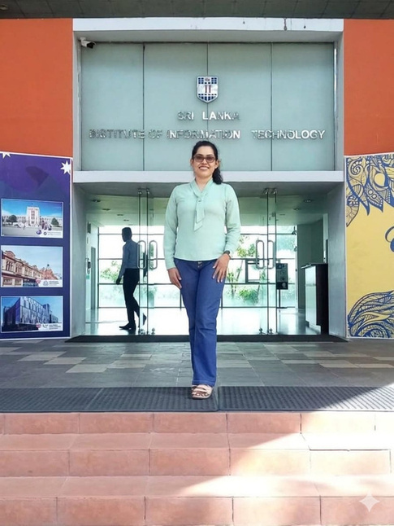
IT22211750 | DE SILVA W.N.N.
Water Quality Classification using Machine Learning
Applies machine-learning models, such as Random Forest or Gradient Boosting, to measured parameters including pH, hardness, turbidity, TDS and fluoride. It produces a water-quality category and parameter-level flags indicating potential concerns.
IT22211750 | DE SILVA W.N.N | R26-IT-005
2026/10/19

Slide 7

IT22193940 | R.M.N.A.RATHNAYAKE
Water Safety Report and Purification Advisor using GenAI and RAG
Combines outputs from the other three components into an understandable report. GenAI with RAG retrieves reference information to explain findings and support purification guidance, while validation rules and deterministic calculations address missing evidence, conflicting results and recommendation suitability.
IT22193940 | R.M.N.A. RATHNAYAKE | R26-IT-005
2026/10/19

Slide 8
WATER PURIFICATION
Results
  The proposed system combines three water-analysis components with automated reporting and purification guidance.
  Detection accuracy, classification performance and report reliability require validation; no confirmed results have been provided.
User Acceptance
  Evaluate ease of use, report clarity, usefulness and trust through user feedback.
  Obtain expert reviews of recommendation suitability. Acceptance findings are not yet available.
Limitations
  Performance depends on dataset quality, image clarity and measurement accuracy.
  Visual and microscopy predictions cannot independently confirm drinking-water safety.
  RAG guidance depends on reference quality and sufficient sample evidence.
  Real-world validation and expert oversight remain necessary.
R26-IT-005
2026/10/19

Slide 9
THANK
YOU
ANY QUESTIONS ?

