Slide 1

UE23CS341A – Command-line based Inventory Management
Project ID : P_59
Team Name : IDEA FORGE
TEAM MEMBERS:
RANJITA HARAVI - PES1UG23CS473
SHESHGIRI S - PES1UG24CS832
SHRUTHANA J - PES1UG24CS832
SONU R - PES1UG24CS832

Slide 2
Outline
Summary
Links for all documents
Jira and sprint management
Git and scrum
Code quality
Continuous testing
Working Software Screenshots

Slide 3
Summary
This project is a simple command-line tool that helps small businesses manage their stock. It allows users to add items, update quantities, check available stock, process customer orders, and store supplier details. The system reduces manual errors, keeps records organized, and makes inventory tracking faster and easier. It is lightweight, easy to use, and works efficiently without needing any complex software or graphical interface

Slide 4
LINKS
SRS Document: https://github.com/pestechnology/PESU_RR_CSE_H_P59_Command_line_based_Inventory_Management_Idea-Forge/blob/main/docs/IdeaForge-SRS.docx
Test Plan Document:
https://github.com/pestechnology/PESU_RR_CSE_H_P59_Command_line_based_Inventory_Management_Idea-Forge/blob/main/docs/Software_Test_Plan_IMS.docx
System Design Document: https://github.com/pestechnology/PESU_RR_CSE_H_P59_Command_line_based_Inventory_Management_Idea-Forge/blob/main/docs/IdeaForge_SAD.docx
JIRA Link: https://shruthana-j-2024-batch-cse-pes-university.atlassian.net/jira/software/projects/INV/summary
REPO Link: https://github.com/pestechnology/PESU_RR_CSE_H_P59_Command_line_based_Inventory_Management_Idea-Forge
Retrspective Document: https://github.com/pestechnology/PESU_RR_CSE_H_P59_Command_line_based_Inventory_Management_Idea-Forge/blob/main/docs/Retrospective.docx

Slide 5
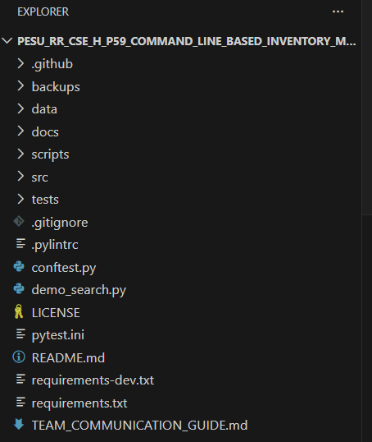
Folder Structure

Slide 6
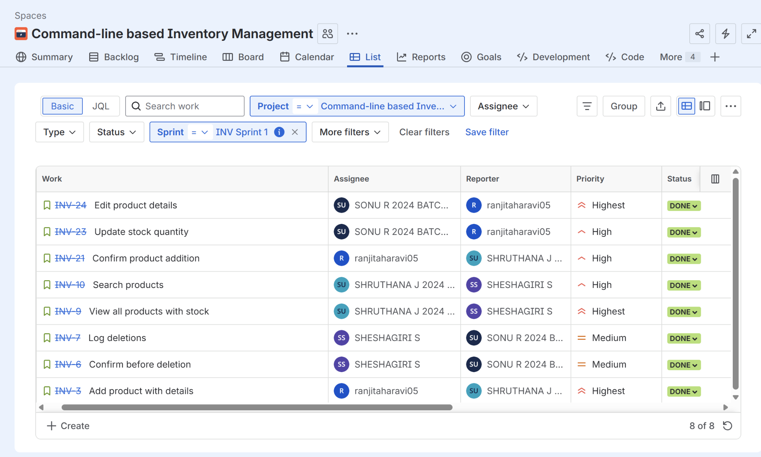
SPRINT 1

Slide 7
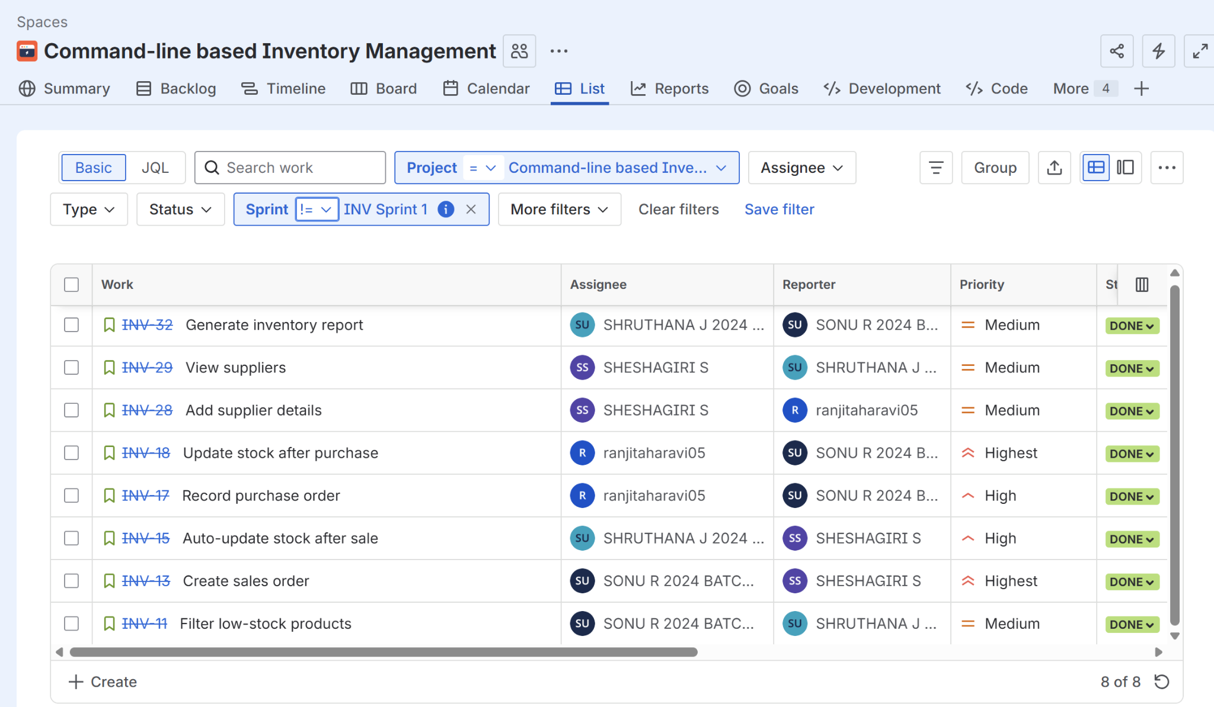
SPRINT 2

Slide 8
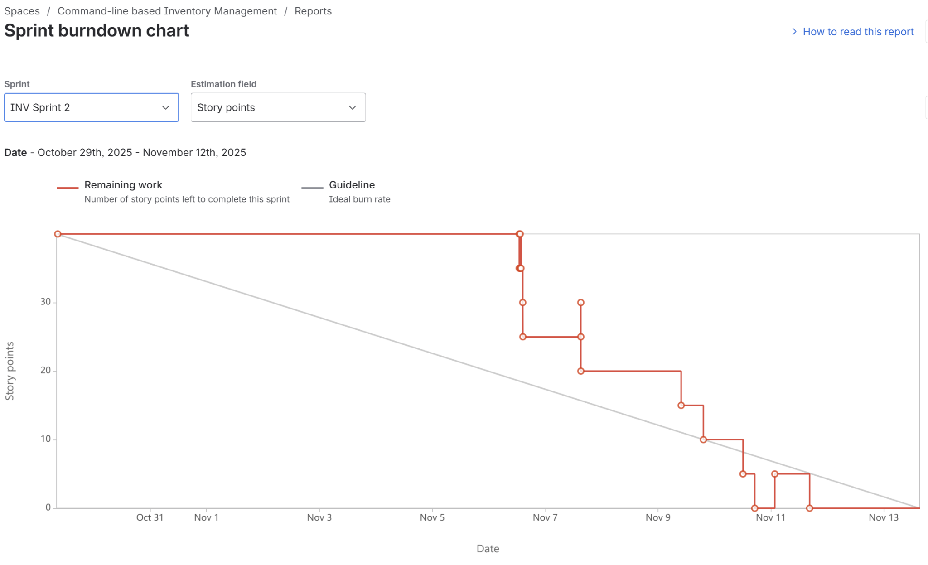
SPRINT 2 BURNDOWN CHART

Slide 9
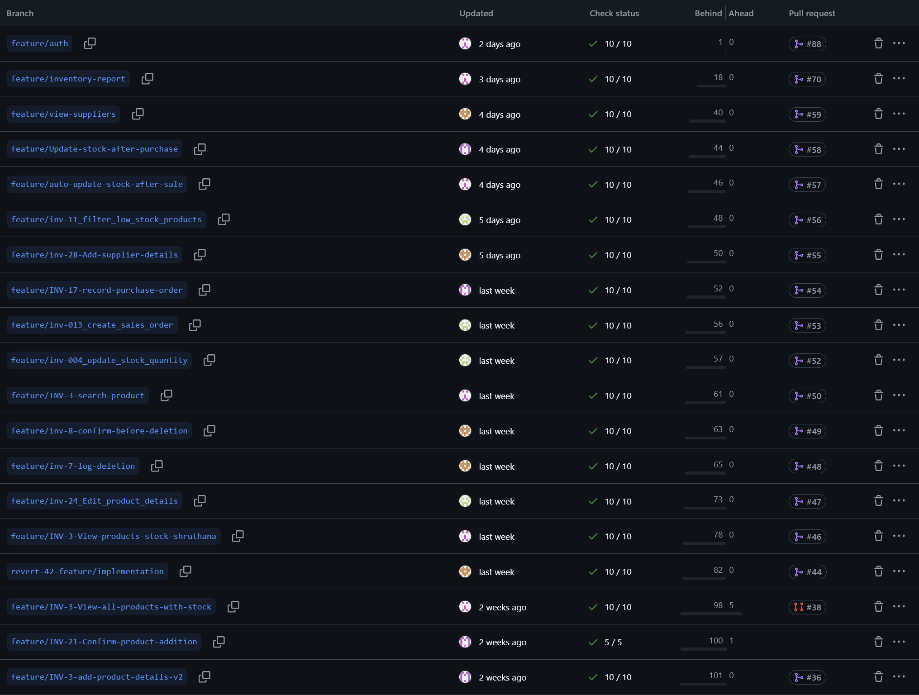
Git and Scrum
Branching:We have created branches according to each user stories

Slide 10
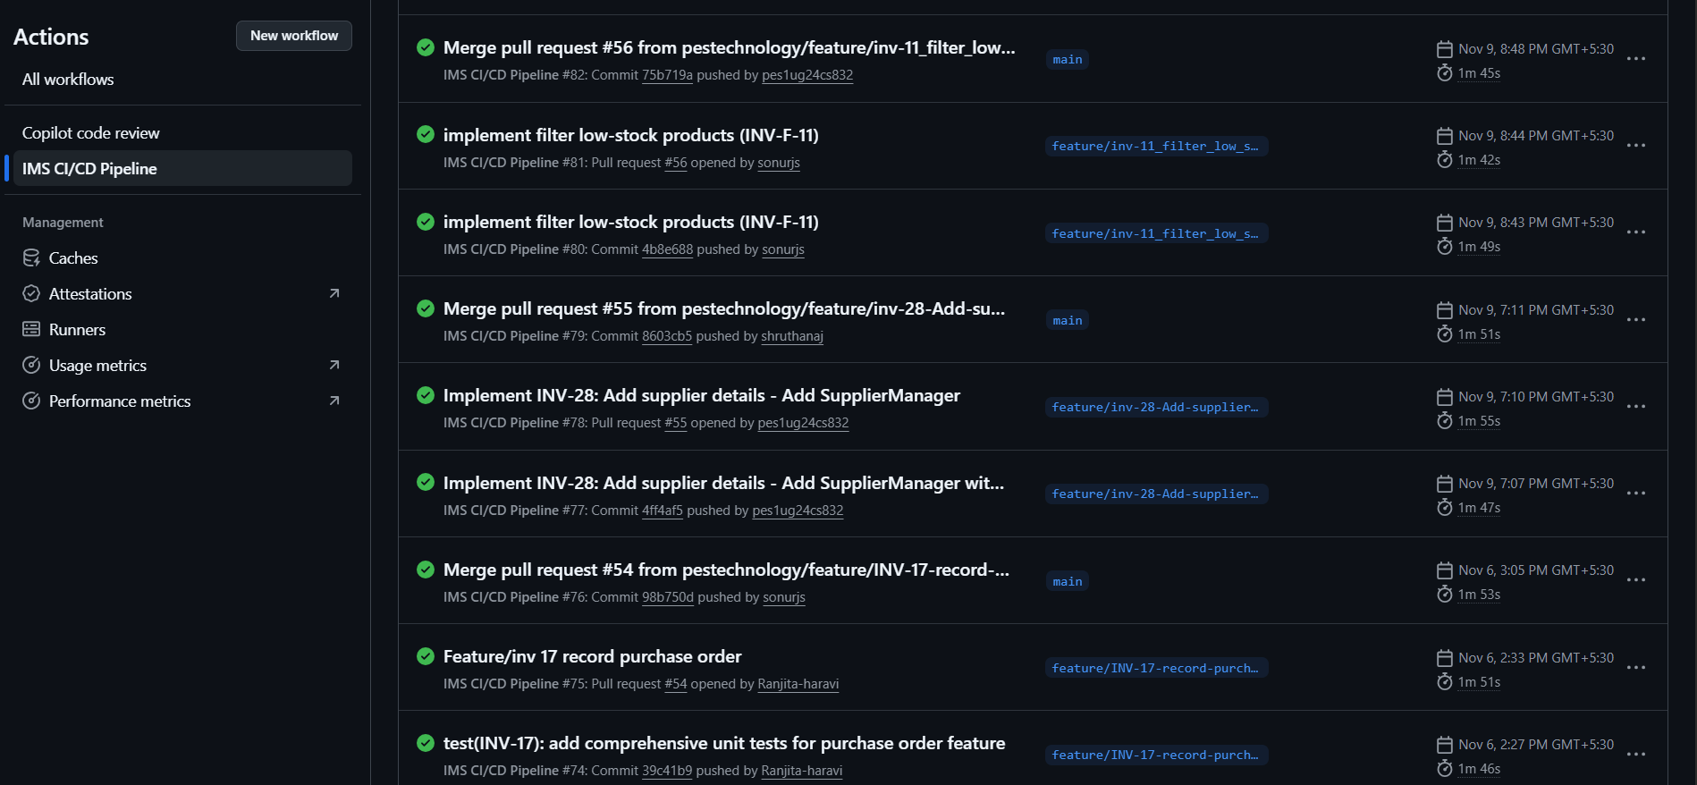
Code Quality
Github actions:

Slide 11
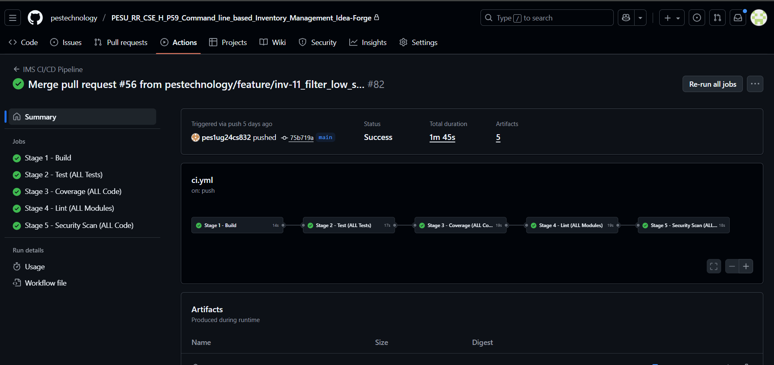
Code Quality
CI/CD PIPELINE

Slide 12
Continuous testing
Testing method | Created | Passed | Failed
Unit Testing: | 296 | 296 | 0
Integration Testing: | 34 | 34 | 0
System Testing: | 1 | 1 | 0
Summary: Total Tests Created: 331,Total Tests Passed: 331,Total Tests Failed: 0

Slide 13
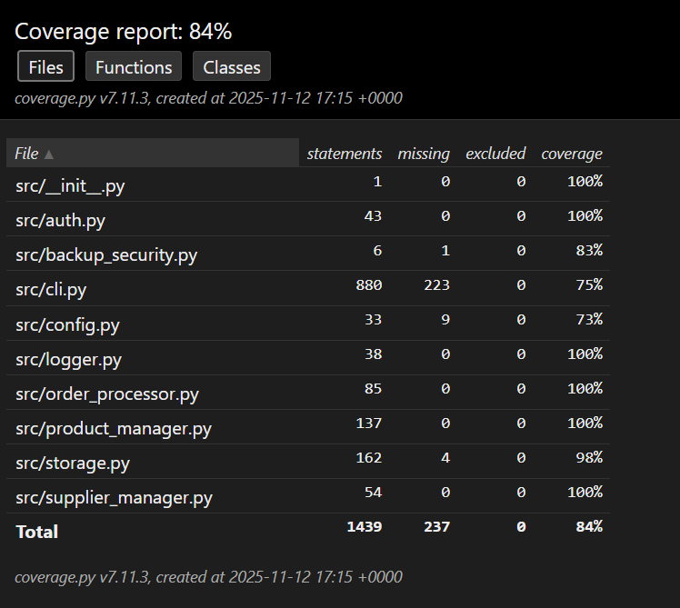
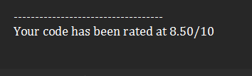
Code Coverage Report

Slide 14
REQUIREMENTS TRACEABILITY MATRIX SAMPLE
User Story | Description | Use Case | Test Cases | Commit
INV-3 | Add New Product | UC-002 | TC-PM-01/02/03 | 39396a3
INV-9 | View All Products | UC-008 | TC-PM-04/11/12 | 8a60507
INV-10 | Search Product | UC-008 | TC-PM-05/06 | 0b8ea8e
INV-13 | Create Sales Order | UC-012 | TC-OP-01/03/04 | 2af2b7f
INV-18 | Update After Purch | UC-016 | TC-OP-06/07/09 | f47b0aa
INV-17 | Record Purchase | UC-016 | TC-OP-06/09 | 39c41b9
INV-24 | Edit Product | UC-022 | TC-PM-07/08 | 17fd09c
INV-23 | Update Stock Qty | UC-022 | TC-OP-01, TC-PM-08 | 85e2697
INV-29 | View Supplier | UC-027 | TC-SM-03/04 | 5f2ef3f
INV-28 | Add Supplier | UC-027 | TC-SM-01/02 | 4ff4af5
INV-32 | Generate Report | UC-031 | TC-INT-01/03/05 | 6be4125

Slide 15
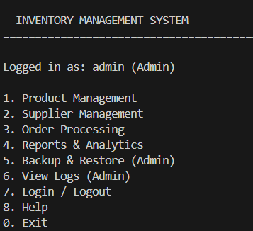
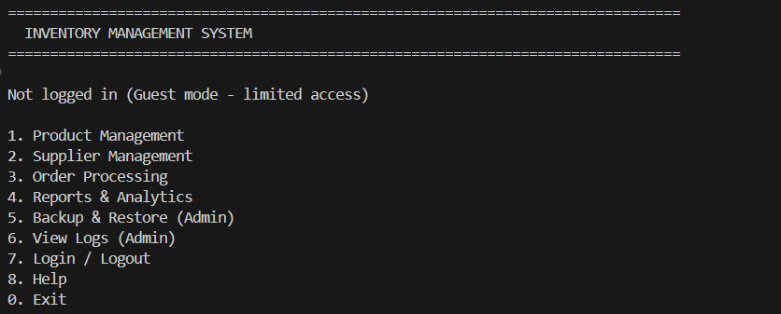
Screenshots of working software:

Slide 16
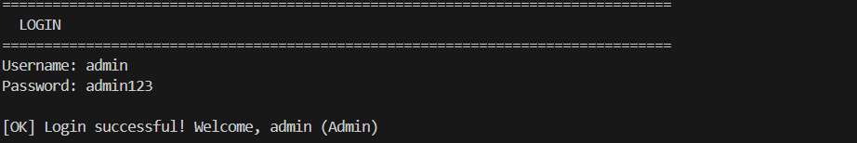

Screenshots of working software:

Slide 17
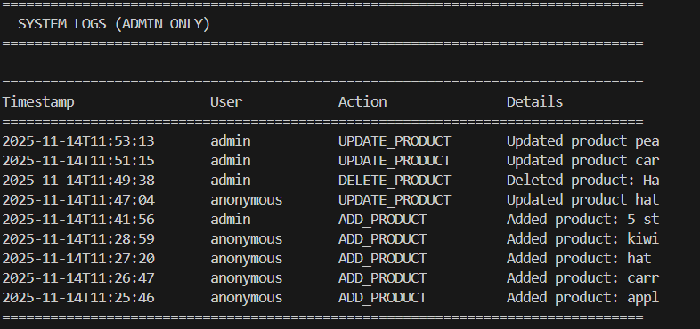
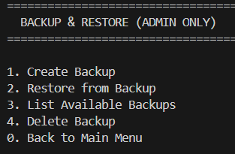
Screenshots of working software:

Slide 18
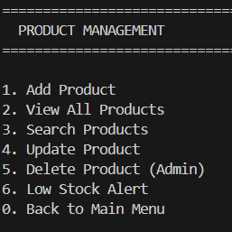
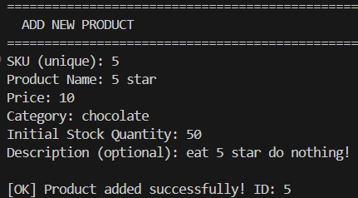
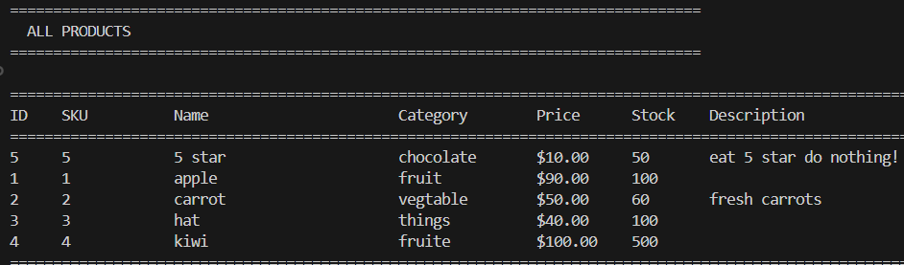
Screenshots of working software:

Slide 19
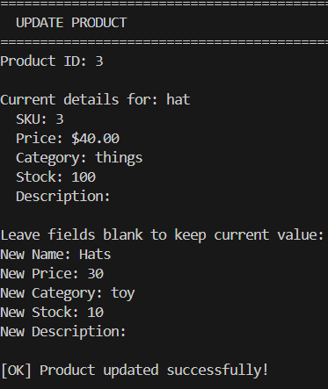
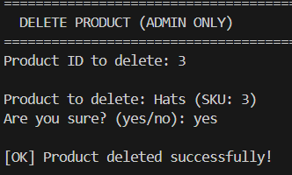
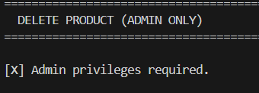
Screenshots of working software:

Slide 20
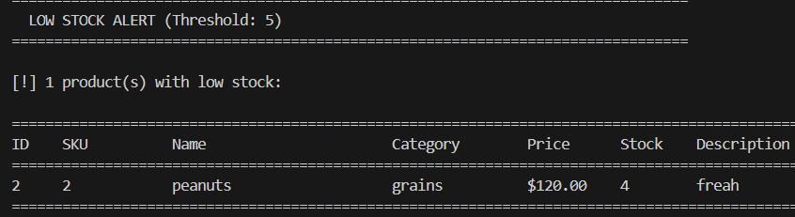
Screenshots of working software:

Slide 21
Thank You

