Slide 1
Apache Kafka
Sheshank Gujjari

Slide 2
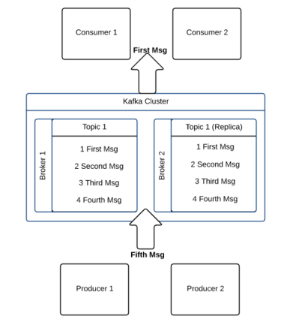
Apache Kafka Architecture
A producer is process that can publish a message to a topic.
A consumer is a process that can subscribe to one or more topics
and consume messages published to topics.
A topic category is the name of the feed to which messages are
published.
A broker is a process running on single machine.
A cluster is a group of brokers working together.

Slide 3
Apache kafka use cases
Messaging
Message brokers are used for a variety of reasons (to decouple processing from data producers, to buffer unprocessed messages, etc). In comparison to most messaging systems Kafka has better throughput, built-in partitioning, replication, and fault-tolerance which makes it a good solution for large scale message processing applications.
Website Activity Tracking
Kafka was to be able to rebuild a user activity tracking pipeline as a set of real-time publish-subscribe feeds. This means site activity (page views, searches, or other actions users may take) is published to central topics with one topic per activity type

Slide 4
Apache kafka use cases continued…
Metrics
Kafka is often used for operational monitoring data. This involves aggregating statistics from distributed applications to produce centralized feeds of operational data.
Log Aggregation
Log aggregation typically collects physical log files off
servers and puts them in a central place
(a file server or HDFS perhaps) for processing.
Kafka abstracts away the details of files and
gives a cleaner abstraction of log or event data as a
stream of messages. This allows for lower-latency
processing and easier support for multiple data
sources and distributed data consumption

Slide 5
Apache kafka use cases continued..
Stream Processing
Easily exploit a limited form of parallel processing.
Event Sourcing
State changes are logged as a time-ordered sequence of records. Kafka's support for very large stored log data makes it an excellent backend for an application built in this style.
Commit Log
Kafka can serve as a kind of external commit-log for a distributed system

Slide 6

Steps to run the Apache Kafka and Zookeeper
Download Apache Kafka
http://kafka.apache.org/downloads.html
Extract the binaries to your workspace
Change your directory to the extracted folder
Execute the following command to run the zookeeper server as shown in the screen shot
bin/zookeeper-server-start.sh config/zookeeper.properties

Slide 7
Steps to run the Apache Kafka and Zookeeper continued…..
Now we need to run the kafka server in the new terminal window
bin/kafka-server-start.sh config/server.properties
7. As Zookeeper and Kafka servers are running we need to create a topic to publish and subscribe the messages. “test” topic is created.
bin/kafka-topics.sh --create --zookeeper localhost:2181 --replication-factor 1 --partitions 1 - -topic test

Slide 8
Steps to run the Apache Kafka and Zookeeper continued…..
8. To retrieve list of topics from the server use the following command
bin/kafka-topics.sh --list --zookeeper localhost:2181
Now publish messages to the server. You can send multiple messages as well.
bin/kafka-console-producer.sh --broker-list localhost:9092 --topic test

Slide 9
Steps to run the Apache Kafka and Zookeeper continued…..
10 . Consume the messages which you have published earlier
bin/kafka-console-consumer.sh --bootstrap-server localhost:9092 --topic test --from-beginning

