Slide 1
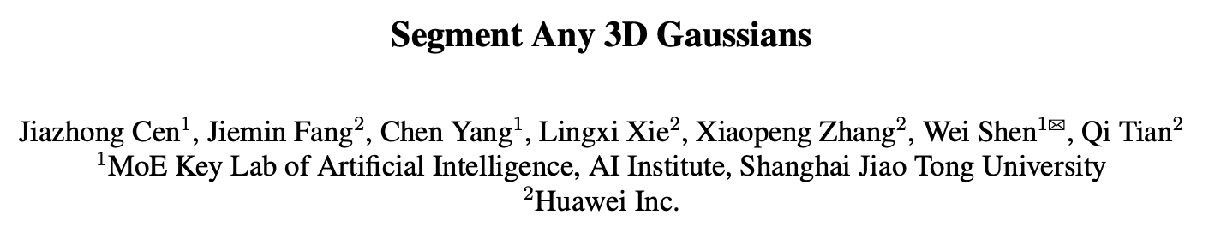
Citations: 7
Source: https://arxiv.org/pdf/2312.00860.pdf

Slide 2
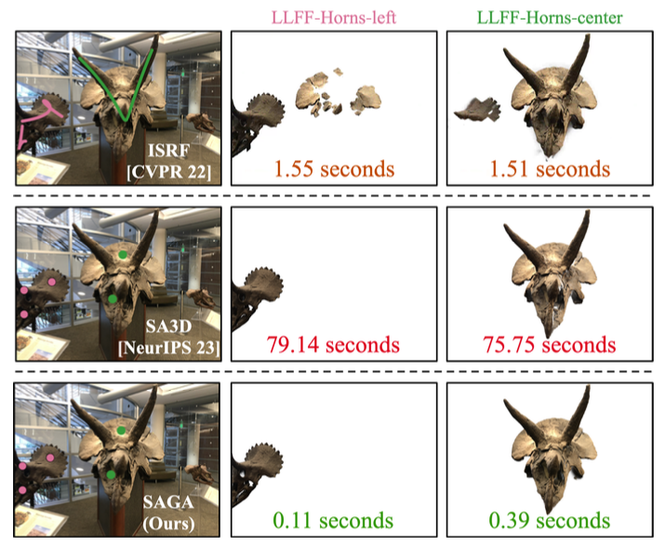

Slide 3
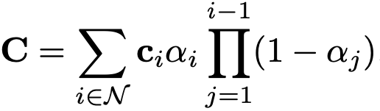



Preliminaries
3D Gaussians Splatting (3DGS)
multi-view 2D images + camera poses
color
Segment Anything Model (SAM)
2D segmentation mask
image
set of prompts

Slide 4
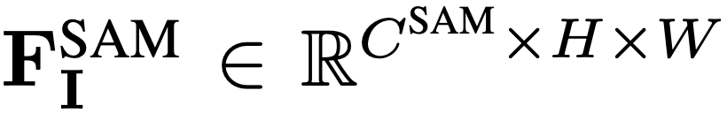



Overall Pipeline
SAM encoder
SAM-guidance loss
point-wise correspondences
Correspondence loss
distills into features

Slide 5
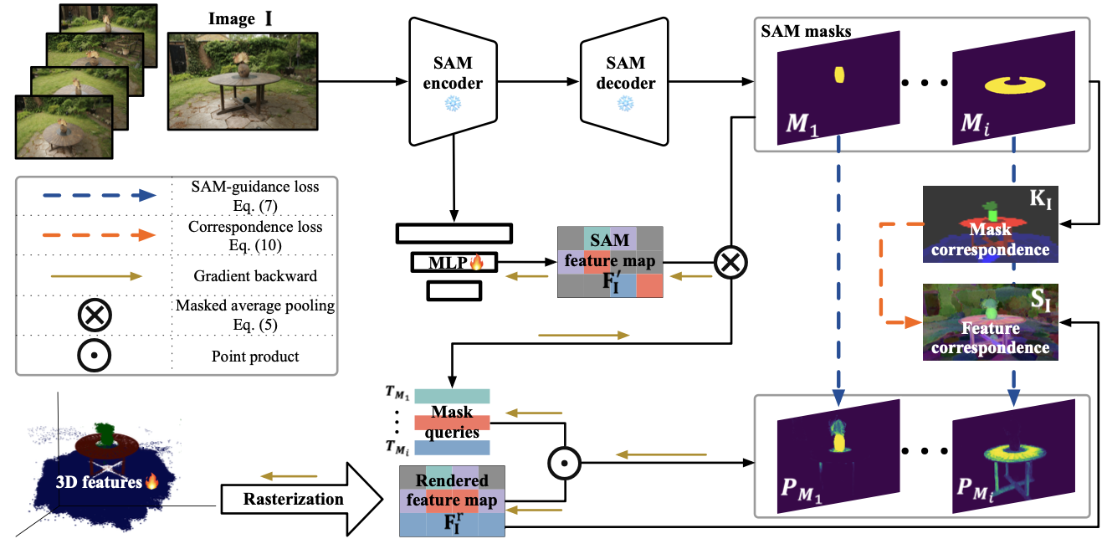

Slide 6
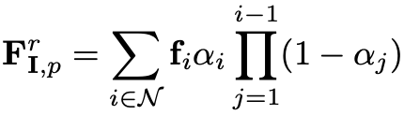
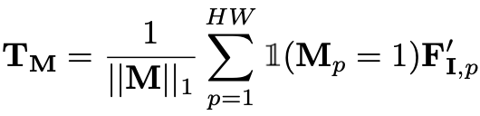

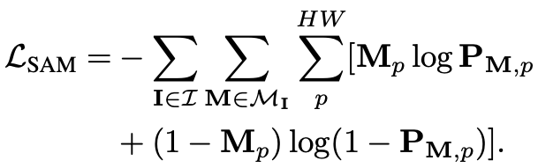

Training Features for Gaussians
Ordered Set of Gaussians
SAM-guidance Loss
MLP
query
indicator function
softmaxed point product
segment
element-wise sigmoid
binary cross entropy
Notes:
Pre-trained
Freeze attributes of 3D Gaussians (mean, covariance, opacity)
low-dimensional space as the 3D features

Slide 7
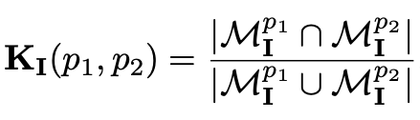

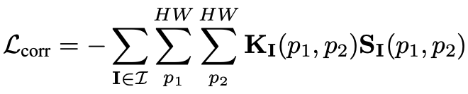

Training Features for Gaussians
Ordered Set of Gaussians
Correspondence Loss
mask correspondence
feature correspondence
Cosine similarity
Notes:
Pre-trained
Freeze attributes of 3D Gaussians (mean, covariance, opacity)

Slide 8
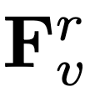
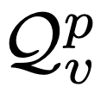
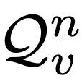
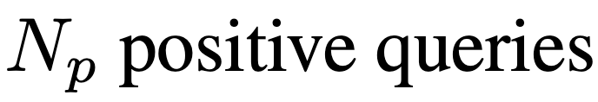
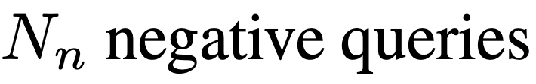
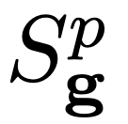
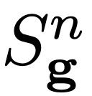
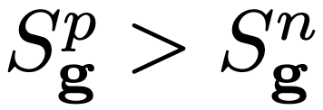
Inference
Point Prompt
rendered feature map
generate queries
=
=
Notes:
3D Gaussian belongs to the target Gt

Slide 9

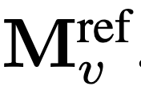







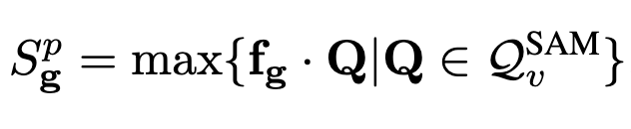


Inference
Mask And Scribble Prompts
K-means
SAM-based Prompts
input prompt → SAM →
(2D Segmentation)
IoU > 90%
else
(
)
or
g ∈ G^{t}
+ve score >
Notes:
Qmask → masked average pooling
Segment(2D rendered feature map)
temporary 2D segmentation

Slide 10
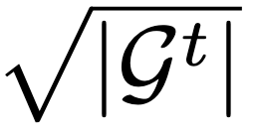

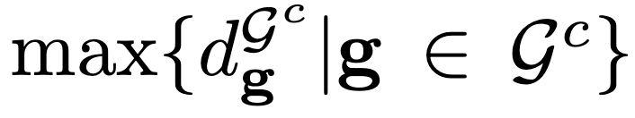
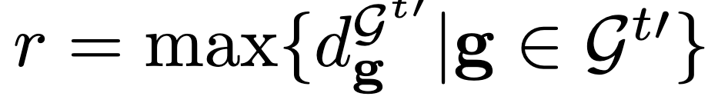
3D Prior Based Post-processing
superfluous noisy Gaussians
omission of certain Gaussians integral to the target object
➔ Point & Scribble → remove noisy Gaussians (Statistical Filtering)
G^{t} → Set of Validated Gaussians → Region Growing Algo
➔ Mask & SAM → 2D mask
G → Exclude Unwanted Gaussians
Statistical Filtering
KNN
K=
remove Gaussians > (μ + σ) (G^{t}). → (G^{t’} )
Region Growing Based Filtering
Distance <
Validated Gaussians
Ball Query Based Growing
Notes:
RGBF → Euclidian
we only apply the region growing based filtering when a mask is available
Ball → not contain all Gaussians belong to the target.

Slide 11
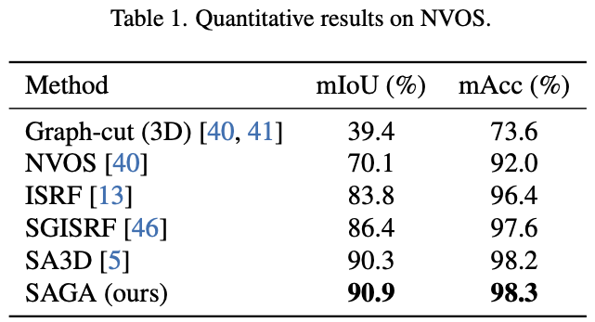
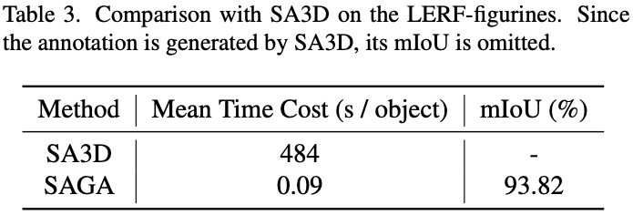
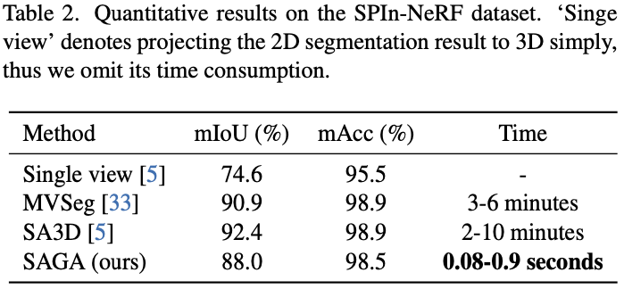

Slide 12
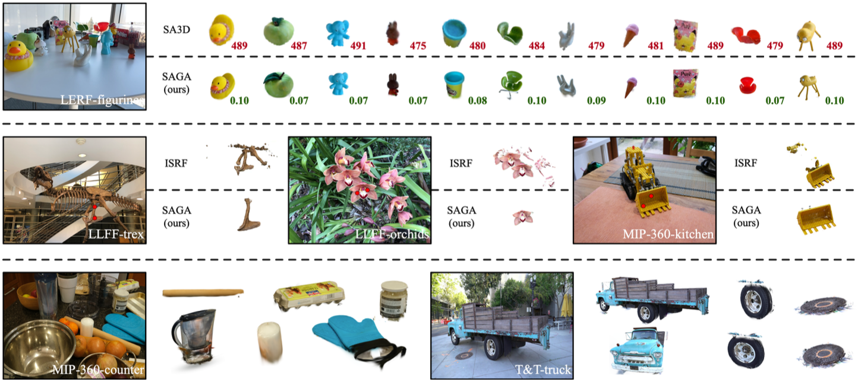
Notes:
Compared with SA3D, SAGA can achieve similar performance within one thousandth of the time. Compared with ISRF, SAGA can distinguish object with similar semantics and realize part segmentation. Furthermore, thanks to the efficient 3D Gaussian representation, the rendering quality of the segmented object is better than previous SOTA SA3D and ISRF.

Slide 13
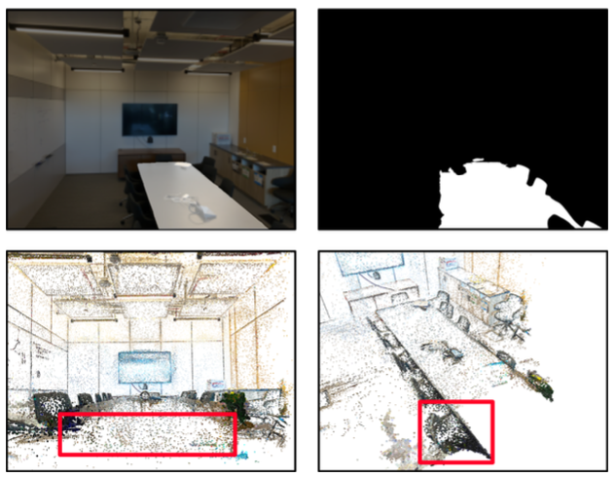
Failure Case

Slide 14
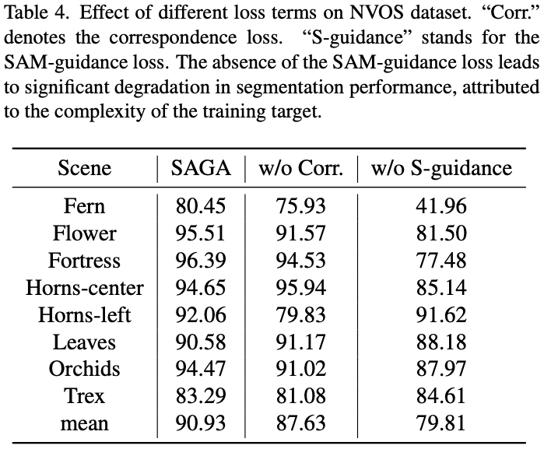
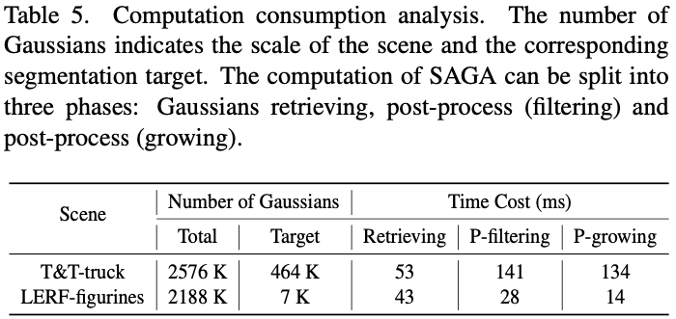

Slide 15
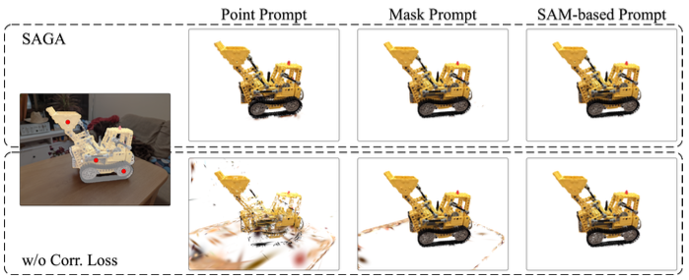
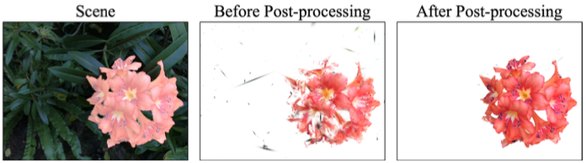

Slide 16
Q&A

