Slide 1
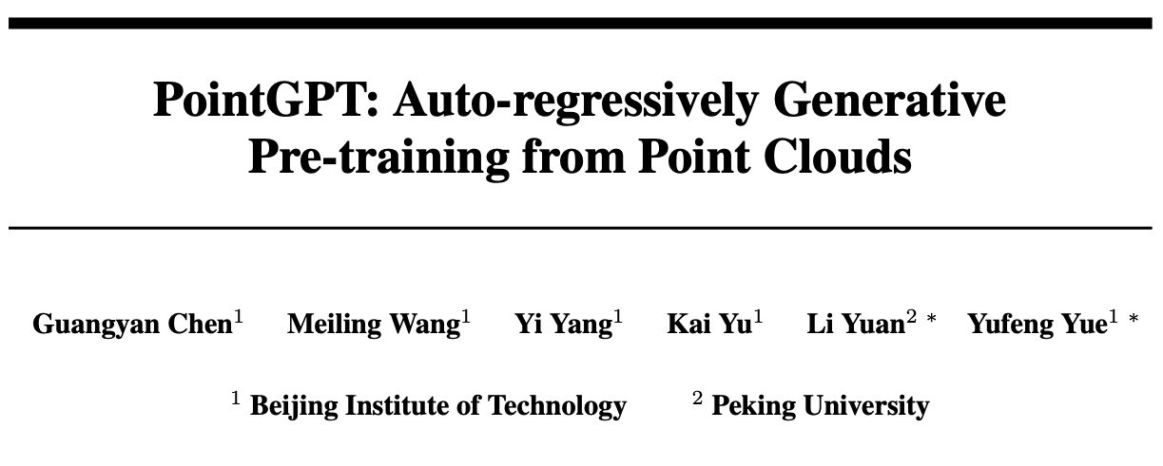
NeurIPs 2024
Citations: 21
Source: https://proceedings.neurips.cc/paper_files/paper/2023/file/5ed5c3c846f684a54975ad7a2525199f-Paper-Conference.pdf

Slide 2
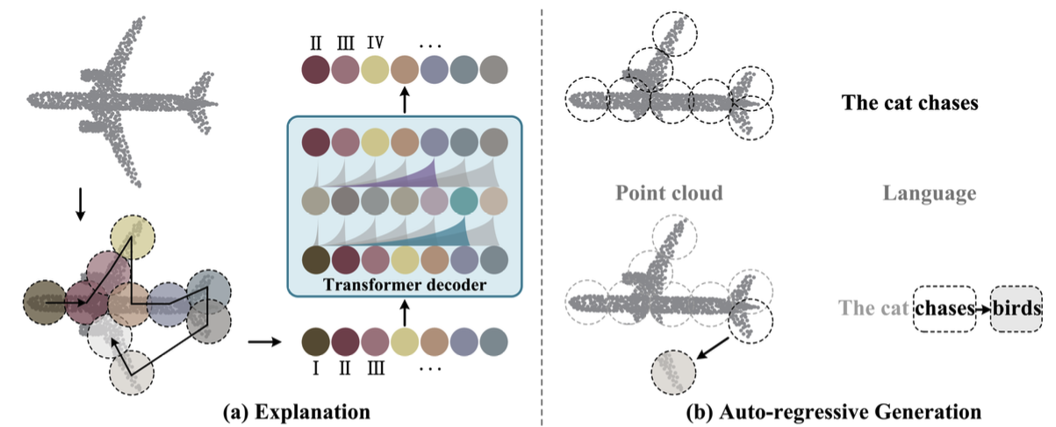
PointGPT
→ employing GPT on point clouds
Disorder properties → Morton order
Information density differences → dual masking strategy
Gaps between generation and downstream tasks → extractor-generator
Notes:
Morton - introduces sequential properties and preserves the local structures.
dual masking strategy - reduces redundancy and provides a challenging task that demands comprehensive understanding
Gaps between generation and downstream tasks → lower semantic level of learned latent reps
rely on positional information → leakage of overall object shape

Slide 3
PointGPT
Point Cloud Sequencer
→ constructs an ordered sequence of point patches.
Point patch partitioning
Sorting
Embedding
Transformer Decoder with a Dual Masking Strategy
Dual masking strategy
Extractor-generator
Prediction head
→learn latent representations
→predict the subsequent point patches
Generation Target
Post-Pre-training
→ downstream tasks

Slide 4
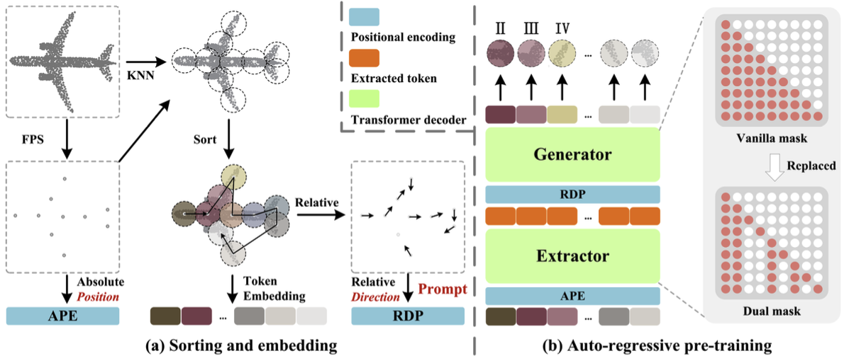
PointGPT

Slide 5

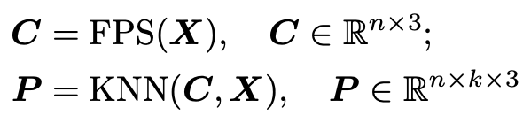

Point Cloud Sequencer
Point patch partitioning
Sorting
Embedding
sorted center points
sorted point patches

Slide 6
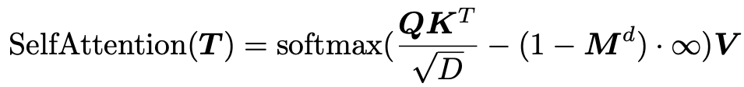
Transformer Decoder with a Dual Masking Strategy
Dual masking strategy
Extractor-generator
location information + global structural information
input tokens
point tokens
relative direction prompts
sorted center points
Prediction head
→ predict the subsequent point patches
2 MLPs, 2 FCs, 1 ReLU
Notes:
utilizing the vanilla transformer decoder to auto-regressively predict point patches + fine-tuning all pre-trained parameters for downstream tasks
Vanilla masking -- receive information from all the preceding point tokens,
DMS -- masks a proportion of the attending preceding tokens of each token during pre-training
unmasked 1, masked 0
T -- each point token only attends to the unmasked preceding tokens.
Extractor – ViT
Phead -- the number of output channels equals the total number of coordinates in a patch

Slide 7

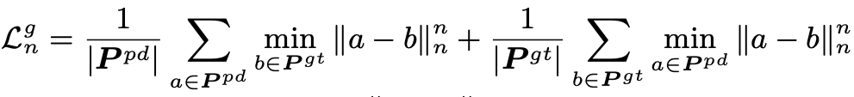


Generation Target
→ predict the coordinates of the points within the subsequent point patches.
predicted
point patches
ground truth
point patches
L_{n} distance
between a and b
Post-Pre-training
SSL methods → fine-tune pre-trained models
potential overfitting ← the limited semantic supervision information
labeled hybrid dataset → incorporate semantic information from multiple sources
Notes:
incorporating the generation task into the fine-tuning process as an auxiliary objective can accelerate training convergence and improve the generalization ability of supervised models.

Slide 8
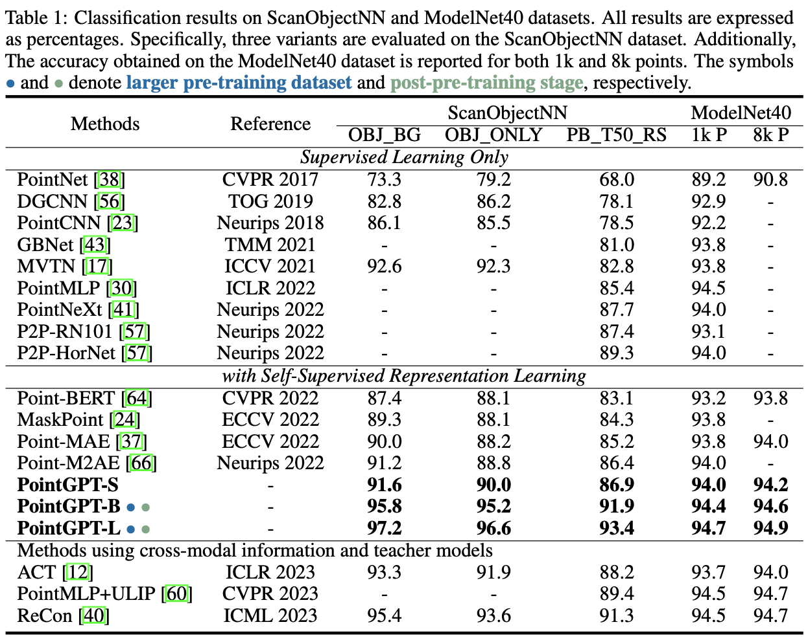
Results
Notes:
pre-trained on the ShapeNet
UHD-300k, LHD-200k, 87 classes

Slide 9
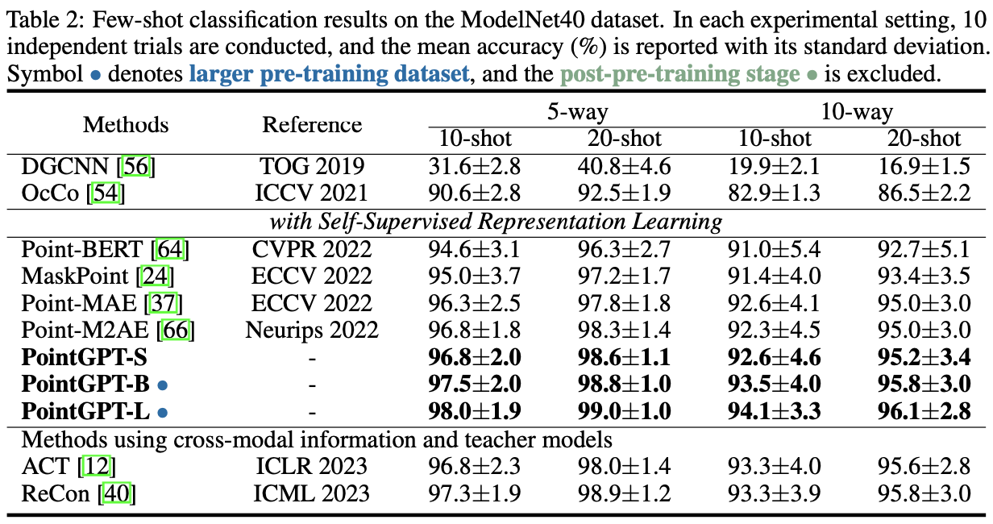
Results

Slide 10
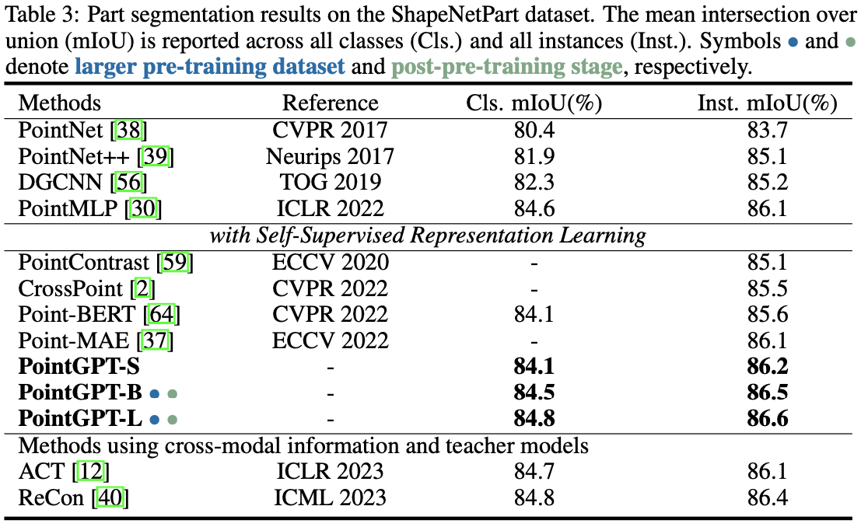
Results

Slide 11
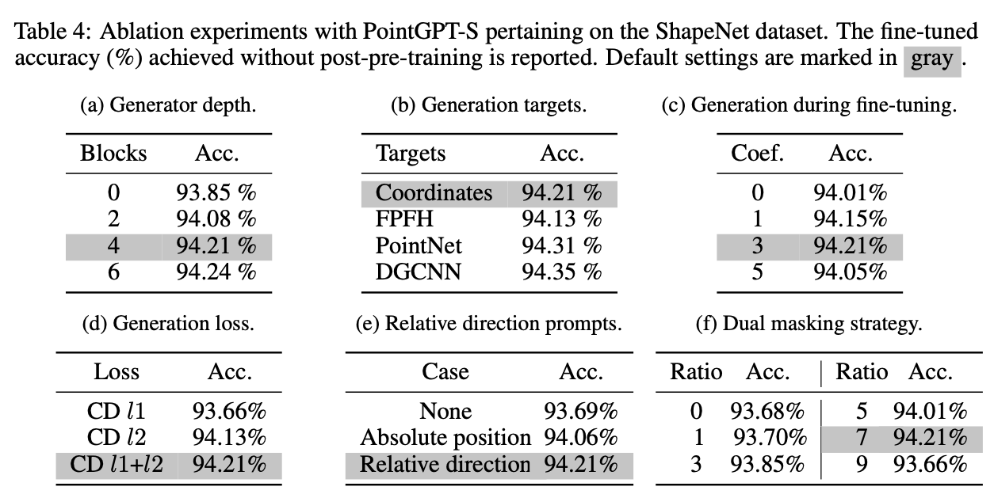
Results

Slide 12
Q&A

