Slide 1
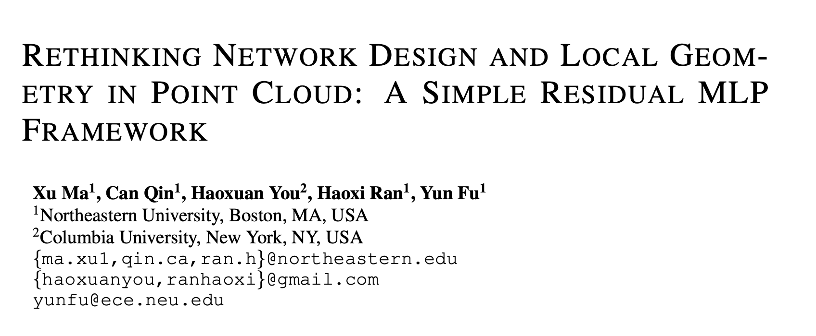
ICLR 2022
Citations: 380

Slide 2
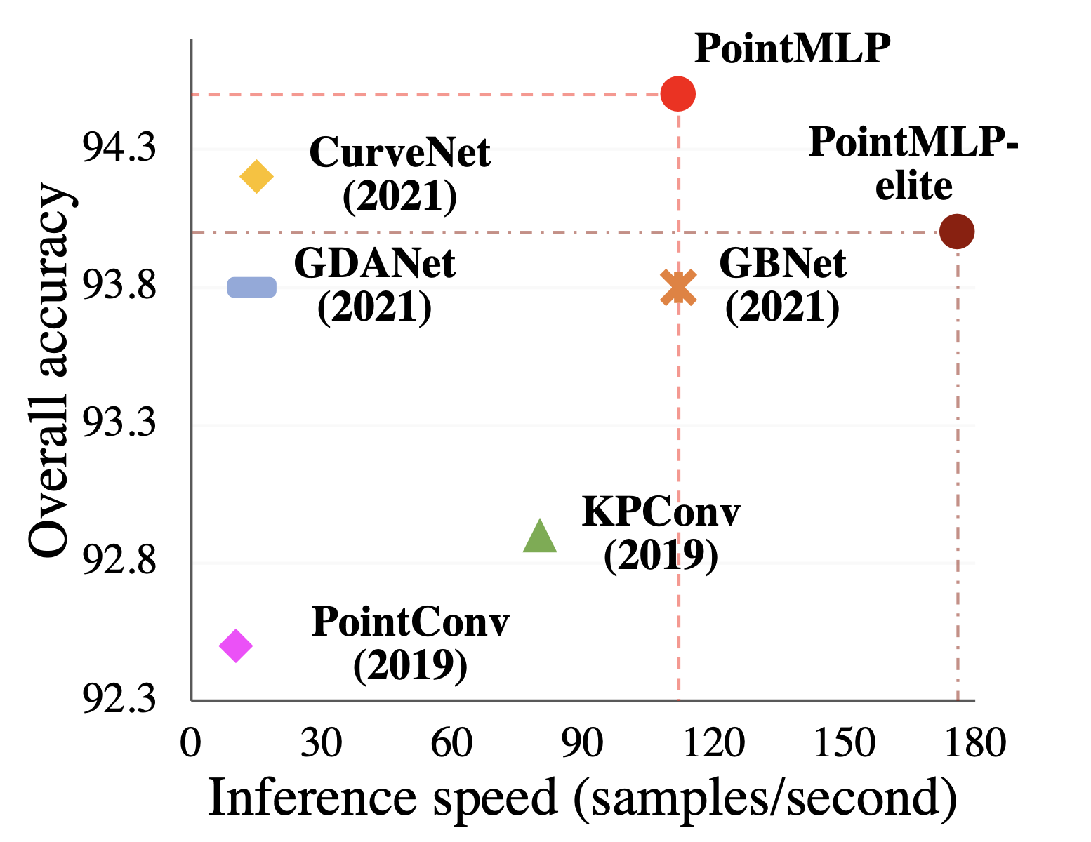

Slide 3
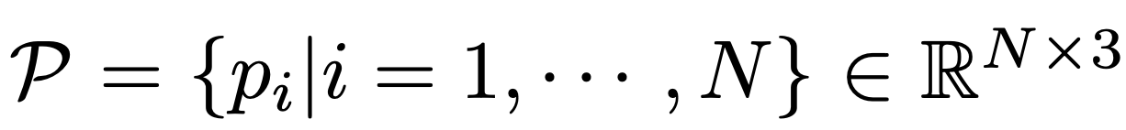
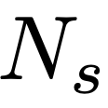
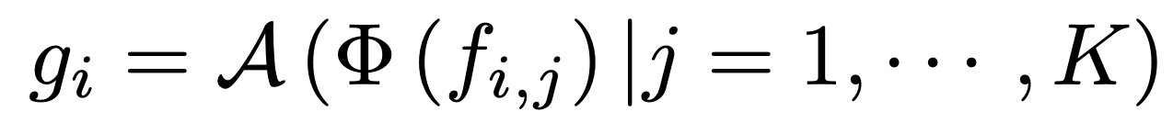
REVISITING POINT-BASED METHODS
f
(x, y, z)
number of points
f_{i,j} is the j^{th} neighbor point feature of i^{th} sampled point
aggregation function
K neighbors
local feature extraction function

Slide 4
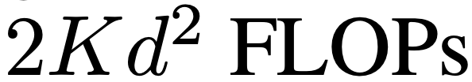
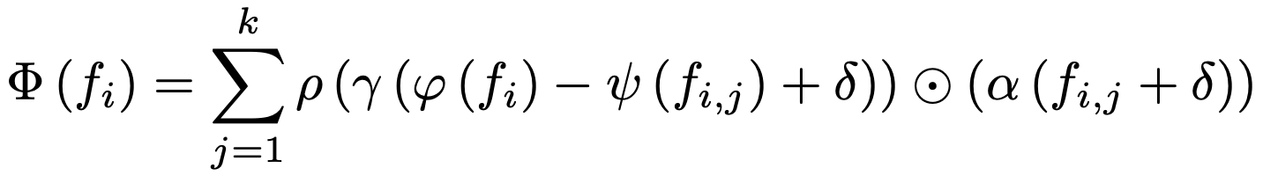
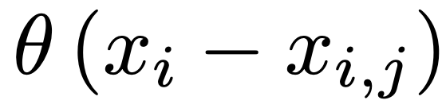
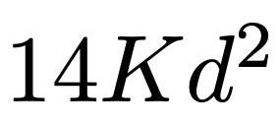
REVISITING POINT-BASED METHODS
RSCNN
small network
(FC,BN,activation)
relative position
anchor point
Euclidian distance
j^{th} neighbor point of i^{th} sampled point
Point Transformer
Hadamard product
relative position encoding
linear mapping function
softmax normalization
computational complexity is largely increased → prohibitive inference latency
performance gain has started to saturate on popular benchmarks
Notes:
PCT- introduces the self-attention mechanism into point cloud analysis and considers the similarities between pair-wise points in a local region.
it re-formulates the extractor

Slide 5
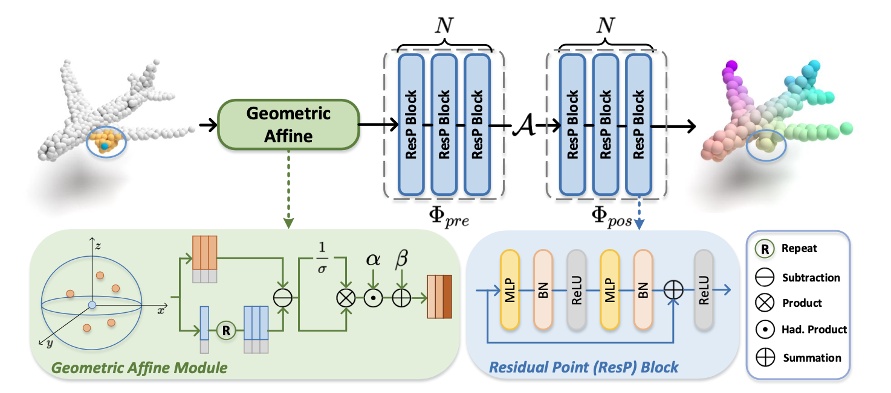
FRAMEWORK OF POINTMLP
residual point MLP blocks
(FC,BN,activation)
extract deep aggregated features
learn shared weights from a local region
Notes:
prominent merits. 1) Since PointMLP only leverages MLPs, it is naturally invariant to permutation, which perfectly fits the characteristic of point cloud. 2) By incorporating residual connections, PointMLP can be easily extended to dozens layers, resulting deep feature representations. 3) In addition, since there is no sophisticated extractors included and the main op- eration is only highly optimized feed-forward MLPs, even we introduce more layers, our PointMLP still performs efficiently.

Slide 6
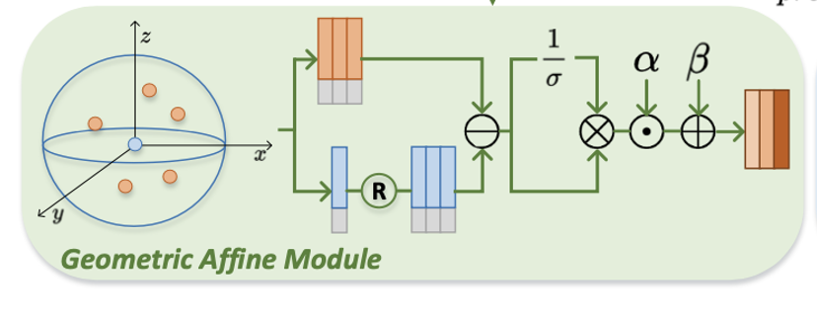
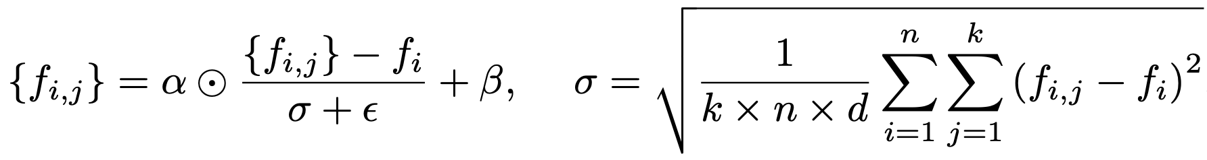
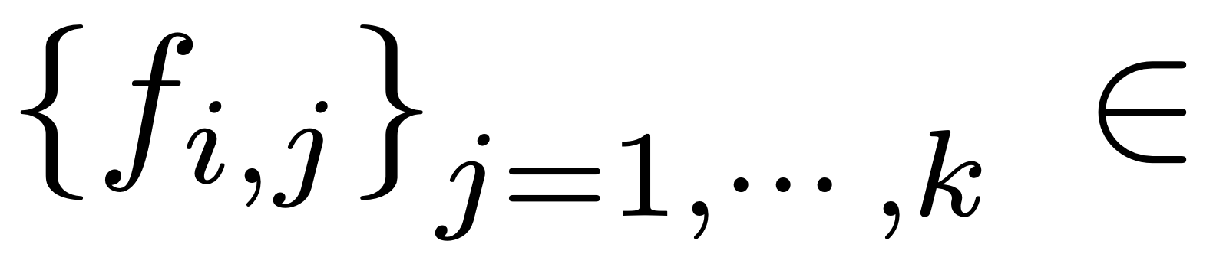

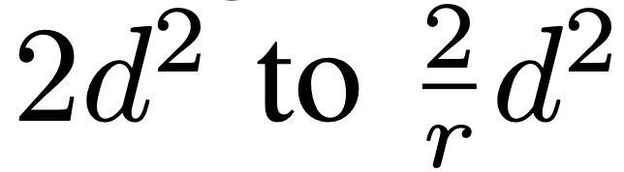

learnable parameters
reduce the channel number of the intermediate FC layer by a factor of r
increase the channel number as the original feature map
PointMLP-elite
Notes:
deep MLP structure will decrease the accuracy and stability, making the model less robust
? sparse and irregular geometric structures in local regions.
σ is a scalar describes the feature deviation across all local groups and channels

Slide 7
Results

Slide 8
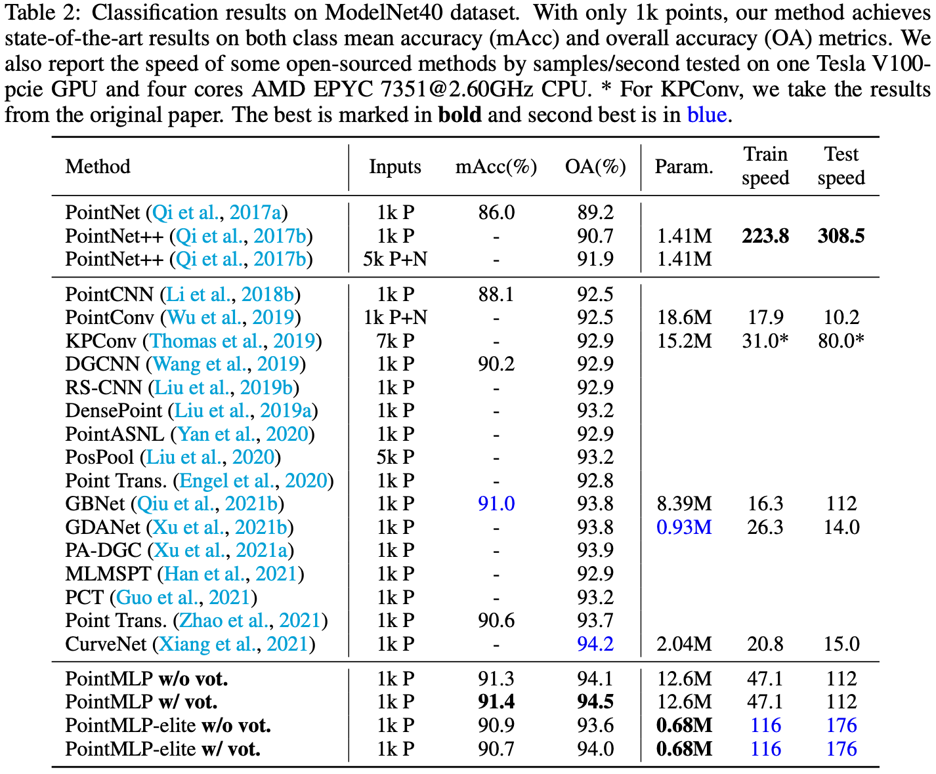

Slide 9
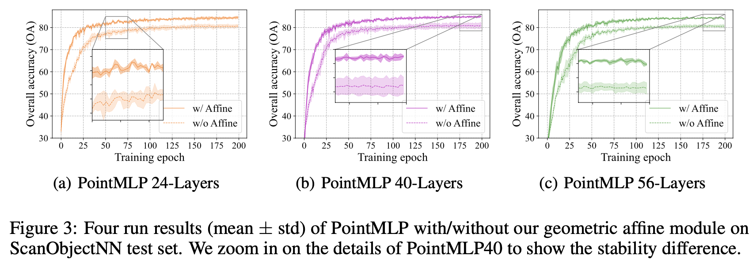

Slide 10
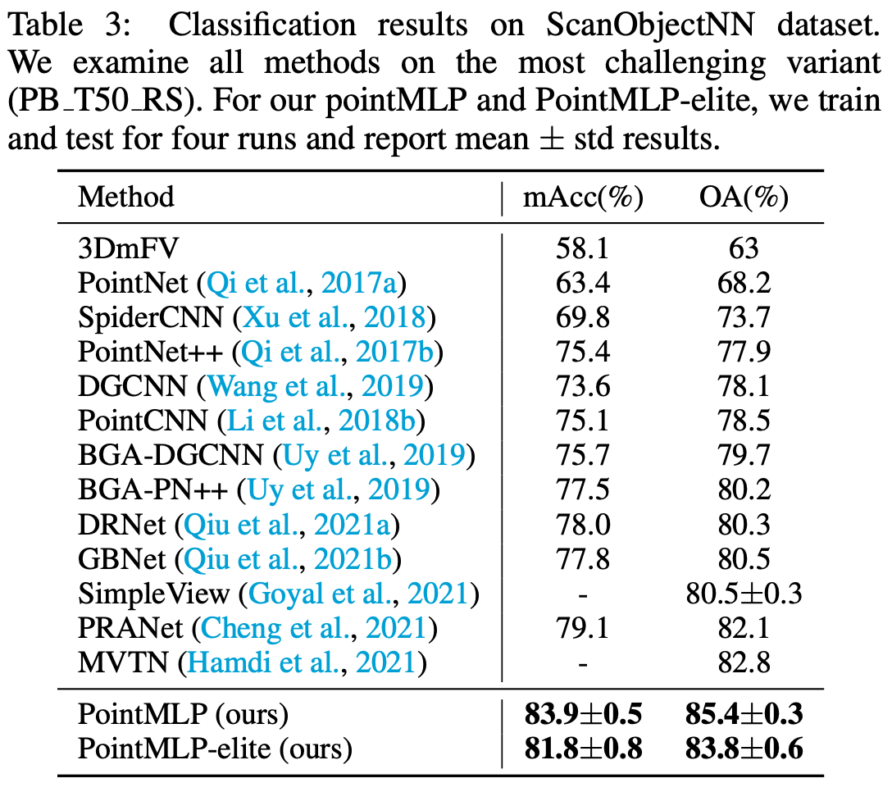

Slide 11
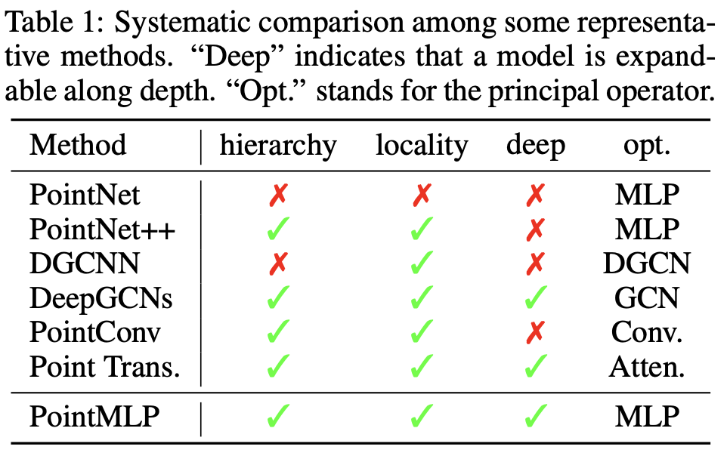

Slide 12
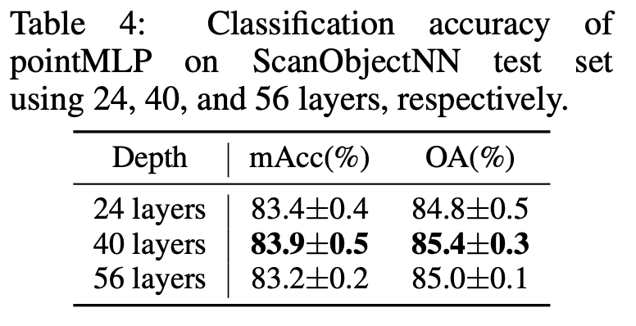
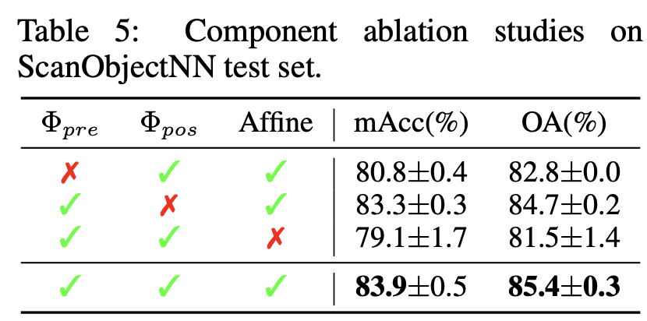

Slide 13
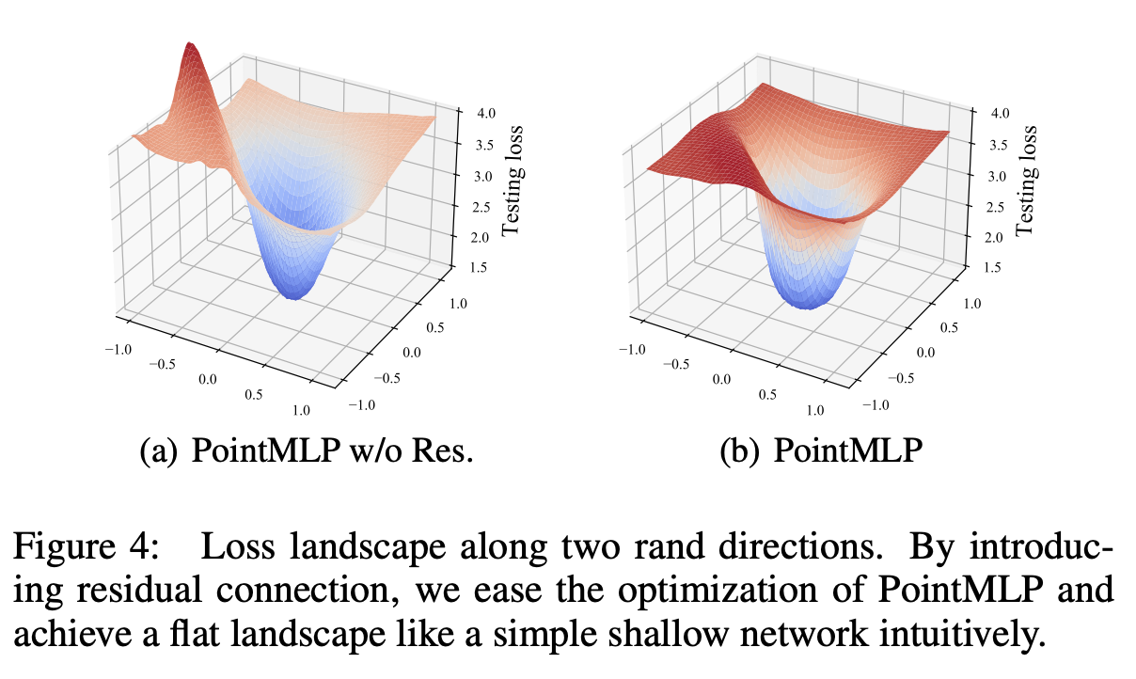

Slide 14
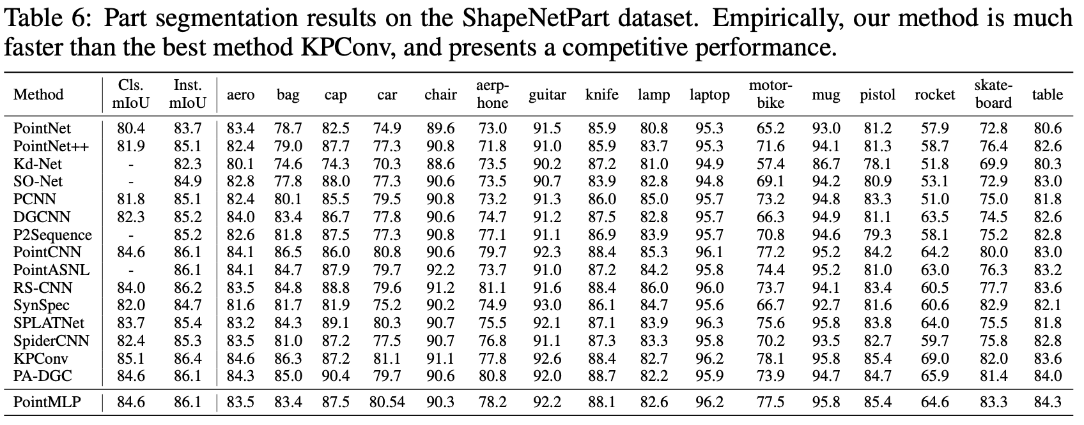
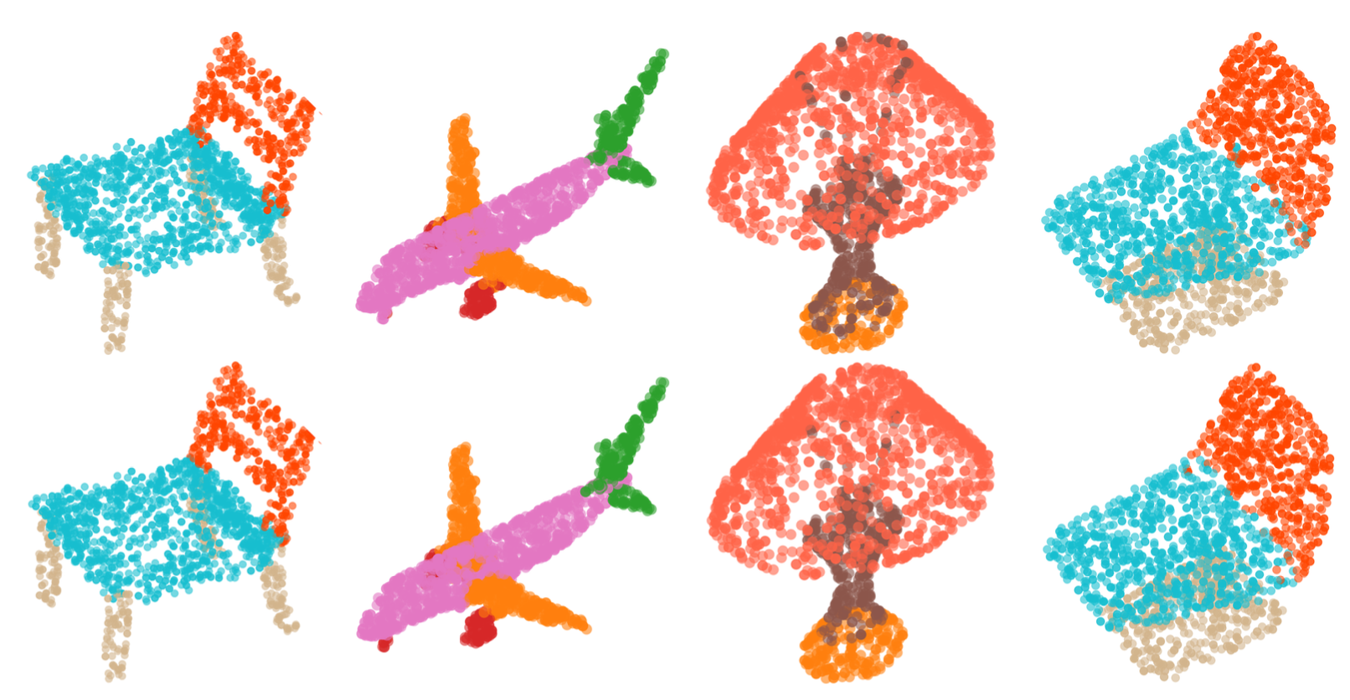

Slide 15
Q&A

