Slide 1
COVID-19 DATA ANALYSIS

Slide 2
OBJECTIVE
To perform data analysis and visualization on Covid-19 data using ETL tools.
To perform data analysis on Covid_19 data and extract the meaningful information from the dataset which will help in taking quick and informed decision.

Slide 3
TECHNOLOGIES USED
AWS Glue
Redshift
AWS S3
SparkSQL
Crawler
AWS Lambda
PySpark

Slide 4
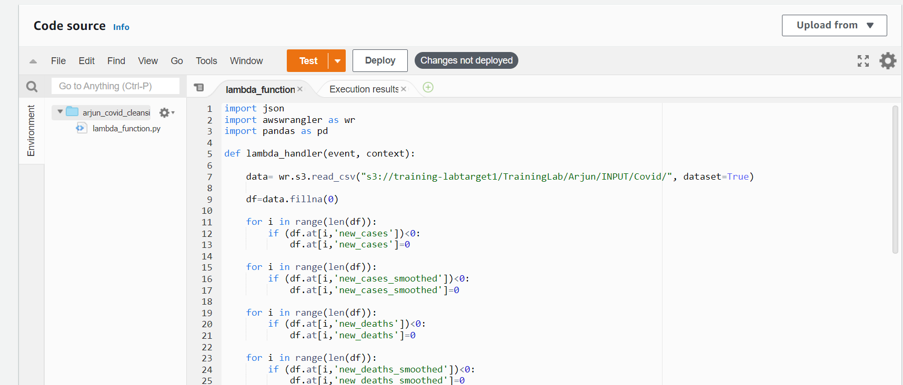
Problem Statements 1.Clean and transform data for processing job name: Arjun_covid_cleansing

Slide 5
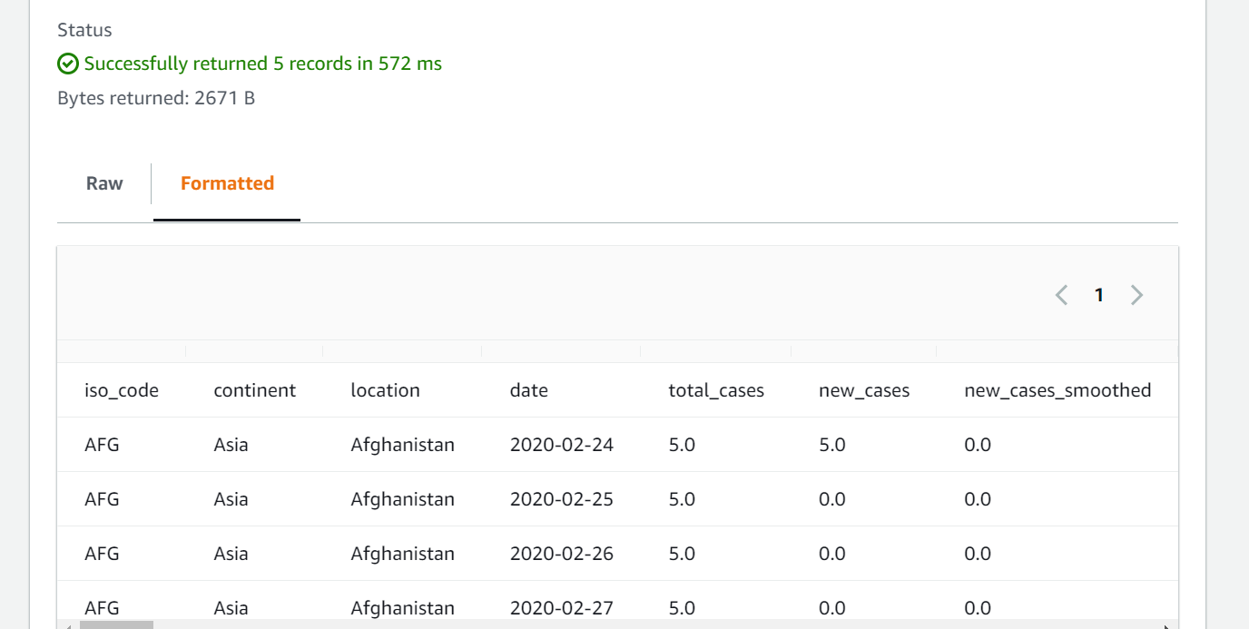
1.Clean and transform data for processing Cont…

Slide 6
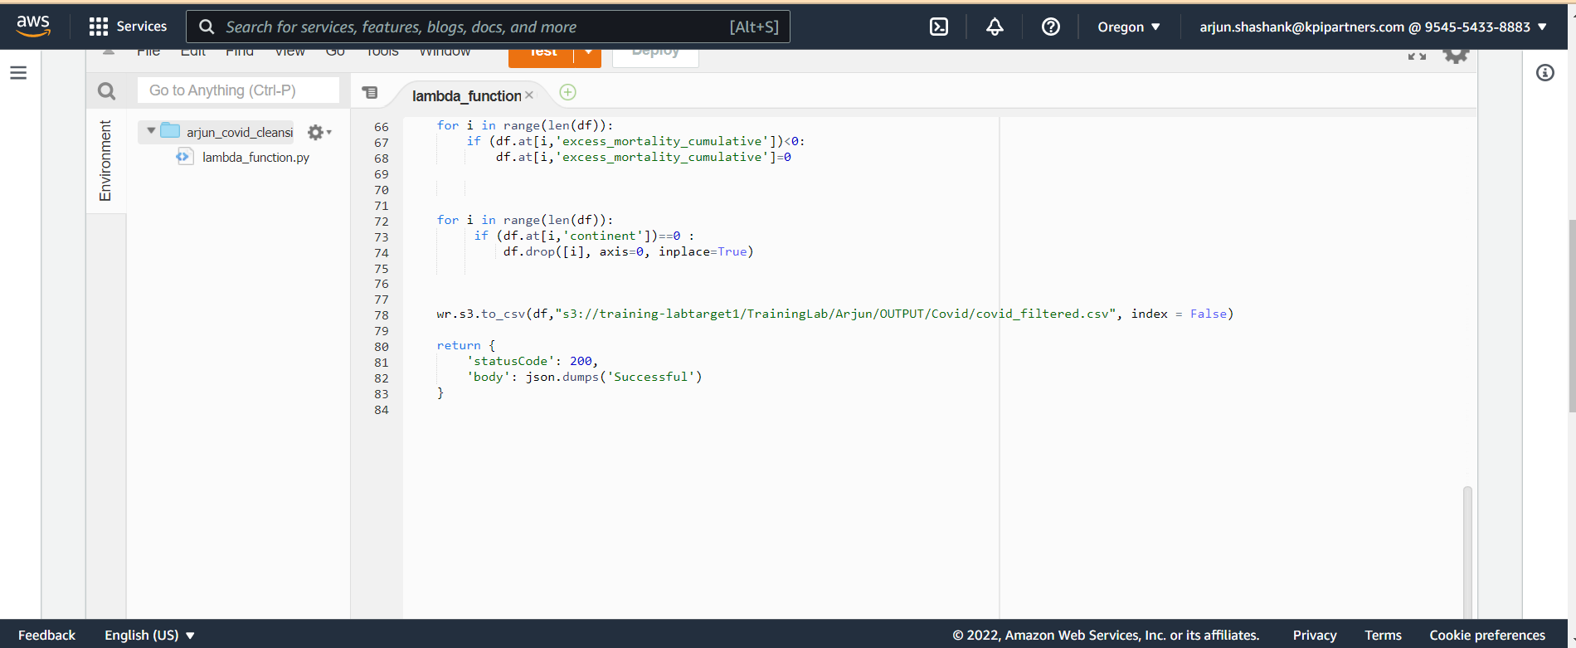
2. ETL operations on dataset

Slide 7
2. ETL operations on dataset Cont…

Slide 8
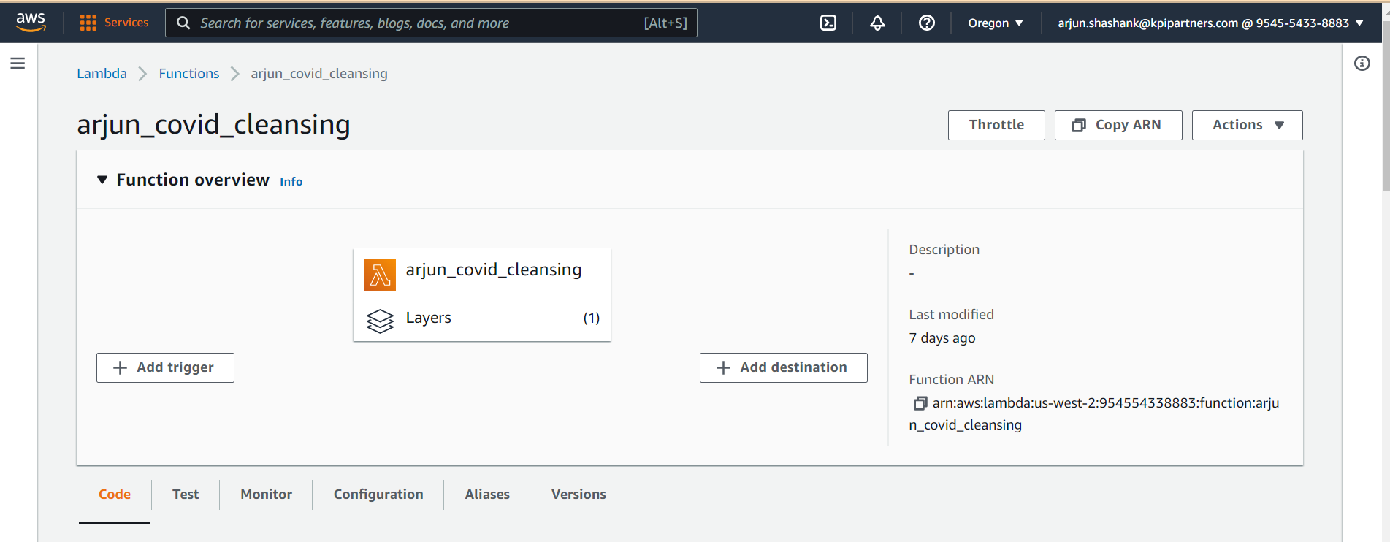
3. Storing the modified data in AWS

Slide 9
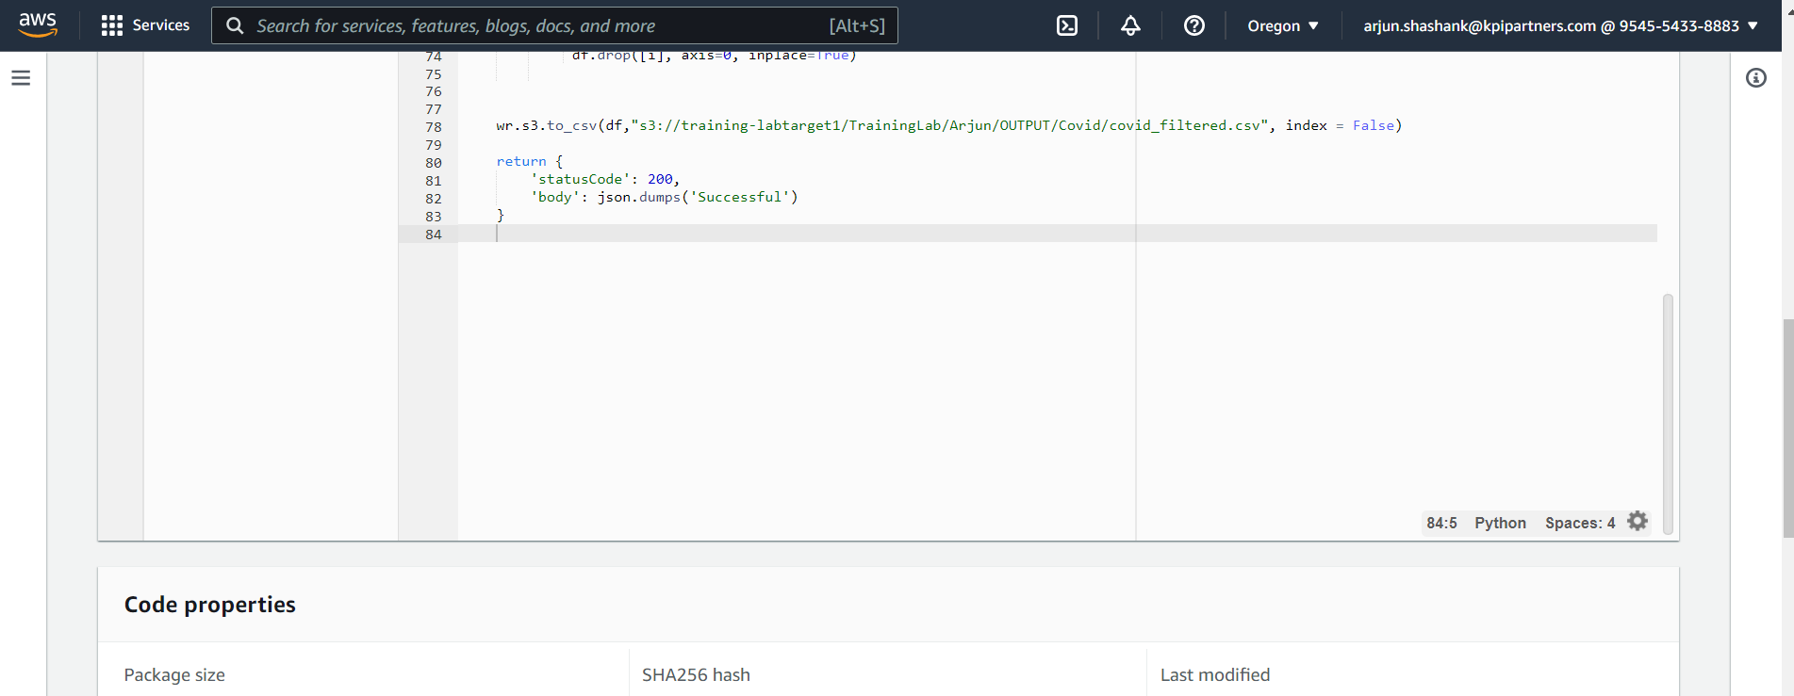
3. Storing the modified data in AWS Cont…

Slide 10
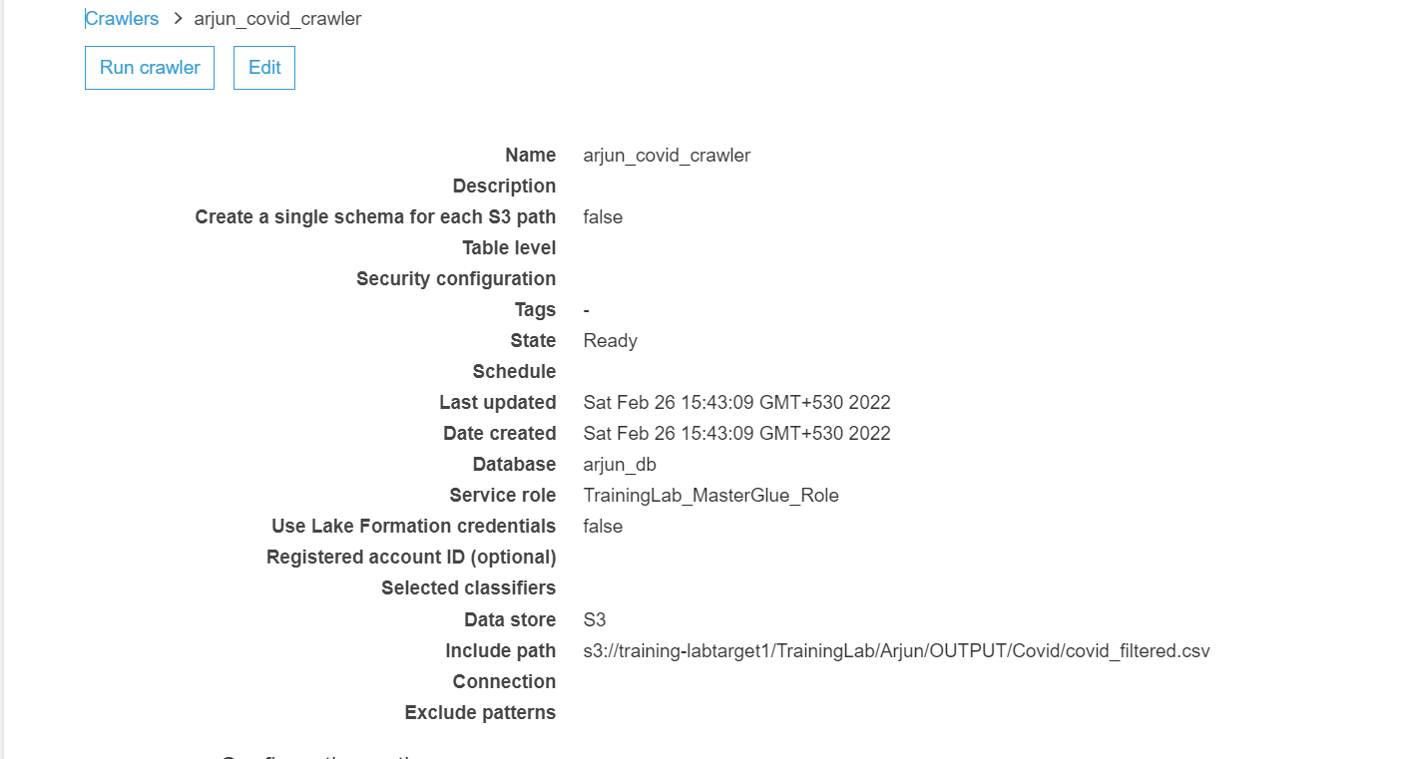
4.Display total cases ,new cases , recovered cases and deaths. CREATING CRAWLER

Slide 11
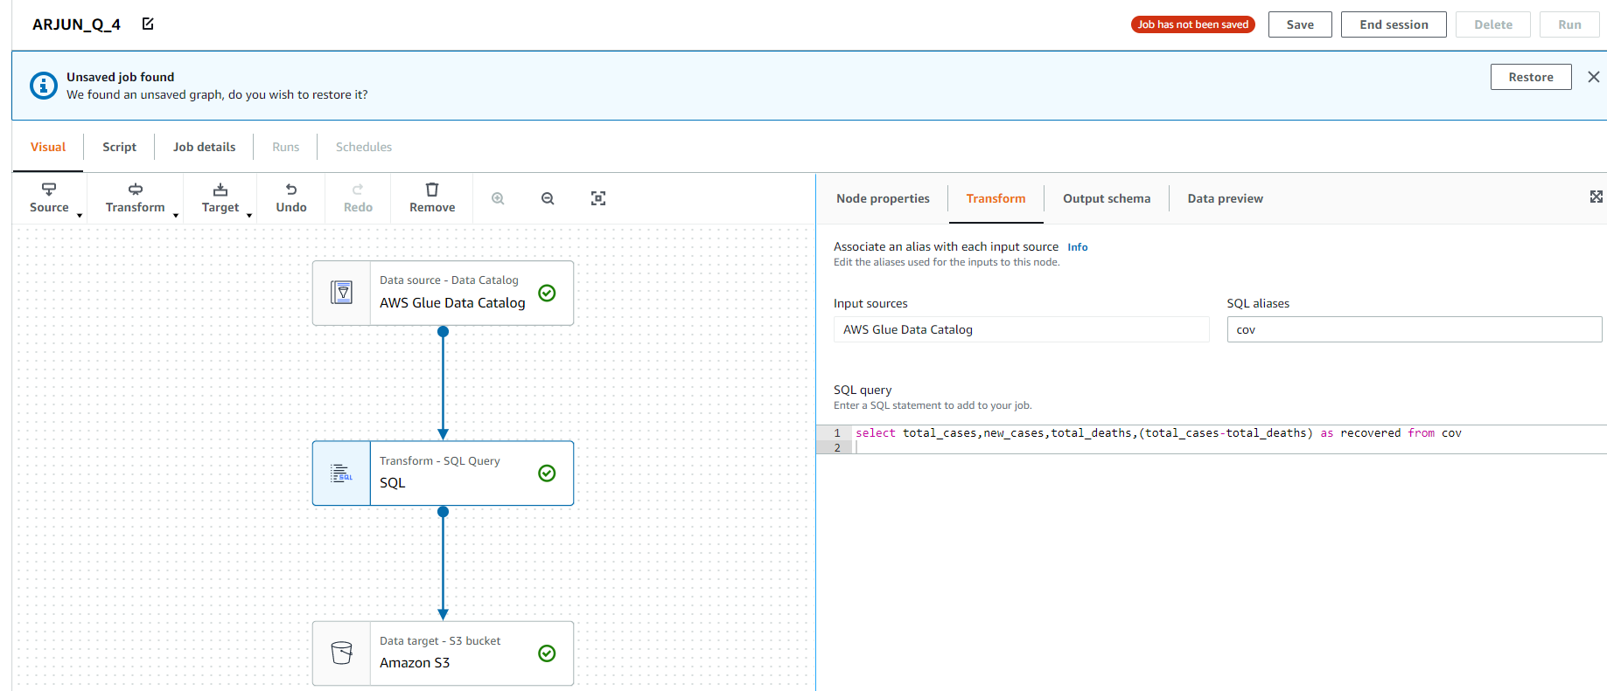
4. Display total cases ,new cases ,recovered cases and deaths. Job name: ARJUN_Q_4

Slide 12
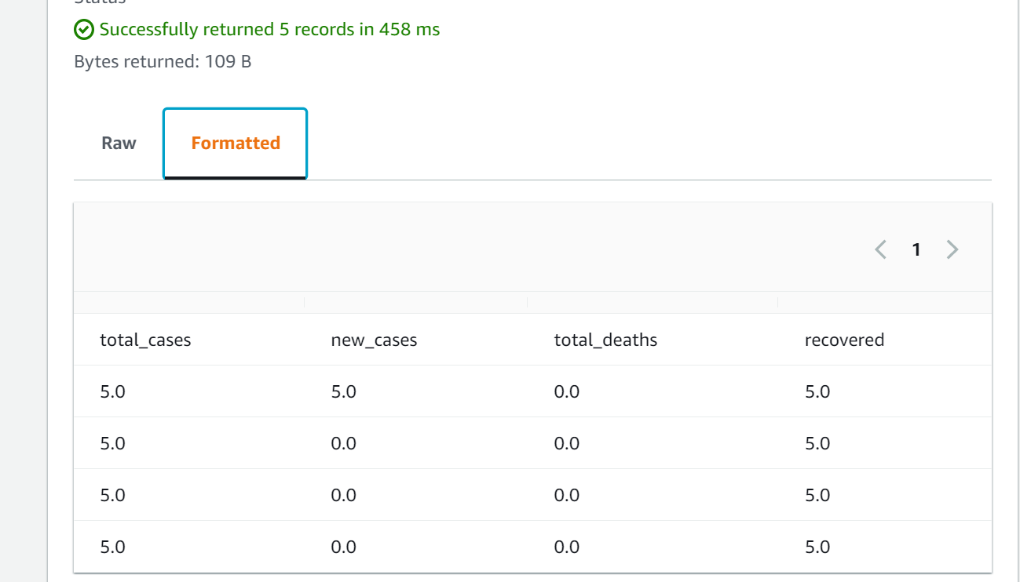
4.OUTPUT

Slide 13
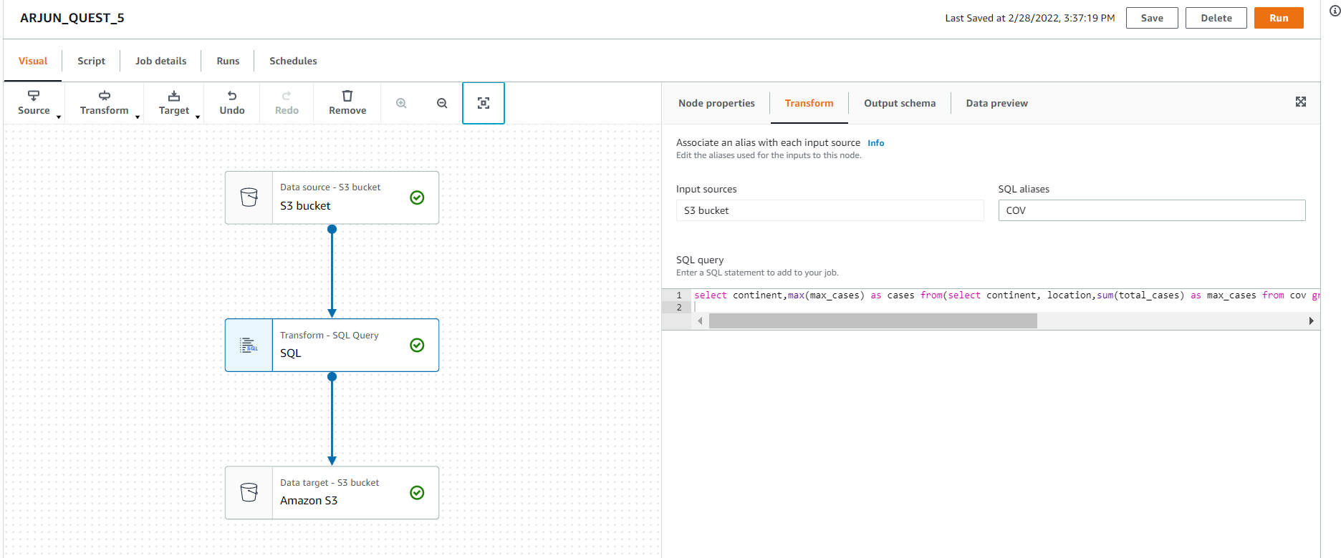
5.Which country in Distinct WHO region highest cases in till date. JOB NAME : ARJUN_QUEST_5

Slide 14
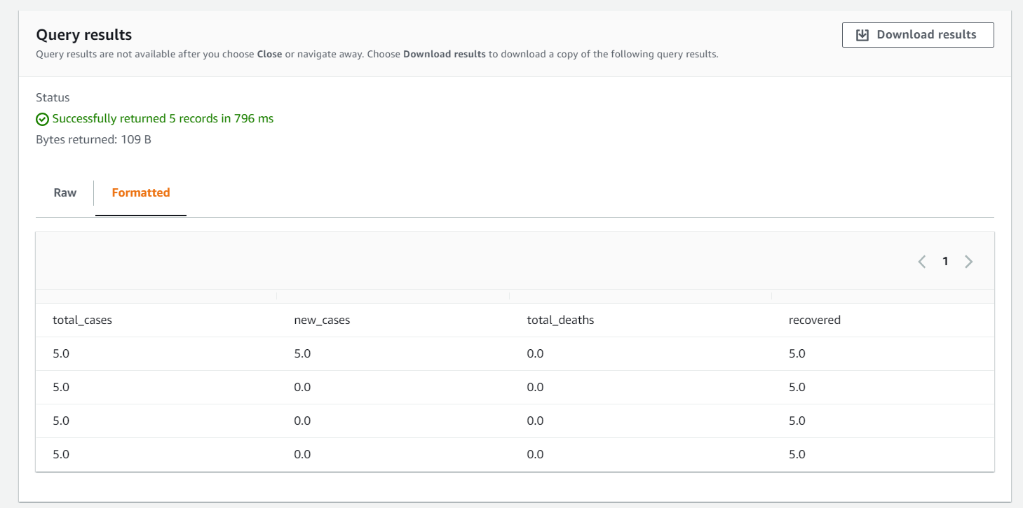
5.OUTPUT

Slide 15
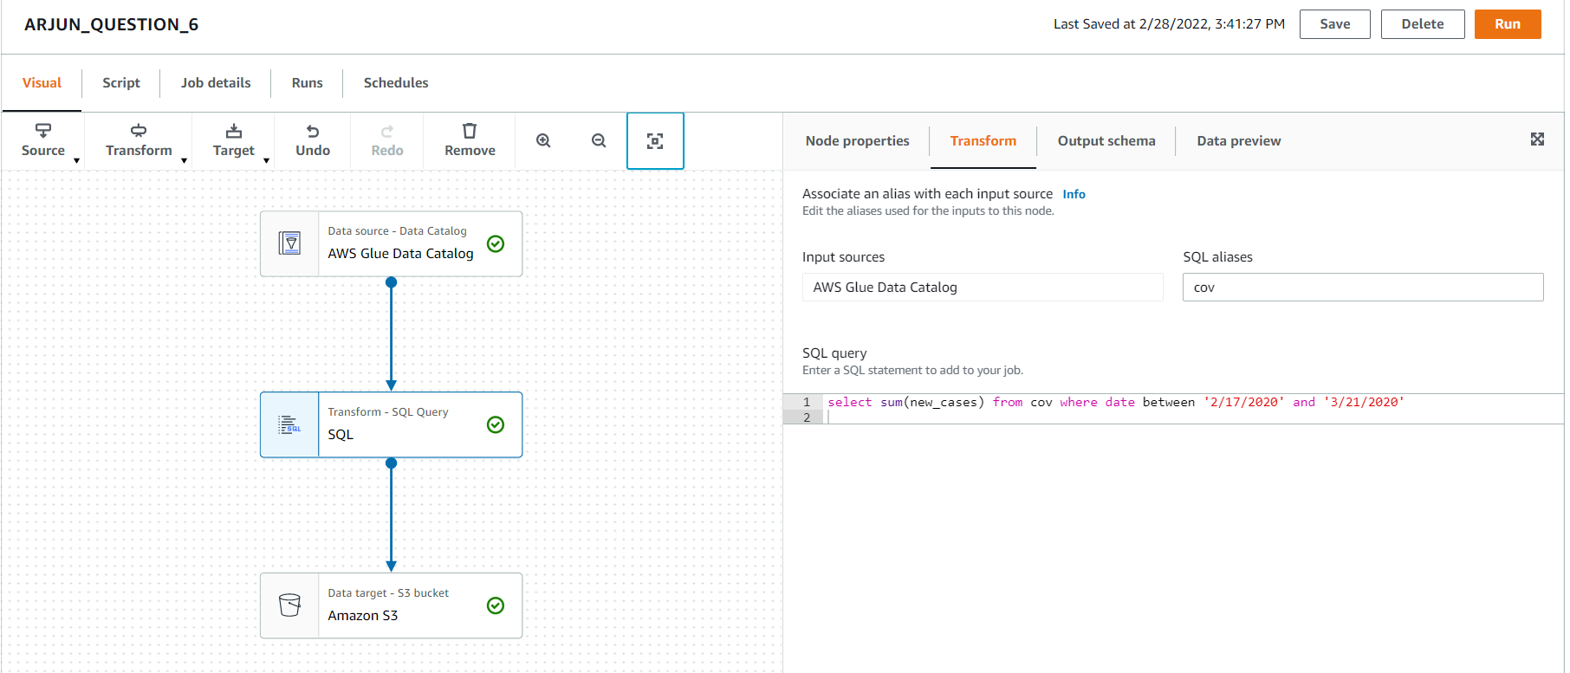
6. Total no of confirmed cases over between a certain date. JOB NAME : ARJUN_QUESTION_6

Slide 16
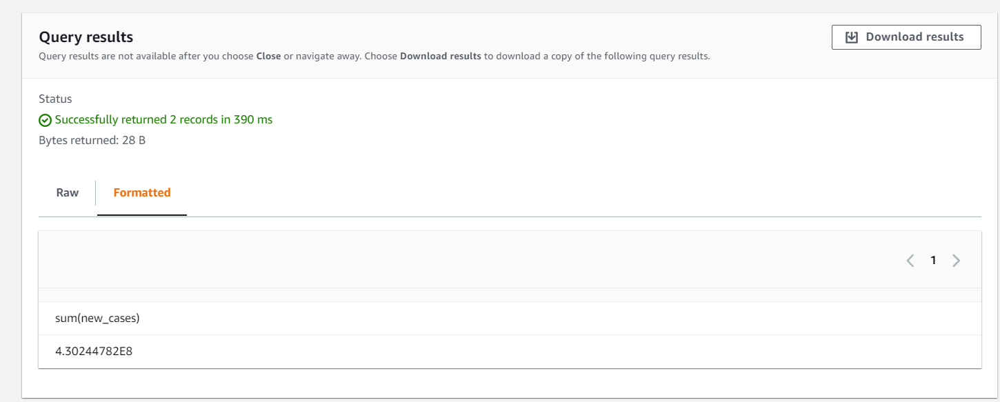
6.OUTPUT

Slide 17
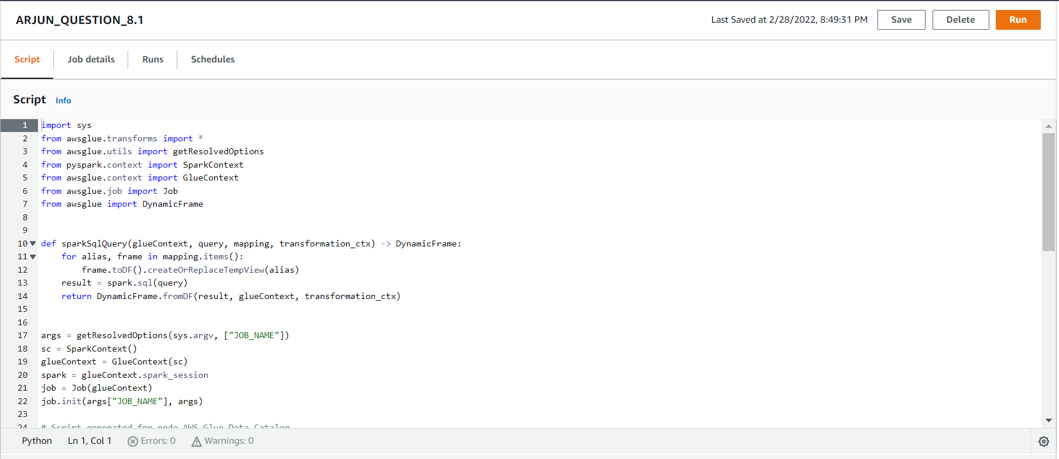
8.Date of first confirmed case in a particular region. JOB NAME : ARJUN_QUESTION_8.1

Slide 18
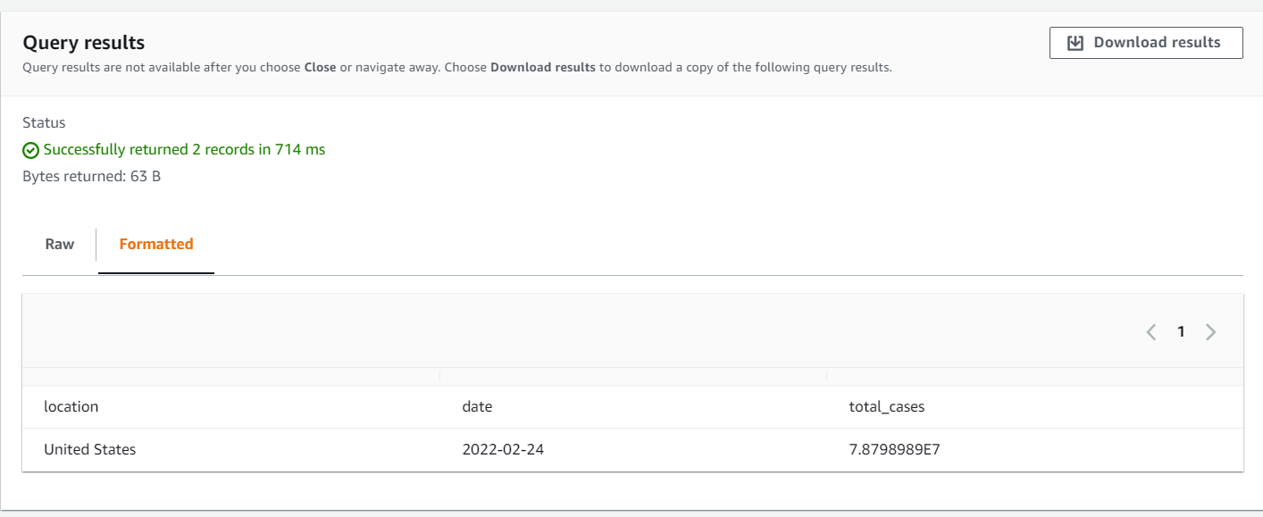
8.OUTPUT

Slide 19
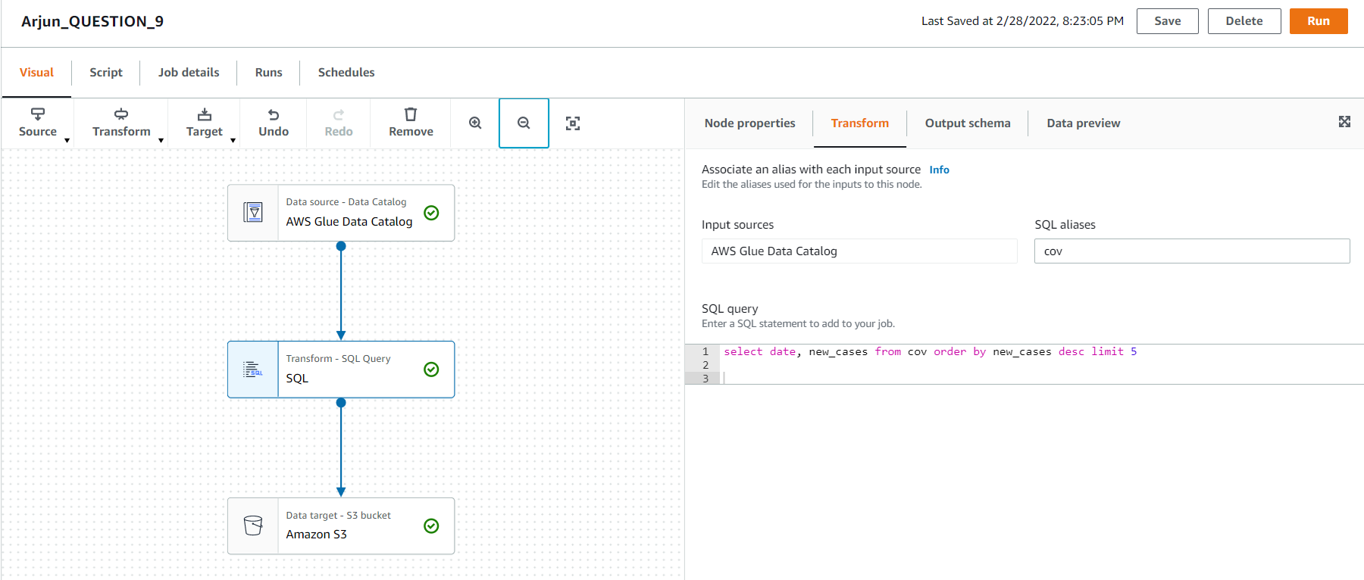
9.Date on which max no. cases were reported in a country. JOB NAME : Arjun_QUESTION_9

Slide 20
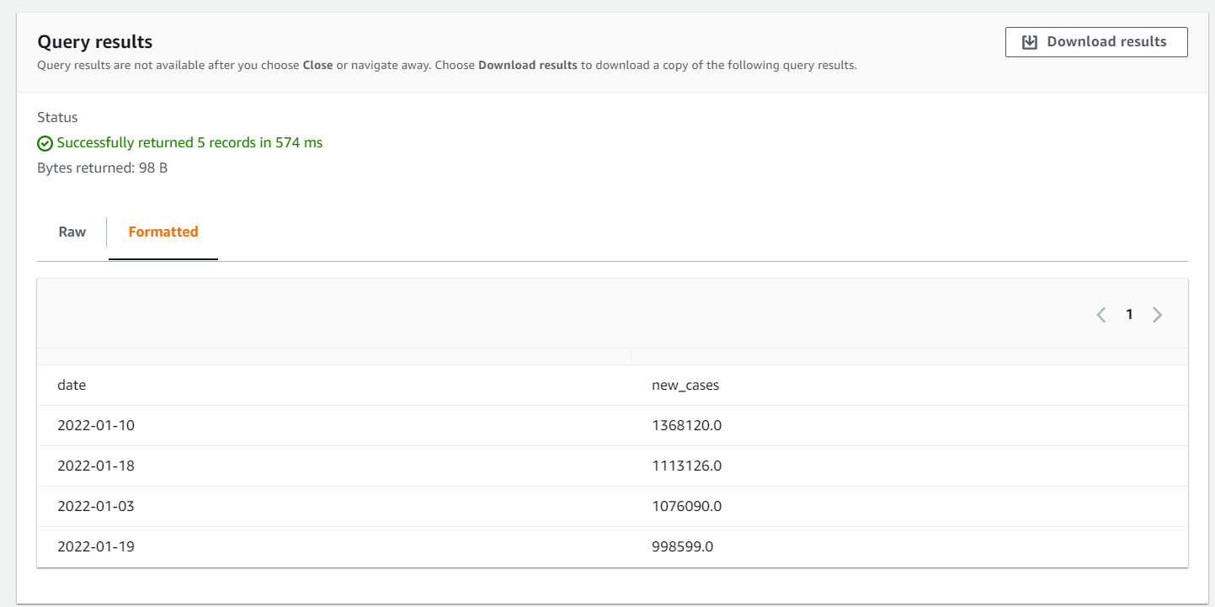
9.OUTPUT

Slide 21
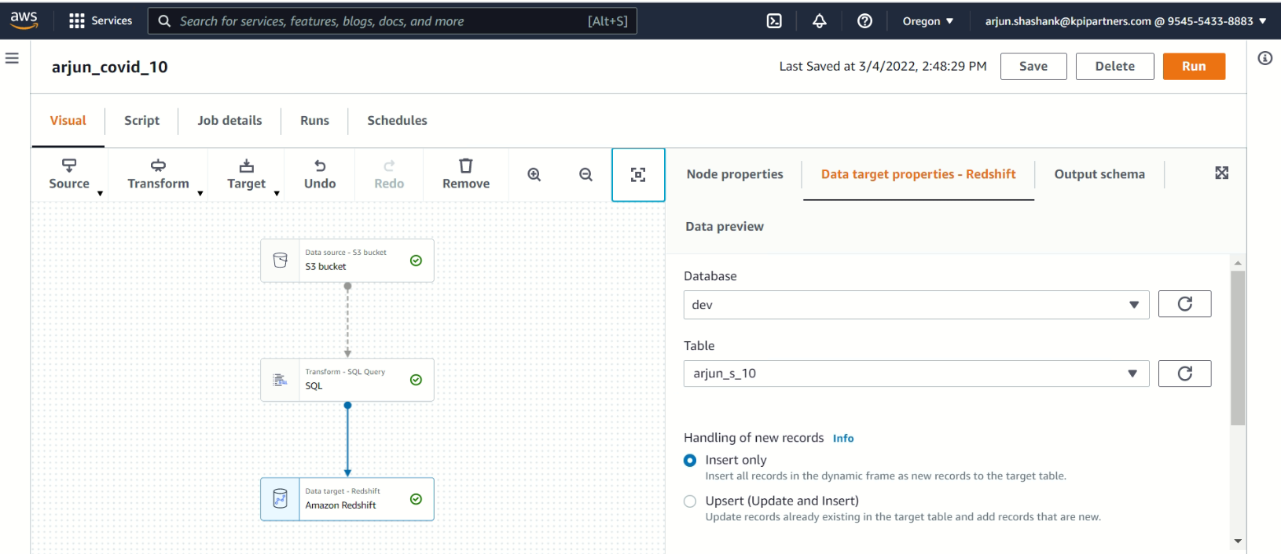
10.Line chart showing total cases, deaths &recoveries of a particular country . JOB NAME: Arjun_covid_10

Slide 22
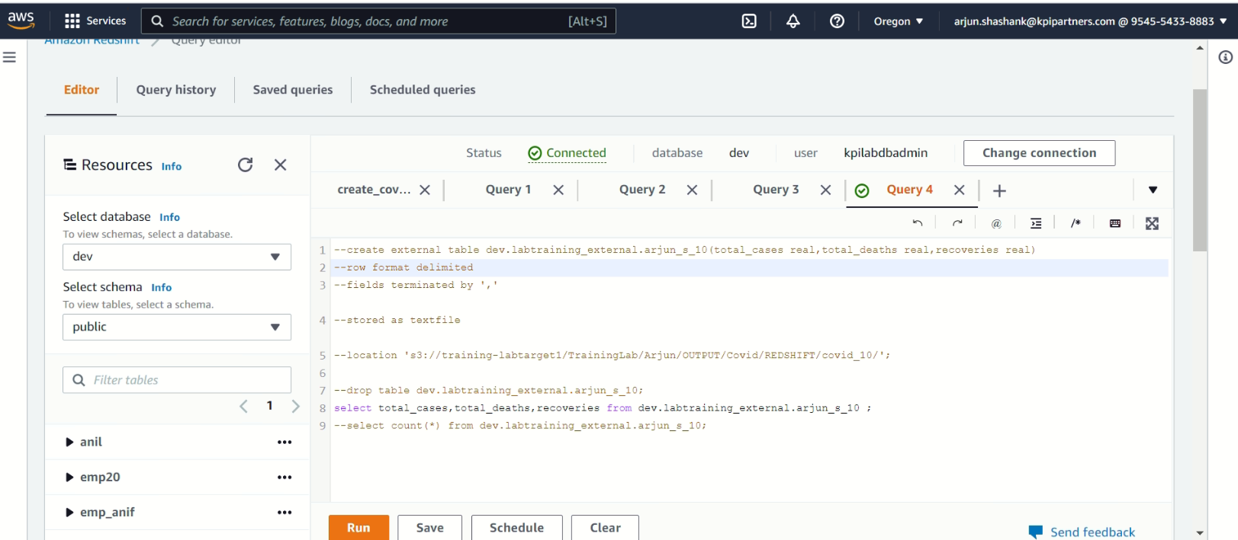
10 . Creating external table

Slide 23
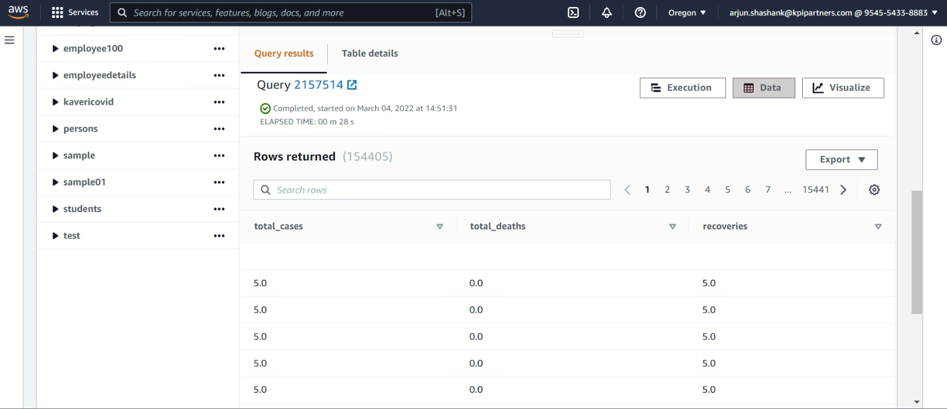
10. OUTPUT

Slide 24
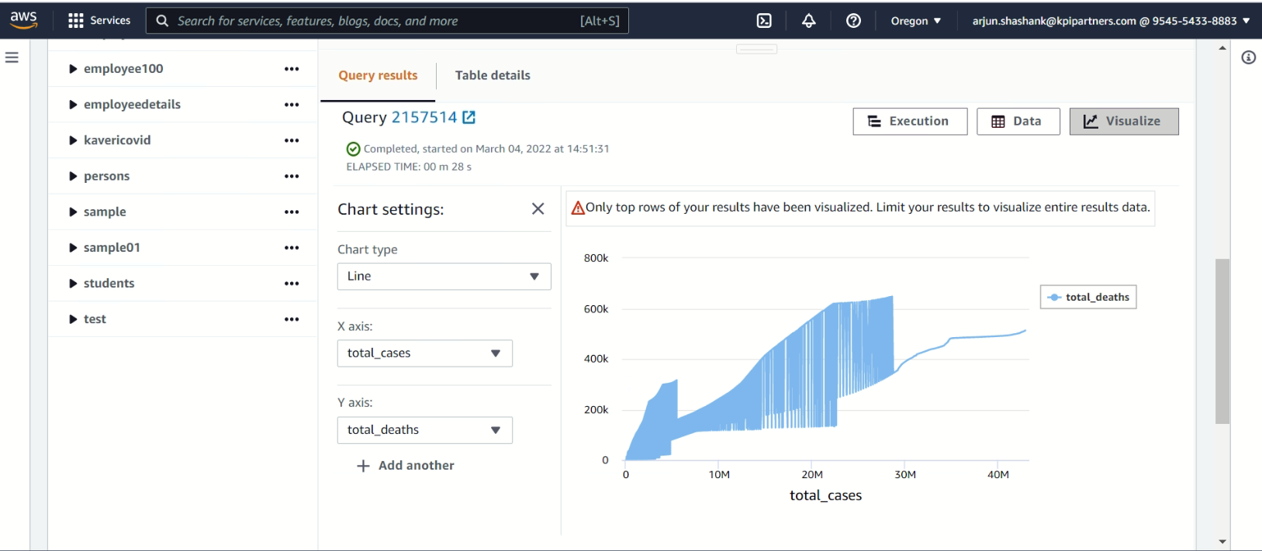
10. Line chart

Slide 25
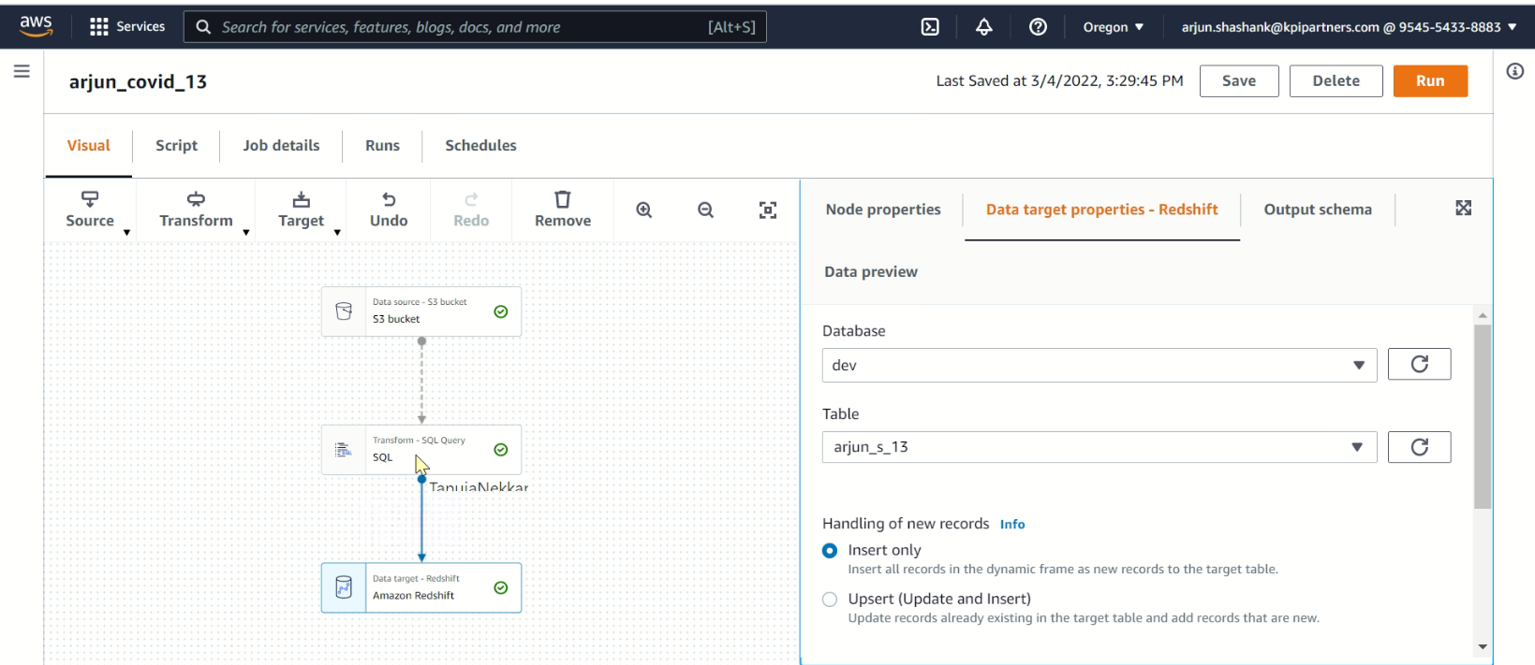
13.No. of active cases vs critical cases of a country. JOB NAME: arjun_covid_13

Slide 26
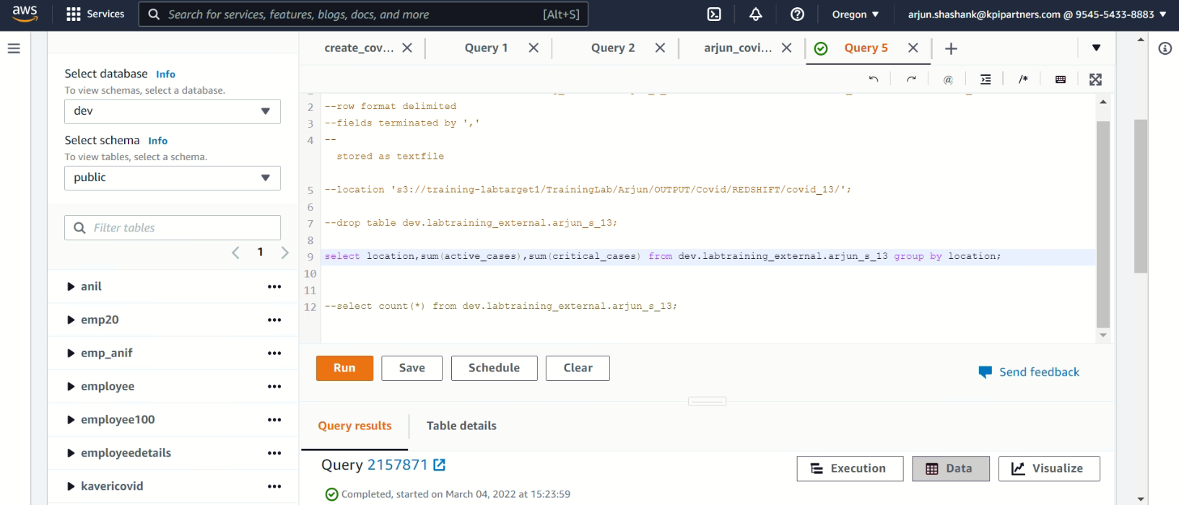
13. Creating external table

Slide 27
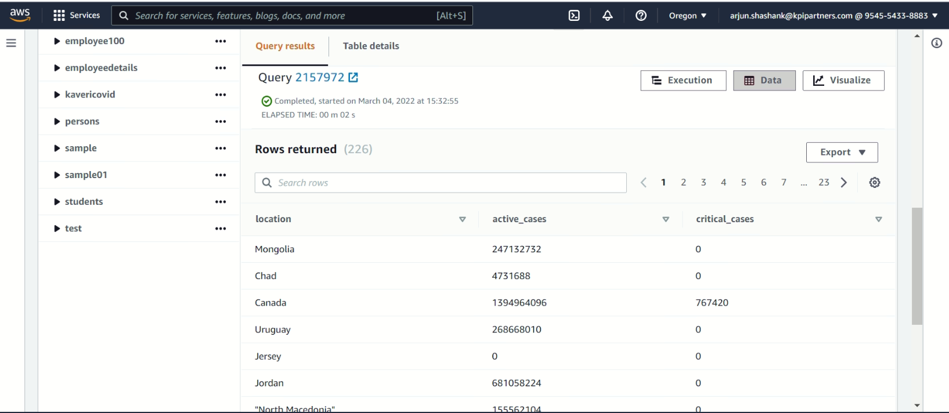
13. OUTPUT

Slide 28
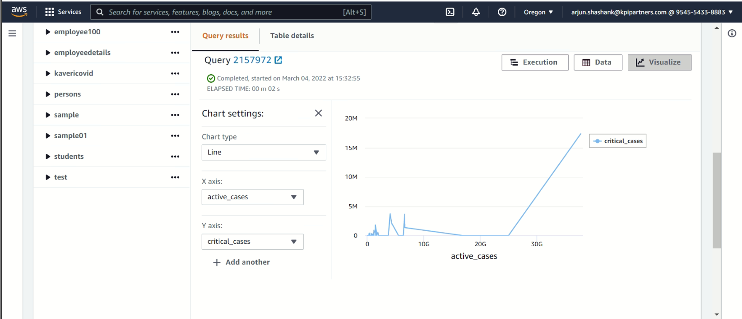
13. active cases vs critical cases

Slide 29
THANK YOU

