Slide 1
Solid principal Assignment

Slide 2
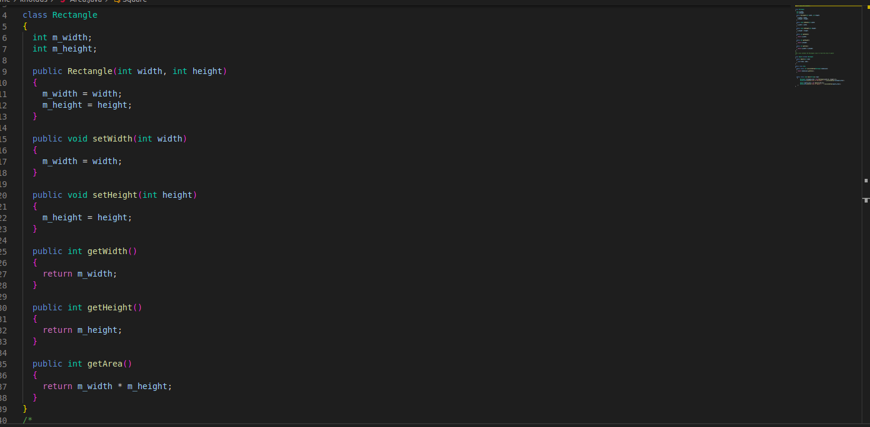
CODE

Slide 3
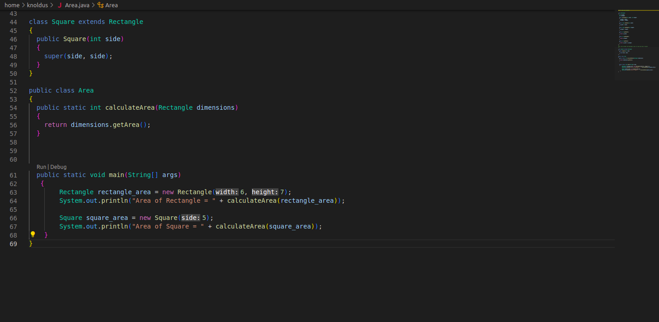
CODE

Slide 4
Code Explanation
The square class extends the Rectangle class and does not modify any of its behaviour. The calculateArea method takes an argument of type rectangle which can be either a Rectangle or a square object . This method calls the getArea method which is a behaviour that is guaranteed to be present in both Rectangle and Square objects

Slide 5
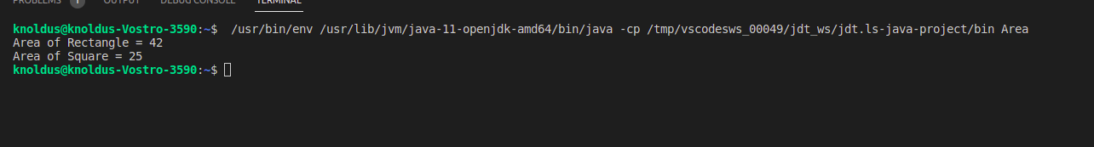
Output

