Slide 1

Vel Tech Rangarajan Dr. Sagunthala R&D Institute of Science and Technology
School of Computing
Department of Computer Science and Engineering
10211CS224 / FULL STACK APPLICATION DEVELOPMENT (JAVA)
PROJECT REVIEW : MILESTONE PROJECT – 1
Date: 23-03-2026
Dynamic Online Examination & Result Processing System
SDG: SDG No – SDG Title(Example: SDG 4 – Quality Education)
Presented By:
A. Sheshu Kumar – VTU25547– 23UECS0045.
Courses Handling Faculty:
Dr. M Mageshwari

Slide 2
INTRODUCTION
In today’s digital era, educational institutions require automated systems to conduct examinations efficiently. Traditional paper-based exams consume time, resources, and require manual result processing. This leads to delays and human errors. A Dynamic Online Examination & Result Processing System provides a secure and automated platform to conduct exams online. It enables instant evaluation and result generation. The system ensures transparency, accuracy, and time efficiency. It also supports remote access and scalable exam management.
Background of the problem
Traditional exams are paper-based and manually evaluated.
Manual correction consumes time and resources.
Why this project is important
Reduces human errors in evaluation.
Generates results instantly.
Saves time, cost, and manpower.
Real-world relevance
Supports remote and online examinations.
Helps institutions manage large numbers of students efficiently
Brief overview of the system
Allows admin to create exams and manage questions.
Students can attend exams online.
System automatically evaluates and generates results.
1
2
3
4
5
6
7
8
9

Slide 3
PROBLEM STATEMENT
Existing examination systems lack full-stack integration between frontend, backend, and database layers.
Manual and semi-automated systems cause delays in exam evaluation and result processing.
There is no robust Java-based backend to handle authentication, exam logic, and result computation securely.
Managing dynamic question banks and exam schedules is inefficient without a centralized system.
Scalability becomes a challenge when handling multiple users simultaneously during exams.
Traditional systems do not support real-time data processing and instant result generation.
Data inconsistency and security issues arise due to improper backend validation.
Hence, a Full Stack Java-based online examination system is required to automate exams and result processing efficiently.
1
2
3
4
5
6
7
8
9

Slide 4
.
OBJECTIVE(S)
To design and develop a dynamic online examination system for conducting objective-based tests with automated result processing.
To implement a secure and efficient platform that evaluates student performance instantly and generates accurate reports.
To improve the efficiency and accuracy of online examinations through automated test management and instant result processing.
To evaluate the performance of students by generating real-time scores, analytics, and detailed reports.
1
2
3
4
5
6
7
8
9

Slide 5
PROPOSED SYSTEM
Students can register and log in securely.
Admin can create and manage exams dynamically.
Questions can be added, edited, and deleted easily.
Timer-based online examination system.
Automatic answer evaluation.
Instant result generation after submission.
Performance analysis and report generation.
Secure database management to store exam records.
Advantages over existing system:
Reduces manual effort
Saves time and cost
Improves accuracy
Instant result processing
Easy accessibility
1
2
3
4
5
6
7
8
9

Slide 6
PROPOSED SYSTEM ARCHITECTURE
Input
Student details, login credentials, exam selection, and answers are provided to the system.
Processing
The system authenticates users, displays questions, evaluates answers, and calculates the score automatically.
Database
Stores student information, question bank, exam records, and results securely.
Output
Displays exam questions, instant results, score, and performance reports to students and admin.
1
2
3
4
5
6
7
8
9

Slide 7
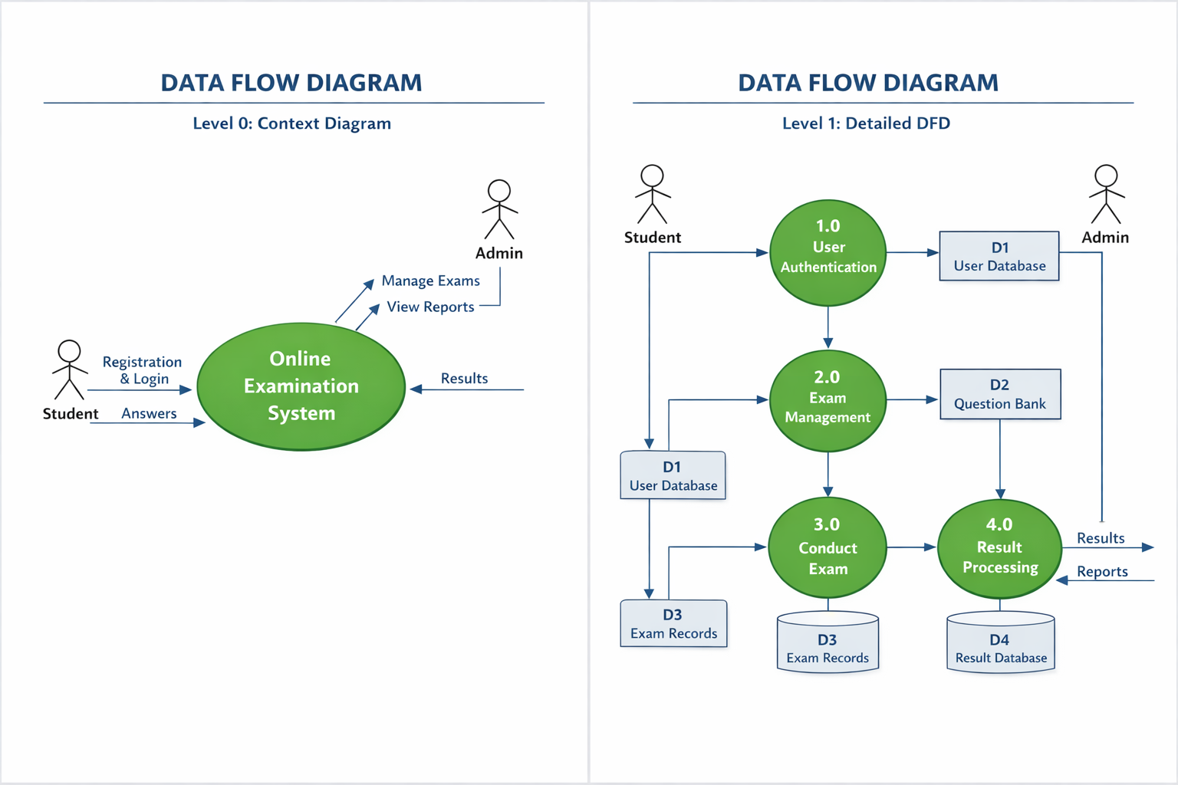
WORKFLOW
1
2
3
4
5
6
7
8
9

Slide 8
TECHNOLOGIES USED
1
Frontend: HTML, CSS, JavaScript Backend: Java (Servlets/JSP) or Spring Boot Database: MySQL Tools: Eclipse / VS Code / MySQL Workbench Hardware Requirements:
4GB RAM minimum
Internet connection Software Requirements:
Windows/Linux OS
JDK 8+
Apache Tomcat Server
2
3
4
5
6
7
8
9

Slide 9
MODULE DESCRIPTION
Module 1: User Management
Handles registration, login, role-based authentication (Admin/Student).
Module 2: Exam Management
Admin creates exams, uploads question bank, sets duration and marks.
Module 3: Examination Module
Displays questions dynamically, timer management, answer submission.
Module 4: Result Processing Module
Automatically evaluates answers and generates scorecard instantly.
Module 5: Database Management
Stores user data, exam details, and results securely.
Module 6: Reporting & Analytics
Generates student performance reports and overall analytics.
1
2
3
4
5
6
7
8
9

Slide 10
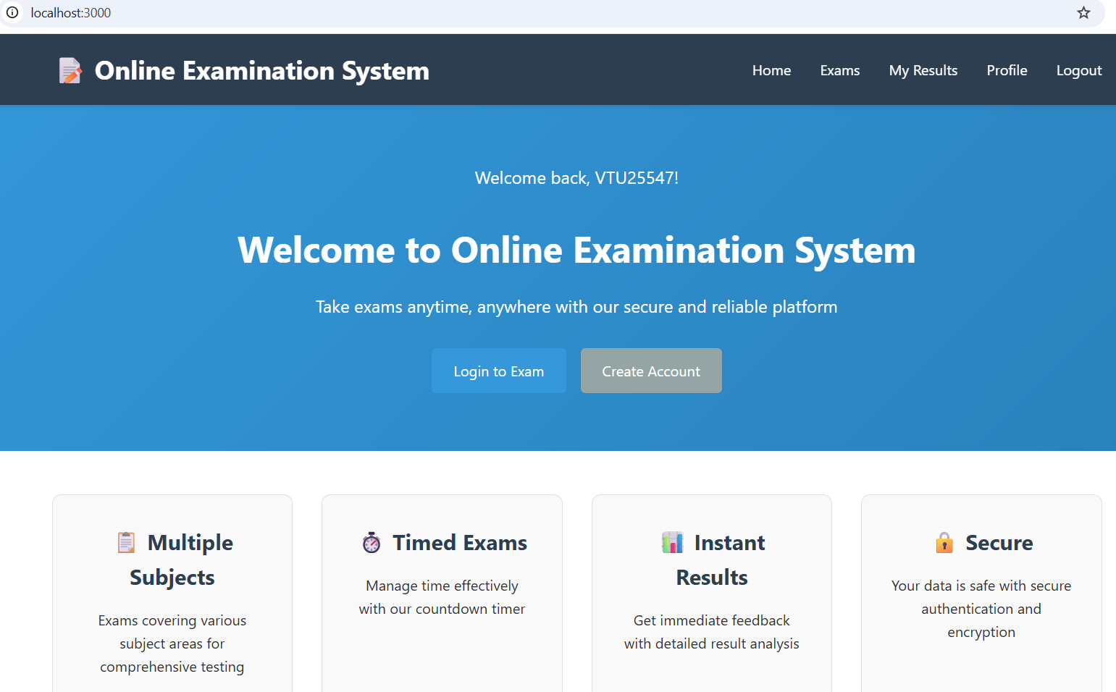
IMPLEMENTATION SCREENSHOTS
1
2
3
4
5
6
7
8
9

Slide 11
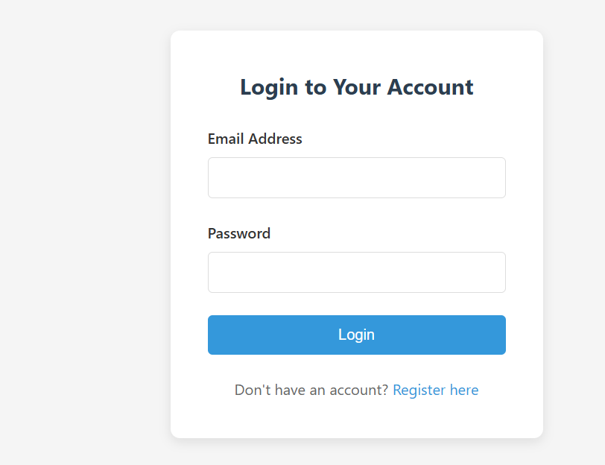
IMPLEMENTATION SCREENSHOTS
1
2
3
4
5
6
7
8(A)
9

Slide 12
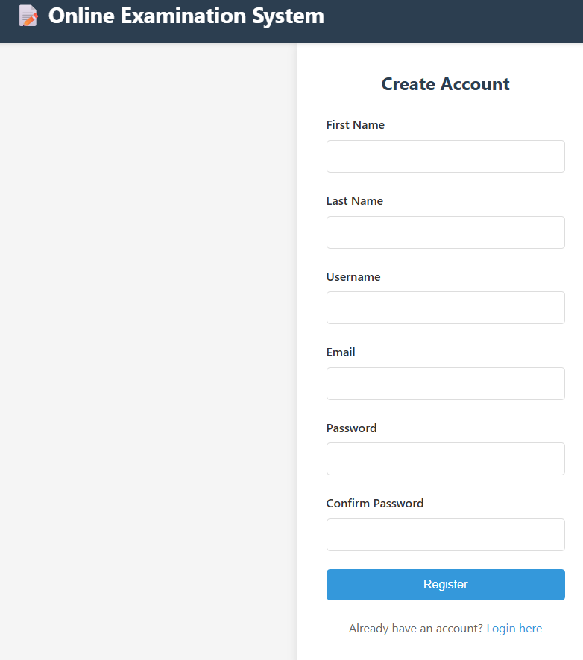
IMPLEMENTATION SCREENSHOTS
1
2
3
4
5
6
7
8(B)
9

Slide 13
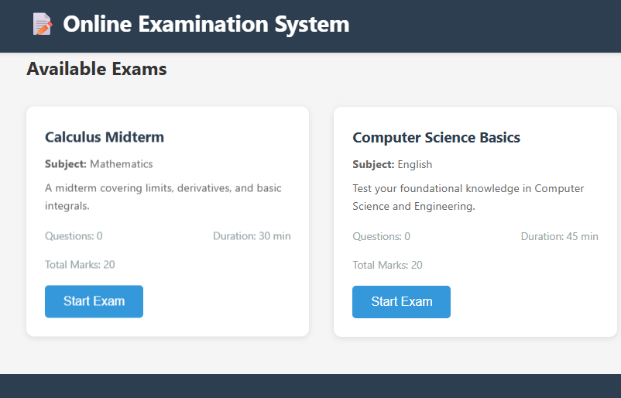
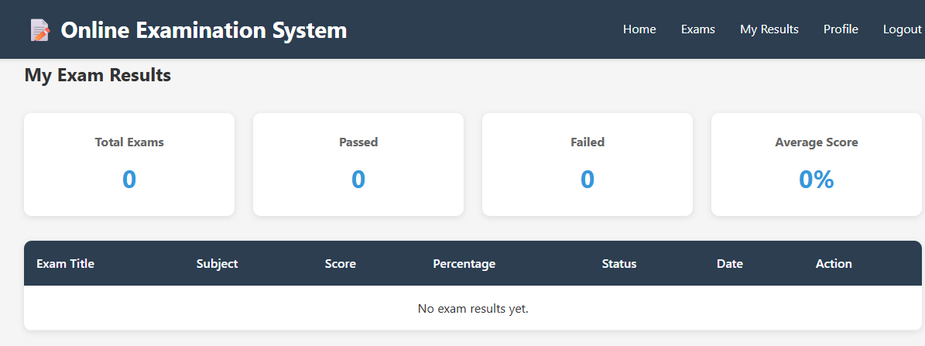
IMPLEMENTATION SCREENSHOTS
1
2
3
4
5
6
7
8(C)
9

Slide 14
ADVANTAGES & LIMITATIONS
ADVANTAGES
Fast and accurate evaluation
Reduces paperwork
Secure and reliable
Accessible from anywhere
Instant feedback
LIMITATIONS
Requires stable internet connection
Risk of cyber security threats
Limited to objective-type questions (if subjective evaluation not implemented)
1
2
3
4
5
6
7
8
9

Slide 15
Thank you

