Slide 1
toyshouse
Group Members – Sandesh Javheri (220343120041)
Sonal Andge (220343120010)
Prasad Bansode (220343120082)
Onkar Shete (220343120100)
Project Guide – Mrs. Harshita Maheshwari

Slide 2
Contents
Introduction
Choice of topic
Proposed System
Methodology
Proposed System Model
Proposed Approach
Screenshot
System Requirements
Applications
Advantages & Limitations
Conclusion
Future Scopes
References

Slide 3
Introduction
ToysHouse is a web application designed for refurbished toys.
This application allows a user to sell and purchase used toys.
It provides admin and user login.
User & admin can add different toys.
This application also provides feedback and helpdesk facility to the user.

Slide 4
Choice of topic
Through this every child gets toys in affordable price.
Easy & Fast
Categorized toys.
Online payment and invoice facility.

Slide 5
Proposed System
AIM:
1. It will provide refurbished toys in reasonable price.
Proposed System:
1. Digitalize buy and sell.
2.Easy for user to reach us through website.
3. Eliminate Intermediates

Slide 6
Methodology
The objective is to create a web site that can perform the following:-
Connecting to an HTTPS site through GPRS/WIFI.
Opening the relevant HTML page using HTTPS POST & GET methods.
Read the data logically into user ,seller and admin.
Creating a local database.

Slide 7
Proposed System Model
There are three main modules:
Admin Seller User
1 Home 1 Home 1 Home
2 Product Category 2 Product Category 2 All Product
3 All Products 3 All Products 3.Helpdesk
4 Add Products 4 Add Products 4.Feedback
5 Log Out 5 Log Out 5 Log Out

Slide 8
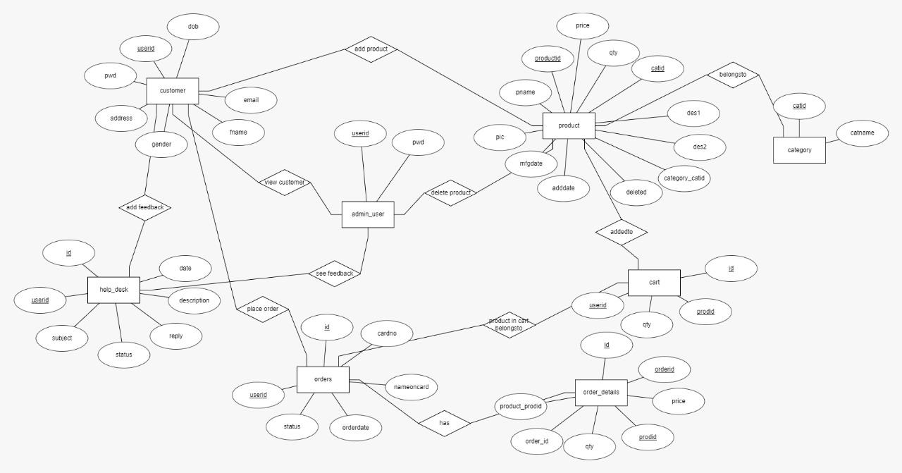
Proposed Approach

Slide 9
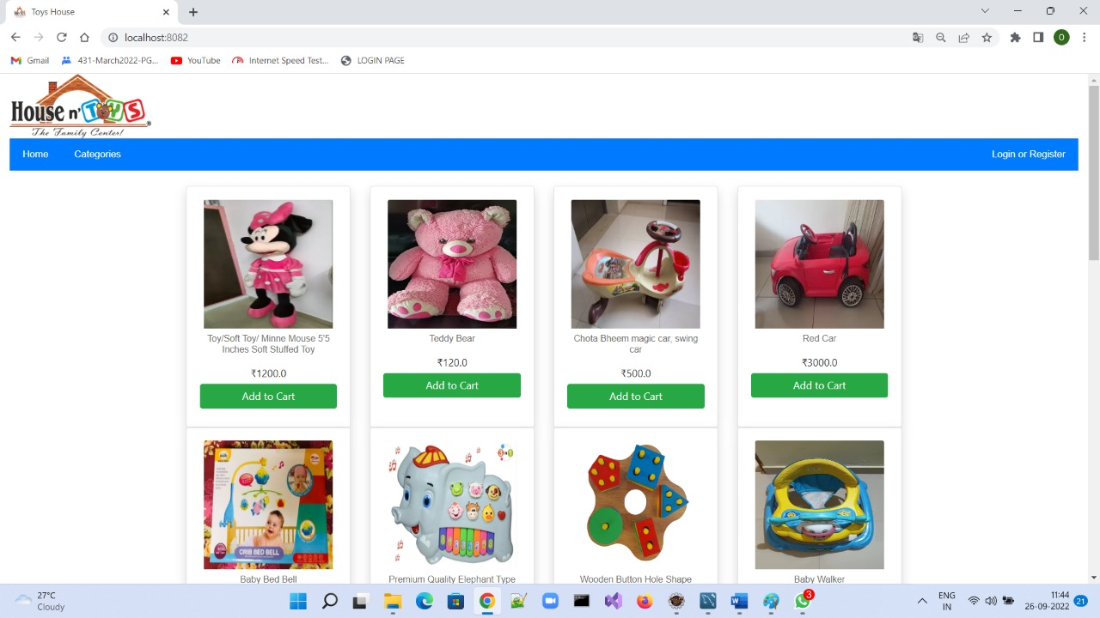
SCREENSHOTS

Slide 10
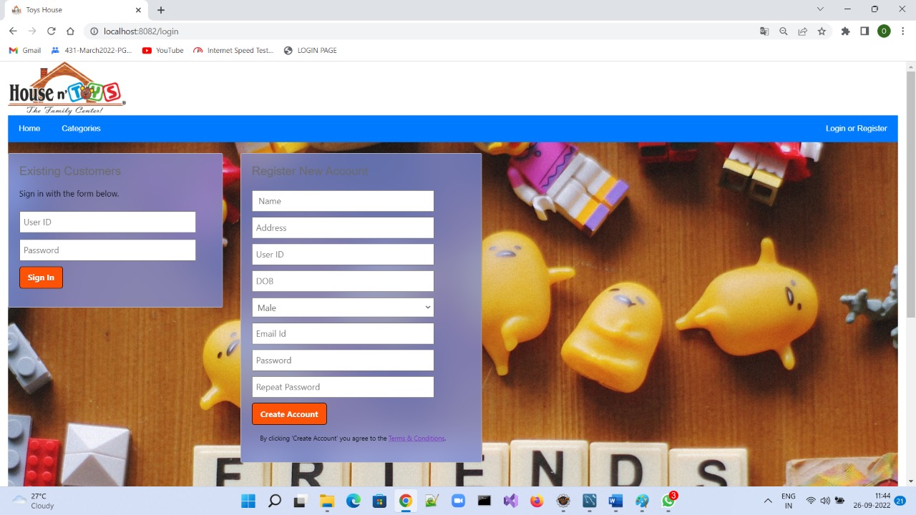
Screenshots

Slide 11
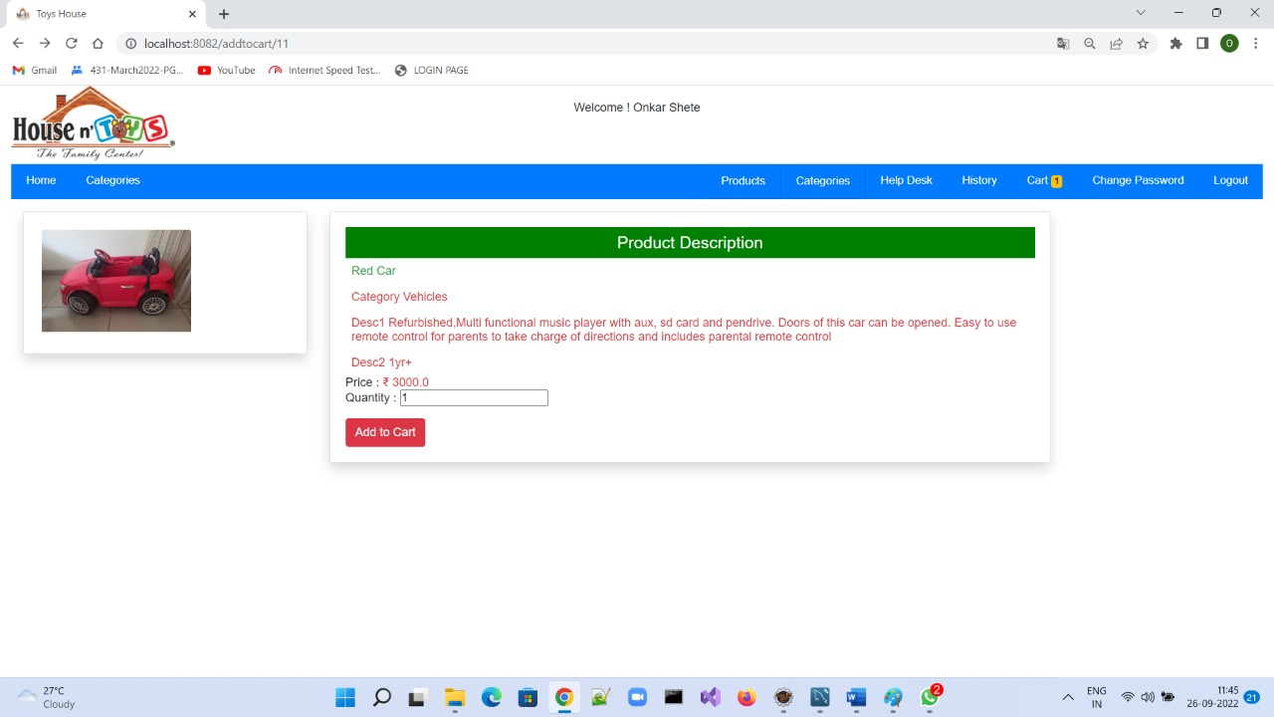

Slide 12
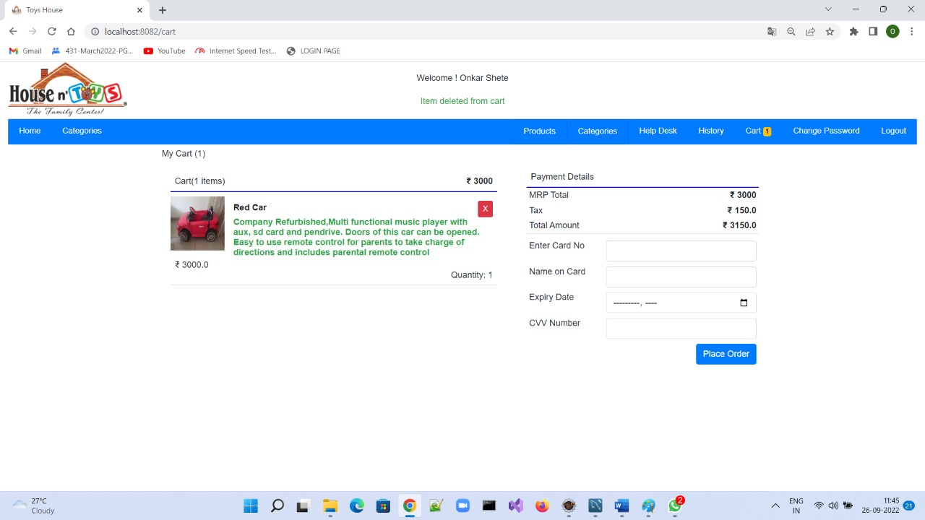

Slide 13
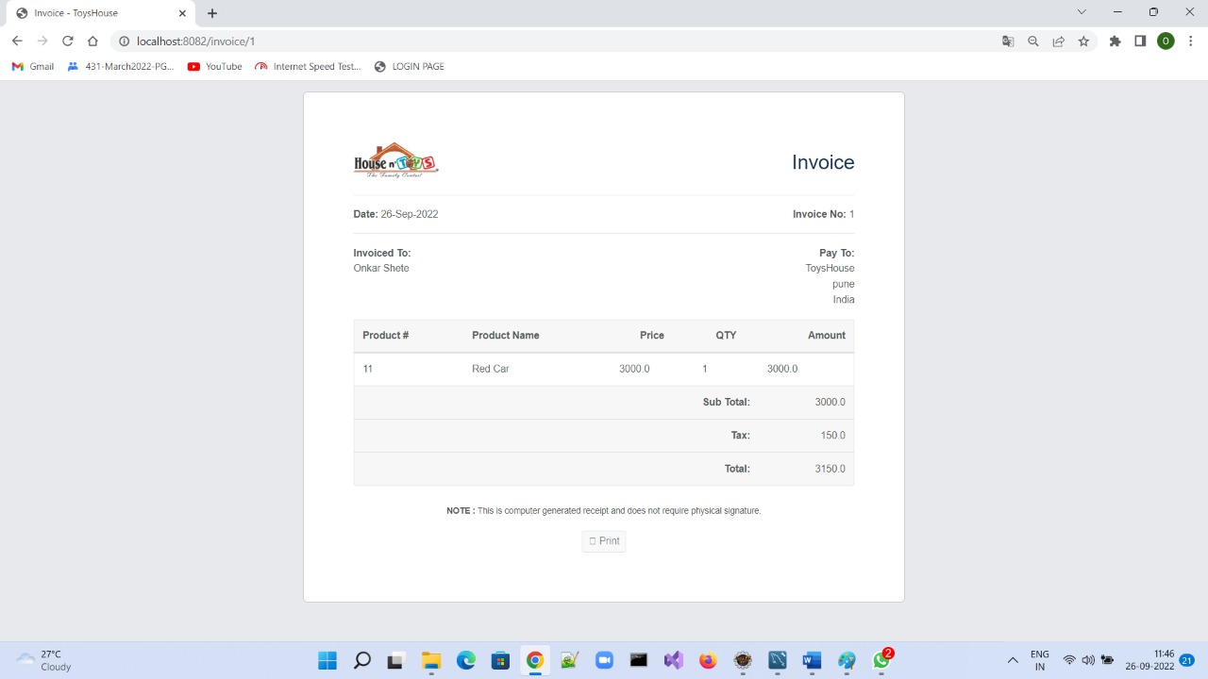

Slide 14
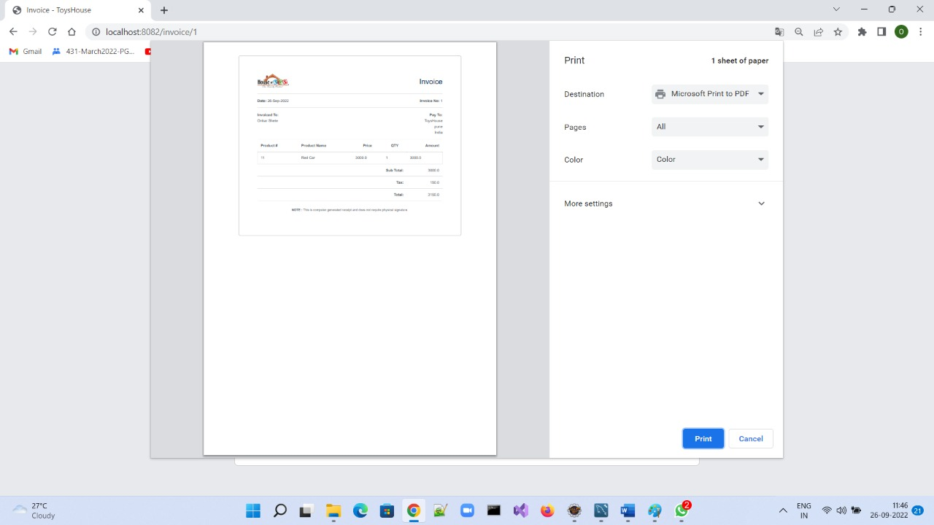

Slide 15
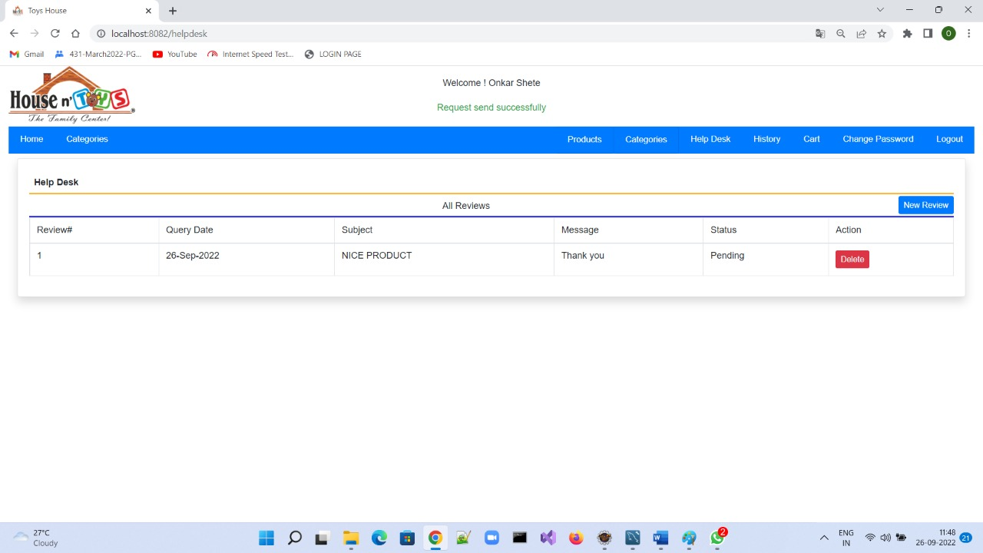

Slide 16
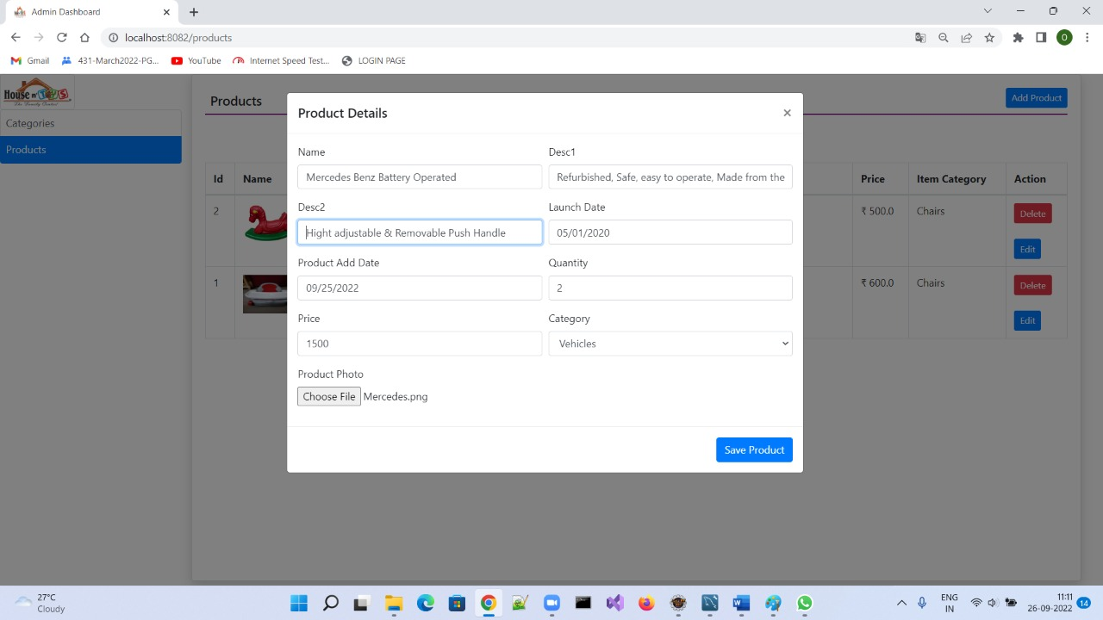

Slide 17
System Requirements
Software Requirements:
• Windows (All Versions)
• Eclipse.
• Springboot, MySql, Javascript.
Hardware Components:
• Processor – i3
• Hard Disk – 8 GB
• Memory – 4GB RAM

Slide 18
Technologies Used
HTML : Page Layout has been designed in HTML.
CSS : Used for all designing part.
SpringBoot:To create database and tables at backend.
JavaScript : All Validation task and animations has been developed by JS.
JSP : All front end logic has been written in JSP.
JAVA : All the business logic has been written in JAVA.
MySQL : MySQL database has been used as database.

Slide 19
Applications
Digital buy and sell.
Can be used in other countries.
Toys Industry.

Slide 20
Advantages
Transparency in the system.
Users can sell and buy their products from door step.
Users can submit their feedback online.
This saves time,cost and Energy.

Slide 21
Limitations
Accurate verification of the users cannot be done online.
It requires an extensive database and memory.

Slide 22
Conclusion
The ToysHouse will be designed and developed to overcome the drawbacks of old manual system and meet the requirement of modern age. This system will provide user to buy and sell their toys without any third party. It will bring transparency between buyers and sellers by removing intermediates. It will save time & energy of everyone using this website. Lastly it can be improved in future according to rising demand of users.

Slide 23
Future Scope
Verification of users.
Improvement in design.
Mobile Application
Integration of new function like charity events for poor children.
UPI Payment
Chat BOT
Rating System

Slide 24
References
Mr. Saleel Bagde for Database.
Mrs. Harshita Maheshwari for HTML JS & CSS also she was our project guide.
Mrs.Mayuri Fakirpure for JSP & JAVA.
https://www.slideshare.net
https://www.projectideas.co.in
International Conference on I2C2, 2020
A special thanks to Infoway Management who arranged extra lab time for us.

Slide 25
THANK YOU

