Slide 1

Sprocket Central Pty Ltd
Data analytics approach
[Division Name] - [Engagement Manager], [Senior Consultant], [Junior Consultant]

Slide 2
Agenda
Introduction
Data Exploration
Model Development
Interpretation

Slide 3
Introduction
New customers analysis:
These are the features used for recommendation to the new customers:
Age distributions.
Number of bike related purchases in 3 years / percentages purchases.
Job industry category.
Wealth segments.
Number of cars owned in each states.

Slide 4
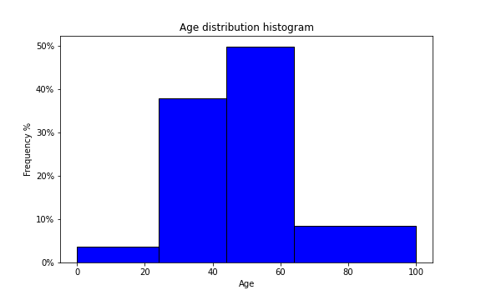
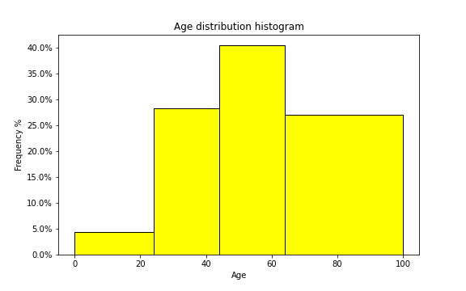
Data Exploration
Customer’s age distribution:
The percentage of <25 is almost similar to the old customer group.
There are fewer customers in the age group 25-44 years old compared to old customers.
Most of the new customers are in the age group 45-64 years old.
There are much more new customers in the age group >=65.

Slide 5
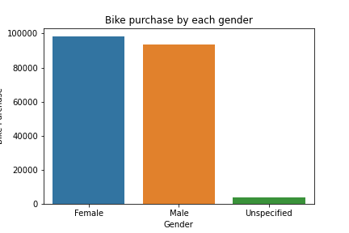
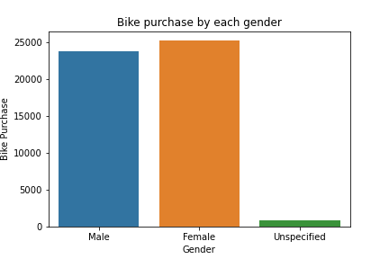
Model Development
Bike purchases within the last 3 years:
In the new customers group, there are slightly more female buyers (50.6% or 25,212 bikes) compared to male buyers (47.7% or 23,765 bikes).
The distribution of the two group is very similar. So, depending on the marketing strategy, you could either try to attract more male buyers or focus on female retention rate.

Slide 6
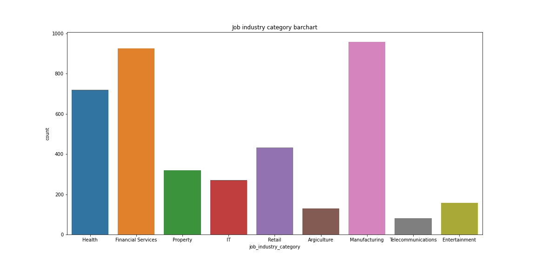
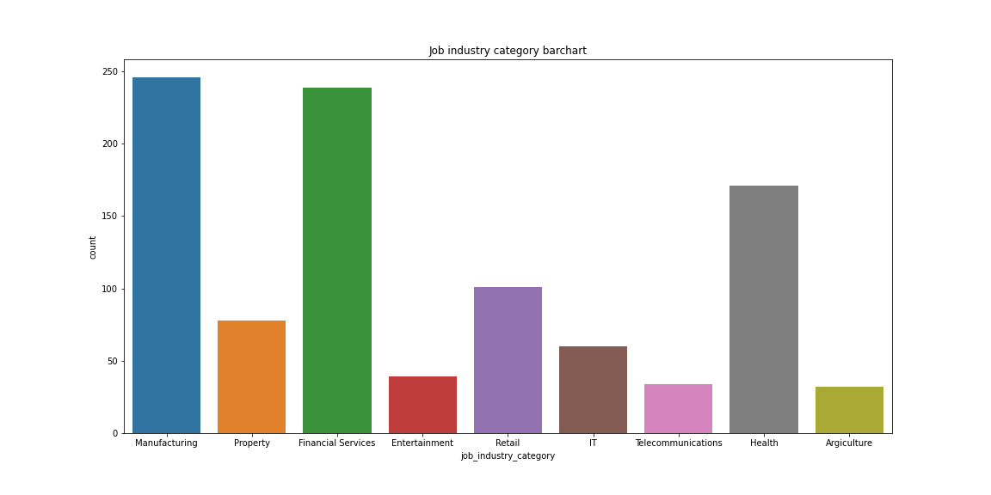
Interpretation
Job industry category:
The job industry profile of the new customers shares some similarities to the old customers.
The top three industry for the original group are: Manufacturing, Financial services and Health (respectively).
The top three industry for the new group are: Manufacturing, Financial services and Health (respectively).

Slide 7
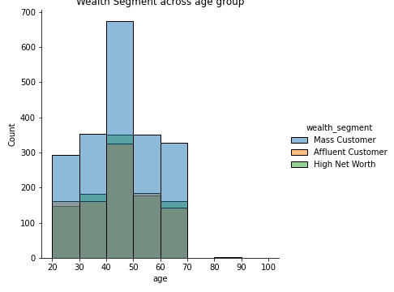
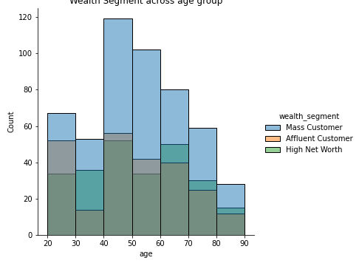
Interpretation
Wealth segment:
The average and median age of the new group is older.
In almost all the age group, the number of ‘Mass customers’ makes up the largest group.
There are relatively lower proportion of ‘Mass customers’ compared with ‘High Net Worth’ and ‘Affluent customers’ in the new groups than Old groups.
We should focus more on the two group, ‘High Net Worth’ and ‘Affluent customers’.

Slide 8
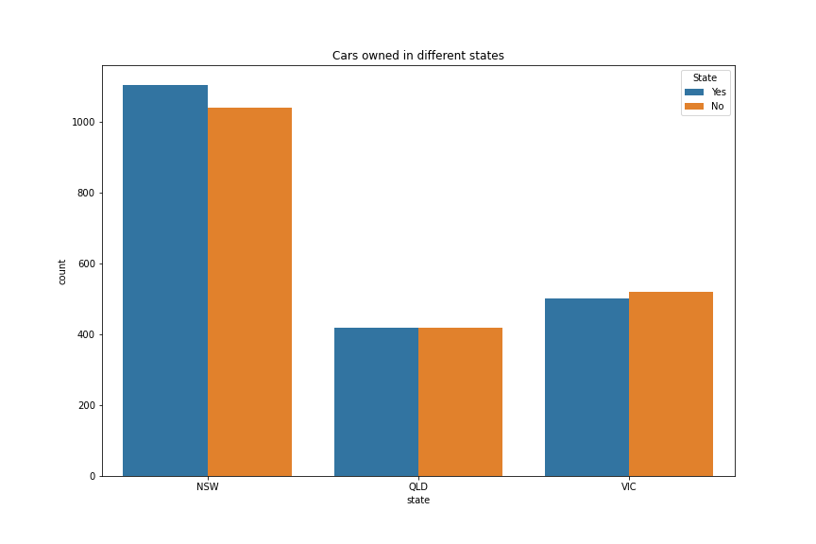
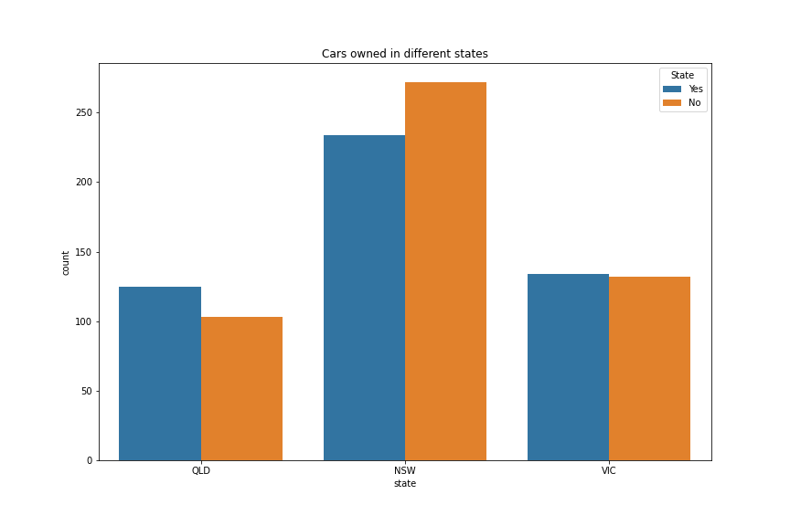
Interpretation
Numbers of cars owned in each state:
NSW has the most number of owned cars, but proportionally has more customers who doesn’t own cars.
VIC is the next highest in the number of owned cars, and there relatively equal proportion who doesn’t own cars.
QLD has the least number of owned cars, so we could target this state.

Slide 9
Appendix

