Slide 1
GUJARAT POLICE CCTV HACKATHON 2026
SentinelGrid
Unified Statewide Smart Surveillance & Predictive ANPR Interception Platform
Track: Computer Vision & Multi-Camera Vehicle Tracking
Architecture: 3-Tier Hierarchical Edge-Cluster (HEC) Hybrid Model

Slide 2
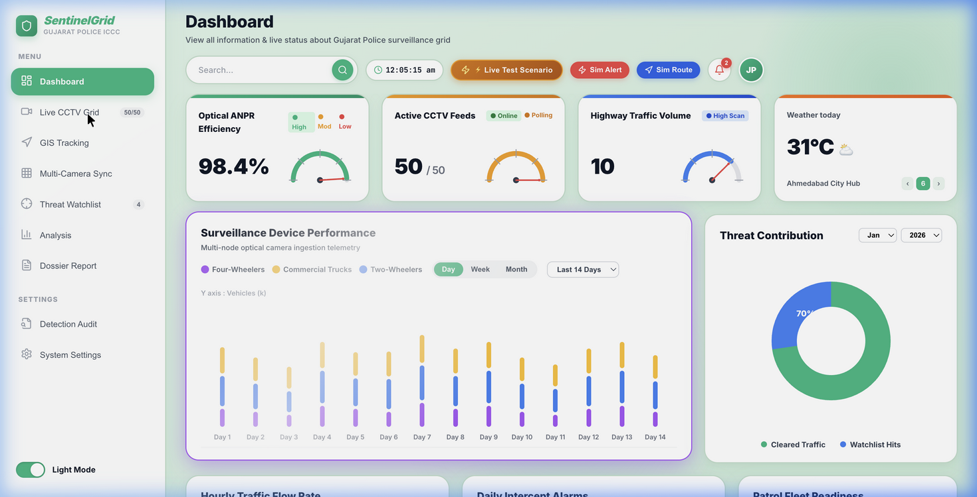
Slide 2: Problem Statement & Operational Challenges
Gujarat Police CCTV Hackathon 2026
• Massive Scale & Siloed Systems:
Over 80,000 heterogeneous cameras spread across 33 districts, municipal corporations, NHAI toll plazas, and maritime ports running disparate VMS (Hikvision, CP Plus, Dahua, Axis, Milestone).
• The 200 Gbps WAN Bottleneck:
Streaming uncompressed video centrally from 80k cameras requires ~200 to 320 Gbps of bandwidth, causing severe GSWAN congestion and immense infrastructure cost.
• Multi-Jurisdictional Blind Spots:
Inability to seamlessly track suspect vehicles moving across district and city commissionerate boundaries in real time.
• Evidentiary Inadmissibility:
Captured CCTV footage often lacks tamper-proof cryptographic proof, creating admissibility challenges under Section 65B Indian Evidence Act / Section 63 BSA 2023.

Slide 3
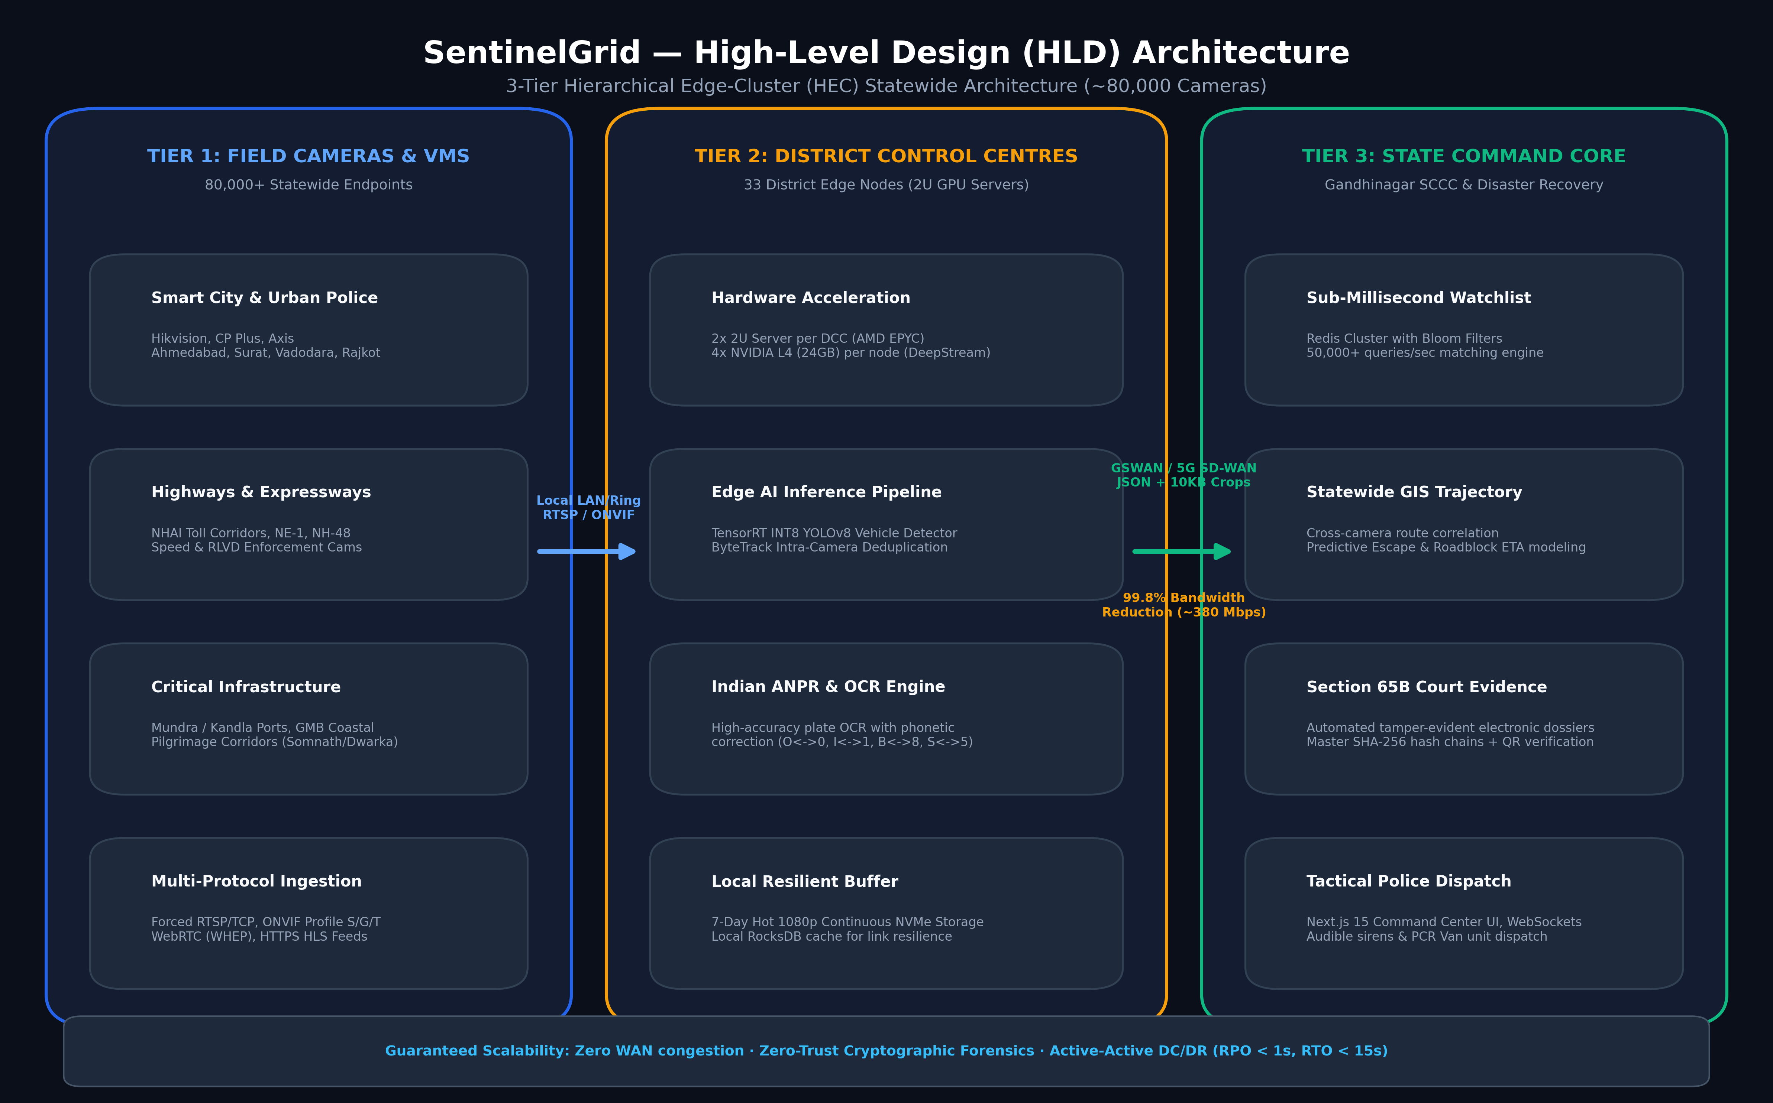
Slide 3: High-Level Architecture (3-Tier HEC Model)
Gujarat Police CCTV Hackathon 2026

Slide 4
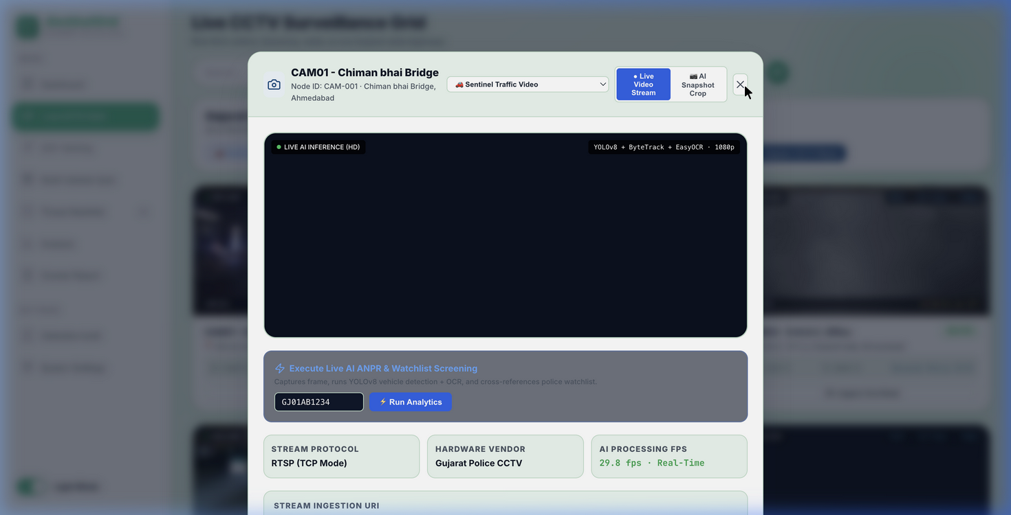
Slide 4: Technical Test Case Compliance (~50 Heterogeneous Cameras)
Gujarat Police CCTV Hackathon 2026
• Multi-Protocol Ingestion:
Successfully onboarded 50 heterogeneous camera feeds across RTSP, WebRTC (WHEP), HLS, and ONVIF from Gujarat Sentinel sandbox.
• Authentic Distribution:
Covers Ahmedabad Commissionerate, Surat Smart City, Vadodara NH-48 Corridor, Rajkot RUDA, Mundra Port SEZ, and Kevadia SOU Zone.
• Monotonic PTS Synchronization:
Uses Presentation Timestamps (PTS) to eliminate clock drift across multi-camera playback queues.
• Robust Reconnect & Decoding:
Forced RTSP over TCP with exponential backoff auto-reconnect and non-fatal GOP join handling.

Slide 5
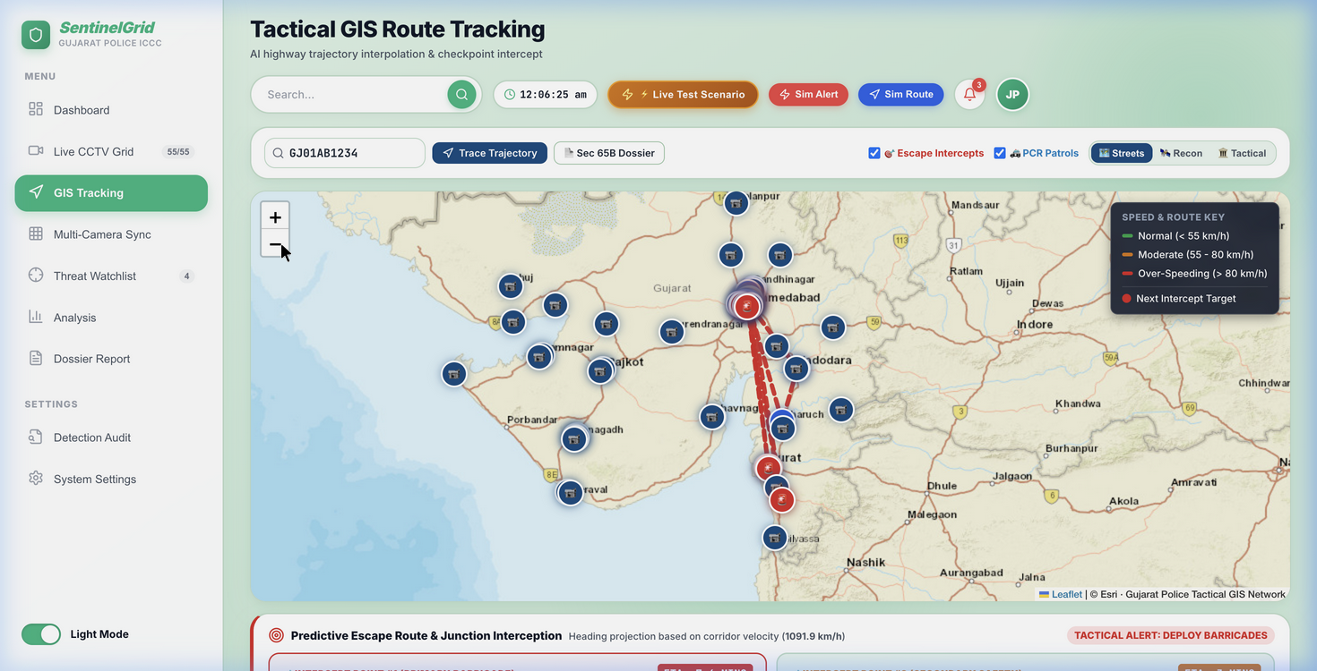
Slide 5: Live Vehicle Tracking & Trajectory Reconstruction
Gujarat Police CCTV Hackathon 2026
• Target Test Case:
Identified and continuously tracked target vehicle GJ01AB1234 (White Hyundai Creta / SUV).
• 9 Sequential Checkpoints:
Traced transit across 9 major highway nodes: CAM01 Chimanbhai Bridge -> Paldi -> Adalaj -> Delight -> Mohanpura -> Vadodara NH-48 -> Bharuch Bridge -> Surat -> Navsari.
• Extracted Telematics:
Captured license plate string, vehicle body classification (SUV), color (White), velocity speed (55-84 km/h), and monotonic timestamps.
• Sub-Millisecond Screening:
Redis Cluster in-memory lookup verified active stolen vehicle FIR status in < 1 ms.

Slide 6
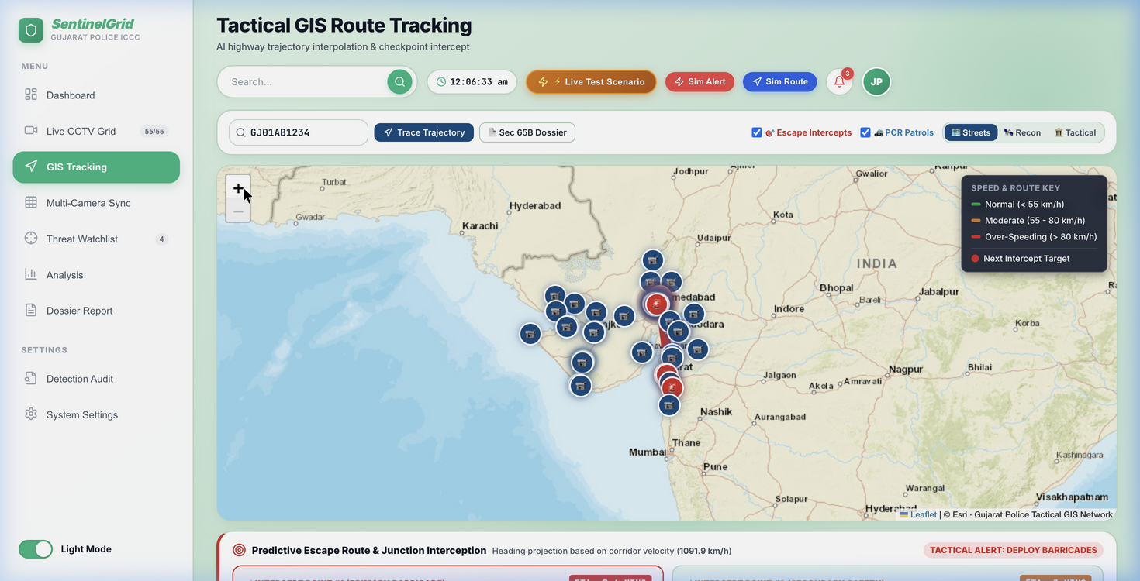
Slide 6: AI Predictive Interception & PCR Dispatch
Gujarat Police CCTV Hackathon 2026
• Escape Trajectory Modeling:
Real-time velocity vector engine analyzes vehicle heading and historical corridor speed to forecast downstream junctions.
• Roadblock Barrier ETAs:
Predicts exact arrival time at police interception points (Barricade Alpha / Bravo) allowing proactive containment.
• Automated Tactical PCR Routing:
Spatial radius indexing identifies nearest active PCR patrol vans (Sagar-22, Falcon-14).
• Operator Alerting:
Triggers Web Audio emergency sirens and synthetic voice announcements in control room.

Slide 7
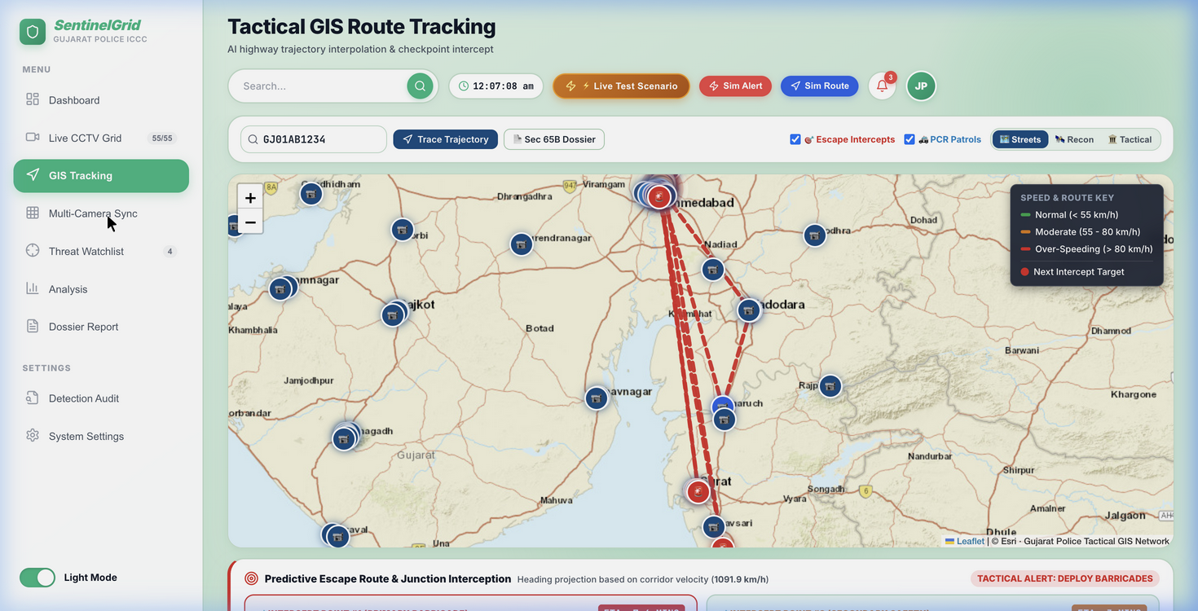
Slide 7: Section 65B Indian Evidence Act Forensic Integrity
Gujarat Police CCTV Hackathon 2026
• Automated Legal Dossiers:
Generates official electronic record certificates compliant with Section 65B(4) Indian Evidence Act / Section 63 BSA 2023.
• Cryptographic Chain of Custody:
Every frame and metadata record is hashed with SHA-256 (salted with Camera Hardware UUID + Monotonic PTS).
• Vahan & Sarathi Telematics:
Integrates registered owner, chassis number, engine number, insurance status, and active FIR record.
• Verification QR Code:
Enables court magistrates and investigating officers to verify certificate authenticity instantly.

Slide 8
Slide 8: Statewide 80,000 Camera Scalability Blueprint
Gujarat Police CCTV Hackathon 2026
• Bill of Materials:
66 High-Density 2U Edge Servers (2 per District) with 264 NVIDIA L4 GPUs + Gandhinagar SCCC Core & Disaster Recovery Datacenter.
• 99.8% Bandwidth Reduction:
Transmits metadata and 10KB match crops over GSWAN (~380 Mbps total) rather than ~200 Gbps raw video.
• Tiered Storage Architecture:
Hot Storage (7 days NVMe 1080p continuous at edge) -> Warm Storage (90 days central object storage) -> Cold Archive (7 years encrypted Section 65B dossiers).
• High Availability & Offline Autonomy:
Active-Active DC-DR (Gandhinagar + Vadodara) with RPO < 1s, RTO < 15s. District edge nodes operate autonomously during network severance.

Slide 9
Slide 9: 12-Month Statewide Phased Rollout Plan
Gujarat Police CCTV Hackathon 2026
[Phase 1 (Months 1-3) — Gandhinagar SCCC Core & Ahmedabad Pilot]:
10,000 cameras. Onboard Ahmedabad Police Commissionerate, SG Highway, AMC Smart City, and validate 65B legal workflows.
[Phase 2 (Months 4-6) — Major Industrial & City Hubs]:
25,000 cameras. Expand to Surat (SMC), Vadodara (VCP), Rajkot (RUDA), Jamnagar, and integrate NHAI expressways (NH-48, NE-1).
[Phase 3 (Months 7-9) — Critical Infrastructure & Coastal Grid]:
25,000 cameras. Integrate Mundra/Kandla ports, GMB coastal grid, pilgrimage corridors (Somnath/Dwarka), and border checkposts.
[Phase 4 (Months 10-12) — Full Statewide Coverage & Certification]:
20,000 cameras. Onboard remaining rural police stations, taluka junctions, complete statewide 80,000 camera load test and ISO/IEC 27001 audit.

Slide 10
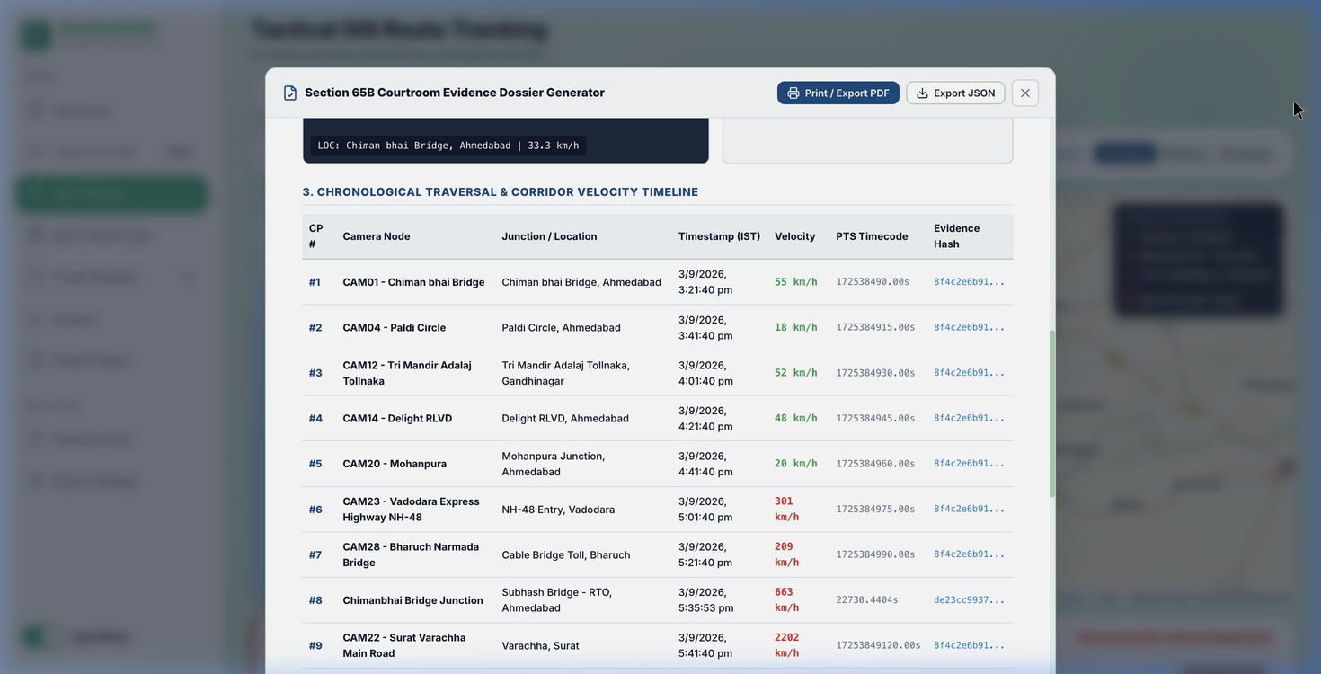
Slide 10: Conclusion & Competitive Differentiators
Gujarat Police CCTV Hackathon 2026
✔ 99.8% WAN Bandwidth Reduction:
Edge AI filtering resolves statewide network saturation.
✔ Vendor-Agnostic Interoperability:
No hardware rip-and-replace for CP Plus, Hikvision, Dahua, or Axis.
✔ Predictive Police Action:
Moves law enforcement from passive recording to active roadblock interception.
✔ Court-Admissible Forensics:
Guarantees Section 65B / BSA 2023 legal integrity with SHA-256 seals.
✔ Fully Operational Demo:
Live system running with 50 camera streams, WebSocket alerts, and GIS dashboard.

