Slide 1


SU safety campus shuttle management system

Slide 2
Team: The Quad Squad
05
DIYA SHAH
HIRAL PAGHADAL
PRIYANKA SHETH
TARUN TALREJA

Slide 3
Contents
1. | Project overview
2. | Goals
3. | E-R diagram
4. | Conceptual model
5. | Logical Model
6. | Problem Statement 1
7. | Problem Statement 2
8. | Problem Statement 3
9. | Problem Statement 4
10. | Problem Statement 5
11. | Logical Design of UI Layout
12. | Conclusion

Slide 4
Project Overview
The purpose of developing the SU safety shuttle system is to provide students with an efficient system to book a safety escort shuttle anywhere around the campus. The system will manage bookings, track rides, store student information, and provide real-time tracking and arrival estimation.

Slide 5
Goals
Define
Implement
Design
Venus is the second planet from the Sun
Despite being red, Mars is actually a cold place
Mercury is the closest planet to the Sun

Slide 6
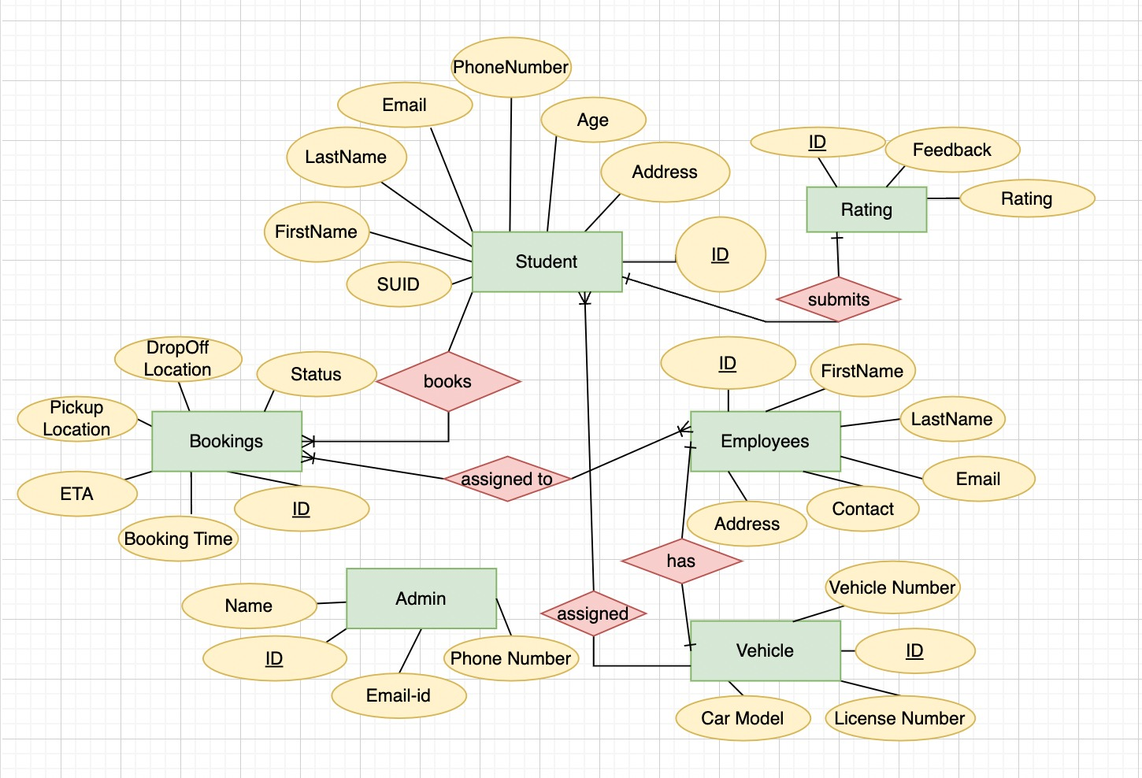
E-R Diagram

Slide 7
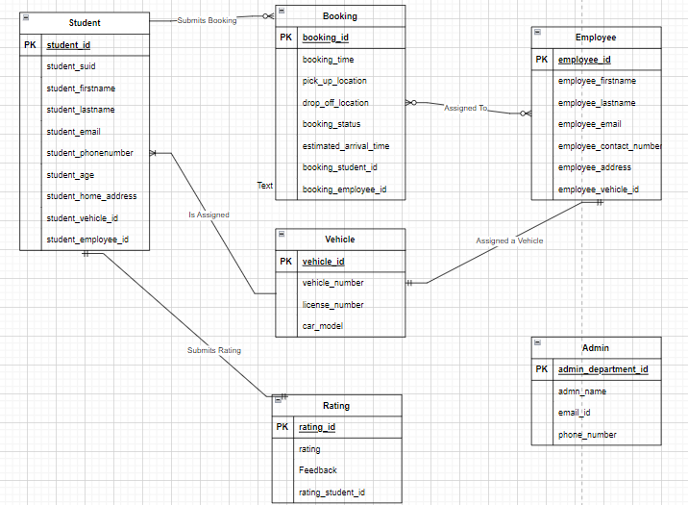
Conceptual Diagram

Slide 8
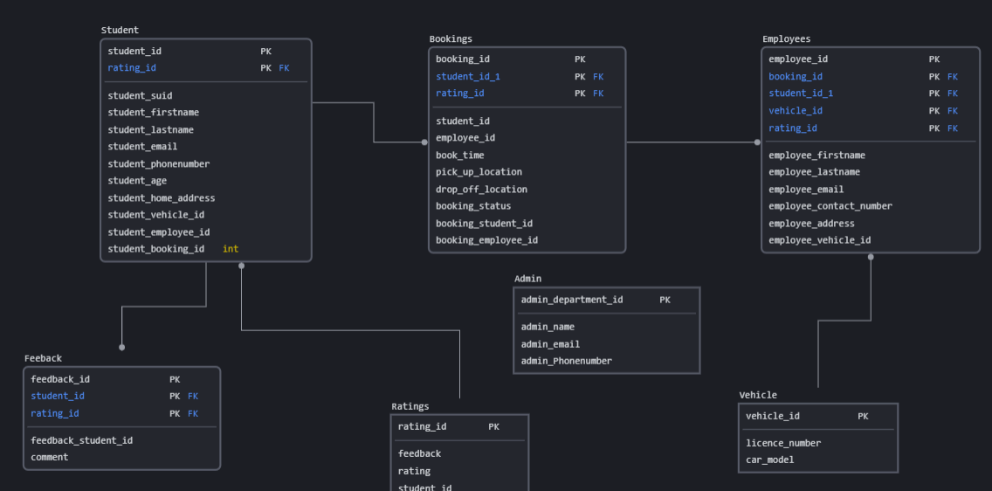
Logical Diagram

Slide 9
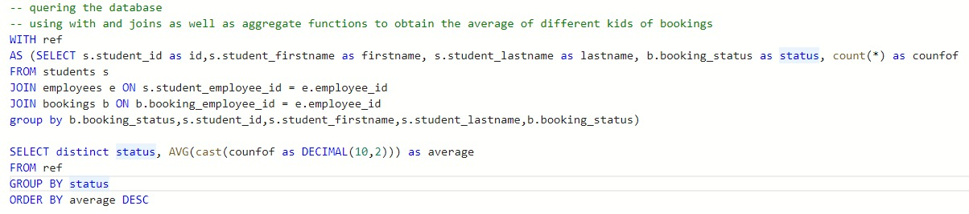
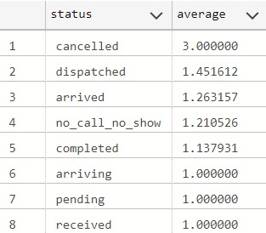
AVERAGE ACCORDING TO BOOKING STATUS
Problem Statement 1
Implemented sub query
Generated report to display average for different booking statuses (Pending, dispatched, arriving, completed, no call no show)

Slide 10
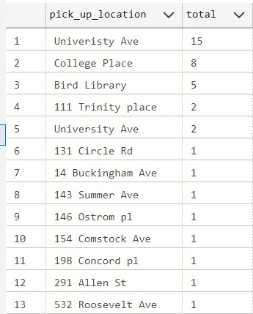
TOP PICKUP LOCATIONS
Problem Statement 2
Implemented windows function
Displayed the top 5 locations which had the most number of bookings

Slide 11
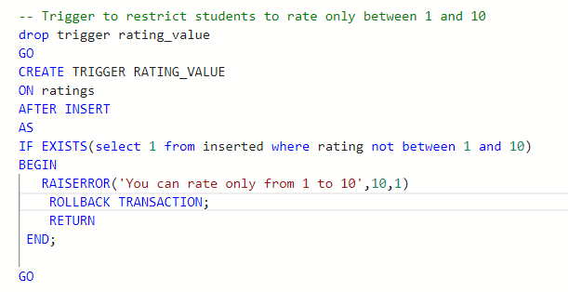
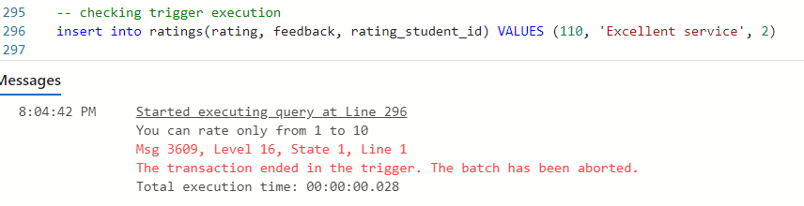
Implemented Trigger
Problem Statement 3
Students rate their overall experience with the shuttle.
The rating is a field that should accept only ratings from 1-10.
Created a trigger to raise an error if a students rates beyond the range of accepted values

Slide 12
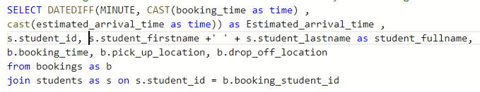
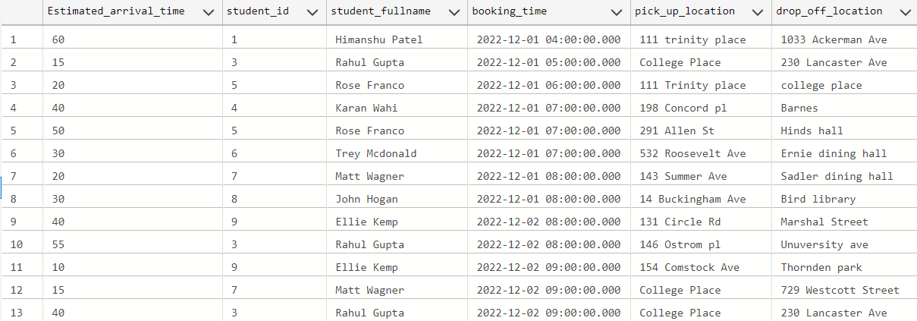
Calculating estimated arrival time for the shuttle
Problem Statement 4
Each booking is associated with a booking time.
To calculate the estimated arrival time of the shuttle we calculated the difference of the booking time and arrival time estimates

Slide 13
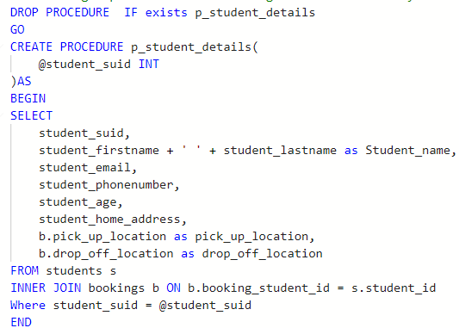

Implementing Procedure
Problem Statement 5
Mercury is the smallest planet in the Solar System. Its name has nothing to do with the liquid metal

Slide 14
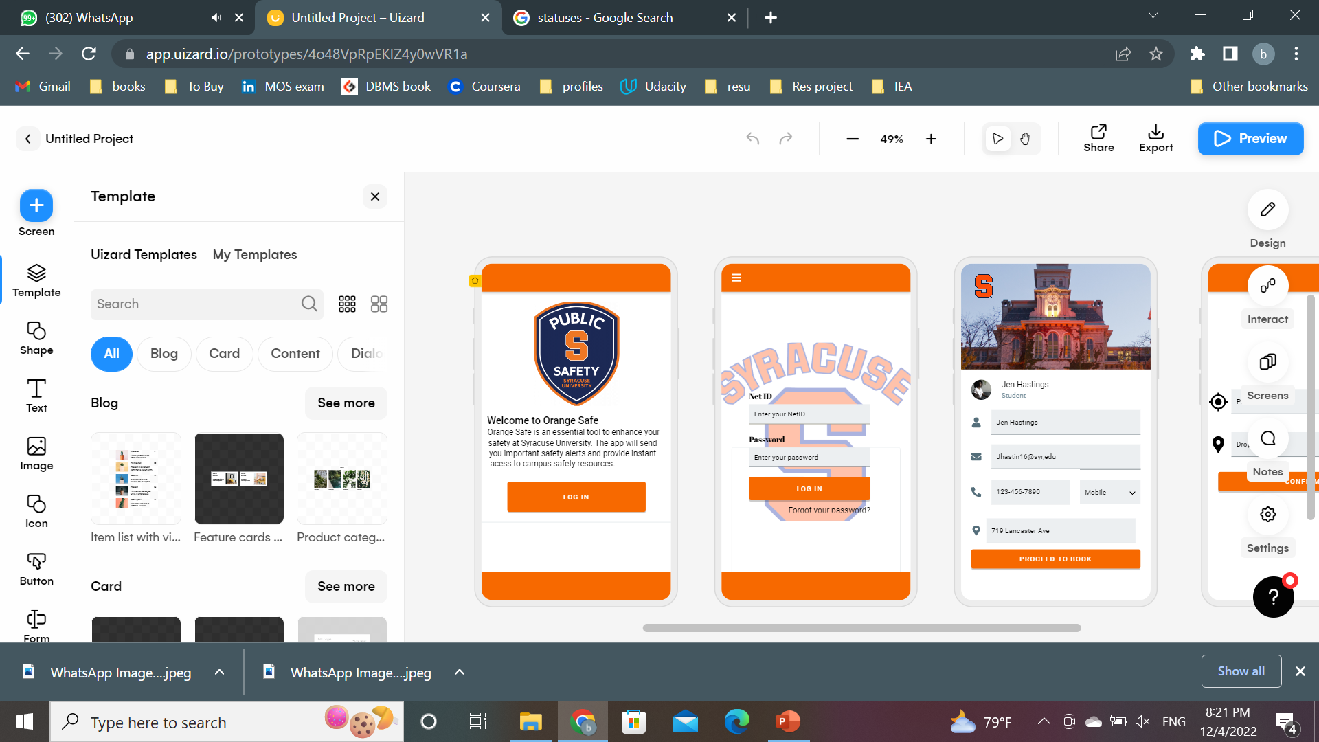

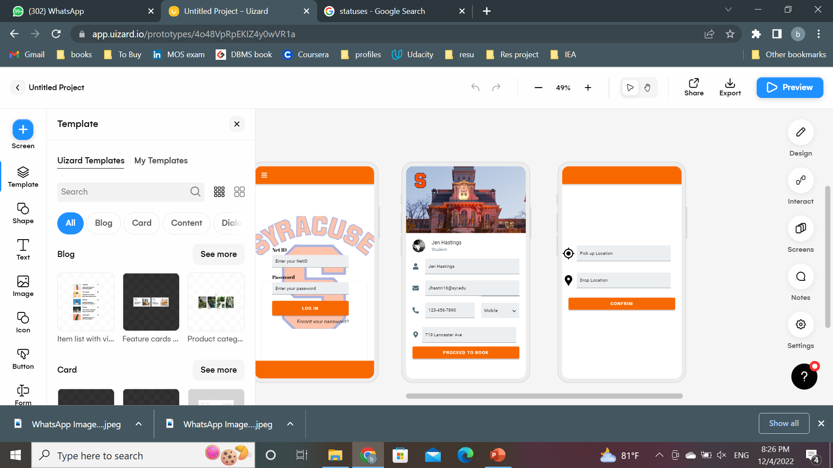
Logical Design of UT Layout
Page 1
Page 2
Page 3
Page 4

Slide 15
Conclusion

