Slide 1
Library
Raami Mohamed Sharif, Solvi Mar Magnusson and Sukhada S. Sheth

Slide 2




Tools used
Flask
Python
Sqlite3
GitHub

Slide 3
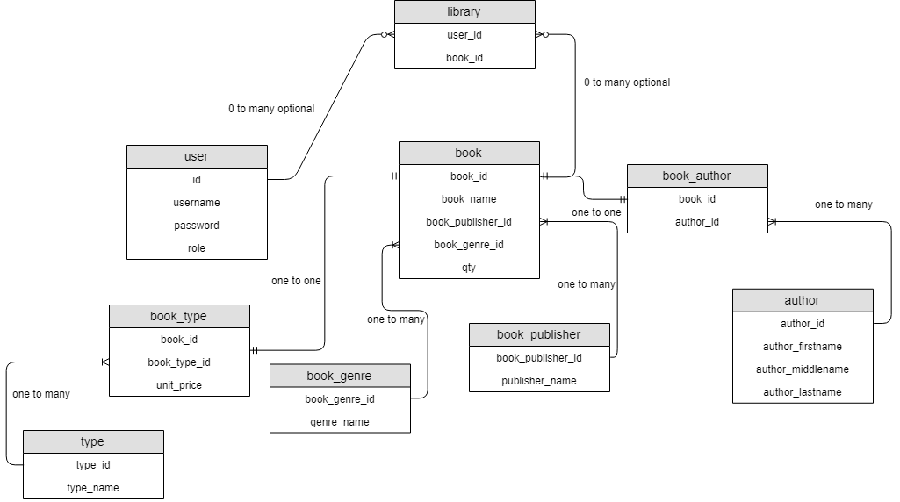
Our database

