Slide 1
Monte Carlo simulation: Optimization of computer time and memory
Sachin Shet¹ and K.V.Subbaiah²
¹Junior Research Fellow, ²Consultant Professor
Manipal Centre for Natural Sciences
Manipal University
Manipal-576104, Karnataka
Email: iamsachinshet@gmail.com
Technical Report
Ref:Stream/ Basic Science/BS-RF005
Work is done under the project:
DAE-BRNS Project Ref. No. :36(4)/14/40/2015/36007

Slide 2
Presentation Layout
Monte Carlo Method
What is Monte Carlo Method
Various Applications
Estimation of Finite integral
Estimation of ‘π’ with Buffon’s needle experiment
Basic elements
Pseudo Random number generator
Dynamic Allocation
Unionized energy Grid
Searching Algorithms
Conclusions
References

Slide 3
Monte-Carlo Method
What is Monte-Carlo Method
Monte Carlo methods are a class of computational algorithms for simulating the behavior of various physical and mathematical systems, in which observations are randomly generated from the model.
History
In 1777s : Estimation of Pi - Buffon
In 1940s : Named as Monte Carlo by Enricho Fermi,
Stan Ulam and Van Neumann.
Notes:
Static vs. dynamic
Static: E.g., Simulation solution to integral
Dynamic: Systems that evolve over time; simulation of traffic system over morning or evening rush period
Deterministic vs. stochastic
Deterministic: No randomness; solution of complex differential equation in aerodynamics
Stochastic (Monte Carlo): Operations of store with randomly modeled arrivals (customers) and purchases
Continuous vs. discrete
Continuous: Differential equations; “smooth” motion of object
Discrete: Events occur at discrete times;
Radiation sources are widely employed in industry, medicine and research. While harnessing them for useful purposes on one side, it is also important on the other hand to avoid causing deleterious effects. Therefore, it is essential to predict or calculate the magnitudes of these radiations while passing through materials.
Monte Carlo technique is widely employed for solving practical radiation transport problems to arrive at a precise solution in a complex geometrical arrangement of materials
Monte Carlo simulation, in which observations are randomly
generated from the model,

Slide 4
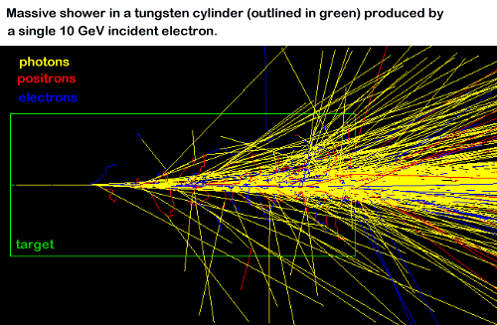
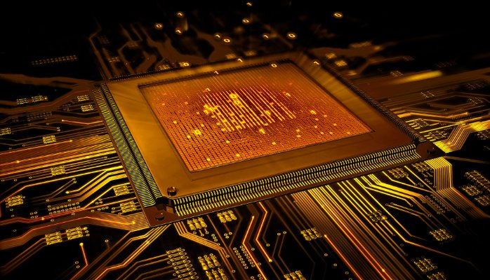
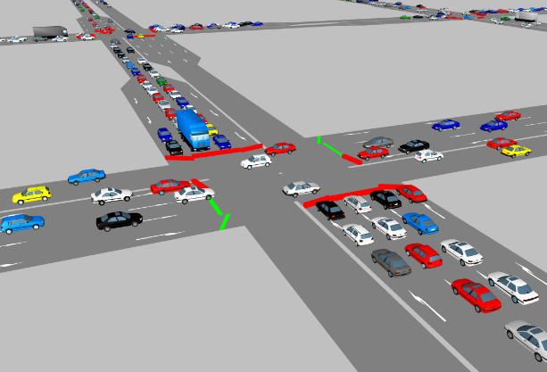
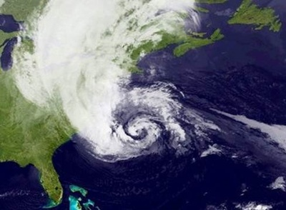
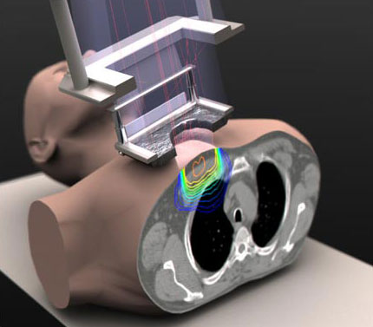
Monte-Carlo Method
Applications of Monte-Carlo Method
This method is used for solving problems in many branches of science, they are :
Radiation transport problems
VLSI design
Traffic flow
Dow-Jones weather forecasting
Radiation therapy

Slide 5
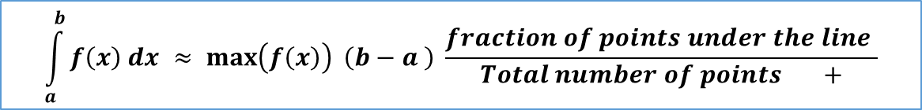
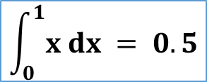
Monte-Carlo Method
Estimation of a finite Integral: Deterministic Method
Deterministic system : In which the later states of the system are determined by the earlier ones.
This method enables artificial construction of a probabilistic model.
$$\int_{a}^{b}{f\left(x\right) dx ≈ \max\left(f\left(x\right)\right) \left(b−a \right) \frac{fraction of points under the line }{Total number of points +}}$$
f(x) = x
$$\int_{0}^{1}{x dx = 0.5}$$
Number of trials | Points enclosed by the curve | Value of the integral
10 | 6 | 0.600
100 | 56 | 0.56
1000 | 497 | 0.497
10000 | 5001 | 0.5001

Slide 6
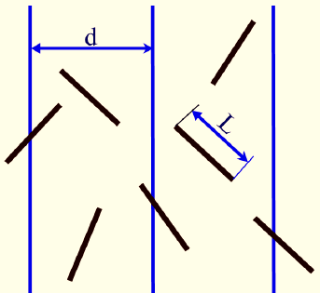
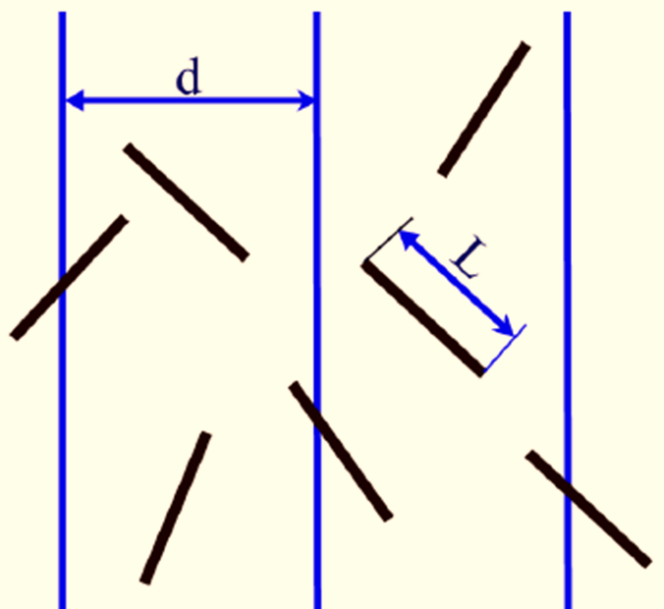

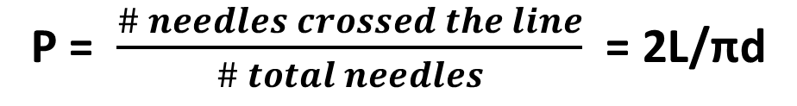
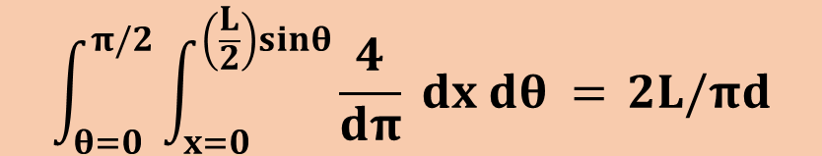


Monte-Carlo Method
Buffon’s needle experiment [1777s]: Estimation of ‘ π ‘
$$\int_{θ=0}^{π/2}{\int_{x=0}^{\left(\frac{L}{2}\right)sinθ}{\frac{4}{dπ} dx dθ = }}2L/πd$$
P = $\frac{\# needles crossed the line}{\# total needles}$ = 2L/πd
$$π=\frac{2L}{Pd}$$
Number of trials | Value of Pi
100 | 3.26086957
1000 | 3.06122449
10000 | 3.12434909
100000 | 3.14348005
1000000 | 3.13580546
10000000 | 3.14196728
100000000 | 3.14205106
Geometry of needle
position in experiment
In 1901
Italianan Mathematician
Mario Lazzarini
Tossed needle 3408 time
Pi $=3.14159292$
$π$= 3.141592

Slide 7
Basic elements of Monte Carlo method:
Random number generator
Sampling of Probability distribution functions
Scoring /tally specification
Error estimation ( 1/ √N, N = number of trials )
Parallelization and vectorization

Slide 8
Pseudo Random number Generator :
Optimization of Computer time.
Random numbers are the back bone of all the Monte Carlo methods .
Monte Carlo simulation make use of random numbers generated by computer algorithms .
Required properties of Pseudo Random number generators
Uniformity
Long Period
Reproducibility
Minimum number of Arithmetic steps

Slide 9
Description | Seeds | Period | Average
r4_random ( s1, s2, s3 ). Linear Congruential 32 bit generator.^{[1]} | No of Seeds: 3 1< S1, S2, S3 < 30000 | 6.9x10¹² | 0.4998
2. r4_uni ( s1, s2 ). Linear Congruential 32 bit generator.^{[1]} | No of Seeds: 2 1< S1,S2 <2147483562 | 2.3x10¹⁸ | 0.5000
3. r8_random ( s1, s2, s3 ). Linear Congruential 64 bit generator.^{[1]} | No of Seeds: 3 1 < S1, S2, S3 < 30000 | 6.9x10¹² | 0.4998
4. r8_uni ( s1, s2 ). Linear Congruential 64 bit generator.^{[1]} | No of Seeds:2 1< S1,S2 <2147483562 | 2.3x10¹⁸ | 0.5000
5. r4_uniform_01 ( seed2 ). Multiplicative pseudo random number generator.^{[2] [3] [4] [5]} 32 bit generator | No of Seeds: 1 1< S1 <2147483562 | NA | 0.4997
6. r8_uniform_01 ( seed3 ). Multiplicative pseudo random number generator.^{[2] [3] [4] [5]} 64 bit generator | No of Seeds: 1 1< S1 <2147483562 | NA | 0.4997
7. r8_uniform_02 ( seed1 ). Multiplicative pseudo random number generator.^{[2] [3] [4] [5]} 64 bit generator | No of Seeds:1 1< S1 <2147483562 | NA | 0.4997
ranC( idumC ). Multiplicative pseudo random number generator.^{[6]} It is a 32 bit generator, and it uses intrinsic MIN MAX functions. | No of Seeds:1 S1 = Negative integer | >2x10¹⁸ | 0.4999
ranE( idumE ) Multiplicative pseudo random number generator. ^{[6]} Uses absolute value function and is a 32 bit generator. | No of Seeds:1 S1 = Negative integer | >2x10¹⁸ | 0.5003

Slide 10
Pseudo Random number Generator :
Results of 9 Pseudo Random number generators:
1. r4_random ( s1, s2, s3 ).
2. r4_uni ( s1, s2 ).
3. r8_random ( s1, s2, s3 ).
4. r8_uni ( s1, s2 ).
5. r4_uniform_01 ( seed2 ).
6. r8_uniform_01 ( seed3 ).
7. r8_uniform_02 ( seed1 ).
8. ranC( idumC ).
9. ranE( idumE )

Slide 11
Memory Allocation:
Optimization of memory in radiation transport problem :
Monte Carlo simulation requires the interaction probabilities of radiation with matter
For Neutron transport problem:
The data table of nuclides contains large number of data points in it.
Data files
Hydrogen
.
Few thousands
Uranium
.
.
.
.
.
Few Millions
Notes:
AThe huge size data points are handled by using the Array concept to save the computer memory.
n array is a collection of (scalar) data, all of the same type, whose individual elements are arranged in a regular pattern
Interaction probabilities are depend on type of radiation and material

Slide 12
Memory Allocation:
Static Allocation :
Size of the memory allocated is fixed, can not be altered during the execution.
Fortran: -------------- Allocate (Array(3,3))-----------------
Hydrogen
Allocated Memory
Uranium
Dynamic Allocation :
The size and the amount of storage can be altered during the execution of the program
-------- Real , Dimension ( : , : ) , Allocatable : : Array -----Fortran: --------- Allocate ( Array ( N , N ) ) --------
Deallocate
Free Memory
Hydrogen
Free Memory
Free Memory
Uranium
Notes:
Static Array: Allocate (Array(3,3))

Slide 13
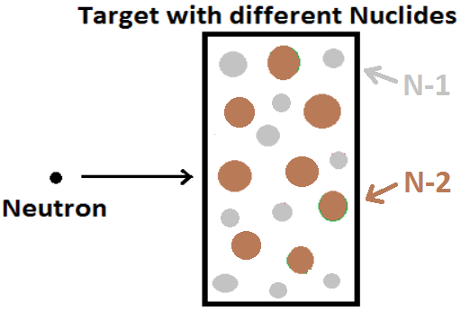
Radiation transport problem:
more than one nuclide in target
Data files of Nuclides
Nuclide
1
Nuclide
2
Large number of points of energy.
Notes:
The target material may have more than one nuclide. Since each nuclide has a unique microscopic cross sections , This requires looking up the microscopic cross sections for these reactions for each nuclide within the target material
This is a very time-consuming process.
At each collision, it is necessaTo reduce the time required for the indexing search for energy in each nuclide data for a given incident neutron energy, We unionize the energy grid of all the Nuclide.
ry to sample the probability of having a particular type of interaction whether it will be elastic scattering, inelastic scattering, etc.

Slide 14
Unionized energy grid:
If two energy grids are
Overlapping
n(N1)+n(N2)-n(N1∩N2)
Unionized Energy
Nuclide
1
Nuclide
2
E-1
E-1
E-3
E-2
E-2
E-4
E-3
E-3
U
E-5
E-4
E-4
E-6
E-5
E-5
E-7
E-6
[n(N1) = 5]
[n(N2) = 5]
E-7
n(N1 U N2) = 7

Slide 15
Unionized energy grid:
If two energy grids are
Identical
n(N1UN2) = n(N1)
Nuclide
1
Nuclide
2
Unionized Energy
E-1
E-1
E-1
E-2
E-2
E-2
E-3
E-3
E-3
U
E-4
E-4
E-4
E-5
E-5
E-5
[n(N1) = 5]
[n(N2) = 5]
n(N1 U N2) = 5

Slide 16
Unionized energy grid:
If two energy grids are
Disjoint
n(N1UN2) = (N1)+n(N2)
Nuclide
1
Nuclide
2
Unionized Energy
E-1
E-6
E-1
E-6
E-2
E-7
E-2
E-7
E-3
U
E-8
E-3
E-8
E-4
E-9
E-4
E-9
E-5
E-10
E-5
E-10
[n(N1) = 5]
[n(N2) = 5]
n(N1 U N2) = 10
16

Slide 17
Searching Algorithm:
Binary Search:
In the given Array A[ ], We have to search for the index i
such that A[ i ] = Search value
a[lo] ≤ Search value ≤ a[hi].
Ex. Binary search for 95.
53
6
13
14
25
33
43
51
53
64
72
84
93
95
96
97
0
1
2
3
4
5
6
7
8
9
10
11
12
13
14
lo
mid
hi

Slide 18
Searching Algorithm:
Binary Search:
In the given Array A[ ], We have to search for the index i
such that A[ i ] = Search value
a[lo] ≤ Search value ≤ a[hi].
Ex. Binary search for 95.
6
13
14
25
33
43
51
53
64
72
84
93
95
96
97
0
1
2
3
4
5
6
7
8
9
10
11
12
13
14
lo
mid
hi

Slide 19
Searching Algorithm:
Binary Search:
In the given Array A[ ], We have to search for the index i
such that A[ i ] = Search value
a[lo] ≤ Search value ≤ a[hi].
Ex. Binary search for 95.
6
13
14
25
33
43
51
53
64
72
84
93
95
96
97
0
1
2
3
4
5
6
7
8
9
10
11
12
13
14
lo
mid
hi

Slide 20
Searching Algorithm:
Binary Search:
In the given Array A[ ], We have to search for the index i
such that A[ i ] = Search value
a[lo] ≤ Search value ≤ a[hi].
Ex. Binary search for 95.
51
53
64
93
95
6
13
14
25
33
43
72
84
95
96
97
0
1
2
3
4
5
6
7
8
9
10
11
12
13
14
lo
hi
mid

Slide 21
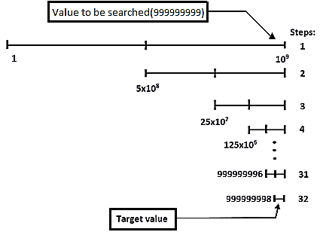
Searching Algorithms:
Comparison of search algorithms:
Sequential Search: Number of Steps : N ( total number of elements in search )
999,999,999
Binary Search: Number of Steps : log₂N
Sequential | Binary
999,999,999 steps | 32 steps
1000 seconds | 32 µs

Slide 22
Conclusion
Monte Carlo simulation is very time consuming, and requires huge memory storage.
With usage of
Good Random number generating function
Dynamic allocation of the array
Unionized energy grid of nuclides and
Different searching algorithms
the time and the storage space required for the Monte Carlo simulation can be optimized considerably

Slide 23
Acknowledgements
Authors express sincere thanks to Dr. Kapil Deo Singh and Dr. S. Anand for the training and for the constant encouragement. And I am thankful for the guidance given by other supervisor as well as the panels especially in our project.

Slide 24
References
Particle-transport simulation with the
Monte Carlo method
Carter, L.L. ; Cashwell, E.D.
Monte Carlo N–Particle Transport Code System
Contributed by: Los Alamos
National Laboratory, Los
Alamos, New Mexico
Monte Carlo methods
Malvin H. Kalos
Bennett Fox,
Algorithm 647:
Implementation and Relative Efficiency
of Quasirandom
Sequence Generators,
ACM Transactions on Mathematical
Software,
Volume 12, Number 4, December 1986,
pages 362-376.
Pierre L'Ecuyer,
Random Number Generation,
in Handbook of Simulation,
edited by Jerry Banks,
Wiley, 1998,
ISBN: 0471134031,
LC: T57.62.H37.
Peter Lewis, Allen Goodman, James Miller,
A Pseudo-Random Number Generator for the System/360,
IBM Systems Journal,
Volume 8, 1969, pages 136-143.
Numerical Recipes in Fortran
The art of scientific computing
William H. Press, Saul A. Teukolsky
William T. Vetterling, Brian P. Flannery
Notes:
Brian Wichman, David Hill,
Algorithm AS 183: An Efficient and
Portable Pseudo Random Number Generator,
Applied Statistics, Volume 31
Paul Bratley, Bennett Fox, Linus Schrage,
A Guide to Simulation,
Second Edition,
Springer, 1987,
ISBN: 0387964673,
LC: QA76.9.C65.B73.
Bennett Fox,
Algorithm 647:
Implementation and Relative Efficiency of Quasirandom
Sequence Generators,
ACM Transactions on Mathematical Software,
Volume 12, Number 4, December 1986, pages 362-376.
Pierre L'Ecuyer,
Random Number Generation,
in Handbook of Simulation,
edited by Jerry Banks,
Wiley, 1998,
ISBN: 0471134031,
LC: T57.62.H37.
Peter Lewis, Allen Goodman, James Miller,
A Pseudo-Random Number Generator for the System/360,
IBM Systems Journal,
Volume 8, 1969, pages 136-143.
Numerical Recipes in Fortran
The art of scientific computing
William H. Press, Saul A. Teukolsky
William T. Vetterling, Brian P. Flannery
Particle-transport simulation with the Monte Carlo method
Carter, L.L. ; Cashwell, E.D.
Monte Carlo N–Particle Transport Code System
Contributed by: Los Alamos National Laboratory, Los Alamos, New Mexico
Monte Carlo methods
Malvin H. Kalos

Slide 25
Thank You

Slide 26
Development of Monte Carlo code for the estimation of K_{eff}
Sachin.
JFR, MCNS.
This work carried out under BRNS Project:
Development of indigenous Monte Carlo code for estimation of k_{eff} in nuclear fuel cycle facilities.(Project Ref. No. :36(4)/14/40/2015/36007 )

Slide 27
Outline
Monte Carlo method
Neutron multiplication factor of a system ( k_{eff} )
Introduction and Explanation of developed code
Solved problems and results
Plan of further development

Slide 28

Monte Carlo
Probability of getting head or tail is $\frac{1}{2}$ = $\frac{ favorable events}{total events}$
Random numbers ( 0 to 1 )
1
1
0.5
0.5
T
P(x)
0.5
Tossing a coin:
H
0
0
H
T
Let’s toss a coin for 10 times
pdf
cdf
T
H
T
H
H
T
T
H
T
H
Trials | Number of heads | Expected number
10 | 6 | 5
20 | 11 | 10
50 | 28 | 25
Randomly

Slide 29

Monte Carlo
Monte Carlo methods are a class of computational algorithms for simulating the behavior of various physical and mathematical systems, in which observations are randomly generated from the model.
Neutron multiplication factor of a system
weather forecasting
Radiation therapy
Traffic flow
Radiation transport problems

Slide 30
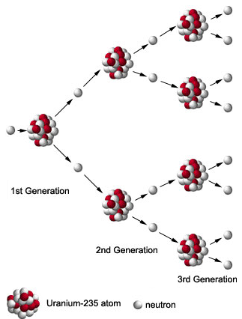
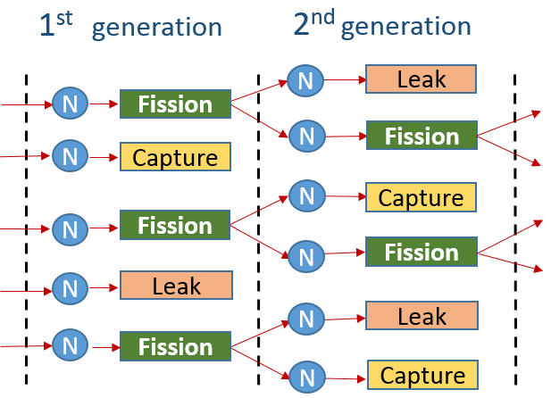
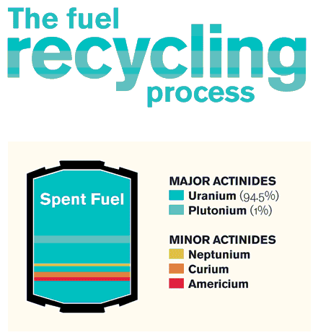
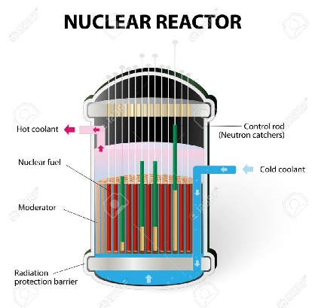
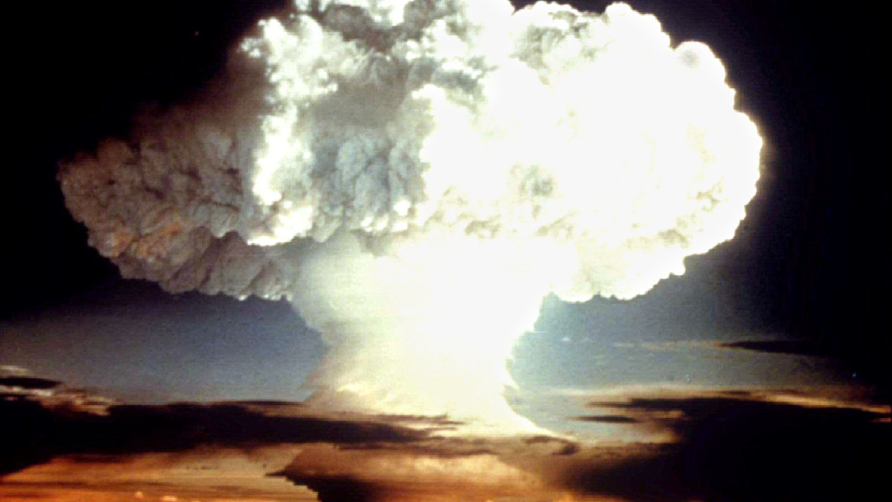

Neutron multiplication factor ( K_{eff} )
Nuclear Fission
Chain reaction
$$Keff= \frac{Number of neutrons produced (2nd )}{Number of neutrons started (1st)}$$
K_{eff} < 1
K_{eff} = 1
K_{eff} > 1
Notes:
Subcritical super sustained

Slide 31
Reason for development
Licensed Monte Carlo Criticality codes are not available in India
Not much significant organized effort for situations outside reactor geometry
To ensure safety, a proper tool is required for analysis of complex fissile systems.
Therefore, development of a Monte Carlo code indigenously , which is applicable to complex geometries is highly desirable.

Slide 32
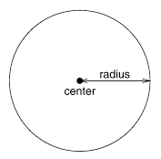
Method
Program flow
Input
1.Processing user input (Geometry and Materials)
2.Reading nuclide cross-section data
MODULE INPUT
Shows Warning
Execution stops with fatal error
Godiva Reactor (Benchmark Problem)
U-235, U-238 U-234
Input
Simulate all particles
output
User need to provide the cross section data of all nuclide
MODULE CROSS_SECTION
Reads the cross section of all nuclide from ace formatted file and stores them in computer memory for further usage
8.741 cm
Cell 1
Cell 2
1 1 -18.74 -1 imp:n=1 $ enriched uranium sphere (godiva)
2 0 1 imp:n=0 $ all space outside the sphere
Cells
1 so 8.741 $ radius of the Godiva sphere
Surfaces
m1 92235 -93.71 92238 -5.27 92234 -1.02
Materials

Slide 33
Program flow
Input
Simulate all particles
output
1. Random number Generation
2. Required Physics
3. Computational Geometry
Requirement of huge quantity of random Numbers with
good quality
How far to collision ?
Which Nuclide ?
New Energy & Direction ?
Any secondary ?
Is particle alive ?
In which cell a particle is ?
How far to boundary ?
What is after the boundary?
Does particle leaking out ?

Slide 34
Program flow
Input
Simulate all particles
output
1. Random number generation
Requirement of HUGE quantity (millions) of random numbers
Required properties
Long period – capable of generating huge quantity of random
numbers without repetition
Uniformity – should generate random numbers uniformly from 0 to 1
Time – should generate random numbers in optimum time
MODULE RANDOM
Gives random numbers
Description | Seeds | Period | Average | Time for 100 million(sec)
1. r4_random (s1, s2, s3) | 1< S1, S2, S3 < 30000 | >6.9x10¹² | 0.4998 | 9.6250
2. r4_uni (s1, s2) | 1< S1,S2 <2147483562 | >2.3x10¹⁸ | 0.5000 | 7.0156
3. r8_random (s1, s2, s3) | 1 < S1, S2, S3 < 30000 | >6.9x10¹² | 0.4998 | 11.3906
4. r8_uni (s1, s2) | 1< S1,S2 <2147483562 | >2.3x10¹⁸ | 0.5000 | 8.0625
5. r4_uniform_01 (seed2) | 1< S1 <2147483562 | NA | 0.4997 | 5.2655
6. r8_uniform_01 (seed3) | 1< S1 <2147483562 | NA | 0.4997 | 8.5156
7. ranC(idumC) | S1 = Negative integer | >2x10¹⁸ | 0.4999 | 28.4062
8. ranE(idumE) | S1 = Negative integer | >2x10¹⁸ | 0.5003 | 18.6094
9. Prn(s) | S1= positive integer | >2.3x10¹⁸ | 0.5001 | 5.0186
Notes:
To transport 10,000 Particle it
requires 4,74,053 random numbers !!!

Slide 35
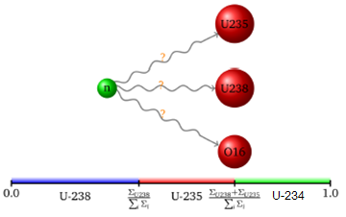

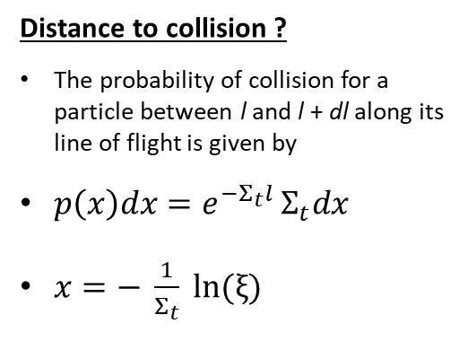
Program flow
Input
Simulate all particles
output
2. Required Physics
Distance to collision ?
The probability of collision for a particle between l and l + dl along its line of flight is given by
$p\left(x\right)dx=e^{{−Σ}_{t}l^{ }}Σ_{t}dx$
$x=− \frac{1}{Σ_{t}} ln(ξ)$
Which nuclide ?
We compare cross-section to determine which nuclide a neutron collides with
Normalize the Nuclide cross-sections for sampling
U-235
U-234
1
R.N
U-238
0

Slide 36

Program flow
Input
Simulate all particles
output
2. Required Physics
MODULE physics
Gives which nuclide a neutron collides with
Gives the type of interaction
Tells Whether the neutron is alive
Gives the exit energy and direction
Gives the number of neutron produced from the fission
What is the particle direction and energy after the interaction ?
(if particle is alive )
What is the number of neutron after the fission ?
(if fission event occurs)

Slide 37
Program flow
Input
Simulate all particles
output
For each collision of neutron having energy E,
it is required to search the energy and in the ACE file of that collision nuclide
Double indexing
E=1
1
2
3
4
5
6
7
1
2
3
4
5
5
5
0
0
1
2
3
4
5
E=1
E=3
E=2
Unionized energy grid method
E=2
E=4
E=3
E=3
∪
E=5
=
E=4
E=4
E=6
E=5
E=5
E=7
E=6
Nuclide-1
Nuclide-2
E=7
Hydrogen – few thousands
Uranium – few millions
Unionized energy grid
Nuclide-1
Nuclide-2
Notes:
Which is the type of interaction of neutron with nuclide?
absorption ? scattering? Or fission ?
Normalize the interaction cross-sections of nuclide and sampling.

Slide 38
Program flow
Simulate all particles
output
Input
Simulate all particles
Input
Comparison of search algorithms
1. Sequential Search: Number of Steps : N ( total number of elements in search )
999,999,999
2. Binary Search: Number of Steps : log₂N
Sequential | Binary
999,999,999 steps | 32 steps
1000 seconds (16 min) | 32 µs

Slide 39
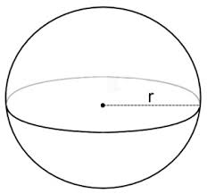
Program flow
Input
Simulate all particles
output
3. Computational Geometry
Surfaces
For a given point in space, (x,y,z), and surface equation, F(x’,y’,z’)=0,
the sense of the point with respect to the surface is defined as:
Inside the surface, sense < 0 if F(x,y,z) < 0
Outside the surface, sense > 0 if F(x,y,z) > 0
On the surface, sense = 0 if F(x,y,z) = 0
x-plane
y
Negative
sense
Positive
sense
Negative sense
Negative
sense
Positive
sense
X-5 = 0
x
Positive sense

Slide 40
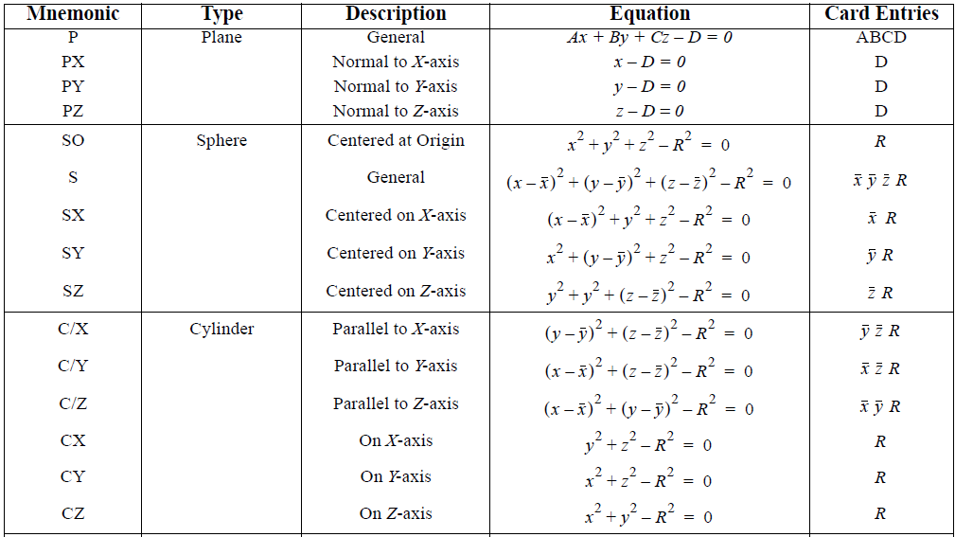
Program flow
Input
Simulate all particles
output
3. Computational Geometry
Surfaces

Slide 41
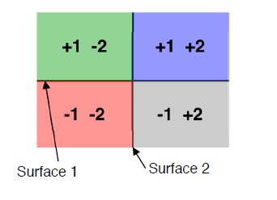
Create cell with intersection of spaces
Program flow
Input
Simulate all particles
output
3. Computational Geometry
Godiva Reactor
Surface 1
1 1 -18.74 -1 imp:n=1 $ enriched uranium sphere (godiva)
2 0 1 imp:n=0 $ all space outside the sphere
1 so 8.741 $ radius of the godiva sphere

Slide 42
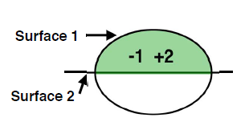
Distance to boundary
Program flow
Input
Simulate all particles
output
3. Computational Geometry
Finding cell for a co-ordinate
For all cells and each surfaces of a cell
(substitute particle co-ordinates in surface equation)
(if any one surface doesn’t satisfy the user defined geometry specification – particle is outside)
For a cell and each surfaces
Evaluate:
D_{surf} = smallest positive root of
F_{surf}( x, y, z ) = 0
d = min ( d, D_{surf} )
.

Slide 43
Program flow
Input
Simulate all particles
output
3. Computational Geometry
Cross surface -- Handles surface crossings
Cell contains -- to check whether particle in a cell
Sense -- checks the sense of all type of surfaces with a given co-ordinate
Neighbor list – which is used in surface crossing
Module geometry
Status of a particle and various other parameters of a particle in user defined geometry specification

Slide 44
Simulate a particle (tracking)
Program flow
Input
Simulate all particles
output
Random numbers
Required Physics
Module tracking
Start a particle Find cell
Geometry
Calculate:
Distance to boundary(DB)
Distance to collision(DC)
Cross the surface move to new cell
DB > DC ?
Cell ?
Particle with New Energy and Direction
true
if no cell,
Particle leaked
got collision, handle in physics module
K_{eff}
(tracklength)
(collision)
(absorption)
true
Alive ?
Particle absorbed in material
Terminate particle

Slide 45
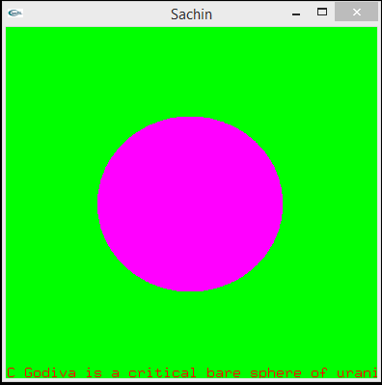
Results
1. Godiva (Benchmark problem)
1 -18.74 -1 imp:n=1 $ enriched uranium sphere (godiva)
2 0 1 imp:n=0 $ all space outside the sphere
1 so 8.741 $ radius of the godiva sphere
m1 92235.72c -93.71 92238.72c -5.27 92234.72c -1.02
codes | Keff
Benchmark Keff | 1.000 ± 0.0010
MCNP | 0.9995 ± 0.0005
This code | 1.0070 ± 0.0006

Slide 46
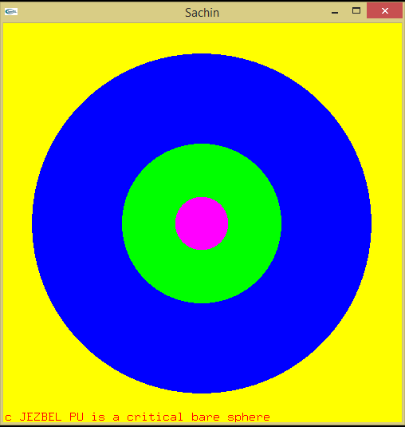
Results
2.Jezbel (Benchmark problem)
1 1 .038918 -1 imp:n=1
2 1 .038918 1 -2 imp:n=1
3 1 .038918 2 -3 imp:n=1
0 3 imp:n=0
1 so 1.0
2 so 3.0
so 6.385
m1 94239.72c 0.03705 94240.72c 0.001751
94241.72c 0.000117
m2 94239.72c 1.0
m3 94240.72c 1.0
m4 94241.72c 1.0
code | Keff
Benchmark Keff | 1.000 ±0.0010
MCNP | 0.99902 ±0.00057
This code | 0.99691±0.00062

Slide 47
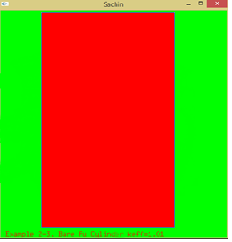
Results
3.Bare Pu-239 cylinder (Benchmark problem)
1 1 -15.8 -1 2 -3 imp:n=1
0 1:-2:3 imp:n=0
1 cz 4.935
2 Pz 0
3 pz 17.273
m1 94239.66c 1.0
code | Keff
Benchmark Keff | ≈ 1.01
MCNP | 1.01403 ±0.00066
This code | 1.023241± 0.0007

Slide 48
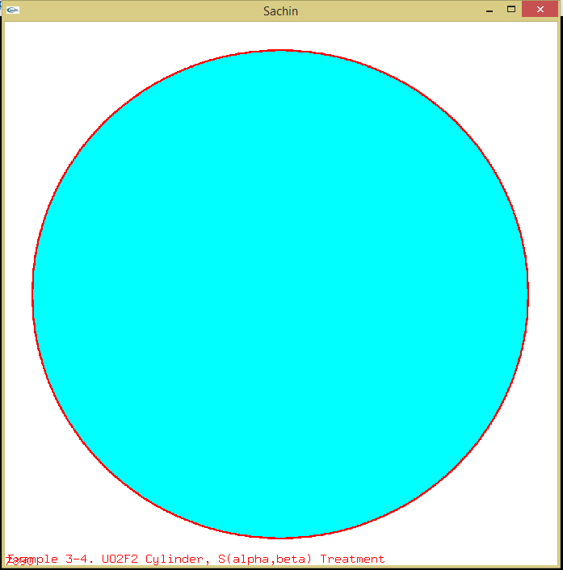
Results
4. UO2F2 Cylinder (Benchmark problem)
1 1 9.6586E-2 -1 3 -4 imp:n=1
2 0 -1 4 -5 imp:n=1
3 2 -2.7 -2 -3 6 imp:n=1
4 2 -2.7 1 -2 -5 3 imp:n=1
5 0 2:5:-6 imp:n=0
1 cz 20.12
2 cz 20.2787
3 pz 0.0
4 pz 100.0
5 pz 110.0
6 pz -0.1587
m1 1001.62c 5.7058e-2 8016.62c 3.2929e-2"
9019.62c 4.3996e-3 92238.66c 2.0909e-3"
92235.66c 1.0889e-4"
mt1 hh2o.71t "
m2 13027.62c 1
code | Keff
Benchmark Keff | ≈ 1.000
MCNP | 0.99842± 0.00077
This code | 0.996797 ± 0.0008

Slide 49
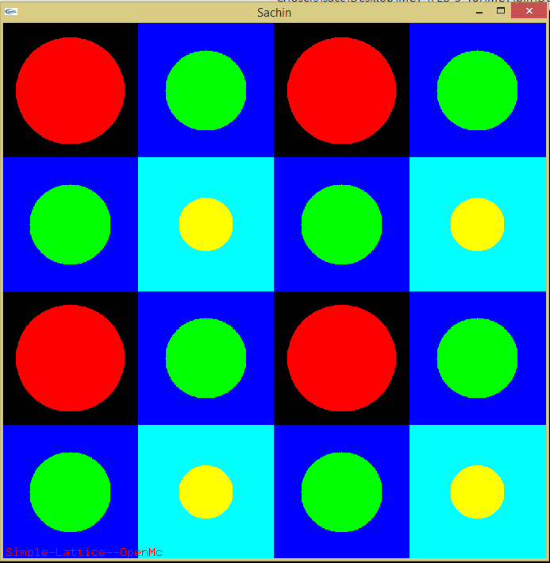
Results
5. Simple lattice
1 0 fill=5 1 -2 3 -4 imp:n=1
101 1 -4.5 -5 u=1 imp:n=1
102 2 -1.0 5 u=1 imp:n=1
201 1 -4.5 -6 u=2 imp:n=1
202 2 -1.0 6 u=2 imp:n=1
301 1 -4.5 -7 u=3 imp:n=1
302 2 -1.0 7 u=3 imp:n=1
3 0 -1:2:-3:4 imp:n=0
0 1 -2 3 -4 imp:n=1 lat=1 u=5 fill=0:3 0:3 0:0 1 2 1 2
2 3 2 3
1 2 1 2
2 3 2 3
1 px -2.0
2 px 2.0
3 py -2.0
4 py 2.0
5 cz 0.4
6 cz 0.3
7 cz 0.2
m1 92235.72c 1.0
m2 1001.72c 2.0 8016.72c 1.0
mt2 hh2o.71t
code | Keff
OpenMC | 0.05983 ± 0.0001
This code | 0.072534 ± 0.0002

Slide 50
To do
Incorporate input feature ( include other surface like cone ellipsoid )
lattice – hexagonal
nested lattice
complex cell ( union and complement operators)
write code to for parallel mode
much more

Slide 51
References
Numerical Recipes in Fortran The art of scientific computing
William H. Press, Saul A. Teukolsky William T. Vetterling, Brian P. Flannery
Monte Carlo methods, Malvin H. Kalos
Monte Carlo N–Particle Transport Code System Contributed by: Los Alamos
National Laboratory, Los Alamos, New Mexico
Roger Brewer, “Criticality Calculations with MCNP5: A Primer”,
Los Alamos National Laboratory,LA-UR-09-00380, January 2009
A Monte Carlo Primer, Stephen A Dupree and Stanley K. Fraley
http:// www.stackoverflow.com, http://gcc.gnu.org http://github.com
,
Conference papers
1. “Advances in Monte Carlo methods in Radiation Transport” Sachin Shet, K.V.Subbaiah
Indian Association for Radiation Protection International Conference – 2018,
2. “Monte Carlo simulation: Optimization of computer time and memory”, Sachin Shet, K.V.Subbaiah
Manipal Research Colloquium – 2017
3. “Comparison of measured and calculated dose rates of Am-Be source with Monte Carlo simulation.”
Sachin Shet, K V Subbaiah, 21st National Symposium on Radiation Physics-2018

Slide 52
cxs
normalize_ao
logarithmic_grid
calculate_xs
calculate_nuclide_xs
calculate_urr_xs
read_xs
read_ace_table
read_esz
read_nu_data
read_reactions
read_angular_dist
read_energy_dist
get_energy_dist
length_energy_dist
read_unr_res
generate_nu_fission
read_thermal_data
get_int
get_real
is_fission
is_disappearance
is_scatter
reaction_name
calculate_sab_xs
common
write_fatalerror
write_warning
write_message
int_read_write
binary_search
int_to_str
interpolate_tab1
real_to_str
free_memory
geometry
cell_contains
simple_cell_contains
complex_cell_contains
find_cell
cross_surface
cross_lattice
distance_to_boundary
Sense
handle_lost_particle
Graphics
C-binding modules
Opengl_kinds
Opengl_gl
Opengl_glu
Opengl_glut
Physics
Collision
sample_reaction
sample_nuclide
sample_fission
Absorption
Scatter
elastic_scatter
sab_scatter
sample_target_velocity
sample_cxs_target_velocity
create_fission_sites
sample_fission_energy
inelastic_scatter
sample_angle
rotate_angle
sample_energy
maxwell_spectrum
watt_spectrum
nu_total
nu_prompt
nu_delayed
Particle_header
deallocate_coord
initialize_particle
clear_particle
Thank you . . .
Input
split_string
Tokenize
to_lower
to_upper
is_number
string_contains
generate_rpn
already_contains
neighbor_list
input_check
id_index
input_print
input_read
input_block_process
input_samples
input_file_read
Eigenvalue
run_eigenvalue
output_print
initialize_batch
initialize_generation
finalize_generation
finalize_batch
synchronize_bank
reset_result
Random_lcg
Prn
initialize_prng
set_particle_seed
Source
initialize_source
sample_external_source
get_source_particle
copy_source_attributes
Graphics
Plot
position_rgb
Plotter
Display
declarations
contains all type
and class declarations
required
constants
Contains all constant
parameter required
for the code
Tracking
transport

Slide 54
13 k lines
cxs
normalize_ao
logarithmic_grid
calculate_xs
calculate_nuclide_xs
calculate_urr_xs
read_xs
read_ace_table
read_esz
read_nu_data
read_reactions
read_angular_dist
read_energy_dist
get_energy_dist
length_energy_dist
read_unr_res
generate_nu_fission
read_thermal_data
get_int
get_real
is_fission
is_disappearance
is_scatter
reaction_name
calculate_sab_xs
common
write_fatalerror
write_warning
write_message
int_read_write
binary_search
int_to_str
interpolate_tab1
real_to_str
free_memory
geometry
cell_contains
simple_cell_contains
complex_cell_contains
find_cell
cross_surface
cross_lattice
distance_to_boundary
Sense
handle_lost_particle
Graphics
C-binding modules
Opengl_kinds
Opengl_gl
Opengl_glu
Opengl_glut
Physics
Collision
sample_reaction
sample_nuclide
sample_fission
Absorption
Scatter
elastic_scatter
sab_scatter
sample_target_velocity
sample_cxs_target_velocity
create_fission_sites
sample_fission_energy
inelastic_scatter
sample_angle
rotate_angle
sample_energy
maxwell_spectrum
watt_spectrum
nu_total
nu_prompt
nu_delayed
Particle_header
deallocate_coord
initialize_particle
clear_particle
Input
split_string
Tokenize
to_lower
to_upper
is_number
string_contains
generate_rpn
already_contains
neighbor_list
input_check
id_index
input_print
input_read
input_block_process
input_samples
input_file_read
Eigenvalue
run_eigenvalue
output_print
initialize_batch
initialize_generation
finalize_generation
finalize_batch
synchronize_bank
reset_result
Random_lcg
Prn
initialize_prng
set_particle_seed
Source
initialize_source
sample_external_source
get_source_particle
copy_source_attributes
Graphics
Plot
position_rgb
Plotter
Display
declarations
contains all type
and class declarations
required
constants
Contains all constant
parameter required
for the code
Tracking
transport

Slide 55

Thank you for your attention . . .

Slide 58
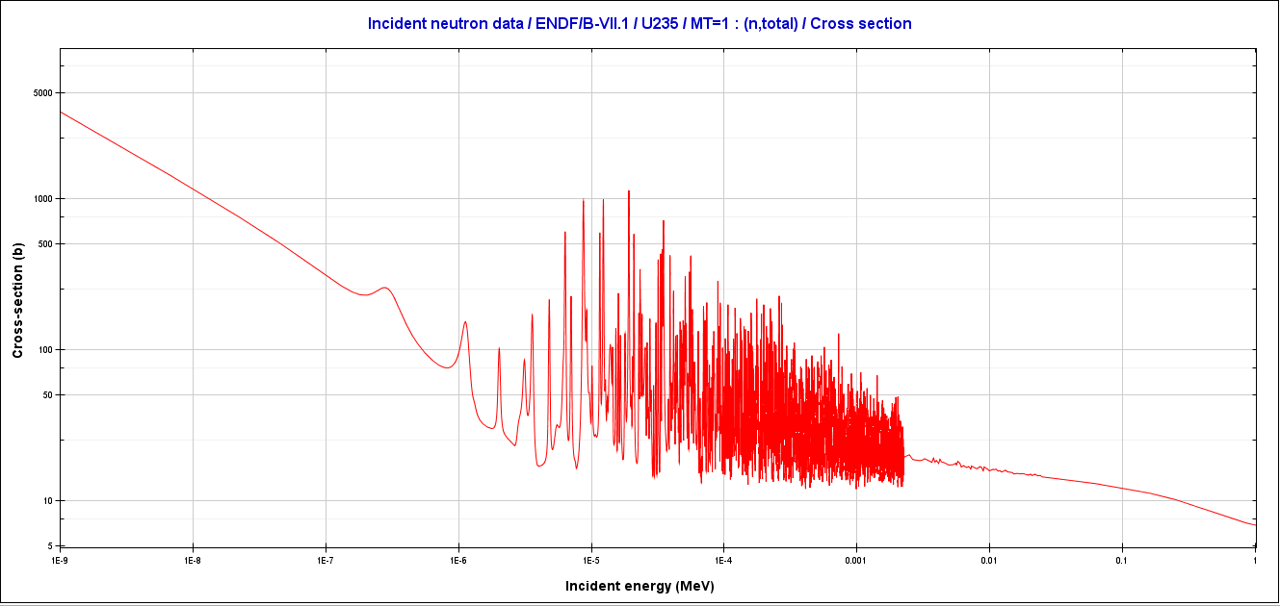
Program flow
Input
Simulate all particles
output
2.cross-section data visualization
By using the NJOY code the evaluated neutron cross section data of many nuclides are processed from ENDF-6 format to ACE format.
MODULE cxs
Reads all nuclide cross-section data and store it in system memory
Plotted using JANIS-4.0 (Java-based Nuclear Data Information System)

Slide 59
Tools used for the code
Compiler – gfortran windows binaries 64 bit
Mingw-gfortran 32 bit
Debugger -- gdb ( by Gnu )
IDE(Integrated-development env) – codeblocks
Written with fortran 2003 features
Graphics – open graphics library ( C libraries )

Slide 60

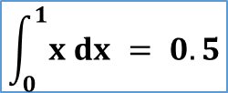
Monte Carlo
Estimation of a finite Integral: Deterministic Method
Deterministic system : In which the later states of the system are determined by the earlier ones.
This method enables artificial construction of a probabilistic model.
f(x) = x
$$\int_{a}^{b}{f\left(x\right) dx ≈ \max\left(f\left(x\right)\right) \left(b−a \right) \frac{fraction of points under the line }{Total number of points +}}$$
$$\int_{0}^{1}{x dx = 0.5}$$
Number of trials | Points enclosed by the curve | Value of the integral
10 | 6 | 0.600
100 | 56 | 0.56
1000 | 497 | 0.497
10000 | 5001 | 0.5001

Slide 61
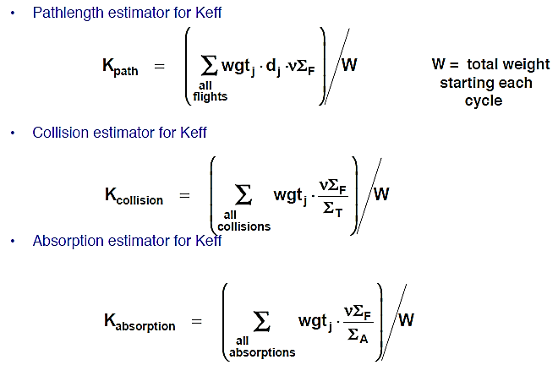
Program flow
Input
Simulate all particles
output
Keff estimators
K(collision) ----- tracking
K(track length) ------ tracking
K(absorption) ------- physics

Slide 62
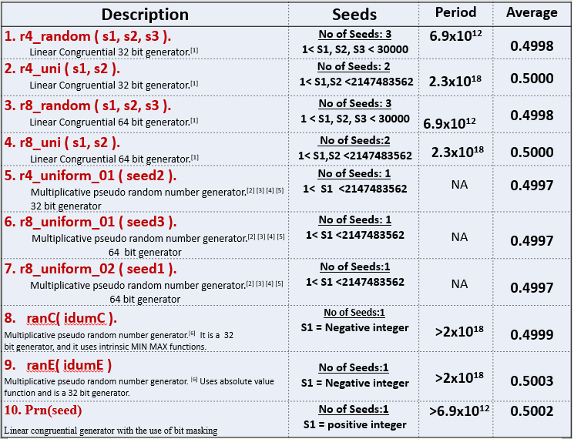
Program flow
Input
Simulate all particles
output
1. Random number generation

Slide 63
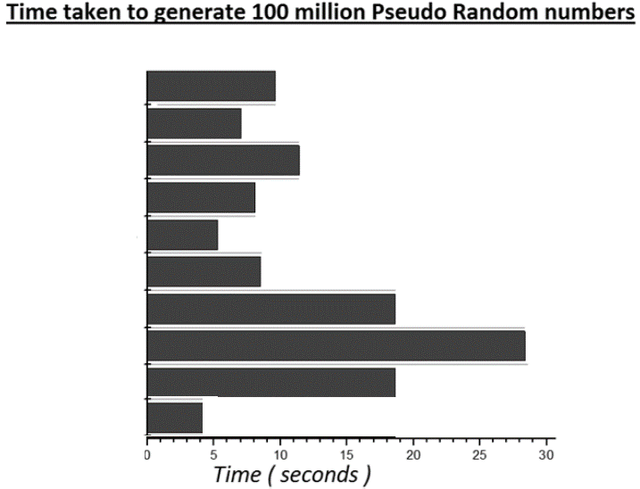
Program flow
Input
Simulate all particles
output
1. Random number generation
1. r4_random ( s1, s2, s3 ).
2. r4_uni ( s1, s2 ).
3. r8_random ( s1, s2, s3 ).
4. r8_uni ( s1, s2 ).
5. r4_uniform_01 ( seed2 ).
6. r8_uniform_01 ( seed3 ).
7. r8_uniform_02 ( seed1 ).
8. ranC( idumC ).
9. ranE( idumE )
10. prn()
MODULE random_lcg
Gives huge quantity of random numbers with all required properties

Slide 64
Program flow
Input
Simulate all particles
output
3. Computational Geometry
Surfaces
x-plane
y
Negative sense
Negative
sense
Positive
sense
Negative
sense
Positive
sense
x
X-5 = 0
Positive sense
1 so 8.741 $ radius of the godiva sphere

Slide 65
Program flow
Input
Simulate all particles
output
U-235, U-238 U-234
Godiva Reactor
Available in endf-6 format by
ENDF, JEFF and JENDL etc
NJOY code [ available ]

Slide 66
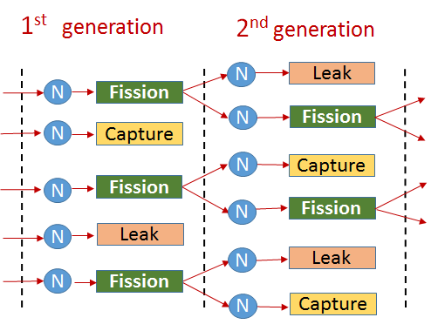
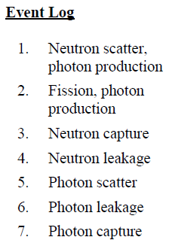
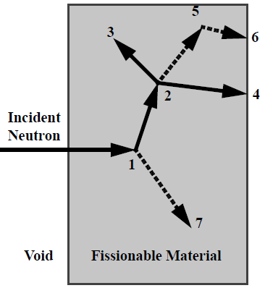
Getting K_{eff} with Monte Carlo method
Over all batches (generations)
Over all particles
Simulate(transport) the behavior of each particle in user defined geometry and material specification. (Monte Carlo)

