Slide 1
Breadcrumb analytics- How to understand your users and improve UX
Shanthi Chillara
Shravan shetty

Slide 2
Topics
Introduction Breadcrumb
Breadcrumb analysis on FOPS customer’s user.
Recommendation engine to improve navigation for FOPS Columbia Sportswear users
Summary and Further improvements
Introduction to Breadcrumb
Breadcrumb analysis
Summary and Further improvements
Recommendation Engine
Introduction to Breadcrumb
Breadcrumb analysis
Summary and Further improvements
Recommendation Engine

Slide 3
Introduction to Breadcrumb
Breadcrumb analysis
Summary and Further improvements
Recommendation Engine

Slide 4
Breadcrumbs helps to discover customer secrets
Breadcrumbs are footprints. Trails left by customers not on purpose.
Breadcrumbs store customer information like:
Which webpage they visited [ Current report information]
From which website they visited [ Previous history information]
When they visited [Time they viewed a report]
Who visited [User information]
Using this information, we can learn about which report a Business analyst / Office Manager/Sales rep/VP visits and when they visit and from where they visit.
By harnessing this information we created knowledge in the form of:
Breadcrumb trail analysis
Using breadcrumb data, to predict the next report a user will view using recommendation engine.
Introduction to Breadcrumb
Breadcrumb analysis
Summary and Further improvements
Recommendation Engine

Slide 5
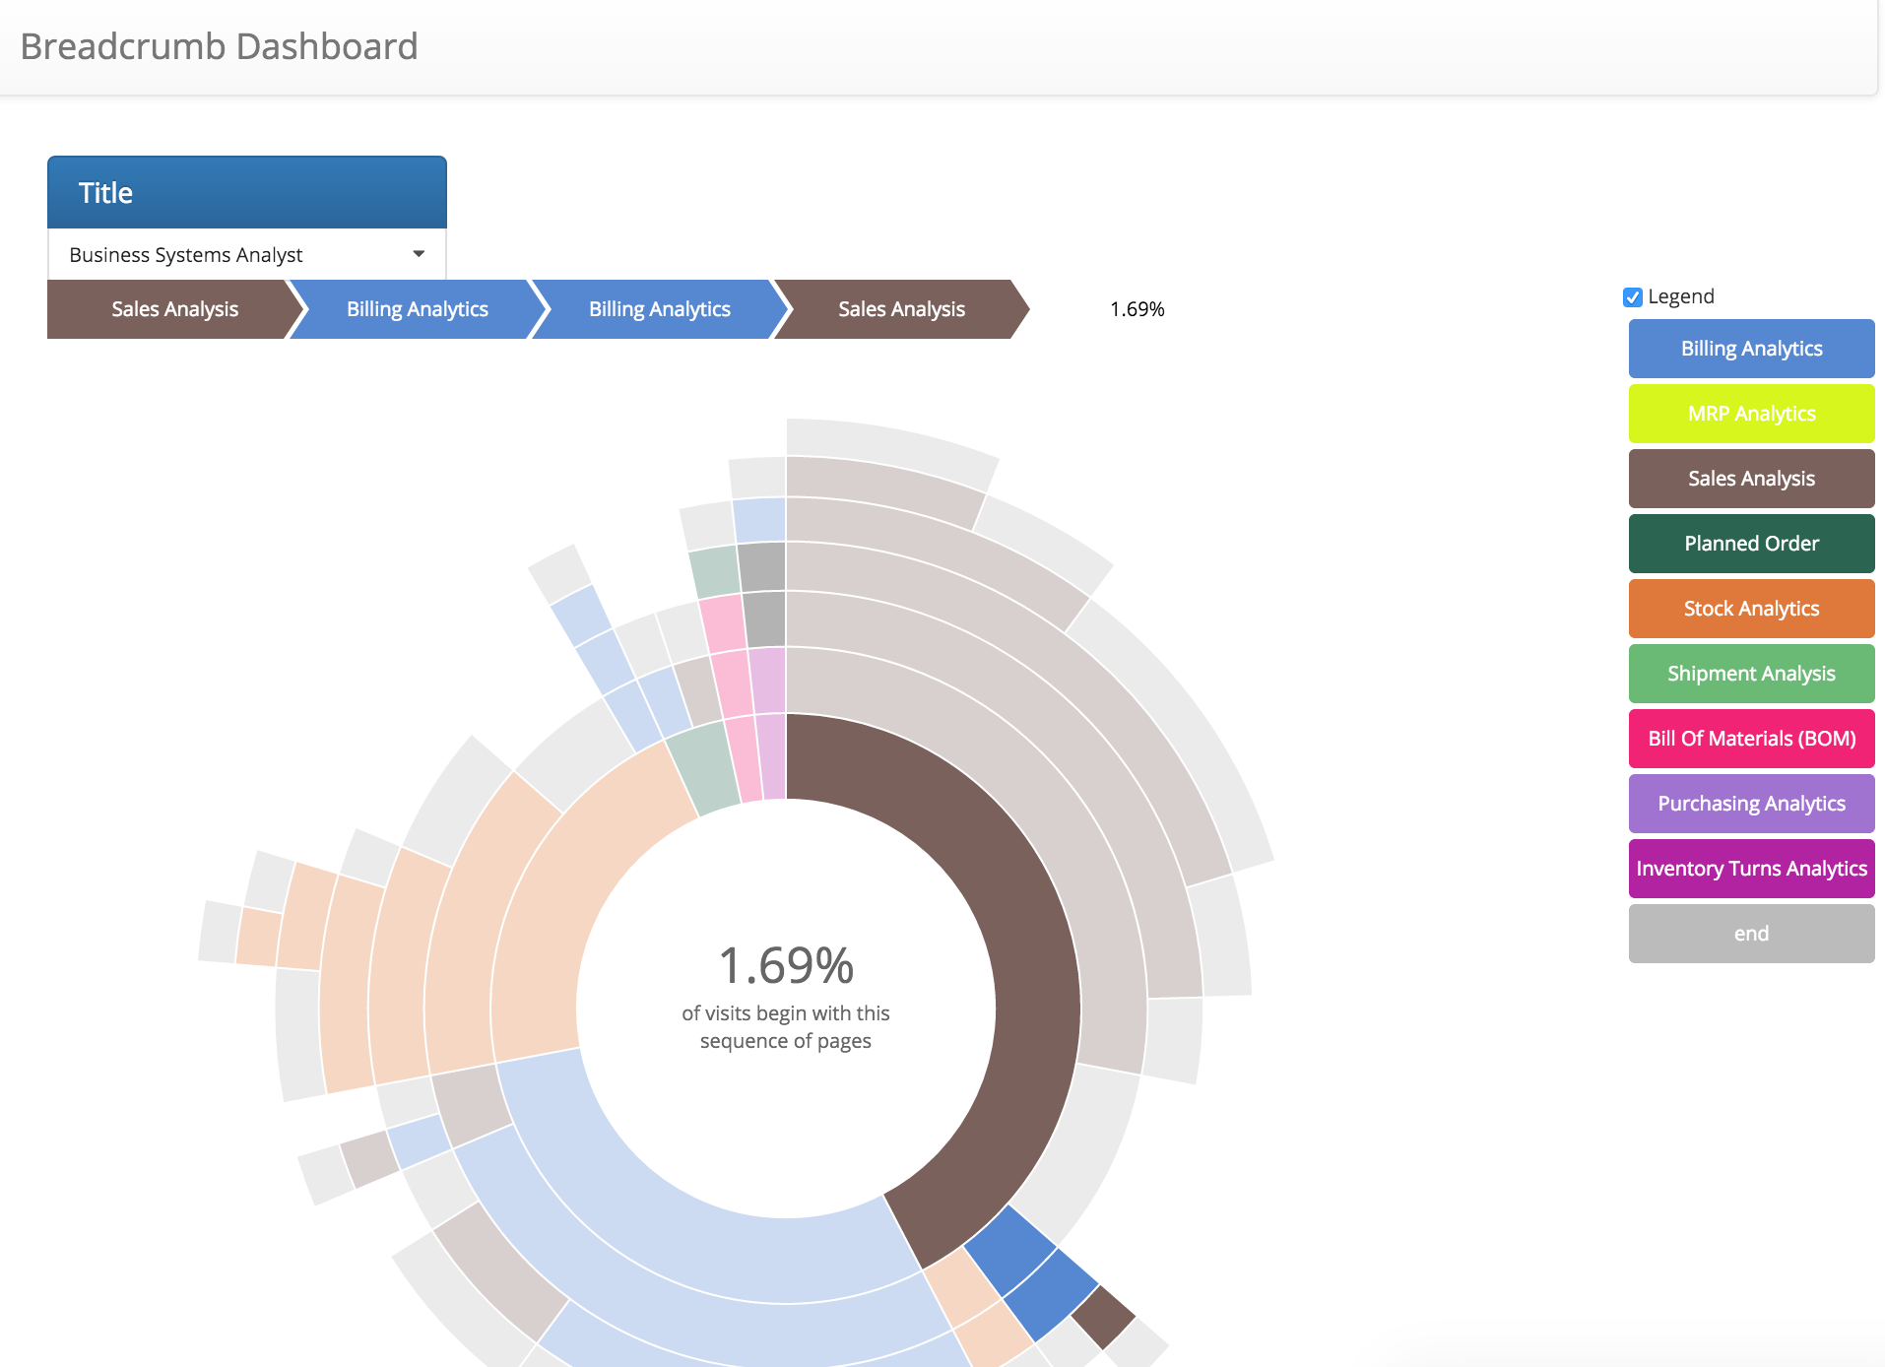
Breadcrumb analysis
Developed a Dashboard that keeps track of user’s trails.
Filtered according to the title of the user in that customer’s company.
Such analysis can help in understa- nding users behavior and tendency to move within FOPS app.
From the example, we can see that 1.69 % of time a Business system analyst moves from Sales analysis> Billing analysis> Billing Analysis> Sales Analysis within FOPS app.
Introduction to Breadcrumb
Breadcrumb analysis
Summary and Further improvements
Recommendation Engine

Slide 6
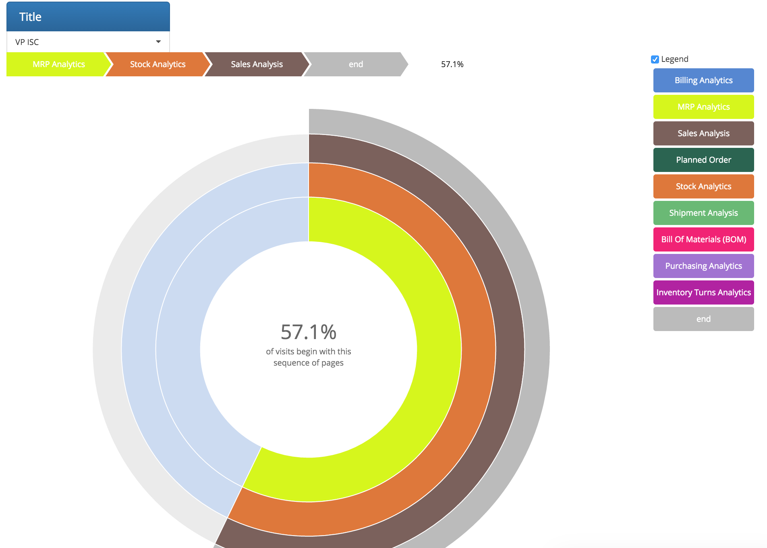
FOPS application view from VP’s perspective
VP of Textron always visits MRP analytics > Stock analytics > Sales analytics
Introduction to Breadcrumb
Breadcrumb analysis
Summary and Further improvements
Recommendation Engine

Slide 7
Recommendation using Breadcrumb
Imagine getting a recommendation from a web application about the next report to visit according to your breadcrumb history.
We developed a prediction algorithm that recommends following reports a user can click depending on its previous report history.
This prediction algorithm has an accuracy of 82.56% i.e. 82.56% of the time, it can predict the next report clicked by user.
Since our breadcrumb analysis shows lot of users move from one fact to another. This can be integrated inside FOPS application to improve user experience.
Introduction to Breadcrumb
Breadcrumb analysis
Summary and Further improvements
Recommendation Engine

Slide 8
Use of Breadcrumb in FOPS application
Use of Breadcrumb Analysis
Understanding users who play with FOPS application
Can help in understanding usage and the flow of reports within customer’s organization.
If Error flows are tracked, we can get a scenarios where FOPS application fails through dashboard.
Use of Recommendation engine with Breadcrumb data
Improve UX
Recommendation according to the type of user
Reduce the number of clicks to reach a destination report.
Introduction to Breadcrumb
Breadcrumb analysis
Summary and Further improvements
Recommendation Engine

Slide 9
Special thanks to David O. for providing data.

