Slide 1


EASY Move-in

Slide 2
CONTENT
Problem Statement
Solution
Object Model
Use Cases
Screenshots
Examples

Slide 3

Problem Statement
Construction of new buildings and structures always leads to a huge amount of problems for the people displaced.
Finding a new place as per person’s convenience and the similar environment is a tedious task to do it single-handedly.
It also leads to a wide array of new problems such as finding new schools, workplaces and safe areas to stay.

Slide 4

Solution
The aim of our application is to ease the search of the customer by communicating with the government and providing them the comfortable accommodations.
It takes care of the entire process starting from government approval as well as ending with the various amenities provided including getting them moved to the respective location.

Slide 5
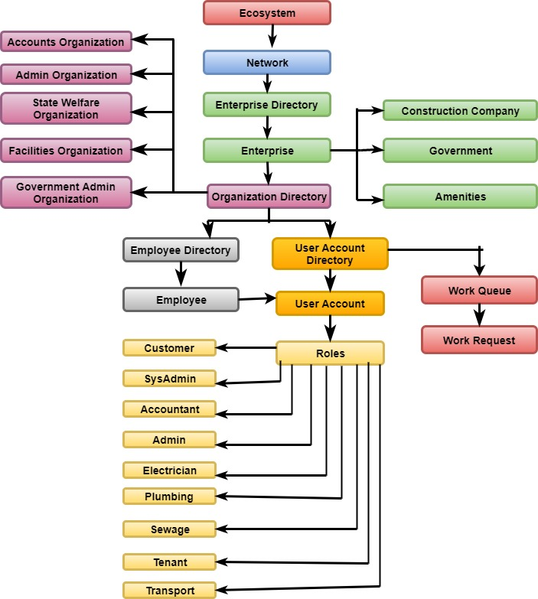
Object Model

Slide 6
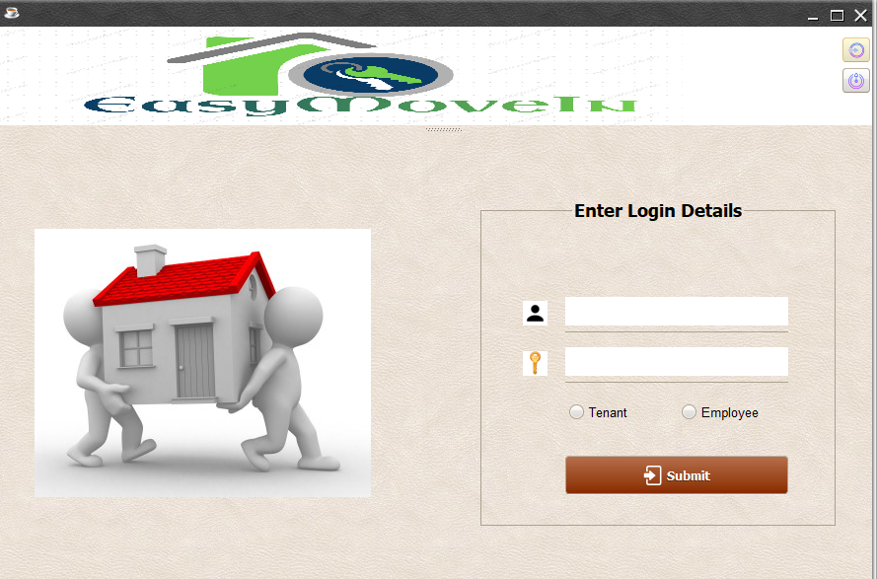
Login

Slide 7
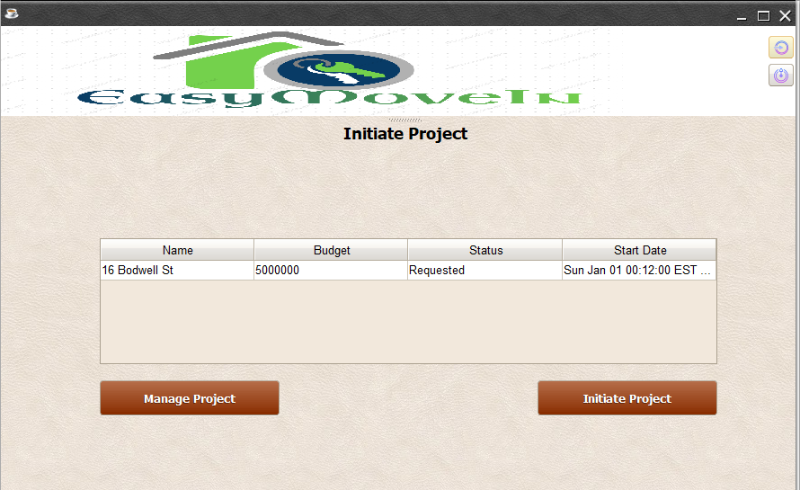
Project Initiation

Slide 8
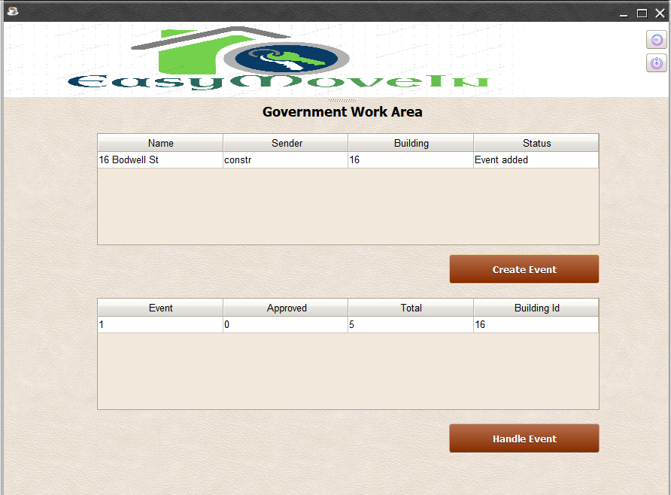
Event Creation

Slide 9
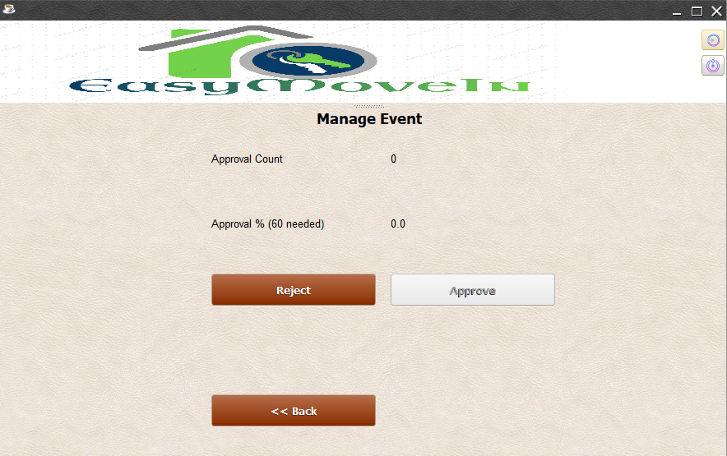
Handle Event

Slide 10
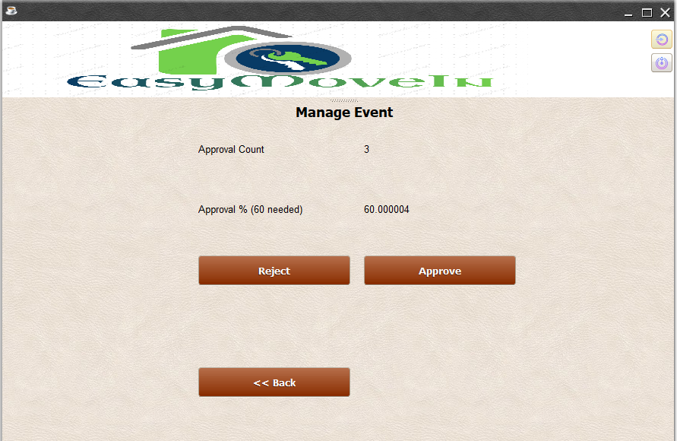
Approval Request

Slide 11
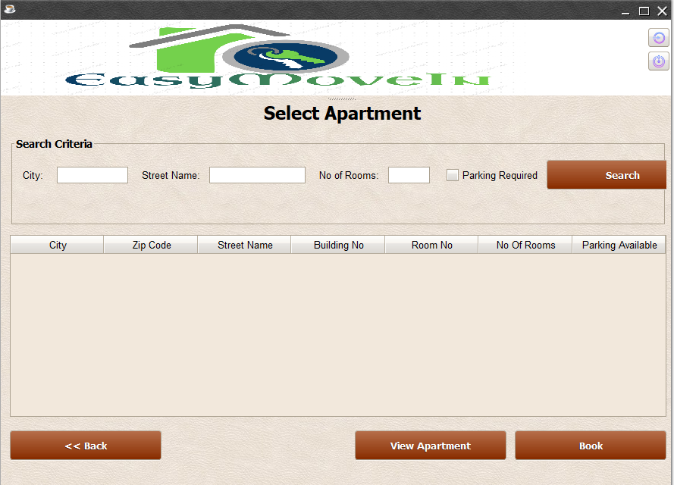
Select Apartment

Slide 12
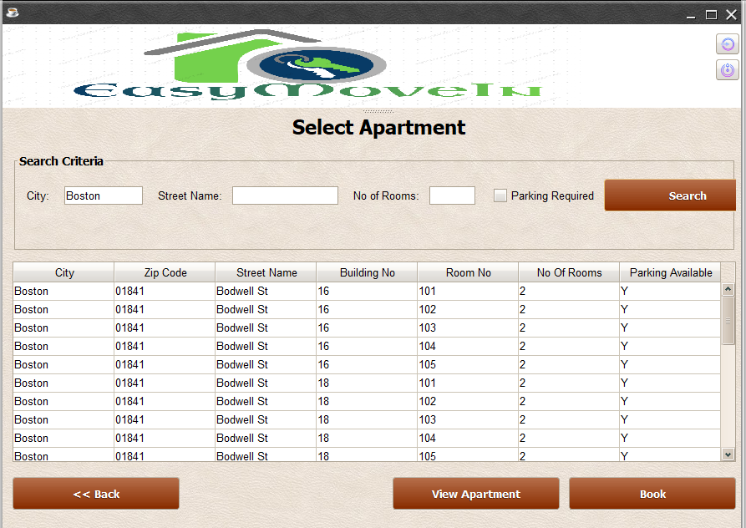

Slide 13
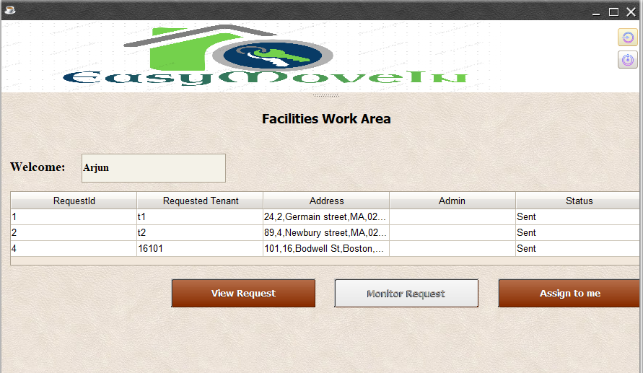
Facility Admin

Slide 14
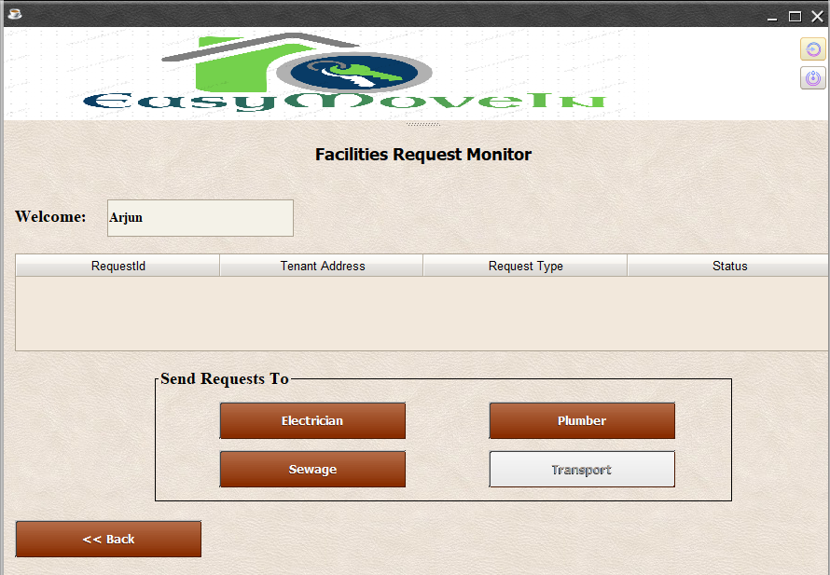
Monitor Request

Slide 15
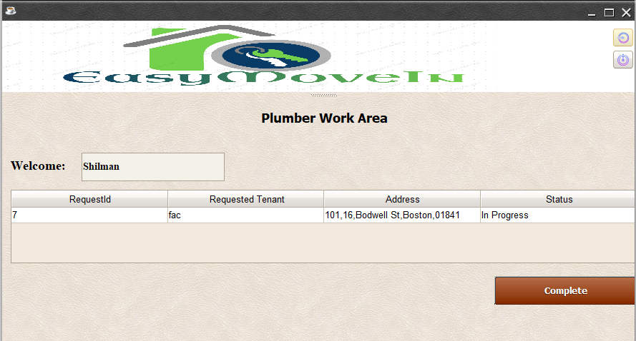
Plumber Request Handle

Slide 16
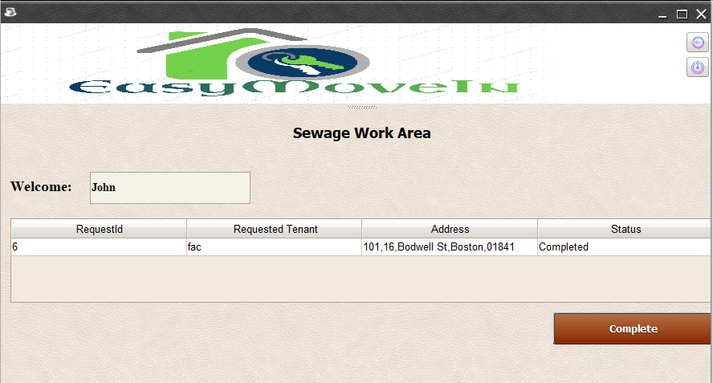
Sewage Request

Slide 17
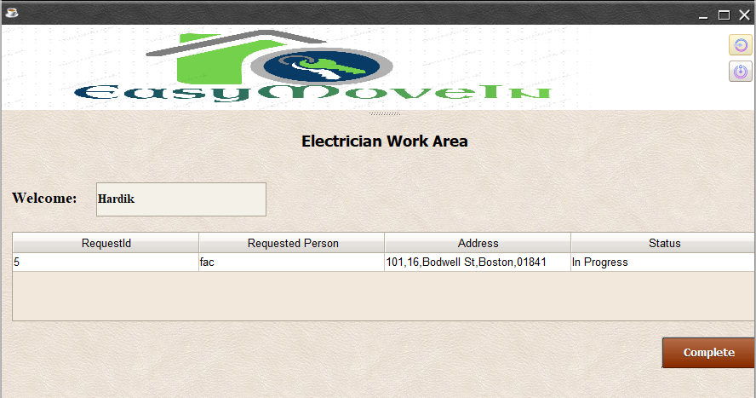
Electrician Request

Slide 18
Transport Request

