Slide 1
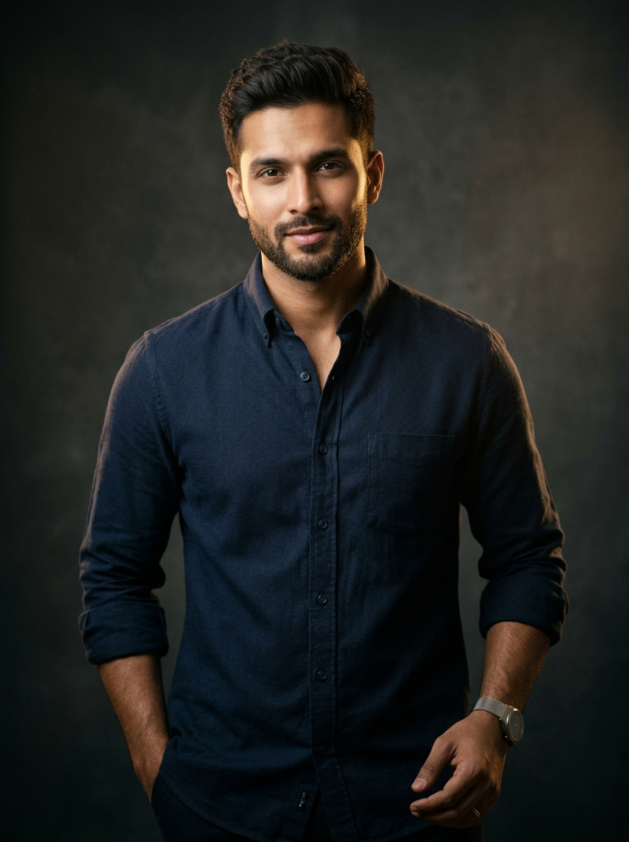
CLIENT ACQUISITION & GROWTH PROPOSAL
JONTYS HUB
Building a Premium Men's Fashion Brand
Through Performance Marketing.
A commercially disciplined partnership blueprint engineered to elevate brand authority, drive qualified local footfall, and protect store-level gross margins.
Strategic Growth Proposal | LB Nagar, Hyderabad
Beside B.D. Reddy Gardens, B.N. Reddy Nagar, Hyderabad, Telangana – 500079
01 / 15

Slide 2
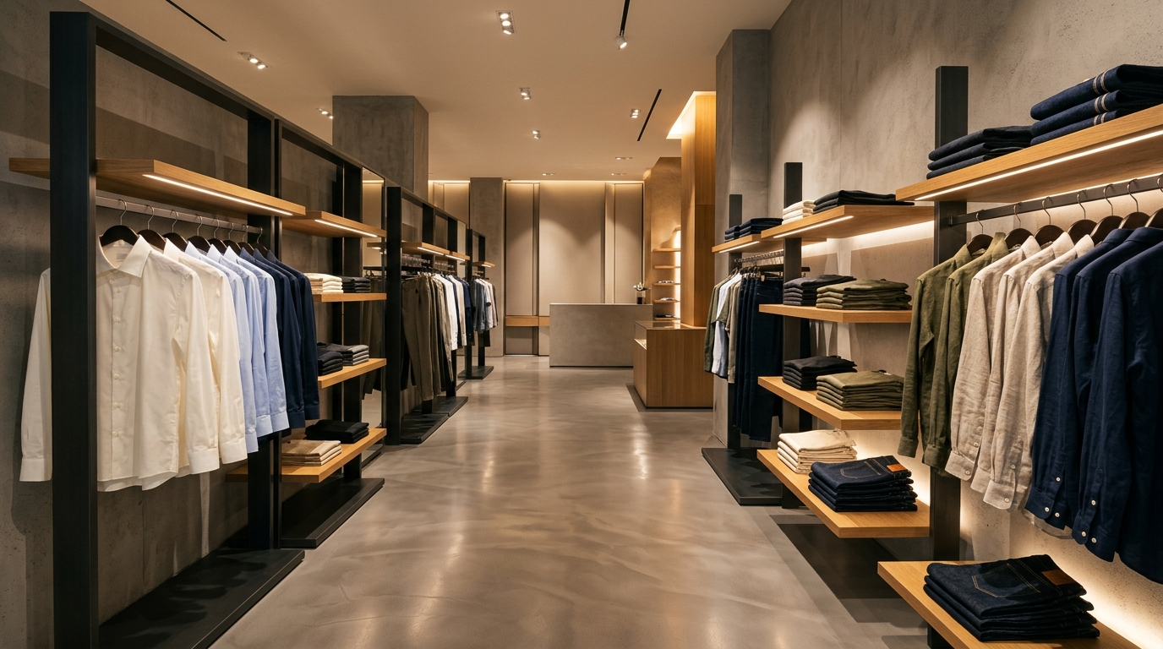
BUSINESS FOUNDATION
JONTYS HUB | GROWTH STRATEGY
A Premium Men's Fashion Destination.
AVG PRODUCT PRICE
AVG CUSTOMER BILL
GROSS MARGIN
₹2,000
₹5,000
< 25%
Premium entry price point
Multi-item basket strength
Strict CAC & discount discipline
FIVE CORE MENSWEAR CATEGORIES
01
Casual Shirts
Weekend, smart-casual & textured contemporary weaves
02
Formal Shirts
Tailored crisp workwear & occasion silhouettes
03
T-Shirts
Elevated everyday crew-necks & structured basics
BRAND POSITIONING & STORE ANCHOR
Dedicated exclusively to premium men's apparel in LB Nagar — engineered around curated wardrobing rather than mass-market discounting.
04
Jeans
Clean-wash, modern tapered & stretch denim fits
05
Trousers
Tailored office, chino & dress trouser staples
Location: Beside B.D. Reddy Gardens, B.N. Reddy Nagar, LB Nagar, Hyderabad – 500079
Jontys Hub • B.N. Reddy Nagar, LB Nagar, Hyderabad – 500079 • Confidential Client Proposal
02 / 15

Slide 3
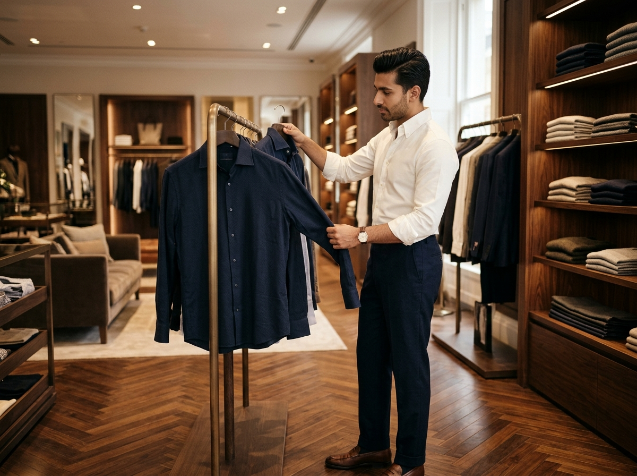
CATEGORY & CONSUMER SHIFTS
JONTYS HUB | GROWTH STRATEGY
The Future of Men's Fashion Is Style, Quality & Experience.
01
Video-First Discovery
Local men watch short-form Instagram Reels & YouTube ads to shortlist styles before ever stepping into a store.
02
Product Education Wins
Showing fabric quality, collar structure & fit builds premium value far faster than price-led banners.
03
Dedicated Men-Only Trust
Discerning buyers prefer focused menswear stores for personalised sizing and curated outfit pairings.
04
High-Intent Local Walk-Ins
Remarketing educated viewers with Maps directions turns casual video watchers into store visitors.
STRATEGIC MARKET INSIGHT
05
Community-Led Retention
Local menswear shoppers already buy across ₹2,000+ price tiers when digital inspiration smoothly guides them to a high-trust physical try-on experience.
WhatsApp stock updates & referral discounts keep buyers returning without costly paid re-acquisition.
Jontys Hub • B.N. Reddy Nagar, LB Nagar, Hyderabad – 500079 • Confidential Client Proposal
03 / 15

Slide 4
DIAGNOSTIC & GROWTH GAPS
JONTYS HUB | GROWTH STRATEGY
Connecting Digital Discovery With Physical Store Sales.
PRELIMINARY STRATEGIC IMPROVEMENT AREAS (TO VALIDATE IN DAYS 1–15 AUDIT)
VERIFIED BUSINESS FACTS
Confirmed operational baseline prior to Phase-1 audit:
01
Distinct Brand Positioning
02
Educate Through Video
STORE FORMAT
Position Jontys Hub on Instagram, Facebook & Maps as B.N. Reddy Nagar’s specialist menswear destination.
Use short Reels & YouTube ads to highlight fabric quality, tailoring, and complete outfit pairings.
Pure-play Premium Men's Fashion Retail
CATCHMENT ANCHOR
B.N. Reddy Nagar, LB Nagar, Hyderabad
MERCHANDISE MIX
03
Video-View Remarketing
04
Goal: High-Intent Store Visits
Casual & Formal Shirts, T-shirts, Jeans, Trousers
Retarget engaged video viewers across Meta & Display to nurture warm, high-intent buying audiences.
Guide educated prospects straight to the store with Maps pins, styling checks & fresh-stock hooks.
AVG PRODUCT PRICE
₹2,000 per piece
AVG CUSTOMER BILL
₹5,000 (strong multi-piece basket)
05
WhatsApp Community & Referrals
06
Profit-Led Measurement
MARGIN PROFILE
Share daily/weekly new-stock drops and margin-safe referral perks to spark repeat walk-ins.
Track every ad Rupee against store visits, ₹5,000+ bills, and net gross profit contribution.
Below 25% gross margin constraint
Jontys Hub • B.N. Reddy Nagar, LB Nagar, Hyderabad – 500079 • Confidential Client Proposal
04 / 15

Slide 5
STRATEGIC POSITION
JONTYS HUB | GROWTH STRATEGY
SWOT Analysis: Building on Strengths, Protecting Margins.
INTERNAL • POSITIVE
INTERNAL • CONSTRAINTS
STRENGTHS
WEAKNESSES
100% dedicated men's fashion focus — clear specialist brand positioning
Five complementary categories built for complete outfit cross-selling
Established B.N. Reddy Nagar store in a prime LB Nagar corridor
Strong ₹5,000 average bill (~2.5x ₹2,000 avg product price)
Gross margin under 25% forbids unfocused, low-intent ad spend
Digital brand positioning & video storytelling need structured launch
No active video-view remarketing pool capturing warm local viewers
No store-visit attribution linking online impressions to bills
EXTERNAL • UPSIDE
EXTERNAL • RISKS
OPPORTUNITIES
THREATS
Capture 50%+ video-ad viewers as warm local remarketing audiences
Educate buyers on fit & fabric to attract high-intent store visits
WhatsApp community for daily/weekly new-stock alerts & referrals
Outfit styling hooks to expand ₹5,000+ multi-item store baskets
Competing retail chains & nearby menswear outlets
Market-wide discounting habits that compress net margins
Rising CPMs if ads target low-intent cold traffic without retargeting
Price resistance when brand positioning & quality are not explained
Jontys Hub • B.N. Reddy Nagar, LB Nagar, Hyderabad – 500079 • Confidential Client Proposal
05 / 15

Slide 6
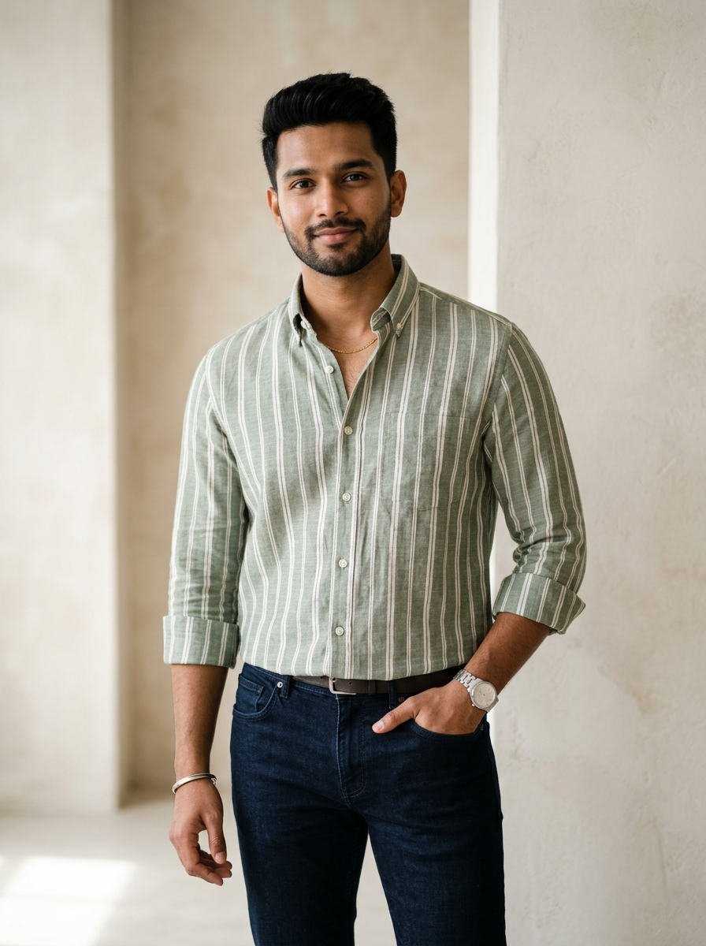
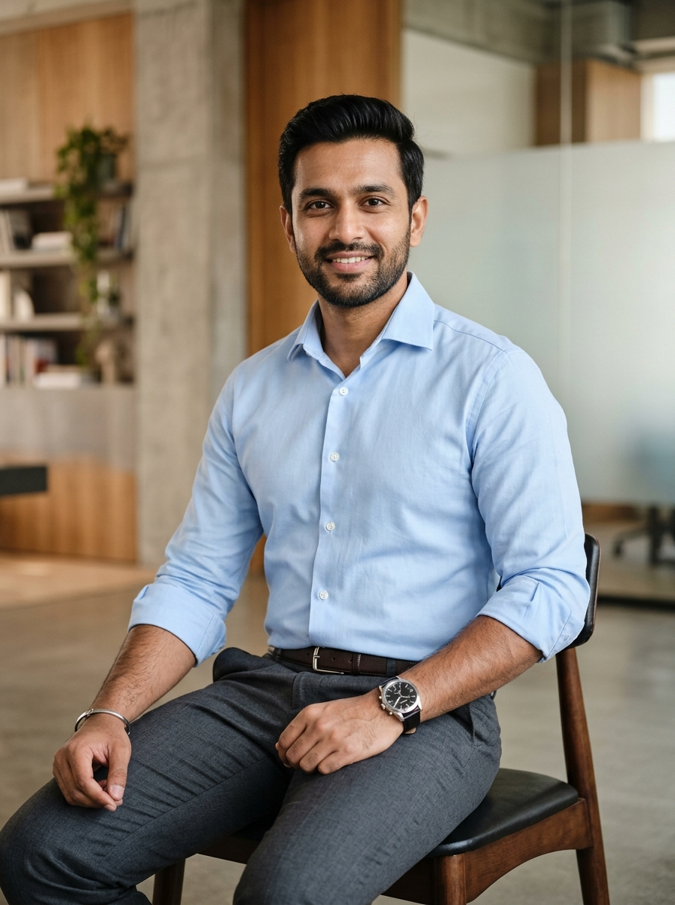
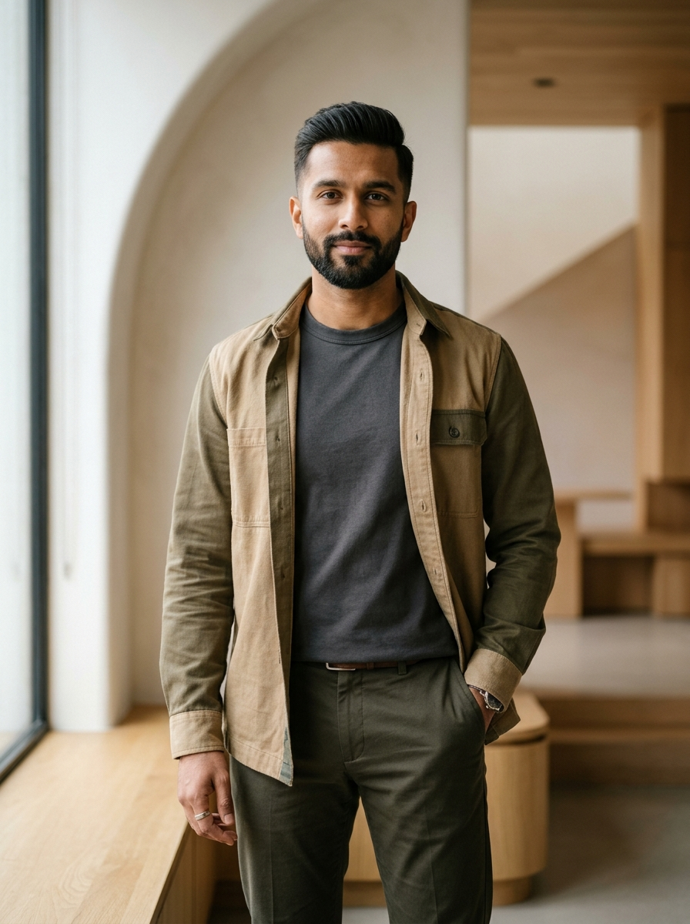
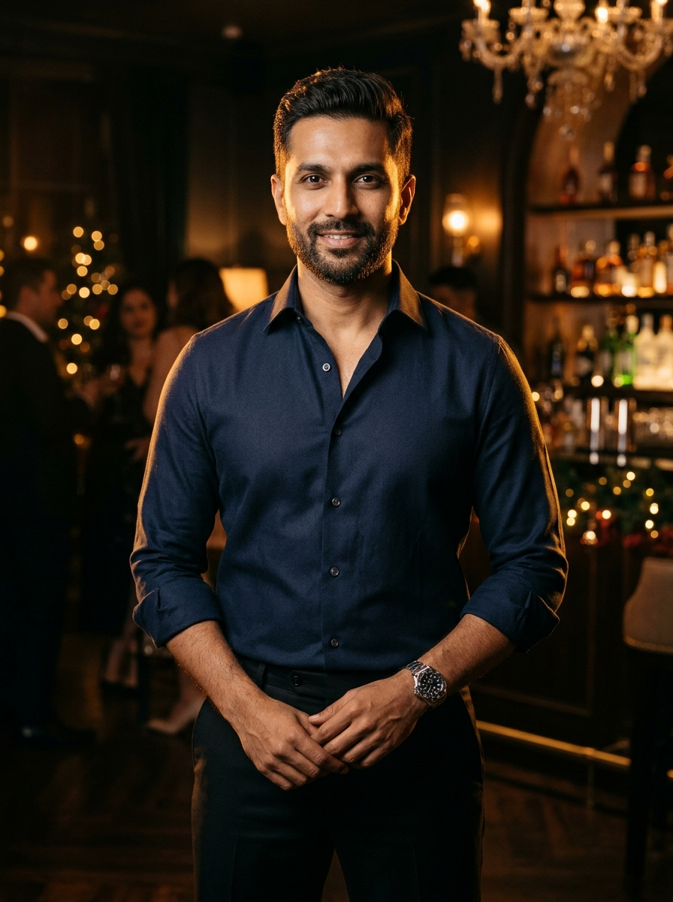
TARGET AUDIENCE ARCHITECTURE
JONTYS HUB | GROWTH STRATEGY
Reaching the Right Customers.
PROPOSED AUDIENCE SEGMENTS TO VALIDATE • ALL PERSONAS REPRESENT HYPOTHESES FOR PHASE-1 CAMPAIGN TESTING
01
02
03
04
AGE 20 – 30
AGE 25 – 40
AGE 25 – 40
AGE 23 – 45
SEGMENT
TO TEST
SEGMENT
TO TEST
SEGMENT
TO TEST
SEGMENT
TO TEST
Young Fashion-Conscious Men
Working Professionals
Aspirational Fashion Buyers
Occasion-Based Shoppers
MOTIVATION
MOTIVATION
MOTIVATION
MOTIVATION
Trend-aligned styling, sharp silhouettes & social confidence.
All-day comfort, crisp polish & reliable office-to-evening versatility.
Upgrading personal wardrobe from basic wear to elevated essentials.
Ready-to-wear elevated outfits for celebrations, dinners & events.
PRODUCT FOCUS
PRODUCT FOCUS
PRODUCT FOCUS
PRODUCT FOCUS
Casual Shirts, T-Shirts, Slim Jeans
Formal Shirts, Tailored Trousers
Layered Casuals, T-Shirts, Trousers
Dark Formal Shirts, Crisp Trousers
COMMUNICATION
COMMUNICATION
COMMUNICATION
COMMUNICATION
Short-form Reels, outfit styling hooks & fresh drop alerts.
Fit & fabric quality focus via Meta, Display & YouTube ads.
Complete lookbook pairings & weekly WhatsApp stock alerts.
Event outfit videos, WhatsApp previews & referral invitations.
Jontys Hub • B.N. Reddy Nagar, LB Nagar, Hyderabad – 500079 • Confidential Client Proposal
06 / 15

Slide 7
HYPER-LOCAL CATCHMENT TARGETING
JONTYS HUB | GROWTH STRATEGY
Winning the Local Men's Fashion Market.
HYDERABAD SOUTH-EAST CATCHMENT TOPOLOGY (NO INVENTED DEMOGRAPHIC ESTIMATES)
TIER 01 • PRIMARY ZONE
B.N. Reddy Nagar, Vanasthalipuram, Hastinapuram
Core always-on local reach, Google Maps visibility, and high-frequency store-visit creative.
NH 65 / Vijayawada Hwy
Kothapet
TIER 02 • SECONDARY ZONE
LB Nagar & Chintalkunta
LB Nagar
Category-led Instagram, Facebook, YouTube & Display ads for nearby B2C shoppers.
Chintalkunta
TIER 03 • TESTING ZONE
Vanasthalipuram
Kothapet
JONTYS HUB
B.N. Reddy Nagar
Controlled budget expansion tests to measure travel willingness and incremental store-visit economics.
Hastinapuram
Nagarjuna Sagar Rd
STORE LOCATION ANCHOR
Beside B.D. Reddy Gardens, B.N. Reddy Nagar, LB Nagar, Hyderabad – 500079
Store Anchor
Primary Zone
Secondary Zone
Testing Zone
Budget expands outward only after Primary Zone unit economics are proven.
Jontys Hub • B.N. Reddy Nagar, LB Nagar, Hyderabad – 500079 • Confidential Client Proposal
07 / 15

Slide 8
CONVERSION ARCHITECTURE
JONTYS HUB | GROWTH STRATEGY
From Fashion Discovery to Store Purchase.
01 VIDEO DISCOVERY
Capture attention & pool engaged local video viewers.
Instagram Reels • Facebook Video • YouTube
Style-led video ads reach LB Nagar men; 50%+ video viewers enter the custom remarketing pool.
02 EDUCATE & POSITION
Educate warm viewers & establish premium positioning.
Video-View Remarketing • Meta & Display
Sequential ads teach fabric feel, collar fit & complete styling—building authority before store entry.
03 HIGH-INTENT FILTER
Qualify high-intent buyers ready to visit the store.
WhatsApp Community • Google Business Profile
Maps directions, sizing previews & fresh-stock highlights isolate serious local shoppers.
04 STORE VISIT GOAL
Convert high-intent walk-ins into ₹5,000+ bills.
In-Store Trial • Outfit Styling
Educated buyers arrive pre-sold on quality—staff guide complete multi-item outfit trials.
05 RETENTION
Turn buyers into repeat members and peer referrers.
WhatsApp Drops • Referrals
Daily/weekly new-stock updates & margin-safe referral discounts drive repeat store visits.
Jontys Hub • B.N. Reddy Nagar, LB Nagar, Hyderabad – 500079 • Confidential Client Proposal
08 / 15

Slide 9
REMARKETING & POSITIONING ARCHITECTURE
JONTYS HUB | GROWTH STRATEGY
Turn Video Viewers Into High-Intent Store Visitors.
CORE REMARKETING STRATEGY
Anyone who watches our Reels or YouTube video ads enters a custom Remarketing Audience — educated sequentially to build brand positioning and drive high-intent walk-ins to our LB Nagar store.
01 • AUDIENCE CAPTURE
02 • CUSTOMER EDUCATION
03 • BRAND POSITIONING
04 • ULTIMATE GOAL
Build Video-View
Remarketing Pool
Educate on Fit,
Fabric & Quality
Build Distinct Store
Positioning
Convert High-Intent
Store Visits
50%+ VIDEO WATCHERS
SHOW VALUE BEFORE PRICE
MEN-ONLY STYLE AUTHORITY
IN-STORE TRIAL & ₹5,000+ BILLS
Launch style-led Instagram Reels, Facebook Video & YouTube Ads locally. Engaged viewers (50%+ watch time) automatically build a warm custom audience.
Retarget warm viewers with close-up fabric weaves, collar structure & 5-category outfit pairings — proving why ₹2,000+ garments hold sharper drape.
Consistent Meta & Display creative positions Jontys Hub as B.N. Reddy Nagar’s specialist men’s destination — eliminating bargain-shopper perception.
Serve high-intent viewers Google Maps directions, fresh-stock previews & WhatsApp sizing checks — turning pre-sold locals into walk-in buyers.
Signal: Real Interest
Outcome: Educated Buyer
Outcome: Brand Preference
Goal: Visit the Store
WHY THIS PROTECTS OUR < 25% MARGIN
We avoid wasting store-visit budget on uninterested cold scrollers. Broad video reaches locals cheaply; remarketing budget concentrates purely on educated, high-intent men ready to visit B.N. Reddy Nagar.
Jontys Hub • B.N. Reddy Nagar, LB Nagar, Hyderabad – 500079 • Confidential Client Proposal
09 / 15

Slide 10
CHANNEL ARCHITECTURE
JONTYS HUB | GROWTH STRATEGY
A Connected Digital Growth Strategy.
VIDEO DISCOVERY & POOL
OMNICHANNEL LOOP
SEQUENTIAL RECALL
Instagram Ads
Every Meta, YouTube & Display impression feeds store visits or the WhatsApp community.
Google Display Ads
Style reels that capture 50%+ video viewers for warm remarketing & local positioning.
Keep Jontys Hub top-of-mind with educated local viewers until they visit the store.
LOCAL REMARKETING
CENTRAL GROWTH ENGINE
GOAL: STORE VISIT
Facebook Ads
JONTYS HUB
B2C COMMUNITY
Google Business Profile
Educate warm video viewers across LB Nagar on fabric, fit & complete outfit pairings.
Maps pins, photos & reviews converting high-intent prospects into store walk-ins.
Store Visits • Stock Drops • Referrals
EDUCATION & STORYTELLING
STOCK DROPS & REFERRALS
YouTube Ads
MARGIN DISCIPLINE
WhatsApp Community
Shorts & in-stream videos building brand authority and feeding high-intent remarketing.
Paid ads build our WhatsApp community, lowering future CAC via stock drops & referrals.
Daily/weekly new stock alerts & margin-safe referral perks driving repeat bills.
Jontys Hub • B.N. Reddy Nagar, LB Nagar, Hyderabad – 500079 • Confidential Client Proposal
10 / 15

Slide 11
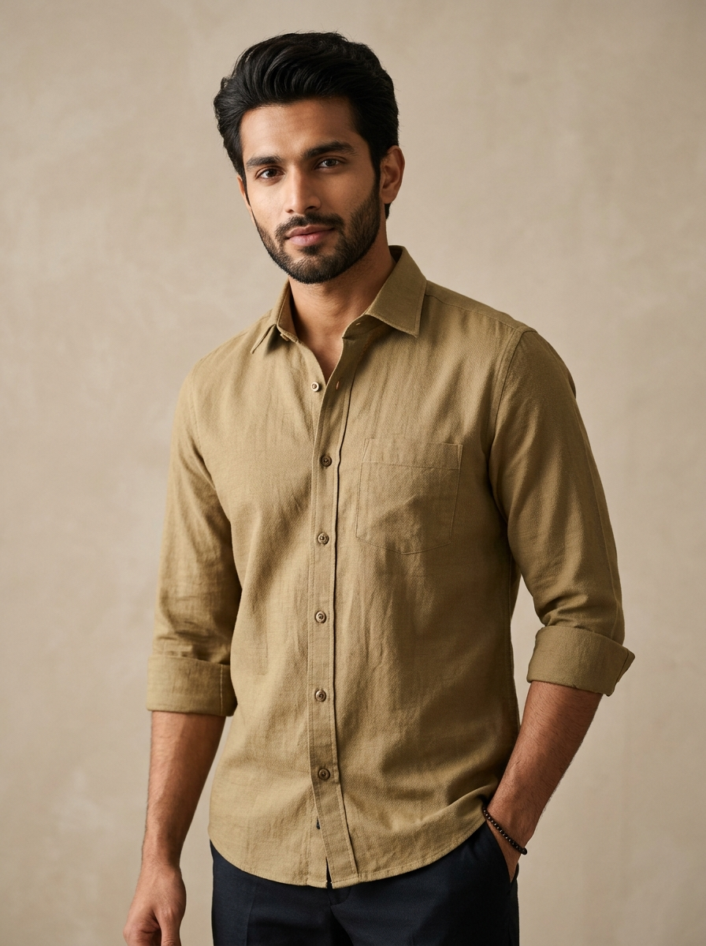
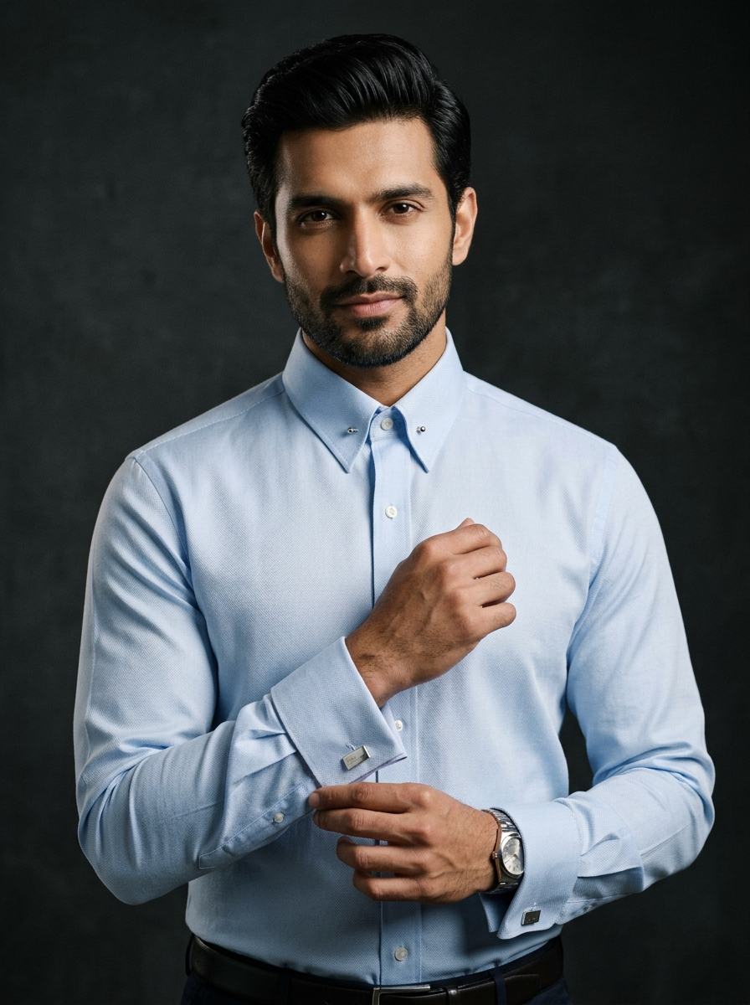
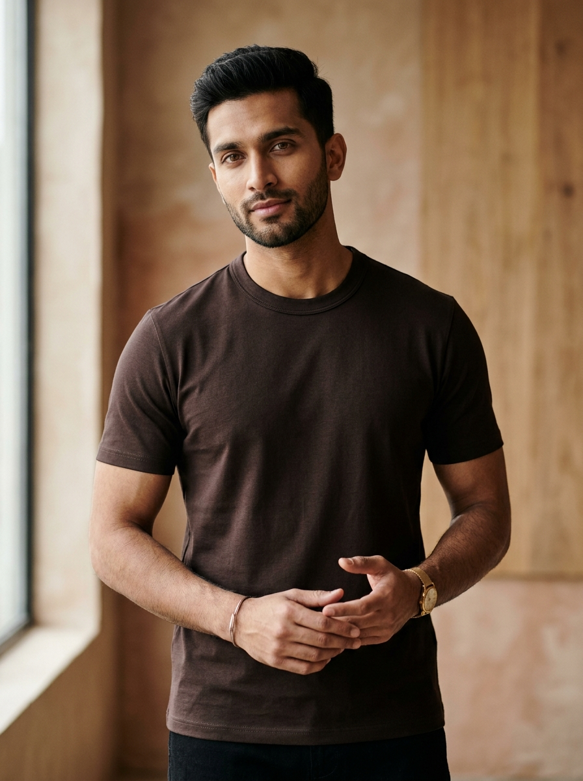
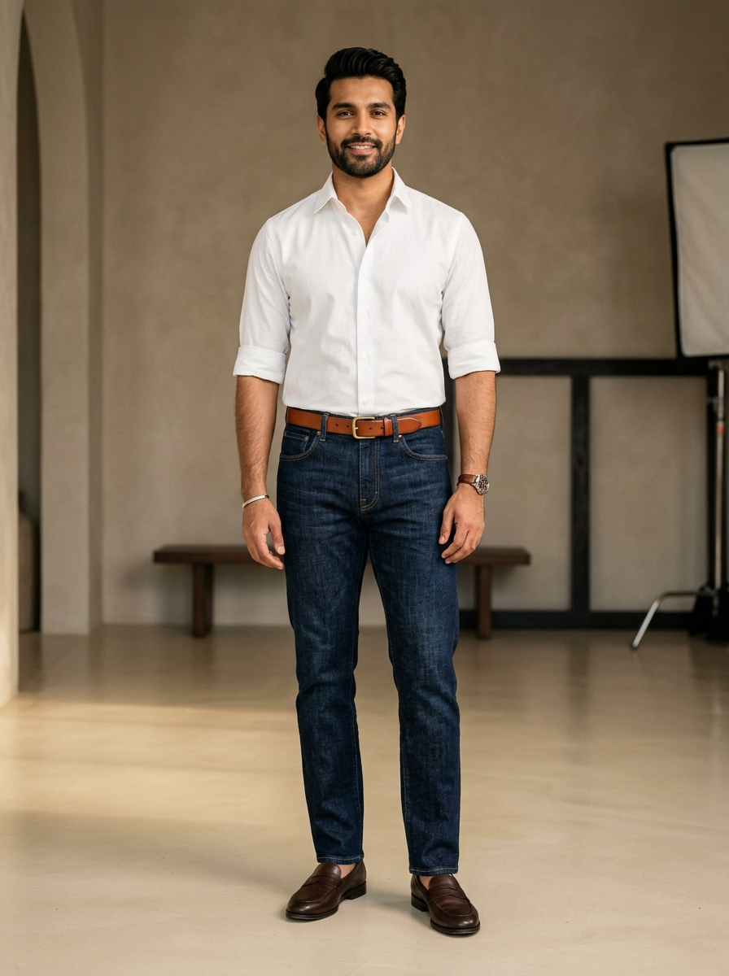
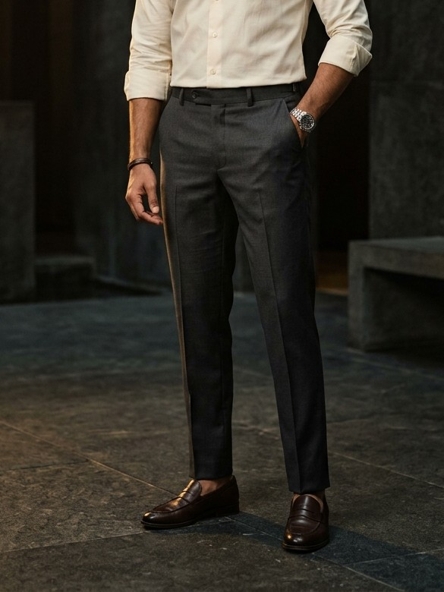
CREATIVE & MERCHANDISING DIRECTION
JONTYS HUB | GROWTH STRATEGY
Make Every Product Worth Discovering.
CASUAL SHIRTS
FORMAL SHIRTS
T-SHIRTS
JEANS
TROUSERS
"Upgrade Your Everyday Style."
"Premium Style. Everyday Confidence."
"Dress Better. Feel Better."
"Find Your Perfect Fit."
"Redefine Your Wardrobe."
Weekend transition reels pairing textured cottons with rolled cuffs & effortless fits.
Sharp collar, cuff & fabric close-ups built for office leaders and formal occasions.
Minimalist studio lookbooks highlighting heavyweight drape, neckline hold & clean tones.
360-degree fit-check videos demonstrating tapered leg cuts, wash depth & all-day comfort.
Full-outfit styling showing how tailored trousers elevate both casual & formal shirts.
Jontys Hub • B.N. Reddy Nagar, LB Nagar, Hyderabad – 500079 • Confidential Client Proposal
11 / 15

Slide 12
COMMERCIAL & UNIT-ECONOMICS DISCIPLINE
JONTYS HUB | GROWTH STRATEGY
Grow Sales Without Compromising Margins.
AVG PRODUCT PRICE
AVG CUSTOMER BILL
GROSS MARGIN
Revenue Is Not Equal to Profit
₹2,000
₹5,000
< 25%
With < 25% gross margin, scaling clicks without high buyer intent erodes net store cash.
Remarket Educated Video Viewers
ILLUSTRATIVE BASKET SCENARIOS (₹) — FOR PLANNING ONLY
Focus conversion spend on warm 50%+ video viewers who already understand our quality & fit.
Complete outfit styling multiplies gross profit headroom per ad click compared to single-item sales.
Complete Outfit Recommendations
Pair Shirts + Jeans/Trousers so each store visit converts at ₹5,000+ rather than ₹2,000.
Structured Referrals Over Blanket Discounts
Protect positioning—use referral perks only on verified repeat/referred bills, never storewide cuts.
WhatsApp Community & Repeat Growth
Daily/weekly stock drops bring high-intent community members back at near-zero CAC.
*Illustrative 3-item outfit scenario (e.g. Shirt + Trouser/Jeans + T-Shirt). Not a revenue forecast.
Jontys Hub • B.N. Reddy Nagar, LB Nagar, Hyderabad – 500079 • Confidential Client Proposal
12 / 15

Slide 13
IMPLEMENTATION PLAN
JONTYS HUB | GROWTH STRATEGY
From Strategy to Measurable Growth.
01
02
03
04
DAYS 01 – 15
DAYS 16 – 30
DAYS 31 – 60
DAYS 61 – 90
Foundation & Positioning
Video Capture & Education
High-Intent Store Visits
Scale & Referral Loops
Audit Instagram, Facebook & Google Business Profile
Set custom Video-View Remarketing audiences & Meta Pixel
Define <25% margin guardrails & referral reward caps
Film fabric, fit & styling videos across 5 categories
Launch local Instagram Reels, Facebook & YouTube video ads
Pool 50%+ video viewers into warm remarketing lists
Run fabric & fit education ads via Meta & Display
Start weekly WhatsApp new-stock update broadcasts
Retarget educated viewers with Maps & Store-Visit CTAs
Filter high-intent buyers across 4 male shopper personas
Onboard store walk-ins into the WhatsApp Community
Verify in-store bills from remarketing & stock alerts
Shift spend to top store-visit & gross-profit creatives
Expand winning remarketing into LB Nagar & Kothapet
Activate WhatsApp customer referral perks & daily drops
Deliver 90-day gross profit vs. ad spend review
EXPECTED MILESTONE
EXPECTED MILESTONE
EXPECTED MILESTONE
EXPECTED MILESTONE
Positioning, tracking & video assets ready
Warm video-view remarketing audience built
High-intent walk-ins & validated visit cost
Repeatable, community-led B2C growth
Jontys Hub • B.N. Reddy Nagar, LB Nagar, Hyderabad – 500079 • Confidential Client Proposal
13 / 15

Slide 14
EXECUTIVE BI DASHBOARD FRAMEWORK
JONTYS HUB | GROWTH STRATEGY
Measuring What Actually Matters.
NORTH STAR PROFITABILITY METRIC • TRACKED WEEKLY
FRAMEWORK ONLY — NO INVENTED CAMPAIGN RESULTS
Marketing-Generated Gross Profit Versus Advertising Spend
STAGE 01 • VIDEO & REMARKETING POOL
STAGE 02 • GOAL: HIGH-INTENT WALK-INS
STAGE 03 • COMMERCIAL PROFITABILITY
Local Video Reach
Store Directions
Average Bill Value
Unique men reached in LB Nagar radius.
Google Maps & remarketing route taps to store.
Tracked against ₹5,000 store benchmark.
Marketing-Attributed Revenue
Video Viewers (50%+)
Educated Store Visits
Total sales verified from tracked visitors.
Warm audience captured for sequential education.
Walk-in shoppers pre-sold via video positioning.
Gross Profit Contribution
Net gross profit earned after product cost.
High-Intent Enquiries
Verified Purchases
WhatsApp & DM sizing/stock questions.
In-store bills attributed to remarketing & drops.
Repeat & Referral Purchases
Repeat visits & referred bills from WhatsApp community.
Jontys Hub • B.N. Reddy Nagar, LB Nagar, Hyderabad – 500079 • Confidential Client Proposal
14 / 15

Slide 15
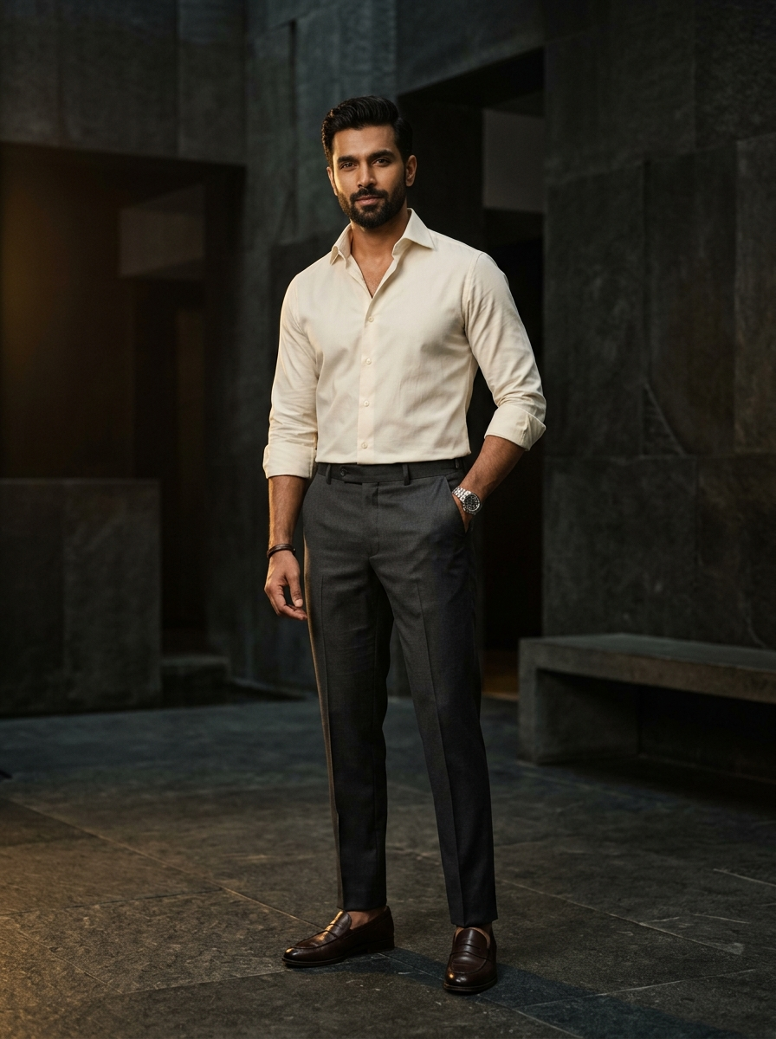
PARTNERSHIP ROADMAP
LET'S BUILD THE NEXT GROWTH
CHAPTER OF JONTYS HUB.
01
UNDERSTAND
Understand the business, margin structure and local male shoppers.
02
BUILD
Develop the digital marketing, visual content and tracking foundation.
03
GROW
Optimise profitable customer acquisition, store visits and repeat retention.
Our objective is to help Jontys Hub reach the right customers, attract more shoppers and build a stronger premium men's fashion business through measurable performance marketing.
Jontys Hub • B.N. Reddy Nagar, LB Nagar, Hyderabad – 500079
15 / 15

