Slide 1
APEXPLANET SOFTWARE PVT. LTD. · DATA ANALYTICS INTERNSHIP · TASK 4
PROJECT SCOPE
End-to-End Sales Analytics,
From Raw Data to Business Intelligence
From 1,000 raw transactions to statistically validated business decisions
6
Analytics disciplines
8
Cities covered
5
Product categories
Durga Prasad
Data Analyst Intern · July 2026
4
Statistical tests
2
Power BI dashboards
1,000
₹139.4M
4 / 4
8
Action recommendations
TRANSACTIONS ANALYSED
TOTAL REVENUE
QUESTIONS ANSWERED
Notes:
Good morning. I'm Durga Prasad. Over the next twelve minutes I'll show you how one thousand raw sales transactions become decisions leadership can sign. Three stages: understand the data, find the patterns, then test every pattern statistically before reporting it. The headline: one hundred thirty-nine million rupees of revenue, now fully understood. Let's begin.

Slide 2







SALES ANALYTICS · PROJECT OVERVIEW
One dataset, six disciplines, one decision-ready narrative
An end-to-end engagement: every stage from raw data to validated boardroom story
The objective
Transform a raw sales log into intelligence a business can act on — identifying what drives revenue, who buys, and where growth belongs.
Data Cleaning
Profiling, nulls, types, de-duplication
Exploratory Analysis
Trends, mix, category and city distributions
What makes it end-to-end
Six disciplines run in sequence, each feeding the next. Every claim is formally tested before it reaches this deck. Every stage produced a versioned, auditable deliverable.
SQL Intelligence
Business KPIs queried against MySQL
Statistical Tests
t-test, ANOVA, correlation, CI at α = 0.05
Six delivered artifacts
Cleaned dataset · SQL library · EDA notebooks · test suite · 2 Power BI dashboards · this narrative
Power BI Dashboards
Two interactive views for daily use
Executive Story
Insights framed as decisions, not data summaries
ApexPlanet Software Pvt. Ltd. · Data Analytics Internship · Task 4
02
Notes:
The objective: turn a raw transaction log into intelligence the business acts on. What makes this genuinely end-to-end is the sequence on the right — six disciplines, each producing a versioned deliverable. I cleaned the data before exploring it, explored it before querying it, queried it before testing it, and only reported what the tests confirmed. That discipline separates analytics from reporting.

Slide 3




SALES ANALYTICS · BUSINESS PROBLEM
Four questions the business could not answer with confidence
The data existed — the structure, evidence and statistical confidence to act on it did not
What drives revenue?
Who is the customer?
Where is the growth?
Can we trust the patterns?
Which categories, products and price points actually move the ₹139.4M top line — and by how much?
Do gender and age genuinely shape spending behaviour, or are those assumptions myths waiting to be retired?
Which of the 8 cities deserve marketing and inventory investment first, and by what margin?
With a 1,000-row sample, are the signals real — or artefacts of noise that evaporate under formal testing?
Decision at stake: next year’s inventory levels, marketing allocation and customer retention strategy.
ApexPlanet Software Pvt. Ltd. · Data Analytics Internship · Task 4
03
Notes:
Every project should start with the questions, not the data. Four questions shaped this one. What actually drives revenue. Whether demographics like gender and age really change spending — or if leadership was acting on assumption. Which cities deserve the next marketing dollar. And the question that separates analytics from reporting: can we trust what we see in a sample of this size? The stakes: next year's budgets depend on these answers being right.

Slide 4

SALES ANALYTICS · DATASET
1,000 transactions, audited and analysis-ready
Retail sales transaction log · FY2025 · one row per order line
1,000
13
ORDER
CUSTOMER
TRANSACTION
TRANSACTIONS
ATTRIBUTES PER ROW
Order_ID
Order_Date
Customer_ID
Name
Age · Age_Group
Gender
City
Product
Category
Quantity
Unit_Price
Total_Sales
992 unique orders · FY2025
order, customer, product
992 unique orders
Jan – Dec 2025
grain: one order line
8
5
CITIES
PRODUCT CATEGORIES
metro + tier-2 coverage
Electronics to Grocery
Quality audited before every analysis
Type casting · null handling · de-duplication · outlier review · documented data quality report
Derived field: Age_Group (Young / Adult / Middle Age / Senior) engineered during wrangling.
ApexPlanet Software Pvt. Ltd. · Data Analytics Internship · Task 4
04
Notes:
The raw material: one thousand transaction rows, nine hundred ninety-two orders, all of FY2025. Thirteen attributes per row in three groups — order identifiers, customer demographics, and transaction economics. Eight cities from Mumbai to Patna. Before any analysis, every column went through a documented quality audit. I also engineered one derived field — Age Group — which becomes critical on the customer story slide. The result: a dataset I can defend, not just describe.

Slide 5


SALES ANALYTICS · TECHNOLOGY
A production-shaped toolchain — nothing decorative
Each tool earns its place; the full pipeline is reproducible end-to-end on GitHub
Data Engineering
Storage & Query
Business Intelligence
Workflow & Versioning
Python — core analysis language
Pandas — wrangling and aggregation
NumPy — numerical computing
MySQL — relational data store
SQL — business KPI queries
Ingest — cleaned CSV loaded to MySQL
Power BI — two interactive dashboards
Data model — KPI cards and drill-downs
Slicers — month, city, category filters
Jupyter — reproducible notebooks
Git — version control
GitHub — public portfolio repository
Fully reproducible: raw CSV → Python cleaning → MySQL → notebooks → Power BI · all versioned on GitHub
ApexPlanet Software Pvt. Ltd. · Data Analytics Internship · Task 4
05
Notes:
The toolchain mirrors what a real analytics team runs. Python for cleaning and aggregation. MySQL for business KPI queries — the same SQL a BI team would productionize. Power BI for two interactive dashboards. The whole workflow lives in Jupyter notebooks under Git, published to GitHub. The point isn't the logos — it's the shape. Anyone who clones the repo can re-run this entire analysis from raw file to dashboard output.

Slide 6
SALES ANALYTICS · METHODOLOGY
Six stages, each closing with a committed artifact
Insight quality is decided long before the dashboard — discipline is the differentiator
01
02
03
04
05
06
Data Immersion
Wrangling
EDA in Python
SQL Analysis
Statistical Validation
BI & Narrative
Profile 1,000 raw records; data quality audit; data dictionary with field-level notes.
›
Cast types, handle nulls, de-duplicate records; engineer the Age_Group feature.
›
Revenue distributions, monthly trends, category mix, city and age breakdowns.
›
Express every business KPI as a MySQL query; reproducible query library committed.
›
t-test, one-way ANOVA, Pearson correlation, 95% CI — α = 0.05 throughout.
›
Two Power BI dashboards and this executive narrative close the pipeline.
data quality report
cleaned_dataset.csv
EDA notebooks
MySQL query library
statistical test suite
dashboards + narrative
Every stage closed with a versioned artifact on GitHub — any number on any slide traces back to the raw rows that produced it.
ApexPlanet Software Pvt. Ltd. · Data Analytics Internship · Task 4
06
Notes:
Six stages, run in strict order. Data immersion first — you can't clean what you haven't profiled. Wrangling followed, then exploratory analysis in Python. Stage four expressed every business question as SQL. Stage five is the differentiator: statistical validation, where every pattern faced a formal test. Only what survived the tests made it into this deck. Every stage ended with a committed artifact on GitHub, so the entire chain is auditable.

Slide 7
SALES ANALYTICS · EXECUTIVE KPIS
The business on one page
FY2025 headline metrics — the baseline every later insight refines
TOTAL REVENUE
TOTAL ORDERS
UNIQUE CUSTOMERS
₹139.40M
992
947
12 months · 5 categories · 8 cities
≈ 2.7 orders per day, steady throughout the year
95% single-purchase buyers — retention is the largest growth lever
UNITS SOLD
AVERAGE ORDER VALUE
REVENUE PER CUSTOMER
5,435
₹140,524
₹147,201
across 6 product lines, led by Mobile on volume
95% CI: ₹132,319 – ₹146,480
52% male · 48% female — statistically indistinguishable
ApexPlanet Software Pvt. Ltd. · Data Analytics Internship · Task 4
07
Notes:
Before the stories, the scoreboard. Total revenue: one hundred thirty-nine million rupees. Nine hundred ninety-two orders at roughly two point seven a day. Nine hundred forty-seven unique customers — and that deserves a pause. Ninety-five percent bought exactly once. That single number is the most important on this slide: retention is the largest untapped lever in the data. Average order value is one forty thousand, bounded with ninety-five percent confidence between one thirty-two and one forty-six thousand. Everything that follows refines one of these six baselines.

Slide 8
SALES ANALYTICS · REVENUE STORY
A resilient year with one addressable soft patch
Monthly revenue, ₹ million · FY2025 · seasonal, not structural decline
MONTHLY REVENUE (₹M)
PEAK MONTHS
Mar ₹13.1M · Jun ₹12.9M · Nov ₹12.6M
Fiscal year-end and festive cycles reliably lift demand.
SOFT PATCH
Aug ₹9.4M · Sep ₹9.2M
A –30% trough vs. the March peak. Seasonal, not structural.
STRATEGIC READ
₹9M–₹13M operating band
No downtrend. Fix the trough with counter-seasonal campaigns; protect the peaks with inventory.
ApexPlanet Software Pvt. Ltd. · Data Analytics Internship · Task 4
08
Notes:
The revenue line tells a healthy story. Revenue lives in a nine-to-thirteen million band all year, with three reliable peaks — March at thirteen point one on fiscal year-end buying, June at twelve point nine, and the October-November festive run. The one genuine weakness: August and September sag to nine-point-three million, a thirty percent drop from the March peak. The structural read matters: this is seasonality, not decline. There is no downtrend. The prescription: protect the peaks with inventory readiness, and attack the trough with pre-festive campaigns.

Slide 9
SALES ANALYTICS · CUSTOMER STORY
Spending is uniform — demographics are not a segment
Gender and age patterns, then the statistical verdict on both
REVENUE BY GENDER
REVENUE BY AGE GROUP (₹M)
What the tests found
Gender gap is statistical noise
t-test p = 0.495 — the 52:48 split does not hold under testing.
Age groups spend identically
ANOVA p = 0.973 — seniors buy less often, not smaller baskets.
Implication for strategy
Segment on behaviour — category, city, season — not demographics.
ApexPlanet Software Pvt. Ltd. · Data Analytics Internship · Task 4
09
Notes:
Who is the customer? Males contribute fifty-two percent of revenue; Adults lead the age groups at forty-six million. It would be easy to build a persona deck around that. But this is where validation earns its keep. A t-test on gender returns p equals zero point four nine five — the gap is noise. ANOVA across age groups returns zero point nine seven — order values are statistically identical across every age band. The business implication: stop splitting marketing budgets by demographics. Segment on what people buy, where they live, and when.

Slide 10
SALES ANALYTICS · GEOGRAPHIC STORY
Patna leads every metro — tier-2 India buys premium
Revenue by city, ₹ million · 8 markets ranked
REVENUE BY CITY (₹M)
MARKET LEADER
Patna — ₹20.8M
14.9% of national revenue; out-sells Mumbai, Bengaluru and Delhi.
CONCENTRATION
Top 5 cities = 67.7%
Two-thirds of revenue in five markets — efficient focus, manageable tail.
STRATEGIC READ
Revenue density, not city size
High-value baskets in tier-2 India. Expand by revenue density, not metro prestige.
ApexPlanet Software Pvt. Ltd. · Data Analytics Internship · Task 4
10
Notes:
The geographic story carries the deck's biggest surprise. Ranking all eight cities, the winner isn't Mumbai or Delhi — it's Patna, at twenty point eight million and nearly fifteen percent of national revenue. Two readings matter. First: five cities hold sixty-eight percent of revenue — focused marketing is efficient. Second: high-value demand is not metro-exclusive. Tier-2 India buys premium baskets. The expansion playbook should follow revenue density, not city prestige.

Slide 11



SALES ANALYTICS · PRODUCT PERFORMANCE
Electronics is the engine — Fashion is the repositioning brief
Category revenue, ₹ million · with product-level standouts
REVENUE BY CATEGORY (₹M)
Laptop — ₹25.4M
Highest-revenue product; premium anchor of the Electronics engine.
Mobile — 1,008 units
Highest-volume product; the traffic driver for the category.
Grocery — ₹145.3K AOV
Highest average order value of any category; bulk-buying behaviour.
Fashion — ₹19.8M
Weakest line, –61% vs Electronics. Repositioning candidate: pricing and bundle strategy.
ApexPlanet Software Pvt. Ltd. · Data Analytics Internship · Task 4
11
Notes:
Product tells a story of concentration. Electronics generates fifty point eight million — thirty-six percent of all revenue, more than double the next category. Laptop is the highest-revenue product at twenty-five million; Mobile is the volume king at over a thousand units. Two nuances add texture: Grocery posts the highest average order value at one forty-five thousand — bulk-buying worth cultivating. Fashion is the laggard at nineteen point eight million, sixty-one percent behind Electronics. That's a repositioning brief, not a reason to exit.

Slide 12
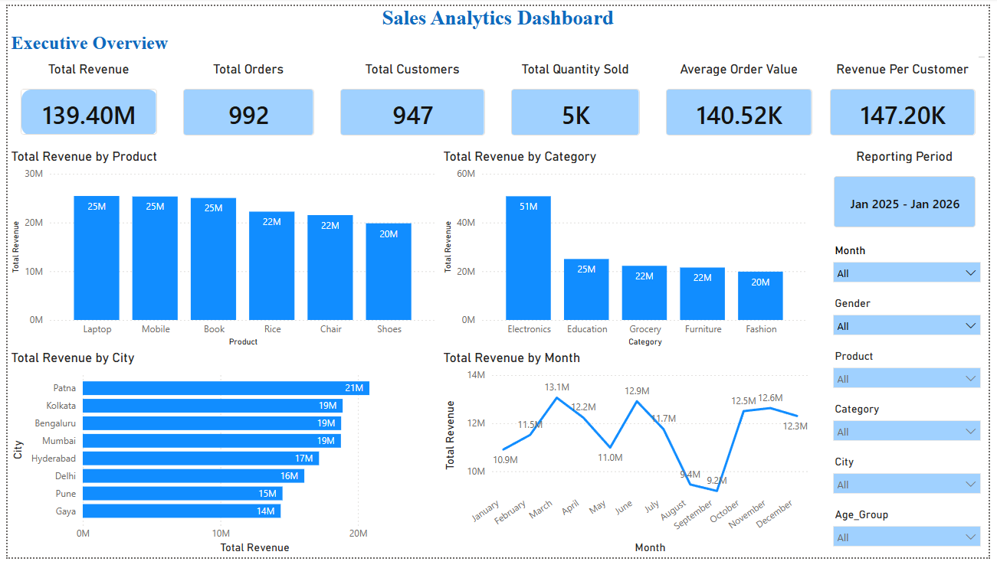
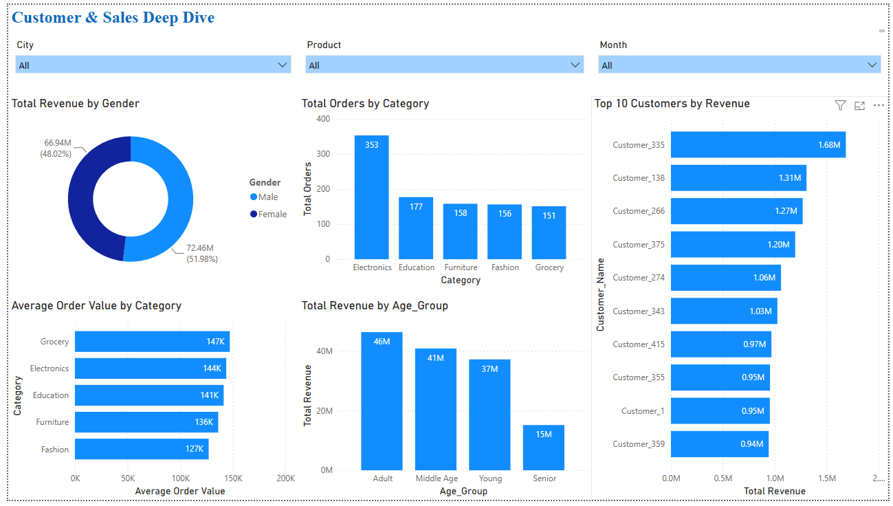
SALES ANALYTICS · POWER BI
Two dashboards: monitor operations, then target customers
Executive Overview for daily posture · Customer Deep Dive for targeting decisions
01 · Executive Overview
02 · Customer Deep Dive
KPI cards · revenue by product, category & city · monthly trend
Gender & age analysis · top customers · orders by category · AOV
Both dashboards are fully interactive — slicers for month, city and category drive every visual simultaneously.
ApexPlanet Software Pvt. Ltd. · Data Analytics Internship · Task 4
12
Notes:
Analysis only creates value if decision-makers can use it without me in the room. The Executive Overview is the daily posture check: KPI cards, revenue breakdowns, monthly trend. The Customer Deep Dive serves targeting decisions: demographics, top customer list, order patterns by category. Both are fully interactive — a regional manager slices to their city and quarter and every visual recalculates instantly. Together they turn a one-time analysis into an operating tool.

Slide 13
SALES ANALYTICS · STATISTICAL VALIDATION
Every reported insight survived a formal test
Four tests at α = 0.05 — only findings that passed are in this deck
PEARSON CORRELATION
INDEPENDENT T-TEST
ONE-WAY ANOVA
95% CONFIDENCE INTERVAL
r = 0.6466
p = 0.4950
p = 0.9727
₹132,319 – ₹146,480
SIGNIFICANT ✓
NOT SIGNIFICANT
NOT SIGNIFICANT
SIGNIFICANT ✓
p < 0.001
Male vs. Female spend
Across 4 age groups
True mean order value
Quantity sold and revenue move together strongly. Volume is a proven growth lever — attach-rate programmes and cross-selling are provably profitable, not just directionally sensible.
The 52:48 gender split is statistical noise. No meaningful difference in basket size or frequency. Gender-based segmentation wastes budget — redirect to city, category and season.
Order values are statistically identical across all four age bands. Seniors buy less often, not smaller baskets. Age-targeted messaging is unlikely to shift spend per transaction.
The true average order value sits in this band with 95% confidence. Tight enough to build an AOV target against. Any promotion lifting spend above ₹146.5K is measurably above baseline.
Method: SciPy statistical suite on the cleaned dataset · α = 0.05 throughout.
ApexPlanet Software Pvt. Ltd. · Data Analytics Internship · Task 4
13
Notes:
This slide is why the deck can be trusted. Four formal tests, alpha five percent throughout. Pearson correlation: r equals zero point six five, p below one in a thousand — volume genuinely drives the top line. T-test on gender: p equals zero point five — the apparent gap is noise, not insight. ANOVA across age groups: p equals zero point nine seven — age does not shape order value. Confidence interval: the true average order value sits between one thirty-two and one forty-six thousand with ninety-five percent confidence. Two findings confirmed, two myths retired.

Slide 14
SALES ANALYTICS · STRATEGIC POSITION
One engine, two gaps, three opportunities — and three threats to manage
Every point traces to a tested finding — this is data, not opinion
S
Strengths
W
Weaknesses
– Electronics engine at 36% of total revenue
– Premium basket: ₹140.5K average order value
– Balanced 8-city footprint across metros and tier-2
– Fashion at ₹19.8M — 61% below Electronics
– Aug–Sep trough: –30% below the March peak
– ~95% single-purchase buyers — near-zero retention
O
Opportunities
T
Threats
– Cross-category bundles to push AOV past ₹140K
– Loyalty programme to convert 947 one-time buyers
– Reinforce Patna & East-India revenue momentum
– Seasonal cash-flow swings from demand troughs
– Revenue concentration: top 5 cities = 67.7%
– Metro price competition on Electronics and Fashion
ApexPlanet Software Pvt. Ltd. · Data Analytics Internship · Task 4
14
Notes:
Every point in this SWOT traces to a tested finding. Strengths: a genuine revenue engine in Electronics, a premium average basket above one-forty thousand, and a well-spread eight-city footprint. Weaknesses mirror them directly: Fashion underperforms by sixty-one percent, the August-September trough cuts a third off peak revenue, and ninety-five percent of customers buy only once. The opportunities target those exact gaps: bundles, loyalty, East-India expansion. Notice the symmetry — every opportunity is a weakness, inverted. That's what makes the next slide actionable, not generic.

Slide 15
SALES ANALYTICS · RECOMMENDATIONS
Eight moves, each tied to a tested finding
Sequenced from quick wins to structural plays — none based on intuition
Protect the Electronics engine
Prioritise inventory and availability for the 36% revenue core.
Focus on the top-5 cities first
Patna, Kolkata, Bengaluru, Mumbai, Hyderabad = 67.7% of revenue.
01
05
Promote Laptop and Mobile as hero SKUs
They lead both revenue (₹25.4M) and volume (1,008 units).
Reposition Fashion with pricing and bundles
Revival of the weakest line rather than category exit.
02
06
Launch cross-category bundles
Lift AOV past ₹140.5K — Grocery’s ₹145.3K AOV proves the headroom exists.
Systematise cross-selling at checkout
Volume correlates with revenue at r = 0.65 — attach-rate is provably profitable.
03
07
Build a loyalty programme
Convert the ~5% repeat rate — the single largest untapped lever in the data.
Counter-seasonal Aug–Sep campaigns
Pre-festive offers and targeted pricing to smooth the –30% trough.
04
08
ApexPlanet Software Pvt. Ltd. · Data Analytics Internship · Task 4
15
Notes:
Eight recommendations in priority order. One and two protect the core: keep Electronics stocked and market Laptop and Mobile as hero products. Three and four are the value plays: bundles to push AOV past its current baseline, and a loyalty programme attacking the ninety-five percent one-time-buyer problem — the largest untapped lever in the data. Five: concentrate marketing where two-thirds of revenue lives, starting with Patna. Six: reposition Fashion rather than abandon it. Seven: cross-selling is provably profitable at r equals zero point six five. Eight: counter-seasonal campaigns to fill the August-September trough.

Slide 16

SALES ANALYTICS · BUSINESS IMPACT
Six outcomes already in stakeholders’ hands
Measured against the four original business questions — all answered with quantified confidence
Revenue drivers quantified
Costly assumptions retired
Insights statistically certified
36%
of revenue traced to Electronics; Laptop + Mobile confirmed as hero SKUs worth ₹50.8M combined.
2
demographic myths — gender and age — disproven before they misdirected a marketing budget.
4
formal tests at α = 0.05 — only findings that survived statistical scrutiny are reported.
Decision tools in daily use
Evidence-backed action plan
Business questions answered
2
interactive Power BI dashboards — executive monitoring and customer targeting, live now.
8
recommendations, each traceable to a tested finding — not one based on intuition.
4 / 4
of the original questions resolved with quantified confidence intervals where applicable.
ApexPlanet Software Pvt. Ltd. · Data Analytics Internship · Task 4
16
Notes:
The impact in business terms, not analytical ones. Revenue drivers identified and quantified: thirty-six percent of the top line traced, hero SKUs confirmed. Two costly demographic myths retired before they could misdirect budgets. Every reported insight statistically certified. Two Power BI dashboards live. Eight evidence-backed recommendations ready to act on. All four original business questions answered with quantified confidence. That is decision support: not more charts — fewer, better-defended decisions.

Slide 17
SALES ANALYTICS · CONCLUSION
From raw rows to decisions leadership can sign
Three things this project proves — about the business, and about the method
From raw to reliable
Patterns, verified
Decisions, operationalised
1,000 messy records became a cleaned, documented, SQL-queryable asset with a full audit trail — every number on every slide is traceable to source.
Formal testing confirmed the real drivers — volume, category, geography — and retired two myths about gender and age that would have misdirected budgets.
Two live dashboards and eight evidence-backed recommendations turn analysis into an operating rhythm the business checks daily.
“Good analytics doesn’t end with charts — it ends with decisions someone is willing to sign.”
ApexPlanet Software Pvt. Ltd. · Data Analytics Internship · Task 4
17
Notes:
Three things demonstrated. First, engineering discipline: a thousand messy rows became a reliable, queryable asset with a full audit trail. Second, intellectual honesty: validation confirmed the real levers and retired two myths that could have misdirected an entire marketing budget. Third, operational value: the work ends in dashboards the business checks daily and recommendations it acts on this quarter. Good analytics ends with decisions someone is willing to sign.

Slide 18




SALES ANALYTICS · FUTURE SCOPE
From describing the past to predicting and automating the future
Six natural extensions — each building on an asset this project already created
Demand Forecasting
RFM Segmentation
Market-Basket Analysis
ARIMA or Prophet on the monthly revenue series — plan inventory ahead of the March and festive-season peaks now proved in the data.
Cluster the 947 customers by Recency, Frequency and Value to give the loyalty programme a precise, scored target list rather than a blanket offer.
Association rules across the 1,000 transactions to design recommended bundles from real co-purchase patterns, not assumption.
Automated ETL Pipeline
Real-Time Dashboards
Promotion Uplift Testing
Scheduled ingest, clean and load — removing every manual refresh step and enabling daily data freshness in the dashboards.
Power BI Service with scheduled refresh and row-level security per region, so each city manager sees only their market.
A/B frameworks to measure campaign ROI as it happens — extending the statistical toolkit from validating the past to optimising the future.
ApexPlanet Software Pvt. Ltd. · Data Analytics Internship · Task 4
18
Notes:
Where this goes next. Demand forecasting with ARIMA or Prophet lets inventory decisions run ahead of the seasonal peaks we proved. RFM segmentation gives the loyalty programme a precise target list. Market-basket analysis designs the bundles from actual co-purchase patterns. Automated ETL and Power BI Service with row-level security remove manual refresh and enable regional access. A/B frameworks extend the statistical toolkit from validating the past to measuring campaign ROI as it happens. Each item builds directly on an asset this project already created.

Slide 19
SALES ANALYTICS · END-TO-END PROJECT · APEXPLANET DATA ANALYTICS INTERNSHIP · TASK 4
PROJECT AT A GLANCE
Thank you.
₹139.4M
revenue analysed
1,000
transactions processed
Durga Prasad
Data Analyst Intern · ApexPlanet Software Pvt. Ltd.
4
statistical tests run
Project repository github.com/shettyprasad-git/Sales-Analytics-End-to-End-Project-ApexPlanet
Python · Pandas · NumPy · SQL · MySQL · Power BI · Jupyter · Git · GitHub
2
Power BI dashboards
8
action recommendations
4 / 4
questions answered
Notes:
Thank you. One thousand raw transactions, cleaned and audited; explored in Python and SQL; every insight statistically validated; delivered as two live Power BI dashboards and eight evidence-backed recommendations. The full project is public on GitHub — notebooks, SQL scripts, test results, dashboard files. I welcome questions on any stage of the pipeline, from cleaning decisions to the choice of statistical tests.

