Slide 1

Car Market Trends Analysis with Car Dekho Data
Durga Prasad
STU6a0332abbabea1778594475

Slide 2

PROBLEM STATEMENT
The used-car market has significant variation in resale prices based on factors such as vehicle age, present price, kilometers driven, fuel type, transmission, seller type, and previous ownership.
The objective of this project is to analyze the Car Dekho dataset to identify the key factors affecting car selling prices, understand resale-value and depreciation patterns, and generate meaningful insights that can support better pricing and purchasing decisions.

Slide 3
This project performs an end-to-end exploratory data analysis of Car Dekho used-car data. The analysis begins with understanding the dataset structure, variables, data types, missing values, duplicates, and data quality. The data is then cleaned and validated, followed by feature engineering such as car age, depreciation amount, resale retention percentage, price gap, age bands, and mileage bands. Various statistical analyses and visualizations are performed to understand relationships between selling price and vehicle characteristics. The project analyzes fuel type, seller type, transmission, ownership, vehicle age, kilometers driven, present price, and individual car models to identify pricing patterns. Correlation and outlier analysis are also performed to understand the major numerical drivers of selling price. Finally, the analysis converts these findings into business insights and recommendations for used-car buyers, sellers, dealers, and automotive analysts.
Project Description

Slide 4

WHO ARE THE END USERS?
Used-car buyers – compare asking prices against vehicle characteristics.
Used-car sellers and dealers – benchmark competitive resale pricing.
Automotive analysts – understand market and vehicle-price patterns.
Business teams – support pricing, inventory and customer decisions.

Slide 5

Technology Used
Python
Pandas – data loading, cleaning and aggregation
NumPy – numerical calculations and feature engineering
Matplotlib & Seaborn – data visualization
Jupyter Notebook – end-to-end analysis workflow

Slide 6
RESULTS — Executive Summary
Key findings from the complete analysis
299
Vehicle listings
9
Variables
₹4.59L
Avg. selling price
₹7.54L
Avg. present price
36.9K
Avg. km driven
• Data quality is strong: no missing values and no exact duplicate rows.
• Present Price has the strongest positive correlation with Selling Price (r ≈ 0.88).
• Vehicle age is negatively associated with resale price (r ≈ −0.23).
• Higher mileage is weakly negatively associated with price (r ≈ −0.09).
• Fuel type, seller type and transmission show clear pricing differences.

Slide 7
RESULTS — Data Exploration & Quality
The analysis starts with structure, completeness and validity checks
• Dataset size: 301 rows × 9 columns.
• Car models: 98 unique names; model years: 2003–2018.
• No missing values were detected across any column.
• Exact duplicate rows detected: 2.
• Numeric variables contain no negative values.
• Categorical fields have consistent business categories: 3 fuel types, 2 seller types and 2 transmission types.
• Cleaning therefore focuses on validation, text standardization, duplicate removal and derived analytical features.

Slide 8
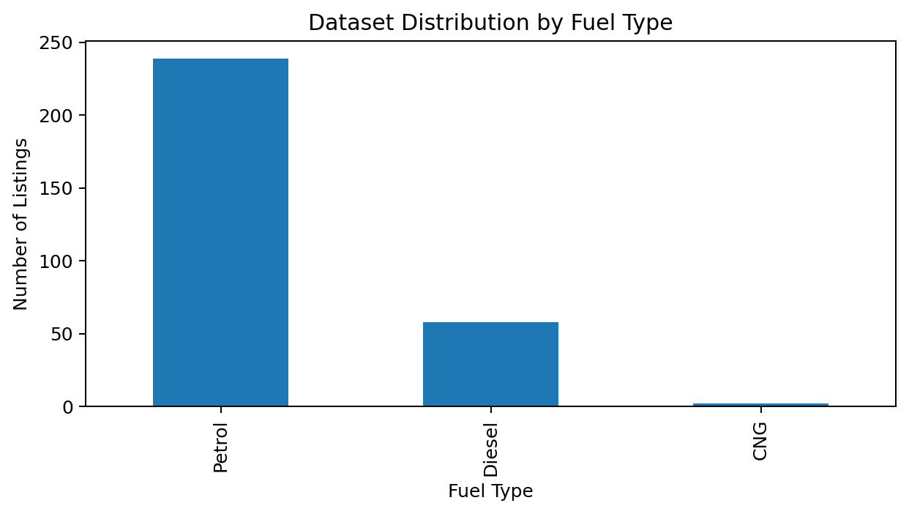
RESULTS — Fuel Mix
• Petrol is the dominant fuel category with 239 listings.
• Diesel accounts for 58 listings.
• CNG has very limited representation, so its average-price comparison should be interpreted cautiously.

Slide 9
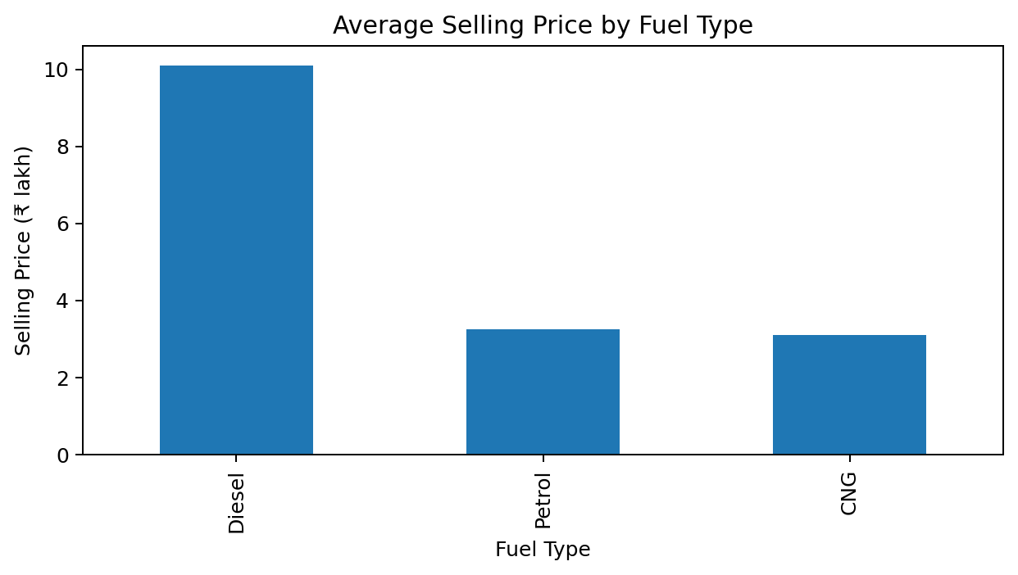
RESULTS — Average Selling Price by Fuel
• Diesel has the highest average selling price at ₹10.10 lakh.
• Petrol forms the largest volume segment but has a lower average selling price than diesel.
• Fuel type is useful for segmentation, but price differences also reflect vehicle mix and original price.

Slide 10
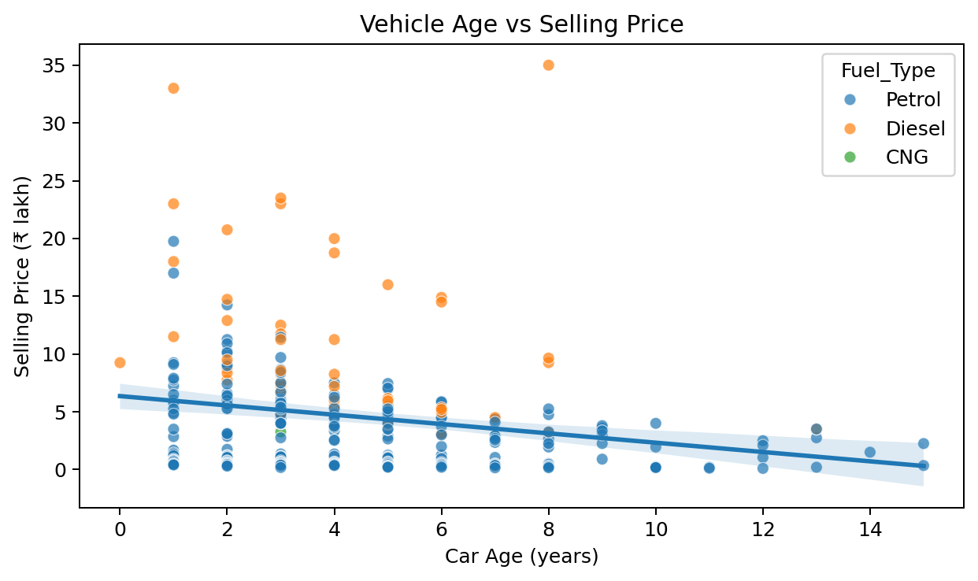
RESULTS — Vehicle Age and Selling Price
• Car age correlation with selling price: -0.23.
• The fitted trend slopes downward, indicating depreciation with age.
• Newer cars generally command higher resale prices, although individual models vary considerably.

Slide 11
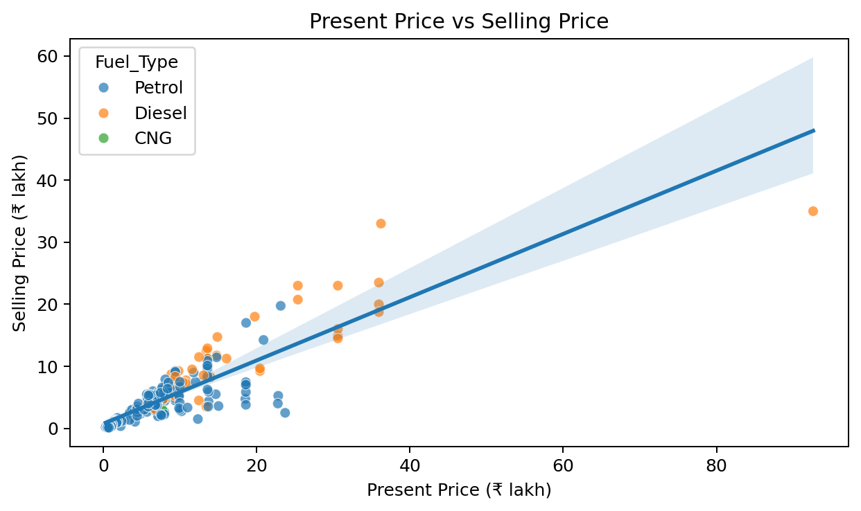
RESULTS — Present Price vs Selling Price
• Correlation: 0.88.
• This is the strongest direct numerical relationship with selling price in the analysis.
• Higher-value vehicles generally have higher resale prices.
• Present Price should be a core benchmark when estimating resale value.

Slide 12
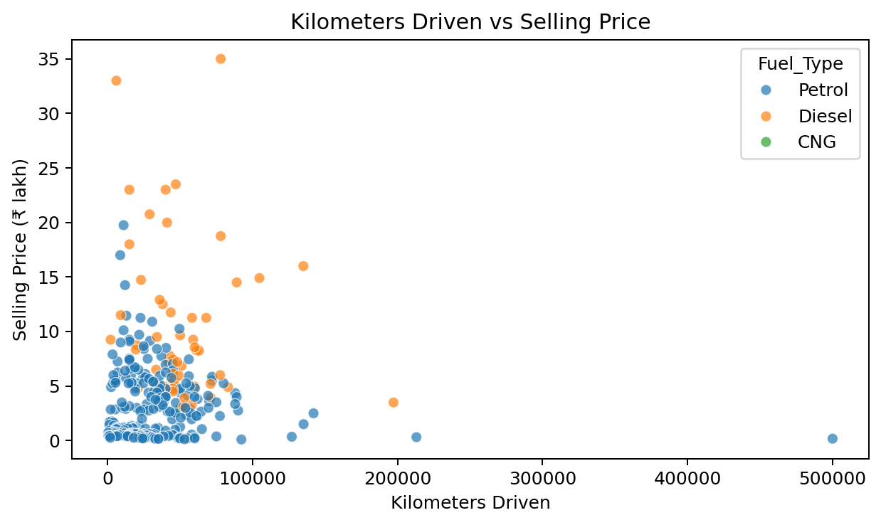
RESULTS — Kilometers Driven vs Selling Price
• Correlation: 0.03.
• The relationship is weakly negative overall.
• Mileage matters, but it is not sufficient on its own to explain resale price.
• Model, original price, age and configuration need to be considered together.

Slide 13
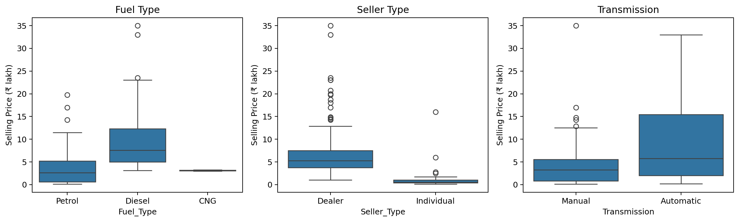
RESULTS — Fuel, Seller & Transmission
• Diesel listings show a higher price distribution than petrol listings.
• Dealer listings have a substantially higher price distribution than individual listings.
• Automatic vehicles have a higher price distribution than manual vehicles.
• These comparisons describe the dataset; they should not be interpreted as causal effects.

Slide 14
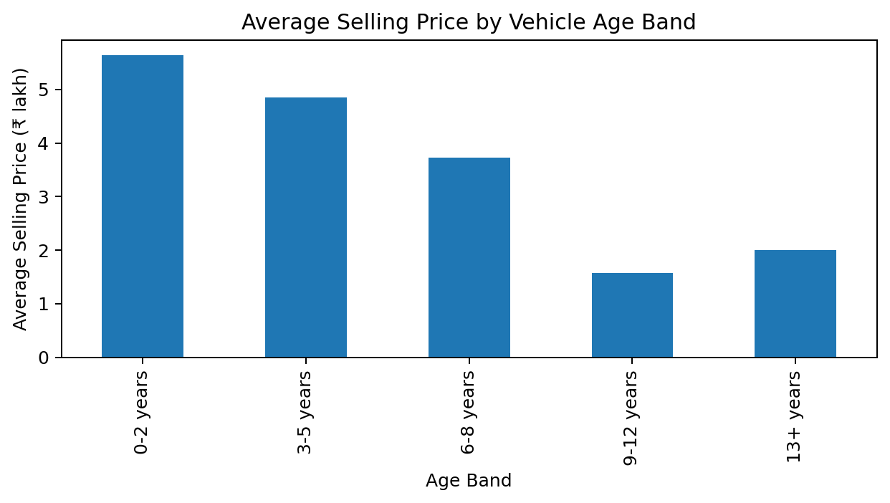
RESULTS — Price by Vehicle Age Band
• Average resale price declines as vehicles move into older age bands.
• The newest age bands have the highest average selling prices.
• Older vehicles have a much wider range of resale outcomes, reflecting model-level differences.

Slide 15
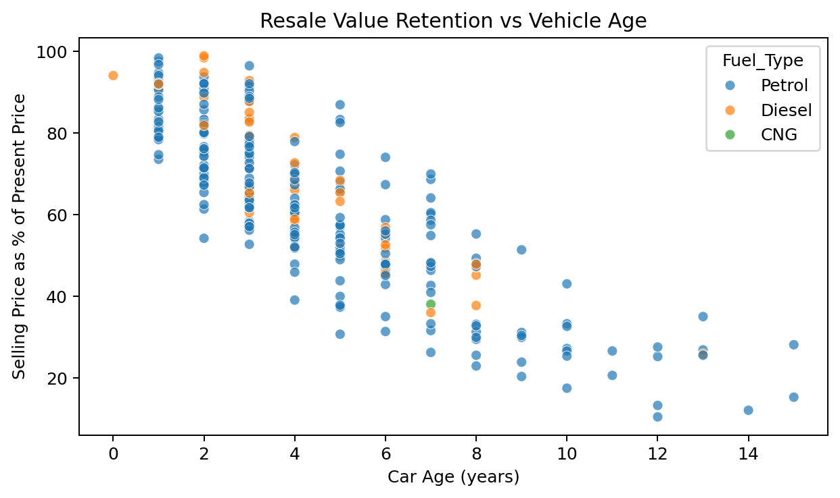
RESULTS — Resale Value Retention
• Resale retention falls strongly as vehicle age increases.
• Younger vehicles tend to retain a larger share of their present/original price.
• This metric provides a more intuitive depreciation view than selling price alone.

Slide 16
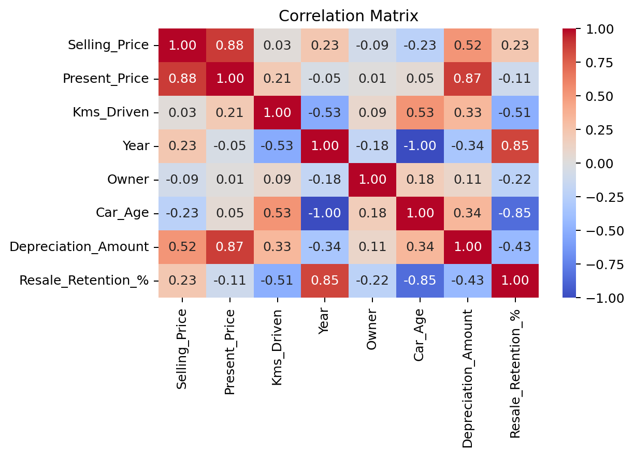
RESULTS — Correlation & Key Drivers
• Present Price: strongest positive correlation with Selling Price (≈ 0.88).
• Car Age: negative relationship with Selling Price (≈ −0.23).
• Kms Driven: weak negative relationship (≈ −0.09).
• Year is positively related to selling price (≈ 0.23), consistent with newer vehicles retaining more value.
• Correlation indicates association, not causation.

Slide 17
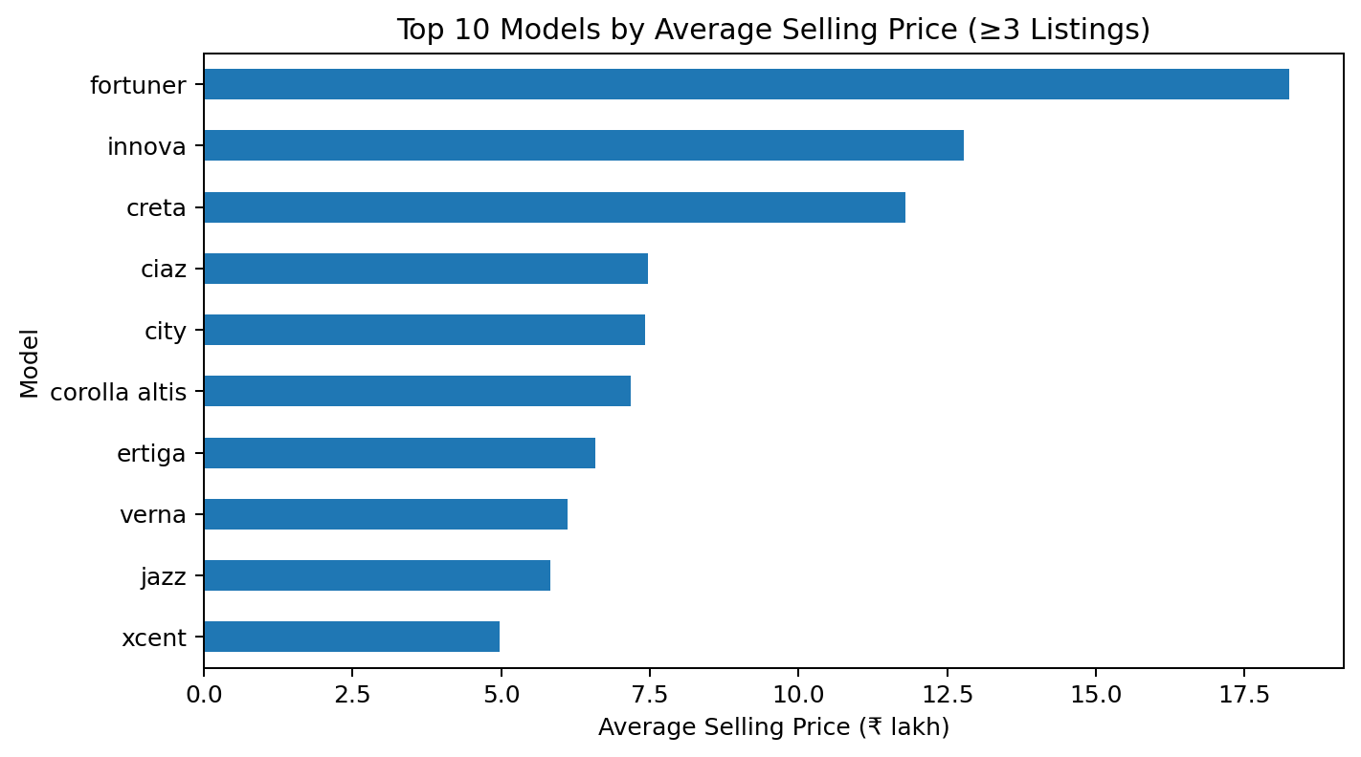
RESULTS — Top Models by Average Selling Price
• The top model comparison is restricted to models with at least 3 listings for greater stability.
• Fortuner ranks among the highest-priced frequently listed models.
• Model-level pricing varies substantially, so generic segment averages can hide important differences.

Slide 18
RESULTS — Outlier Investigation
• Selling Price IQR outliers: 16.
• Present Price IQR outliers: 14.
• Kms Driven IQR outliers: 8.
• Outliers were identified but not automatically deleted.
• High-value and high-mileage observations can be genuine market cases rather than data errors.
• Mean and median are both retained in summaries to reduce the risk of misleading conclusions.

Slide 19
RESULTS — Final Insights & Recommendations
• Pricing: Present Price is the strongest direct numerical benchmark for Selling Price.
• Depreciation: vehicle age is associated with lower resale value, and resale retention declines as age increases.
• Usage: kilometers driven has a weaker relationship with price than Present Price and Age.
• Segmentation: fuel type, transmission and seller type show clear differences in price distributions.
• Model effect: vehicle model remains important; compare listings within comparable models rather than relying only on market-wide averages.
• For buyers: evaluate selling price against present price, age, mileage and comparable models.
• For sellers/dealers: benchmark inventory against comparable vehicles and use age/mileage-adjusted pricing.

Slide 20
Thank you
.
.

