Slide 1
TRUEBIKER
Bike Researcher for Riders
Team Members
Sachin Shetty 4MT25MC077
Saidarshan Shetty 4MT25MC078
Guide: Shwetha V Bhat
Department of MCA • MITE • 2025–26

Slide 2
INTRODUCTION
A centralized motorcycle research and recommendation platform
• The motorcycle market contains many models with different prices, specifications and riding characteristics.
• Users often depend on multiple websites, reviews and videos before choosing a bike.
• TrueBiker combines research, filtering, comparison and personalized recommendations in one platform.
• The system matches riding type, budget, mileage, brand, reliability and other preferences with motorcycle data.
Core Idea
Help riders move from searching for bikes to finding bikes that fit their needs.
Main Outcome
Recommendations with specifications, match percentage, comparison and a Know More link to the manufacturer.
2

Slide 3
EXISTING SYSTEM & PROBLEMS
Limitations of current motorcycle research methods
Multiple Websites
Low Personalization
Manual Comparison
Separate manufacturer, review and comparison websites.
Limited recommendations based on individual needs.
Users collect and compare specifications themselves.
Budget Difficulty
Scattered Information
Popularity Bias
Hard to identify the best option within budget and requirements.
Brand information is distributed across platforms.
Some recommendations depend on popularity or advertising.
3

Slide 4
PROPOSED SYSTEM
How TrueBiker addresses the identified problems
Secure Access
Preference Selection
Recommendation
JWT login and bcrypt password hashing.
Riding type, budget, brand, mileage, reliability and features.
Preference-to-bike matching and scoring.
Research & Compare
Know More
Detailed specifications, side-by-side comparison and favourites.
Direct navigation to the official manufacturer's website.
4

Slide 5
KEY OBJECTIVES & PROJECT SCOPE
What the current system is designed to achieve
Personalization
Centralized Research
Secure Application
Recommend motorcycles using riding style, budget, mileage, brand and features.
Combine specifications, filtering, comparison and favourites.
Registration, login, protected routes and secure password handling.
• User-side motorcycle discovery and recommendation
• Motorcycle database management through admin module
• Advanced search and filtering
• Comparison and favourite management
• Official manufacturer redirection through Know More
5

Slide 6
EXISTING SYSTEM vs TRUEBIKER
A direct comparison of the research experience
Existing Approach
TrueBiker
Multiple sites
Manual comparison
Limited personalization
Scattered information
Manual shortlisting
Centralized research
Side-by-side comparison
Preference-based recommendations
Structured database
Match percentage
Know More → official website
11

Slide 7
SYSTEM METHODOLOGY
End-to-end workflow of TrueBiker
01. REGISTER / LOGIN
02. SELECT PREFERENCES
03. MATCH & SCORE
Secure account authentication.
Riding, budget, brand, mileage and features.
Compare preferences with motorcycle records.
04. VIEW RESULTS
05. COMPARE / SAVE
06. KNOW MORE
Show recommended bikes and match percentage.
Compare bikes and save favourites.
Continue to the official manufacturer website.
6

Slide 8
TECHNOLOGY STACK
Technologies used in the implementation
Frontend
Backend
Database
React.js
Tailwind CSS
React Router DOM
Axios
Node.js
Express.js
REST APIs
MongoDB
Mongoose
Security
Development
Testing / Tools
JWT
bcrypt
Protected Routes
JavaScript ES6+
Vite
npm
VS Code
Postman
Git
Chrome / Edge
7

Slide 9
MAJOR SYSTEM MODULES
Modular design for maintainability and scalability
Authentication
Preference Selection
Motorcycle Database
Functional module
Functional module
Functional module
Recommendation Engine
Search & Filter
Bike Comparison
Functional module
Functional module
Functional module
Favorites
Bike Details / Know More
Admin Dashboard
Functional module
Functional module
Functional module
9

Slide 10
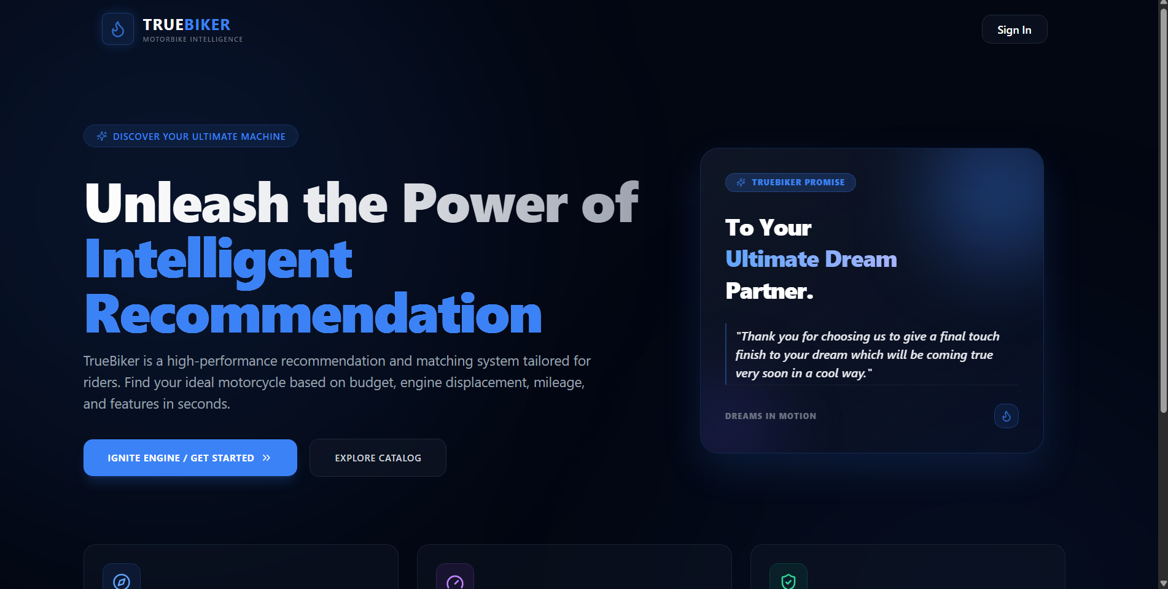
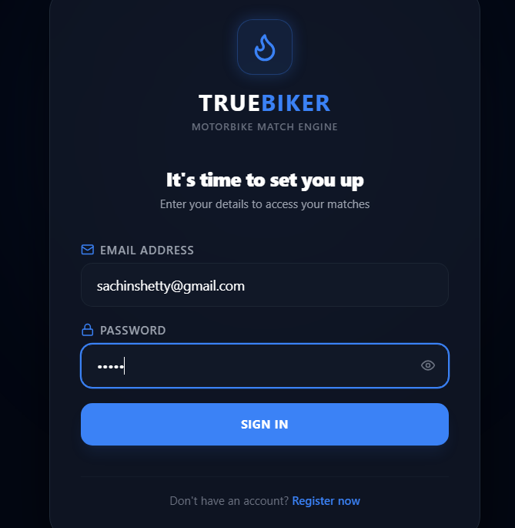
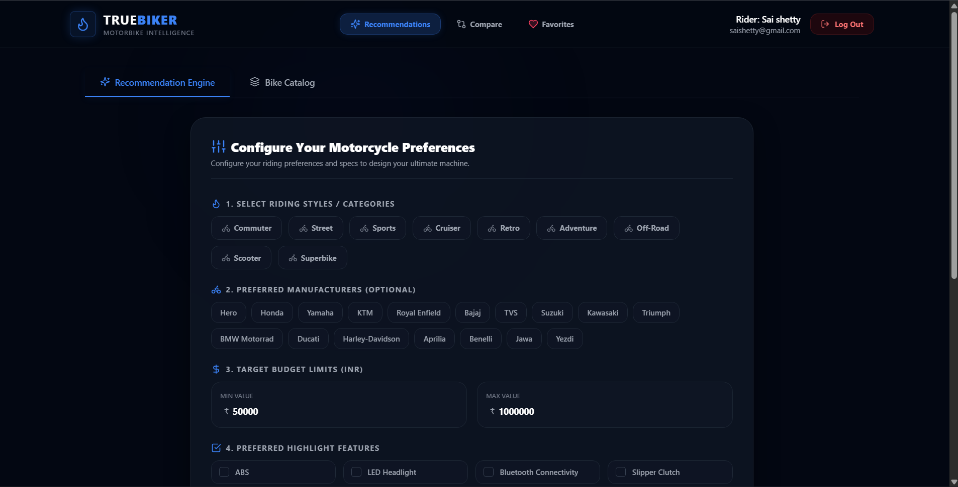
SYSTEM IMPLEMENTATION
Key application screens
HOME PAGE
LOGIN
PREFERENCE
10

Slide 11
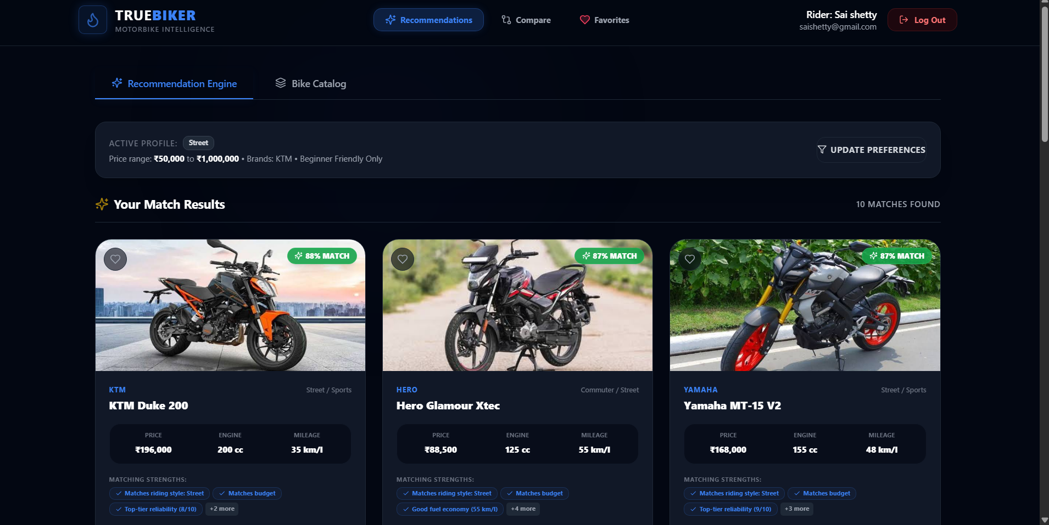
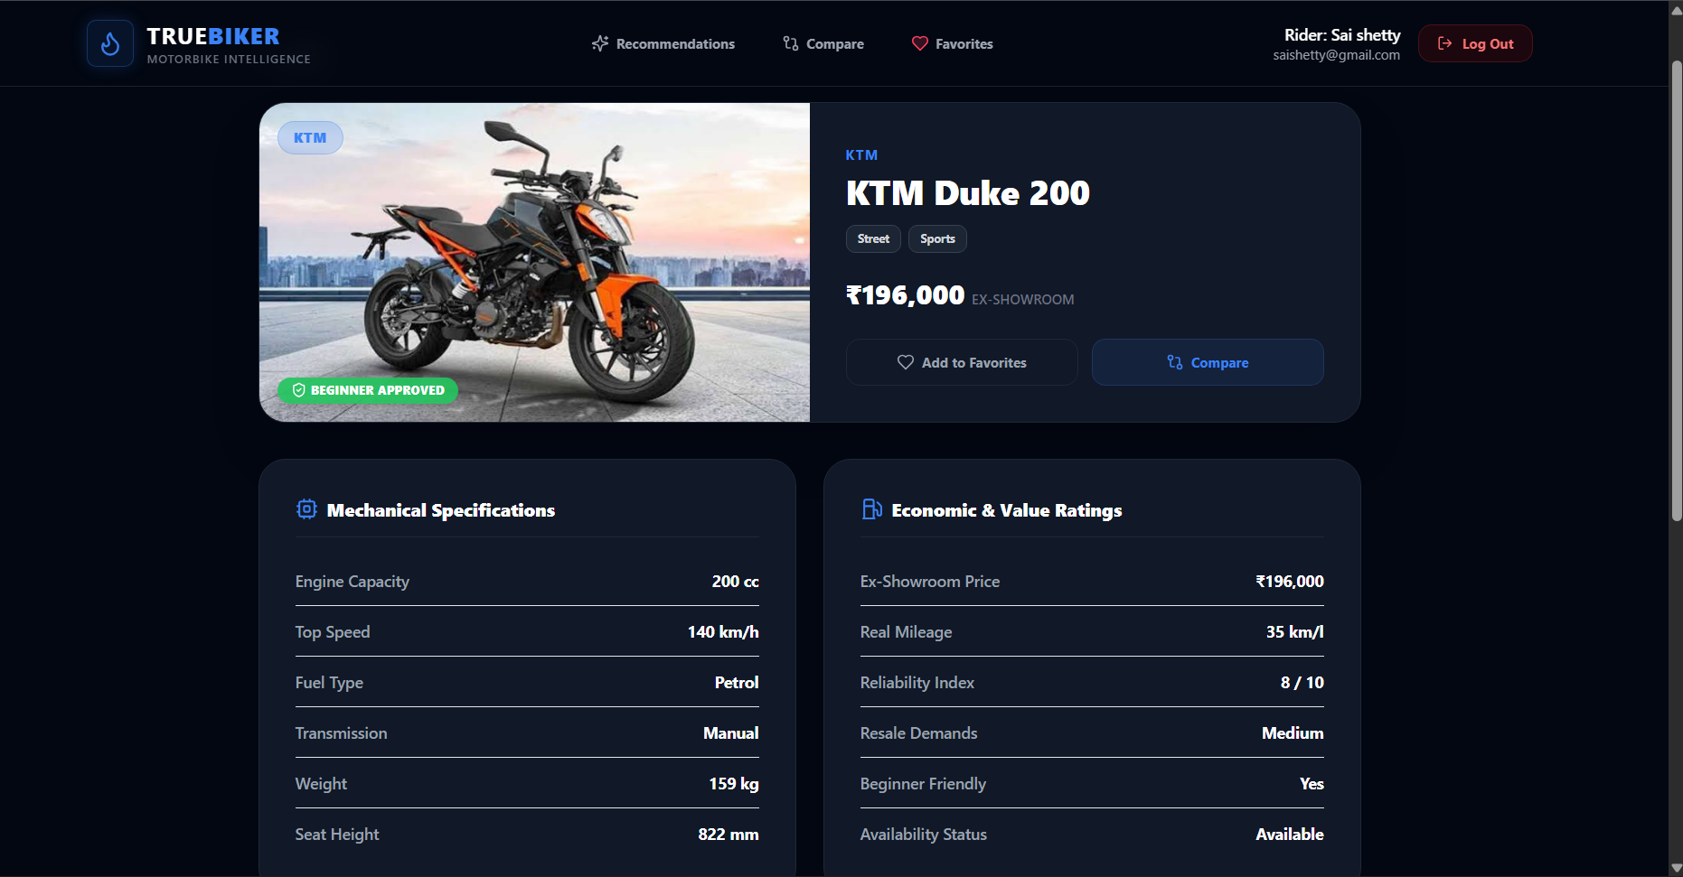
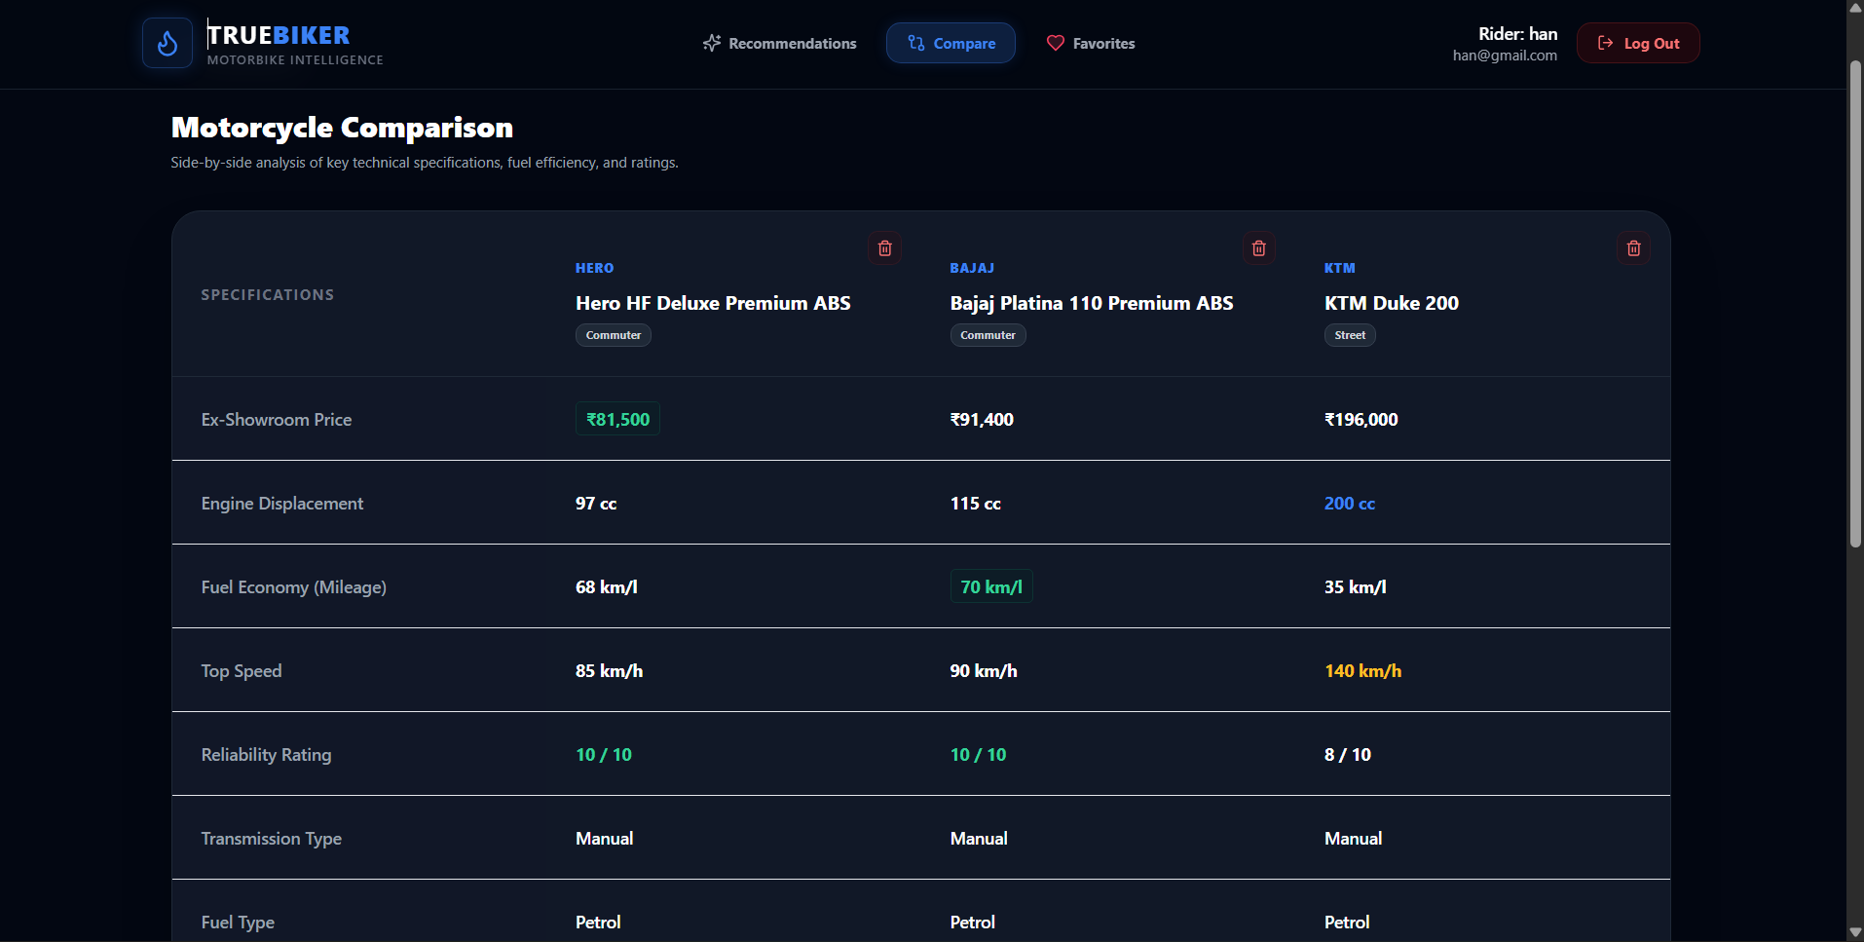
SYSTEM IMPLEMENTATION
Key application screens
RECOMMENDATION
RECOMMENDED BIKE
COMPARISION
10

Slide 12
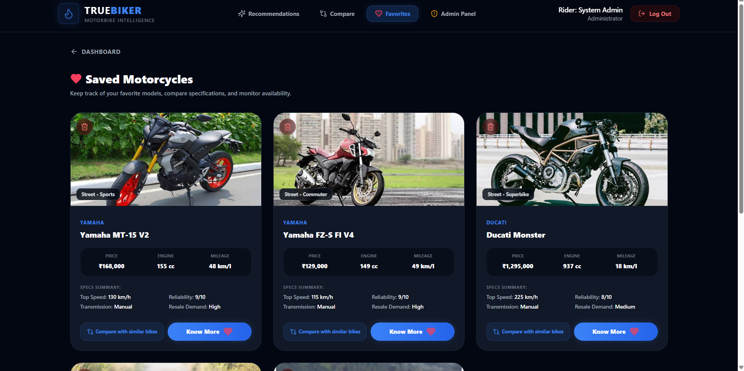
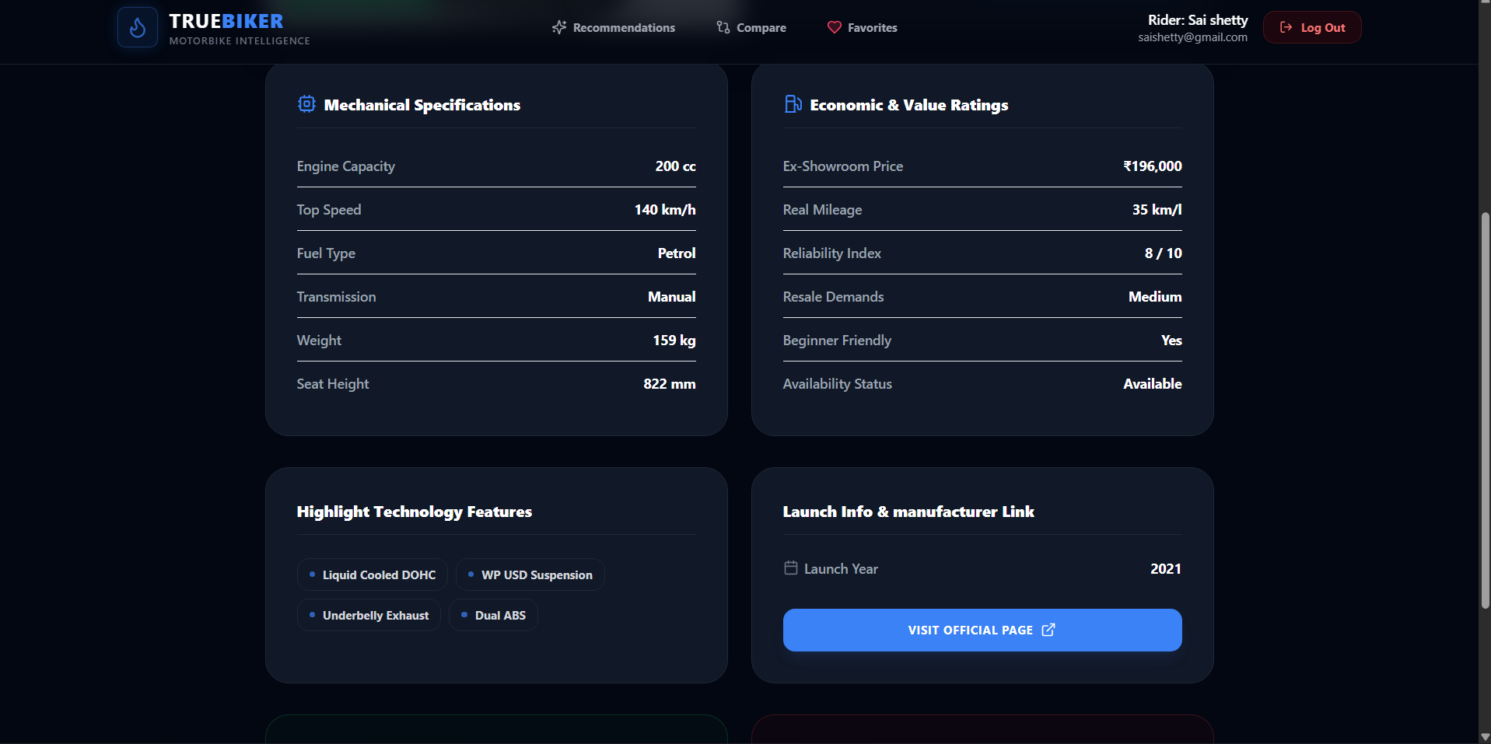
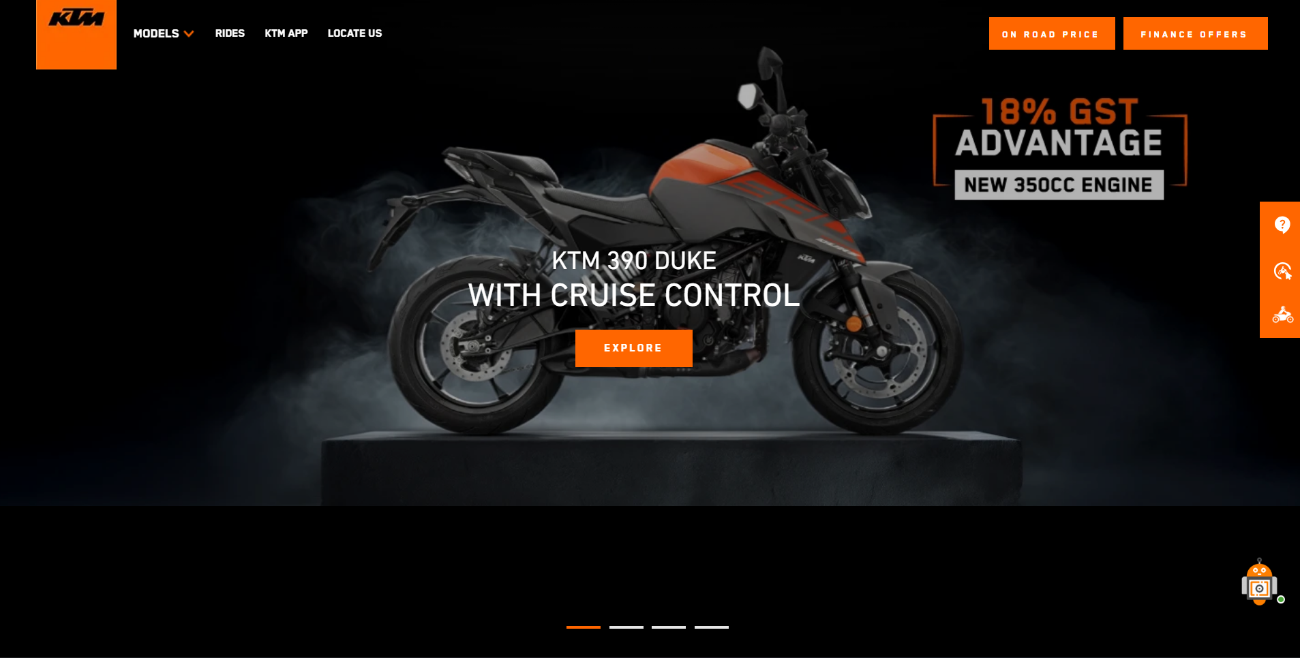
SYSTEM IMPLEMENTATION
Key application screens
FAVORITES
DETAILED DESCRIPTION
OFFICIAL WEBSITE
10

Slide 13
SYSTEM REQUIREMENTS
Hardware and software needed to run the project
Processor
Memory
Storage
Intel Core i3 (7th Gen) or higher / equivalent AMD.
8 GB recommended; minimum 4 GB.
256 GB SSD or 500 GB HDD.
Software
Tools
Network
Windows 10/11, Node.js, MongoDB, modern browser.
VS Code, npm, Git and Postman.
Internet connection for database access and deployment
8

Slide 14
RESULTS & DISCUSSION
What the implemented system provides
• Secure registration and login before protected functionality.
• Interactive preference selection for motorcycle requirements.
• Recommendation results based on selected preferences.
• Detailed specifications, comparison and favourites.
• Know More connects riders to official manufacturer websites.
• Modular MERN architecture supports future expansion.
12

Slide 15
FUTURE SCOPE
Possible extensions beyond the current academic version
More Categories
Industry Partnerships
Live Data
Expand riding, comfort, performance and ownership preferences.
Explore partnerships with manufacturers, dealers and verified providers.
Use trusted APIs/data services for updated prices, launches and specifications.
AI Recommendations
Buying Assistance
Mobile & Voice
Use machine learning and interaction history to improve scoring.
Add EMI, dealer locations, price trends and best-time-to-buy analysis.
Extend to mobile devices and voice-based motorcycle search.
13

Slide 16
CONCLUSION
TrueBiker as a smarter starting point for motorcycle research
• TrueBiker simplifies motorcycle selection by combining user preferences with structured motorcycle data.
• It reduces the effort of searching across multiple platforms and manually comparing models.
• The MERN architecture provides a modern, modular and scalable foundation.
• Recommendations, comparison, favourites and official manufacturer links support informed decision-making.
• Future growth can include larger datasets, live data, AI recommendations and industry partnerships.
Personalized discovery • Centralized research • Better motorcycle decisions
14

Slide 17
THANK YOU
TRUEBIKER
Bike Researcher for Riders
Sachin Shetty • Saidarshan Shetty

