Slide 1
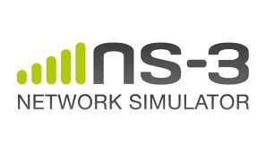
ns-3
A Discrete Event Simulator for Internet Systems
Ashish Shetty

Slide 2
Overview
Open simulation environment for networking research
licensed under the GNU GPLv2 license
Scripting in ns-3 is done in C++ or Python
Mercurial
Traces, Logging, tcpdump, graph plots
waf

Slide 3
Problem Definition
Enhancing ns-3 for IPv6
Path MTU Discovery
Flow Monitor

Slide 4
Refined Problem Definition
Path MTU Discovery
RFC : http://www.ietf.org/rfc/rfc1981.txt
Decrease size if Packet Too Big message is received
MTU might change
Check periodically (10 minutes)
Minimum size 1280

Slide 5
Open Source Organisation
Bug Fixing (bugzilla)
Version Control (Mercurial)
Coding Standard (GNU)
Code Review , Patches
Documentation (Doxygen)
Mailing List , IRC (#ns-3)

Slide 6
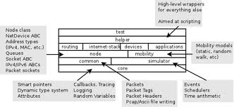
ns-3 Organisation

Slide 7
ns-3 Organisation
Callback Mechanism
Logging
Simulation Models
Helpers
Output

Slide 8
Challenges Faced
Understanding the working of the tool
Understanding the Callback mechanism used to trace the log and provide the required output.
Locating the model where changes are to be added

