Slide 1
Misorientation
Definition of misorientation†: given two orientations (grains, crystals), the misorientation is the rotation required to transform tensor quantities (vectors, stress, strain) from one set of crystal axes to the other set [passive rotation].

Slide 2
Rotations at a Grain Boundary
z
g_{B}
In terms of orientations:
rotate back from position A
to the reference position.
Then rotate to position B.
Compound (“compose”)
the two rotations to arrive
at the net rotation between
the two grains.
y
g_{A}⁻¹
reference
position:
(001)[100]
x
Net rotation = g_{B}g_{A}⁻¹
NB: these are passive rotations

Slide 3
Alternate Diagram
g_{B}
g_{D}
g_{B}g_{A}⁻¹
g_{C}
g_{A}

Slide 4
Grain Boundary Representation
Axis-angle representation: axis is the common crystal axis (but could also describe the axis in the sample frame); angle is the rotation angle, θ.
3x3 Rotation matrix, ∆g=g_{B}g_{A}^{T}.
Rodrigues vector: 3 component vector whose direction is the axis direction and whose length = tan(θ /2).

Slide 5
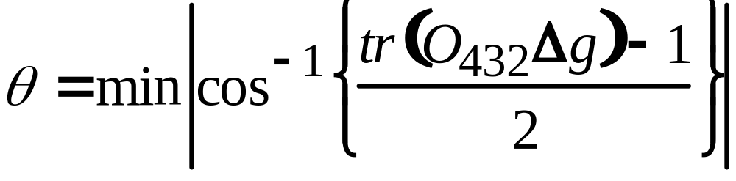
How to Choose the
Misorientation Angle: matrix
If the rotation angle is the only criterion, then only one set of 24 operators need be applied: sample versus crystal frame is indifferent because the angle (from the trace of a rotation matrix) is invariant under axis transformation.
Note: taking absolute value of angle accounts for
switching symmetry

Slide 6

Rotation Axis, Angle
g_{B}
g_{D}
∆g=g_{B}g_{A}⁻¹≡ g_{A}g_{B}⁻¹
g_{C}
g_{A}
Switching symmetry:
A to B is indistinguishable
from B to A
rotation axis,
common to both crystals

Slide 7
Worked Example
In this example, we take a pair of orientations that were chosen to have a 60°<111> misorientation between them (rotation axis expressed in crystal coordinates).
We calculate the 3x3 Rotation matrix for each orientation, g_{A} and g_{B}, and then form the misorientation matrix, ∆g=g_{B}g_{A}⁻¹.
From the misorientation matrix, we calculate the angle,
= cos⁻¹(trace(∆g)-1)/2), and the rotation axis.
In order to find the smallest possible misorientation angle, we have to apply crystal symmetry operators, O, to the misorientation matrix, O∆g, and recalculate the angle and axis.

Slide 8
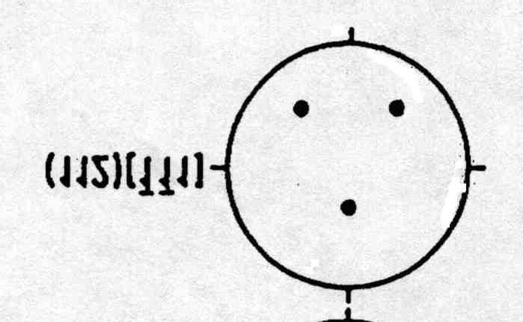
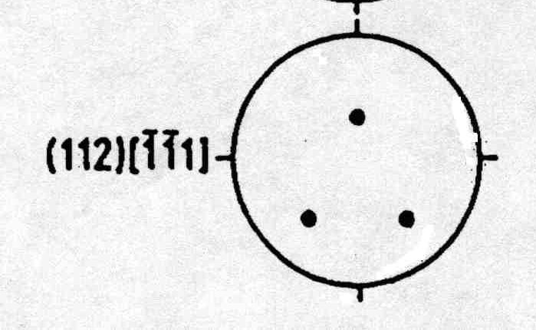
Worked Example
angles.. 90. 35.2599983 45.
angles.. 270. 35.2599983 45.
1st Grain: Euler angles: 90. 35.2599983 45.
2nd Grain: Euler angles: 270. 35.2599983 45.
1st matrix: (passive)
[ -0.577 0.707 0.408 ]
[ -0.577 -0.707 0.408 ]
[ 0.577 0.000 0.817 ]
2nd matrix: (passive)
[ 0.577 -0.707 0.408 ]
[ 0.577 0.707 0.408 ]
[ -0.577 0.000 0.817 ]
Product matrix for gA X gB^-1: (local frame)
[ -0.667 0.333 0.667 ]
[ 0.333 -0.667 0.667 ]
[ 0.667 0.667 0.333 ]
MISORI: angle= 60. axis= 1 1 -1
{100} pole figures
+

Slide 9
Detail Output
Symmetry operator number 5
Product matrix for gA X gB^-1:
[ -0.667 -0.667 -0.333 ]
[ 0.333 -0.667 0.667 ]
[ -0.667 0.333 0.667 ]
Trace = -0.666738987
angle = 146.446442
Symmetry operator number 6
Product matrix for gA X gB^-1:
[ 0.667 0.667 0.333 ]
[ 0.333 -0.667 0.667 ]
[ 0.667 -0.333 -0.667 ]
Trace = -0.666738987
angle = 146.446442
Symmetry operator number 7
Product matrix for gA X gB^-1:
[ 0.667 -0.333 -0.667 ]
[ 0.333 -0.667 0.667 ]
[ -0.667 -0.667 -0.333 ]
Trace = -0.333477974
angle = 131.815872
Symmetry operator number 8
Product matrix for gA X gB^-1:
[ 0.667 -0.333 -0.667 ]
[ -0.333 0.667 -0.667 ]
[ 0.667 0.667 0.333 ]
Trace = 1.66695571
angle = 70.5199966
Symmetry operator number 9
Product matrix for gA X gB^-1:
[ 0.333 -0.667 0.667 ]
[ 0.667 -0.333 -0.667 ]
[ 0.667 0.667 0.333 ]
Trace = 0.333477855
angle = 109.46682
Symmetry operator number 10
Product matrix for gA X gB^-1:
[ -0.333 0.667 -0.667 ]
[ -0.667 0.333 0.667 ]
[ 0.667 0.667 0.333 ]
Trace = 0.333477855
angle = 109.46682
Symmetry operator number 11
Product matrix for gA X gB^-1:
[ -0.333 0.667 -0.667 ]
[ 0.667 0.667 0.333 ]
[ 0.667 -0.333 -0.667 ]
Trace = -0.333261013
angle = 131.807526
Symmetry operator number 12
Product matrix for gA X gB^-1:
[ 0.667 0.667 0.333 ]
[ 0.667 -0.333 -0.667 ]
[ -0.333 0.667 -0.667 ]
Trace = -0.333261073
angle = 131.807526
Symmetry operator number 13
Product matrix for gA X gB^-1:
[ -0.333 0.667 -0.667 ]
[ -0.667 -0.667 -0.333 ]
[ -0.667 0.333 0.667 ]
Trace = -0.333261013
angle = 131.807526
Symmetry operator number 14
Product matrix for gA X gB^-1:
[ -0.667 -0.667 -0.333 ]
[ -0.667 0.333 0.667 ]
[ -0.333 0.667 -0.667 ]
Trace = -1.
angle = 180.
Symmetry operator number 15
Product matrix for gA X gB^-1:
[ 0.333 -0.667 0.667 ]
[ -0.667 -0.667 -0.333 ]
[ 0.667 -0.333 -0.667 ]
Trace = -1.
angle = 180.
Symmetry operator number 16
Product matrix for gA X gB^-1:
[ -0.667 -0.667 -0.333 ]
[ 0.667 -0.333 -0.667 ]
[ 0.333 -0.667 0.667 ]
Trace = -0.333260953
angle = 131.807526
Symmetry operator number 17
Product matrix for gA X gB^-1:
[ 0.333 -0.667 0.667 ]
[ 0.667 0.667 0.333 ]
[ -0.667 0.333 0.667 ]
Trace = 1.66652203
angle = 70.533165
Symmetry operator number 18
Product matrix for gA X gB^-1:
[ 0.667 0.667 0.333 ]
[ -0.667 0.333 0.667 ]
[ 0.333 -0.667 0.667 ]
Trace = 1.66652203
angle = 70.533165
Symmetry operator number 19
Product matrix for gA X gB^-1:
[ 0.333 -0.667 0.667 ]
[ -0.667 0.333 0.667 ]
[ -0.667 -0.667 -0.333 ]
Trace = 0.333044171
angle = 109.480003
Symmetry operator number 20
Product matrix for gA X gB^-1:
[ 0.667 -0.333 -0.667 ]
[ 0.667 0.667 0.333 ]
[ 0.333 -0.667 0.667 ]
Trace = 2.
angle = 60.
Symmetry operator number 21
Product matrix for gA X gB^-1:
[ 0.667 0.667 0.333 ]
[ -0.333 0.667 -0.667 ]
[ -0.667 0.333 0.667 ]
Trace = 2.
angle = 60.
Symmetry operator number 22
Product matrix for gA X gB^-1:
[ 0.667 -0.333 -0.667 ]
[ -0.667 -0.667 -0.333 ]
[ -0.333 0.667 -0.667 ]
Trace = -0.666522205
angle = 146.435211
Symmetry operator number 23
Product matrix for gA X gB^-1:
[ -0.667 -0.667 -0.333 ]
[ -0.333 0.667 -0.667 ]
[ 0.667 -0.333 -0.667 ]
Trace = -0.666522026
angle = 146.435196
Symmetry operator number 24
Product matrix for gA X gB^-1:
[ -0.333 0.667 -0.667 ]
[ 0.667 -0.333 -0.667 ]
[ -0.667 -0.667 -0.333 ]
Trace = -0.999999881
angle = 179.980209
MISORI: angle= 60. axis= 1 1
MISORI: angle= 60. axis= 1 1 -1-1
1st matrix:
[ -0.691 0.596 0.408 ]
[ -0.446 -0.797 0.408 ]
[ 0.569 0.100 0.817 ]
2nd matrix:
[ 0.691 -0.596 0.408 ]
[ 0.446 0.797 0.408 ]
[ -0.569 -0.100 0.817 ]
Symmetry operator number 1
Product matrix for gA X gB^-1:
[ -0.667 0.333 0.667 ]
[ 0.333 -0.667 0.667 ]
[ 0.667 0.667 0.333 ]
Trace = -1.
angle = 180.
Symmetry operator number 2
Product matrix for gA X gB^-1:
[ -0.667 0.333 0.667 ]
[ -0.667 -0.667 -0.333 ]
[ 0.333 -0.667 0.667 ]
Trace = -0.666738808
angle = 146.446426
Symmetry operator number 3
Product matrix for gA X gB^-1:
[ -0.667 0.333 0.667 ]
[ -0.333 0.667 -0.667 ]
[ -0.667 -0.667 -0.333 ]
Trace = -0.333477736
angle = 131.815857
Symmetry operator number 4
Product matrix for gA X gB^-1:
[ -0.667 0.333 0.667 ]
[ 0.667 0.667 0.333 ]
[ -0.333 0.667 -0.667 ]
Trace = -0.666738927
angle = 146.446442
This set of tables shows each successive result as a different symmetry operator is applied to ∆g. Note how the angle and the axis varies in each case!

Slide 10
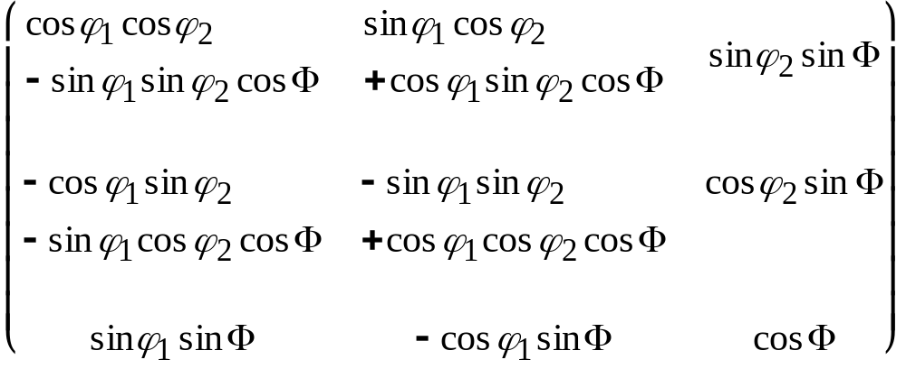
Matrices
g = Z₂XZ₁ =
Passive Rotations (Axis Transformations);
in the local/crystal frame

