Slide 1



Political_party_donations
View in Power BI
Last data refresh:
11/15/2021 8:05:44 AM UTC
Downloaded at:
12/21/2021 9:07:22 AM UTC

Slide 2
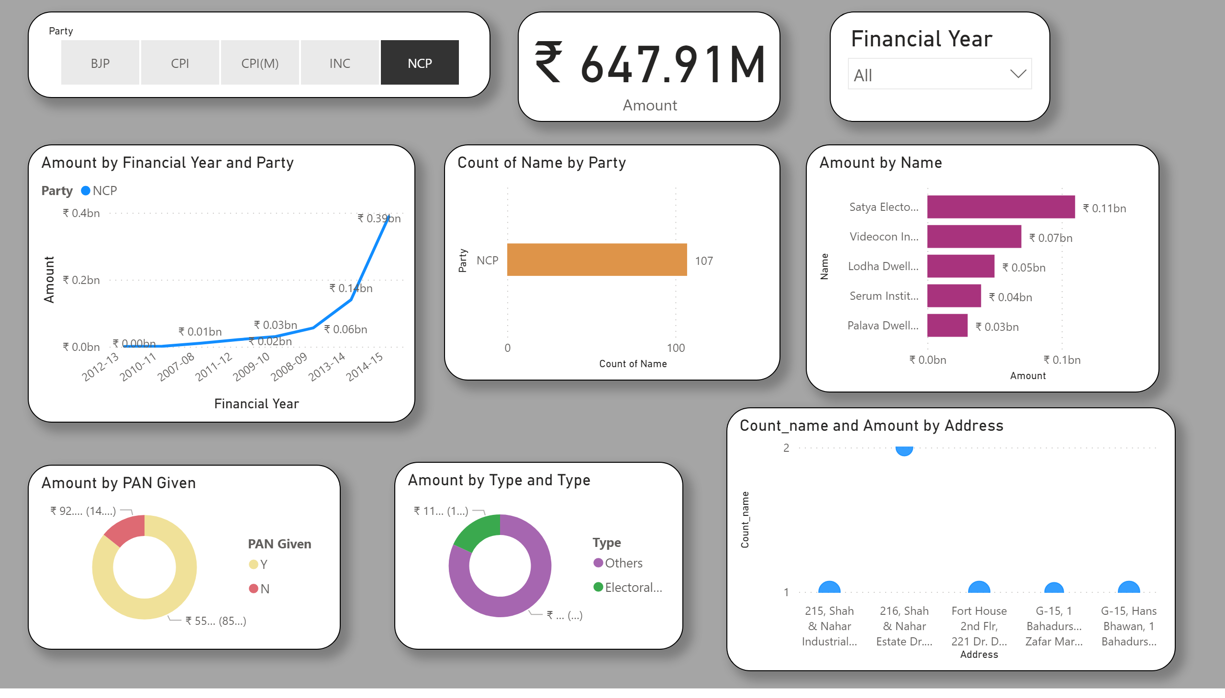
Page 1
Notes:
slicer
No alt text provided
card
No alt text provided
slicer
No alt text provided
lineChart
No alt text provided
donutChart
No alt text provided
donutChart
No alt text provided
barChart
No alt text provided
barChart
No alt text provided
scatterChart
No alt text provided

Slide 3
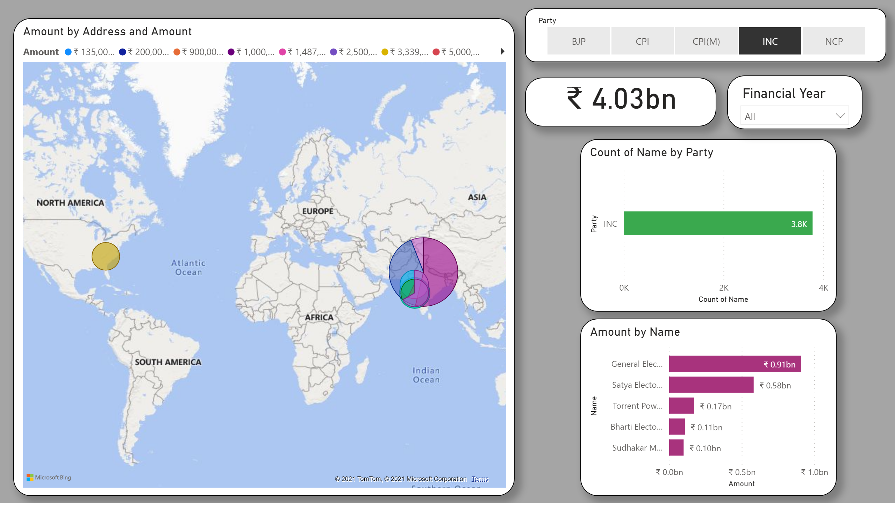
Page 2
Notes:
barChart
No alt text provided
barChart
No alt text provided
slicer
No alt text provided
slicer
No alt text provided
card
No alt text provided
map
No alt text provided

