Slide 1

SCOUTING THE SUMMER LEAGUE
RIRI

Slide 2
Executive Summary
01
02
03
04
PURPOSE
Looking to help NBA managers decide how to allocate payroll
METHODS
Collected data from NBA summer league and NBA regular season
RESULTS
Ran Multivariable Logistic Regression and Created Decision tree
INSIGHTS
Found Key Metrics for NBA personnel to use and applied them to 2022 drafted/undrafted rookies

Slide 3
Purpose
01

Slide 4
$156,983,000
Tax Apron for the 2022/2023 NBA season
Notes:
The salary cap fluctuates each year and has a number of exceptions as teams may go over the cap and only pay a “tax”. However, each team can not exceed the tax apron set during the respective league year. The tax apron for the 2022/2023 NBA season was set at $156,983,000. Thus, it is important for teams to understand how to fully take advantage of their available funds while dealing with such limitations.

Slide 5
How should NBA General Managers allocate their funds?

Slide 6
After players are drafted
NBA teams can extend their rookie players and pay a premium
Can release, trade, or decline a contract extension
Management decides how to allocate funds based on these decisions

Slide 7
Business Problem
NBA managers would be interested in knowing if their rookie talents are worth the initial investment, or if they should allocate their roster and funds elsewhere to avoid exceeding financial restrictions

Slide 8
What is the Summer League
Brief Showcase
Rookies
Undrafted/Unsigned
Each NBA team plays 5-8 games with modified rosters
First chance for recently drafted NBA players to face real NBA talent
Chance for many Free Agents to impress scouts and make a roster
Notes:
Undrafted unsigned fight for roster spot
Each team competes in the summer league and their roster usually consists of rookies or players who are undrafted or unsigned

Slide 9
UNDERSTANDING RELATIONSHIP
PREDICTING FUTURE
STARS (AND BUSTS)
Logistic Regression of Summer League Stats on
NBA League Success
Classification Tree Applied to Rookies 2022 and beyond
Which Stats should Scouts/Coaches/Management Focus on when deciding to keep or drop rookies ?
Which Rookies are Worth Holding Onto for the next five years? Which Rookies are worth Trading For

Slide 10
Methods
02

Slide 11
How did we assemble the data set
XLookup Excel
Matched summer league players by name if they were in the NBA 5 years later
NBA.Com
All NBA players from 2010 to 2021
RealGM
Full Dataset summer league averages from 2005-2016.

Slide 12
Data Set
There are 2848 observations of 24 variables.
PPG SL | RPG SL | FG% SL | In NBA 5 Years Later
24 | 06 | 18 | YES/1
09 | 21 | 98 | NO/0
Damian Lillard
Josh Akognon
Notes:
Each record contains an individual player, their summer league stats: including Points Per Game, Assists Per Game, Rebounds Per Game, and then also statistics such as FG%, 3P% and Turnovers Per Game from the realGM data. We then used the NBA.com data to figure out which players played in both the summer league and the NBA using XLookup on excel. We created another column with a dummy variable called NBA5, which is 0 if the player did not play in the NBA 5 years later, and 1 if they did play
There are 2848 observations of 24 variables.

Slide 13
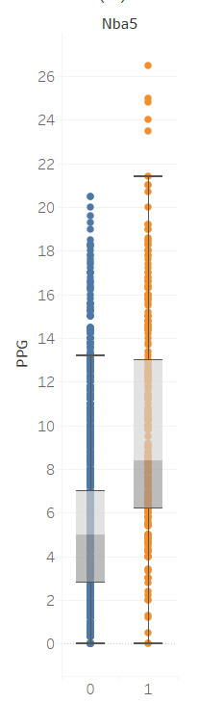
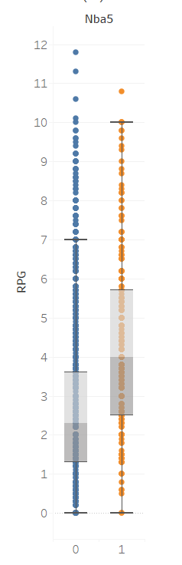
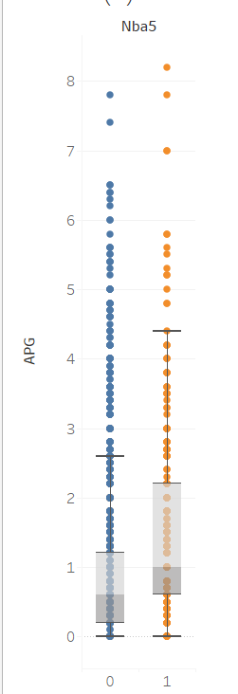
Notes:
Devarshi

Slide 14
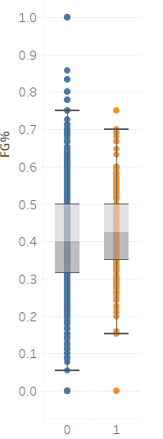
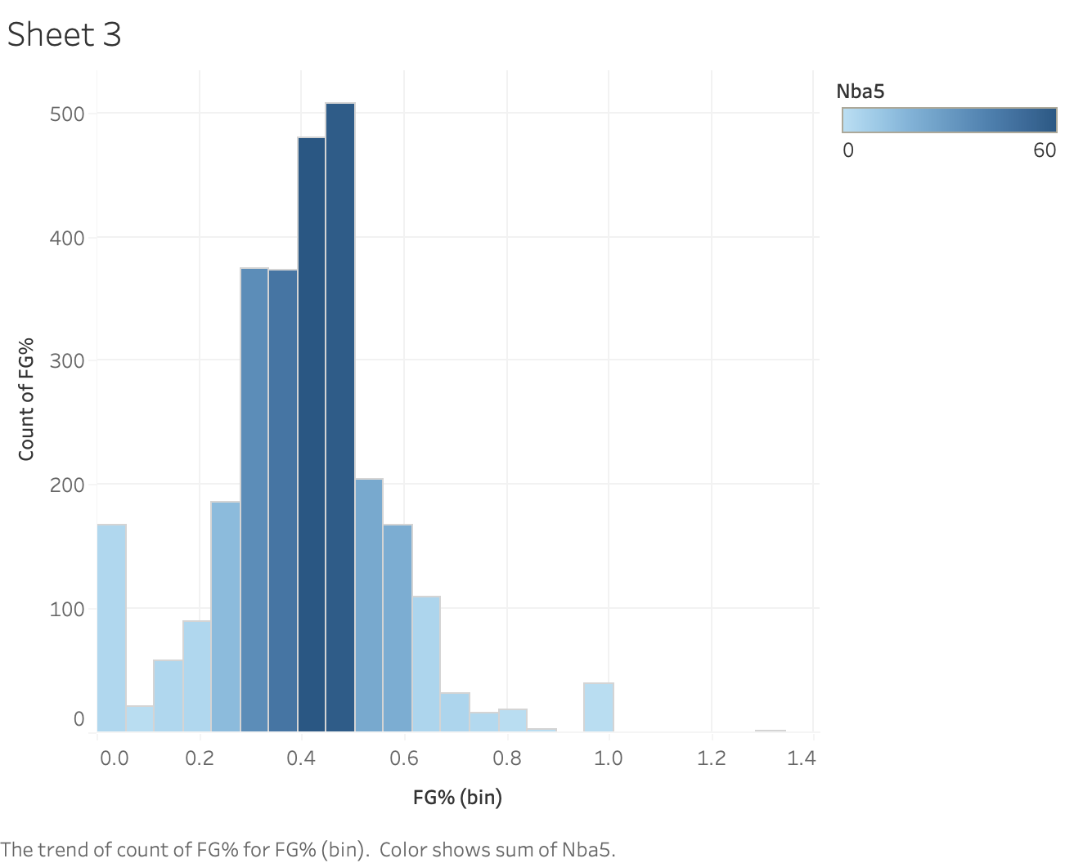
Notes:
Devarshi

Slide 15
Regression Model
02

Slide 16
Coefficients:
Estimate Std. Error z value Pr(>|z|)
(Intercept) -4.67726 0.19166 -24.404 < 2e-16 ***
PPG 0.18917 0.02262 8.362 < 2e-16 ***
RPG 0.11853 0.04214 2.812 0.00492 **
APG 0.06629 0.06620 1.001 0.31669
SPG 0.37713 0.13160 2.866 0.00416 **
TOV 0.18305 0.08698 2.104 0.03534 *
BPG 0.26745 0.13502 1.981 0.04760 *
TPM -0.13158 0.13365 -0.985 0.32487
Notes:
Devarshi

Slide 17
Coefficients:
Estimate Std. Error z value Pr(>|z|)
(Intercept) -4.69384 0.18892 -24.846 < 2e-16 ***
PPG 0.17896 0.01870 9.568 < 2e-16 ***
RPG 0.12469 0.03958 3.150 0.001631 **
SPG 0.41275 0.12464 3.312 0.000928 ***
TOV 0.22696 0.07838 2.896 0.003785 **
BPG 0.25893 0.13220 1.959 0.050161 .
---
Signif. codes: 0 ‘***’ 0.001 ‘**’ 0.01 ‘*’ 0.05 ‘.’ 0.1 ‘ ’ 1

Slide 18
51%
20%
13%
PER GAME
Increase in Odds for Each Additional Steal
Increase in Odds for Each Additional Point
Increase in Odds for Each Additional Rebound

Slide 19
For every additional steal a rookie records per game in the summer league, on average there is an estimated increase in the odds that they will remain in the NBA for at least 5 years by 51.1%
=e^(0.41275)
1.5109672369
For every additional point a rookie scores per game in the summer league, the odds that they will remain in the NBA for at least 5 years increases by an estimated 19.6%.
A multiple of e^(0.17896)
=e^(0.17896)
1.19597290429
For every additional rebound a rookie grabs per game in the summer league, on average there is an estimated increase in the odds that they will remain in the NBA for at least 5 years by an estimated 13.3%
= e^(0.12469)
1.13279723149

Slide 20
25%
30%
PER GAME
Increase in Odds for Each Additional Turnover
Increase in Odds for Each Additional Block

Slide 21
For every additional turnover a rookie records per game in the summer league, on average there is an estimated increase in the odds that they will remain in the NBA for at least 5 years by 25.5%
=e^(0.22696)
1.25477967575
For every additional block a rookie records per game in the summer league, on average there is an estimated increase in the odds that they will remain in the NBA for at least 5 years by 29.6%
=e^(0.25893)
1.29554311364

Slide 22
Classification Tree
02

Slide 23
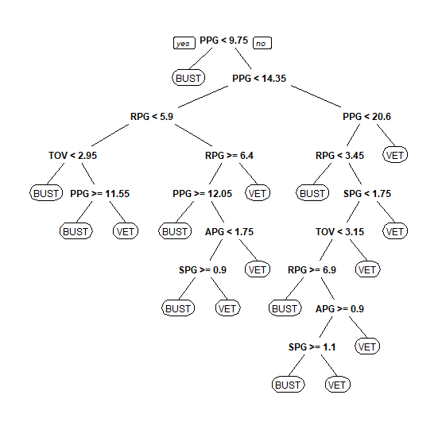

Slide 24
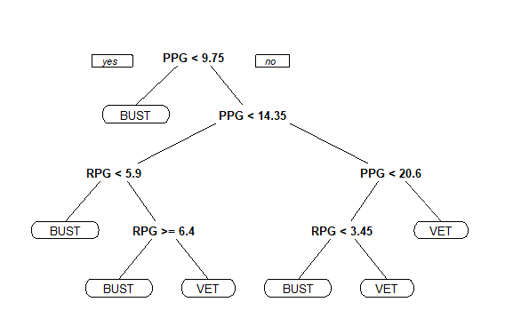

Slide 25
> NBASL.prune$variable.importance
PPG RPG SPG TOV
69.64 5.70 0.81 3.49 APG BPG
1.32 2.09

Slide 26
INSIGHTS FOR BUSINESS ENTITIES
GENERAL MANAGERS
AGENTS
Can allocate more funds to players who match specific cutoffs
Can generate a higher markup or more hype for hidden gems in the Summer League
COMPETING SCOUTS
PLAYERS
Can find players to make offers during free agency/trade targets
Can focus on rebounding and stealing to boost their chance of getting picked up by a roster

Slide 27
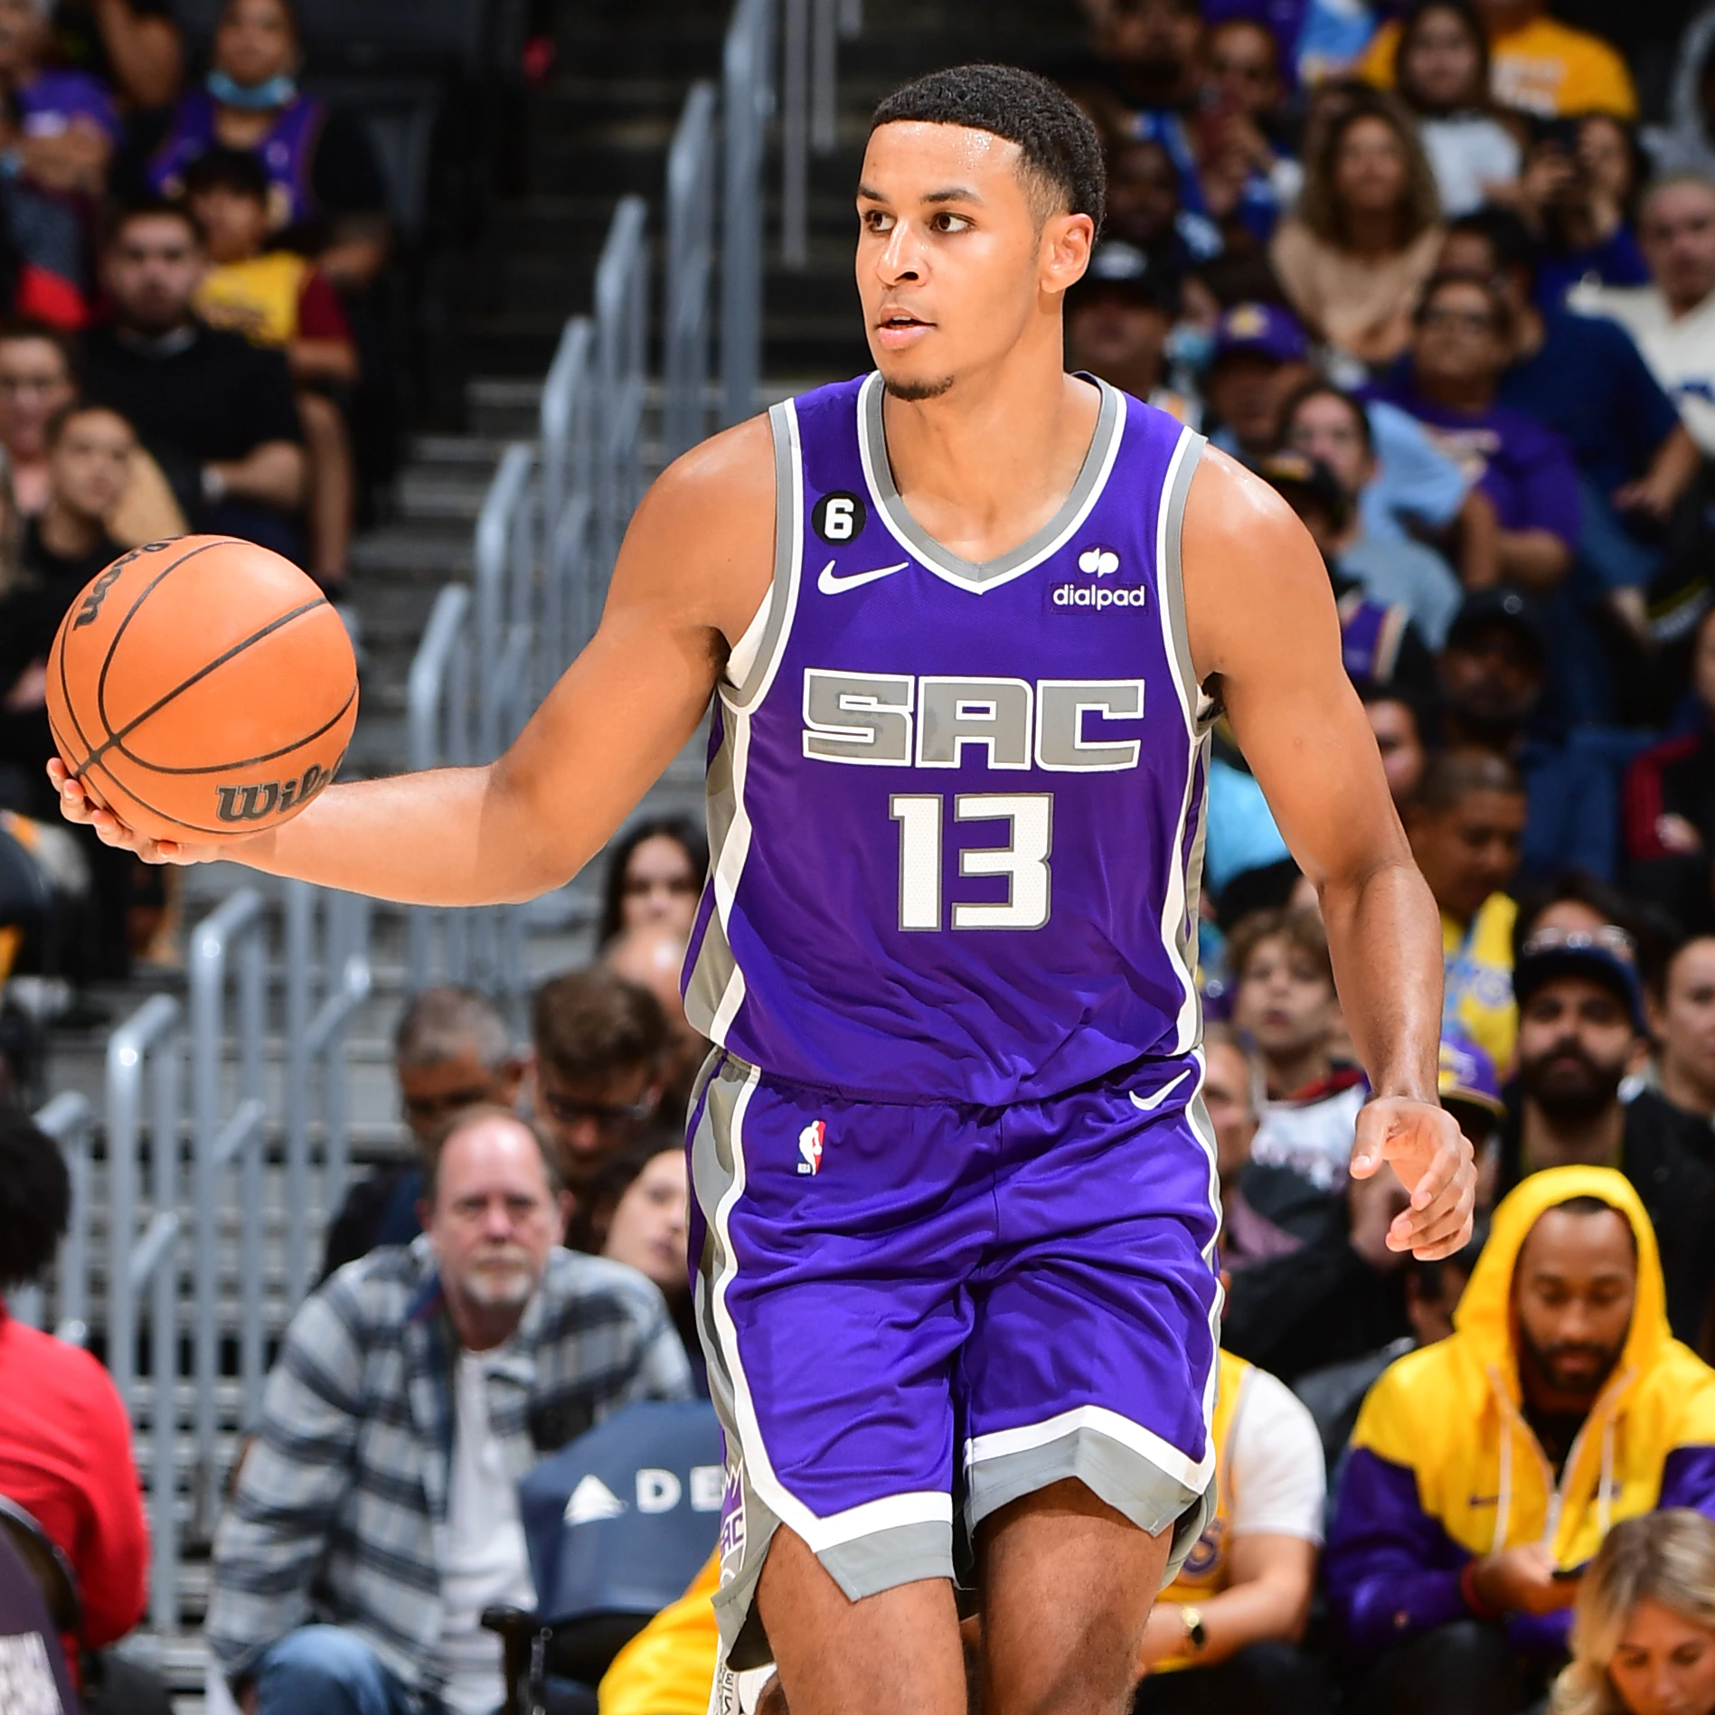
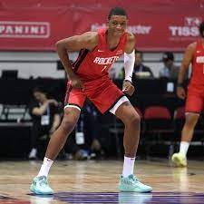
Keegan Murray
GP:4
MPG:31.9
PPG:23.3
RPG:7.0
APG:2.0
SPG:1.3
BPG:0.3
FG: .500
TOV:2.5
Jabari Smith Jr.
GP: 5
MPG: 29.7
PPG: 14.4
RPG: 9.4
APG: 1.8
SPG: 1.6
BPG: 1.4
FG: .377
TOV: 2.2
STAR
STAR

Slide 28
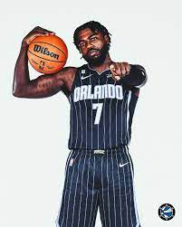
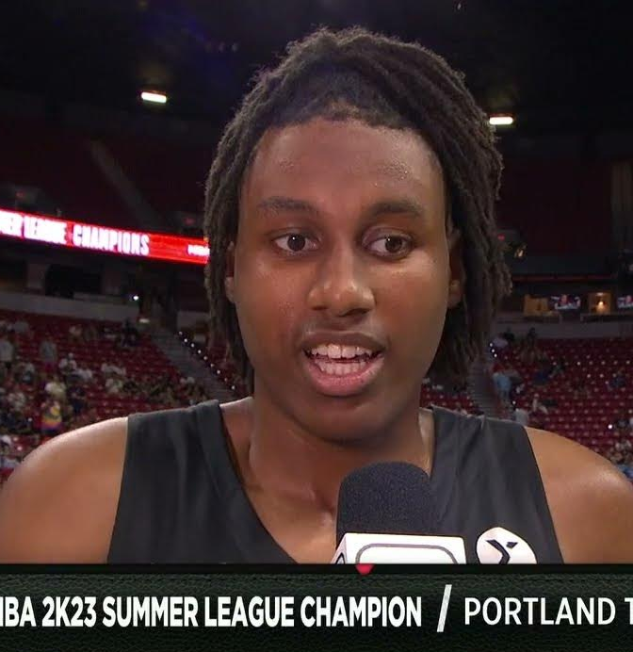
Jabari Walker
GP: 5
MPG: 22.0
PPG:12.4
RPG: 9.0
APG: 1.4
SPG: 1.0
BPG: 1.0
FG: .629
TOV: 0.8
Kevon Harris
GP: 5
MPG: 27.1
PPG: 15.8
RPG: 2.8
APG: 2.0
SPG: 1.0
BPG: 0.4
FG: .577
TOV: 2.6
STAR
BUST

Slide 29
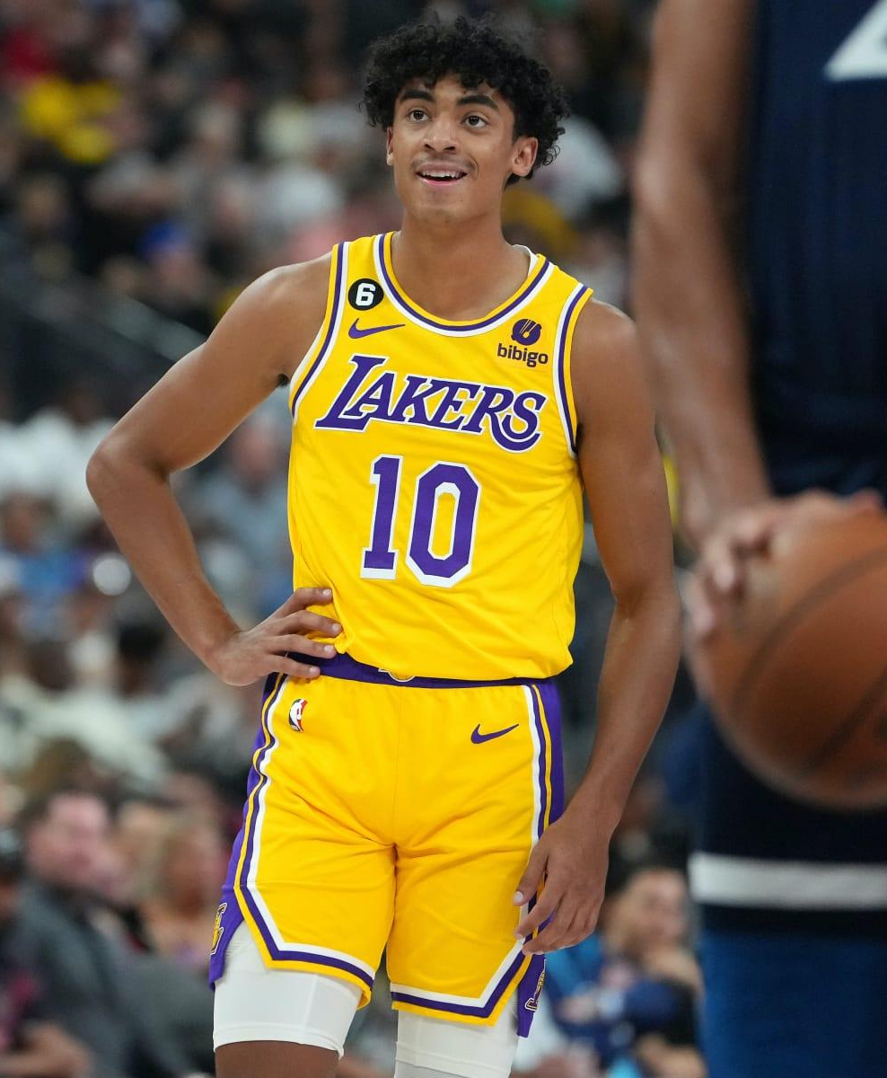
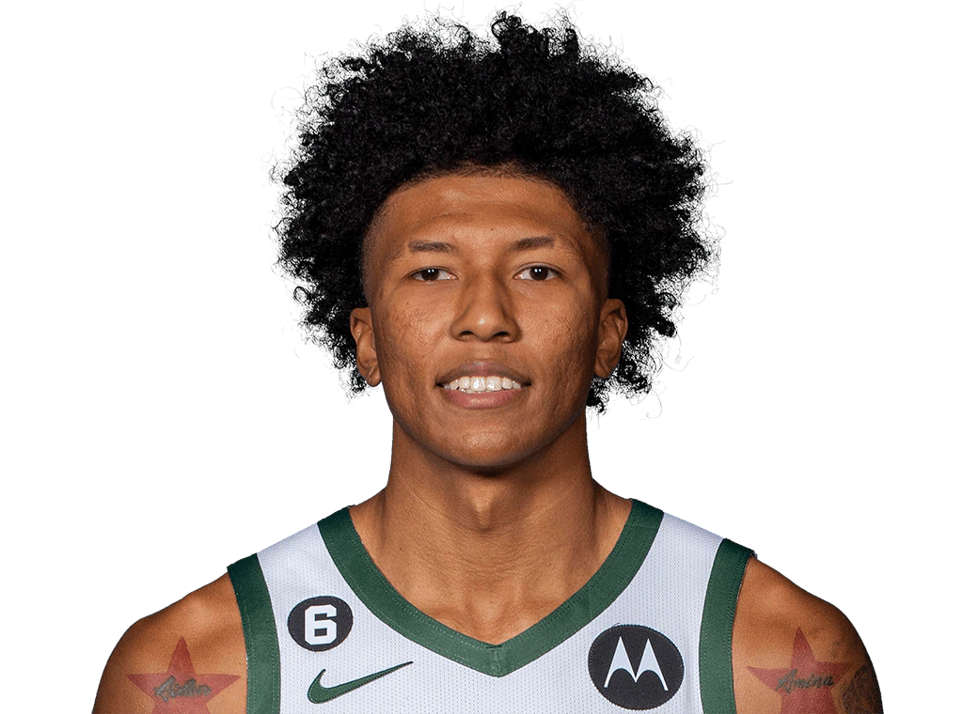
MarJon Beauchamp
GP: 5
MPG: 26.5
PPG: 12.8
RPG: 3.2
APG: 1.6
SPG: 0.8
BPG: 1.0
FG: .426
TOV: 2.0
Max Christie
GP: 5
MPG: 24.4
PPG: 8.2
RPG: 4.4
APG: 1.2
SPG: 0.8
BPG: 0.0
FG: .286
TOV: 1.0
BUST
BUST
BUST

Slide 30
If we had more time…
Unsigned Players
Different Time Length
Other Variables and Statistics
Do their performance in summer league also have a correlation to their NBA Success?
1 year instead of looking at rookie performance 5 years later
Look at variables (Next Gen Stats) that were not recorded by real gm
Notes:
Real GM didn’t take that into consideration
What leads to singing and who doesn’t get singed based on their stats (not whether they last)
struggled to find dataset

Slide 31
What did we learn?
Using Tableau
Made box plots and scatter plots to show critical statistics and make it easier to read and compare
Using R
Create logistic regression models and decision trees using more variables using real-word data
Using Feedback
Didn’t have enough variables, had to adapt our idea and data collection
Notes:
Reingineered way we got data
putting info and models leanre din class into practice
utlizing models practiced in class and intrepeting the results

Slide 32
References
https://basketball.realgm.com/nba/summer/1/NBA-Summer-League/0/stats
https://www.nba.com/stats/players/traditional?PerMode=PerGame&sort=PTS&dir=-1&Season=2021-22
https://www.researchgate.net/publication/334206944_Is_the_NBA_Summer_League_predictive_of_performance_for_NBA_rookies
https://bleacherreport.com/articles/424615-is-the-nba-summer-league-a-good-indicator-the-answer-may-surprise
https://www.celticsblog.com/2022/7/11/23198343/summer-league-success-translate-nba-analysis-boston-celtics-basketball
Notes:
Research gate - KSU Researchers concluded that NBA Summer League performance is positively correlated with performance for the same player during his rookie season in the NBA. They used 5 predictor variables: points, assists, rebounds, steals, and blocks. A strong connection was found between all 5 variables when comparing the player statistics from summer league to rookie season.
Bleacher - Article states that many conclude that the lack of competition in the Summer League produces a lack of ability to predict player performance in future NBA seasons. However, the author compared points, rebounds, assists, and steals during the summer season and compared it to the same statistics during their following NBA season. He saw a slight positive but weak correlation when he created a scatter plot. However, when taking in consideration of the statistics in terms of minutes played per game, he saw that the Summer League season was indeed indicative of performance in regular season.
Celtics - Researchers found that players who perform well in the Summer League will have a 72.5% chance of being in the NBA long-term, 66.3% chance of performing equally the same or better than summer league statistics, 30% chance of being well known, and 17.5% chance of being a star.

