Slide 1

Transfer Tracker
Matthew Hopkins, Cole Parker, James Reilly, Varun Shetty, Abhinav Tayal

Slide 2
01
BACKGROUND
TABLE OF CONTENTS
02
ER DIAGRAM
03
NORMALIZED TABLES
04
SQL DEMO

Slide 3
01
Background of NIL

Slide 4
Background
On July 1, 2021, the NCAA began to allow college athletes to profit off of their Name, Image, and Likeness (NIL)
Universities, sponsors, and third parties
are now able to directly pay and support collegiate athletes, something that was previously illegal
There is a universal need in NCAA sports to track players, brand deals/sponsorships, and transfer opportunities in order for colleges to stay ahead of the recruiting learning curve

Slide 5
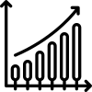


Scope of Database
Stats
Track player stats by position to identify potential recruits
Valuation
Monitor social media engagement, company sponsors, and NIL deals to estimate player valuation
Agents
Find optimal agent representation and company sponsors for schools in different locations

Slide 6
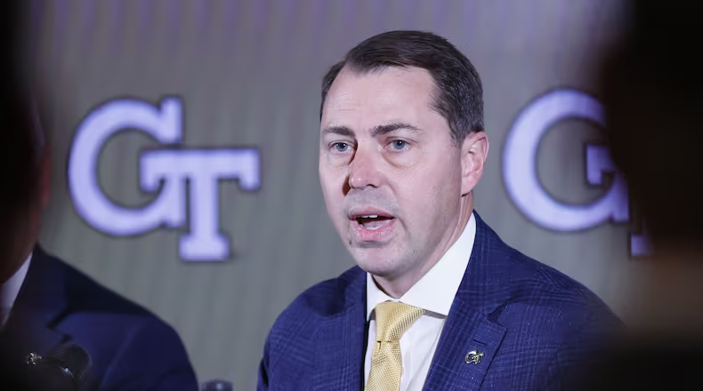
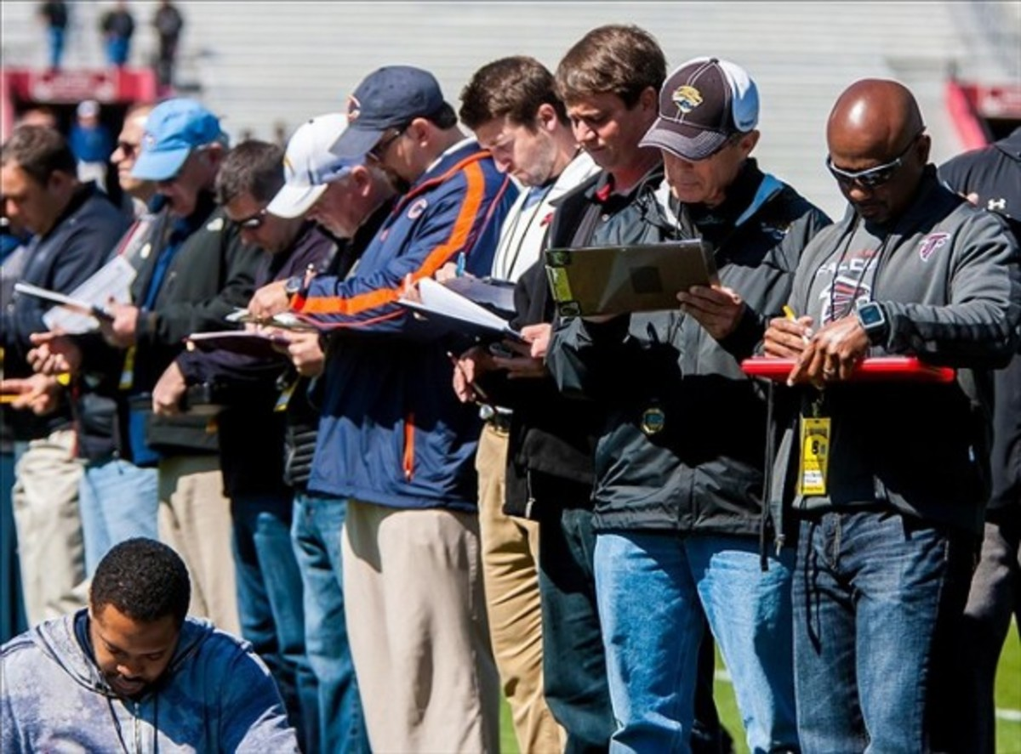
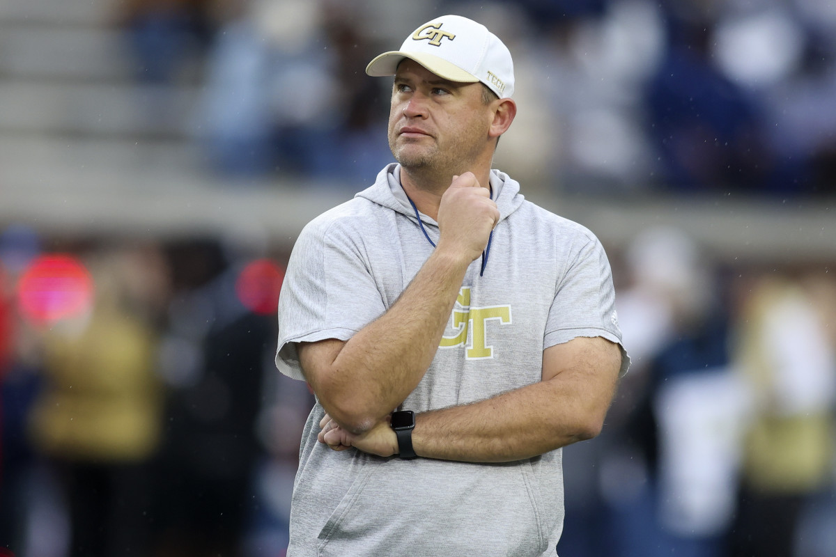

End Users
Scouts
Coaches
Athletic Directors
NIL Fund Managers

Slide 7
ER Diagram

Slide 8
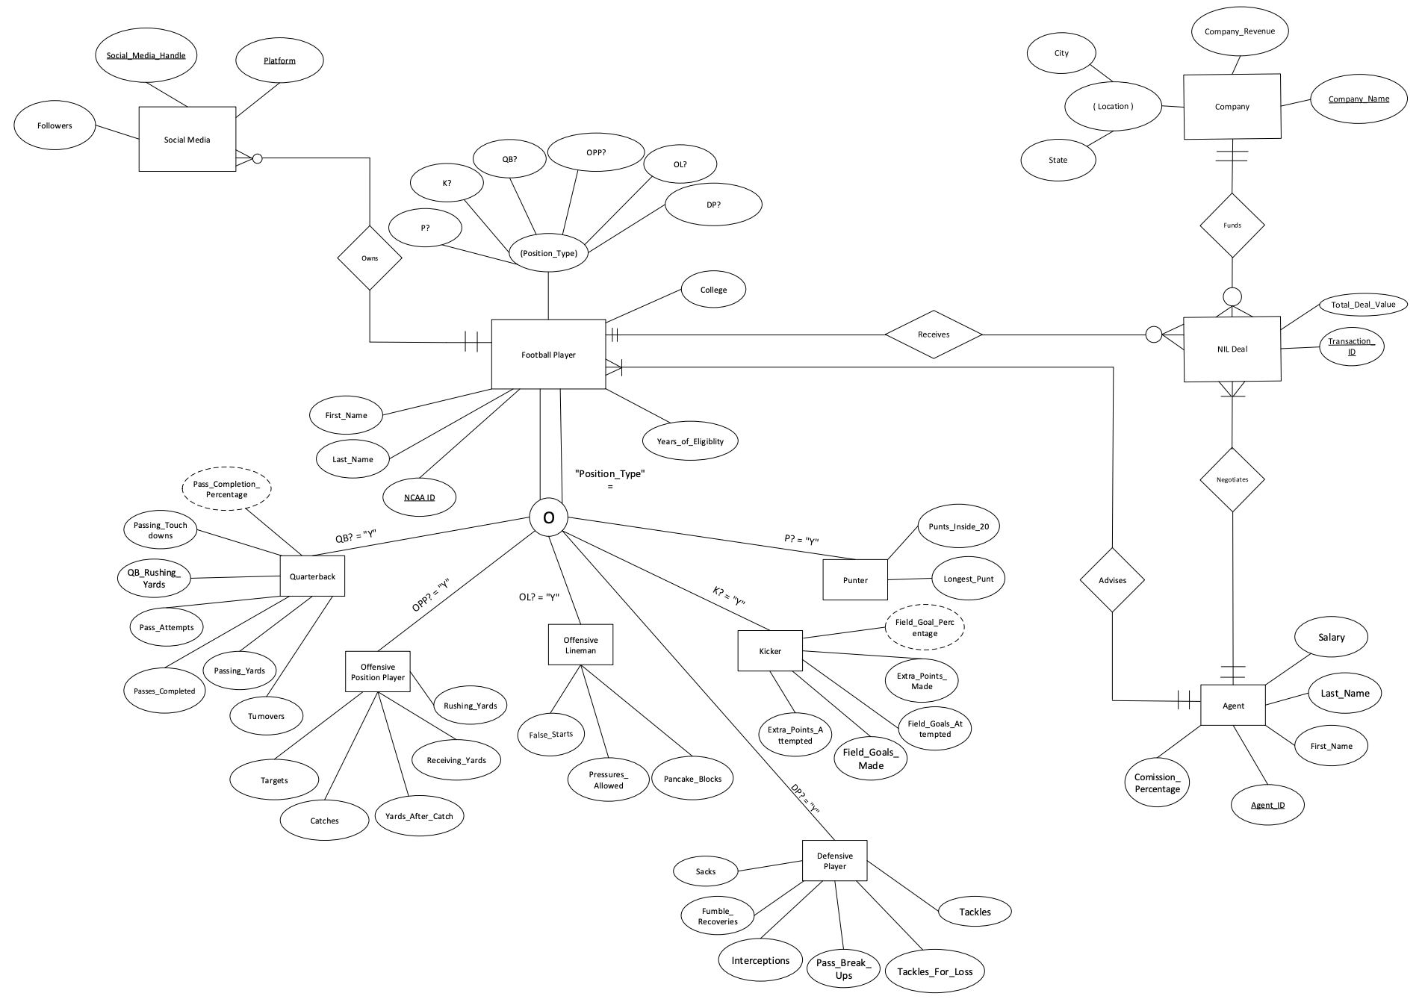

Slide 9

Supertype-Subtype Relationship

Slide 10
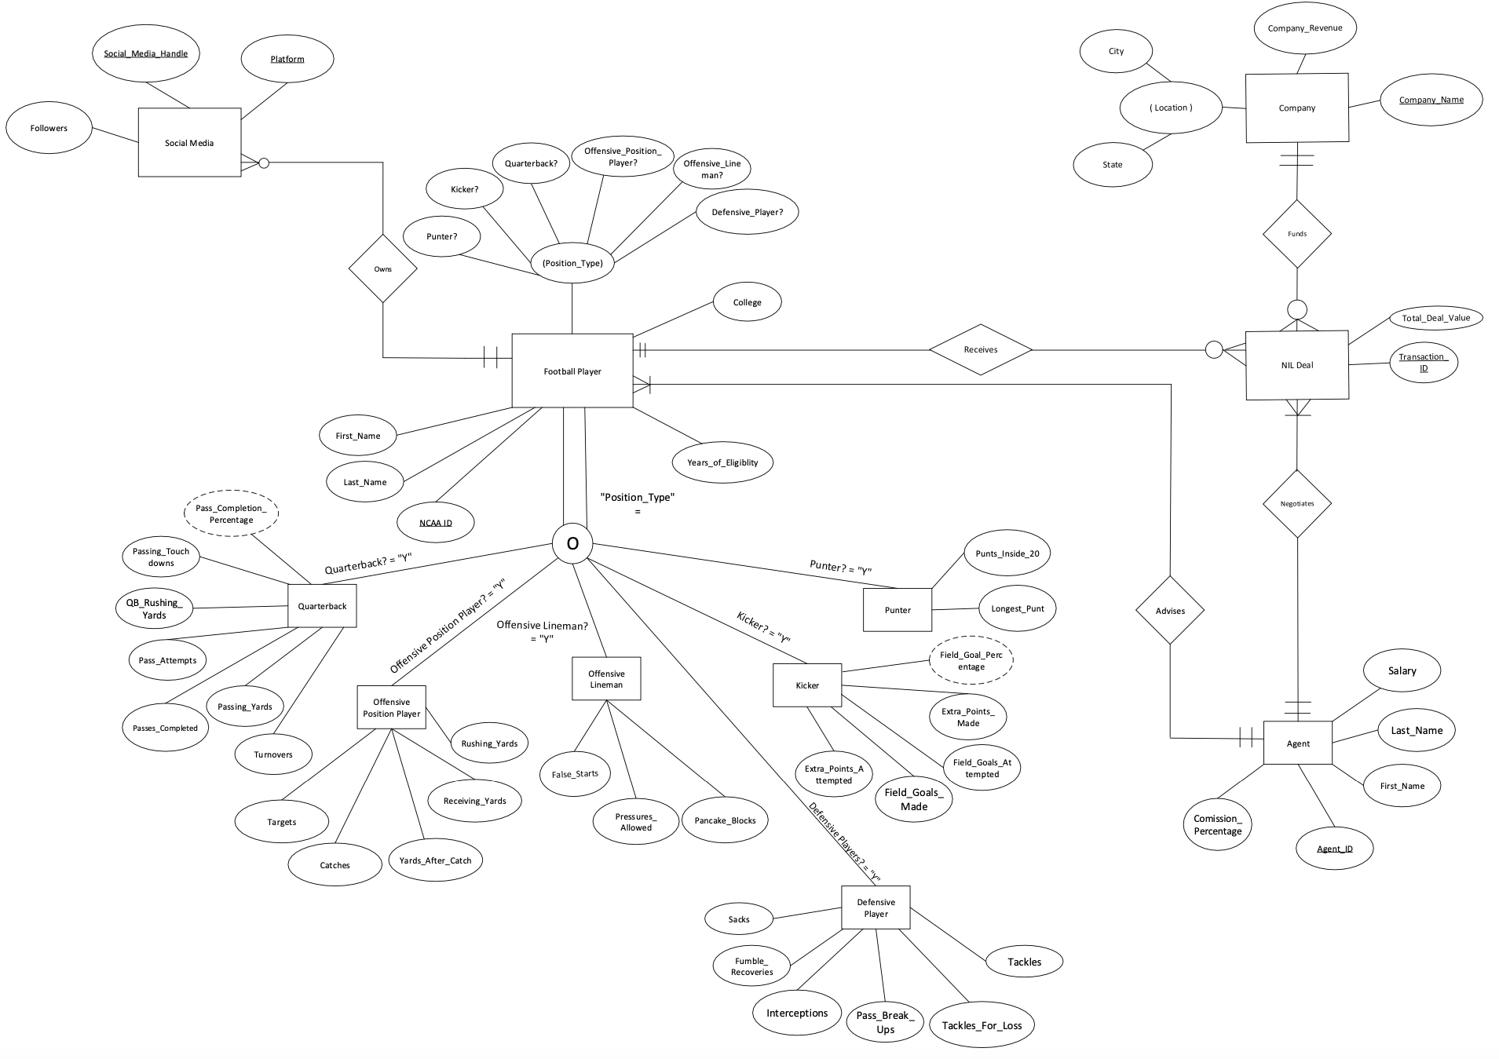
Player/Agent/Company Relationships
Player receives
deal (1-m)
Agent advises player (1-m)
Company funds deal (1-m)
Agent negotiates deal (1-m)

Slide 11

Player Owns Social Media (1-m)

Slide 12
Normalized Tables
02

Slide 13
Normalized Tables
Table Name | Attributes
Football Player | NCAA_ID, First_Name, Last_Name, Years_of_Eligibility, QB?, OPP?, OL?, DP?, K?, P?, College, Agent_ID
Quarterback | Q_NCAA_ID, Passing_Touchdowns, QB_Rushing_Yards, Pass_Attempts, Passes_Completed, Passing_Yards, Turnovers
Offensive Position Player | OPP_NCAA_ID, Targets, Catches, Yards_After_Catch, Receiving_Yards, Rushing_Yards
Offensive Lineman | OL_NCAA_ID, False_Starts, Pressures_Allowed, Pancake_Blocks
Defensive Player | DP_NCAA_ID, Sacks, Fumble_Recoveries, Interceptions, Pass_Break_Ups, Tackles_For_Loss, Tackles

Slide 14
Normalized Tables
Table Name | Attributes
Kicker | K_NCAA_ID, Extra_Points_Attempted, Field_Goals_Made, Field_Goals_Attempted, Extra_Points_Made
Punter | P_NCAA_ID, Punts_Inside_20, Longest_Punt
Agent | Agent_ID, First_Name, Last_Name, Salary, Commission_Percentage
NIL Deal | Transaction_ID, Total_Deal_Value, NCAA_ID, Agent_ID, Company_Name
Company | Company_Name, Company_Revenue, City, State
Social Media | Social_Media_Handle, Platform, Followers, NCAA_ID

Slide 15
Select
From
MySQL
Interactive
Demonstration
Where
Group By

Slide 16
Which players have the highest overall NIL Valuation?

Slide 17
SQL Query
SELECT Football_Player.First_Name, Football_Player.Last_Name, SUM(Total_Deal_Value) as NIL_Money
From NIL_Deal, Football_Player
Where NIL_Deal.NCAA_ID = Football_Player.NCAA_ID
GROUP By Football_Player.First_Name, Football_Player.Last_Name
Having NIL_Money > 5000000
Order By NIL_Money DESC;

Slide 18
What companies are investing in college football in my state?

Slide 19
SQL Query
SELECT Company.Company_Name, SUM(NIL_Deal.Total_Deal_Value) as Total_Company_Investment, Company.State
From NIL_Deal, Company
Where NIL_Deal.Company_Name = Company.Company_Name and Company.State = "Illinois"
Group By Company.Company_Name, Company.State;

Slide 20
Which college football players are generating the most social media attention?

Slide 21
SQL Query
SELECT Football_Player.First_Name, Football_Player.Last_Name, SUM(Social_Media.Followers) AS Total_Followers
FROM Social_Media, Football_Player
WHERE Social_Media.NCAA_ID = Football_Player.NCAA_ID
GROUP BY Football_Player.First_Name, Football_Player.Last_Name
ORDER BY Total_Followers DESC;

Slide 22
Which college football agents provide the best value for our players?

Slide 23
SQL Query
SELECT Agent.First_Name, Agent.Last_Name, SUM(NIL_Deal.Total_Deal_Value) as Negotiated_NIL, SUM(NIL_Deal.Total_Deal_Value * Agent.Commission_Percentage) as Commission
FROM Agent, NIL_Deal
Where Agent.Agent_ID = NIL_Deal.Agent_ID
Group By Agent.First_Name, Agent.Last_Name
Having Negotiated_NIL > 800000 and Commission < 1000000;

Slide 24
Who are the QB’s with more than 5 throwing TD’s, more than 1000 passing yds, and within my NIL budget?

Slide 25
SQL Query
SELECT
Football_Player.First_Name,
Football_Player.Last_Name,
Quarterback.Passing_Touchdowns,
Quarterback.Passing_Yards,
SUM(Social_Media.Followers) AS Followers,
SUM(NIL_Deal.Total_Deal_Value) AS NIL_Valuation
FROM
Quarterback
JOIN
Football_Player ON Quarterback.Q_NCAA_ID = Football_Player.NCAA_ID
LEFT JOIN
Social_Media ON Quarterback.Q_NCAA_ID = Social_Media.NCAA_ID
JOIN
NIL_Deal ON Quarterback.Q_NCAA_ID = NIL_Deal.NCAA_ID
WHERE Quarterback.Passing_Touchdowns >= 5 and Quarterback.Passing_Yards >= 1000
GROUP BY
Football_Player.First_Name,
Football_Player.Last_Name,
Quarterback.Passing_Touchdowns,
Quarterback.Passing_Yards
HAVING NIL_Valuation < 10000000;

Slide 26
What are the total amounts of followers garnered by players on each platform, and how many players utilize each platform?

Slide 27
SQL Query
SELECT
Social_Media.Platform AS Social_Media_Platform,
SUM(Social_Media.Followers) AS Total_Followers,
COUNT(DISTINCT Football_Player.NCAA_ID) AS Total_Players
FROM
Social_Media
JOIN
Football_Player ON Social_Media.NCAA_ID = Football_Player.NCAA_ID
GROUP BY
Social_Media.Platform;

Slide 28
Adding a player into the database

Slide 29
SQL Query
INSERT INTO Football_Player (NCAA_ID, First_Name, Last_Name, Years_of_Eligibility, QB, OPP, OL, DP, K, P, College, Agent_ID)
VALUES (23, 'Tate', 'Ratledge', 1, 0, 0, 1, 0, 0, 0, "UGA", 102);

Slide 30
Updating the stats of a player currently in the database

Slide 31
SQL Query
UPDATE Football_Player SET College = 'You Choose!', Years_of_Eligibility = 2
WHERE NCAA_ID = 2;

Slide 32
What kickers have a higher than average field goal percentage?

Slide 33
SQL Query
Select football_player.First_Name, football_player.last_name, (kicker.Field_Goals_Made/kicker.Field_Goals_Attempted) as FieldGoalPercentage from football_player, kicker
WHERE football_player.ncaa_ID=kicker.K_NCAA_ID and kicker.Field_Goals_Made/kicker.Field_Goals_Attempted>=(SELECT AVG(Field_Goals_Made/kicker.Field_Goals_Attempted) from kicker);

Slide 34
What are the names and statistics of high-performance punters?

Slide 35
SQL Query
SELECT Football_Player.First_Name, Football_Player.Last_Name, Punter.Punts_Inside_20, Punter.Longest_Punt
FROM Football_Player
JOIN Punter ON Football_Player.NCAA_ID = Punter.P_NCAA_ID
WHERE Punter.Punts_Inside_20 > 8 AND Punter.Longest_Punt > 60
GROUP BY Football_Player.First_Name, Football_Player.Last_Name;
We define a high-performance punter as having over 8 punts inside 20 and having a longest punt of over 60 yards.

Slide 36
What archetypes do defensive players fall under?

Slide 37
SQL Query
SELECT football_player.First_Name, football_player.Last_Name, defensive_player.Interceptions, defensive_player.Pass_Break_Ups, defensive_player.Sacks, defensive_player.Tackles_For_Loss,
Case When Defensive_Player.Pass_Break_Ups>2 then 'Lockdown'
When defensive_player.Sacks>2 then 'Pressure'
else 'Average'
End as Archetype
FROM defensive_player,football_player where defensive_player.DP_NCAA_ID=football_player.NCAA_ID;

Slide 38
THANKS!
Does anyone have questions/concerns?

