Slide 1
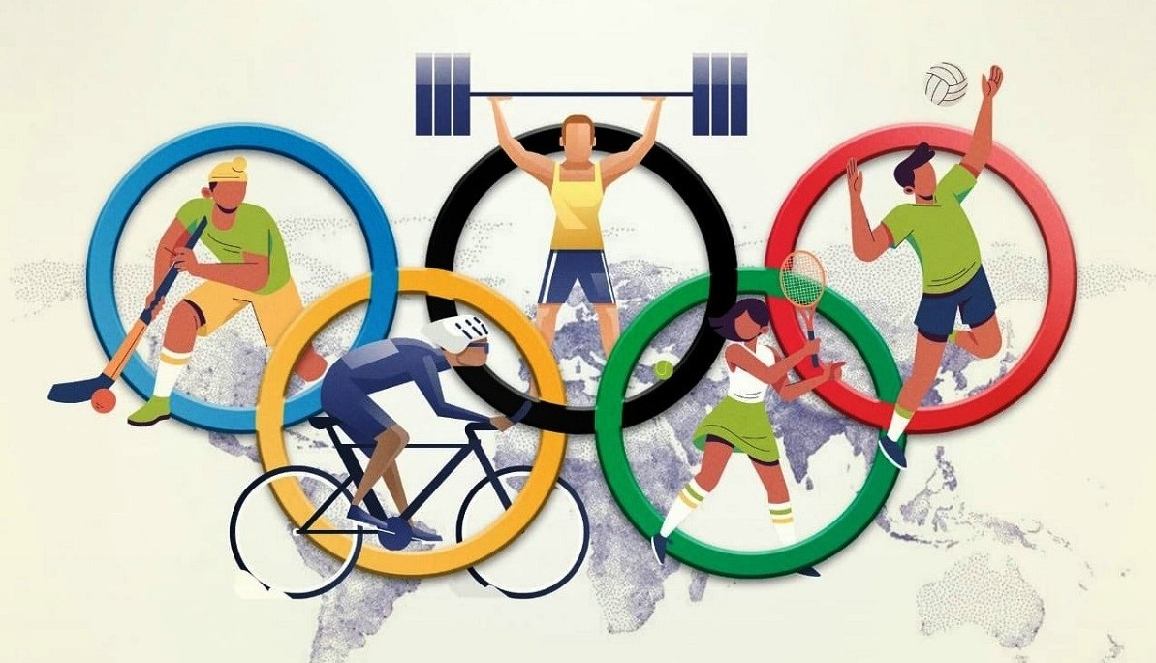
Olympic Dataset analysis

Slide 2
1. How many Indian took participated in every year?
SELECT Year , Count(*) as Total_Participants FROM athlete WHERE NOC='IND' GROUP BY Year ORDER BY Year Asc

Slide 4
Total Number of Successful and Unsuccessful athletes in INDIA in 1896-2006 Olympic
Total Number of Indian athletes : SELECT count(*) AS Total_Indian_athlete FROM sports WHERE Team='India' “
Total_Indian_athlete = 1400
Total Number of Indian unsuccessful athletes : SELECT count(*) AS Total_Indian_unsuccess_athlete FROM sports WHERE Medal=‘NA’ and Team='India' “
Total_Indian_unsuccess_athlete=1203
Total Number of Indian unsuccessful athletes : SELECT count(*) AS Total_Indian_success_athlete FROM sports WHERE Medal In (‘Gold’,’Silver’,’Bronze’) and Team='India' “
Total_Indian_success_athlete=161

Slide 5
Successful and Unsuccessful athletes in INDIA 1896-2006 Olympic

Slide 6
2.How many Gold , silver, Bronze Medal India won from 1896-2006 Olympic.
result="SELECT count(medal) AS Total_Gold_Medals FROM sports WHERE Medal='Gold' AND Team='India' “
Total_Gold_Medals =138
result="SELECT count(medal) AS Total_Bronze_Medals FROM sports WHERE Medal='Bronze' AND Team='India' “
Total_Bronze_Medals=40
result="SELECT count(medal) AS Total_Silver_Medals FROM sports WHERE Medal='Silver' AND Team='India' “
Total_Silver_Medals=19

Slide 7
Number of Medals INDIA won From 1896-2006 Olympic

Slide 8
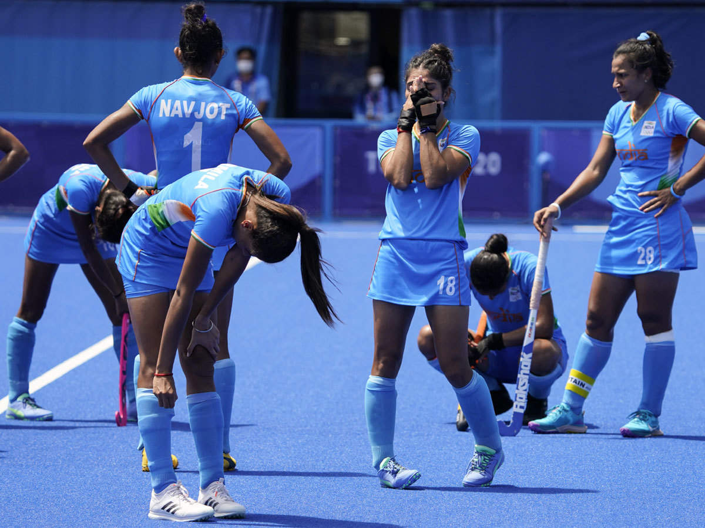
Why World’s second most populous nation has worst Olympic records ?
Sports has never been a priority for the government of India.
There isn’t any proper system for athlete selection and training from a young age.
Sports has always taken back seat over education. Because most Indian families would prefer their children became Doctors, Engineers or Accountants than Olympians .

Slide 9
how many indian male and female took participate in Olympic?
SELECT Count(*)as Female_Participants FROM athlete WHERE Sex='F' and Team='India'
Female_Participants=241
SELECT Count(*)as Male_Participants FROM athlete WHERE Sex='M' and Team='India'
Male_Participants=1159

Slide 10
Indian male and female took participate in Olympic

Slide 11
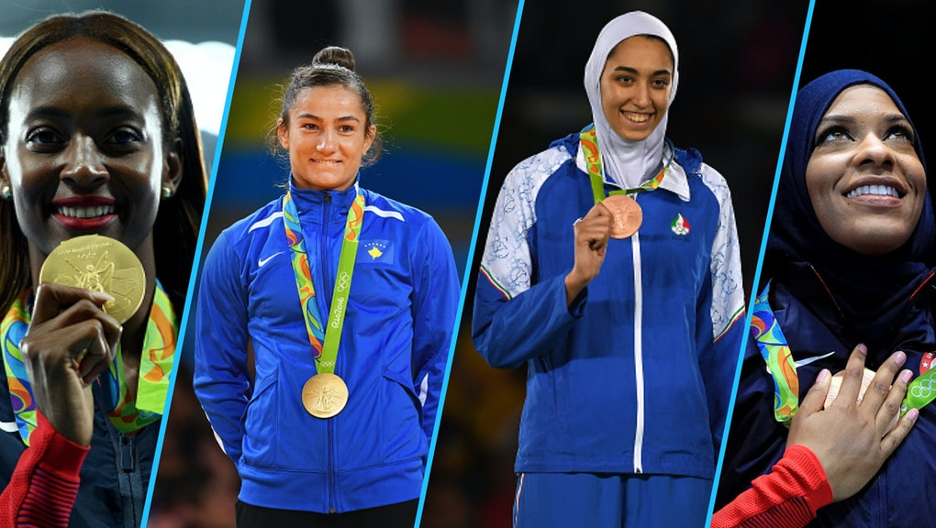
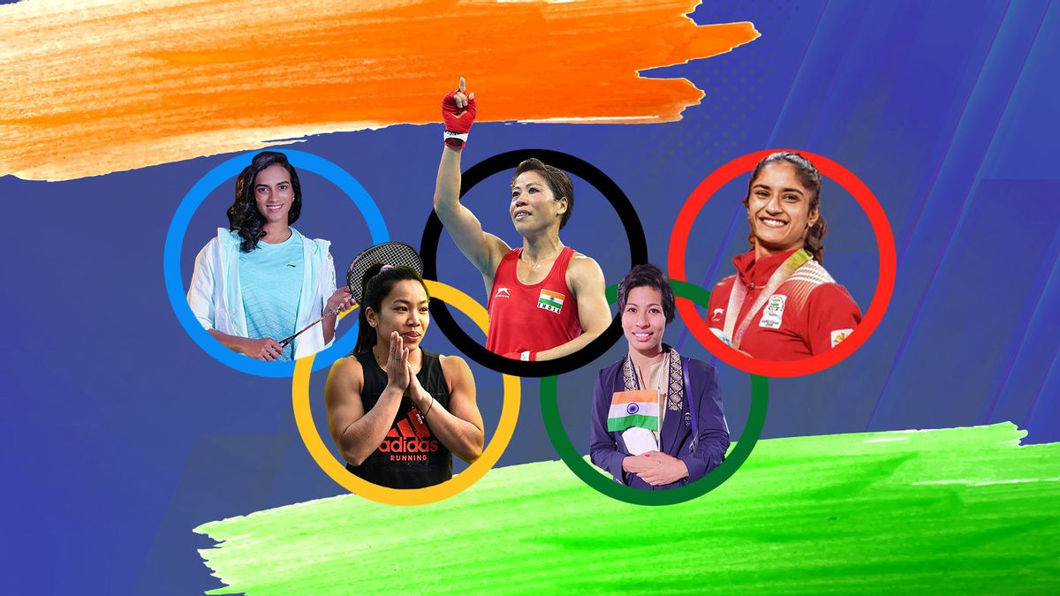
count the number of female participants from each country in every year
SELECT Year, NOC as Country, Count(*) as Total_Female_Count FROM athlete WHERE Sex='F' GROUP BY NOC, Year order by Year

Slide 12
Country wise female participants
In which year women started to enter into Olympics?
SELECT Year FROM athlete WHERE Sex='F' ORDER BY Year Asc LIMIT 1
Year=1900
Country Wise Female Participants in 1900 Olympic?
SELECT Year, NOC as Country, Count(*) as Total_Female_Count FROM athlete WHERE Sex='F' and Year=1900 GROUP BY NOC, Year order by Year
Country Wise Female Participants in 2006 Olympic?
SELECT Year, NOC as Country, Count(*) as Total_Female_Count FROM athlete WHERE Sex='F' and Year=2006 GROUP BY NOC, Year order by Year

Slide 13
female participants in 1900 Olympic
Year | Country | Total_Female_Count
1900 | Switzerland | 3
1900 | Italy | 1
1900 | France | 16
1900 | USA | 8
1900 | BOH | 2

Slide 14
female participants in 2006 Olympic
Year | Country | Total_Female_Count
2006 | Algeria | 2
2006 | Argentina | 9
2006 | Armenia | 1
2006 | Australia | 18
2006 | Austria | 33
2006 | Azerbaijan | 1
2006 | Bosnia | 4
2006 | Belarus | 42
2006 | Brazil | 3
2006 | Bulgaria | 25
2006 | Central Africa | 136
2006 | Chile | 5
2006 | China | 81

Slide 15
female participants in 2006 Olympic
Year | Country | Total_Female_Count
2006 | Croatia | 17
2006 | Czech Republic | 53
2006 | Denmark | 4
2006 | Spain | 16
2006 | Estonia | 24
2006 | Finland | 47
2006 | France | 69
2006 | Uzbekistan | 2
2006 | USA | 138
2006 | Ukraine | 48
2006 | Turks | 7
2006 | Sweden | 73
2006 | Slovakia | 38
Year | Country | Total_Female_Count
2006 | Switzerland | 62
2006 | Salvia | 39
2006 | Serbia | 6
2006 | Russia | 111
2006 | Romania | 26
2006 | North Korea | 5
2006 | Poland | 34
2006 | New Zealand | 8
2006 | Korea | 56
2006 | Netherland | 30
2006 | Montenegro | 5
2006 | Macedonia | 2
2006 | Moldova | 1

Slide 16
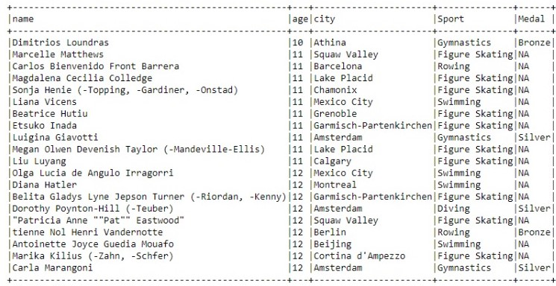
Top 10 youngest athletes of Olympic
"SELECT name, age, city , Sport, Medal FROM athlete where Age is not null Group By Name, age , City, Sport, Medal ORDER BY age"

Slide 17
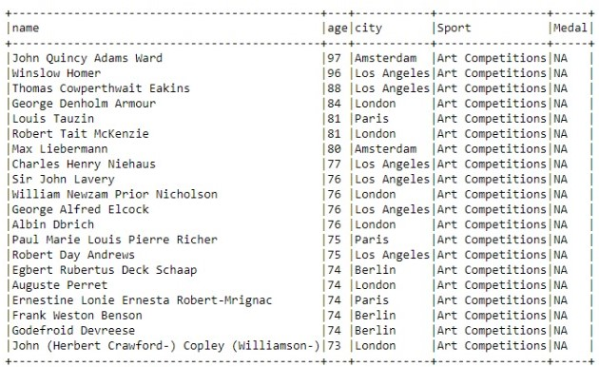
Top 10 oldest athletes of Olympic
"SELECT name, age, city , Sport, Medal FROM athlete where Age is not null Group By Name, age , City, Sport, Medal ORDER BY age"

Slide 18
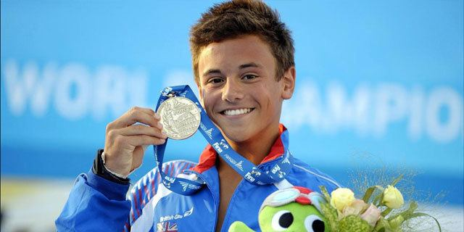
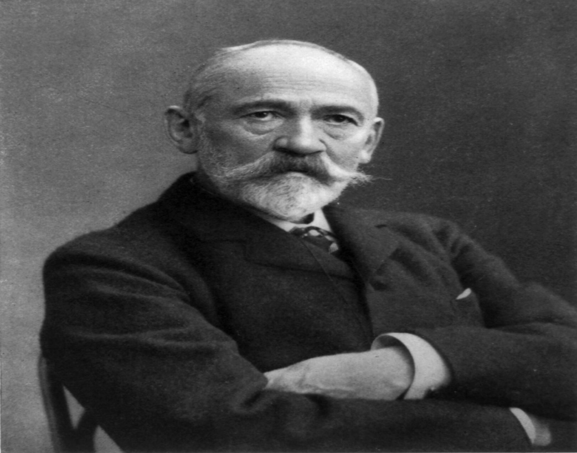
Olympic athletes
youngest
oldest
Dimitrios Loundras
John Quincy Adams ward

Slide 19


