Slide 1
HDFS
Ajay J. Singala

Slide 2
HDFS Characteristics
HDFS has high fault-tolerance
HDFS may consist of thousands of server machines.
HDFS has high throughput
HDFS is designed to store and scan millions of rows of data and to count or add some subsets of the data.
It has been designed to support large datasets in batch-style jobs.
HDFS is economical
HDFS is designed in such a way that it can be built on commodity hardware and heterogeneous platforms, which is low-priced and easily available.
Notes:
HDFS has high fault-tolerance
HDFS may consist of thousands of server machines.
Each machine stores a part of the file system data.
HDFS detects faults that can occur on any of the machines and recovers it quickly and automatically.
HDFS has high throughput
HDFS is designed to store and scan millions of rows of data and to count or add some subsets of the data.
The time required in this process is dependent on the complexities involved.
It has been designed to support large datasets in batch-style jobs.
However, the emphasis is on high throughput of data access rather than low latency.
HDFS is economical
HDFS is designed in such a way that it can be built on commodity hardware and heterogeneous platforms, which is low-priced and easily available.

Slide 3
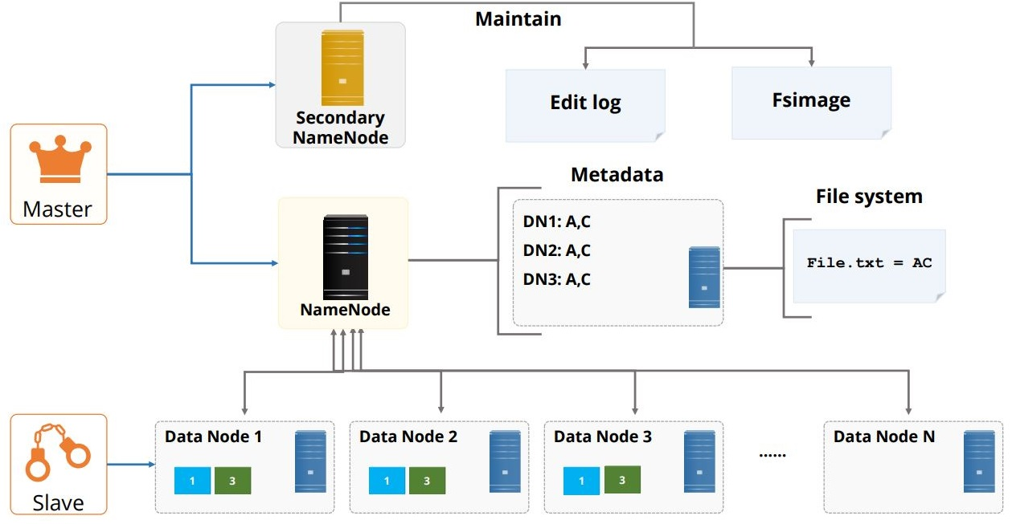
HDFS Components
Namenode
Secondary Namenode
File system
Metadata
Datanode

Slide 4
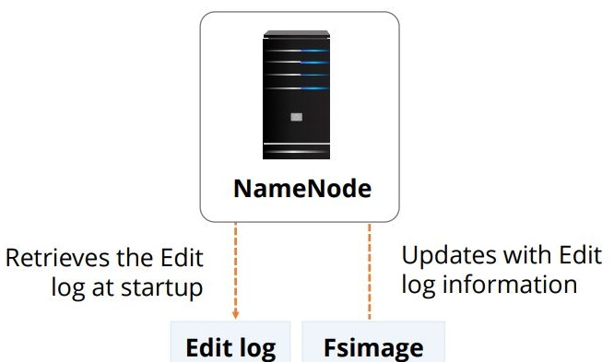
Namenode
The NameNode server is the core component of an HDFS cluster
There can be only one NameNode server in an entire cluster.
Notes:
The NameNode server is the core component of an HDFS cluster
There can be only one NameNode server in an entire cluster.
Namenode maintains and executes the file system namespace operation such as opening, closing, and renaming of files and directories, which are present in HDFS.
The namespace image and the edit log stores information of the data and the metadata.
NameNode also determines the linking of blocks to DataNodes.
Furthermore, the NameNode is a single point of failure.

Slide 5
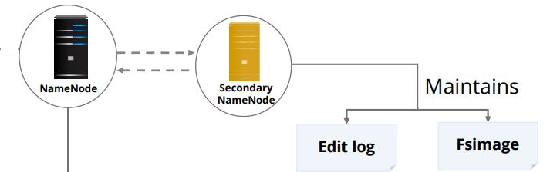
Secondary Namenode
The Secondary NameNode server maintains the edit log and namespace image information in sync with the NameNode server.
Notes:
The Secondary NameNode server maintains the edit log and namespace image information in sync with the NameNode server.
At times, the namespace images from the NameNode server are not updated; therefore, you cannot totally rely on the Secondary NameNode server for the recovery process.

Slide 6
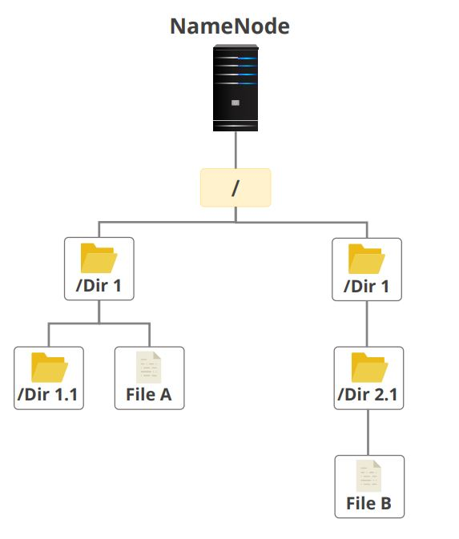
File System
HDFS exposes a file system namespace and allows user data to be stored in files.
HDFS has a hierarchical file system with directories and files.
Notes:
HDFS exposes a file system namespace and allows user data to be stored in files.
HDFS has a hierarchical file system with directories and files.
The NameNode manages the file system namespace, allowing clients to work with files and directories.
A file system supports operations like create, remove, move, and rename.
The NameNode, apart from maintaining the file system namespace, records any change to metadata information.

Slide 7
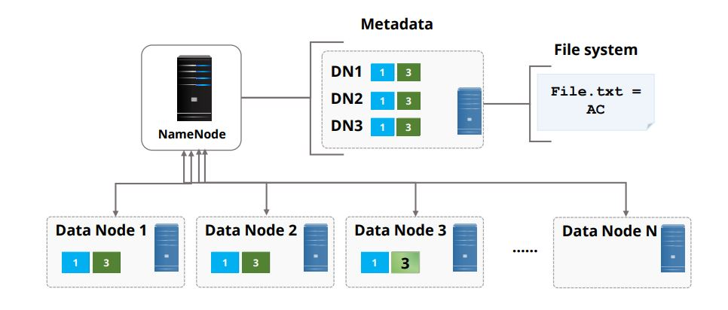
File System : Namenode Operation
NameNode maintains two persistent files:
one a transaction log called an Edit Log and the other,
a namespace image called a FsImage.
Notes:
NameNode maintains two persistent files:
one a transaction log called an Edit Log and the other,
a namespace image called a FsImage.
The Edit Log records every change that occurs in the file system metadata such as creating a new file.
The NameNode is a local filesystem that stores the Edit Log.
The entire file system namespace including mapping of blocks, files, and file system properties is stored in FsImage.
This is also stored in the NameNode local file system.

Slide 8
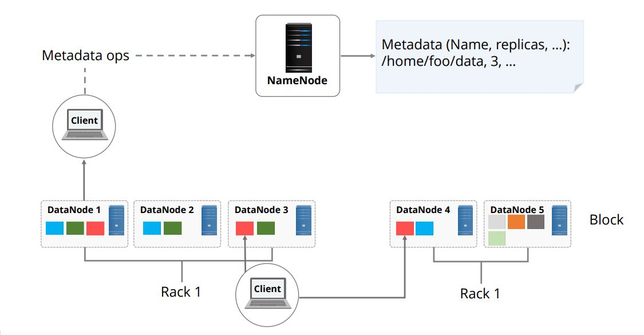
Metadata
Metadata loads the blocks that reside on a specific DataNode into its memory at startup.
The metadata size is limited to the RAM available on the NameNode.
As mentioned earlier, each file is split into one or more blocks stored and replicated in DataNodes.
Each file is split into one or more blocks stored and replicated in DataNodes.
This is Data Block split
Notes:
When new DataNodes join a cluster, metadata loads the blocks that reside on a specific DataNode into its memory at startup. Metadata then periodically loads the data at user-defined or default intervals.
When the NameNode starts up, it retrieves the Edit Log and FsImage from its local file system.
It then updates the FsImage with Edit Log information and stores a copy of the FsImage on the file system as a checkpoint.
The metadata size is limited to the RAM available on the NameNode.
A large number of small files would require more metadata than a small number of large files.
Hence, the in-memory metadata management issue explains why HDFS favors a small number of large files.
If a NameNode runs out of RAM, it will crash, and the applications will not be able to use HDFS until the NameNode is operational again.
Data block split is an important process of HDFS architecture.
Each file is split into one or more blocks stored and replicated in DataNodes.

Slide 9
Datanode
DataNodes manage names and locations of file blocks.
By default, each file block is 128 Megabytes.
Notes:
DataNodes manage names and locations of file blocks.
By default, each file block is 128 Megabytes.
However, this potentially reduces the amount of parallelism that can be achieved as the number of blocks per file decreases.
Each map task operates on one block, so if tasks are fewer than nodes in the cluster, the jobs will run slowly.
However, this issue is lesser when the average MapReduce job involves more files or larger individual files.

Slide 10
Benefits of Data Block Approach
The data block approach provides:
Simplified replication
Fault-tolerance
Reliability.
We will look at:
Block Replication Architecture
Replication Method
Data Replication Topology
Example
Notes:
We spoke about Data Block split when we covered Metadata.
Let us look at some of the benefits of the data block approach.
The data block approach provides:
Simplified replication
Fault-tolerance
Reliability.

Slide 11
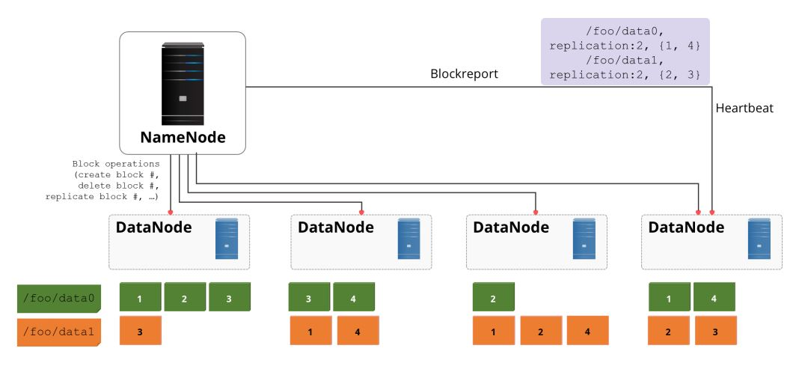
Block Replication Architecture
Each file is split into a sequence of blocks.
All blocks except the last one in the file are of the same size.
Blocks are replicated for fault tolerance.
Notes:
Each file is split into a sequence of blocks.
All blocks except the last one in the file are of the same size.
Blocks are replicated for fault tolerance.
The block replication factor is usually configured at the cluster level but it can also be configured at the file level.
The name node receives a heartbeat and a block report from each data node in the cluster.
The heartbeat denotes that the data node is functioning properly.
A block report lists the blocks on a data node.

Slide 12
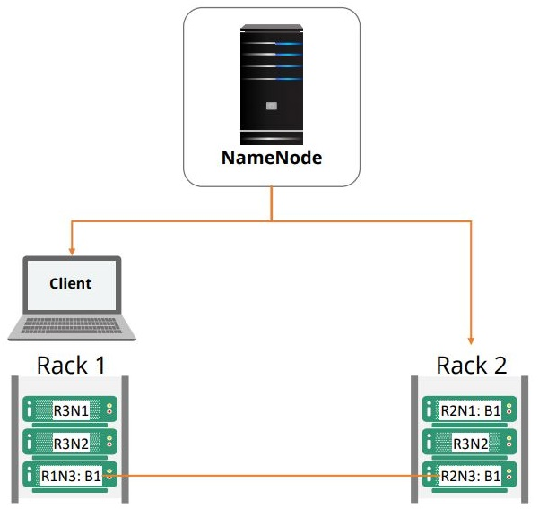
Data Replication Topology
The topology of the replicas is critical to ensure the reliability of HDFS.
Place the first replica on the same node as that of the client.
Place the second replica on a different rack from that of the first replica.
Place the third replica on the same rack as that of the second one but on a different node.
Notes:
The topology of the replicas is critical to ensure the reliability of HDFS. Usually, each data is replicated thrice where the suggested replication topology is as follows
Place the first replica on the same node as that of the client.
Place the second replica on a different rack from that of the first replica.
Place the third replica on the same rack as that of the second one but on a different node.
Let's understand data replication through a simple example.

Slide 13
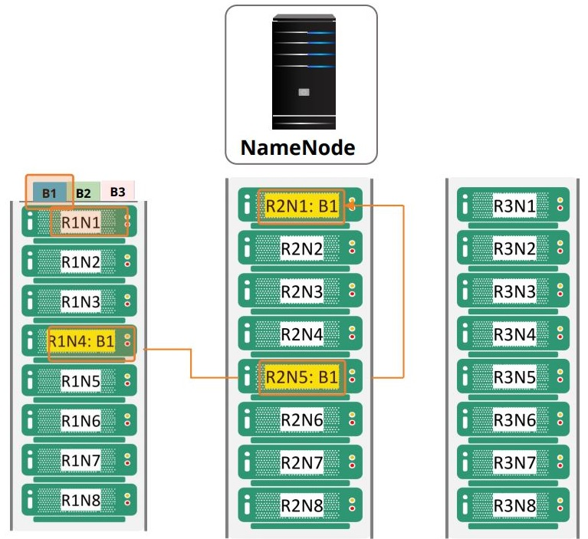
Data Replication Topology - Example
Notes:
The diagram illustrates a Hadoop cluster with three racks.
A diagram for Replication and Rack Awareness in Hadoop is given below.
Each rack consists of multiple nodes.
R1N1 represents node 1 on rack 1.
Suppose each rack has eight nodes.
The name node decides which data node belongs to which rack.
Block 1 which is B1 is first written to node 4 on rack 1.
A copy is then written to a different node on a different rack which is node 5 on rack 2.
The third and final copy of the block is written to the same rack of the second copy, but to a different node, which is rack 2 node 1.

Slide 14
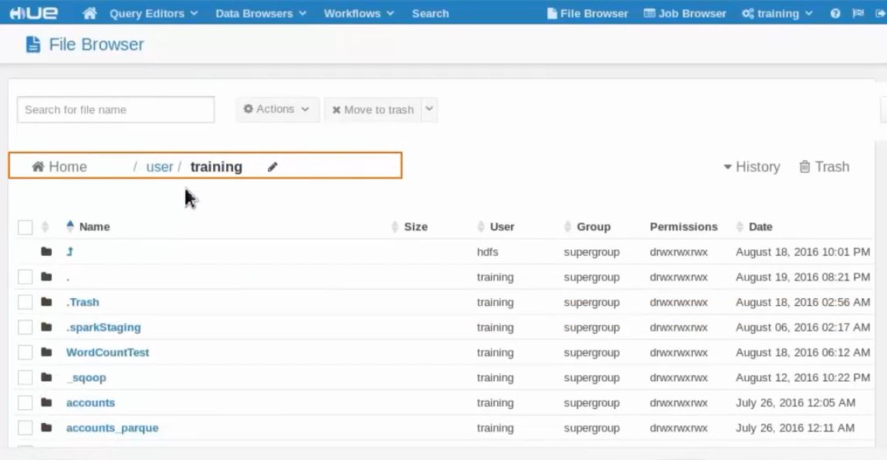
Hue File Browser
Notes:
The file browser in Hue lets you view and manage your HDFS directories and files.
Additionally, you can create, move, rename, modify, upload, download, and delete directories and files.
You can also view the file contents.

Slide 15
HDFS Commands
Notes:
https://www.geeksforgeeks.org/hdfs-commands/

