Slide 1
MUTUAL FUND ANALYTICS PLATFORM
BLUESTOCK FINTECH CAPSTONE PROJECT
End To End Data Engineering – Etl Pipeline- Interactive dashboard
- SHEVANIGA S

Slide 2
PROBLEM STATEMENT AND OBJECTIVE
Data Fragmentation
P1
NAV, AUM, SIP and holdings data scattered across different AMFI formats
Performance Gap
P2
No unified platform to compare funds on risk-adjusted metrics
No Benchmark Tracking
P3
Investors cannot see if their fund beats Nifty 50 / Nifty 100
Investor Blind Spot
P4
Limited visibility into demographic SIP patterns
Slow Reporting
P5
Monthly static PDFs take days - stakeholders need live dashboards

Slide 3
DATA SOURCES AND DATASETS
AMFI India
mfapi.in
amfiindia.com
api.mfapi.in/mf/{code}
NAV, AUM, SIP data
Historical NAV JSON
Daily / Monthly
Daily
NSE India
BSE India
nseindia.com
bseindia.com
Nifty 50, Nifty 100 index
BSE SmallCap index
Daily
Daily
40 Schemes
87K+ Rows
46K Rows
4.5 Years
Real AMFI Funds
Transaction Data
NAV History
Data Coverage

Slide 4
SYSTEM ARCHITECTURE ETL PIPELINE
1
2
3
4
5
EXTRACT
TRANSFORM
LOAD
ANALYSE
VISUALISE
AMFI CSVs
mfapi.in API
NSE Bhavcopy
Pandas cleaning
Holiday ffill
Type casting
SQLite star schema
10 tables
8 indexes
Jupyter notebooks
Sharpe
VaR
HHI
Power BI 4-page dashboard
Streamlit web app

Slide 5
EDA HIGHLIGHTS – INDUSTRY & SIP TRENDS
₹81 L Cr
₹31,002 Cr
26.12 Cr
9.35 Cr
Industry AUM
Dec 2025
Monthly SIP
All-time High
Total Folios
2x since 2022
Active SIP
Accounts
KEY EDA FINDINGS
SIP inflows grew 2.8x from Rs 11,000 Cr/month (Jan 2022) to Rs 31,002 Cr (Dec 2025)
SBI MF dominates with Rs 12.5L Cr AUM - nearly 15% of industry
Folios doubled from 13.26 Cr to 26.12 Cr - India's deepening equity culture
26-35 age group is largest SIP cohort; 46-55 group has highest avg ticket size
Maharashtra, Karnataka, Delhi contribute 50%+ of all SIP inflows

Slide 6
EDA HIGHLIGHTS- FUND & SECTOR ANALYSIS
2023 Bull Run
High Correlation
All 40 equity funds recorded 20-35% NAV gains. Strongest year since fund inception for most large-cap schemes.
NAV returns across large-cap funds show Pearson r > 0.80, offering limited diversification when holding multiple large-caps.
Sector Concentration
2024 Correction
Financial Services + IT = 40-45% of aggregate equity holdings. Systematic exposure to banking and tech cycles.
H1 2024 correction created entry opportunities. Funds with rolling Sharpe > 1.5 recovered fastest by Q3 2024.

Slide 7
PERFORMANCE ANALYTICS – FORMULAS AND RESULTS
CAGR (3YR)
SHARPE RATIO
(NAVend / NAVstart)^(252/n_days) - 1
(Rp - Rf) / sigma_p x sqrt(252) Rf=6.5%
Top funds: 14-19% | Nifty 100: ~12.8%
Best funds Sharpe > 1.5 | Industry avg ~ 0.9
SORTINO
ALPHA (ANN.)
(Rp - Rf) / sigma_downside x sqrt(252)
OLS intercept x 252 vs Nifty 100
Always >= Sharpe; gap shows upside vs downside
Top alpha generators: 2-4% annualised above benchmark
BETA
MAX DRAWDOWN
Cov(Rfund, Rbench) / Var(Rbench)
min(NAV / cummax(NAV) - 1)
Large-cap: beta ~0.85-1.05 | Small-cap: beta > 1.1
Worst drawdown: -28% to -35% during 2022 bear market

Slide 8
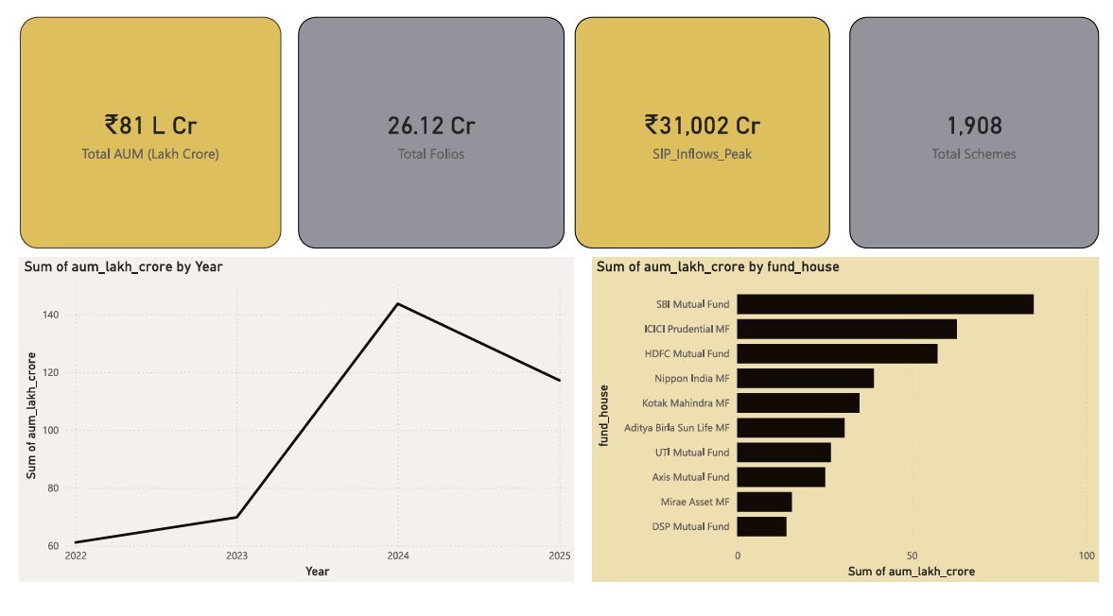
INTERACTIVE DASHBOARD – POWER BI DESKTOP
POWER BI DESKTOP – INDUSTRIAL OVERVIEW PAGE

Slide 9
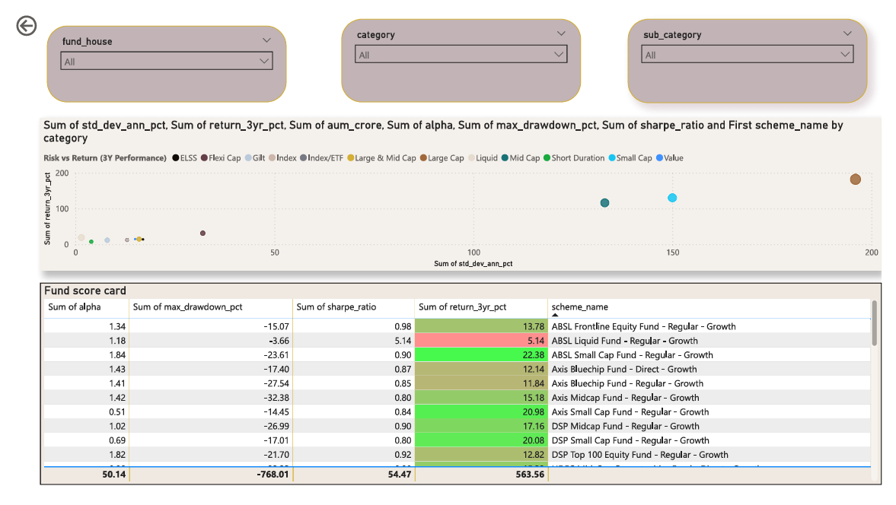
POWER BI DESKTOP – FUND PEFORMANCE PAGE

Slide 10
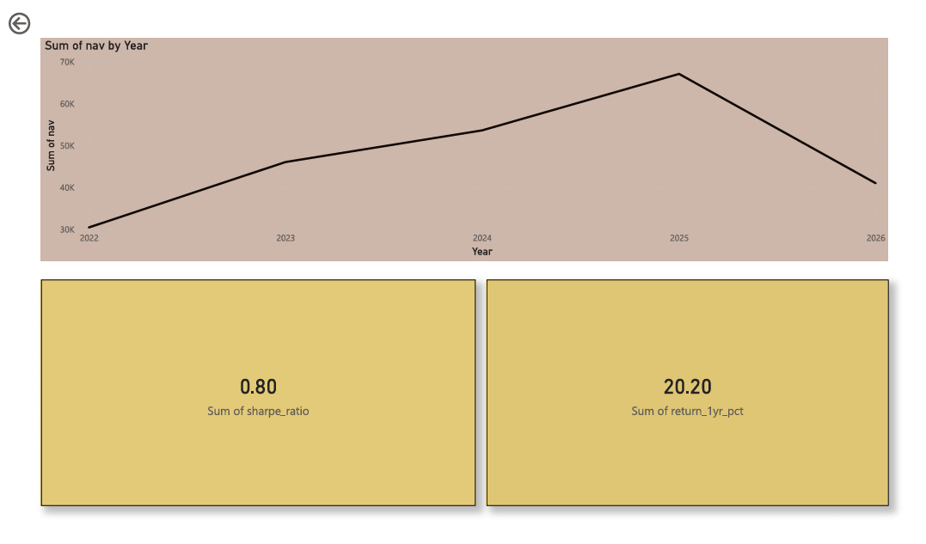
POWER BI DESKTOP – NAV DRILL THROUGH PAGE

Slide 11
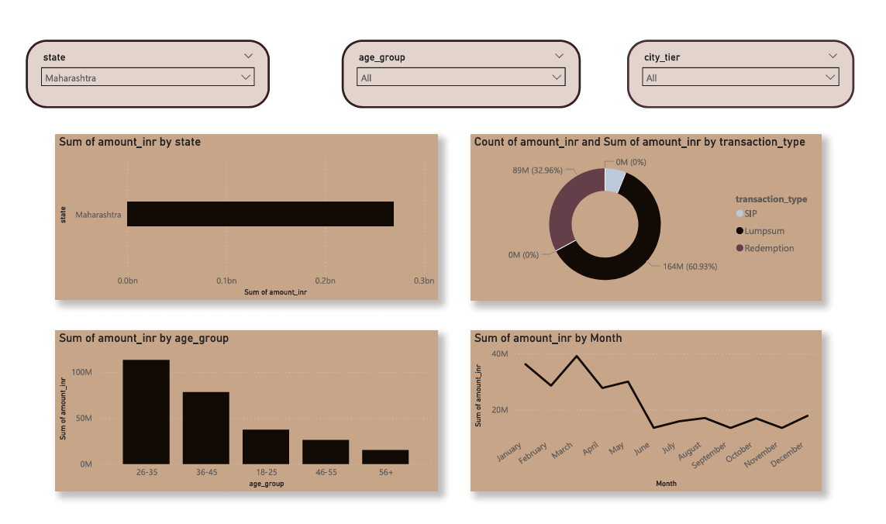
POWER BI DESKTOP – INVESTOR ANALYSIS PAGE

Slide 12
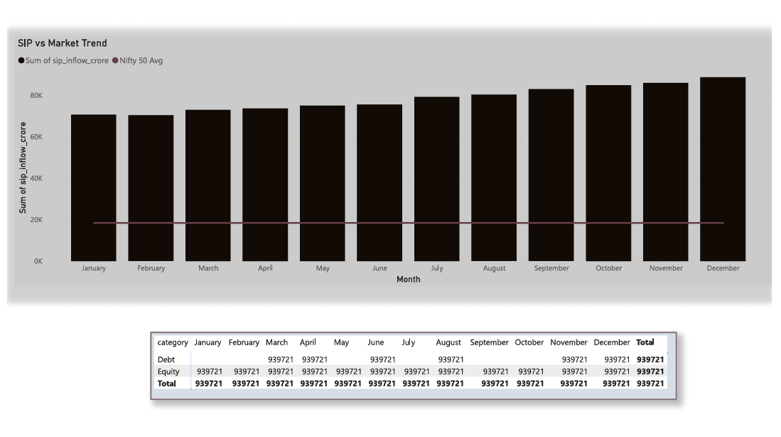
POWER BI DESKTOP – SIP & MARKET TRENDS PAGE

Slide 13
BONUS DELIVERABLE – STREAMLIT WEB APP
B2
Streamlit Web App
4-page dark-themed dashboard with Plotly charts as Power BI alternative
Built with Streamlit and Plotly; runs locally with streamlit run dashboard/streamlit_app.py - no Power BI license needed
Four pages covering industry AUM trends, fund risk-return analysis, investor demographics, and SIP vs market performance
Reads directly from the cleaned CSV outputs of the ETL pipeline, with live filters for fund house, category, state, and year range
Dark-themed, fully responsive layout with branded KPI cards, bubble charts, heatmaps, and dual-axis trend charts

Slide 14
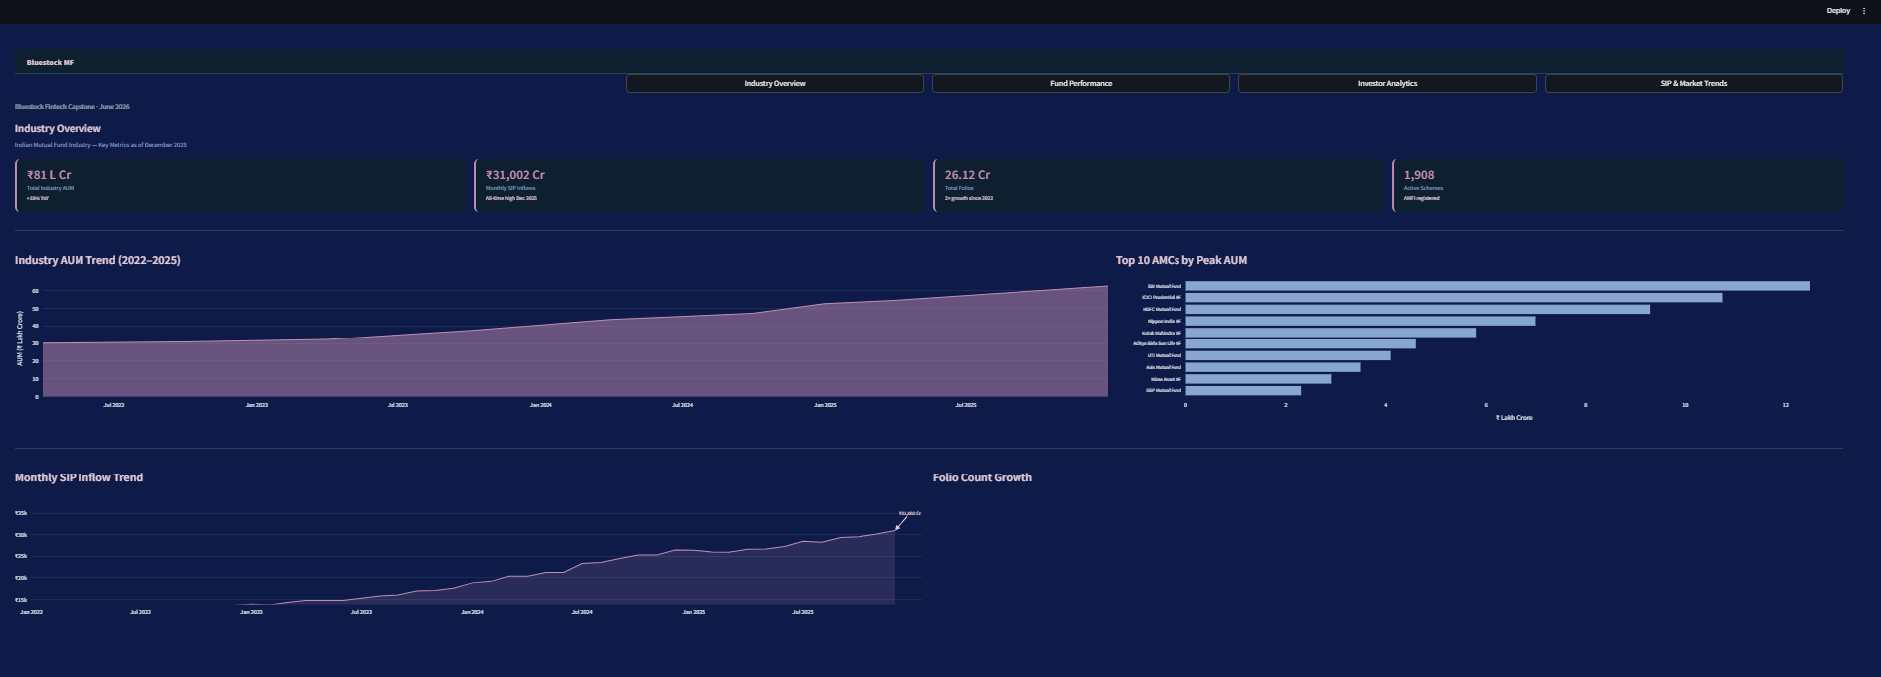
B2
STREAMLIT WEB APP – INDUSTRIAL OVERVIEW PAGE

Slide 15
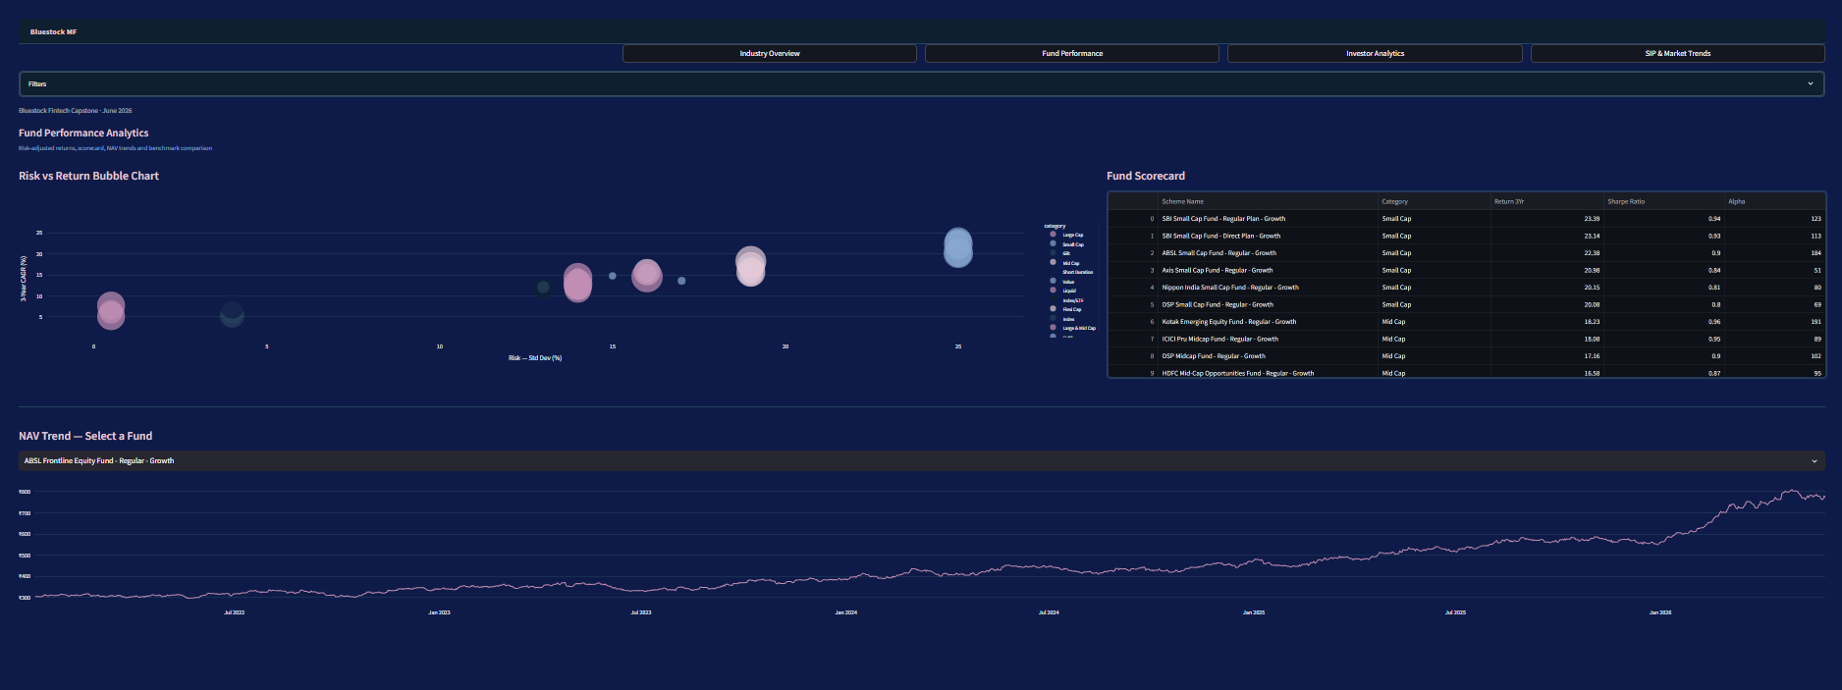
B2
STREAMLIT WEB APP –FUND PEFORMANCE PAGE

Slide 16
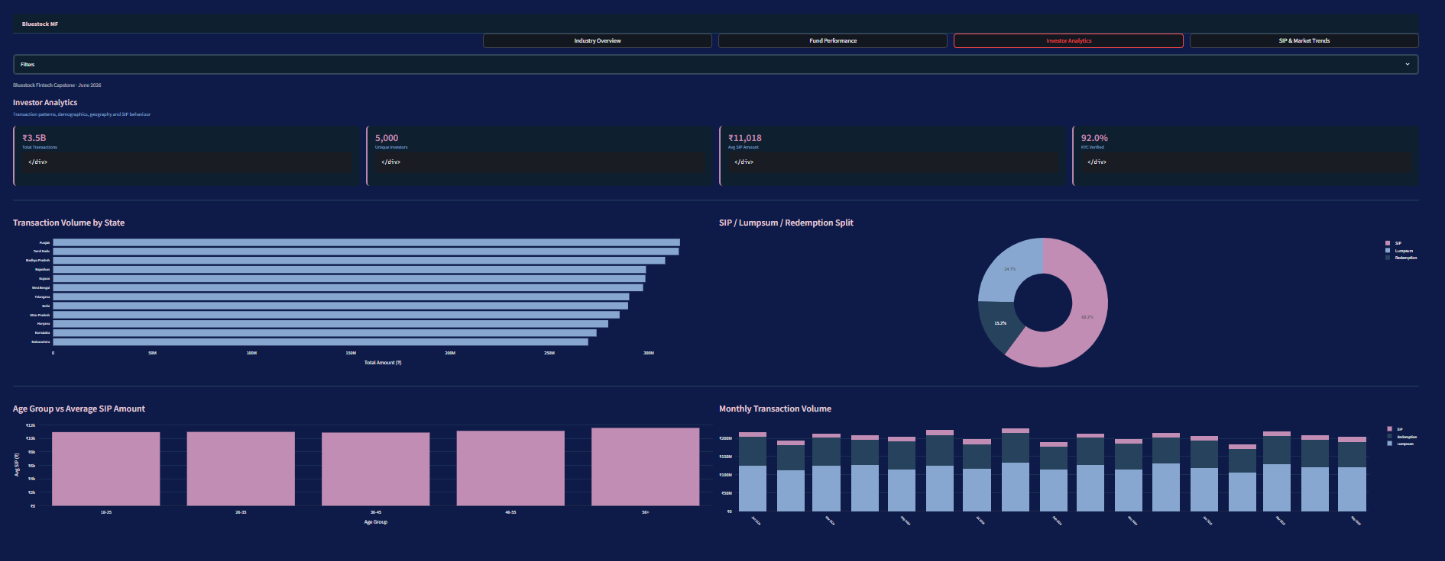
B2
STREAMLIT WEB APP –INVESTOR ANALYSIS PAGE

Slide 17
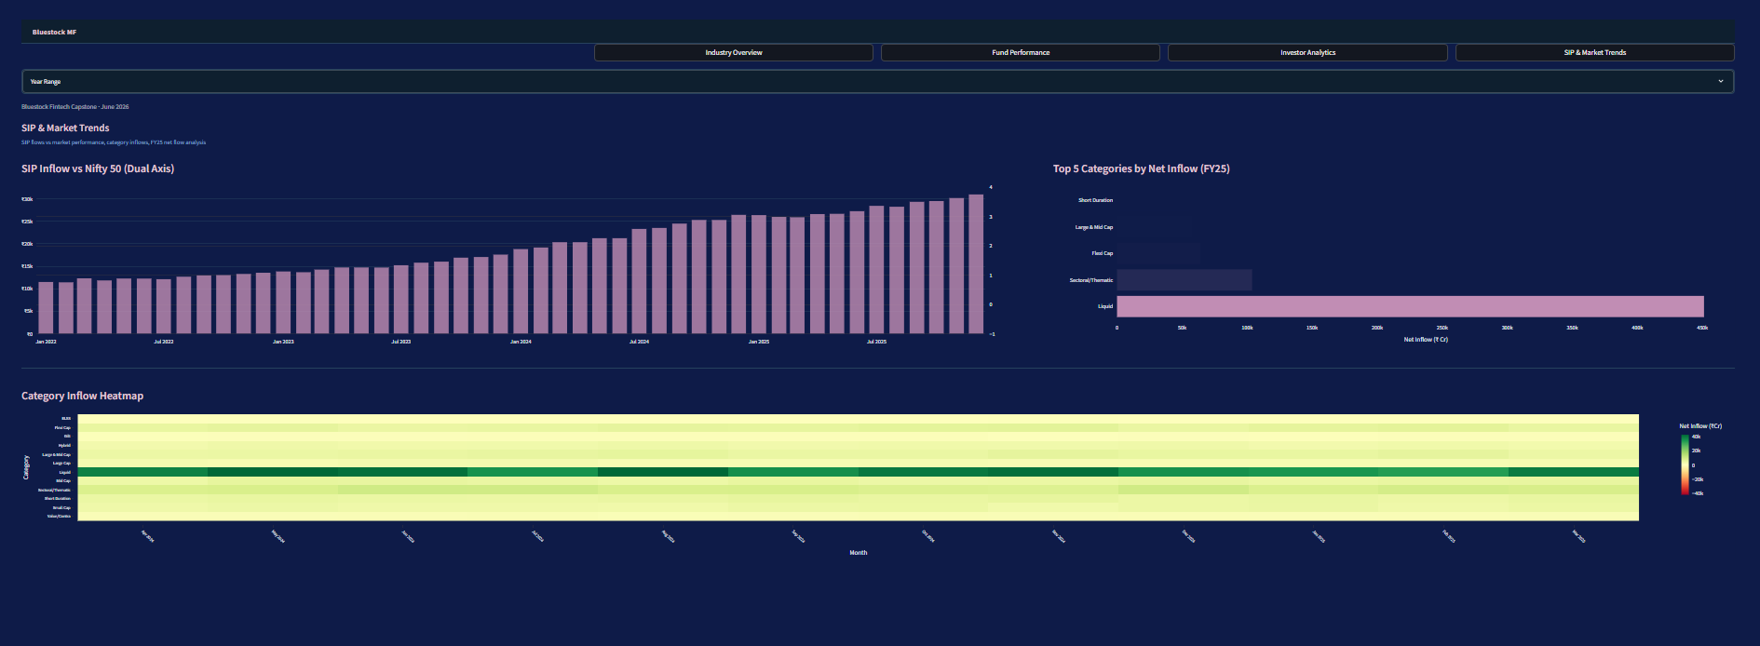
B2
STREAMLIT WEB APP –SIP & MARKET TRENDS PAGE

Slide 18
BONUS DELIVERABLE – AUTOMATED EMAIL
B5
Automated HTML Email Report
Reads live from cleaned CSVs fully data-driven, zero hardcoding
Generates branded HTML with KPI cards, fund table and insights
Complete SMTP delivery block with Gmail TLS and weekly schedule
Browser preview confirms rendering before live email deployment
For email delivery, the script contains a complete SMTP configuration block using Python's smtplib with Gmail TLS authentication. The schedule library triggers delivery every Monday at 08:00 automatically. Credentials are kept outside the codebase for security. During development, the report is previewed instantly by opening in the default browser confirming accurate rendering before live deployment.

Slide 19
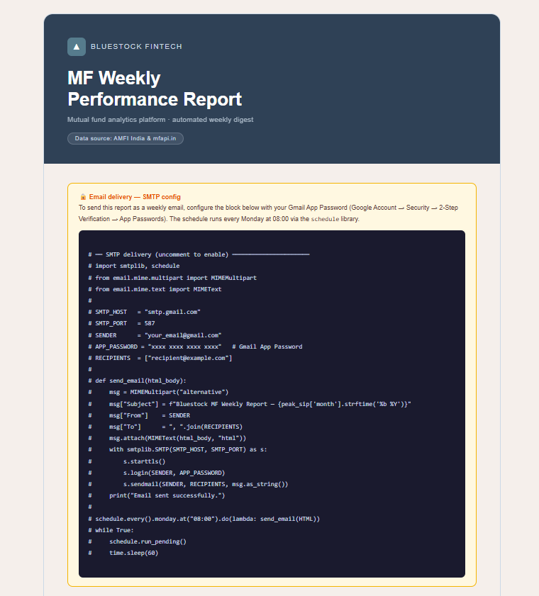
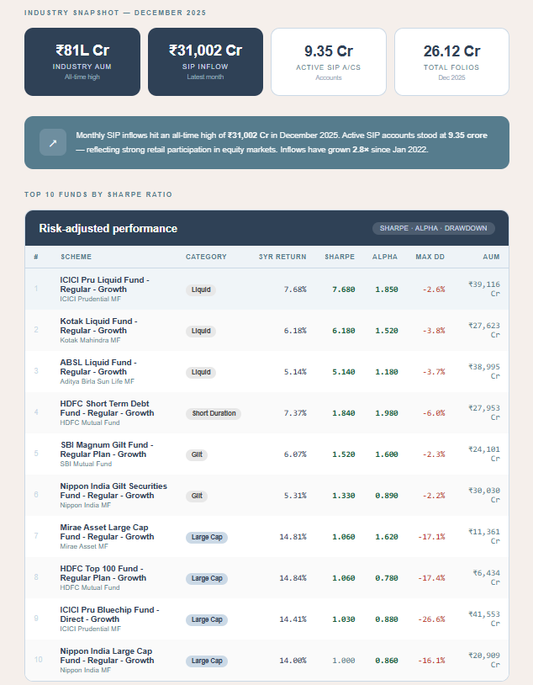
B2
AUTOMATED HTML EMAIL REPORT

Slide 20
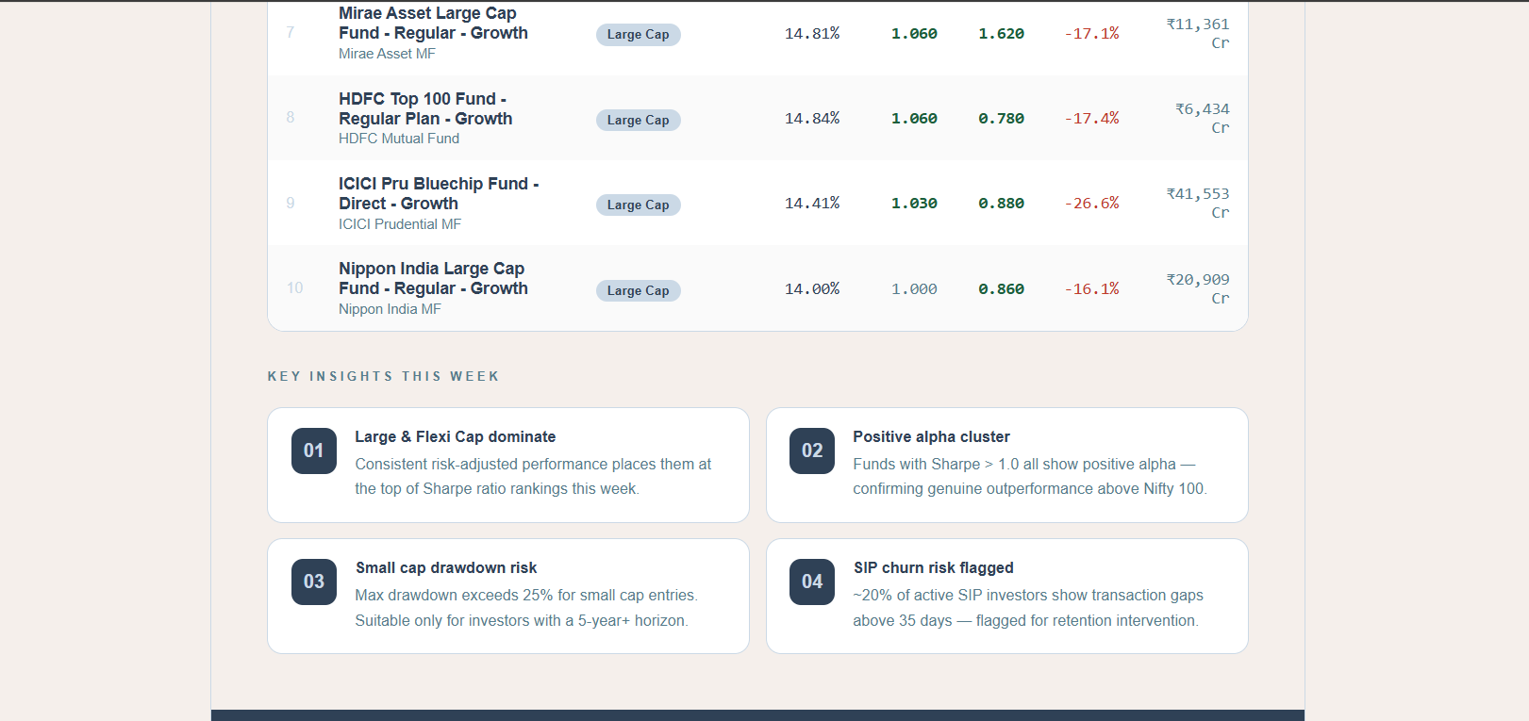
B2
AUTOMATED HTML EMAIL REPORT

Slide 21
KEY FINDINGS
SIP GROWTH
Monthly SIP inflows crossed Rs 31,002 Cr - 2.8x growth since 2022, driven by youth investors aged 26-35.
TOP PERFORMERS
SBI Bluechip, HDFC Top 100, and ICICI Pru Bluechip lead on composite scorecard with Sharpe > 1.4.
AT-RISK INVESTORS
~20% of active SIP investors show avg gaps > 35 days - automated nudges could reduce churn.
DIVERSIFICATION
High return correlation across large-cap funds (r > 0.80) - adding mid-cap or debt improves diversification.
RECOMMENDATION
Low-risk: SBI Bluechip or HDFC Top 100. Moderate: Flexi-cap. High: Mid/small-cap with 5yr+ horizon.

Slide 22
THANKYOU
- SHEVANIGA S

