Slide 1

Modern & Effective C++
2024
A Priority choice!

Slide 2
What is this lecture about?
It is about new changes in C++11/14/17/20 standards
What we will cover in this lecture | What we will not cover today
Move semantics and Rvalues, std::move Universal reference & std::forward Lambdas, std::function, std::bind A lot of small but significant syntax changes in C++/11/14/17 Basic C++20 features coverage | STL changes (except specific cases e.g. std::move) Multithreading Variadic templates C++20 coroutines in depth C++23

Slide 3
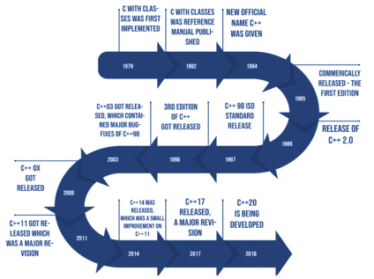
C++ Evolution

Slide 4

Modern C++: What’s new in C++11/14?
Move semantics, R-value references, Universal references Type inference (auto & decltype) Variadic templates (Not in this lecture) Lambdas std::function Range based loops (for each) enum class constexpr explicit noexcept nullptr using (type aliases) Initializer list Huge STL update (Not in this lecture) Smart pointers Concurrency, atomics Move semantics for new and old containers New containers New algorithms - Send help, there are too many changes
Notes:
variadic templates
std::bind

Slide 5

So you decided to use C++11 and beyond...
Rvalue and Lvalue references
Move semantics
std::move
std::forward
Universal references
Perfect forwarding

Slide 6
Rvalue & Lvalue
auto x = 1.5 + 0.2;
auto result = std::sin(x);
Print(std::string("Hello World"));
- Lvalues are named values, for which we can get address
- Rvalues are unnamed temporary values

Slide 7
Rvalue references & std::move
Rvalues can be passed to the functions using rvalue references (T&&)
Any lvalue can be referenced as rvalue using std::move(value)
void Process(Data&& data) {/* ... */}
// ...
Data data(/* ... */)
// Process(data) - ERROR: rvalue reference required
Process(std::move(data)) // Ok!

Slide 8

Remember these rules!
std::move does not do anything fancy! It just casts lvalue reference (T&) to rvalue reference (T&&). An actual logic for “moving” should be in receiving function e.g. Move constructor Object(Object&& rhs)
If rvalue reference has name - it is treated as lvalue (e.g Object&& rhs). std::move or std::forward should be used to pass it to the next function call

Slide 9
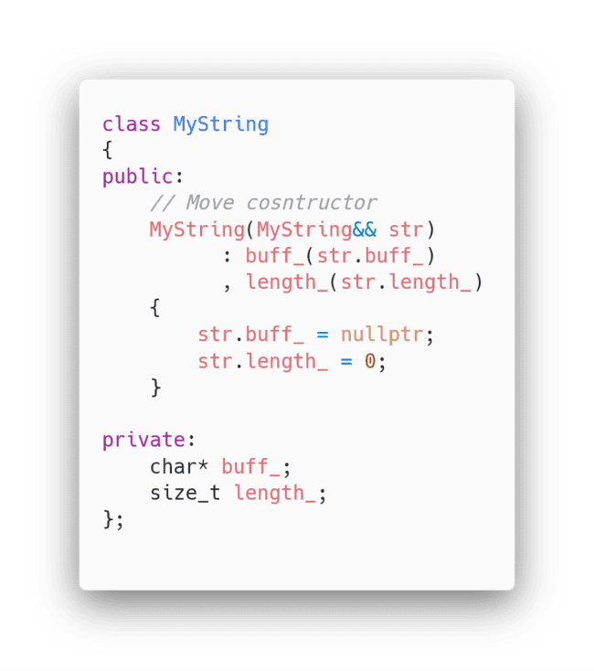
Possible implementation of move constructor

Slide 10
Universal reference
template <typename T,typename Arg>
T create(Arg&& a)
{
return T(std::forward<Arg>(a));
}
Arg&& in type inference context (e.g template argument type inference) is called universal reference:
Passes lvaue references as lvalue references
Passes rvalue references as rvalue references
std::forward<T>(value) should be used in these contexts instead of std::move
Only use std::move when type of value is known.
For template type arguments use std::forward
More about that info in lecture supplement document

Slide 11

So… what?
If your facial expression now is something like this after the previous slides, don’t be afraid - mine was the same when I first learned the new C++11 features!
And now… Let’s see move semantics in action!

Slide 12
C++03 Problem
#include <string> #include <vector> struct Data { public: Data(const std::vector<std::string> v, int i) : v_(v), i_(i) {} void Process(int x) { i_ *= x; } void Print() {/* */}; private: std::vector<std::string> v_; int i_; }; Data ProcessData(const Data& data) { Data newData(data); newData.Process(42); return newData; } | Data MakeData() { std::vector<std::string> v1; v1.push_back("one"); v1.push_back("two"); v1.push_back("three"); Data data = Data(v1, 2); return ProcessData(data); } int main() { Data data = MakeData(); data.Print(); return 0; }
Question: How much overhead do we have?

Slide 13
C++11 Solution
#include <string> #include <vector> struct Data { public: Data(const std::vector<std::string>&& v, int i) : v_(std::move(v)), i_(i) {} void Process(int x) { i_ *= x; } void Print() {/* */}; private: std::vector<std::string> v_; int i_; }; Data ProcessData(Data&& data) { Data newData(std::move(data)); newData.Process(42); return std::move(newData); } | Data MakeData() { std::vector<std::string> v1; v1.push_back("one"); v1.push_back("two"); v1.push_back("three"); Data data = Data(std::move(v1), 2); return ProcessData(std::move(data)); } int main() { Data data = MakeData(); data.Print(); return 0; }
Question: How much overhead do we have NOW?

Slide 14

It just works™
Good news - slides about the most confusing C++11 feature are over!
Have questions?
Now to the less stressing things!

Slide 15
Auto
auto keyword will happily perform type inference for your variables or return value types
auto x = 27; // x => int
auto& lrx = &x; // lrx => int&
// Signature => std::string Stringify(int x)
auto Stringify(int x) { return std::to_string(x); }

Slide 16
Decltype
decltype(...) will return type of the expression inside it
auto x = 42.0;
auto y = 84;
decltype(x + y) z = x + y;
decltype(z) p = z / 2;

Slide 17
using (Type aliases) - More adequate typedef
More adequate typedef with obvious syntax
typedef int MyType; // C++03
using MyType = int; // C++11
typedef (*FunctionPtr)(int); // C++03
using FunctionPtr = void(*)(int); // C++11

Slide 18
Nullptr
In C++11 the separate value for describing null values was introduced - nullptr. It even has its own type - nullptr_t
Previously, only NULL was available, which is just numeric constant
f(int); // (1)
f(char*); // (2)
// C++03
f(NULL); // (1) will be called
// C++11
f(nullptr); // (2) will be called
NULL should not be used in the post-C++11 code. use nullptr instead!

Slide 19

Lambda functions
What is lambda? It is anonymous function objects. They are also can capture variables from outside context!
auto multiplier = 2;
auto fun = [&multiplier](int x) -> auto
{
return x * multiplier;
};
std::cout << fun(2) << "\n"; // 4
multiplier = 16;
std::cout << fun(4) << "\n"; // 64
HL3 confirmed (no)

Slide 20
std::function: Pre-C11 world: function pointers
Passing function to the other function was painful:
Not-so-straightforward typedef’s for the function pointers
Additional (potentially weakly typed) context variable for passing some context
To save function in object, both function pointer and context should be stored separately
#include <string> #include <iostream> typedef std::string (*FormatFun)(const std::string&, void*); std::string FmtBraced(const std::string& str, void*) { return std::string("(") + str + ")"; } std::string FmtPrefixed(const std::string& str, void* ctx) { const char* prefix = (const char*) ctx; return std::string(prefix) + str; } | void PrintFormatted(const std::string& value, FormatFun formatter, void* ctx) { std::cout << "Val: " << formatter(value, ctx) << "\n"; } int main() { // Output: "Val: (value1)" PrintFormatted("value1", &FmtBraced, 0); // Output: "Val: My_value2" PrintFormatted("value2", &FmtPrefixed, (void*)"My_"); return 0; }

Slide 21
std::function: Bye-bye function pointers!
std::function and std::bind to rule them all
#include <string>
#include <iostream>
#include <functional>
using FormatFun = std::function<std::string(const std::string&)>;
std::string FmtBraced(const std::string& str)
{ return std::string("(") + str + ")"; }
void PrintFormatted(const std::string& value, FormatFun formatter)
{ std::cout << "Val: " << formatter(value) << "\n"; }
int main()
{
using namespace std::placeholders;
auto fmtPrefixed = [](const std::string& str, const std::string& prefix)
{ return prefix + str; };
// Output: "Val: (value1)"
PrintFormatted("value1", FmtBraced);
// Output: "Val: My_value2"
PrintFormatted("value2", std::bind(fmtPrefixed, _1, "My_"));
return 0;
}

Slide 22
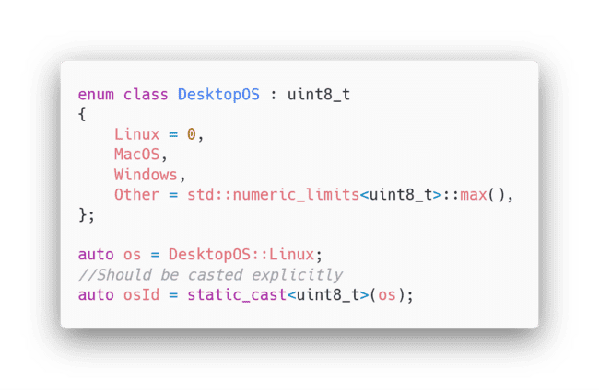
Enum class
Explicit namespace for enum variants
Underlying type can be specified
All casts are explicit
Please forget about old C-style enums for the new code :)

Slide 23
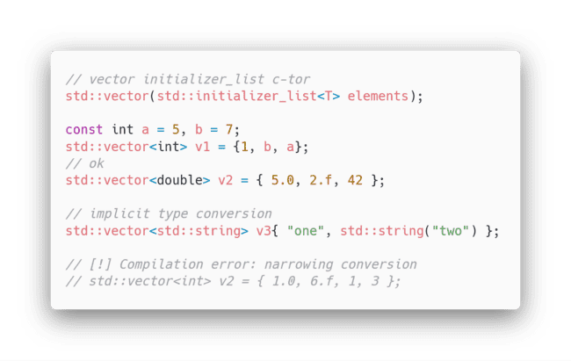
Initializer list
New easy way for collection construction
Can be used as iterable collection in code
Does not permit narrowing conversions

Slide 24
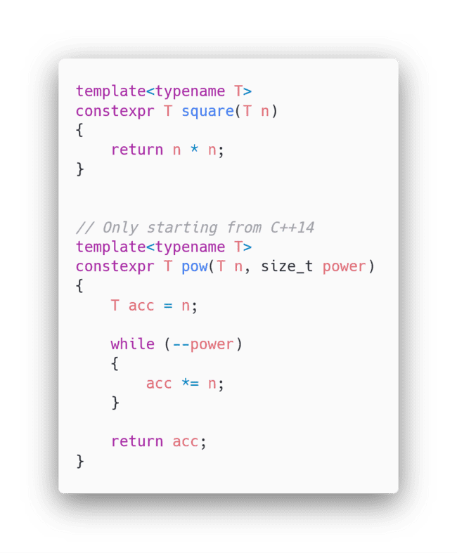
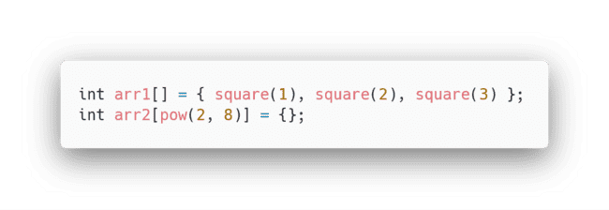
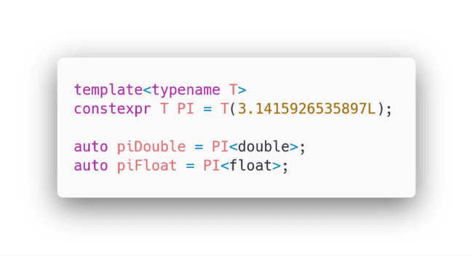
constexpr
Allows to make guaranteed compile-time calculations
Could be used in any context, where constans are required
Can be used with templates

Slide 25
For each loop
Iterating loops was painful… Not anymore!
std::vector<int> v = { 1, 2, 3, 4 };
// C++03
for (std::vector<int>::const_iterator it = v.cbegin(); it != v.cend(); ++it) {
std::cout << *it << "\n";
}
// C++11
for (const auto& i : v) {
std::cout << i << "\n";
}

Slide 26

We did it! C++11-related slides are over!
Ask question about previous slides (if any)
Tired? Brace yourself! We are close!

Slide 27
Syntax changs in C++17
C++17 is more STL-oriented language update than syntax update, so there are not much things which we will cover today
if/switch initializers
Structured bindings
More compact nested namespaces
Type deduction for constructors
C++17

Slide 28
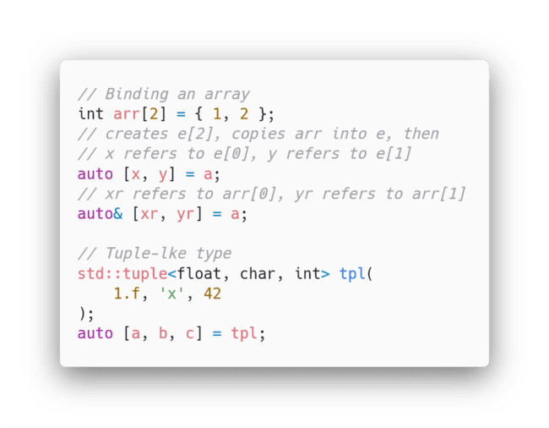
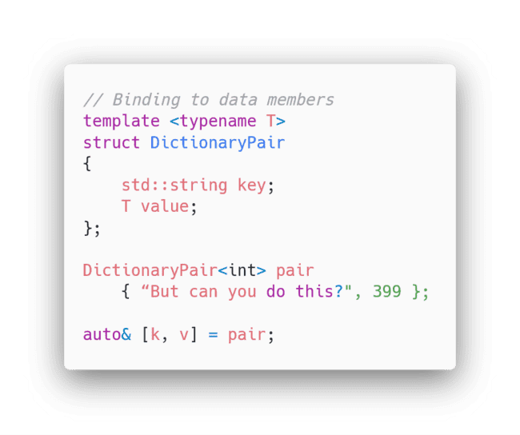
Structured bindings
Structured bindings can make code more readable, but sometimes they make everything worse, so be careful with them!

Slide 29
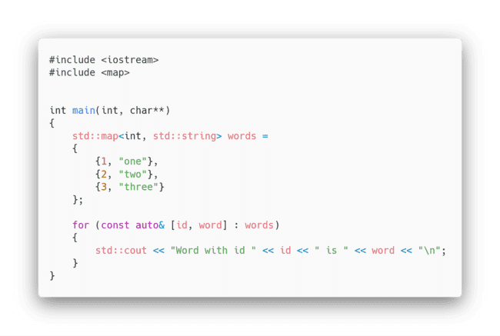
Structured bindings

Slide 30
if/switch initializer
C++17 allows additional initialization statement before condition checking expression for if and switch statements
if (int random_num = std::rand(); random_num % 2 == 0)
cout << random_num << " is an even number\n";
else
cout << random_num << " is an odd number\n";

Slide 31
More compact nested namespaces
// C++11/14
namespace A
{
namespace B
{
// ...
}
}
// C++17
namespace A::B
{
// ...
}

Slide 32
Type deduction for constructors
Type deduction for template classes was absent for constructed calls, but starting from C++17 it has become possible!
// C++11/14
std::vector<int> = { 1, 2, 3 };
// C++17
std::vector v = { 1, 2, 3 };

Slide 33

We almost finished!
The only thing yet to be covered is C++20.
Let’s jump right to it!

Slide 34
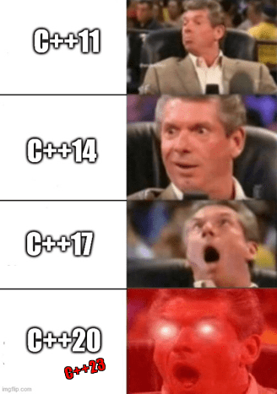
C++20: The Huge upgrade
There are a lot of the changes in C++20, but there are three long-awaited features which are finally were standardized:
Modules
Concepts
Coroutines

Slide 35

Warning!
C++20 standard is not yet fully supported by the all compilers
This lecture only scratches the surface of C++20 features

Slide 36
Modules
C++ 17 | C++ 20
source.hpp | source.ixx
#ifndef _HEADER_CALCULATE_ #define _HEADER_CALCULATE_ // Or non-standard #pragma once double calculate(double x, double y); #endif // _HEADER_CALCULATE_ | export module calc; import <cmath>; export double calculate(double x, double y) { return std::sin(x) + std::cos(y); }
source.cpp | main.cpp
#include <source.hpp> #include <cmath> double calculate(double x, double y) { return std::sin(x) + std::cos(y); } | import calc; import <iostream> int main() { std::cout << calculate(13.3, 23.4); return 0; }

Slide 37

What gives?
Single file modules instead of cpp + hpp
No more actual text “inclusion” - can improve compilation times (sometimes)
Minimizes name collisions - module only provides explicitly exported identifiers
No more include guards

Slide 38
Concepts
// Declaration of the concept "Hashable", which is satisfied by
// any type 'T' such that for values 'a' of type 'T',
// the expression std::hash<T>{}(a) compiles and its result is
// convertible to std::size_t
template<typename T>
concept Hashable = requires(T a) {
{ std::hash<T>{}(a) } -> std::convertible_to<std::size_t>;
};
// constrained C++20 function template
template<Hashable T>
void f(T) { /* ... */ };
// Alternative way to apply the same constraint:
// template<typename T>
// void f(T) requires Hashable<T>;

Slide 39

What gives?
No more SFINAE magic trickery!
Sane syntax for static polymorphism
No more dumb C++ templates errors
Potentially meaningful code autocomplete for code editors
In file included from /usr/include/c++/4.6/algorithm:63:0,
from error_code.cpp:2:
/usr/include/c++/4.6/bits/stl_algo.h: In function ‘_RandomAccessIterator std::__find(_RandomAccessIterator, _RandomAccessIterator, const _Tp&, std::random_access_iterator_tag) [with _RandomAccessIterator = __gnu_cxx::__normal_iterator*, std::vector > >, _Tp = int]’:
/usr/include/c++/4.6/bits/stl_algo.h:4403:45: instantiated from ‘_IIter std::find(_IIter, _IIter, const _Tp&) [with _IIter = __gnu_cxx::__normal_iterator*, std::vector > >, _Tp = int]’
error_code.cpp:8:89: instantiated from here
/usr/include/c++/4.6/bits/stl_algo.h:162:4: error: no match for ‘operator==’ in ‘__first.__gnu_cxx::__normal_iterator::operator* [with _Iterator = std::vector*, _Container = std::vector >, __gnu_cxx::__normal_iterator::reference = std::vector&]() == __val’
/usr/include/c++/4.6/bits/stl_algo.h:162:4: note: candidates are:
/usr/include/c++/4.6/bits/stl_pair.h:201:5: note: template bool std::operator==(const std::pair&, const std::pair&)
/usr/include/c++/4.6/bits/stl_iterator.h:285:5: note: template bool std::operator==(const std::reverse_iterator&, const std::reverse_iterator&)
/usr/include/c++/4.6/bits/stl_iterator.h:335:5: note: template bool std::operator==(const std::reverse_iterator&, const std::reverse_iterator&)
/usr/include/c++/4.6/bits/allocator.h:122:5: note: template bool std::operator==(const std::allocator&, const std::allocator&)
/usr/include/c++/4.6/bits/allocator.h:127:5: note: template bool std::operator==(const std::allocator&, const std::allocator&)
/usr/include/c++/4.6/bits/stl_vector.h:1273:5: note: template bool std::operator==(const std::vector&, const std::vector&)
/usr/include/c++/4.6/ext/new_allocator.h:123:5: note: template bool __gnu_cxx::operator==(const __gnu_cxx::new_allocator&, const __gnu_cxx::new_allocator&)
/usr/include/c++/4.6/bits/stl_iterator.h:805:5: note: template bool __gnu_cxx::operator==(const __gnu_cxx::__normal_iterator&, const __gnu_cxx::__normal_iterator&)
/usr/include/c++/4.6/bits/stl_iterator.h:799:5: note: template bool __gnu_cxx::operator==(const __gnu_cxx::__normal_iterator&, const __gnu_cxx::__normal_iterator&)
/usr/include/c++/4.6/bits/stl_algo.h:4403:45: instantiated from ‘_IIter std::find(_IIter, _IIter, const _Tp&) [with _IIter = __gnu_cxx::__normal_iterator*, std::vector > >, _Tp = int]’
error_code.cpp:8:89: instantiated from here
/usr/include/c++/4.6/bits/stl_algo.h:166:4: error: no match for ‘operator==’ in ‘__first.__gnu_cxx::__normal_iterator::operator* [with _Iterator = std::vector*, _Container = std::vector >, __gnu_cxx::__normal_iterator::reference = std::vector&]() == __val’
/usr/include/c++/4.6/bits/stl_algo.h:166:4: note: candidates are:
/usr/include/c++/4.6/bits/stl_pair.h:201:5: note: template bool std::operator==(const std::pair&, const std::pair&)
/usr/include/c++/4.6/bits/stl_iterator.h:285:5: note: template bool std::operator==(const std::reverse_iterator&, const std::reverse_iterator&)
/usr/include/c++/4.6/bits/stl_iterator.h:335:5: note: template bool std::operator==(const std::reverse_iterator&, const std::reverse_iterator&)
/usr/include/c++/4.6/bits/allocator.h:122:5: note: template bool std::operator==(const std::allocator&, const std::allocator&)
/usr/include/c++/4.6/bits/allocator.h:127:5: note: template bool std::operator==(const std::allocator&, const std::allocator&)
/usr/include/c++/4.6/bits/stl_vector.h:1273:5: note: template bool std::operator==(const std::vector&, const std::vector&)
/usr/include/c++/4.6/ext/new_allocator.h:123:5: note: template bool __gnu_cxx::operator==(const __gnu_cxx::new_allocator&, const __gnu_cxx::new_allocator&)
/usr/include/c++/4.6/bits/stl_iterator.h:805:5: note: template bool __gnu_cxx::operator==(const __gnu_cxx::__normal_iterator&, const __gnu_cxx::__normal_iterator&)
/usr/include/c++/4.6/bits/stl_iterator.h:799:5: note: template bool __gnu_cxx::operator==(const __gnu_cxx::__normal_iterator&, const __gnu_cxx::__normal_iterator&)
/usr/include/c++/4.6/bits/stl_algo.h:170:4: error: no match for ‘operator==’ in ‘__first.__gnu_cxx::__normal_iterator::operator* [with _Iterator = std::vector*, _Container = std::vector >, __gnu_cxx::__normal_iterator::reference = std::vector&]() == __val’
/usr/include/c++/4.6/bits/stl_algo.h:170:4: note: candidates are:
/usr/include/c++/4.6/bits/stl_pair.h:201:5: note: template bool std::operator==(const std::pair&, const std::pair&)
/usr/include/c++/4.6/bits/stl_iterator.h:285:5: note: template bool std::operator==(const std::reverse_iterator&, const std::reverse_iterator&)
/usr/include/c++/4.6/bits/stl_iterator.h:335:5: note: template bool std::operator==(const std::reverse_iterator&, const std::reverse_iterator&)
/usr/include/c++/4.6/bits/allocator.h:122:5: note: template bool std::operator==(const std::allocator&, const std::allocator&)
/usr/include/c++/4.6/bits/allocator.h:127:5: note: template bool std::operator==(const std::allocator&, const std::allocator&)
/usr/include/c++/4.6/bits/stl_vector.h:1273:5: note: template bool std::operator==(const std::vector&, const std::vector&)
/usr/include/c++/4.6/ext/new_allocator.h:123:5: note: template bool __gnu_cxx::operator==(const __gnu_cxx::new_allocator&, const __gnu_cxx::new_allocator&)
/usr/include/c++/4.6/bits/stl_iterator.h:805:5: note: template bool __gnu_cxx::operator==(const __gnu_cxx::__normal_iterator&, const __gnu_cxx::__normal_iterator&)
/usr/include/c++/4.6/bits/stl_iterator.h:799:5: note: template bool __gnu_cxx::operator==(const __gnu_cxx::__normal_iterator&, const __gnu_cxx::__normal_iterator&)
/usr/include/c++/4.6/bits/stl_algo.h:174:4: error: no match for ‘operator==’ in ‘__first.__gnu_cxx::__normal_iterator::operator* [with _Iterator = std::vector*, _Container = std::vector >, __gnu_cxx::__normal_iterator::reference = std::vector&]() == __val’
/usr/include/c++/4.6/bits/stl_algo.h:174:4: note: candidates are:
/usr/include/c++/4.6/bits/stl_pair.h:201:5: note: template bool std::operator==(const std::pair&, const std::pair&)
/usr/include/c++/4.6/bits/stl_iterator.h:285:5: note: template bool std::operator==(const std::reverse_iterator&, const std::reverse_iterator&)
/usr/include/c++/4.6/bits/stl_iterator.h:335:5: note: template bool std::operator==(const std::reverse_iterator&, const std::reverse_iterator&)
/usr/include/c++/4.6/bits/allocator.h:122:5: note: template bool std::operator==(const std::allocator&, const std::allocator&)
/usr/include/c++/4.6/bits/allocator.h:127:5: note: template bool std::operator==(const std::allocator&, const std::allocator&)
/usr/include/c++/4.6/bits/stl_vector.h:1273:5: note: template bool std::operator==(const std::vector&, const std::vector&)
/usr/include/c++/4.6/ext/new_allocator.h:123:5: note: template bool __gnu_cxx::operator==(const __gnu_cxx::new_allocator&, const __gnu_cxx::new_allocator&)
/usr/include/c++/4.6/bits/stl_iterator.h:805:5: note: template bool __gnu_cxx::operator==(const __gnu_cxx::__normal_iterator&, const __gnu_cxx::__normal_iterator&)
/usr/include/c++/4.6/bits/stl_iterator.h:799:5: note: template bool __gnu_cxx::operator==(const __gnu_cxx::__normal_iterator&, const __gnu_cxx::__normal_iterator&)
/usr/include/c++/4.6/bits/stl_algo.h:182:4: error: no match for ‘operator==’ in ‘__first.__gnu_cxx::__normal_iterator::operator* [with _Iterator = std::vector*, _Container = std::vector >, __gnu_cxx::__normal_iterator::reference = std::vector&]() == __val’
/usr/include/c++/4.6/bits/stl_algo.h:182:4: note: candidates are:
/usr/include/c++/4.6/bits/stl_pair.h:201:5: note: template bool std::operator==(const std::pair&, const std::pair&)
/usr/include/c++/4.6/bits/stl_iterator.h:285:5: note: template bool std::operator==(const std::reverse_iterator&, const std::reverse_iterator&)
/usr/include/c++/4.6/bits/stl_iterator.h:335:5: note: template bool std::operator==(const std::reverse_iterator&, const std::reverse_iterator&)
/usr/include/c++/4.6/bits/allocator.h:122:5: note: template bool std::operator==(const std::allocator&, const std::allocator&)
/usr/include/c++/4.6/bits/allocator.h:127:5: note: template bool std::operator==(const std::allocator&, const std::allocator&)
/usr/include/c++/4.6/bits/stl_vector.h:1273:5: note: template bool std::operator==(const std::vector&, const std::vector&)
/usr/include/c++/4.6/ext/new_allocator.h:123:5: note: template bool __gnu_cxx::operator==(const __gnu_cxx::new_allocator&, const __gnu_cxx::new_allocator&)
/usr/include/c++/4.6/bits/stl_iterator.h:805:5: note: template bool __gnu_cxx::operator==(const __gnu_cxx::__normal_iterator&, const __gnu_cxx::__normal_iterator&)
/usr/include/c++/4.6/bits/stl_iterator.h:799:5: note: template bool __gnu_cxx::operator==(const __gnu_cxx::__normal_iterator&, const __gnu_cxx::__normal_iterator&)
/usr/include/c++/4.6/bits/stl_algo.h:186:4: error: no match for ‘operator==’ in ‘__first.__gnu_cxx::__normal_iterator::operator* [with _Iterator = std::vector*, _Container = std::vector >, __gnu_cxx::__normal_iterator::reference = std::vector&]() == __val’
/usr/include/c++/4.6/bits/stl_algo.h:186:4: note: candidates are:
/usr/include/c++/4.6/bits/stl_pair.h:201:5: note: template bool std::operator==(const std::pair&, const std::pair&)
/usr/include/c++/4.6/bits/stl_iterator.h:285:5: note: template bool std::operator==(const std::reverse_iterator&, const std::reverse_iterator&)
/usr/include/c++/4.6/bits/stl_iterator.h:335:5: note: template bool std::operator==(const std::reverse_iterator&, const std::reverse_iterator&)
/usr/include/c++/4.6/bits/allocator.h:122:5: note: template bool std::operator==(const std::allocator&, const std::allocator&)
/usr/include/c++/4.6/bits/allocator.h:127:5: note: template bool std::operator==(const std::allocator&, const std::allocator&)
/usr/include/c++/4.6/bits/stl_vector.h:1273:5: note: template bool std::operator==(const std::vector&, const std::vector&)
/usr/include/c++/4.6/ext/new_allocator.h:123:5: note: template bool __gnu_cxx::operator==(const __gnu_cxx::new_allocator&, const __gnu_cxx::new_allocator&)
/usr/include/c++/4.6/bits/stl_iterator.h:805:5: note: template bool __gnu_cxx::operator==(const __gnu_cxx::__normal_iterator&, const __gnu_cxx::__normal_iterator&)
/usr/include/c++/4.6/bits/stl_iterator.h:799:5: note: template bool __gnu_cxx::operator==(const __gnu_cxx::__normal_iterator&, const __gnu_cxx::__normal_iterator&)
/usr/include/c++/4.6/bits/stl_algo.h:190:4: error: no match for ‘operator==’ in ‘__first.__gnu_cxx::__normal_iterator::operator* [with _Iterator = std::vector*, _Container = std::vector >, __gnu_cxx::__normal_iterator::reference = std::vector&]() == __val’
/usr/include/c++/4.6/bits/stl_algo.h:190:4: note: candidates are:
/usr/include/c++/4.6/bits/stl_pair.h:201:5: note: template bool std::operator==(const std::pair&, const std::pair&)
/usr/include/c++/4.6/bits/stl_iterator.h:285:5: note: template bool std::operator==(const std::reverse_iterator&, const std::reverse_iterator&)
/usr/include/c++/4.6/bits/stl_iterator.h:335:5: note: template bool std::operator==(const std::reverse_iterator&, const std::reverse_iterator&)
/usr/include/c++/4.6/bits/allocator.h:122:5: note: template bool std::operator==(const std::allocator&, const std::allocator&)
/usr/include/c++/4.6/bits/allocator.h:127:5: note: template bool std::operator==(const std::allocator&, const std::allocator&)
/usr/include/c++/4.6/bits/stl_vector.h:1273:5: note: template bool std::operator==(const std::vector&, const std::vector&)
/usr/include/c++/4.6/ext/new_allocator.h:123:5: note: template bool __gnu_cxx::operator==(const __gnu_cxx::new_allocator&, const __gnu_cxx::new_allocator&)
/usr/include/c++/4.6/bits/stl_iterator.h:805:5: note: template bool __gnu_cxx::operator==(const __gnu_cxx::__normal_iterator&, const __gnu_cxx::__normal_iterator&)
/usr/include/c++/4.6/bits/stl_iterator.h:799:5: note: template bool __gnu_cxx::operator==(const __gnu_cxx::__normal_iterator&, const __gnu_cxx::__normal_iterator&)

Slide 40

Coroutines
C++ now officially boarded the async programming hype wagon!
Asynchronous programming is now may be actually usable in C++!
Resumable functions, generators

Slide 41
A function is a coroutine if its definition does any of the following
uses the co_await operator to suspend execution until resumed
task<> tcp_echo_server()
{
char data[1024];
for (;;)
{
size_t n = co_await socket.async_read_some(buffer(data));
co_await async_write(socket, buffer(data, n));
}
}
uses the keyword co_yield to suspend execution returning a value
generator<int> iota(int n = 0)
{
while(true)
co_yield n++;
}
uses the keyword co_return to complete execution returning a value
lazy<int> f()
{
co_return 7;
}

Slide 42
Non only for async: Generator example
#include <iostream>
#include <vector>
#include <cppcoro/generator.hpp>
cppcoro::generator<int> GeneratorForNumbers(int begin, int inc = 1)
{
for (int i = begin;; i += inc)
{
co_yield i;
}
}
int main()
{
// Print number indefinitely
for (auto n: GeneratorForNumbers(42, 2))
std::cout << n << " ";
}

Slide 43

But there is a catch...
There is no completely finalized usable module in STL for using coroutines…
We need to wait for C++23 support in compilers before coroutines library like cppcoro will land in STL

Slide 44

Thanks, that’s all… For the lecture!
More info in lecture supplement
More detailed explanation of move semantics rvalues and perfect forwarding
More detailed C++17 features description
Detailed homework description
Modern and effective
C++ Lecture
I am highly recommend to read the lecture supplement material before doing homework

Slide 45
Homework: Implement your own linked list
Main single-linked list requirements
Move constructor / move assign operator should be implemented (normal/copy constructors too)
List should have constructor with initializer_list
List should have should push_front with move semantics
Container should have split_when method which splits list based on the std::function<bool(const T&)> predicate
Make sure your code can be compiled with the latest compiler, especially if you decided to use C++20 code (Visual Studio 2019 IDE is preferable and highly recommended)
Read more details in your lecture supplement material

Slide 46

Questions?

Slide 47
Thank you for your attention!
Questions?

