Slide 1
Qt Framework
Basic concepts

Slide 2
Qt Framework
History
1990 - Start of development
1995 – First public release (by Troll Tech)
1999 – Qt 2.0 released
2001 – Qt 3.0 released
2005 – Qt 4.0 released
2008 – Acquired by Nokia
2012 – Acquired by Digia, Qt 5.0 released
2014 - Becomes its own entity "The Qt Company", subsidiary of Digia
2020 – Qt 6.0 released
License
Free software licenses: Mandatory to comply with (L)GPL
Qt Commercial License (Application development / Device Creation)

Slide 3





Cross-platform
One interface

Slide 4
Qt usage
Desktop UIs (KDE Plasma, DDE, UKUI…)
Embedded and mobile Uis (Blackberry 10, Ubuntu Touch, Tesla Model S in-car UI…)
Applications (Adobe Photoshop, Autodesk Maya, Bitcoin Core, Google Earth, Teamviewer, Telegram…)
Organizations using Qt: AMD, Blizzard Entertainment, Electronic Arts, Huawei, Lucasfilm, Microsoft, Tesla, Valve, Walt Disney Animation Studios...

Slide 5
Tools
Qt Creator
Qt Design Studio
Qt 3D Studio
Qt Designer
Qt Linguist
Qbs
qmake

Slide 6
Modules
Qt Core
Qt QML
Qt GUI
Qt Widgets
Qt Network
Qt Test
Qt Charts
Qt Concurrent
Qt Image Formats
Qt 3D
Qt Sensors
Qt NFC
Qt SQL
Qt SVG
Qt XML
Qt WebView

Slide 7
QString
String class
QByteArray QString::toUtf8() const
Returns a UTF-8 representation of the string as a array of bytes.
QString QString::fromUtf8(const char *str, int size = -1) [static]
Returns a QString initialized with the first size bytes of the UTF-8 string str.
const ushort *QString::utf16() const
Returns the QString as a '\0'-terminated array of unsigned shorts as UTF-16.
QString QString::fromUtf16(const ushort *unicode, int size = -1) [static]
Returns a QString initialized with the first size characters of the Unicode string unicode (ISO-10646-UTF-16 encoded).
std::string QString::toStdString() const
QString Qstring::fromStdString(const std::string& str) const
bool QString::startsWith(const QStringRef &s, Qt::CaseSensitivity cs = Qt::CaseSensitive) const
bool QString::endsWith(const QStringRef &s, Qt::CaseSensitivity cs = Qt::CaseSensitive) const
Checks if the string starts or ends with the given substring.
String to number and number to string:
QString QString::number(T n, int base = 10)
double QString::toDouble(bool *ok = Q_NULLPTR) const
float QString::toFloat(bool *ok = Q_NULLPTR) const
int QString::toInt(bool *ok = Q_NULLPTR, int base = 10) const

Slide 8
QDateTime
Class that provides date and time functions.
fromString(const QString &string, Qt::DateFormat format)
Returns the QDateTime represented by the string, using the format given
QString toString(const QString &format) const
Returns the datetime as a string.
qint64 QdateTime::toSecsSinceEpoch() const
Returns the datetime as the number of seconds that have passed since 1970-01-01T00:00:00.000, Coordinated Universal Time
QDateTime QDateTime::toUTC() const
Returns a datetime containing the date and time information in this datetime, but specified using the Qt::UTC definition.

Slide 9
QVector, QList, QMap, QMultiMap
Containers
Functional analogs of STL containers, but with additional features and optimized for use with Qt types
Compatibility with STL:
QVector<int> vector;
…
std::sort(vector.begin(), vector.end())
Java-like iterators:
QVector<int> vector;
…
QVectorIterator it(vector);
while(it.hasNext()) { std::cout<< it.next(); }

Slide 10
Smart pointers
QPointer
Provides guarded pointers to QObject. Similar to std::weak_ptr
QScopedPointer
Similar to std::unique_ptr
QSharedPointer
Similar to std::shared_ptr
QWeakPointer
Similar to std::weak_ptr
QSharedData provides thread-safe reference counting. Designed to be used with QSharedDataPointer or QExplicitlySharedDataPointer to implement custom implicitly shared or explicitly shared classes:
QSharedDataPointer – makes a copy of an object on modifications
QExplicitlySharedDataPointer – makes a copy of an object only when detach() is explicitly executed

Slide 11
Hierarchical Object Model
QОbject receives a parent on creation as a parameter
Child object is added into the list of children of its parent object
Child object can be deleted manually
If a widget doesn’t have a parent it becomes a separate window
Don’t confuse inheritance with parent-child relationships
QWidget
QObject
QWidget
QLabel
QWidget
QThread
QLabel
QLabel
QLabel
QPushButton
QLineEdit
Hierarchical model
Inheritance

Slide 12
Signals & Slots
Signal generation:
#include <QObject>
class Emitter : public QObject
{
Q_OBJECT
public:
void WorkFunction()
{
emit SignalExample();
}
signals:
void SignalExample();
};
Signal receiving:
#include <QObject>
#include <iostream>
class Receiver : public QObject
{
Q_OBJECT
public slots:
void SlotExample()
{
std::cout << “Signal received”;
}
};

Slide 13
Signals & Slots
int main (int argc, char *argv[])
{
QApplication app(argc, argv);
Receiver receiver; Emitter emitter;
bool res = QObject::connect(&emitter, &Emitter::SignalExample, &receiver, &Receiver::SlotExample);
if(!res)
{
return -1; //invalid connection
}
// Receiver and Emitter are connected from now
return app.exec();
}

Slide 14
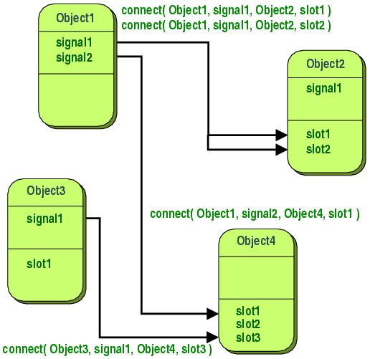
Signals & Slots
Slot 1
Signal 1
Slot n
Signal 1
Slot
Signal n
Signal
Slot
Signal
Signal

Slide 15
Multithreading QThread
Provides a platform-independent way to manage threads. A QThread object manages one thread of control within the program.
void QObject::moveToThread(QThread *targetThread)
Changes the thread affinity for this object and its children.
void QThread::run() [virtual protected]
The starting point for the thread.
void QThread::start(Priority priority = InheritPriority)
Begins execution of the thread by calling run(). The operating system will schedule the thread according to the priority parameter.

Slide 16
Multithreading QtConcurrent
QFuture<T> QtConcurrent::run(Function function, ...)
Similar to std::launch::async. Runs function in a separate thread.
QFuture<T>
Represents the result of an asynchronous computation. Similar to std::future
QFuture<void> QtConcurrent::map(Sequence &sequence, MapFunction function)
Calls function once for each item in sequence. The function is passed a reference to the item, so that any modifications done to the item will appear in sequence.
QFuture<T> QtConcurrent::mapped(ConstIterator begin, ConstIterator end, MapFunction function)
Calls function once for each item in sequence and returns a future with each mapped item as a result.

Slide 17
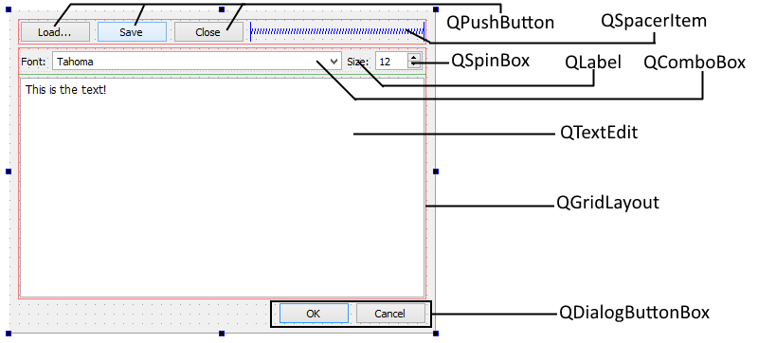
GUI Widgets
QtDesigner

Slide 18
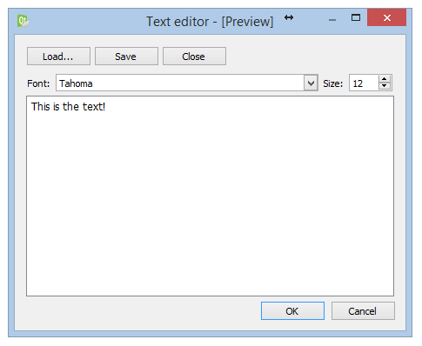
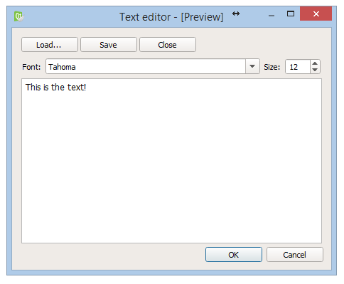
GUI Widgets
Windows style
Fusion style

Slide 19
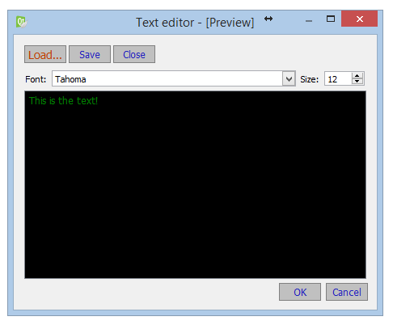
GUI Style Sheet
QPushButton
{
background-color: rgb(192, 192, 192);
font-size: 12px;
color: rgb(32, 32, 192);
border: 1px solid;
border-color: rgb(128, 128, 128);
min-width: 50px;
min-height: 20px;
}
QPushButton#btnLoad
{
color: rgb(192, 64, 0);
font-size: 14px;
}
QTextEdit
{
color: green;
background-color: black;
font-size: 12px;
}

Slide 20
GUI Model/View
Model
data
View
GUI
User
edit
View
GUI
create
edit
Model
data
Delegate
Notes:
20

